Slide 1
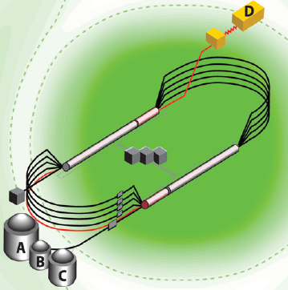
The Jefferson Lab 12-GeV Upgrade and the GlueX Experiment
Curtis A. Meyer
Carnegie Mellon University
19 September, 2011

Slide 2
Outline
The Jefferson Lab 12-GeV Upgrade
Physics Highlights
Quantum Chromodynamics
Gluonic Excitations – LQCD and Experiment
The GlueX Experiment

Slide 3
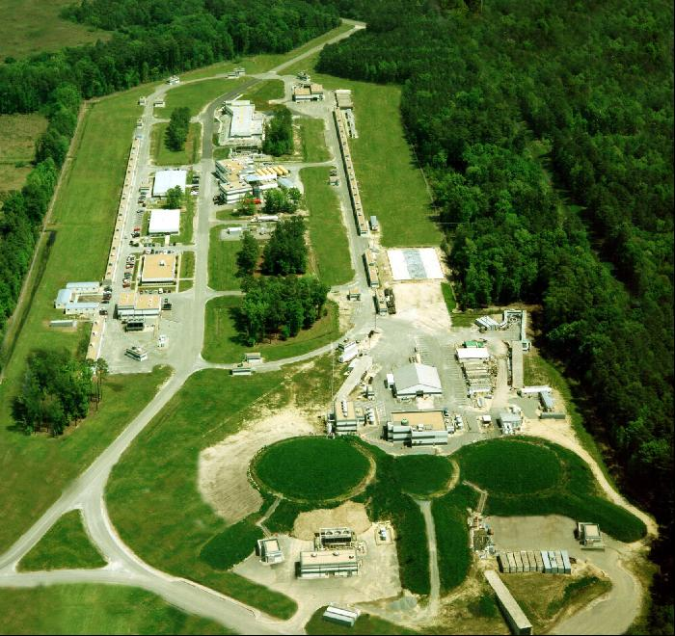
Jefferson Lab
Newport News, Virginia

Slide 4
Jefferson Lab
Newport News, Virginia
A 6-GeV electron accelerator feeding 3 experimental halls. The facility has been in operation since 1996.
The 12-GeV upgrade will double the energy of the accelerator, upgrade the three existing experimental areas and build a new area.
In September 2008, the DOE approved start of construction of of the 320M$ project (CD3).
Actual construction started in October 2008 and is will be complete in 2015 (CD4).

Slide 5
The JLab 12 GeV Upgrade Project
Upgrade is designed to build on existing facility: vast majority of accelerator and experimental equipment have continued use
New Hall
Add 5 cryomodules
Upgrade arc magnets
and supplies
CHL upgrade
Maintain capability to deliver lower pass beam energies:
2.2, 4.4, 6.6….
20 cryomodules
Add arc
20 cryomodules
Add 5 cryomodules
Scope of the project includes:
Doubling the accelerator beam energy
New experimental Hall and beamline
Upgrades to existing Experimental Halls
Enhanced capabilities
in existing Halls

Slide 6
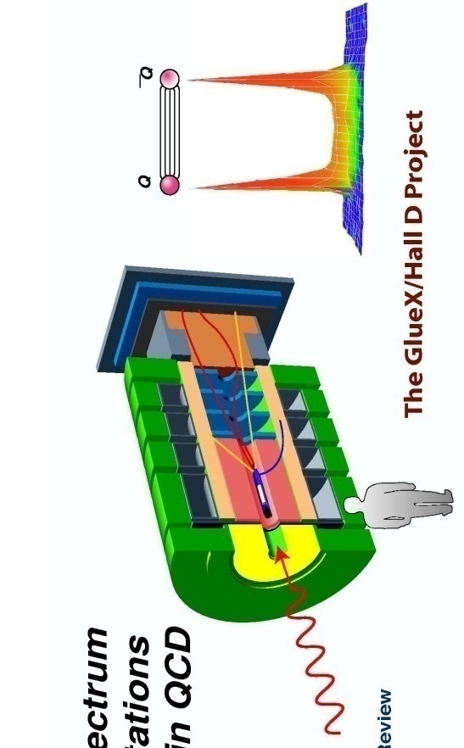
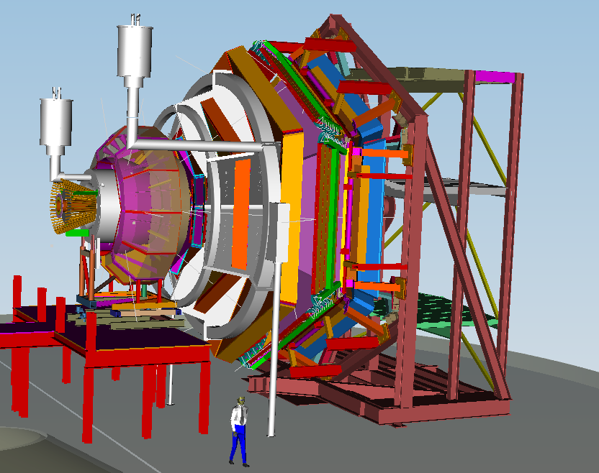
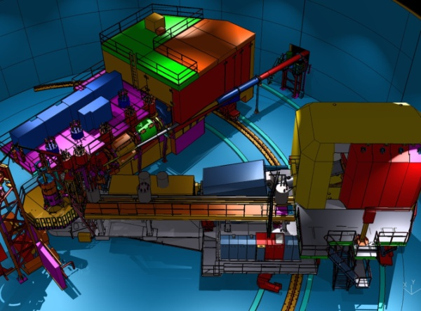
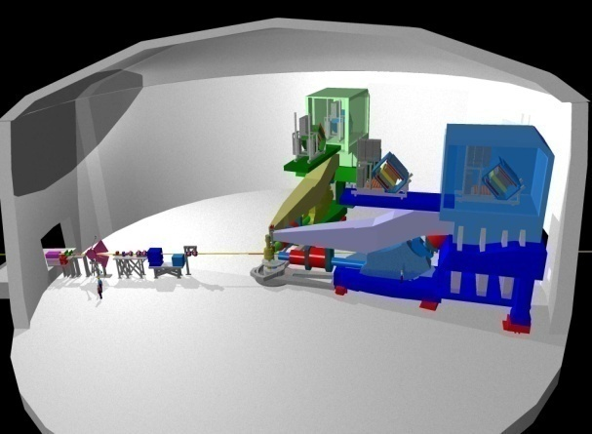
12 GeV Scientific Capabilities
Hall D – exploring origin of confinement by studying exotic mesons
Hall B – understanding nucleon structure via generalized parton distributions
Hall C – precision determination of valence quark properties in nucleons and nuclei
Hall A – short range correlations, form factors, hyper-nuclear physics, future new experiments (e.g., PV and MOLLER)
Notes:
6
Note BSM not included in project

Slide 7
The JLab 12 GeV Science Program
The physical origins of quark confinement (GlueX, meson and baryon spectroscopy)
The spin and flavor structure of the proton and neutron (PDF’s, GPD’s, TMD’s…)
The quark structure of nuclei
Probe potential new physics through high precision tests of the Standard Model
Exciting slate of experiments for 4 Halls planned for
initial five years of operation!

Slide 8
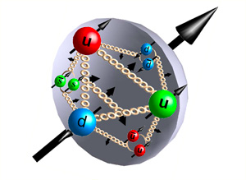
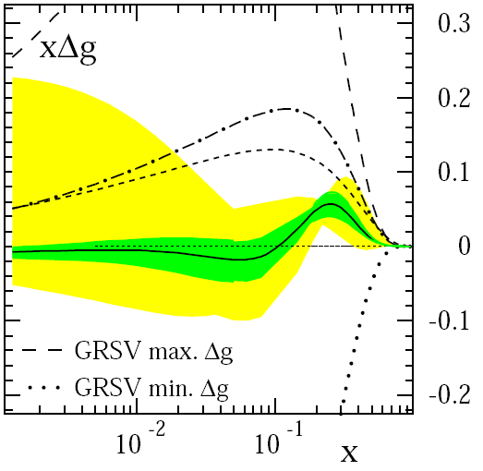
Proton Spin Puzzle
quark angular momentum
quark spins
gluons
DIS → ΔΣ ≅ 0.25 (quarks)
RHIC + DIS → Δg« 1 (gluons)
→ L_{q}
D. de Florian et al., PRL 101 (2008) 072001

Slide 9
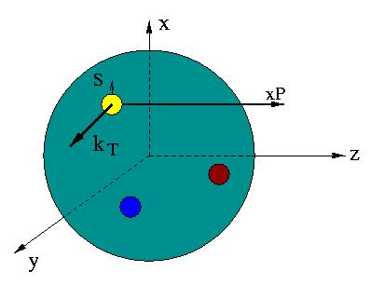
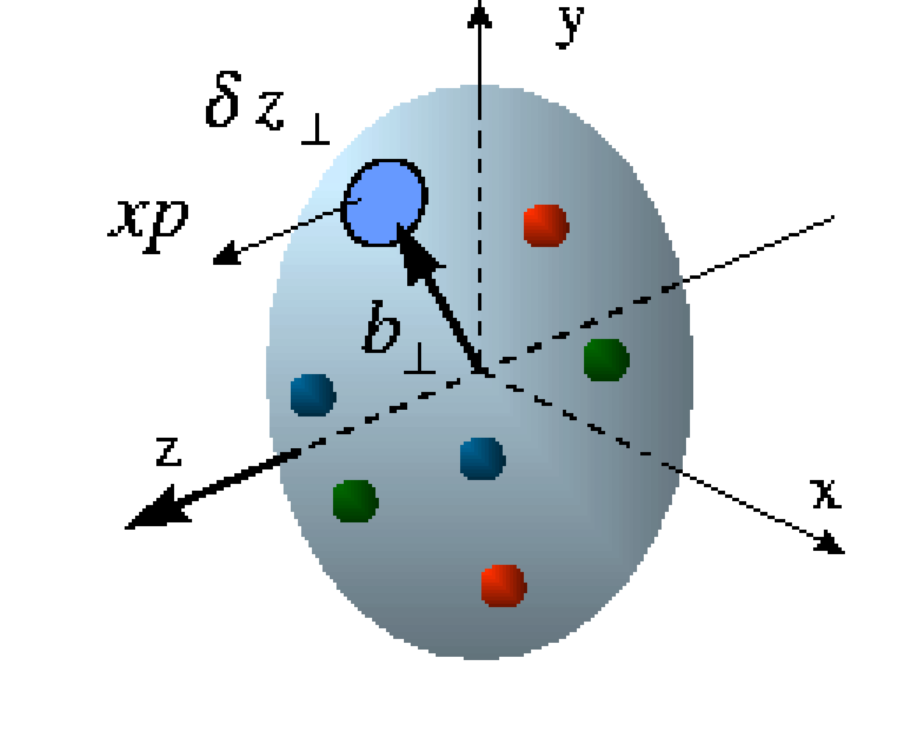
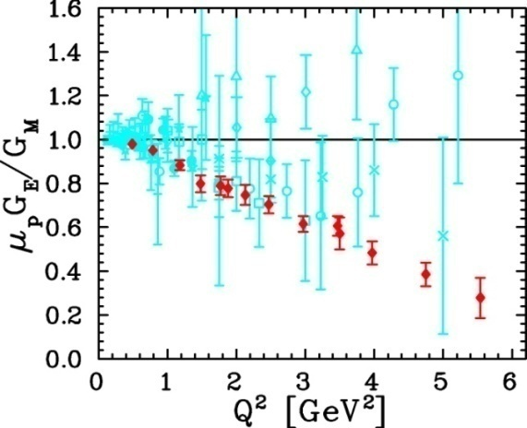
Unified View of Nucleon Structure
W_{p}^{u}(x,k_{T},r ) Wigner distributions
6D Dist.
d³r
d²k_{T} dr_{z}
TMD PDFs f₁^{u}(x,k_{T}), .. h₁^{u}(x,k_{T})‏
GPDs/IPDs
3D imaging
dx &
Fourier Transformation
d²k_{T}
d²r_{T}
Form Factors
G_{E}(Q²),
G_{M}(Q²)‏
PDFs
f₁^{u}(x), .. h₁^{u}(x)‏
1D

Slide 10
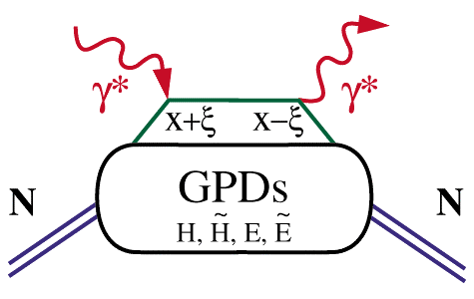
Extraction of GPDs
Cleanest process: Deeply Virtual Compton Scattering
hard vertices
σ⁺ − σ⁻
σ⁺ + σ⁻
Δσ
2σ
A =
=
ξ=x_{B}/(2-x_{B})
t
Polarized beam, unpolarized target:
~
H(ξ,t)
Δσ_{LU}~ sinφ{F₁H+ ξ(F₁+F₂)H+kF₂E}dφ
Unpolarized beam, longitudinal target:
~
~
H(ξ,t)
Δσ_{UL}~ sinφ{F₁H+ξ(F₁+F₂)(H+ξ/(1+ξ)E)}dφ
Unpolarized beam, transverse target:
E(ξ,t)
Δσ_{UT}~ sinφ{k(F₂H – F₁E)}dφ

Slide 11
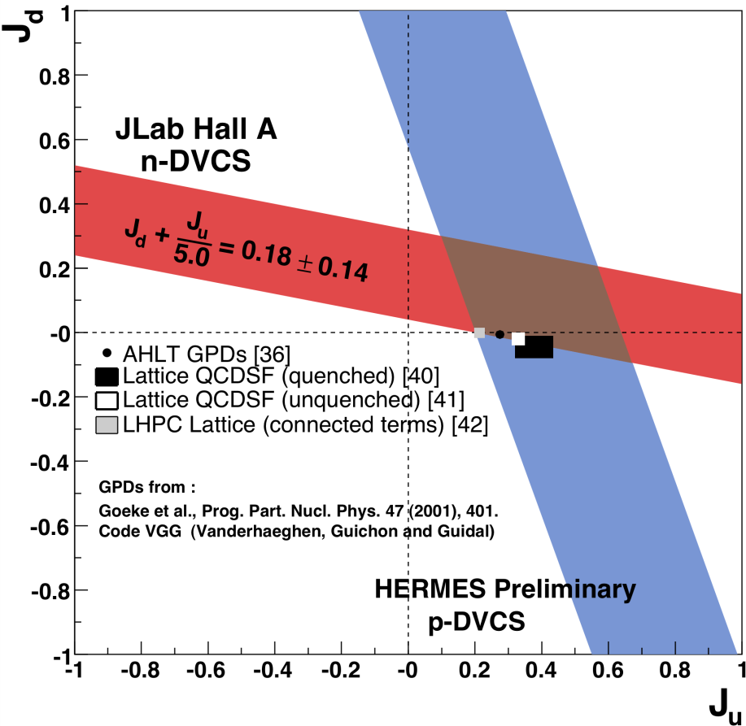
Quark Angular Momentum
→ Access to quark
orbital angular
momentum

Slide 12
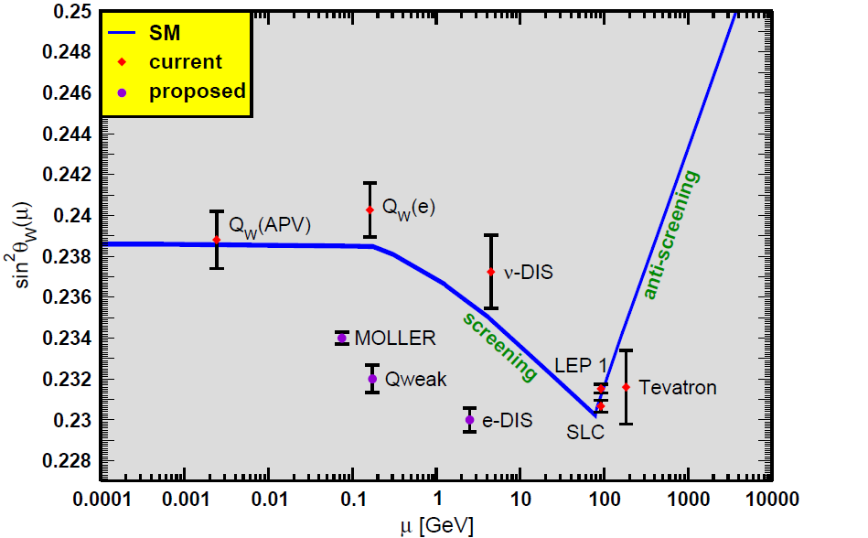
Future Parity Violation Program
Measure the weak charge

Slide 13
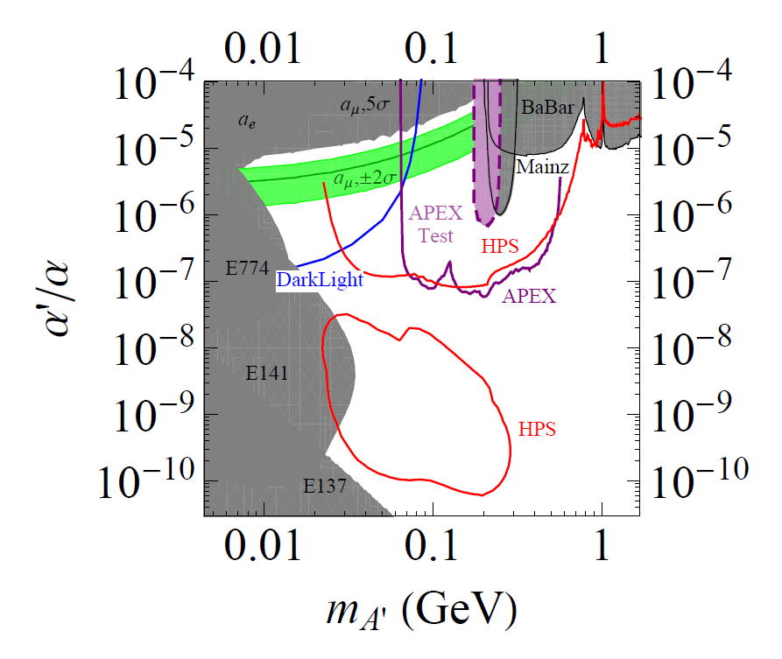
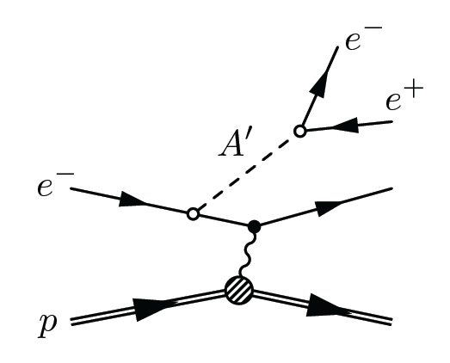
New Opportunity: Search for A’ at JLab
Search for new forces mediated by ~100 MeV vector boson A’ with weak coupling to electrons:
g – 2 preferred!
New ~GeV–scale force carriers are important category of physics beyond the SM.
A’ could couple to dark matter and explain some anomalous astrophysical data.
Fixed-target experiments @JLab (FEL + CEBAF) have unique capability to explore this!

Slide 14
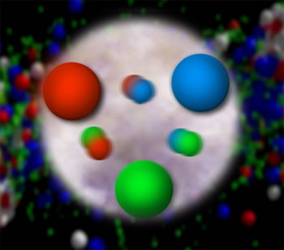
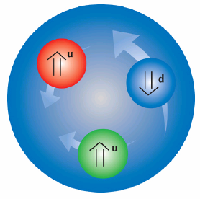
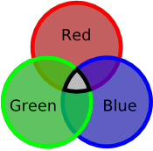
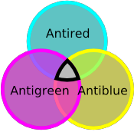
Quantum Chromo Dynamics
The rules that govern how the quarks
froze out into hadrons are given by QCD.
Quarks have color
charge: red, blue and
green. Antiquarks
have anticolors:
cyan, yellow and
magenta.
Atoms are electrically
neutral: a charge and
an anti-charge ( + - ).
Hadrons are color neutral (white),
red-cyan, blue-yellow, green-magenta
or red-blue-green, cyan-yellow-magenta.

Slide 15
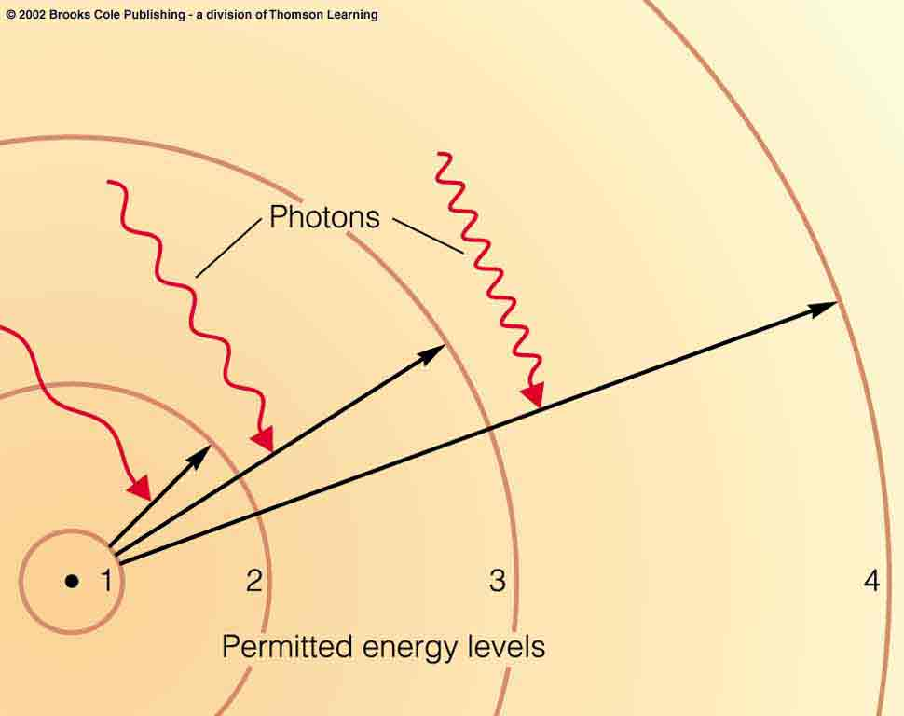
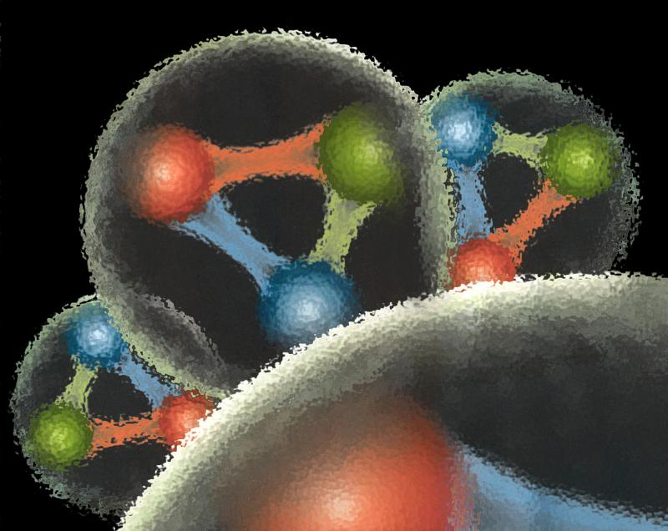
Quantum Chromo Dynamics
QCD describes the interactions of quarks and gluons.
Gluons are the force
carriers of QCD.
Gluons carry a color
and an anticolor
Charge.
Photons are the force
carriers for the E-M
force. Photons are
electrically neutral.
G
R
G
R
G
R

Slide 16
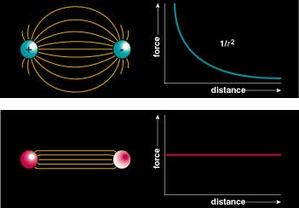
Quantum Chromo Dynamics
Color Field: Because of self interaction, confining flux tubes form between static color charges
Confinement arises from flux tubes and their excitation leads to a new spectrum of mesons

Slide 17
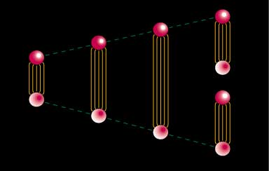
Quark Confinement
quarks can never be isolated
linearly rising potential
  separation of quark from antiquark takes an infinite amount of energy
  gluon flux breaks, new quark-antiquark pair produced

Slide 18
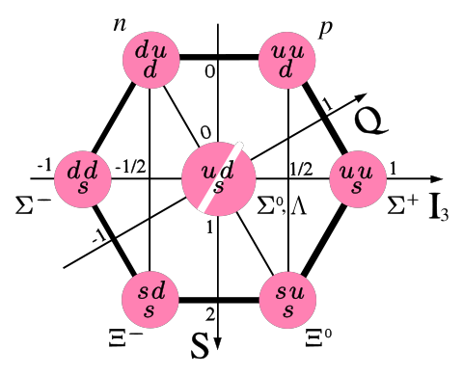
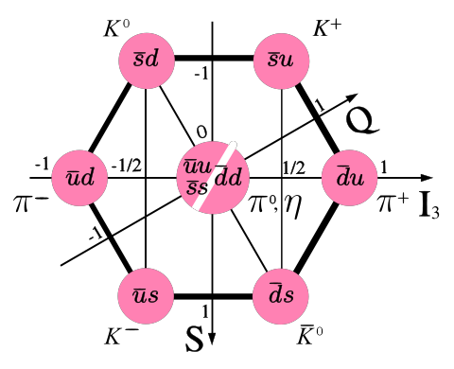
Observed Hadrons
Baryons
Mesons
Groups of 8 (octet)
And 10 (decuplet).
Groups of
9 (nonet).
Other Configurations?
4-quark
glueballs
pentaquarks
hybrids

Slide 19
Positronium
Spectroscopy
A probe of QED
e⁺
e⁻
Spin: S=S₁+S₂=(0,1)
Orbital Angular Momentum: L=0,1,2,…
Total Spin: J=L+S
L=0, S=0 : J=0 L=0, S=1 : J=1
L=1 , S=0 : J=1 L=1, S=1 : J=0,1,2
… …
Reflection in a mirror:
Parity: P=-(-1)^{(L)}
Particle<->Antiparticle:
Charge Conjugation: C=(-1)^{(L+S)}
Notation: J^{(PC)} 0⁻⁺, 1⁻⁻, 1⁺⁻, 0⁺⁺, 1⁺⁺, 2⁺⁺
^{(2S+1)}L_{J} ¹S₀, ³S₁, ¹P₁, ³P₀, ³P₁, ³P₂,…

Slide 20
Spectroscopy and QCD
Quarkonium
Mesons
q
q
radial
Consider the three lightest quarks
4⁺⁺
L=3
3⁺⁺
2⁺⁺
9 Combinations
3⁺⁻
3⁻⁻
L=2
2⁻⁻
1⁻⁻
2⁻⁺
2⁺⁺
L=1
1⁺⁺
0⁺⁺
1⁺⁻
1⁻⁻
S=1
S=0
L=0
0⁻⁺

Slide 21
Spectroscopy and QCD
Quarkonium
Mesons
q
q
4⁺⁺
L=3
3⁺⁺
2⁺⁺
3⁺⁻
ρ,K*,ω,φ
Mesons come in
Nonets of the same
J^{PC} Quantum Numbers
3⁻⁻
L=2
2⁻⁻
π,K,η,η’
1⁻⁻
2⁻⁺
a,K,f,f’
2⁺⁺
L=1
1⁺⁺
b,K,h,h’
SU(3) is broken
Last two members mix
0⁺⁺
1⁺⁻
ρ,K*,ω,φ
1⁻⁻
S=1
S=0
L=0
0⁻⁺
π,K,η,η’

Slide 22
Spectroscopy and QCD
Quarkonium
Mesons
q
q
4⁺⁺
L=3
3⁺⁺
2⁺⁺
Allowed J^{PC} Quantum numbers:
3⁺⁻
3⁻⁻
0⁻⁻ 0⁺⁻
1⁻⁺
2⁺⁻
3⁻⁺
4⁺⁻
5⁻⁺
0⁺⁺ 0⁻⁺
1^{–-} 1⁺⁺ 1⁺⁻
2⁻⁻ 2⁺⁺ 2⁻⁺
3⁻⁻ 3⁺⁺ 3⁺⁻
4⁻⁻ 4⁺⁺ 4⁻⁺
5⁻⁻ 5⁺⁺ 5⁺⁻
L=2
2⁻⁻
1⁻⁻
2⁻⁺
2⁺⁺
L=1
1⁺⁺
0⁺⁺
1⁺⁻
S=1
S=0
Exotic Quantum Numbers
non quark-antiquark description
1⁻⁻
L=0
0⁻⁺

Slide 23
Quarks and Gluons?
The mesons only involve quarks and antiquarks. What does the glue do? Can the gluonic fields be excited as well?
Models: The gluonic field is excited and can be modeled with specific spin and parities (J^{PC)}.
Bag Model: A transverse-electric gluon is 1⁺⁻ .
1⁻⁻, (0,1,2)⁺⁻
Flux-tube Model: gluons are 1⁺⁻ and 1⁻⁺ .
1⁻⁻, 1⁺⁺, (0,1,2)⁺⁻ , (0,1,2)⁺⁻
…. Others ….

Slide 24
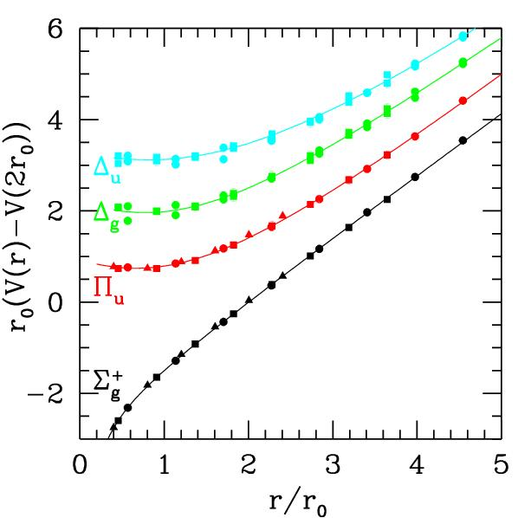
QCD Potential
ground-state
flux-tube
m=0
Excited gluonic field (m=1)
linear potential
Gluonic Excitations provide an
experimental measurement of
the excited QCD potential.
Observations of the nonets on the excited potentials are
the best experimental signal of gluonic excitations.

Slide 25
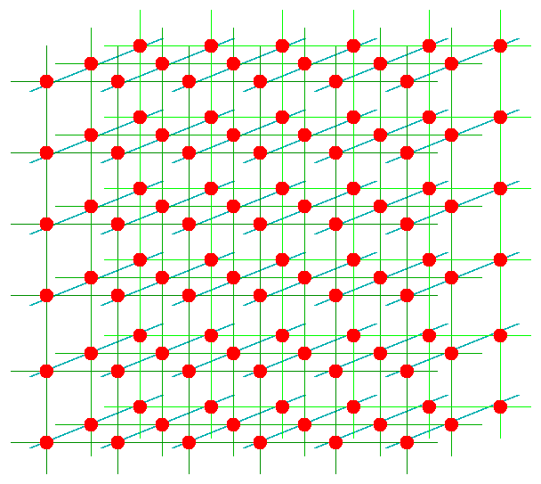
Lattice QCD and The Meson Spectrum
hypercubic space-time lattice
quarks reside on sites, gluons reside on links between sites
lattice excludes short wavelengths from theory (regulator)
regulator removed using standard renormalization procedures (continuum limit)
systematic errors
  discretization
  finite volume
quarks
gluons

Slide 26
Lattice QCD Meson Spectrum
Dudek et. al, 2010, 2011

Slide 27
Lattice QCD Meson Spectrum
States with non-trivial gluonic fields.
1⁻⁻, 0⁻⁺ , 1⁻⁺ , 2⁻⁺
Dudek et. al, 2010, 2011

Slide 28
Lattice QCD Meson Spectrum
isovector
isoscalar
Dudek et. al, 2010, 2011

Slide 29
Finding the States?
Lattice QCD suggest where to look for exotic states:
Models suggest how the states should decay
π₁→ πb₁ , πf₁ , πρ , ηa₁
η₁→π(1300)π , a₁π
b₂ → a₁π , h₁π , ωπ , a₂π
h₂ → b₁π , ρπ , ωη
b₀ → π(1300)π , h₁π
h₀ → b₁π , h₁η
L_{flux}
L_{flux}
Populate final states with
π±,π⁰,K±,K⁰,η, (photons)

Slide 30
Experimental Evidence for Hybrids
Mode Mass Width Production
ηπ⁻ 1370±15+50-30 385±40+65-105 1⁺
ηπ⁰ 1257±20±25 354±64±60 1⁺
ηπ 1400 310 seen in annihilation
π₁(1400)
Mode Mass Width Production
3π 1598 ±8+29-47 168±20+150-12 1⁺,0⁻,1-
η’π 1597±10+45-10 340±40±50 1⁺
b₁π 1664±8±10 185±25±38 0⁻ ,1⁺
f₁π 1709±24±41 403±80±115 1⁺
3π 1660 ±10+64-0 269±21+42-64 1⁺
π₁(1600)
Mode Mass Width Production
b₁π 2014±20±16 230±32±73 1⁺
f₁π 2001±30±92 332±52±49 1⁺
π₁(2015)

Slide 31
Experimental Evidence for Hybrids
Mode Mass Width Production
ηπ⁻ 1370±15+50-30 385±40+65-105 1⁺
ηπ⁰ 1257±20±25 354±64±60 1⁺
ηπ 1400 310 seen in annihilation
Inconsistent with a hybrid?
π₁(1400)
Mode Mass Width Production
3π 1598 ±8+29-47 168±20+150-12 1⁺,0⁻,1-
η’π 1597±10+45-10 340±40±50 1⁺
b₁π 1664±8±10 185±25±38 0⁻ ,1⁺
f₁π 1709±24±41 403±80±115 1⁺
3π 1660 ±10+64-0 269±21+42-64 1⁺
π₁(1600)
Mode Mass Width Production
b₁π 2014±20±16 230±32±73 1⁺
f₁π 2001±30±92 332±52±49 1⁺
π₁(2015)

Slide 32
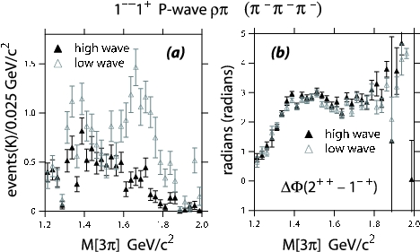
Experimental Evidence for Hybrids
Mode Mass Width Production
3π 1598 ±8+29-47 168±20+150-12 1⁺,0⁻,1⁻ E852
η’π 1597±10+45-10 340±40±50 1⁺ E852,VES
b₁π 1664±8±10 185±25±38 0⁻ ,1⁺ E852,VES,CBAR
f₁π 1709±24±41 403±80±115 1⁺ E852,VES
3π 1660 ±10+64-0 269±21+42-64 1⁺ COMPASS
π₁(1600)
Decay mode sensitive to model
In COMPASS
Exactly the same mass and width as the
Confused production in E852??
This is consistent with a hybrid meson

Slide 33
Experimental Evidence for Hybrids
π₁(2015)
Mode Mass Width Production
b₁π 2014±20±16 230±32±73 1⁺ E852
f₁π 2001±30±92 332±52±49 1⁺ E852
Need two J^{PC}=1⁻⁺ states
π₁(2000)→b₁π
M = 2014±20±16 MeV/c²
Γ = 230±32±73 MeV/c²
Seen primarily in natural
parity exchange.
The natural dominates
m^{ε}=0⁻
1⁻⁺b₁π
m^{ε}=1⁺
1⁻⁺b₁π
Seen in one experiment with low statistics It needs confirmation. If this exists, it is also a good candidate for an exotic hybrid meson.

Slide 34
QCD Exotics
We expect 3 nonets of exotic-quantum-number mesons: 0⁺⁻, 1⁻⁺, 2⁺⁻
Where are the isoscalar states? How are they mixed?
Lattice shows two states here.
π , η , η’ , K → π₁ , η₁ , η’₁, K₁
b₀, h₀, h₀’, K₀
b₂, h₂, h₂’, K₂
What about other states?
π₁ I^{G}(J^{PC})=1⁻(1⁻⁺)
K₁ I^{G}(J^{PC})= ½ (1⁻)
η’₁ I^{G}(J^{PC})=0⁺(1⁻⁺)
η₁ I^{G}(J^{PC})=0⁺(1⁻⁺)

Slide 35
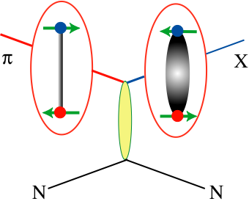
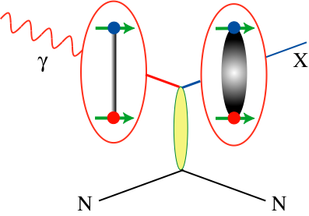
How to Produce Hybrids
Beams of photons may be a more natural
way to create hybrid mesons.
Simple QN counting leads to the exotic mesons
There is almost no data for photon beams at
9GeV energies. GlueX will increase data by
3-4 orders of magnitude.

Slide 36
The GlueX Experiment

Slide 37
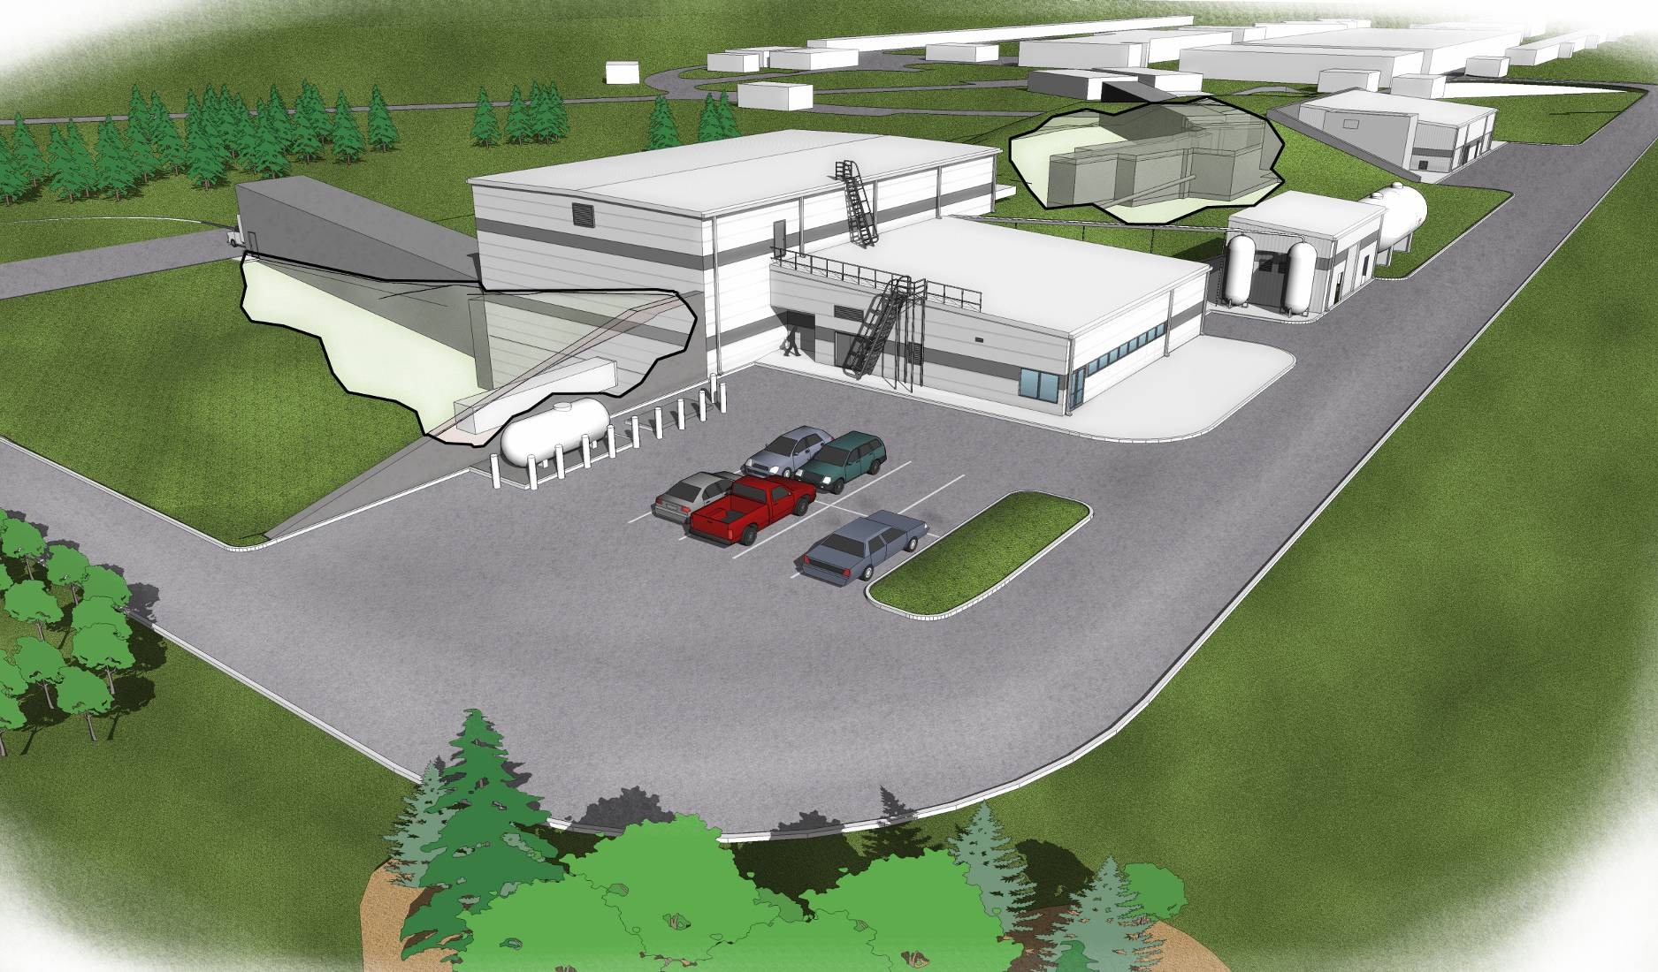
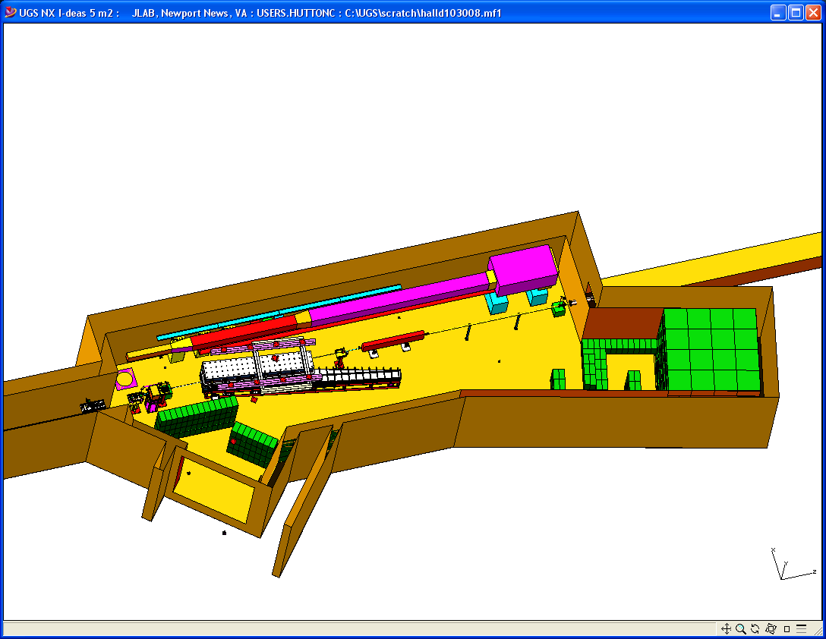
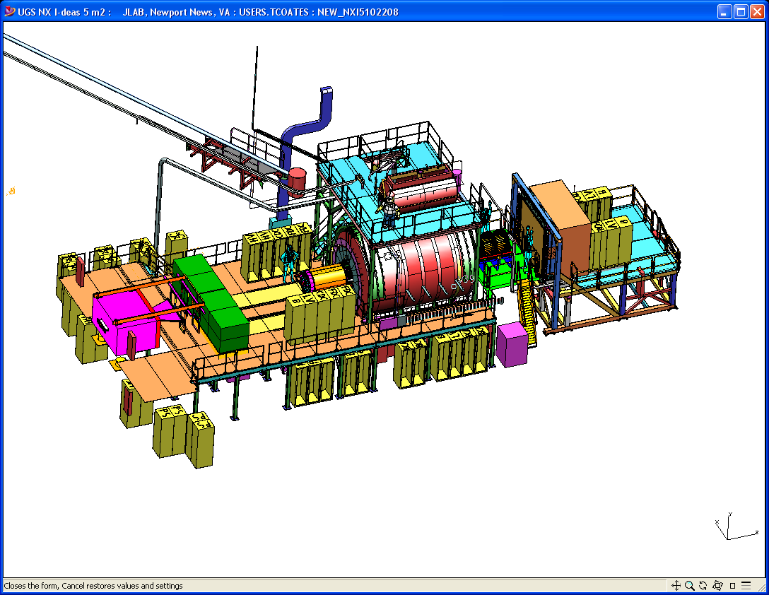
Hall D
Counting House
Tagger Area w/ Electron Beam Dump
Photon Beam Dump
Notes:
Quick slide to show the Hall-D complex as well as the detector and the tagger area. Comment on relevant details such as tagger resolution, magnet, electronics, ….

Slide 38
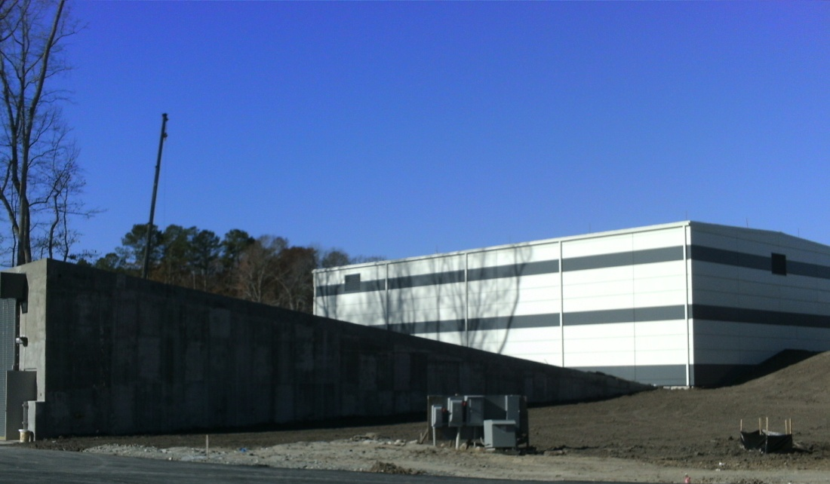
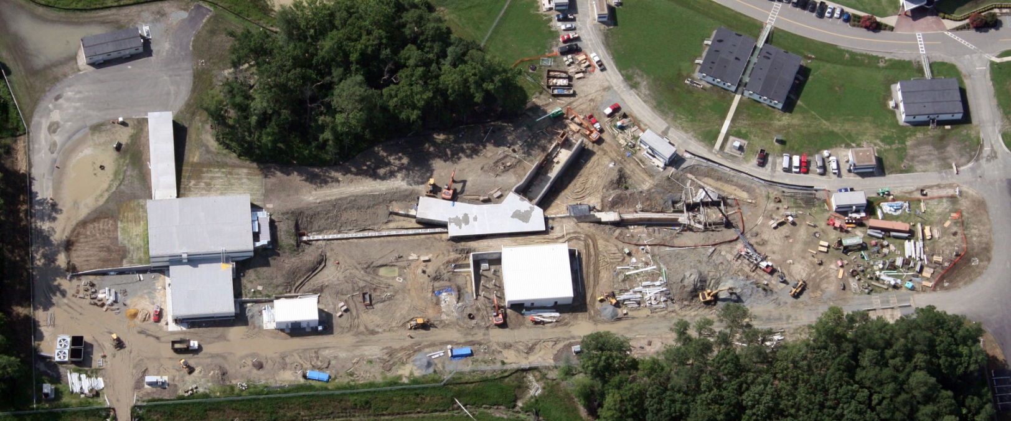
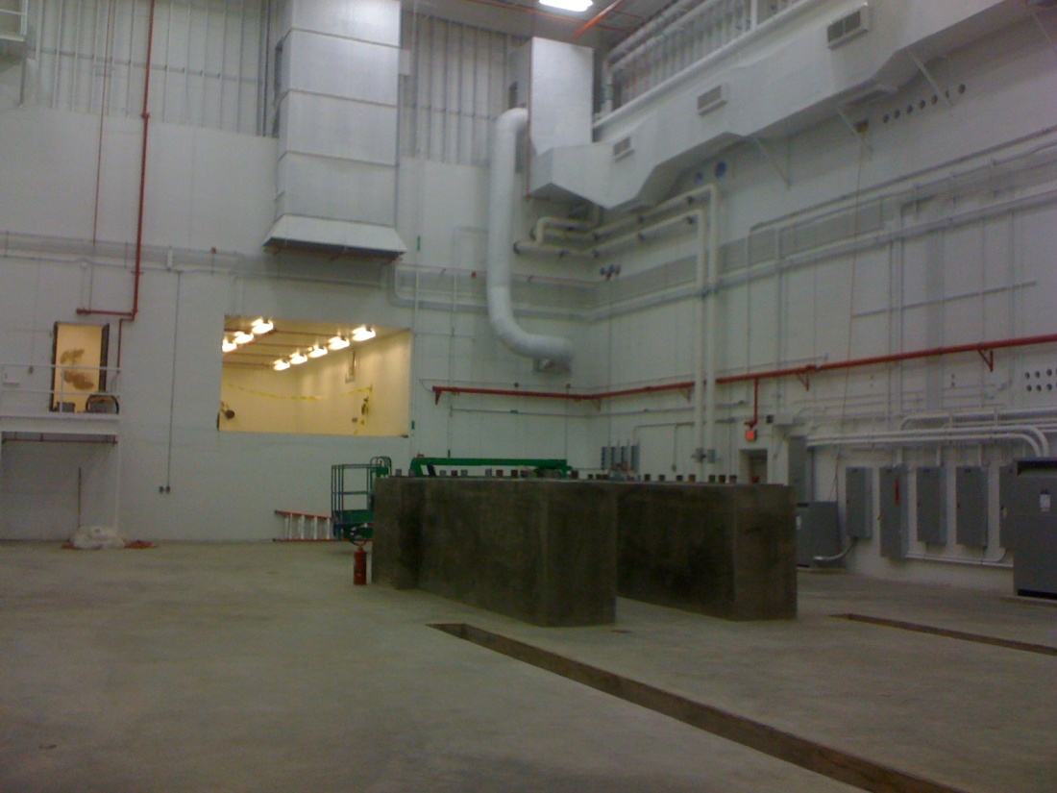
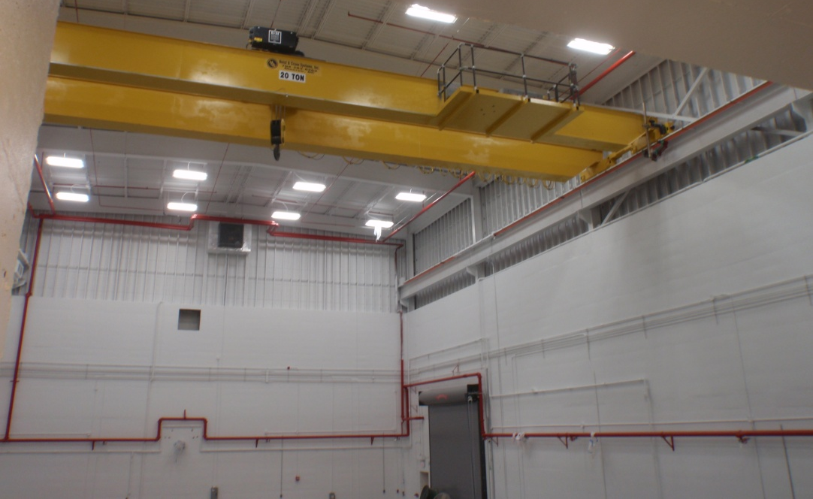
Hall D Status – July 2011
Ready For Equipment (RFE) Dec. 28, 2010

Slide 39
Construction has started
Photon Beam Production and Tagging
Microscope @ UCONN
Polarimetry @ ASU
Support @ UNC A&T
Tagger Magnet @ JLab
Tagger @ CUA
Diamond @ UCONN
Active Collimator @ UCONN

Slide 40
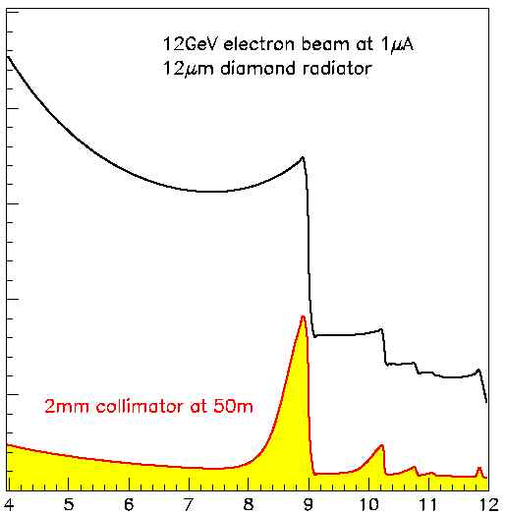
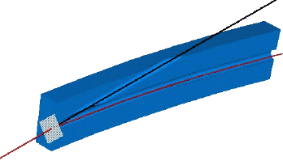
Coherent
Bremsstrahlung
12 GeV electrons
Incoherent &
coherent spectrum
flux
This technique provides requisite energy, flux and polarization
40%
polarization
in peak
Linearly polarized
photons out
collimated
electrons in
spectrometer
diamond
crystal
photon energy (GeV)
tagged
with 0.1% resolution

Slide 41
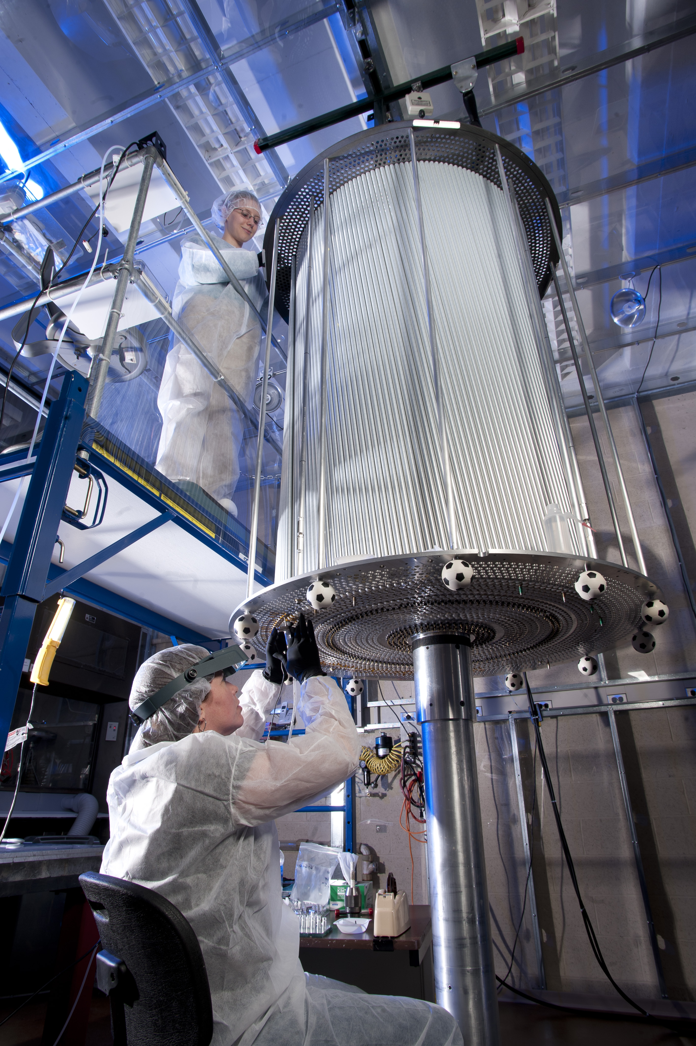
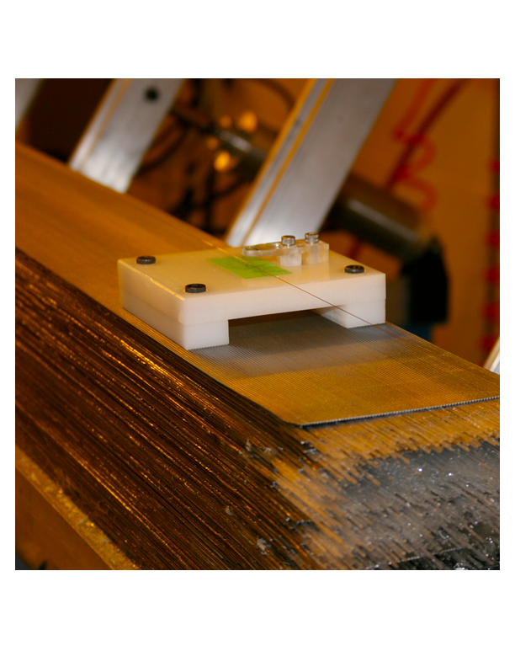
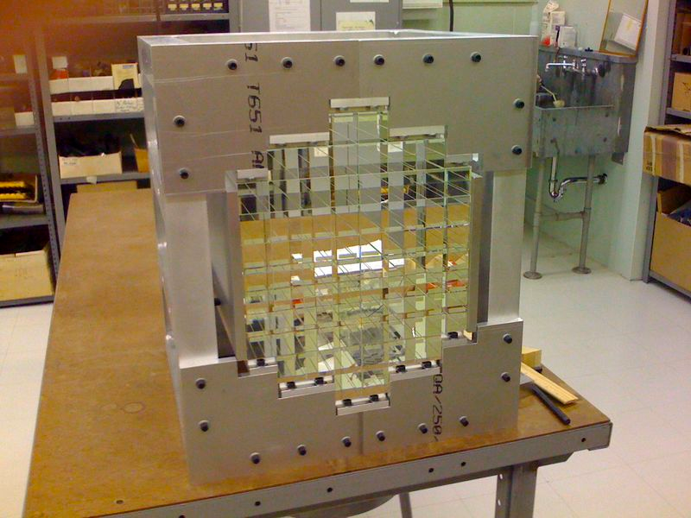
Construction has started
CDC @ CMU
BCAL @ Regina
40/48 modules at JLab
Future PID @ MIT
BCAL Readout @ USM
Calibration @ Athens
FCAL @ IU
FDC @ JLab
P.S. @ UNCW
TOF @ FSU
START @ FIU
TRIGGER @ Jlab, CNU
Electronics @ JLab, ICO, UMASS, USM
Solenoid @ JLab, ICO
DAQ @ JLab
The GlueX Detector

Slide 42
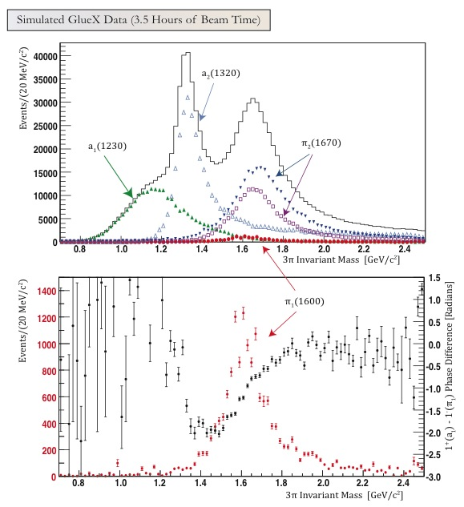
Amplitude Analysis
3.5 Hours of beamtime
Fit the data event-by event to sums of high-dimensional angular distributions using complex weights.
Intensity and phase differences
Search for particles in several final states at once.

Slide 43
Exotics
In Photoproduction
1⁻⁺ nonet
π₁ I^{G}(J^{PC})=1⁻(1⁻⁺)
K₁ I^{G}(J^{PC})= ½ (1⁻)
η’₁ I^{G}(J^{PC})=0⁺(1⁻⁺)
η₁ I^{G}(J^{PC})=0⁺(1⁻⁺)
X
Need to establish nonet nature
of exotics: π η η’
γ
e
Need to establish more than one
nonet: 0⁺⁻ 1⁻⁺ 2⁺⁻
N
N
Need very good partial wave analysis.
γ ⇔ ρ,ω,φ

Slide 44
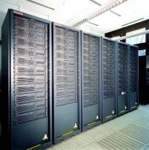
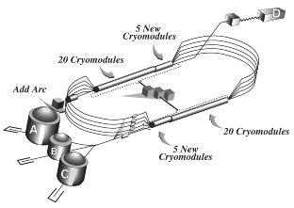
Conclusions
The quest to understand confinement
and the strong force is about to make
great leaps forward.
Advances in theory and computing will soon
allow us to solve QCD and understand the
baryon spectrum and the role of glue.
Definitive experiments to
confirm or refute our expectations
on the role of glue are being built.
The synchronized advances in both areas will allow
us to finally understand QCD and confinement.

Slide 45
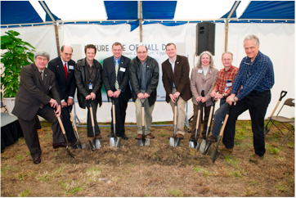
The GlueX Detector in Hall-D
The 12 GeV upgrade of Jefferson Lab is currently under construction
Construction of Hall-D broke ground in April 2009. Starting installation in the Hall now.
Construction of the GlueX detector is well underway.
Lots of room for new collaborators.
Hall-D Groundbreaking
We expect the first beam in Hall-D/GlueX in late 2014 and physics in 2015.

