Slide 1
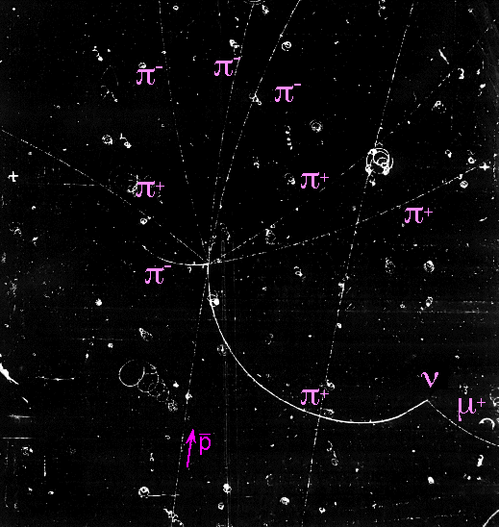
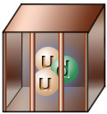
Confinement
Gluonic Hadrons: A Probe of
Curtis A. Meyer
Carnegie Mellon University

Slide 2
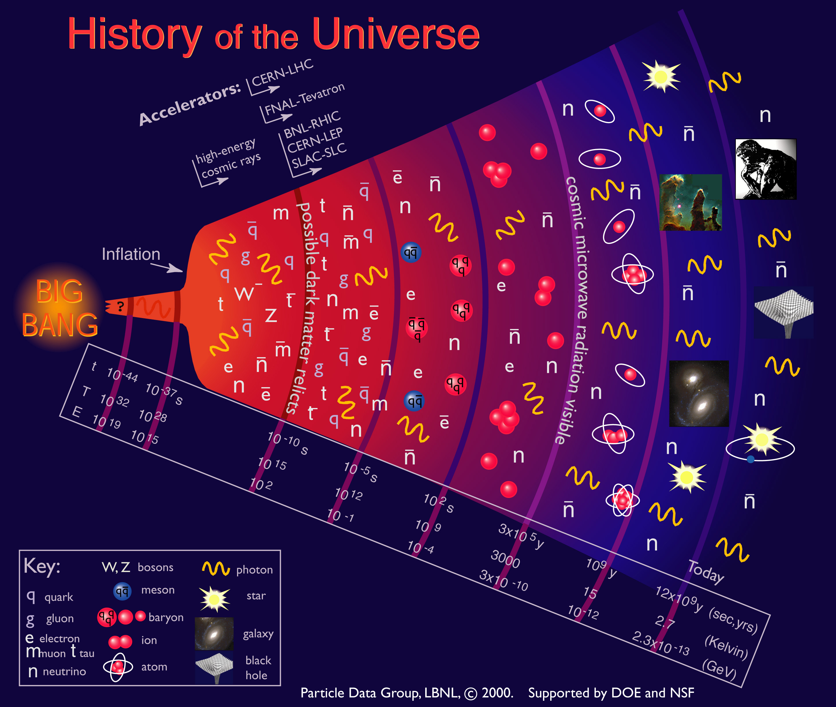


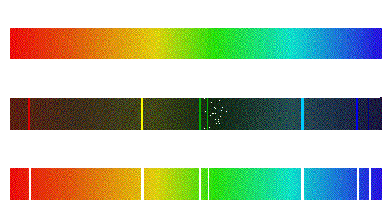
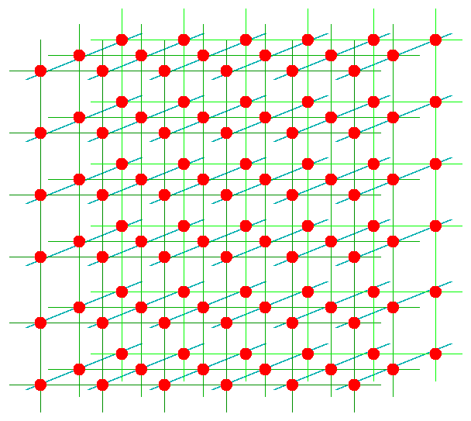
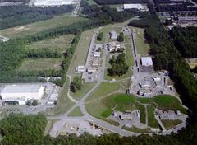
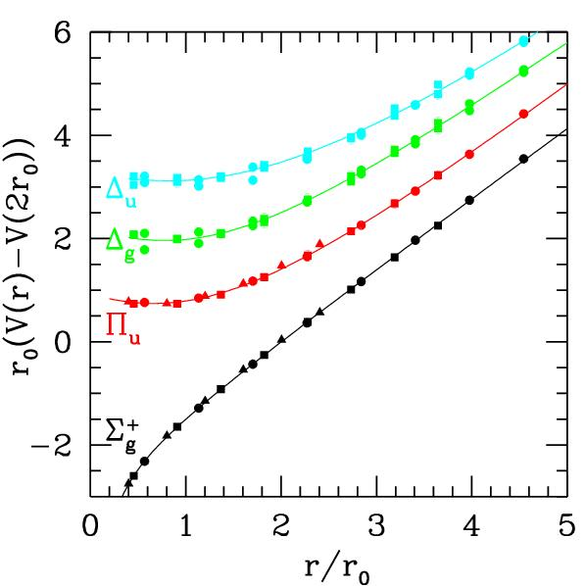
Outline
The beginning
of time.
The strong force
and QCD
Color confinement
Spectroscopy
Lattice QCD
Finding Gluonic
Hadrons
Confinement

Slide 3
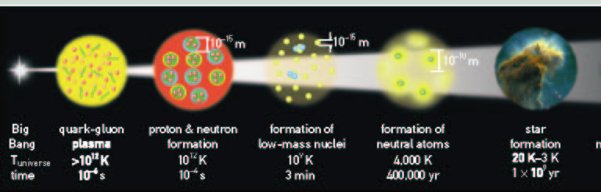
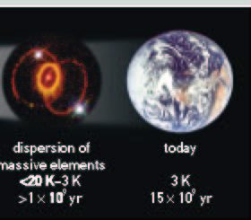
The First Seconds
of The Universe

Slide 4
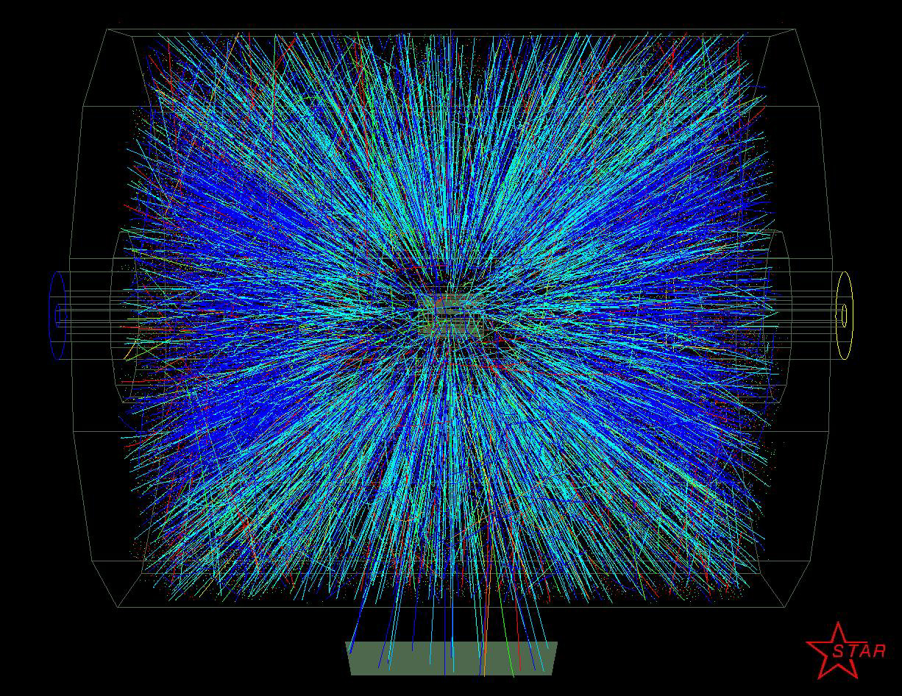
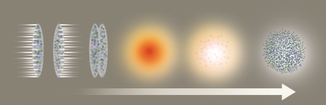
Quark Gluon Plasma
For a period from about 10⁻¹² s to 10⁻⁶ s the universe
contained a plasma of quarks, anti quarks and gluons.
Relativistic Heavy Ion Collisions are trying to
produce this state of matter in collisions

Slide 5
Confinement
From about 10⁻⁶ s on, the quark and antiquarks became
confined inside of Hadronic matter. At the age of 1s,
only protons and neutrons remained.
The gluons produce
the 16 ton force that
holds the hadrons
together.
Mesons
Baryons

Slide 6
The Formation of Nuclei
By the old age of three minutes, the formation of low
mass nuclei was essentially complete.
Primordial hydrogen, deuterium, helium and a
few other light nuclei now exist.
It will be nearly a half a million years before
neutral atoms will dominate matter.

Slide 7
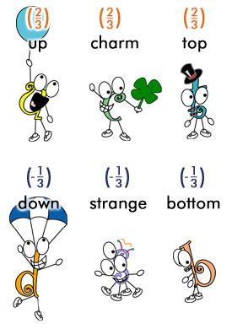
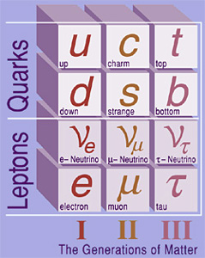
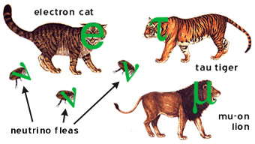
Quarks and Leptons

Slide 8
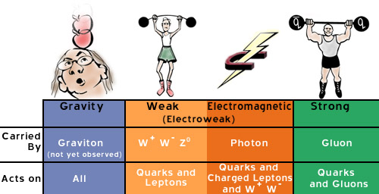
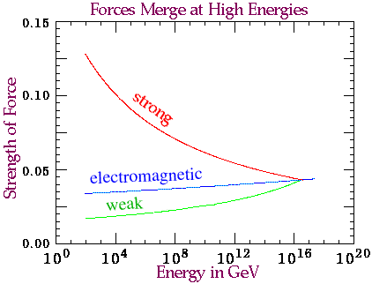
Forces and Interactions

Slide 9
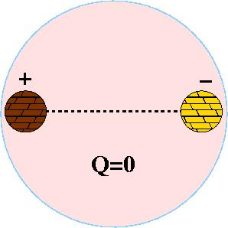
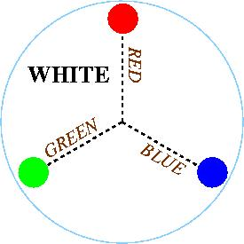
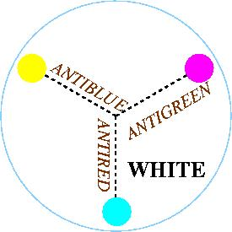
Quantum Chromo
Dynamics
The rules that govern how the quarks
froze out into hadrons are given by QCD.
Just like atoms are
electrically neutral,
hadrons have to be
neutral.
Color Charge
Three charges called RED, BLUE and
GREEN, and three anti colors. The
objects that form have to be color
neutral.

Slide 10
Gluons Carry the Force
The exchange of gluons
is continually changing the
Individual colors of the
quarks, but the overall
Color remains neutral
Meson
G
R
Meson
G
R
G
R
Time
R
R
G
B
B
G

Slide 11
Gluons Carry the Force
The exchange of gluons
is continually changing the
Individual colors of the
quarks, but the overall
Color remains neutral
Meson
G
R
Meson
G
R
G
R
Time
R
R
G
B
B
G

Slide 12
Gluons Carry the Force
The exchange of gluons
is continually changing the
Individual colors of the
quarks, but the overall
Color remains neutral
Meson
G
R
Meson
G
R
G
R
Time
R
R
G
B
Gluons produce the forces that
confine the quarks, but the gluons
do not appear to be needed to
understand normal hadrons
B
G

Slide 13
Gluon Interactions
G
R
R
R
R
R
G
G
B
B
G
G
R
B
G
B
R
R
3 Colors
3 Anti Colors
1 color neutral
8 colored objects
self-interaction of gluons
leads to both interesting
behavior of QCD, and its
extreme complications.
8 Gluons

Slide 14
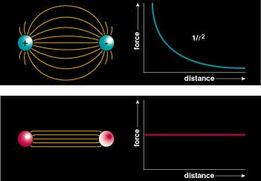
Flux Tubes
Color Field: Because of self interaction, confining flux tubes form between static color charges
Confinement arises from flux tubes and their excitation leads to a new spectrum of mesons

Slide 15
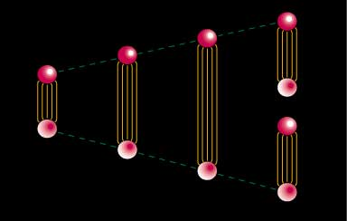
Quark Confinement
quarks can never be isolated
linearly rising potential
  separation of quark from antiquark takes an infinite amount of energy
  gluon flux breaks, new quark-antiquark pair produced

Slide 16
Positronium
Spectroscopy
A probe of QED
e⁺
e⁻
Spin: S=S₁+S₂=(0,1)
Orbital Angular Momentum: L=0,1,2,…
Total Spin: J=L+S
L=0, S=0 : J=0 L=0, S=1 : J=1
L=1 , S=0 : J=1 L=1, S=1 : J=0,1,2
… …
Reflection in a mirror:
Parity: P=-(-1)^{(L)}
Particle<->Antiparticle:
Charge Conjugation: C=(-1)^{(L+S)}
Notation: J^{(PC)} 0⁻⁺, 1⁻⁻, 1⁺⁻, 0⁺⁺, 1⁺⁺, 2⁺⁺
^{(2S+1)}L_{J} ¹S₀, ³S₁, ¹P₁, ³P₀, ³P₁, ³P₂,…

Slide 17
Quarkonium
Spectroscopy and QCD
Mesons
q
q
radial
Consider the three lightest quarks
4⁺⁺
L=3
3⁺⁺
2⁺⁺
9 Combinations
3⁺⁻
3⁻⁻
L=2
2⁻⁻
1⁻⁻
2⁻⁺
2⁺⁺
L=1
1⁺⁺
0⁺⁺
1⁺⁻
1⁻⁻
S=1
S=0
L=0
0⁻⁺

Slide 18
Mesons
Spectroscopy an QCD
Quarkonium
q
q
4⁺⁺
L=3
3⁺⁺
2⁺⁺
3⁺⁻
ρ,K*,ω,φ
Mesons come in
Nonets of the same
J^{PC} Quantum Numbers
3⁻⁻
L=2
2⁻⁻
π,K,η,η’
1⁻⁻
2⁻⁺
a,K,f,f’
2⁺⁺
L=1
1⁺⁺
b,K,h,h’
SU(3) is broken
Last two members mix
0⁺⁺
1⁺⁻
ρ,K*,ω,φ
1⁻⁻
S=1
S=0
L=0
0⁻⁺
π,K,η,η’

Slide 19
Quarkonium
Spectroscopy an QCD
Quarkonium
Mesons
q
q
Nothing to do
with Glue!
4⁺⁺
L=3
3⁺⁺
2⁺⁺
Allowed J^{PC} Quantum numbers:
3⁺⁻
3⁻⁻
0⁻⁻ 0⁺⁻
1⁻⁺
2⁺⁻
3⁻⁺
4⁺⁻
5⁻⁺
0⁺⁺ 0⁻⁺
1^{–-} 1⁺⁺ 1⁺⁻
2⁻⁻ 2⁺⁺ 2⁻⁺
3⁻⁻ 3⁺⁺ 3⁺⁻
4⁻⁻ 4⁺⁺ 4⁻⁺
5⁻⁻ 5⁺⁺ 5⁺⁻
L=2
2⁻⁻
1⁻⁻
2⁻⁺
2⁺⁺
L=1
1⁺⁺
0⁺⁺
1⁺⁻
Exotic Quantum Numbers
non quark-antiquark description
1⁻⁻
S=1
S=0
L=0
0⁻⁺

Slide 20
Lattice QCD
We can write down the QCD Lagrangian, but when
we try to solve it on large distance scales such
as the size of a proton, we fail…
Perturbation parameter α_{s}
is approximately 1.
Solve QCD on a discrete
space-time lattice.

Slide 21
Lattice regularization
hypercubic space-time lattice
quarks reside on sites, gluons reside on links between sites
lattice excludes short wavelengths from theory (regulator)
regulator removed using standard renormalization procedures (continuum limit)
systematic errors
  discretization
  finite volume
quarks
gluons
Work of Prof. Colin Morningstar

Slide 22
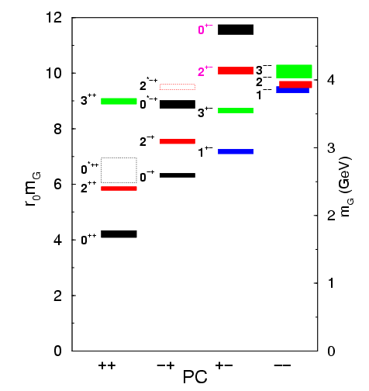
Lattice QCD Predictions
Gluons can bind to form glueballs
EM analogue: massive globs
of pure light.
Lattice QCD predicts masses
The lightest glueballs have
“normal” quantum numbers.
Glueballs will Q.M. mix
The observed states will
be mixed with normal
mesons.
Strong experimental evidence
For the lightest state.

Slide 23
QCD Potential
ground-state
flux-tube
m=0
excited flux-tube
m=1
linear potential
Gluonic Excitations provide an
experimental measurement of
the excited QCD potential.
Observations of the nonets on the excited potentials are
the best experimental signal of gluonic excitations.

Slide 24
Hybrid Predictions
Flux-tube model: 8 degenerate nonets
1⁺⁺,1⁻⁻ 0⁻⁺,0⁺⁻,1⁻⁺,1⁺⁻,2⁻⁺,2⁺⁻ ~1.9 GeV/c²
S=0
S=1
qq Mesons
Start with S=0
1⁺⁺ & 1⁻⁻
2 ^{– +}
2.5
0 ^{– +}
2 ⁺ ⁺
2 ^{+ –}
Start with S=1
0⁻⁺ & 0⁺⁻
1⁻⁺ & 1⁺⁻
2⁻⁺ & 2⁺⁻
Hybrids
2 ^{– +}
2.0
1 – –
1^{– +}
exotic
nonets
Glueballs
1 ^{+ –}
1 ⁺ ⁺
1.5
0 ^{+ –}
0 ^{– +}
0 ⁺ ⁺
1.0
L = 0
1
2
3
4

Slide 25
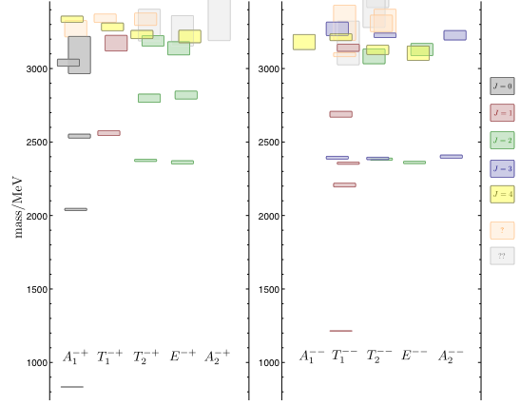
Meson and Hybrid Meson Spectrum
Lattice calculations
predict that the
lightest exotic particle
should have a mass about twice that of the
proton.
Calculational breakthrough
by CMU Professor Colin
Morningstar makes spectrum
calculations possible.
2009: Lattice calculation
of ground state and
excited spectrum.

Slide 26
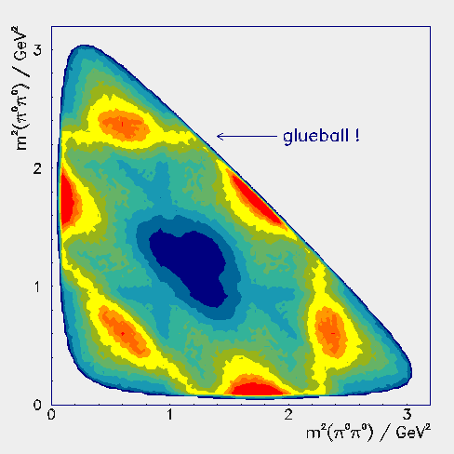
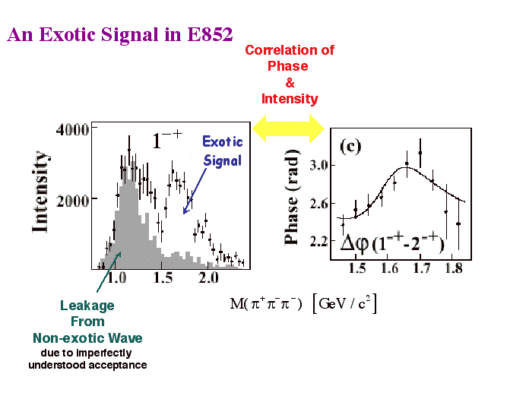
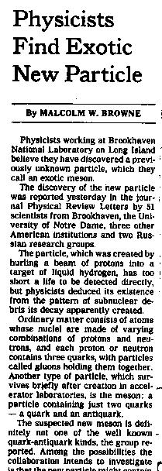
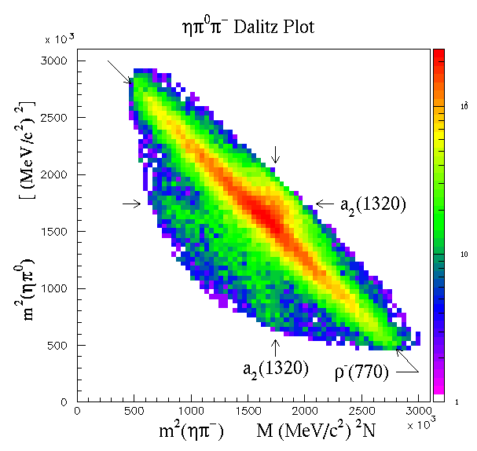
Experimental Evidence
New York Times,
Sept. 2, 1997
Evidence for both
Glueball and Hybrid
States

Slide 27
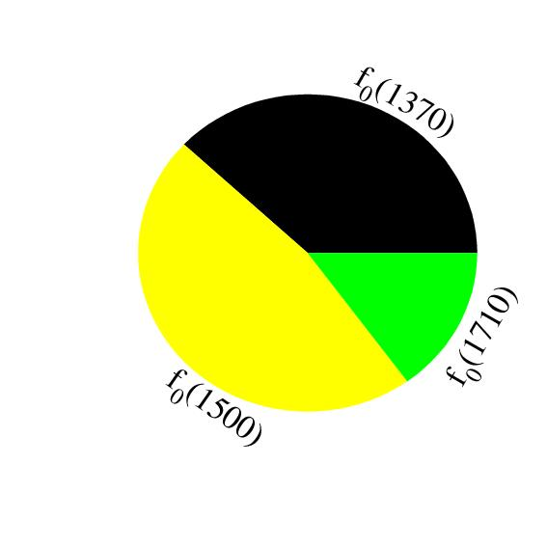
Glueballs
Experimental Evidence
Scalar (0⁺⁺) Glueball and two
nearby mesons are mixed.
f₀(1710)
f₀(1500)
a₀(1450)
K*₀(1430)
f₀(1370)
Glueball
spread
over 3
mesons
a₀(980)
f₀(980)
Are there other glueballs?
Crede & Meyer, Prog. Part. Nucl. Phys.
63, 74, (2009).

Slide 28
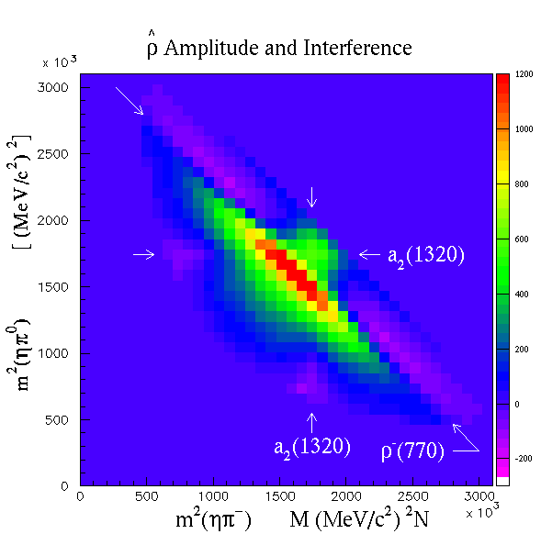
Hybrids
Experimental Evidence
New York Times,
Sept. 2, 1997
Exotic Mesons
1⁻⁺ mass 1.4
E852 BNL ’97
CBAR CERN ’97
Too light, decays
are wrong … ?
Exotic Mesons
1⁻⁺ mass 1.6
E852 BNL ’99
VES Russia ’99
Is this the first hybrid?

Slide 29
Hybrid Nonets
Experimental Evidence
New York Times,
Sept. 2, 1997
1⁻⁺
Establish other Nonets:
0⁺⁻ 1⁻⁺ 2⁺⁻
Levels
Built on normal mesons
Identify other
states in nonet
to establish hybrid
Since 2005, this
There is some doubt
About the 1600 state

Slide 30
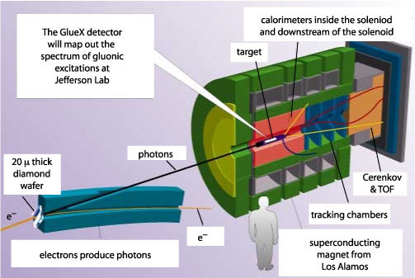
The GlueX Experiment

Slide 31
How to Produce Hybrids
Quark spins anti-aligned
q
q
A pion or kaon beam,
when scattering occurs,
can have its flux tube excited
π or   Κ
before
after
beam
_
Much data in hand with some
evidence for gluonic excitations
(tiny part of cross section)
_
q
q
q
q
Quark spins aligned
γ
before
Almost no data in hand
in the mass region
where we expect to find exotic hybrids
when flux tube is excited
after
beam
_
_
q
q

Slide 32
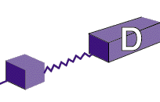
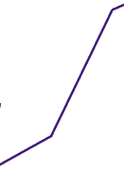
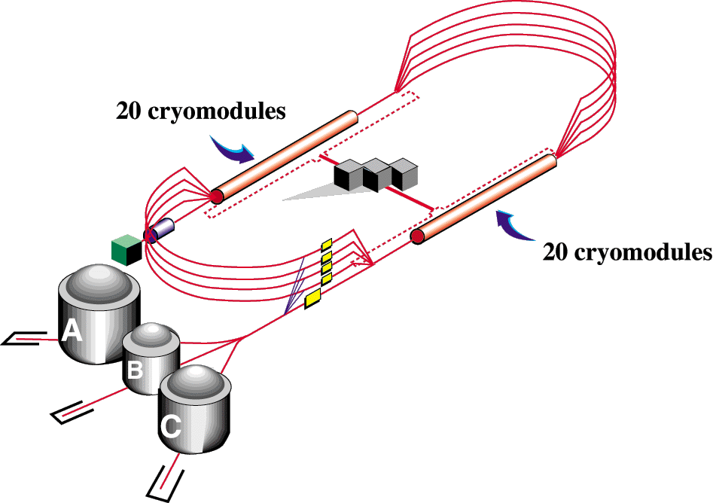
Jefferson Lab Upgrade

Slide 33


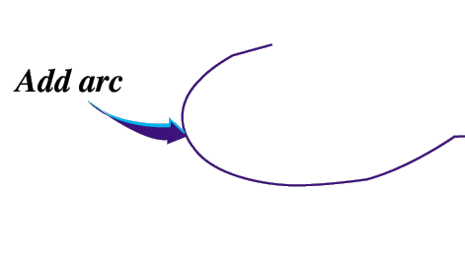

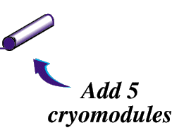
Jefferson Lab Upgrade
Upgrade magnets and power supplies
CHL-2

Slide 34
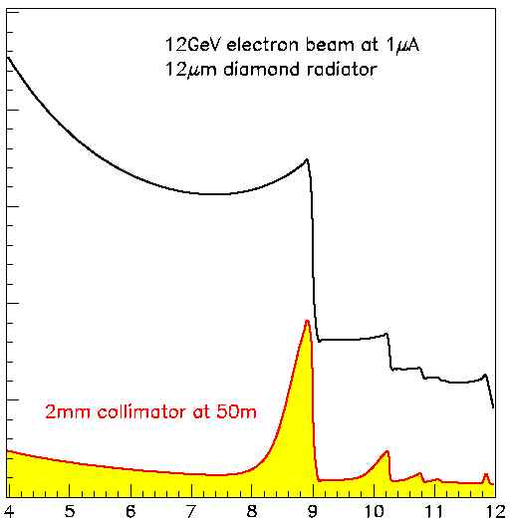
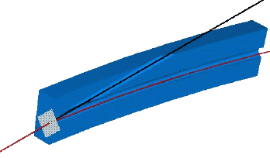
Coherent
Bremsstrahlung
12 GeV electrons
Incoherent &
coherent spectrum
flux
This technique provides requisite energy, flux and polarization
40%
polarization
in peak
Linearly polarized
photons out
collimated
electrons in
spectrometer
diamond
crystal
photon energy (GeV)
tagged
with 0.1% resolution

Slide 35
Jefferson Lab Upgrade
Timeline for GlueX
1997 – first meeting.
2001 – NSAC LRP
2004 – CD0
2006 – CD1
2007 – CD2
2007 – NSAC LRP
2008 – CD3
2009 – Construction
2010 - Const @ CMU
2014 – Beam
2014 – CD4
2015 - Physics
Hall-D on September 21, 2009

Slide 36
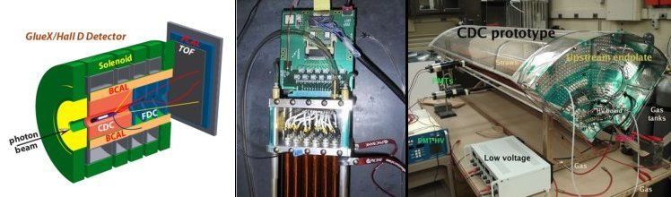
The GlueX Experiment
CDC @ CMU
At CMU, we will be building a 3500 channel drift chamber
for the GlueX experiment. Construction starts in early 2010
and continues through 2012. Unique opportunity to be
involved in the construction of hardware.

Slide 37
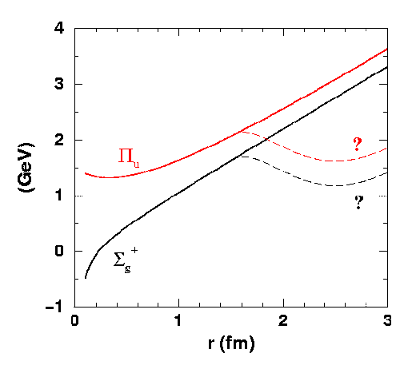
Gluonic Hadrons and Confinement
What are the light quark
Potentials doing?
ΔE
Potentials corresponding
To excited states of glue.
Non-gluonic mesons –
ground state glue.
Lattice QCD potentials

Slide 38
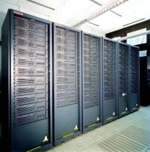
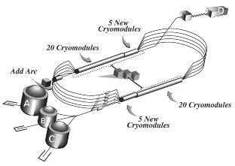
Conclusions
The quest to understand confinement
and the strong force is about to make
great leaps forward.
Advances in theory and computing
will soon allow us to solve QCD
and understand the role of glue.
The definitive experiments to
confirm or refute our expectations
are being designed
The synchronized advances in both areas will allow
us to finally understand QCD and confinement.

Slide 39


Slide 40
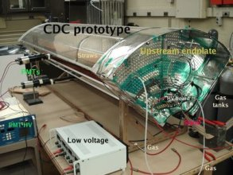
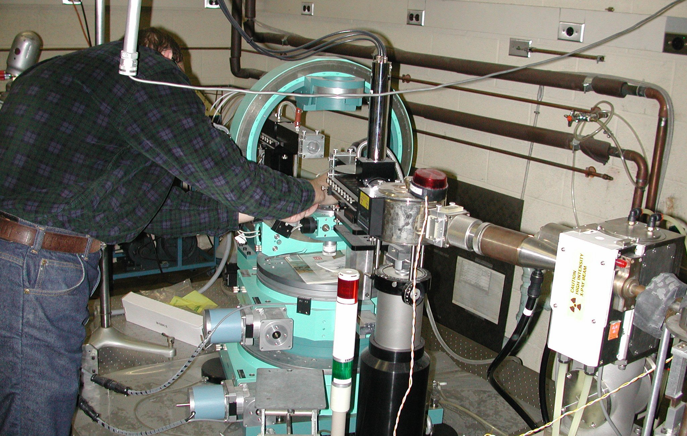
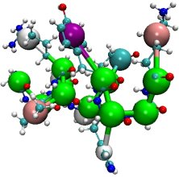
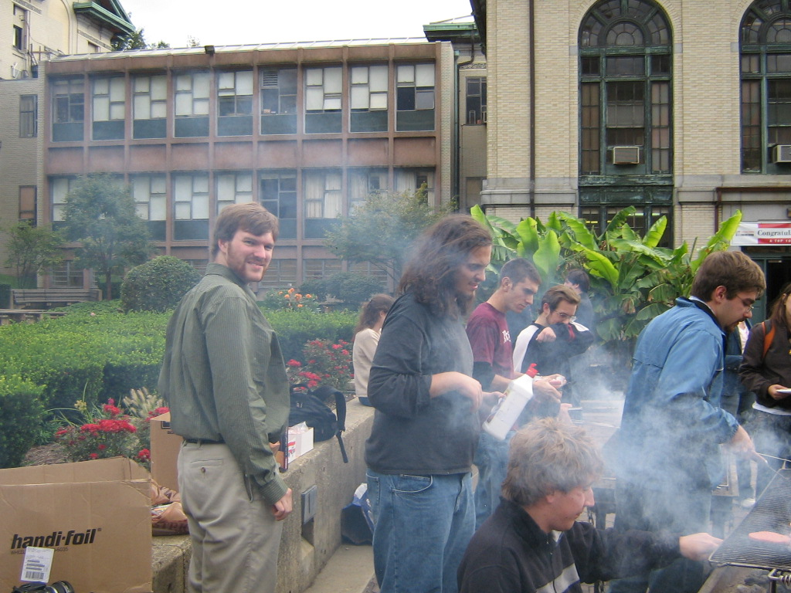
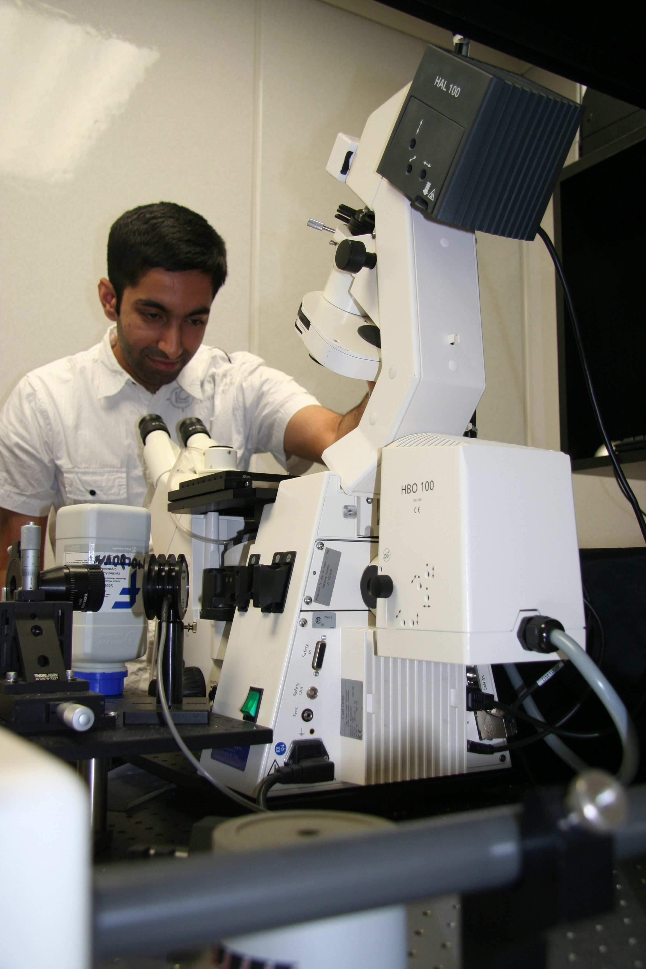
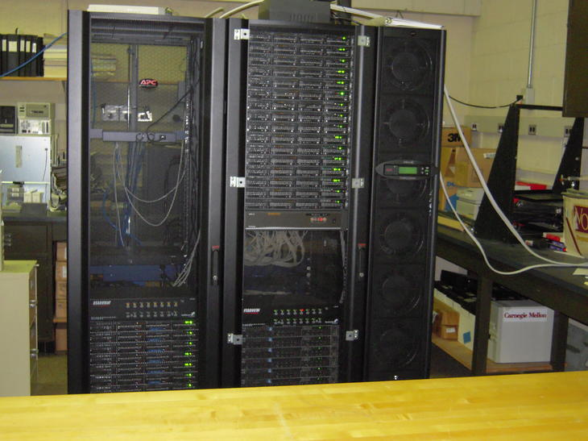
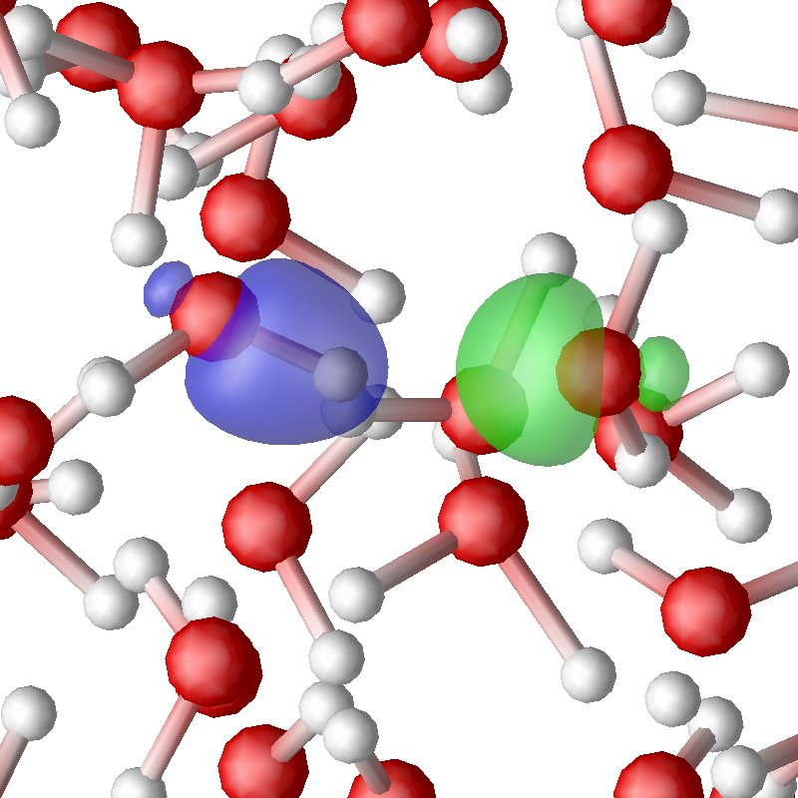
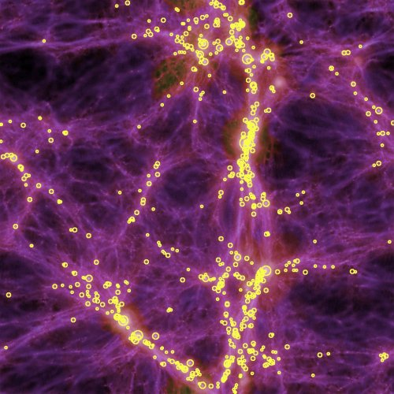
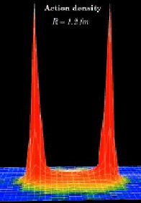


Physics at Carnegie Mellon

Slide 41





Astrophysics/Cosmology
Croft
Di Matteo
Holman
Peterson
Trac
2+ Hires
McWilliams Center for Cosmology
Emphasis on early universe modeling.
Griffiths

Slide 42








Biological Physics
Deserno
Evilovitch
Loesche
Nagle
T-Nagle
Widom
Very strong efforts in
experiment, computation
and theory with strong
connections to outside
groups.
Swendsen
Garoff
Majetic
Woods

Slide 43




Computational Physics
Croft
Deserno
Di Matteo
Meyer
Morningstar
Suter
Swendsen
Widom
Sekerka
A diverse group of people solving physics problems with large scale
Computing resources. Utilize in-house clusters and facilities like PSC.

Slide 44



Condensed Matter
Feenstra
Garoff
Islam
McHenry
Sekerka
Suter
Strong connections to groups
in other departments. Many
lab facilities on campus.
Swendsen
Widom
Majetic

Slide 45








High Energy Physics
Briere
Ferguson
Gilman
Holman
Paulini
Rothstein
Work carried out at FNAL,
CERN and BES (China). Strong
Experimental and theory
program.
Russ
Vogel
Wolfenstein

Slide 46




Medium Energy Physics
Franklin
Kisslinger
Meyer
Morningstar
Quinn
Schumacher
Strong experimental, computational and theoretical programs.
Experimental work carried out at Jefferson Lab. In-house
resources to build large detectors. Largest computational
facilities in the department.

Slide 47
Links outside Physics
Other CMU Departments:
Biology
Chemistry
Chemical Engineering
Electrical Engineering
Computer Science
Material Science
Math
Outside CMU
Argonne Natl. Lab
BES (China)
Brookhaven Natl. Lab
CERN
Jefferson Lab
Fermi Lab
NIST
SLOAN (SDSS)
LSST

Slide 48
Going to Graduate School?
Crucial Elements:
Grades
Undergraduate Research
GRE Subject
Letters of Recommendation
Personal Statement
At CMU, 3.5 in upper level physics
and math courses.
At least one semester, more is better.
Understand what you did.
Physics is crucial, 40th percentile is ok.
Get people that know your physics
ability. An instructor, research
advisors, ….
This is your chance to talk about what
you did and what you want to do. It
is also your chance to explain issues
in your record.

Slide 50
Hybrid Predictions
Flux-tube model: 8 degenerate nonets
1⁺⁺,1⁻⁻ 0⁻⁺,0⁺⁻,1⁻⁺,1⁺⁻,2⁻⁺,2⁺⁻ ~1.9 GeV/c²
S=0
S=1
Lattice calculations --- 1⁻⁺ nonet is the lightest
UKQCD (97) 1.87 ±0.20
MILC (97) 1.97 ±0.30
MILC (99) 2.11 ±0.10
Lacock(99) 1.90 ±0.20
Mei(02) 2.01 ±0.10
~2.0 GeV/c²
1⁻⁺
0⁺⁻
2⁺⁻
Splitting ≈ 0.20
In the charmonium sector:
1⁻⁺ 4.39 ±0.08
0⁺⁻ 4.61 ±0.11
Splitting = 0.20

