Slide 1
Meson spectroscopy with photo- and electro-production
Curtis A. Meyer
Carnegie Mellon University

Slide 2
Outline
What are the current issues in spectroscopy?
What is needed to do spectroscopy?
What might be interesting in the future?

Slide 3



Observed Hadrons
Color singlet (white) objects observed in nature:
In nature, QCD appears to have two configurations.
three quarks ( ) Baryons
proton: uud neutron: udd
quark-antiquark ( ) Mesons
There are a large number of excited states which are
also considered particles. QCD should predict these
spectra and we can compare them to experiment.

Slide 4
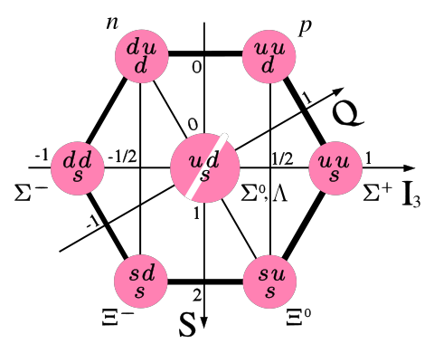
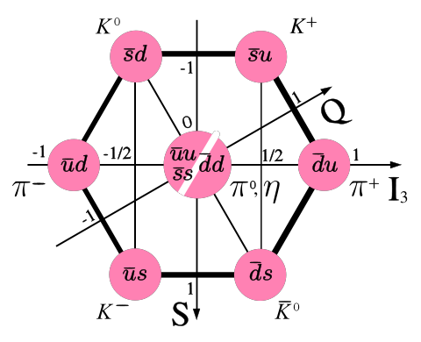
Observed Hadrons
Baryons
Mesons
Groups of 8 (octet)
And 10 (decuplet).
Groups of
9 (nonet).
Other Configurations?
4-quark
glueballs
pentaquarks
hybrids

Slide 5
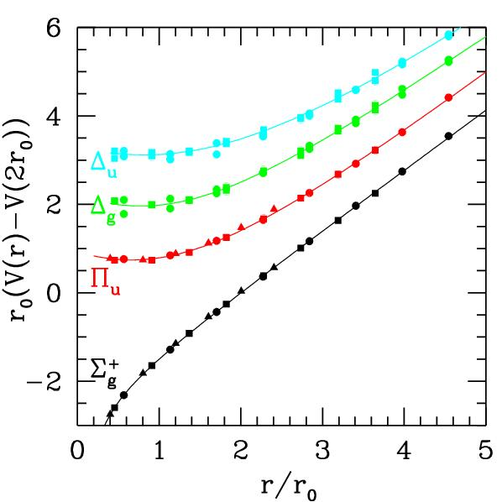
QCD Potential
ground-state
flux-tube
m=0
excited flux-tube
m=1
linear potential
Gluonic Excitations provide an
experimental measurement of
the excited QCD potential.
Observations of the nonets on the excited potentials are
the best experimental signal of gluonic excitations.

Slide 6
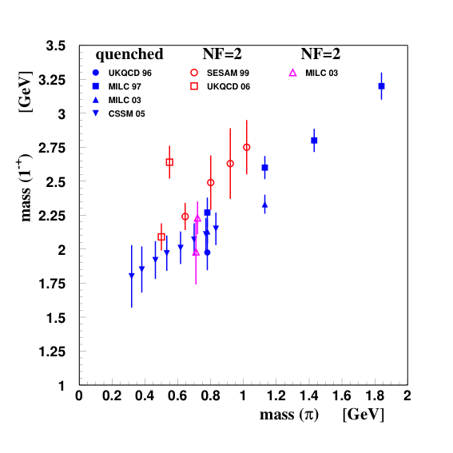
Hybrid Meson Predictions
Flux-tube model, start with a system and add one
unit of angular momentum in the flux tube.
S( ) J^{PC} of hybrid
0 1⁺⁺ 1⁻⁻
1 0⁻⁺,0⁺⁻,1⁻⁺,1⁺⁻,2⁻⁺,2⁺⁻
8 degenerate nonets
~1.9 GeV/c²
Lattice QCD: 1⁻⁺ nonet is lightest.
Mass Hierarchy
1⁻⁺ 1.9+/- 0.2 GeV/c²
2⁺⁻ 2.0+/- 1.1 GeV/c²
0⁺⁻ 2.3+/- 0.6 GeV/c²
In the charmonium sector:
1⁻⁺ 4.39 ±0.08 GeV/c²
0⁺⁻ 4.61 ±0.11 GeV/c²

Slide 7
Looking for Hybrids
Decay Predictions
Analysis Method
Partial Wave Analysis
Meson
Fit n-dim. angular distributions
Fit models of production and
decay of resonances.
Meson
L_{glue}
Meson
Angular momentum
in the gluon flux stays confined.
π₁ I^{G}(J^{PC})=1⁻(1⁻⁺)
K₁ I^{G}(J^{PC})= ½ (1⁻)
Nine state
η’₁ I^{G}(J^{PC})=0⁺(1⁻⁺)
η₁ I^{G}(J^{PC})=0⁺(1⁻⁺)
This leads to complicated multi-particle final states.

Slide 8
The Baryons
The Issues with Hadrons
What are the fundamental degrees of freedom
inside of a proton and a neutron?
Quarks? Combinations of Quarks? Gluons?
The spectrum is very sparse.
The Mesons
What is the role of glue in a quark-antiquark
system and how is this related to the confinement
of QCD?
What are the properties of predicted states
beyond simple quark-antiquark?
Need to map out new states.

Slide 9
Detector Specifications
Nearly full detector coverage for both charged particles and photons. We need to be able to reconstruct 8-10 particle final states with good efficiency.
Good to excellent resolution depending on the physics (are states narrow such as charmonium?).
Good particle identification.

Slide 10
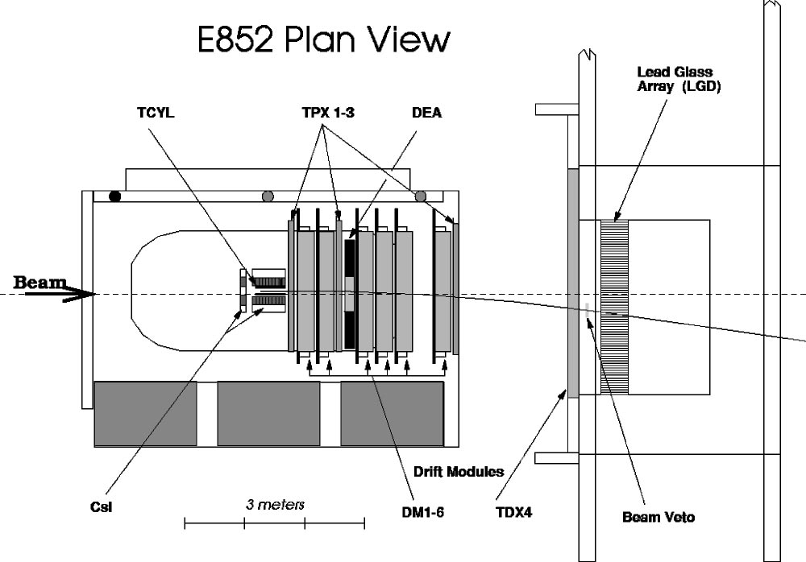
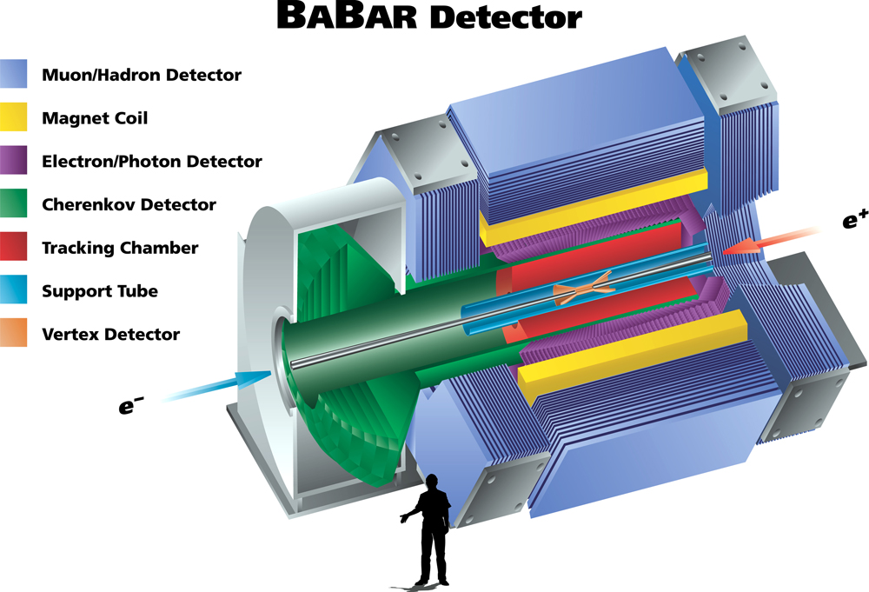
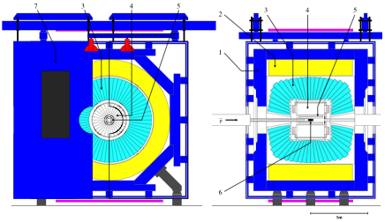
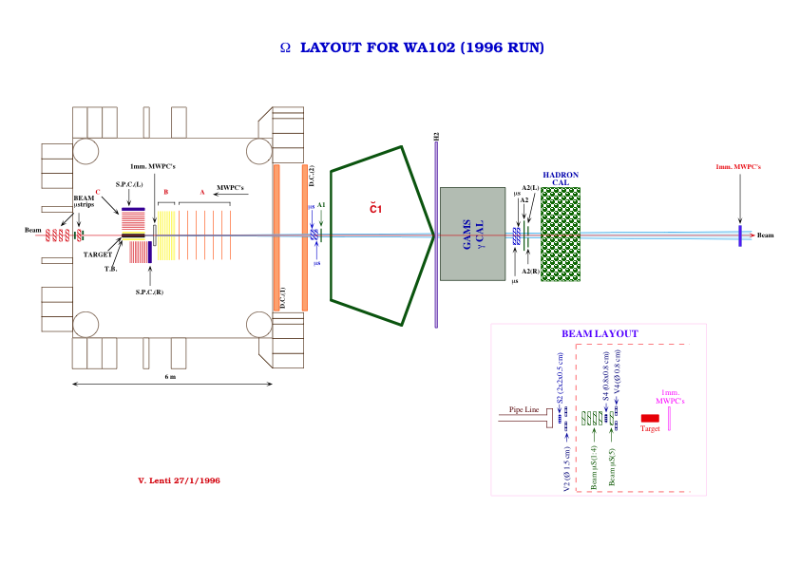
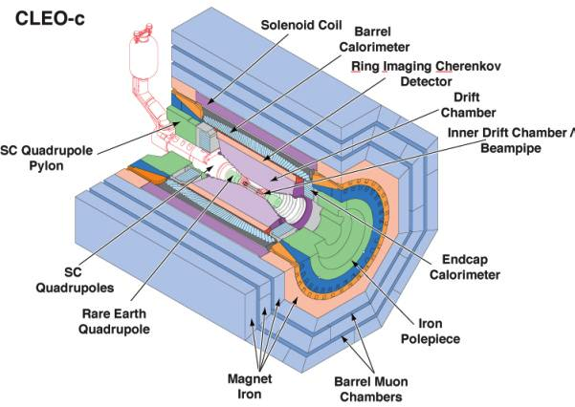
Spectroscopy Experiments
Crystal Barrel: LEAR/CERN
WA102: CERN
E852:BNL
CLEO-c:Cornell
Detector Features
Good charged particle tracking.
Good photon detection.
Good particle identification.
Very large and uniform acceptance
BaBar: SLAC

Slide 11
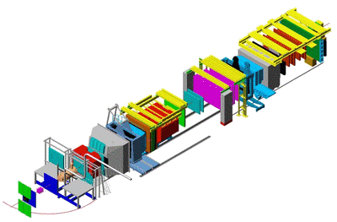
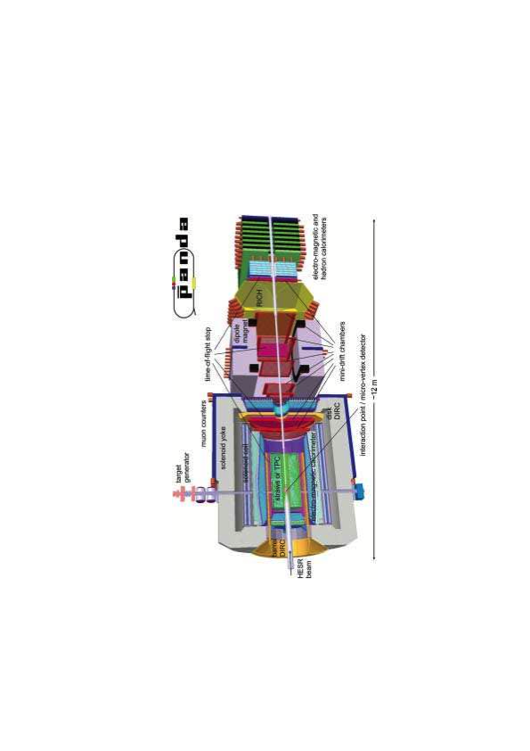
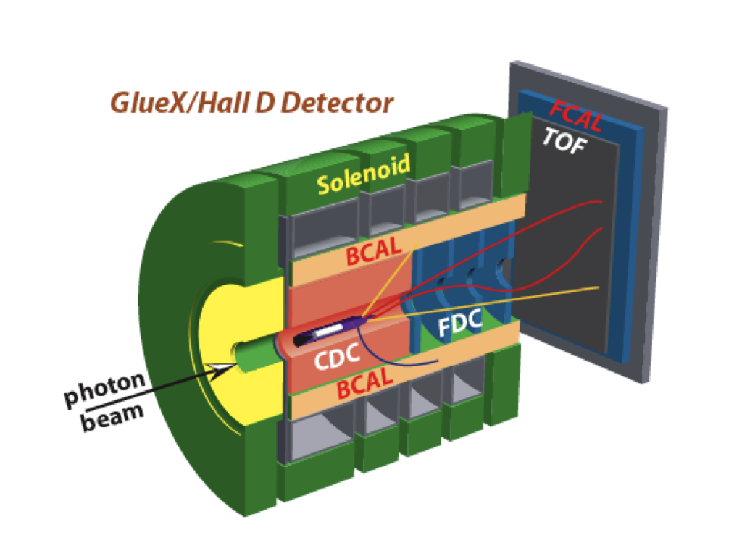
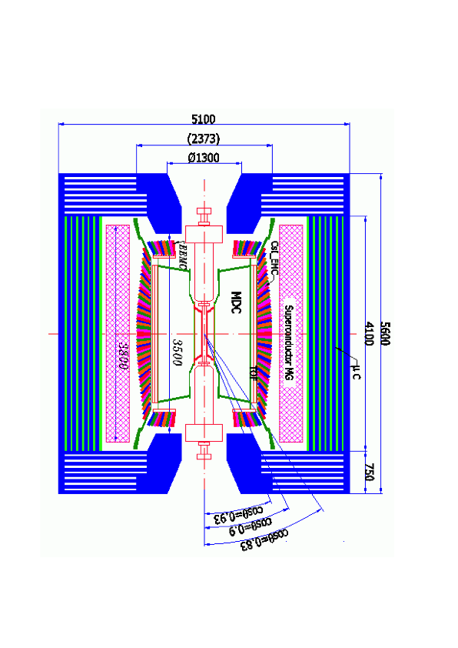
Spectroscopy Experiments
COMPASS: CERN (now)
charmonium and charmonium
hybrids
PANDA: GSI (~2015)
Light-quark systems, glueballs
And hybrid mesons
BESIII: Beijing (now)
GLUEX: JLAB-12GeV (~2014)
Open charm, glueballs,
Light-quark systems
Light-quark systems,
Hybrids mesons,
baryons

Slide 12
Partial Wave Analysis
It is very helpful to know something about the production process:
Proton-anti-proton at rest: Initial atomic states are limited, know initial J^{PC}
e⁺e⁻: Initial state is known
Radiative decays: Initial state is known
Other decays: Initial state is known
Peripheral Production: Momentum transfer t
Peripheral Production: Energy dependence s
Take advantage of polarization: Beam, target, final states.
It is important to map out phase motion:
Need to observe production as a function of mass, and need to see the
Production of more than one thing.

Slide 13
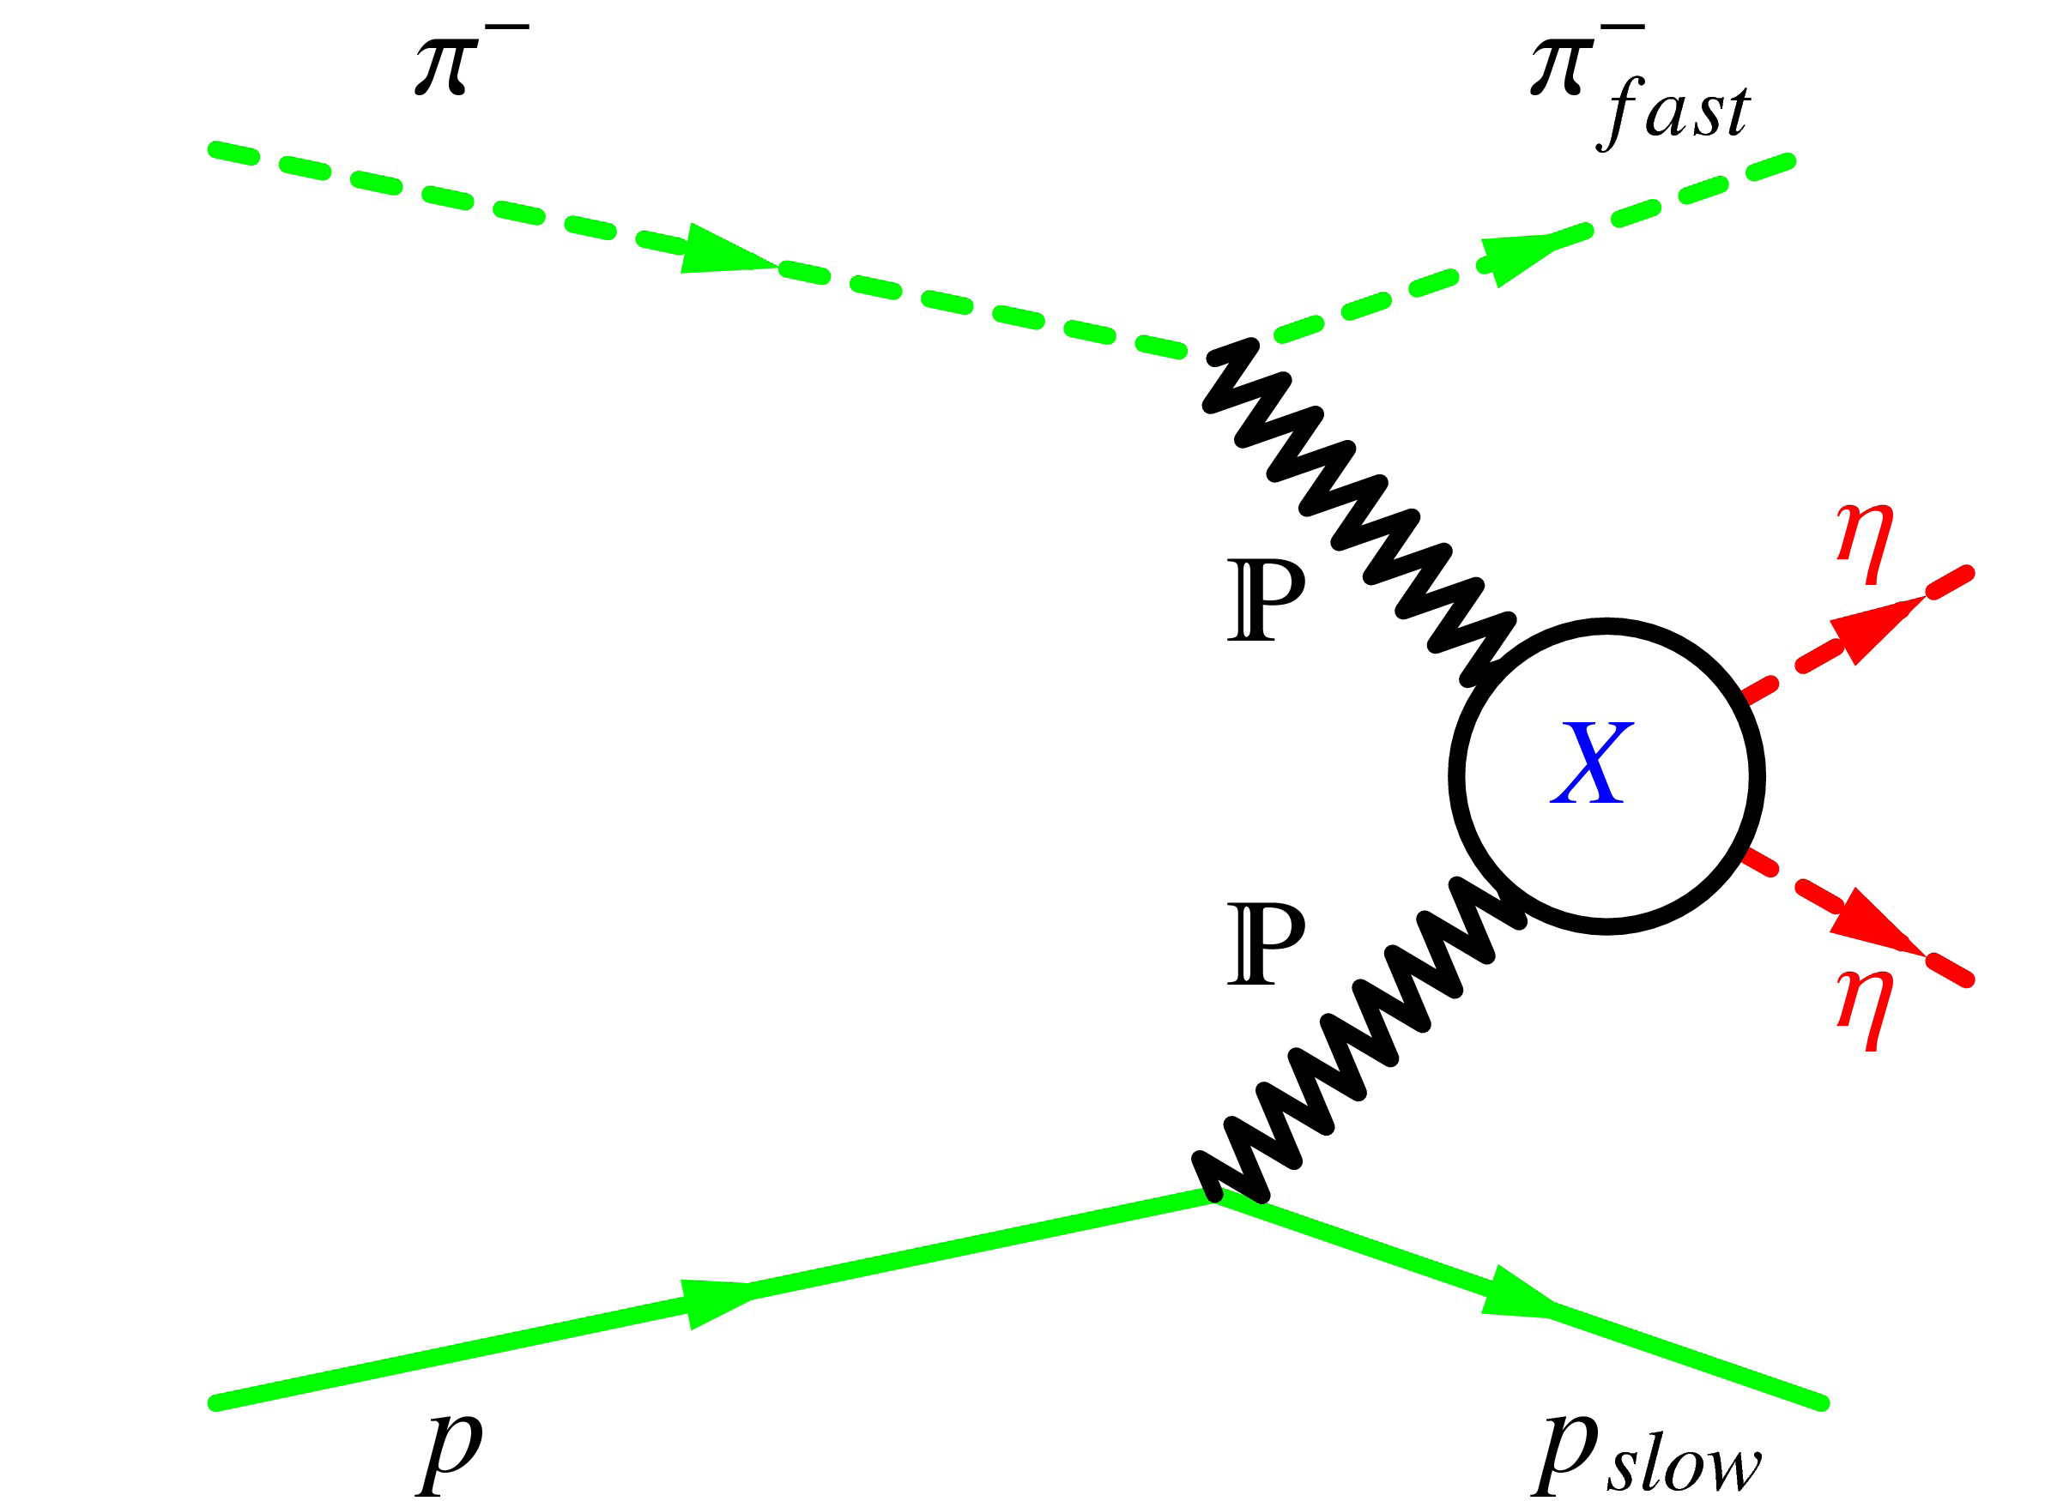
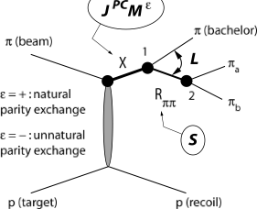
Production
Photo- and Hadro-peripheral Production
Central Production
beam
Very high energy for double pomeron
Need sufficient energy to produce “X”.
Want small |t| to have larger cross section.
Isolate this process from others.

Slide 14
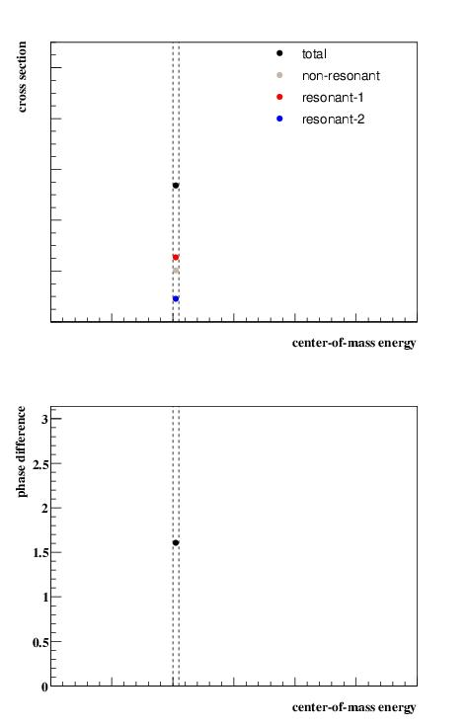
Partial Wave
Analysis
A simple model with three
complex amplitudes, 2 of
which are particles with
different QNs
Start with a single energy
bin.
Fit to get the strengths and
the phase difference between
the two resonances.

Slide 15
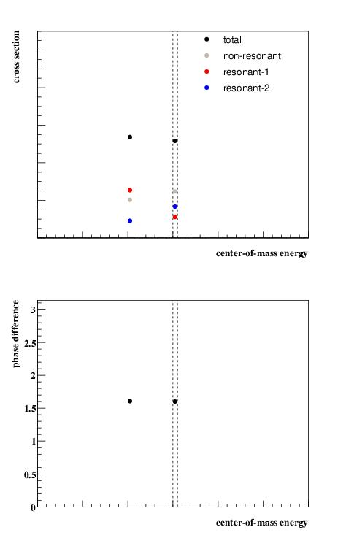
Partial Wave
Analysis
A simple model with three
complex amplitudes, 2 of
which are particles with
different QNs
Start with a single energy
bin.
Fit to get the strengths and
the phase difference between
the two resonances.
Fit a 2nd bin.

Slide 16
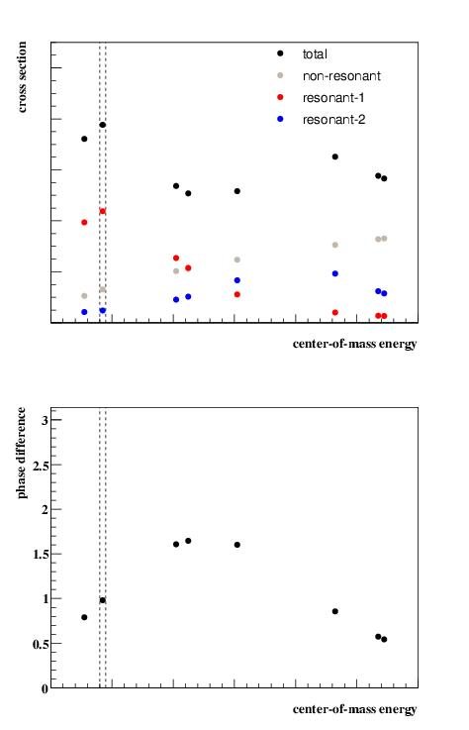
Partial Wave
Analysis
A simple model with three
complex amplitudes, 2 of
which are particles with
different QNs
Start with a single energy
bin.
Fit to get the strengths and
the phase difference between
the two resonances.
Continue fitting bins …

Slide 17
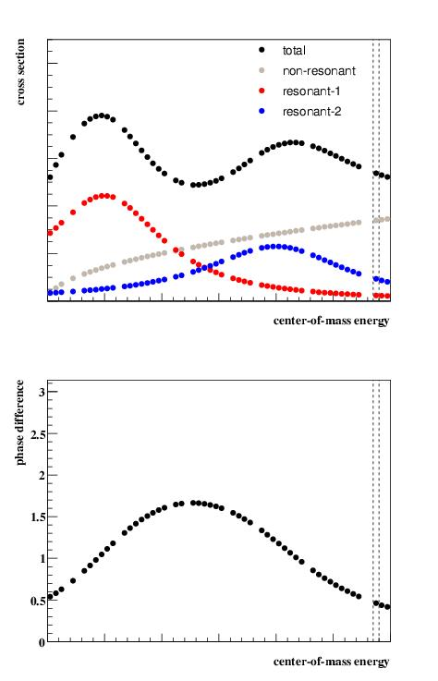
Partial Wave
Analysis
A simple model with three
complex amplitudes, 2 of
which are particles with
different QNs
Start with a single energy
bin.
Fit to get the strengths and
the phase difference between
the two resonances.
… and continue …

Slide 18
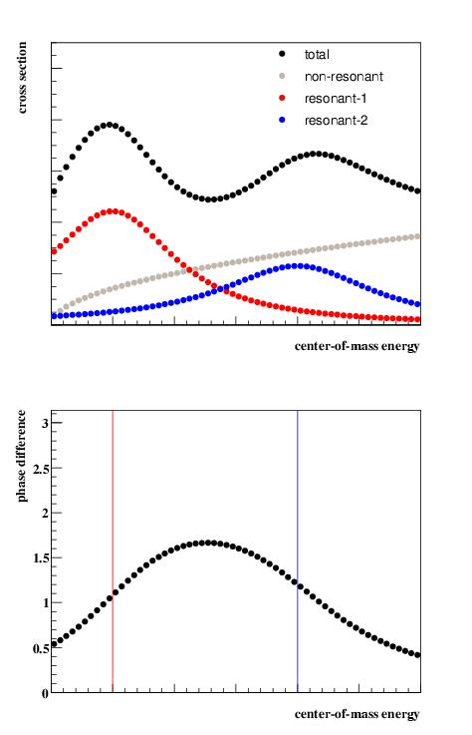
Partial Wave
Analysis
A simple model with three
complex amplitudes, 2 of
which are particles with
different QNs. The masses
peak where the two lines
are.
The need for intensity and
the phase difference are
indicative of two resonances.
Can fit for masses and widths.

Slide 19





Electroproduction
There is a lot of data on the electroproduction of ``simple” systems:
What is the Q² dependence?
Can we measure form factors?

Slide 20
Electroproduction
Presumably anything that can be photoproduced can also
be electroproduced.
Hybrid mesons – need to determine which have the largest
cross sections. They are broad states with 4-6 particles in
the final state, so a PWA is also required.
Are form factors different from conventional states?

Slide 21

Electroproduction
Presumably anything that can be photoproduced can also
be electroproduced.
Glueballs – not expected to be a good production mechanism,
but they are mixed with normal mesons. Can we say anything?
Are form factors different from conventional states?

Slide 22
Summary
There is a robust spectroscopy program from now through the end of the current decade: COMPASS, BESIII, GlueX and PANDA (designed for spectroscopy).
What we learn from photoproduction exotic and other mesons may lead to an interesting electroproduction program.
To exploit such a program, it is important to design detectors with spectroscopy in mind from the beginning.

