Slide 1
The GlueX Experiment
Curtis A. Meyer
Carnegie Mellon University

Slide 2
The GlueX Collaboration
Carnegie Mellon, Catholic University, Christopher Newport,
Florida International, Florida State, Glasgow, Indiana University,
IUCF, Jefferson Lab, Langzou University, University of Connecticut,
University of Alberta, University of Athens, University of
Pennsylvania, University of Regina, Yerevan
Several other institutions are in discussion to join GlueX and we
welcome new participants.

Slide 3
Outline
The Physics of GlueX
The Jefferson Lab Upgrade
The GlueX Detector

Slide 4
QCD Potential
Lattice QCD
ground-state
flux-tube
m=0
linear potential
The normal mesons are built up from a “quark-antiquark
pair” with and a “ground-state” flux tube.
(¼,K,´,´⁰ )
(½,K*,!,Á, Á)
(b₁,K₁,h₁,h₁⁰)
( ☹ )
J^{PC}=0⁻⁺
J^{PC}=1⁻⁻
J^{PC}=1⁺⁻
0⁺⁺,1⁺⁺,2⁺⁺,2⁻⁻,2⁻⁺,3⁺⁺,3⁻ ⁻,3⁺ ⁻

Slide 5
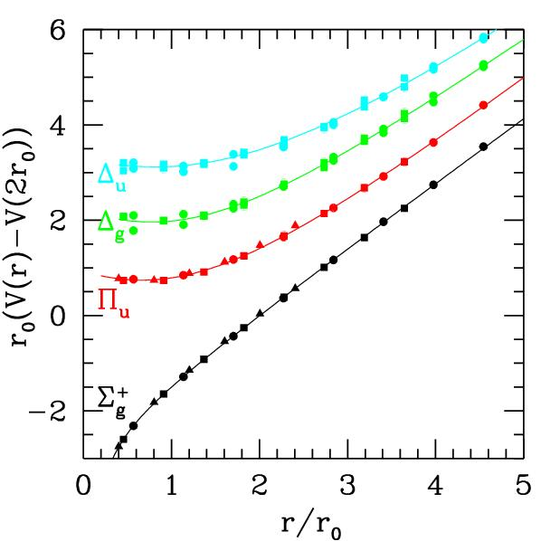
QCD Potential
Lattice QCD
ground-state
flux-tube
m=0
S=0,L=0,m=1
S=1,L=0,m=1
excited flux-tube
m=1
J=1 CP=+
J=1 CP=-
J^{PC}=1⁺⁺,1⁻⁻
(not exotic)
J^{PC}=0⁻⁺,0⁺⁻
1⁻⁺,1⁺⁻
2⁻⁺,2⁺⁻
linear potential
exotic
Gluonic Excitations provide an
experimental measurement of
the excited QCD potential.
Many of the hybrid nonets have exotic quantum numbers.

Slide 6
Hybrid Predictions
Flux-tube model: 8 degenerate nonets
1⁺⁺,1⁻⁻ 0⁻⁺,0⁺⁻,1⁻⁺,1⁺⁻,2⁻⁺,2⁺⁻ ~1.9 GeV/c²
S=0
S=1
Lattice calculations --- 1⁻⁺ nonet is the lightest
UKQCD (97) 1.87 ±0.20
MILC (97) 1.97 ±0.30
MILC (99) 2.11 ±0.10
Lacock(99) 1.90 ±0.20
Mei(02) 2.01 ±0.10
Bernard(04) 1.792§0.139
All masses in GeV/c²
1⁻⁺ 1.9§ 0.2
2⁺⁻ 2.0§ 0.11
0⁺⁻ 2.3§ 0.6
In the charmonium sector:
1⁻⁺ 4.39 ±0.08
0⁺⁻ 4.61 ±0.11
Splitting = 0.20

Slide 7
Hybrid Decays
L_{flux}
The angular momentum in the flux
tube stays in one of the daughter
mesons (an (L=1) and (L=0) meson).
L_{flux}
Exotic Quantum Number Hybrids
π₁→ πb₁ , πf₁ , πρ , ηa₁
η₁→π(1300)π , a₁π
b₂ → a₁π , h₁π , ωπ , a₂π
h₂ → b₁π , ρπ , ωη
b₀ → π(1300)π , h₁π
h₀ → b₁π , h₁η
Mass and model
dependent
predictions
Populate final states with
¼§,¼⁰,K§,´ (°)
Final States (in GlueX)
(p,n) +
¼¼¼ , ¼¼¼¼ , ¼¼¼´ , ¼¼¼¼´
70% involve at least 1 ¼±
50% involve more than 1 πº

Slide 8
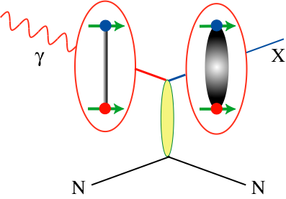
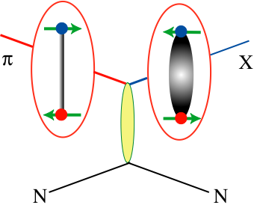
Photoproduction
Photon behaves like a spin-1 meson (½ ! Á )
More likely to find exotic hybrid mesons using beams of photons
Virtually no photo-production data at 8-9 GeV
(literally a few thousand events)
Theoretically we expect some hybrid production
cross sections similar to normal mesons
No photo-production data with multiple ¼±
A high-statistics experiment with performance
similar to other successful spectroscopy
experiments can make a big impact.
GlueX will collect ~4-5 orders of magnitude
more data than existing photon experiments
and we will by exceed the highest statistics
experiments by 1-2 orders of magnitude.
¼ and K beams are spin-0

Slide 9
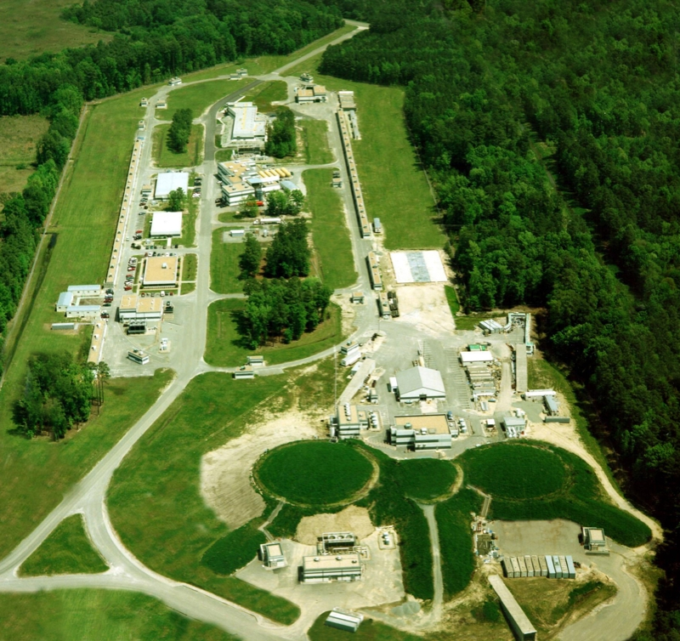
GlueX Here
Jefferson Lab
Accelerator
Newport News
VA
A
B
C

Slide 10
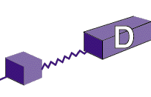
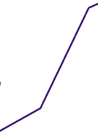

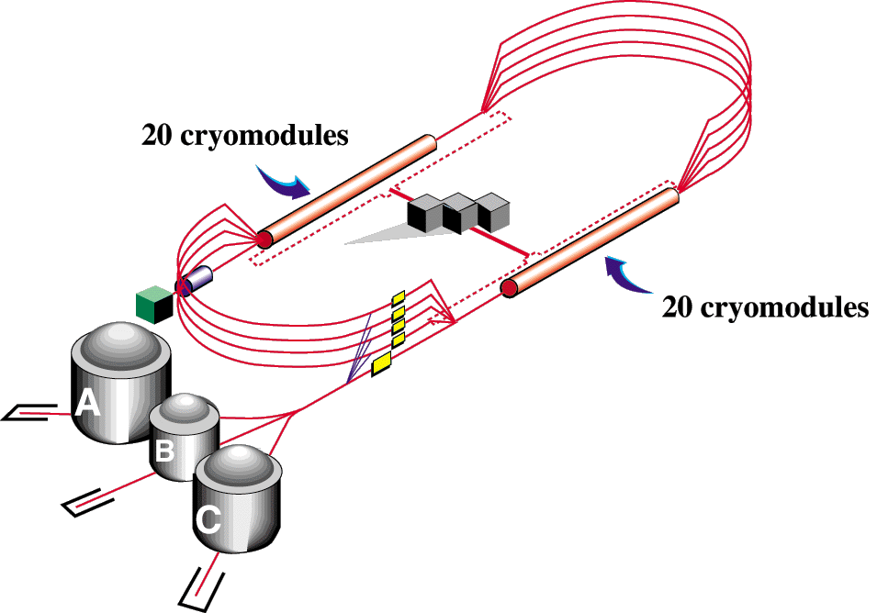

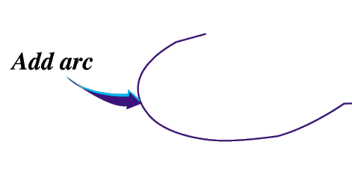

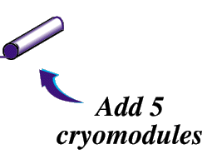
JLab Upgrade
Upgrade magnets and power supplies
CHL-2

Slide 11
The Jefferson Lab Upgrade
The JLab upgrade is a ~$300,000,000 project within the Department of Energy to double the energy of the CEBAF machine to 12 GeV.
Equipment in Halls B (CLAS 12) and C (new spectrometers) will be upgraded.
A new, photon-only experimental Hall, D, will be built and the GlueX experiment will be installed.

Slide 12
Milestones
Progress towards construction is tracked by Critical Decisions, CD0 … CD4.
April 2004, CD0 --- Conecptual
February 2006, CD1 --- R&D
November 2007, CD2 --- Project Engineering
September 2008, CD3 --- Start of construction.
Fall 2015, CD4 --- Start of operations
Currently awaiting the passing of a budget by the
U.S. Congress.

Slide 13
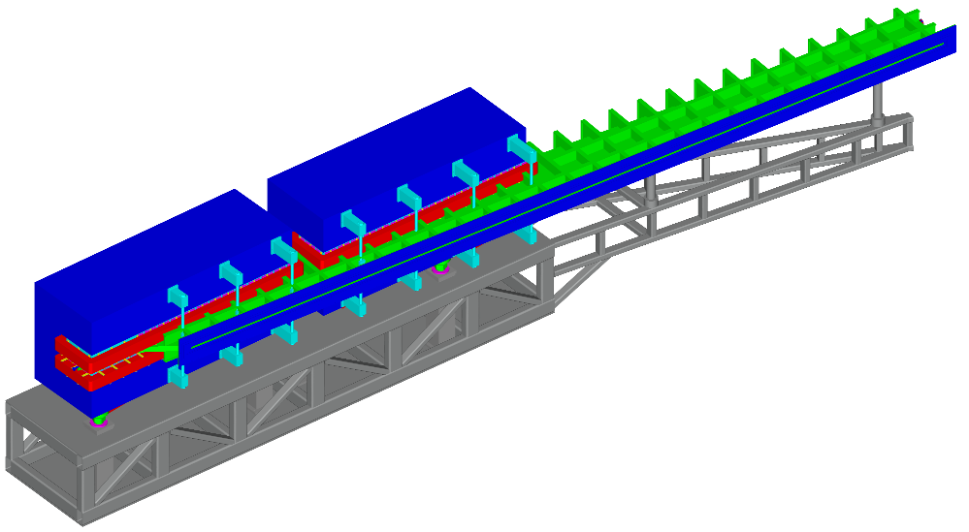
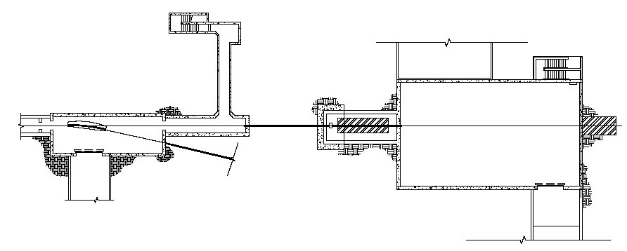
Linearly Polarized Photon Beam
linear polarization
determined by crystal orientation
not affected by electron polarization
vanishes at end-point
Vacuum
chamber
Photon
beam
Hodoscope
Microscope
20 μm
Diamond
scattered electrons
Electron
beam
Tagger Magnet:
  1 Dipoles 1.5T
  Main beam deflection 13.4° Analyze E_{γ}=8.5-9GeV
  30 mm pole gap, 3m long, and 38 metric tons ea.
Vacuum chamber:
  12 meters long integrated into magnet
  Thin exit window
75 m
Photon
Dump
Collimator
Detector
Electron beam

Slide 14
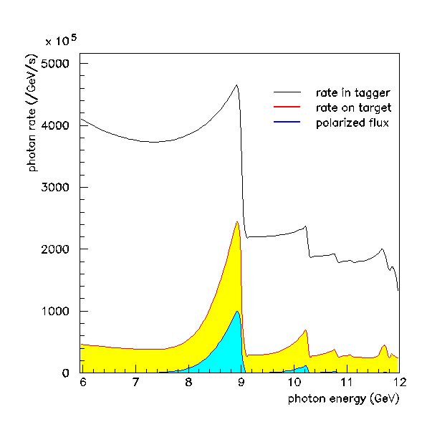
Linearly Polarized Photon Beam
Photon Beam Intensity Spectrum
Rates based on:
12 GeV endpoint
20 μm diamond crystal
300 nA electron beam
diamond – collimator: 76m
collimator diameter: 3.5 mm
Leads to 10⁷ γ/s on target
(after the collimator)
4
nominal
tagging
interval
Design goal is to build an experiment with ultimate rate capability as high as 10⁸ γ/s on target.
tagged
UCONN, CUA, Glasgow, JLab, Yerevan
0.1% resolution
photon energy (GeV)

Slide 15
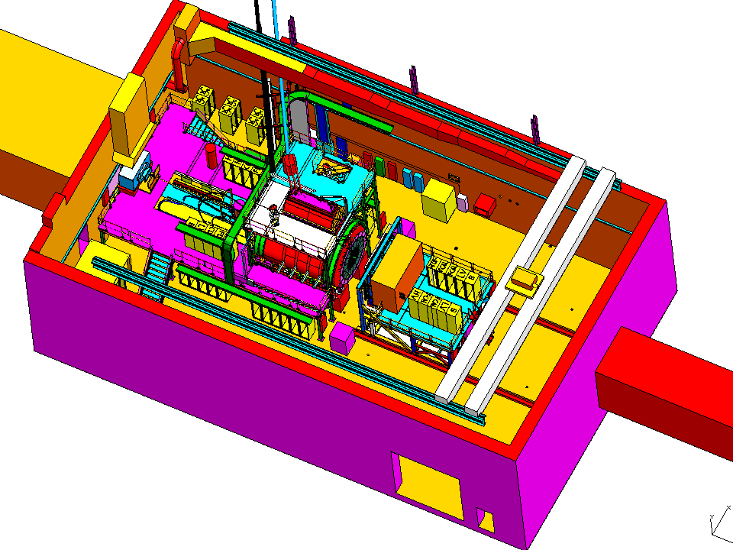
The GlueX Detector in Hall D
Beam
AC ducts
Cryogenics platform
North Wall
Cable trays
Collimator alcove
Penetrations for gas lines
Overhead crane
Upstream platform
Electronics racks
Photon dump
Solenoid
Truck ramp entrance

Slide 16
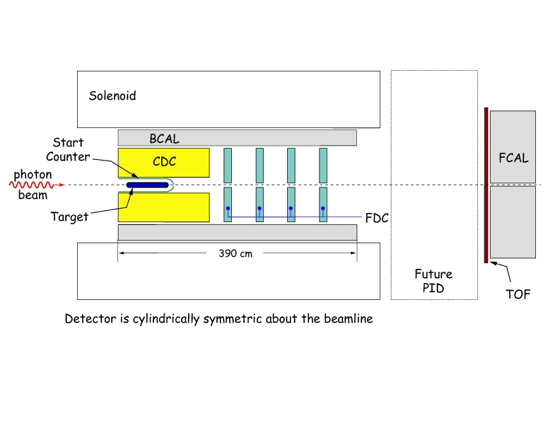
The GlueX Detector
Linearly polarized photons
Initial rate: 10⁷° /s
tagged 8.4-9 GeV (to .1%)
Up to: 10⁸ ° /s
~2.25 T solenoid magnet
(refurbished and updated
LASS/MEGA magnet).
Pb Glass Calorimeter
(glass from BNL E852)
30-cm long LH2 target
Scintillator
start counter
Central straw
tube drift chamber
Planar cathode drift
chambers
Plastic scintillator
time-of-flight wall
Pb scintillator sandwich
calorimeter inside the
solenoid. Also measure
TOF of charged particles.

Slide 17
Tracking: Startcounter
Photon
Beam
Setup
  40 scintillators
  10mm x 500mm, bended with 35º towards beam
  acceptance 3º to 134º σ_{t}= 0.5ns
Readout:
  single sided in high magnetic field
  SiPMs or Hamamatsu R5924-70
Electronics:
  energy measurement: 250 MHz FADCs (16ch)
  timing measurement: CFD (16ch) & 62ps F1-TDC (32ch)
Florida International

Slide 18
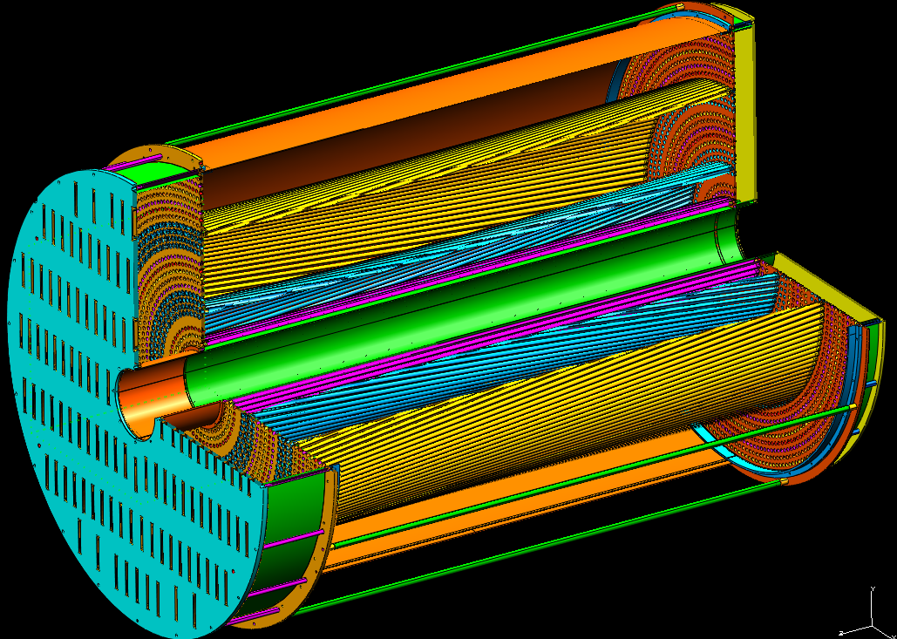
Tracking: Central Drift Chamber
Support tube
Downstream end plate
Upstream end plate (Φ 119.5cm)
Stereo straws
Upstream gas plenum cap
Outer skin (forms stiff tube)
Inner skin
180cm
Endplates, tubes and skin form stiff structure!
Carnegie Mellon University, UPENN, JLab, IUCF

Slide 19
Tracking: Central Drift Chamber
Setup:
  straw tube tracker
  3098 straws (r: 0.8 cm; 100 μm Kapton 5 μm Al)
  radius: inner-10cm outer-58cm length-1.5m
  4 layers +6º; 4 layers -6º; 16 radial layers
Readout / Electronics:
  preamp cards the same as for FDC based on ASIC
  energy/timing measurement: 125 MHz FADCs (72ch)
HV
  24 straws / HV channel (130 HV channels)
Carnegie Mellon University, UPENN, JLab, IUCF

Slide 20
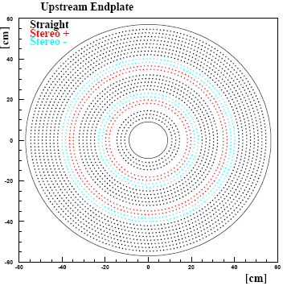
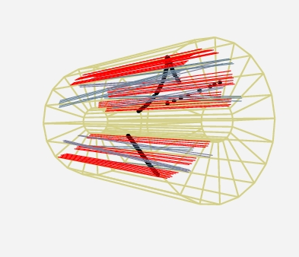
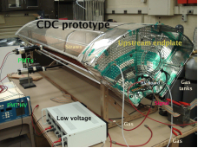
Tracking: Central Drift Chamber
Cylindrical Drift Chamber
dE/dx for p < 450 MeV/c
Gas mixture: 87/13 Ar/CO₂
Angular Coverage: 6º-155º
Resolution:
σ_{rφ} ~ 150 μm, σ_{z}~1.5 mm
Status:
full scale prototype with
16 staws fully instrumented
Cosmic Track

Slide 21
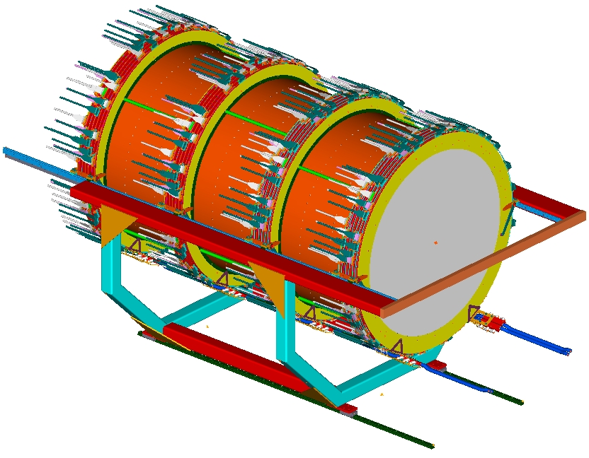
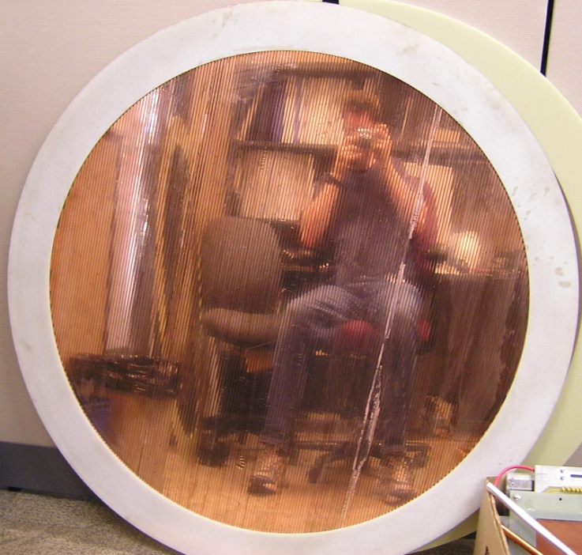
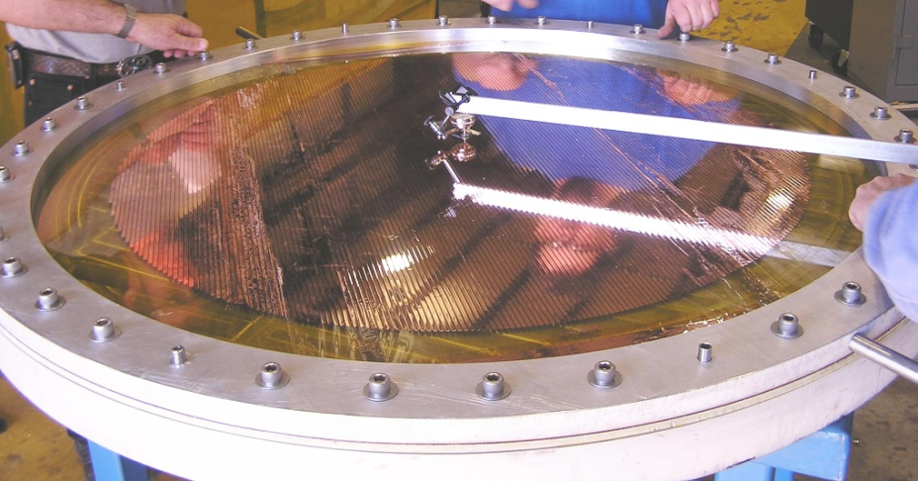
Tracking: Forward Drift Chamber
4 packages
Forward Drift Chamber
Resolution: 200 μm
Gas Mixture: 40:60 Ar/CO₂
Angular Coverage: 1º – 30º
cathode-wire-cathode strong
suppression of hit ambiguities
Status:
small scale prototype existing
full scale prototype underway
Connecting tubes
Cables
Outer skin
Assy tooling

Slide 22
Forward Drift Chamber
Setup:
  cathode strip chamber
  4 packages;
  ground- cathode(24)-wire(24)-spacer(24)-cathode(24)
  96 sense + 97 field wires & 216 cathode strips
    total: 12672 channels
  wires; u-v strips +/- 75º to wires
  diameter: 1.2m
Readout / Electronics:
  Preamp. boards based on ASIC
  cathodes: 125 MHz FADCs (72 ch) → 144 modules
  anodes: 125ps F1-TDC (48 ch) → 48 modules
HV
  384 channels
JLab, UPENN, IUCF

Slide 23
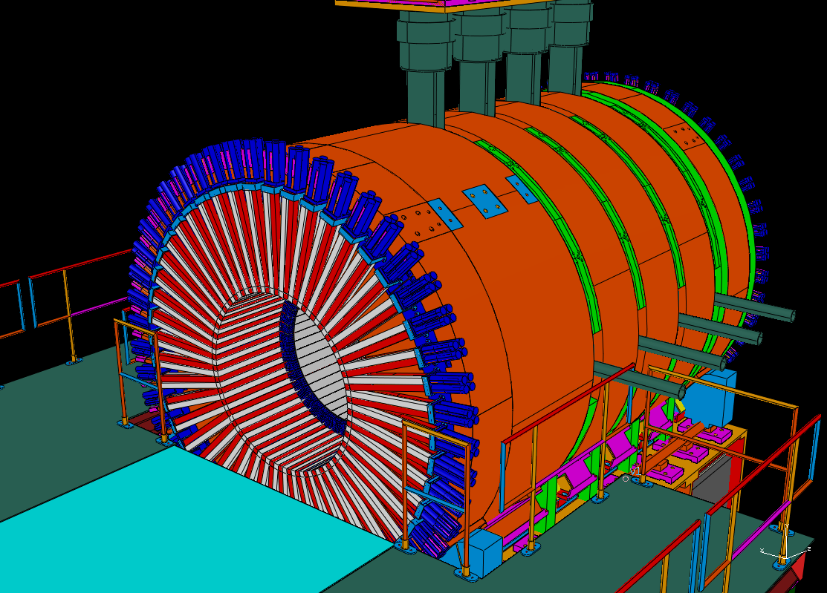
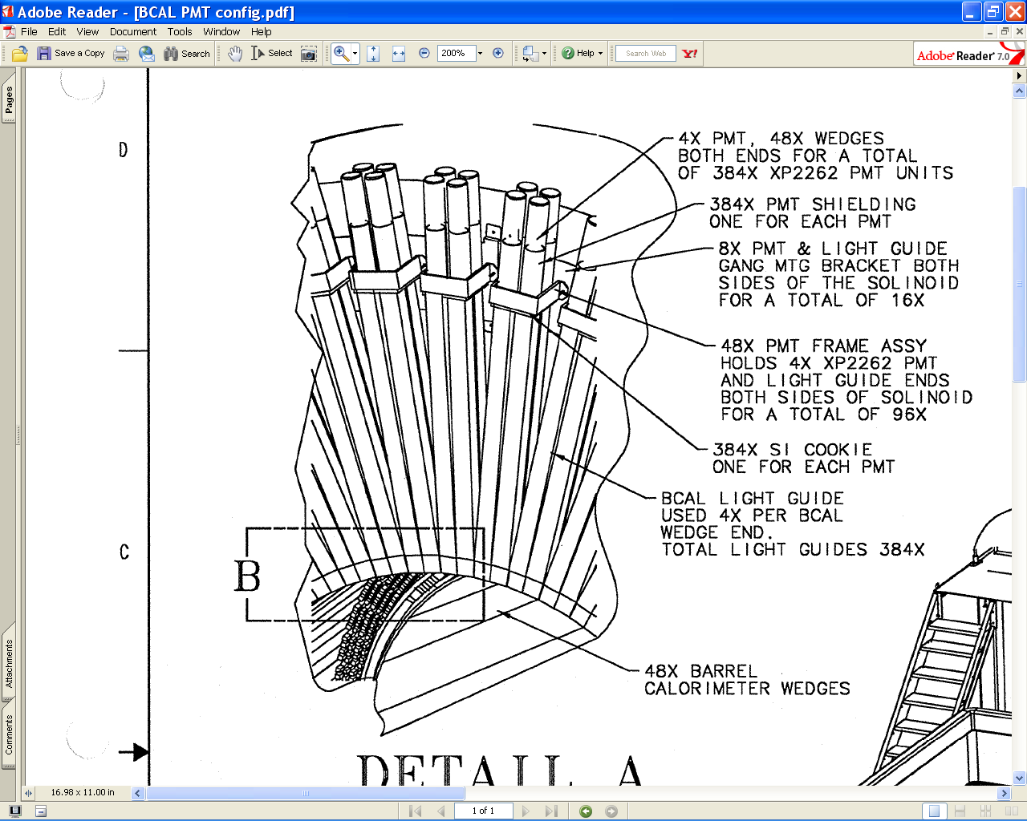
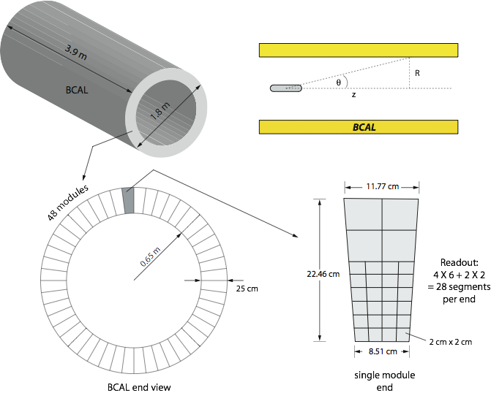
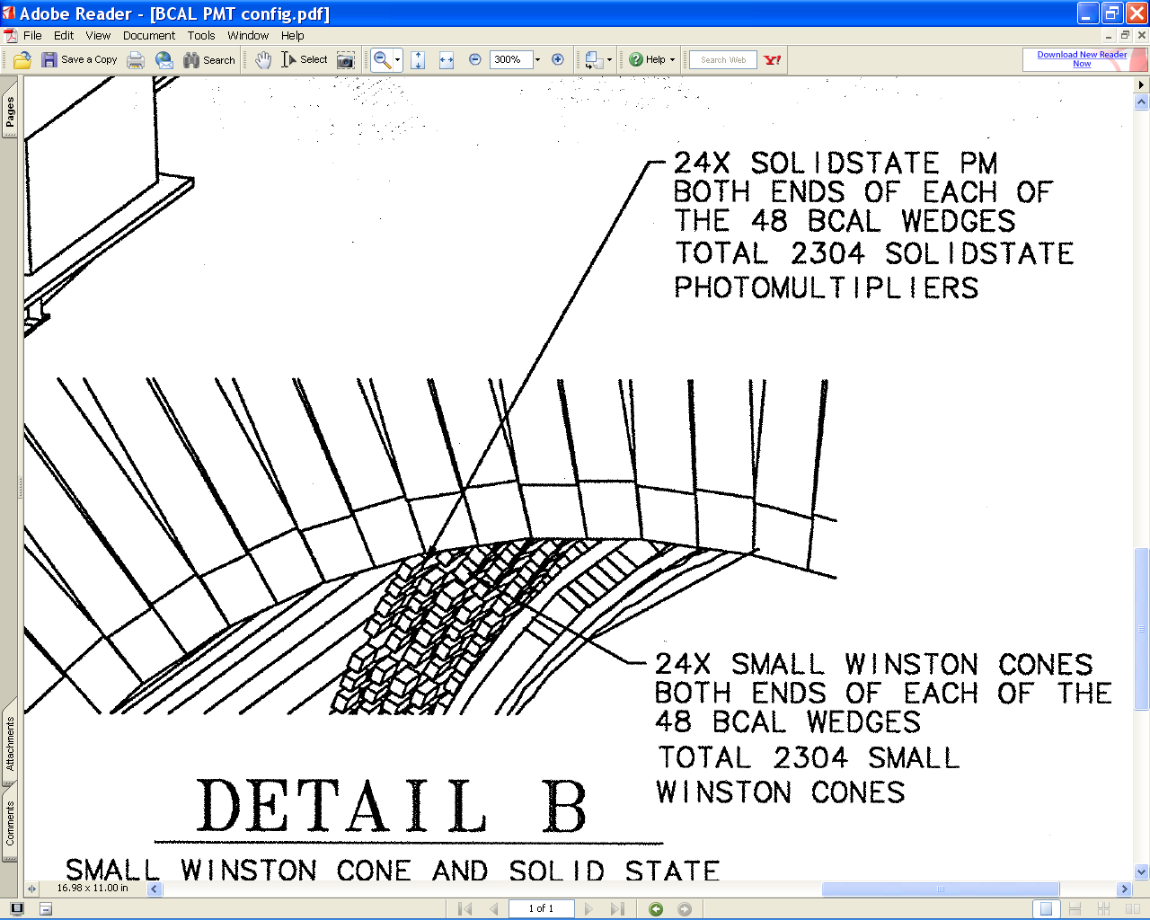
The Barrel Calorimeter
48 modules (phi sectors)
PMT Base
Magnetic
Shielding
PMT Frame
Mounting Brkt
Si cookie
24 SiPM’s on each
end of each wedge
Light Guide
Wedges
Winston Cones Glued
to each end of
fiber/lead matrix
σ_{E}/E=5.54%/√E ⊕ 1.5%

Slide 24
The Barrel Calorimeter
48 Modules:
  191 layers of 0.5 mm Pb and 1 mm SciFi and Glue (37:49:14)
  Sampling fraction: 0.125
  inner radius 65 cm; outer radius: 90 cm; length 3.9m
  X₀ = 1.45cm → 15.5 X₀
Readout:
  in high magnetic field
  double sided
  inner part: 48x2x24 SiPMTs (2304 ch)
  outer part: 48x2x4 XP2262 PMTs (384 ch)
Electronics:
  photon energy measurement: 250 MHz FADCs (16 ch)
  charged particle TOF inner BCal: F1-TDC (62ps) (32 ch)
HV / LV
  inner: 16 SiPMT / LV channel
  outer: 1 PMT / HV channel
Regina, Alberta, Athens, JLab

Slide 25
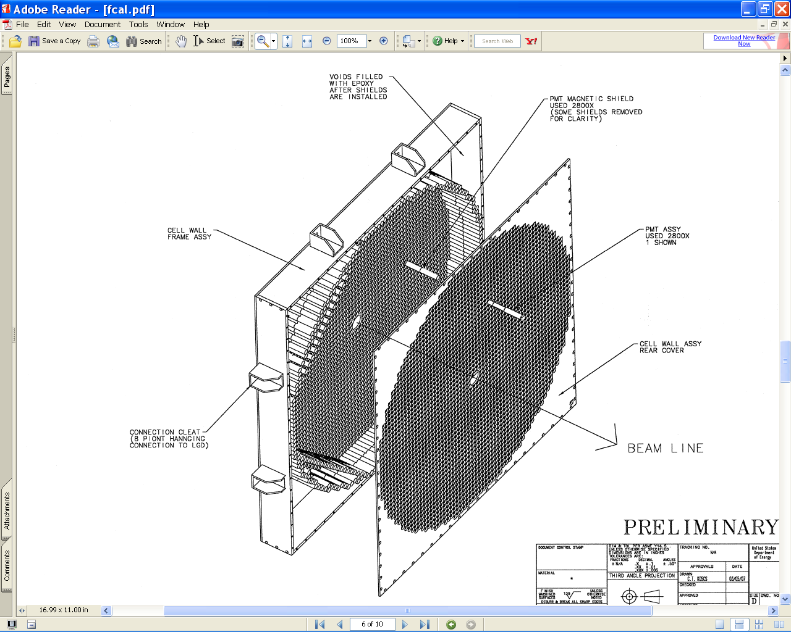
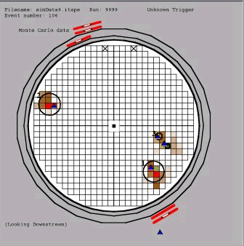
The Forward Calorimeter
Forward Calorimeter (LGD)
Status:
improved light coupling compared to RadPhi
σ/E=7.3%/√E 3.5%
σ_{x,y} ~ 0.64 cm/√E
γ−energy threshold: 60MeV
Magnetic
Shield tube
PMT x2800
Fill empty space with epoxy after assy for stiffness
Downstream Plate
2800 Pb-glass blocks (4cmx4cmx45cm)
Read out using 250MHz FADC (16-chan.)
Used in E852@BNL
& RadPhii @ JLab
Indiana University

Slide 26
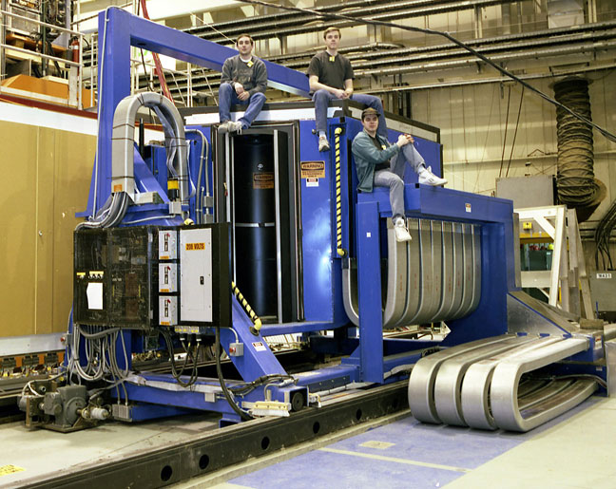
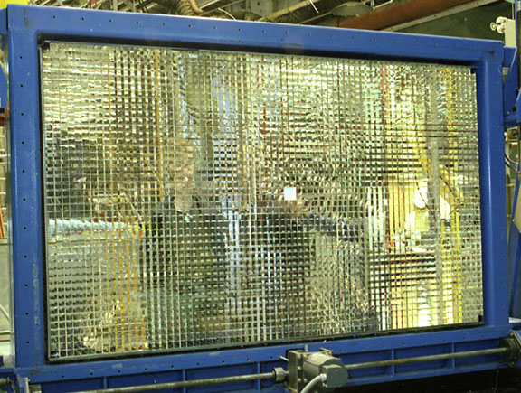
The Forward Calorimeter
As used in E852 at BNL

Slide 27
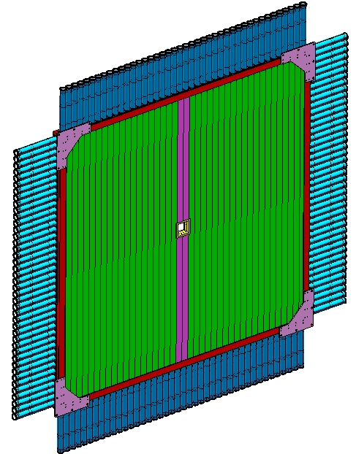
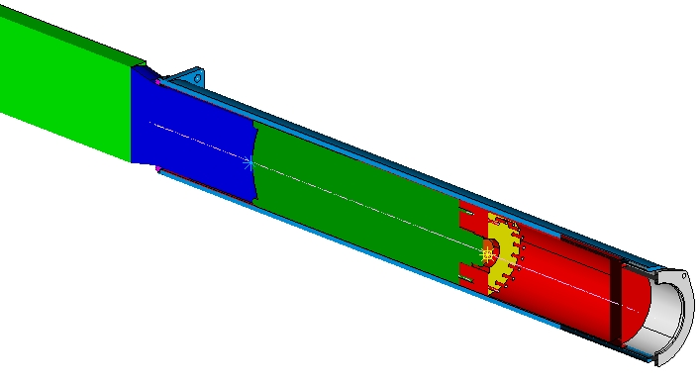
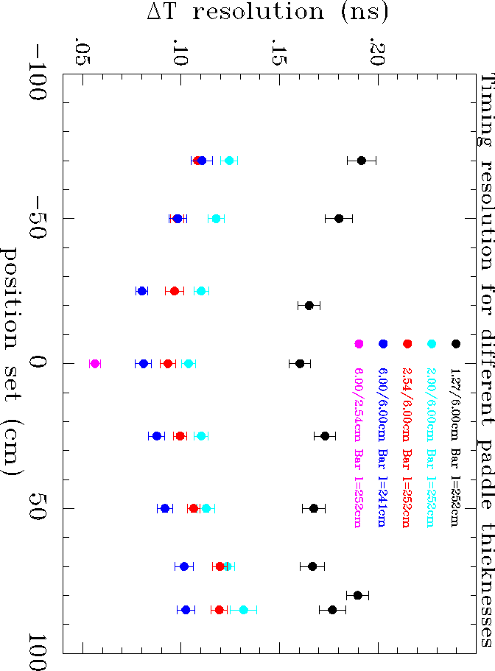
Time-of-Flight
12 cm square opening
TOF Scintillator Wall
Status:
time resolution / plane: 80ps
Split paddles
PMT’s
Detail of guide, pmt
and HV divider
nominal
σ_{diff} (ns)
Scintillator bars
252 cm

Slide 28
Time-of-Flight
Setup
  2 layers each with 42 scintillator bars (x –y)
  6cm x 2.54cm x 252cm
Readout:
  double sided readout
  XP2020 PMTs
Electronics:
  energy measurement: 250 MHz FADCs (16ch)
  timing measurement: CDF (16ch) & 62ps F1-TDC (32ch)
HV
  168 channels
Florida State

Slide 29
GlueX Design Parameters
Capability | Quantity | Range
Charged particles | Coverage | 1º < θ < 160º
 | Momentum Resolution (5º-140º) | σ_{p}/p = 1 − 3%
 | Position resolution | σ ~ 150-200 μm
 | dE/dx measurements | 20 < θ < 160º
 | Time-of-flight measurements | σ_{ToF} ~ 60 ps; σ_{BCal} ~ 200ps
 | Barrel time resolution | σ_{t} ^{γ} < (74 /√E 33) ps
Photon detection | Energy measurements | 2 < θ < 120º
 | LGD energy resolution (E > 60 MeV) | σ_{E}/E = (7.3/√E 3.5)%
 | Barrel energy resolution (E > 40 MeV) | σ_{E}/E =(5.54/√E 1.6)%
 | LGD position resolution | σ_{x,y,} ~ 0. 64 cm/√E
 | Barrel position resolution | σ_{z} ~ 0.5cm /√E
DAQ/trigger | Level 1 | < 200 kHz
 | Level 3 event rate to tape | ~ 15 kHz
 | Data rate | 300 MB/s
Electronics | Fully pipelined | 250 / 125 MHz fADCs, TDCs
Photon Flux | Initial: 10⁷ γ/s | Final: 10⁸ γ/s

Slide 30
Physics in GlueX
We have designed a detector with high acceptance and efficiency for charged and neutral particles.
Will be able to concurrently analyze different final states for the same hybrid states---both isospin related and different decay modes.
We will not only be able to map out the spectrum of exotic states, but also make statements about relative decay rates.

Slide 31
Summary
We expect to start taking data in late 2014.
The GlueX detector in Hall D at Jefferson Lab has been designed to fully reconstruct final states with charged particles and photons.
Very high statistics data sets collected with 9GeV linearly polarized photons will open a new window on the study of light-quark exotic hybrids.
We welcome new participants in GlueX.
Our RICH detector as part of PID needs a family.

