Slide 1
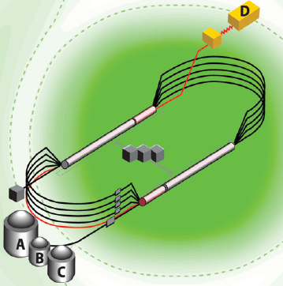
The Jefferson Lab 12-GeV Upgrade and the GlueX Experiment
Curtis A. Meyer
Carnegie Mellon University
6 March, 2014

Slide 2
Outline
The Jefferson Lab 12-GeV Upgrade
Physics Highlights
Quantum Chromodynamics
Gluonic Excitations – LQCD and Experiment
The GlueX Experiment

Slide 3
Jefferson Lab
Newport News, Virginia
A 6-GeV electron accelerator feeding 3 experimental halls. The facility has been in operation since 1996.
The 12-GeV upgrade will double the energy of the accelerator, upgrade the three existing experimental areas and build a new area.
In September 2008, the DOE approved start of construction of of the 340M$ project (CD3).
Actual construction started in October 2008 and will be complete in 2017 (CD4).
First physics will start in 2015.

Slide 4
The JLab 12 GeV Upgrade Project
Upgrade is designed to build on existing facility: vast majority of accelerator and experimental equipment have continued use
New Hall
Add 5 cryomodules
Upgrade arc magnets
and supplies
CHL upgrade
Maintain capability to deliver lower pass beam energies:
2.2, 4.4, 6.6….
20 cryomodules
Add arc
20 cryomodules
Add 5 cryomodules
Scope of the project includes:
Doubling the accelerator beam energy
New experimental Hall and beamline
Upgrades to existing Experimental Halls
Enhanced capabilities
in existing Halls

Slide 5
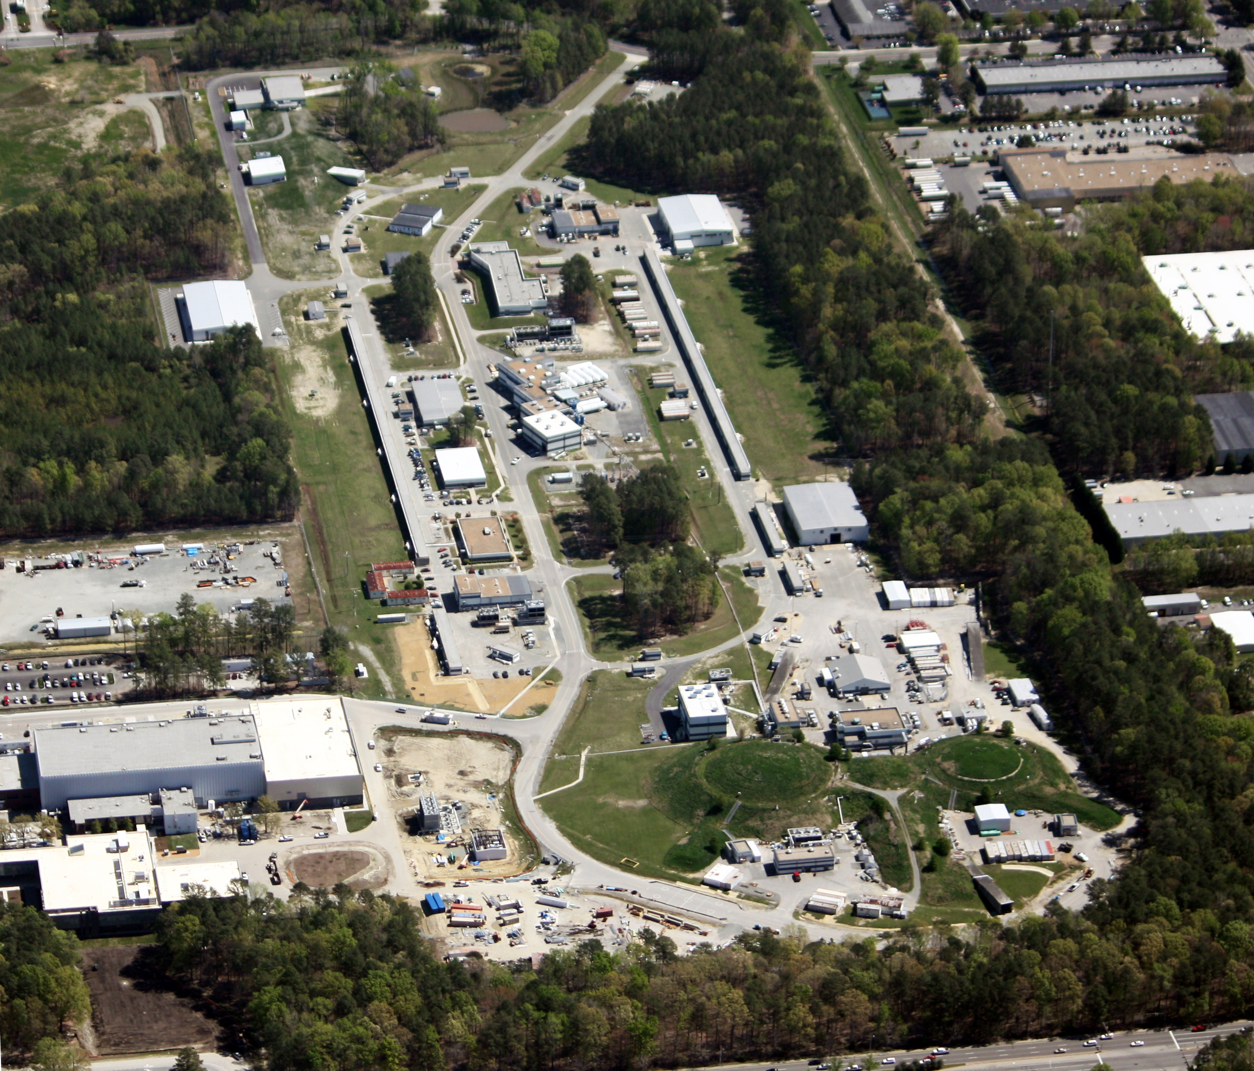
Jefferson Lab
Newport News, Virginia
D
C
A
B

Slide 6
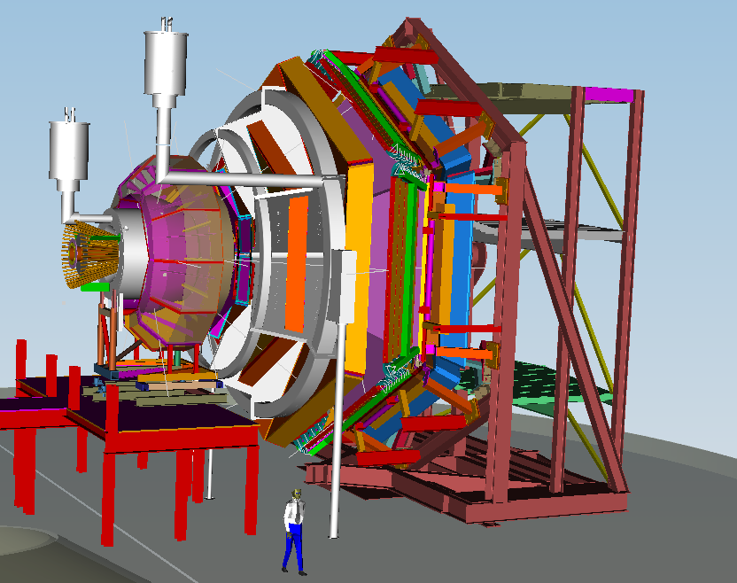
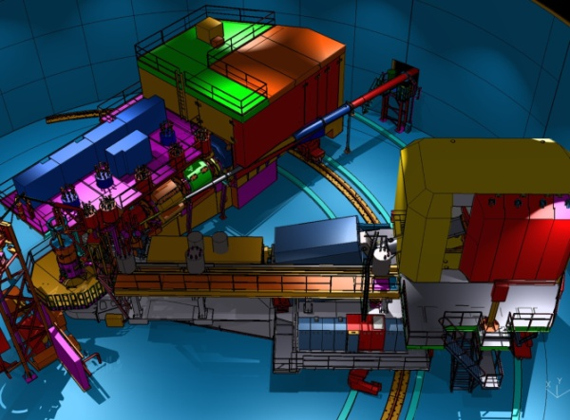
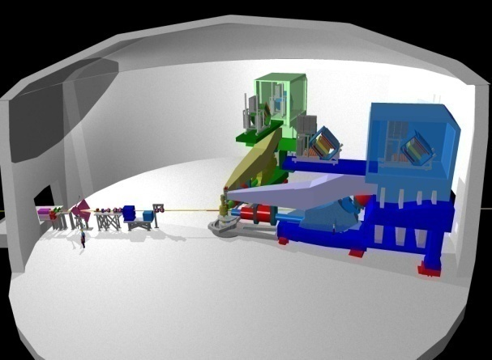
12 GeV Scientific Capabilities
Hall D – exploring origin of confinement by studying exotic mesons
Hall B – understanding nucleon structure via generalized parton distributions
Hall C – precision determination of valence quark properties in nucleons and nuclei
Hall A – short range correlations, form factors, hyper-nuclear physics, future experiments (fundamental symmetries)
Notes:
6
Note BSM not included in project

Slide 7
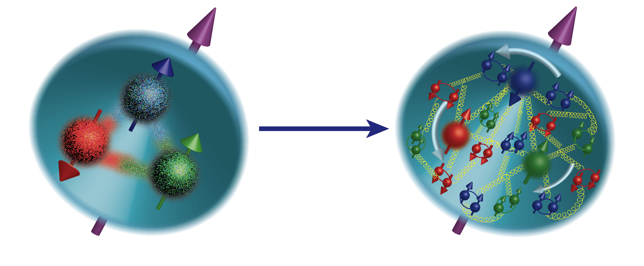
The Science
What makes up the spin of the proton?
Spin of quarks? ΔΣ
Spin of gluons? J_{g}
Orbital motion? L_{q}
DIS → ΔΣ ≅ 0.25
Latest RHIC results suggest J_{g} is probably similar to ΔΣ
Orbital motion, L_{q}, is essentially unexplored.
JLab 12-GeV program – orbital motion of the valence quarks
RHIC – Measurement of gluon spin contribution.
COMPASS-II – 200 GeV muon and hadron beam, complementary to JLab
To pin down gluon and sea quark contribution fully one needs an EIC

Slide 8
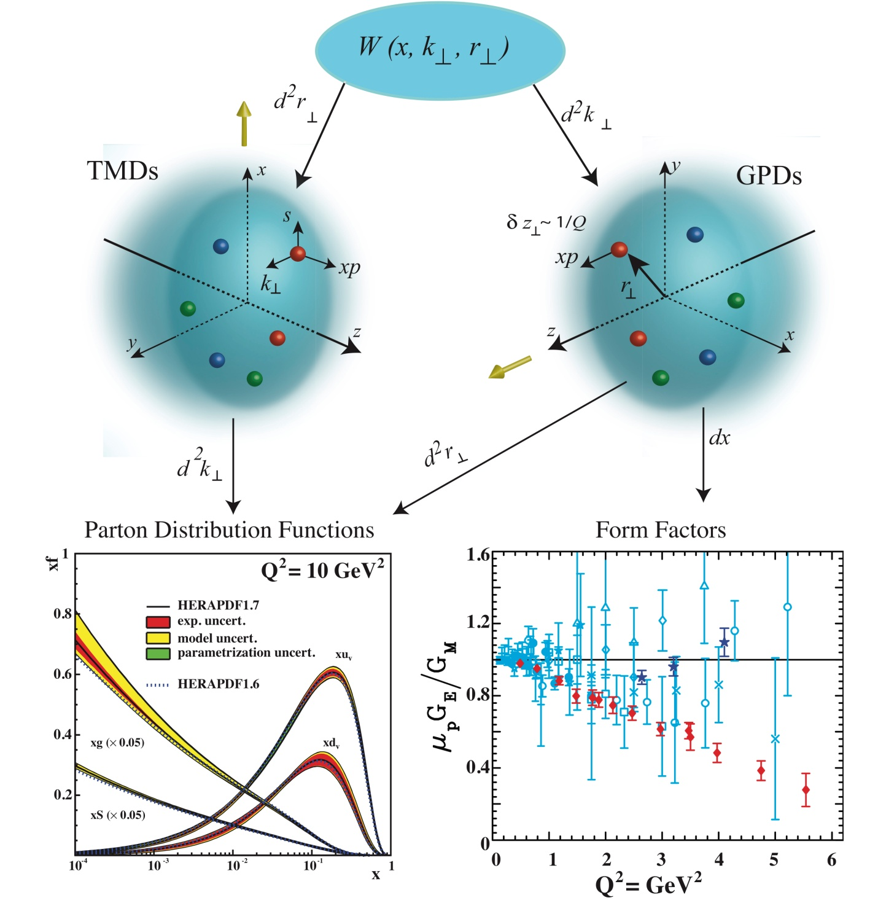
The Science
A program of detailed experiments that will carry out 3-D spatial tomography of the nucleon and begin to explore the GPDs.
A program of detailed experiments that will carry out 3-D momentum tomography of the nucleon and begin to explore the TMDs.
Up and down quark densities (GPD@12GeV)
Low-x gluon distributions ( @RHIC-Spin)
Valence quark distributions at high x (12GeV)
Valence quark spin-orbit correlations, and tensor charge (TMD@12GeV)
Strange quark tomography (GPDs and TMDs@12 GeV)
Precision measurement of the proton charge radius ( @12GeV )

Slide 9
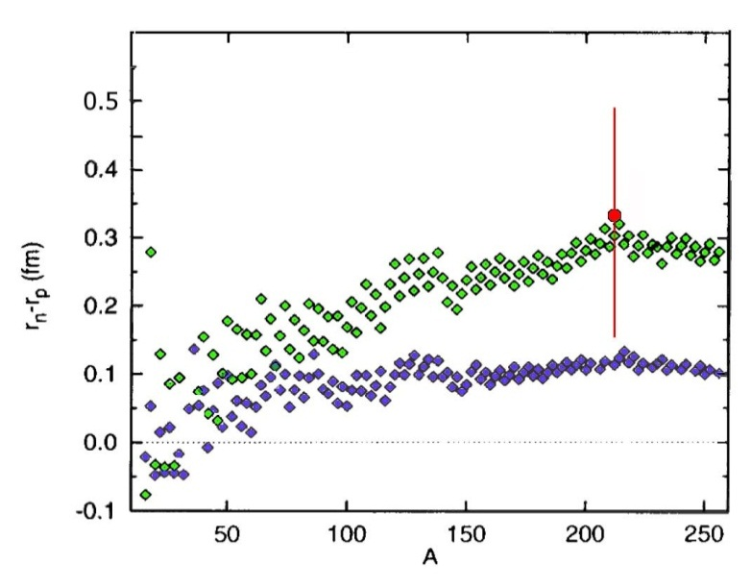
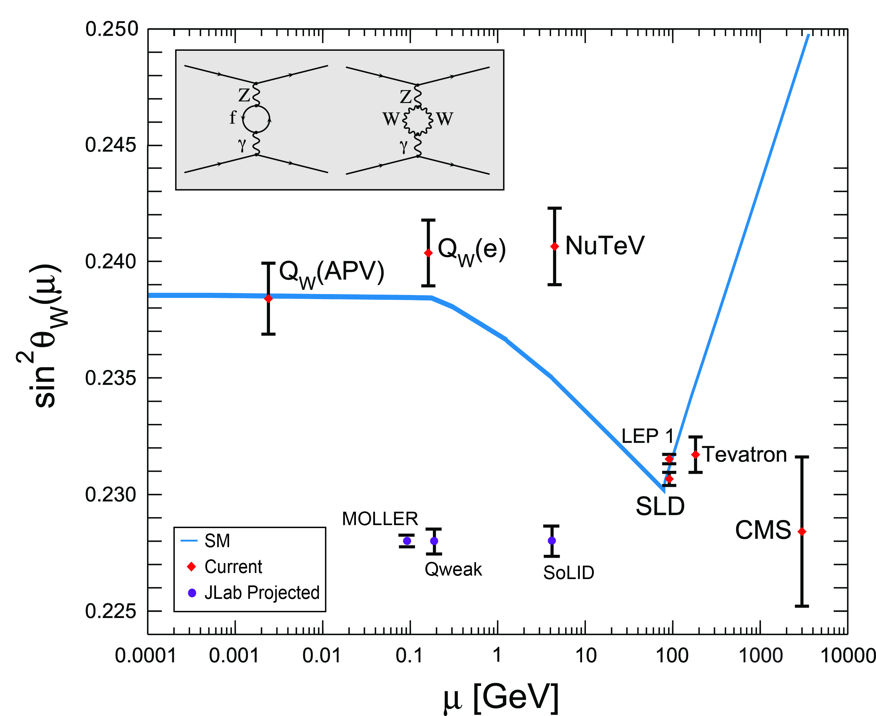
Parity Violation Experiments at JLab
Strangeness Form Factors – how large is the strange-quark content of the proton? Very small.
  HAPPEX (Hall A)
  G0 (Hall C)
PREX – how thick is the neutron skin on lead? In progress, but relevant in neutron stars.
Qweak – what is the weak charge of the proton? Analysis in progress.
MOLLER and SoLID – future experiments to probe beyond the standard model physics.
PREX I
PREX II (Projected)
Relativistic
mean field
Nonrel.
skyrme

Slide 10
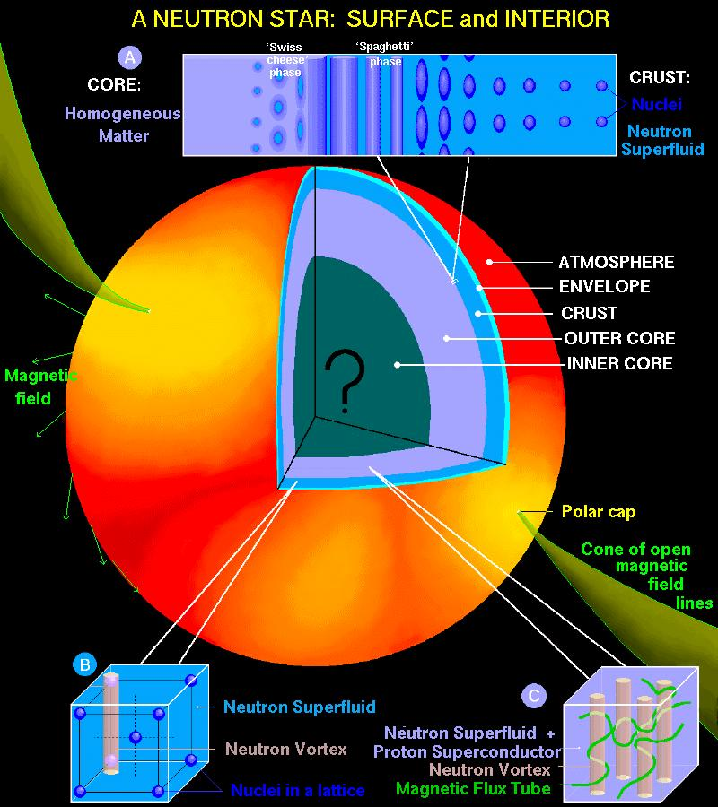
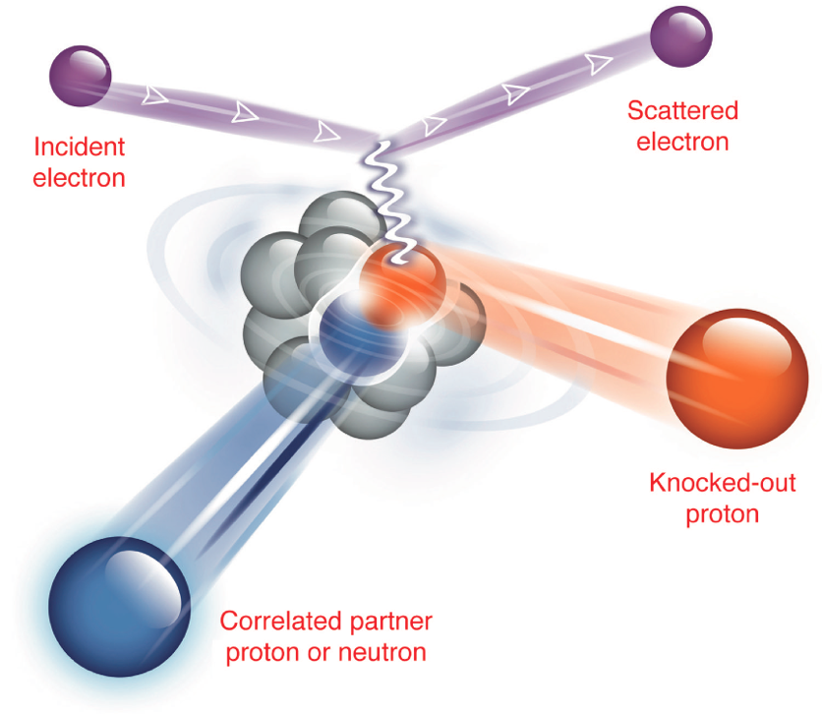
The Science
The nuclear force that binds protons and neutrons together in a nucleus is the result of a delicate balancing of QCD forces. QCD describes how quarks and gluons in nucleons interact, but how do the nuclei of atoms emerge from QCD?
A neutron skin of 0.2 fm or more has implications for our understanding of neutron stars and their ultimate fate
Measure the neutron skin of heavy nuclei (0.06fm accuracy for lead)
Correlation of parton dynamics and short–range nuclear structure. Important information in connecting the quarks in protons and neutrons to the nuclei of atoms.

Slide 11
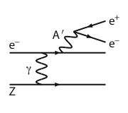
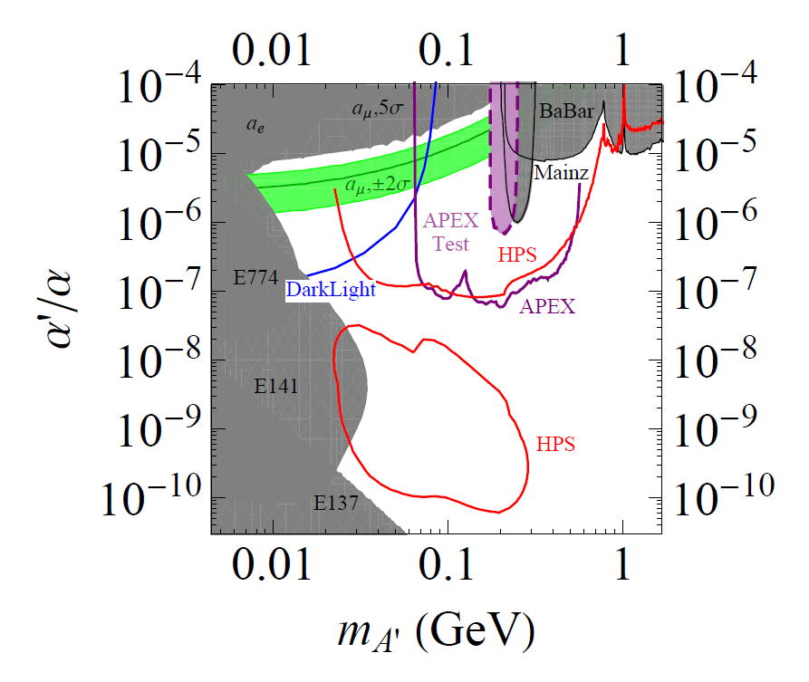
Scientific Opportunities
Search for A’ at Jefferson Lab
Implications for dark-matter models
g – 2 preferred!
BNL “g-2” expt:
Δa_{μ}(expt-thy) = (295±88) x 10⁻¹¹ (3.4 σ)
No evidence for SUSY at LHC (yet)
Another solution: A’, a massive neutral vector boson
Jlab contributions are unique.
3 JLab Experiments
APEX test run (Hall A) – published
PRL 107, 191804 (2011)
HPS test run (Hall B) – complete
DarkLight test run (FEL) – complete

Slide 12
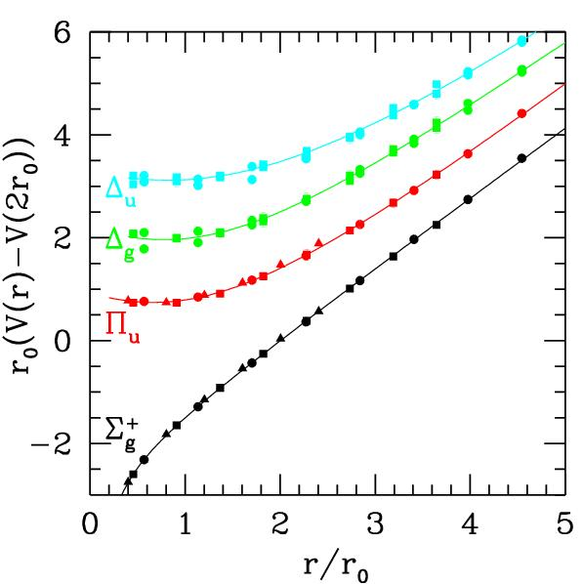
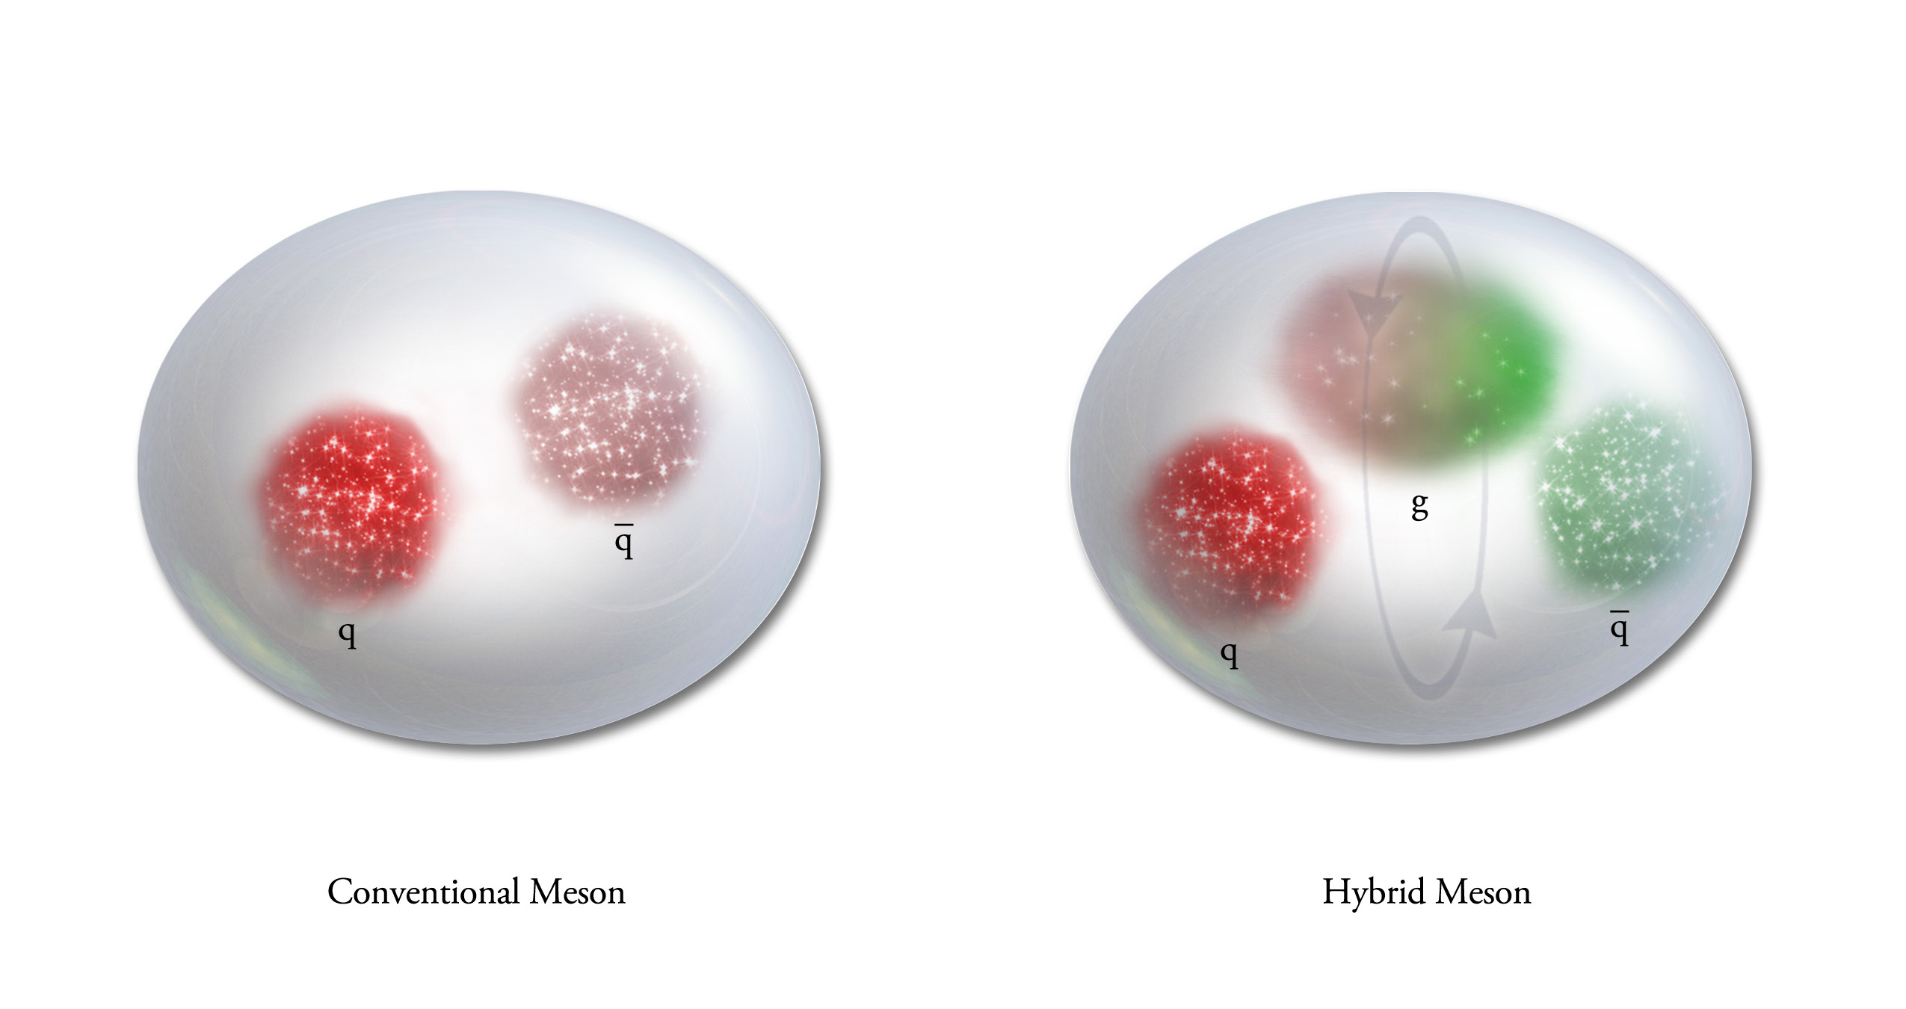
QCD Potential
Conventional Meson
Hybrid Meson
Exciting the Glue provides an
experimental window to the confining potential of QCD.
Mapping out the nonets of hybrid meson is the best
experimental signature of gluonic excitations.

Slide 13
QCD Potential
ground-state
flux-tube
m=0
Excited gluonic field (m=1)
linear potential
Mapping the spectrum of meson states associated with excitations of the gluonic field. The light-quark systems will be measured at Jefferson Lab.

Slide 14
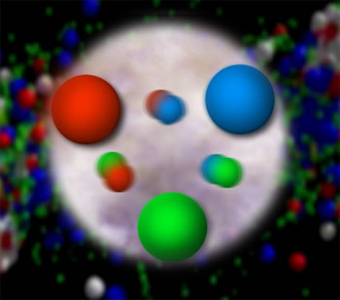
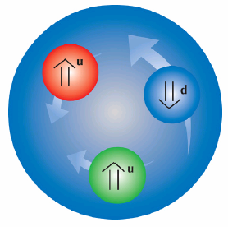
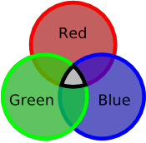
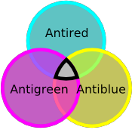
Quantum Chromo Dynamics
The rules that govern how the quarks
froze out into hadrons are given by QCD.
Quarks have color
charge: red, blue and
green. Antiquarks
have anticolors:
cyan, yellow and
magenta.
Atoms are electrically
neutral: a charge and
an anti-charge ( + - ).
Hadrons are color neutral (white),
red-cyan, blue-yellow, green-magenta
or red-blue-green, cyan-yellow-magenta.

Slide 15
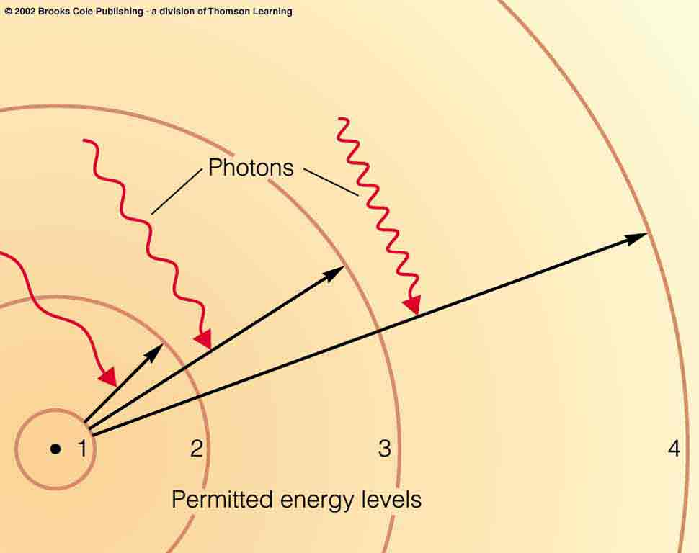
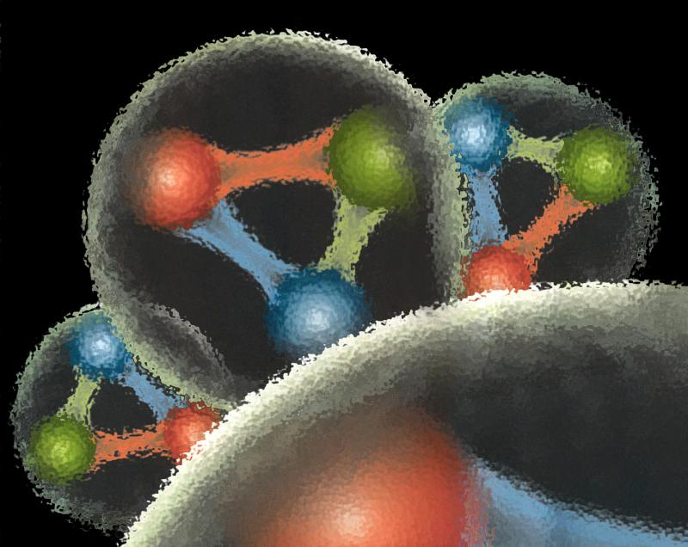
Quantum Chromo Dynamics
QCD describes the interactions of quarks and gluons.
Gluons are the force
carriers of QCD.
Gluons carry a color
and an anticolor
Charge.
Photons are the force
carriers for the E-M
force. Photons are
electrically neutral.
G
R
G
R
G
R

Slide 16
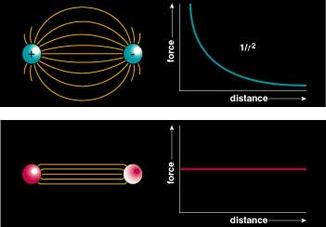
Quantum Chromo Dynamics
Color Field: Because of self interaction, confining flux tubes form between static color charges
Confinement arises from flux tubes and their excitation leads to a new spectrum of mesons

Slide 17
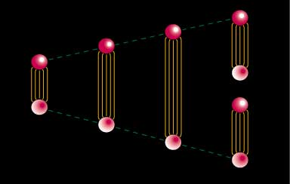
Quark Confinement
Quarks can never be isolated
A Linearly rising potential
  separation of quark from antiquark takes an infinite amount of energy
  gluon flux breaks, new quark-antiquark pair produced

Slide 18
Positronium
Spectroscopy - a probe of QED
e⁺
e⁻
Spin: S=S₁+S₂=(0,1)
Orbital Angular Momentum: L=0,1,2,…
Total Spin: J=L+S
L=0, S=0 : J=0 L=0, S=1 : J=1
L=1, S=0 : J=1 L=1, S=1 : J=0,1,2
… …
Reflection in a mirror:
Parity: P=-(-1)^{(L)}
Particle<->Antiparticle:
Charge Conjugation: C=(-1)^{(L+S)}
Notation: J^{(PC)} 0⁻⁺, 1⁻⁻, 1⁺⁻, 0⁺⁺, 1⁺⁺, 2⁺⁺
^{(2S+1)}L_{J} ¹S₀, ³S₁, ¹P₁, ³P₀, ³P₁, ³P₂,…

Slide 19
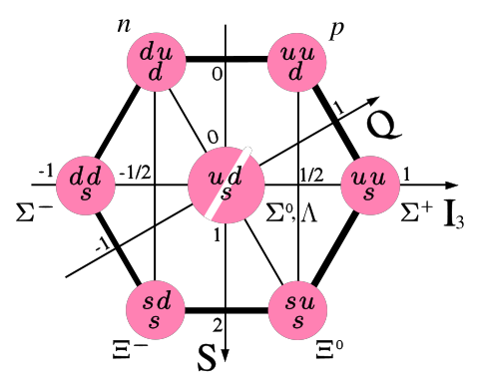
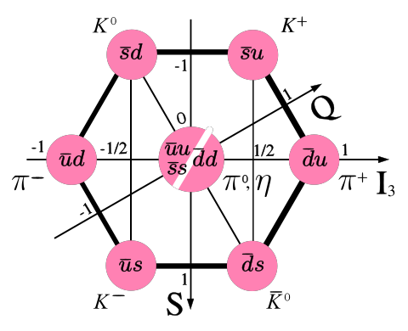
Observed Quark Configurations
3-Quark Systems
Baryons
Quark-antiquark Systems
Mesons
Groups of 8 (octet)
and 10 (decuplet).
Groups of
9 (nonet).
proton and neutron
π meson or pion
Other Configurations?
4-quark
glueballs
pentaquarks
hybrids

Slide 20
QCD and Spectroscopy: quark-antiquark
Quarkonium
Mesons
Each state is a particle
q
q
radial
Consider the three lightest quarks
4⁺⁺
L=3
3⁺⁺
2⁺⁺
9 Combinations
3⁺⁻
3⁻⁻
L=2
2⁻⁻
1⁻⁻
2⁻⁺
2⁺⁺
L=1
1⁺⁺
0⁺⁺
1⁺⁻
1⁻⁻
S=1
S=0
L=0
0⁻⁺

Slide 21
QCD and Spectroscopy: quark-antiquark
Quarkonium
Mesons
q
q
4⁺⁺
L=3
3⁺⁺
2⁺⁺
3⁺⁻
ρ,K*,ω,φ
Mesons come in
Nonets of the same
J^{PC} Quantum Numbers
3⁻⁻
L=2
2⁻⁻
π,K,η,η’
1⁻⁻
2⁻⁺
a,K,f,f’
2⁺⁺
L=1
1⁺⁺
b,K,h,h’
SU(3) is broken
Last two members mix
0⁺⁺
1⁺⁻
ρ,K*,ω,φ
1⁻⁻
S=1
S=0
L=0
0⁻⁺
π,K,η,η’

Slide 22
QCD and Spectroscopy: quark-antiquark
Quarkonium
Mesons
q
q
4⁺⁺
L=3
3⁺⁺
2⁺⁺
Allowed J^{PC} Quantum numbers:
3⁺⁻
0⁻⁻ 0⁺⁻
1⁻⁺
2⁺⁻
3⁻⁺
4⁺⁻
5⁻⁺
3⁻⁻
0⁺⁺ 0⁻⁺
1^{–-} 1⁺⁺ 1⁺⁻
2⁻⁻ 2⁺⁺ 2⁻⁺
3⁻⁻ 3⁺⁺ 3⁺⁻
4⁻⁻ 4⁺⁺ 4⁻⁺
5⁻⁻ 5⁺⁺ 5⁺⁻
L=2
2⁻⁻
1⁻⁻
2⁻⁺
2⁺⁺
L=1
1⁺⁺
0⁺⁺
1⁺⁻
S=1
S=0
Exotic Quantum Numbers
non quark-antiquark description
1⁻⁻
L=0
0⁻⁺

Slide 23
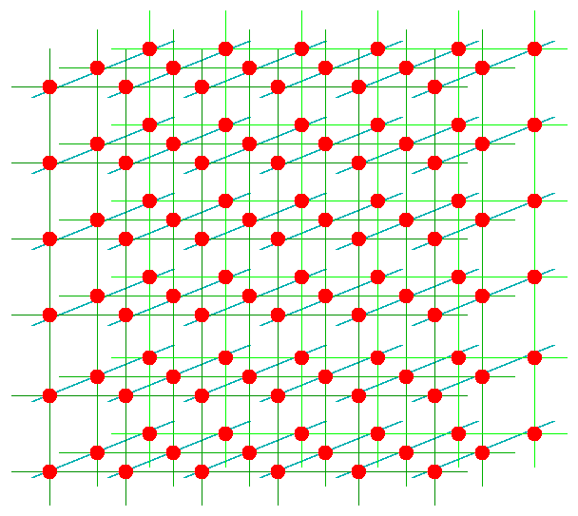
Lattice QCD
Numerically solve QCD on a space-time lattice.
quarks
gluons
Computationally very intensive
Gauge configurations on leadership-class computers.
``Mine’’ the configurations for physics on smaller clusters.

Slide 24
Lattice QCD Meson Spectrum
Dudek et. al, 2010, 2011,2012,2013

Slide 25
Lattice QCD Meson Spectrum
isovector
isoscalar

Slide 26
Lattice QCD Meson Spectrum
States with non-trivial gluonic fields.
1⁻⁻, 0⁻⁺ , 1⁻⁺ , 2⁻⁺

Slide 27
QCD Exotics
We expect 5 nonets of exotic-quantum-number mesons:
1 nonet of 0⁺⁻
2 nonets of 1⁻⁺
2 nonets of 2⁺⁻
Lattice shows two nonets here.
π₁ I^{G}(J^{PC})=1⁻(1⁻⁺)
K₁ I^{G}(J^{PC})= ½ (1⁻)
η’₁ I^{G}(J^{PC})=0⁺(1⁻⁺)
η₁ I^{G}(J^{PC})=0⁺(1⁻⁺)

Slide 28
Finding the States?
Lattice QCD suggest where to look for exotic states:
Models suggest how the states should fall apart
π₁→ πb₁ , πf₁ , πρ , ηa₁
η₁→π(1300)π , a₁π
b₂ → a₁π , h₁π , ωπ , a₂π
h₂ → b₁π , ρπ , ωη
b₀ → π(1300)π , h₁π
h₀ → b₁π , h₁η
L_{flux}
L_{flux}
Populate final states with
π±,π⁰,K±,K⁰,η, (photons)

Slide 29
Experimental Evidence for Hybrids
Pion peripheral production:
The most extensive data sets to date are from the BNL E852 experiment. There is also data from the VES experiment at Protvino and from the COMPASS experiment at CERN.
Proton-antiproton annihilation:
There is data from the Crystal Barrel experiment at LEAR. This is also one of the pushes of the future PANDA experiment.

Slide 30
Experimental Evidence for Hybrids
X
γ
Photo Production:
There are limited results from the CLAS experiment at Jefferson Lab. This is the main push of the future GlueX experiment at Jefferson Lab.
e
N
N
Charmonium Decays:
There is data from the CLEO-c at Cornell. This is also an area of interest of the BES III experiment in Beijing. This will also be part of the PANDA program at FAIR.

Slide 31
Experimental Evidence for Hybrids
The most extensive data sets to date are from the BNL E852 experiment. There is
also data from the VES experiment at Protvino and some results from the Crystal
Barrel experiment at LEAR. Finally, there is CLEO-c and a CLAS (Jefferson Lab) result. There are results from the COMPASS experiment at CERN.
Diffractive production
E852: 18 GeV/c
VES 37 GeV/c
COMPASS:160 GeV/c
M: spin projection
: reflectivity
Natural-parity-exchange: J^{P}=0⁺,1⁻,2⁺, …
Unnatural-parity-exchange: J^{P}=0⁻,1⁺,2⁻, …

Slide 32
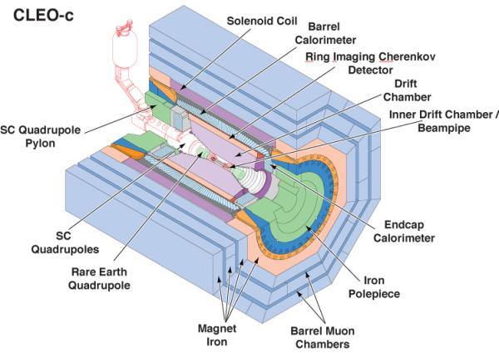
Experimental Evidence for Hybrids
Charmonium Decays:
There is data from the CLEO-c at Cornell. This is also an area of interest of the BES III experiment in Bejing.
The CLEO-c Experiment

Slide 33
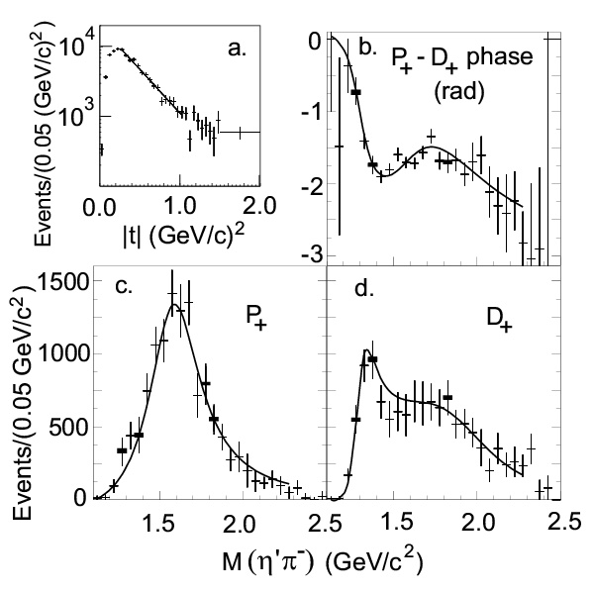
Experimental Evidence for Hybrids
Mode Mass Width Production
3π 1598 ±8+29-47 168±20+150-12 1⁺,0⁻,1⁻ E852
η’π 1597±10+45-10 340±40±50 1⁺ E852,VES,CLEO
b₁π 1664±8±10 185±25±38 0⁻ ,1⁺ E852,VES,CBAR
f₁π 1709±24±41 403±80±115 1⁺ E852,VES
3π 1660 ±10+64-0 269±21+42-64 1⁺ COMPASS
π₁(1600)
This is consistent with a hybrid meson

Slide 34
Experimental Evidence for Hybrids
π₁(2015)
Mode Mass Width Production
b₁π 2014±20±16 230±32±73 1⁺ E852
f₁π 2001±30±92 332±52±49 1⁺ E852
Need two J^{PC}=1⁻⁺ states
π₁(2000)→b₁π
M = 2014±20±16 MeV/c²
Γ = 230±32±73 MeV/c²
Seen primarily in natural
parity exchange.
The natural dominates
m^{ε}=0⁻
1⁻⁺b₁π
m^{ε}=1⁺
1⁻⁺b₁π
Seen in one experiment with low statistics It needs confirmation. If this exists, it is also a good candidate for an exotic hybrid meson.

Slide 35
Experimental Evidence for Hybrids
Mode Mass Width Production
3π 1598 ±8+29-47 168±20+150-12 1⁺,0⁻,1-
η’π 1597±10+45-10 340±40±50 1⁺
b₁π 1664±8±10 185±25±38 0⁻ ,1⁺
f₁π 1709±24±41 403±80±115 1⁺
3π 1660 ±10+64-0 269±21+42-64 1⁺
π₁(1600)
Mode Mass Width Production
b₁π 2014±20±16 230±32±73 1⁺
f₁π 2001±30±92 332±52±49 1⁺
π₁(2015)

Slide 36
QCD Exotics
We expect 3 nonets of exotic-quantum-number mesons: 0⁺⁻, 1⁻⁺, 2⁺⁻
Where are the isoscalar states? How are they mixed?
Lattice shows two states here.
π , η , η’ , K → π₁ , η₁ , η’₁, K₁
b₀, h₀, h₀’, K₀
b₂, h₂, h₂’, K₂
What about other states?
π₁ I^{G}(J^{PC})=1⁻(1⁻⁺)
K₁ I^{G}(J^{PC})= ½ (1⁻)
η’₁ I^{G}(J^{PC})=0⁺(1⁻⁺)
η₁ I^{G}(J^{PC})=0⁺(1⁻⁺)

Slide 37
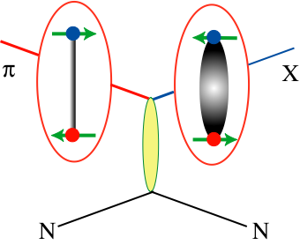
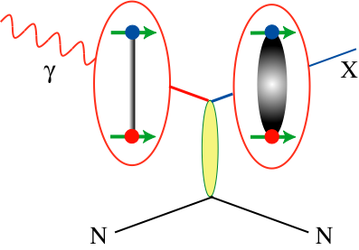
How to Produce Hybrids
Beams of photons may be a more natural
way to create hybrid mesons.
Simple QN counting leads to the exotic mesons
There is almost no data for photon beams at
9GeV energies. GlueX will increase data by
3-4 orders of magnitude.

Slide 38
The GlueX Experiment

Slide 39
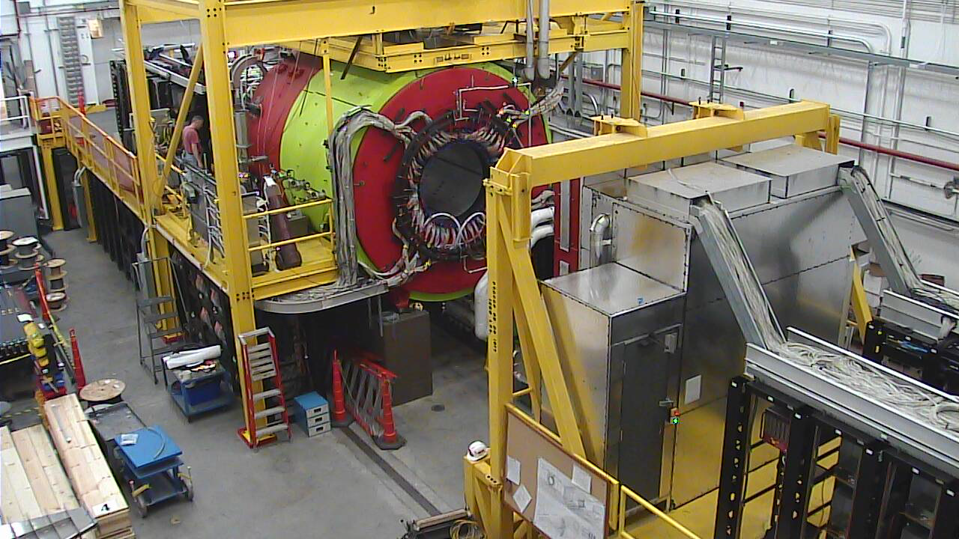
Hall-D Experimental Hall

Slide 40
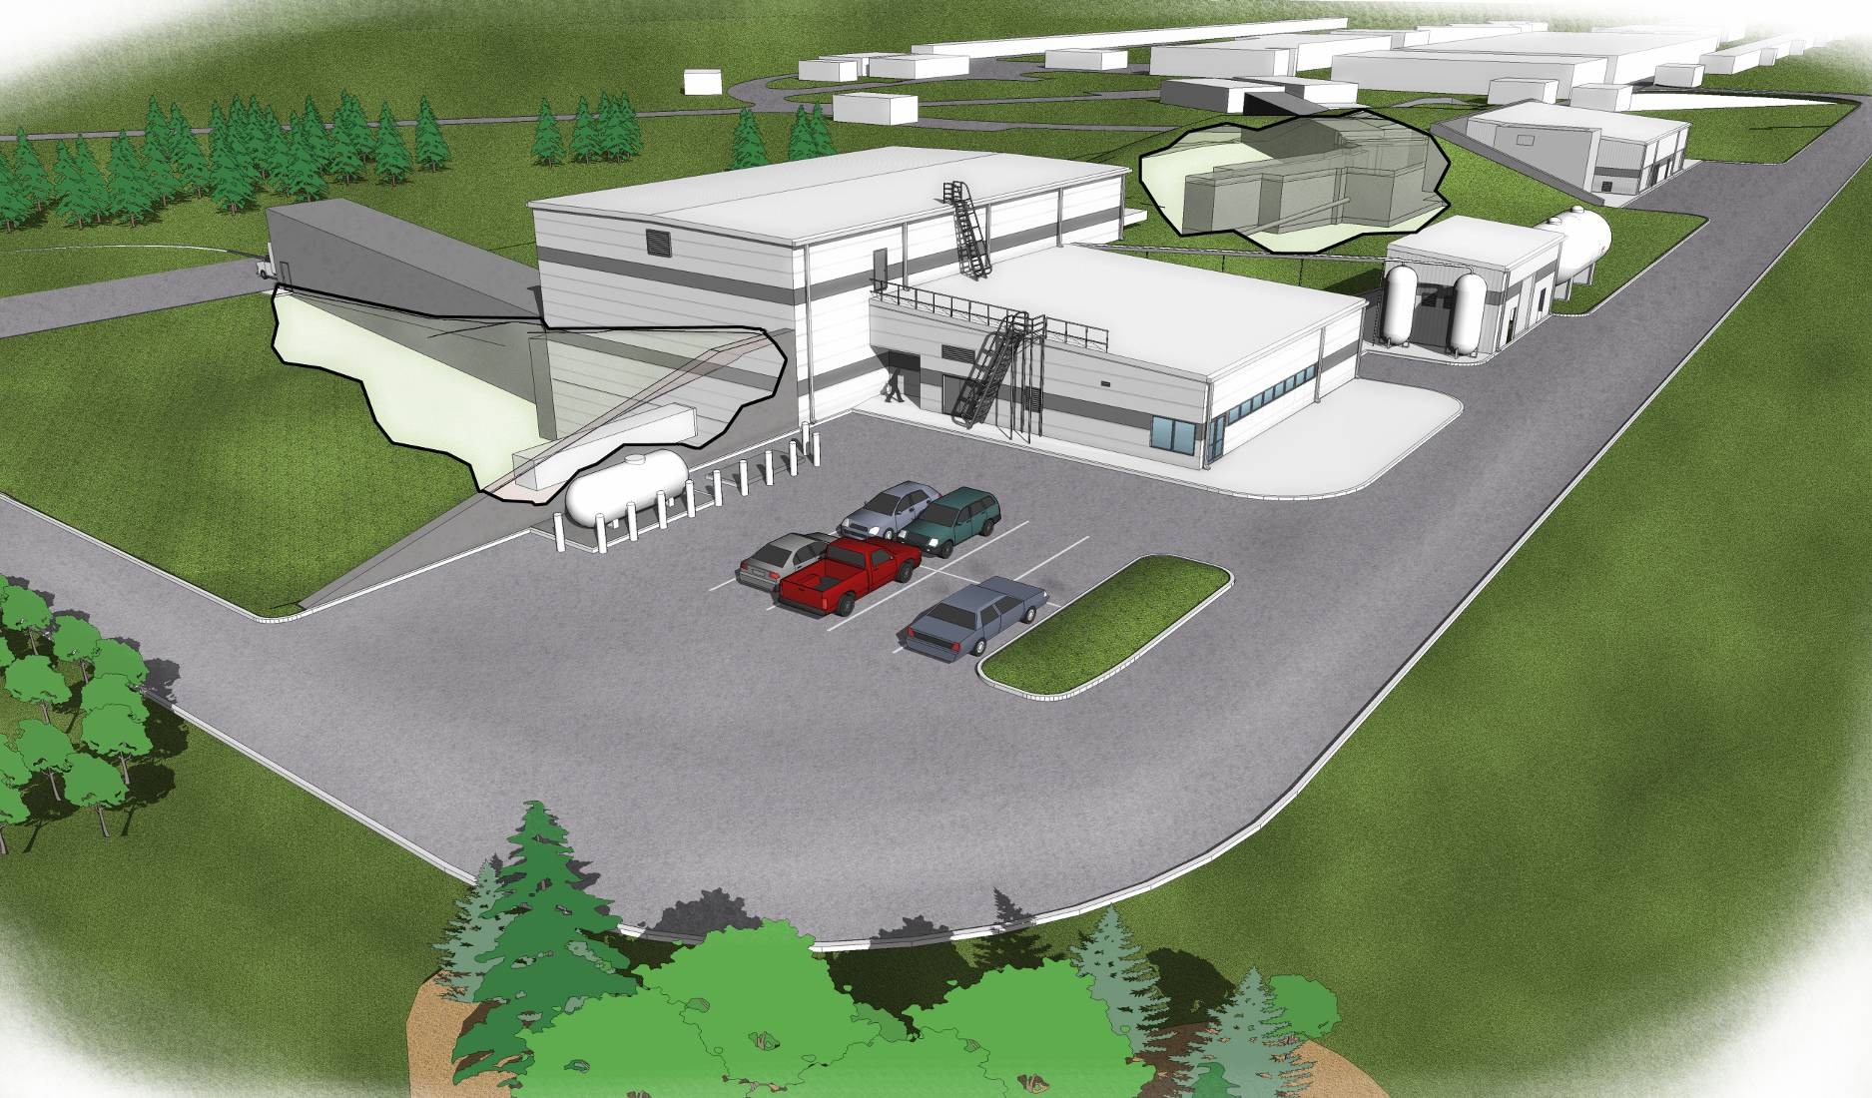
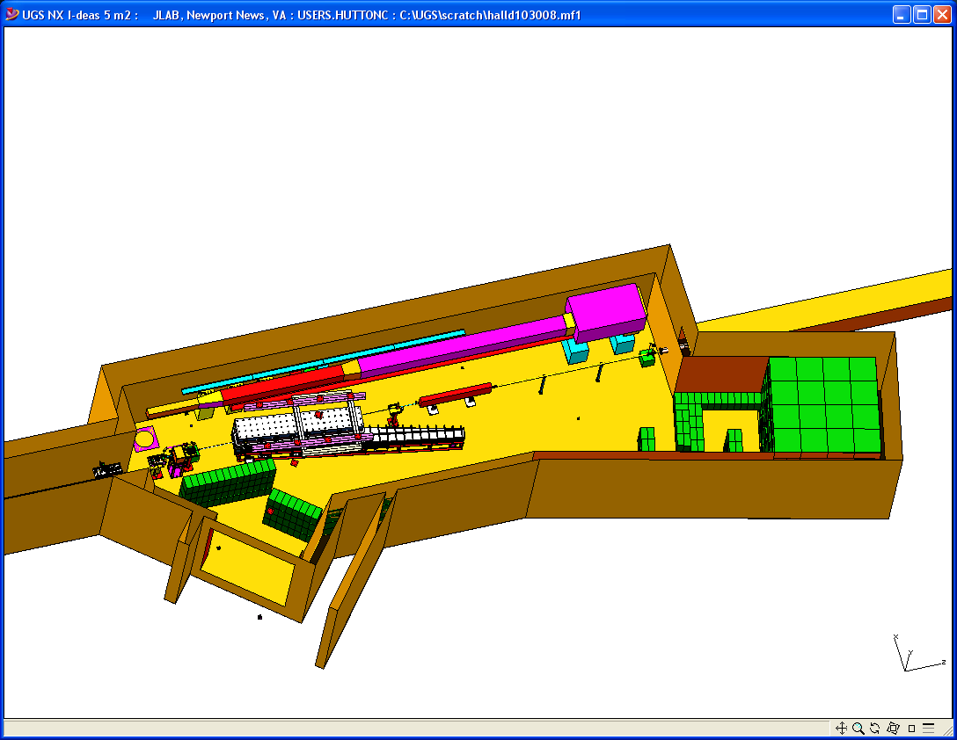
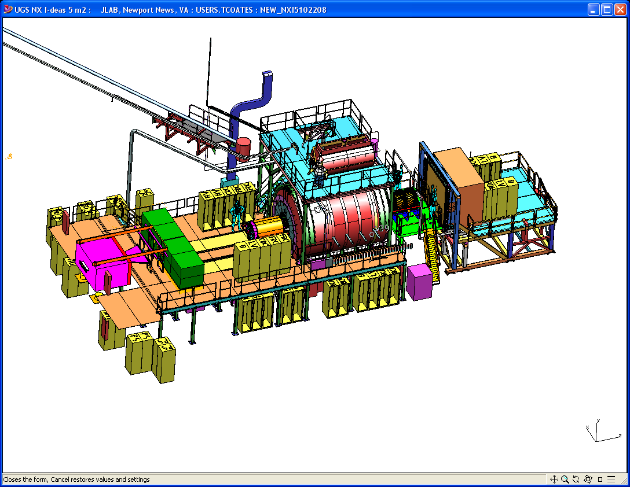
Hall D
Counting House
Tagger Area w/ Electron Beam Dump
Photon Beam Dump
Notes:
Quick slide to show the Hall-D complex as well as the detector and the tagger area. Comment on relevant details such as tagger resolution, magnet, electronics, ….

Slide 41
Installation is ongoing.
Photon Beam Production and Tagging
Microscope @ UCONN
Polarimetry @ ASU
Support @ UNC A&T
Tagger Magnet @ JLab
Support@Yervan
Tagger @ CUA
Diamond @ UCONN
Goniometer@Glasgow
Active Collimator @ UCONN
Pair Spectrometer@UNC Wilmington

Slide 42
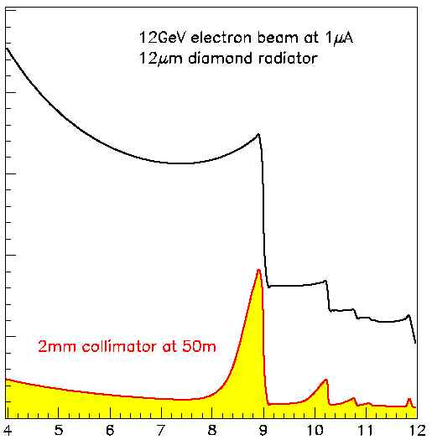
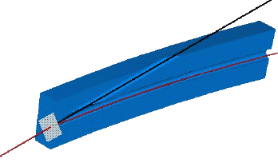
Coherent
Bremsstrahlung
12 GeV electrons
Incoherent &
coherent spectrum
flux
This technique provides requisite energy, flux and polarization
40%
polarization
in peak
Linearly polarized
photons out
collimated
electrons in
spectrometer
20 μm thick
Diamond crystal
photon energy (GeV)
tagged
with 0.1% resolution

Slide 43
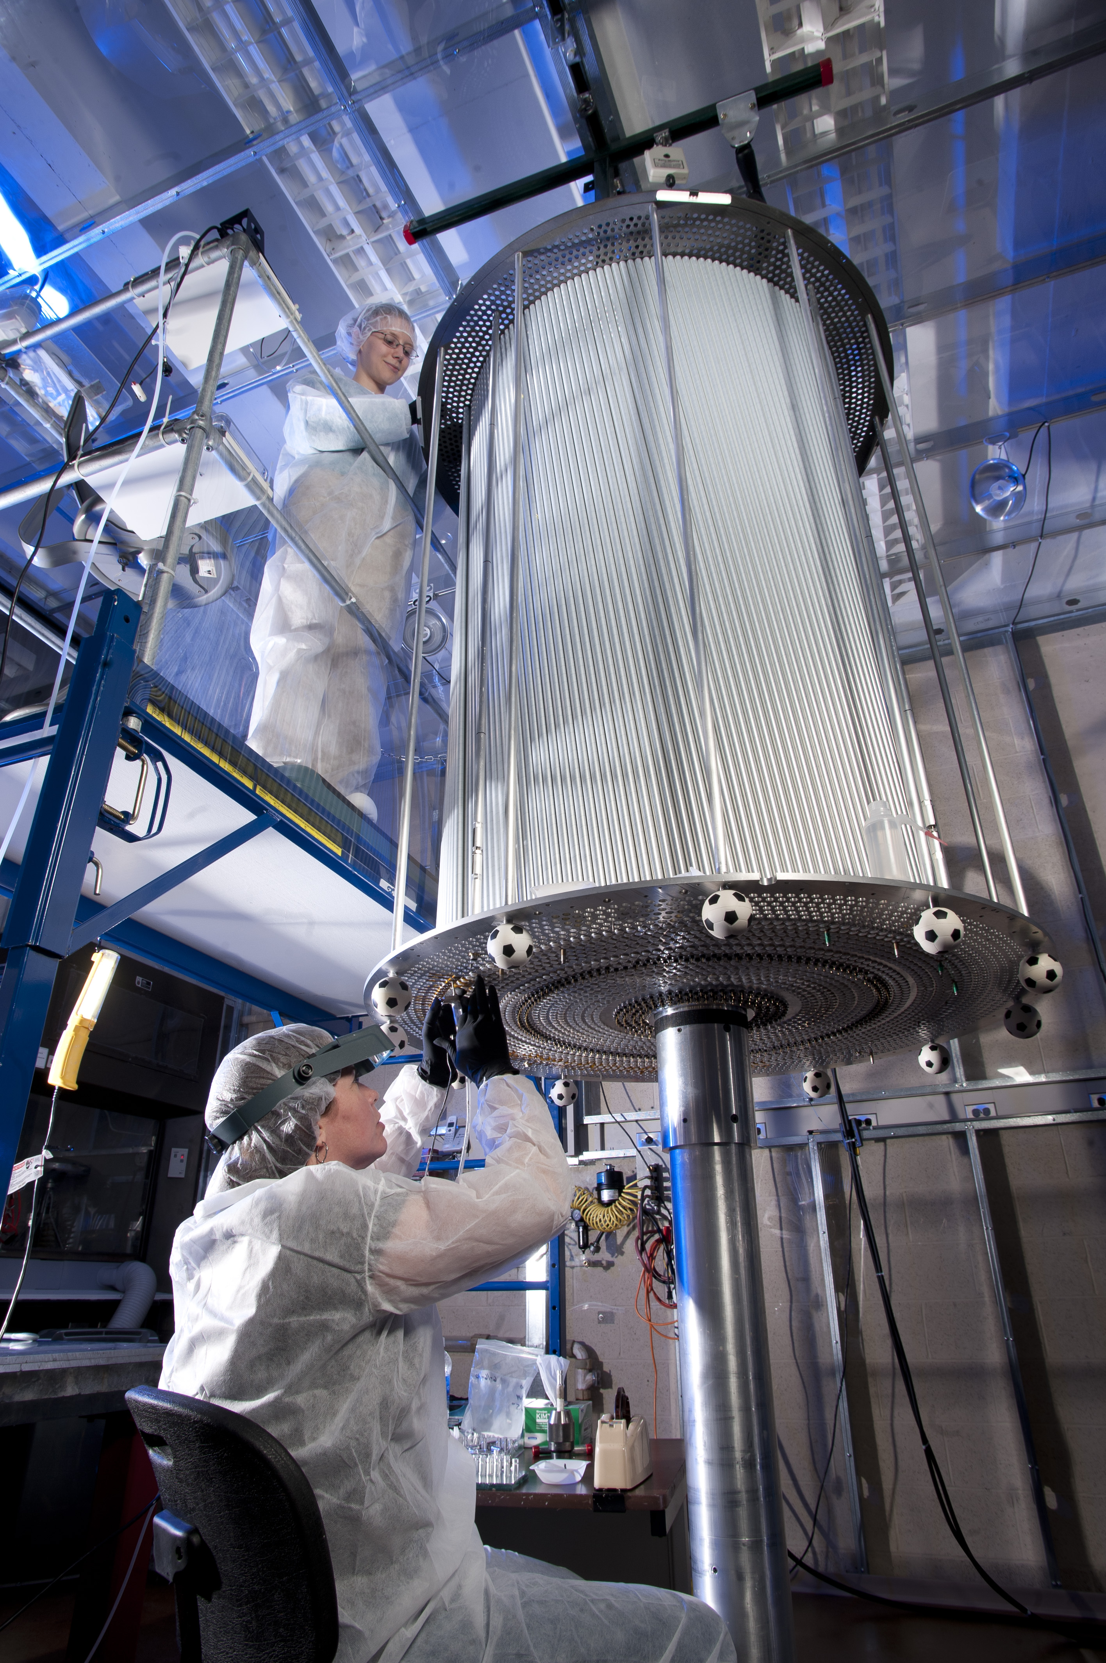
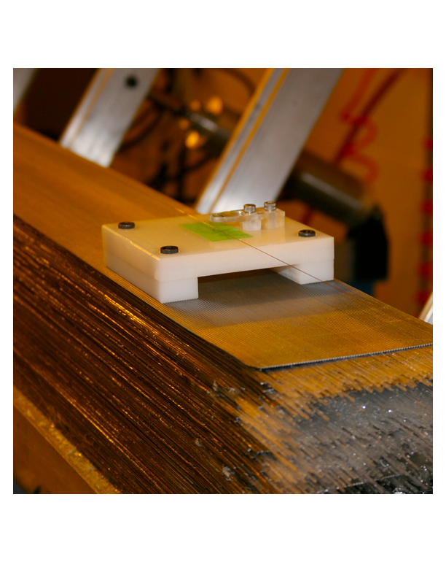
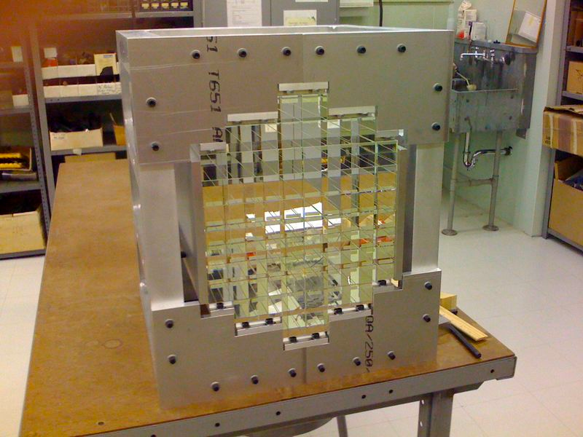
Installation is ongoing
CDC @ CMU
BCAL @ Regina
40/48 modules at JLab
Future PID @ MIT
BCAL Readout @ USM
Calibration @ Athens
FCAL @ IU
FDC @ JLab
P.S. @ UNCW
TOF @ FSU
START @ FIU
TRIGGER @ Jlab, CNU
Calibration@Northwestern
Electronics @ JLab, ICO, UMASS, USM
Solenoid @ JLab, ICO
DAQ @ JLab
The GlueX Detector

Slide 44
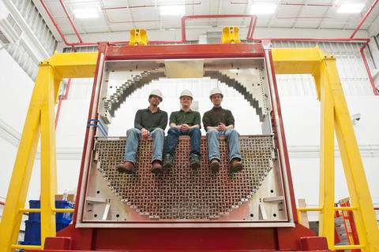
Forward Calorimeter

Slide 45
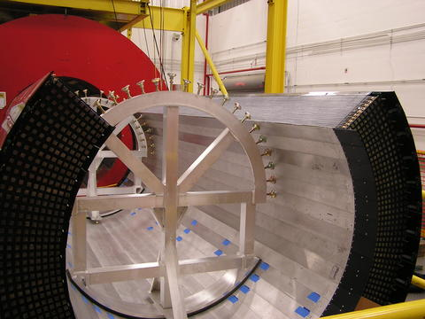
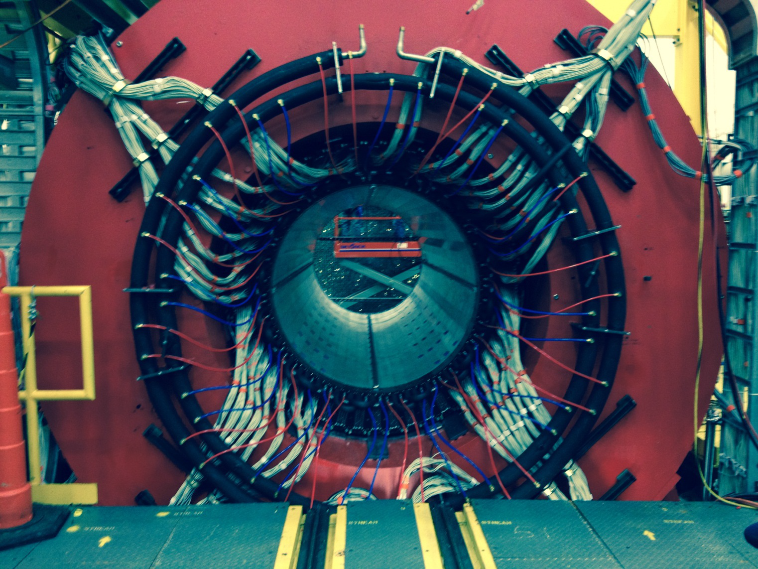
Barrel Calorimeter

Slide 46
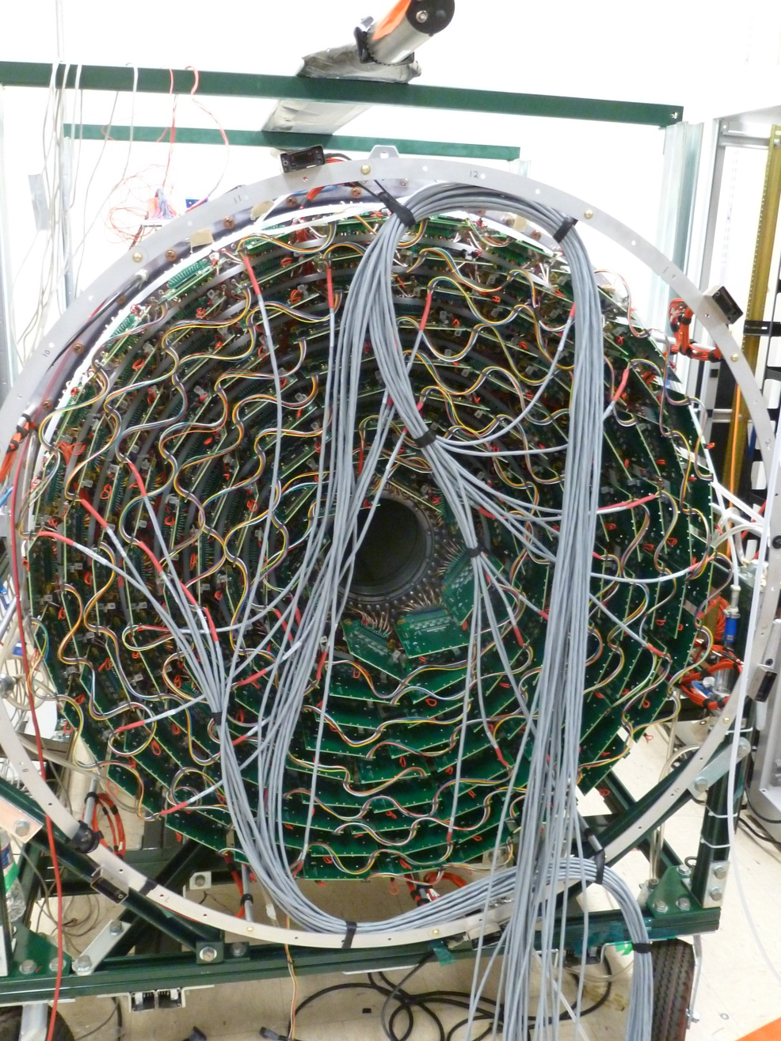
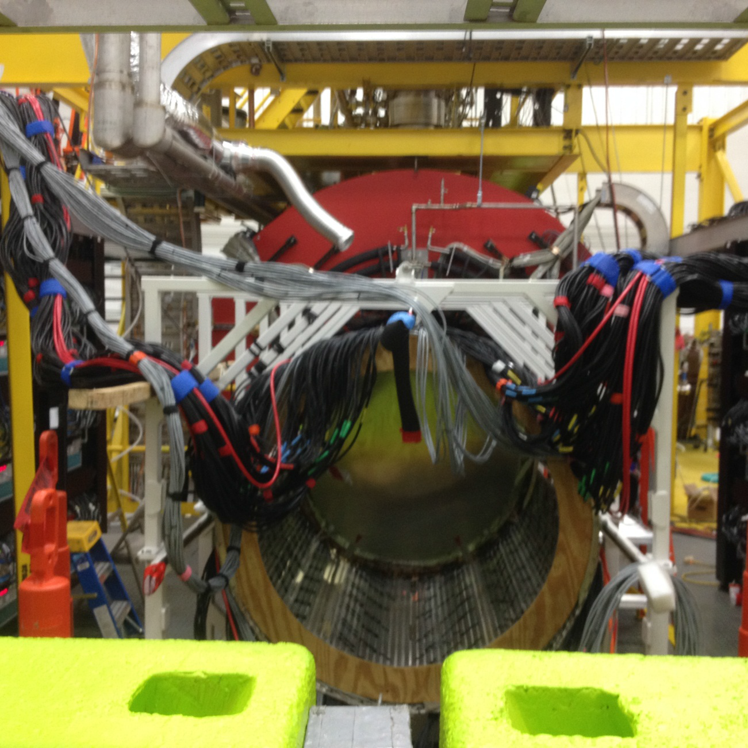
Charged Particle Tracking

Slide 47
Exotics
In Photoproduction
1⁻⁺ nonet
π₁ I^{G}(J^{PC})=1⁻(1⁻⁺)
K₁ I^{G}(J^{PC})= ½ (1⁻)
η’₁ I^{G}(J^{PC})=0⁺(1⁻⁺)
η₁ I^{G}(J^{PC})=0⁺(1⁻⁺)
An unexplored production mechanism with statistics at least as large as all other experiments will allow us to search and map the spectrum of exotics.
X
γ
e
N
N
Need to establish nonet nature
of exotics: π η η’
γ ⇔ ρ,ω,φ
Need to establish more than one
nonet: 0⁺⁻ 1⁻⁺ 2⁺⁻

Slide 48
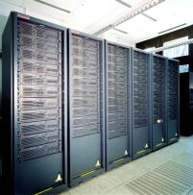
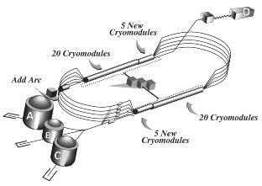
Conclusions
The quest to understand confinement
and the strong force is about to make
great leaps forward.
Advances in theory and computing will soon
allow us to solve QCD and understand the
the role of glue in the spectrum of hadrons.
Definitive experiments to confirm or refute our expectations on the role of glue will start in 2015.
The synchronized advances in both areas will allow
us to finally understand QCD and confinement.

Slide 49
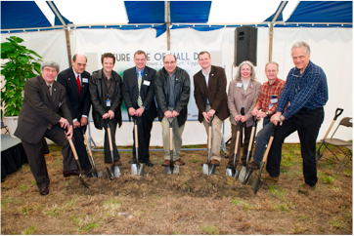
The GlueX Detector in Hall-D
Construction of Hall-D broke ground in April 2009. Starting installation in the Hall now.
The 12 GeV upgrade of Jefferson Lab is nearly complete. Installation of the GlueX detector is nearly complete.
Lots of room for new collaborators.
Hall-D Groundbreaking
We expect the first beam in Hall-D/GlueX in late 2014 and physics in 2015.

Slide 51
Quarks and Gluons?
The mesons only involve quarks and antiquarks. What does the glue do? Can the gluonic fields be excited as well?
Models: The gluonic field is excited and can be modeled with specific spin and parities (J^{PC)}.
Bag Model: A transverse-electric gluon is 1⁺⁻ .
1⁻⁻, (0,1,2)⁺⁻
Flux-tube Model: gluons are 1⁺⁻ and 1⁻⁺ .
1⁻⁻, 1⁺⁺, (0,1,2)⁺⁻ , (0,1,2)⁺⁻
…. Others ….

Slide 52
Experimental Evidence for Hybrids
Mode Mass Width Production
ηπ⁻ 1370±15+50-30 385±40+65-105 1⁺
ηπ⁰ 1257±20±25 354±64±60 1⁺
ηπ 1400 310 seen in annihilation
π₁(1400)
Mode Mass Width Production
3π 1598 ±8+29-47 168±20+150-12 1⁺,0⁻,1-
η’π 1597±10+45-10 340±40±50 1⁺
b₁π 1664±8±10 185±25±38 0⁻ ,1⁺
f₁π 1709±24±41 403±80±115 1⁺
3π 1660 ±10+64-0 269±21+42-64 1⁺
π₁(1600)
Mode Mass Width Production
b₁π 2014±20±16 230±32±73 1⁺
f₁π 2001±30±92 332±52±49 1⁺
π₁(2015)

Slide 53
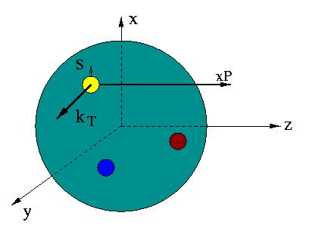
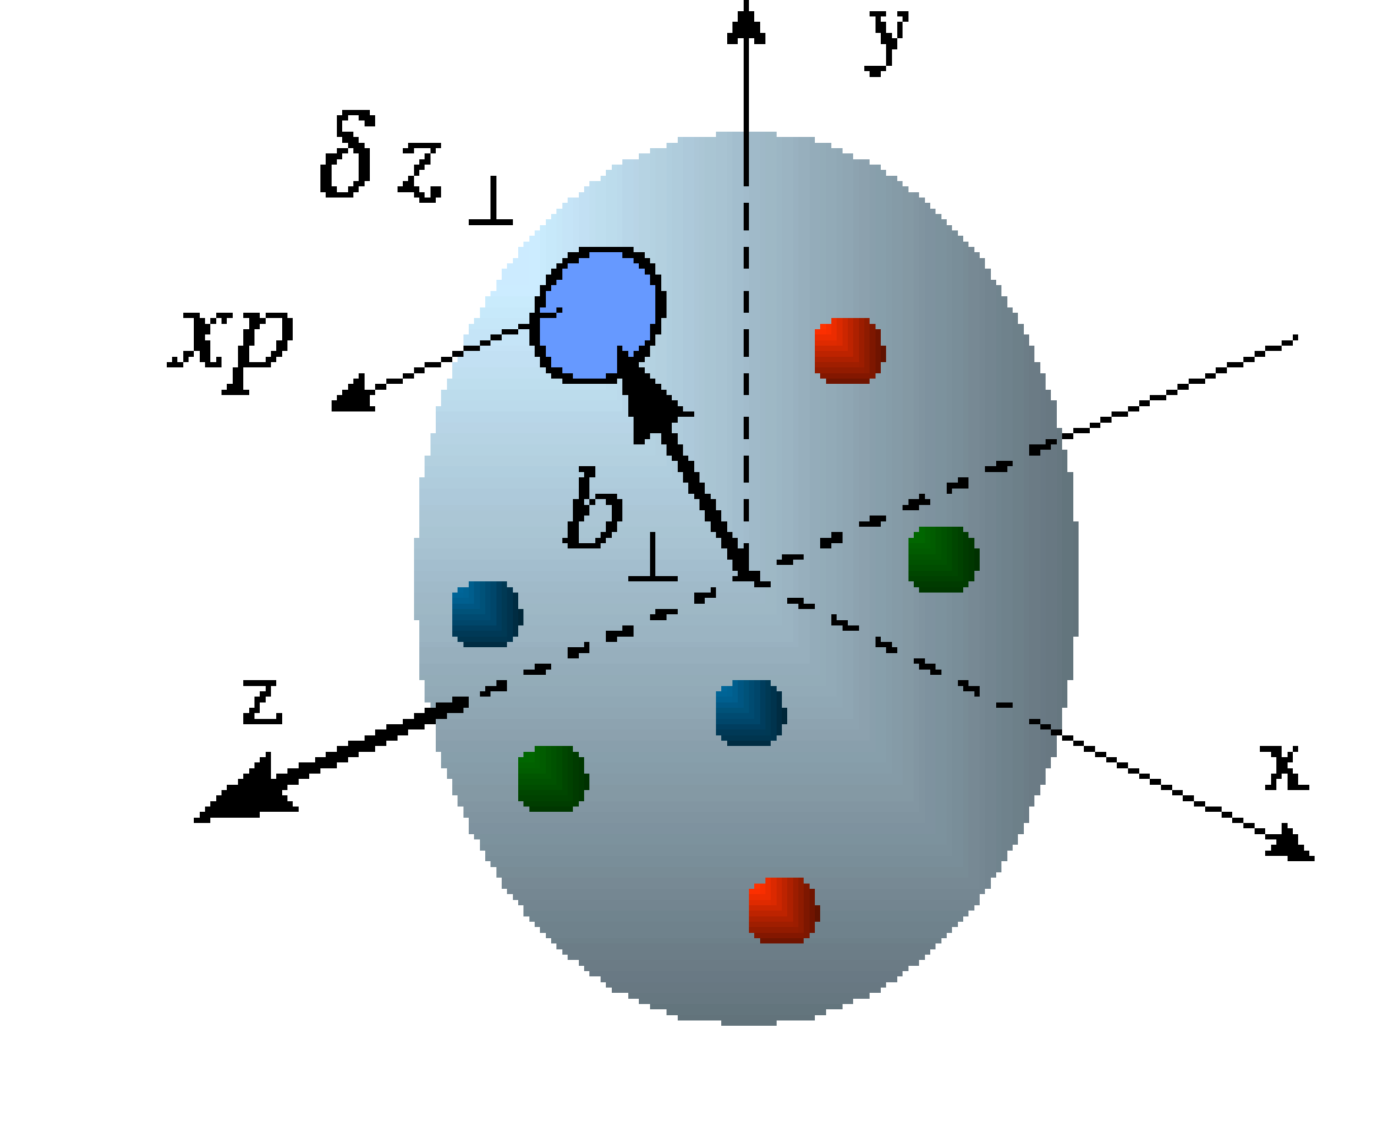
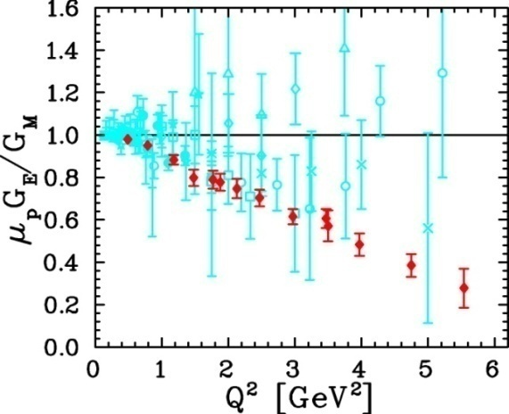
Unified View of Nucleon Structure
W_{p}^{u}(x,k_{T},r ) Wigner distributions
6D Dist.
d³r
d²k_{T} dr_{z}
TMD PDFs f₁^{u}(x,k_{T}), .. h₁^{u}(x,k_{T})‏
GPDs/IPDs
3D imaging
dx &
Fourier Transformation
d²k_{T}
d²r_{T}
Form Factors
G_{E}(Q²),
G_{M}(Q²)‏
PDFs
f₁^{u}(x), .. h₁^{u}(x)‏
1D

Slide 54

Extraction of GPDs
Cleanest process: Deeply Virtual Compton Scattering
hard vertices
σ⁺ − σ⁻
σ⁺ + σ⁻
Δσ
2σ
A =
=
ξ=x_{B}/(2-x_{B})
t
Polarized beam, unpolarized target:
~
H(ξ,t)
Δσ_{LU}~ sinφ{F₁H+ ξ(F₁+F₂)H+kF₂E}dφ
Unpolarized beam, longitudinal target:
~
~
H(ξ,t)
Δσ_{UL}~ sinφ{F₁H+ξ(F₁+F₂)(H+ξ/(1+ξ)E)}dφ
Unpolarized beam, transverse target:
E(ξ,t)
Δσ_{UT}~ sinφ{k(F₂H – F₁E)}dφ

Slide 55

Quark Angular Momentum
→ Access to quark
orbital angular
momentum

Slide 56
QCD and Spectroscopy: quark-antiquark
Quarkonium
Mesons
q
q
4⁺⁺
L=3
3⁺⁺
2⁺⁺
3⁺⁻
ρ,K*,ω,φ
Mesons come in
nonets of the same
J^{PC} Quantum Numbers
3⁻⁻
L=2
2⁻⁻
π,K,η,η’
1⁻⁻
2⁻⁺
a,K,f,f’
2⁺⁺
L=1
1⁺⁺
b,K,h,h’
SU(3) is broken
Last two members mix
0⁺⁺
1⁺⁻
ρ,K*,ω,φ
1⁻⁻
S=1
S=0
L=0
0⁻⁺
π,K,η,η’

Slide 57
Experimental Evidence for Hybrids
The most extensive data sets to date are from the BNL E852 experiment. There is also data from the VES experiment at Protvino and some results from the Crystal Barrel experiment at LEAR. Results from the COMPASS experiment at CERN are available . There is a single result from the CLEO-c experiment and a null result from CLAS.
π₁(1400) Width ~ 0.3 GeV, Decays: only to ηπ
weak signal in πp production (scattering??)
strong signal in antiproton-deuterium.
π₁(1600) Width ~ 0.30 GeV, Decays ρπ,η’π,b₁π,f₁π
Seen in πp production, (E852,VES,COMPASS)
Seen in χ_{c} decays. There is some controversy
around the ρπ decay mode. Not observed in
photo production.
π₁(2000) Weak evidence in preferred hybrid
modes f₁π and b₁π only seen in E852.

Slide 58

Amplitude Analysis
3.5 Hours of beamtime
Fit the data event-by event to sums of high-dimensional angular distributions using complex weights.
Intensity and phase differences
Search for particles in several final states at once.

Slide 59

New Opportunity: Search for A’ at JLab
Search for new forces mediated by ~100 MeV vector boson A’ with weak coupling to electrons:
g – 2 preferred!
New ~GeV–scale force carriers are important category of physics beyond the SM.
A’ could couple to dark matter and explain some anomalous astrophysical data.
Fixed-target experiments @JLab (FEL + CEBAF) have unique capability to explore this!

Slide 60
The Science
What is the source of the proton’s spin? Measurements at 12-GeV Jefferson Lab will allow us to access the orbital motion of the valence quarks. The RHIC-spin program will provide a more accurate measurement of the contribution of the gluons.
Experiments to relate the dynamics of quarks and gluons in nuclei to the short-range structure of nuclei, combined progress in Lattice QCD, will further elucidate how do the nuclei of atoms emerge from QCD?

Slide 61
The Science
Mapping the spectrum of meson states associated with excitations of the gluonic field. The light-quark systems will be measured at Jefferson Lab.

Slide 62

Experimental Evidence for Hybrids
The E852 Detector at BNL
E852 used an 18 GeV/c beam
of π⁻ on a hydrogen target. It
detects photons and charged
particles in the final state.

