Slide 1
Experiment Overview on Meson Spectroscopy: Current and Future
Curtis A. Meyer - Carnegie Mellon University
2014 Long-range plan Joint Town Meeting on QCD

Slide 2
Outline
Mesons and Gluonic Excitations.
Experimental Status.
Jefferson Lab at 12-GeV.
The Charm Sector.
The International Scene.

Slide 3
Mesons and QCD
Bound states of quarks and glue with baryon number zero.
Mesons
Hybrid mesons
4-quark states/molecules
Glueballs
u, d, s, c and b quarks can
form mesons.
``onium’’
light-quark mesons: u, d, s
Characterize by (I^{G})J^{PC}
Isospin (I) , G-parity,
Total Spin (J), Parity (P),
Charge Conjugation (C)

Slide 4
Beyond the Quark Model
Other configurations can be color-neutral:
Hybrid Mesons where the gluonic field plays an active role.
4-quark states
Should we expect to see these?
MIT Bag Model – quarks confined to a finite space, add a TE gluon J^{PC}=1⁺⁻ .
This leads to four new nonets of “hybrid mesons” 1⁻⁻ 0⁻⁺ 1⁻⁺ and 2⁻⁺ .
Mass(1⁻⁺) = 1.0 – 1.4 GeV
QCD spectral sum rules – a two-point correlator related to a dispersion relation. This predicts a 1⁻⁺ hybrid meson.
Mass(1⁻⁺) = 1.0 – 1.9 GeV
Flux-tube Model – model the gluonic field as 1⁺⁻ and 1⁻⁺ objects.
This leads to eight new nonets 0⁺⁻ 0⁻⁺ 1⁻⁻ 1⁺⁺ 1⁻⁺ 1⁺⁻ 2⁻⁺ and 2⁺⁻.
Mass(1⁻⁺) = 1.8 – 2.0 GeV
QCD Coulomb Gauge Hamiltonian: Lightest hybrids not exotic, need to go to L=1 to get 1⁻⁺ 3⁻⁺ and 0⁻⁻.
Mass(1⁻⁺) = 2.1 – 2.3 GeV

Slide 5
Lattice QCD
Light-quark Mesons (u,d,s)

Slide 6
Lattice QCD
Light-quark Mesons (u,d,s)
2⁻⁺
1⁻⁺
States with non-trivial gluonic fields.
Supermultiplet
1⁻⁻
1⁻⁻, 0⁻⁺ , 1⁻⁺ , 2⁻⁺
0⁻⁺

Slide 7
Spectroscopy and QCD
Phys. Rev. D84 (2011) 074023
``Constituent gluon’’ behaves like it has J^{PC} = 1⁺⁻
Mass ~ 1-1.5 GeV
Lightest hybrid nonets: 1⁻⁻, (0⁻⁺,1⁻⁺, 2⁻⁺)
The 0+- and two 2+- exotic nonets and
also a second 1⁻⁺ nonet p-wave meson plus a
``gluon’’
2.5Gev
2.0GeV
0⁺⁻
1⁻⁺
2⁺⁻
Several nonets predicted
π₁ I^{G}(J^{PC})=1⁻(1⁻⁺)
K₁ I^{G}(J^{PC})= ½ (1⁻)
η’₁ I^{G}(J^{PC})=0⁺(1⁻⁺)
η₁ I^{G}(J^{PC})=0⁺(1⁻⁺)
Notes:
What are gluonic excitations and why are we looking for them? Lattice QCD predictions for the mesons and in particular, a class of mesons with non-quark-antiquark quantum numbers. Also not that mixing angles are predicted. GlueX needs to measure particle J(PC), masses, widths and decay modes to be able to map these out.

Slide 8
Experimental Evidence for Hybrids
Pion peripheral production:
The most extensive data sets to date are from the BNL E852 experiment. There is also data from the VES experiment at Protvino and from the COMPASS experiment at CERN.
Proton-antiproton annihilation:
There is data from the Crystal Barrel experiment at LEAR. This is also one of the pushes of the future PANDA experiment.
Charmonium Decays:
There is data from the CLEO-c at Cornell. This is also an area of interest of the BES III experiment in Beijing. This will also be part of the PANDA program at FAIR.

Slide 9
Experimental Evidence for Hybrids
Pion peripheral production on nucleon and nuclear targets:
VES at Protvino Largest statistics and most
E852 at BNL most decay modes studies.
COMPASS at CERN Three π₁ states reported.
J/ψ Decays:
CLEO-c One decay mode studied.
BES-III One π₁ state reported.
Proton-antiproton annihilation at rest:
Crystal Barrel at LEAR One π₁ state reported.
Obelix at LEAR
π₁ I^{G}(J^{PC})=1⁻(1⁻⁺)
No η₁ or η₁’ seen.
K₁ I^{G}(J^{PC})= ½ (1⁻)
η’₁ I^{G}(J^{PC})=0⁺(1⁻⁺)
η₁ I^{G}(J^{PC})=0⁺(1⁻⁺)

Slide 10
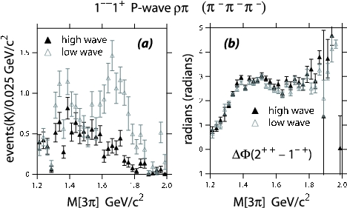
Experimental Evidence for Hybrids
Mode Mass Width Production
3π 1598 ±8+29-47 168±20+150-12 1⁺,0⁻,1⁻ E852
η’π 1597±10+45-10 340±40±50 1⁺ E852,VES,CLEO-c
b₁π 1664±8±10 185±25±38 0⁻ ,1⁺ E852,VES,CBAR
f₁π 1709±24±41 403±80±115 1⁺ E852,VES
3π 1660 ±10+64-0 269±21+42-64 1⁺ COMPASS
π₁(1600)
Decay mode sensitive to model
But not in
COMPASS
Exactly the same mass and width as the
Confused production in E852??
This is consistent with a hybrid meson

Slide 11
Experimental Evidence for Hybrids
π₁(2015)
Mode Mass Width Production
b₁π 2014±20±16 230±32±73 1⁺ E852
f₁π 2001±30±92 332±52±49 1⁺ E852
Need two J^{PC}=1⁻⁺ states
π₁(2000)→b₁π
M = 2014±20±16 MeV/c²
Γ = 230±32±73 MeV/c²
Seen primarily in natural
parity exchange.
The natural dominates
m^{ε}=0⁻
1⁻⁺b₁π
m^{ε}=1⁺
1⁻⁺b₁π
Seen in one experiment with low statistics It needs confirmation. If this exists, it is also a good candidate for an exotic hybrid meson.

Slide 12
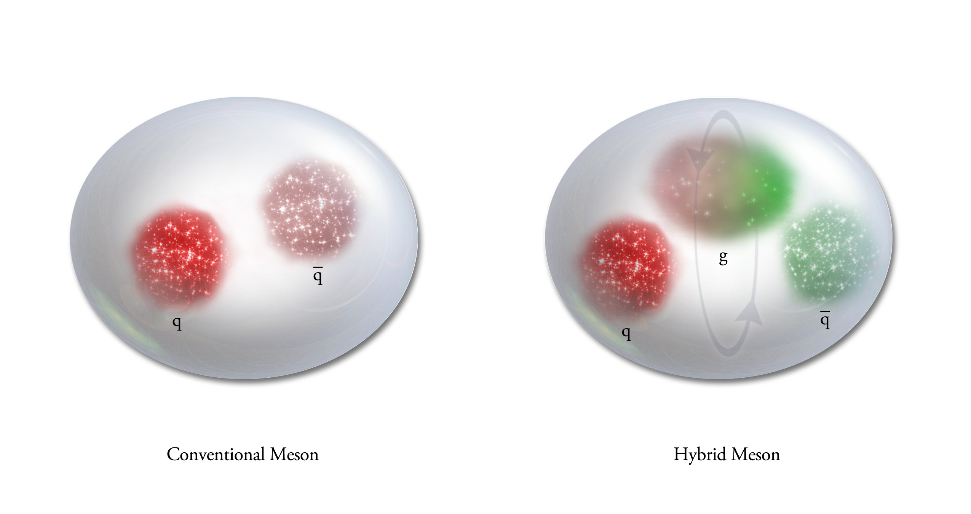
QCD Exotics
Lattice QCD suggests 5 nonets of mesons with exotic quantum number:
1 nonet of 0⁺⁻ exotic mesons
2 nonets of 1⁻⁺ exotic mesons
2 nonets of 2⁺⁻ exotic mesons
Lattice shows two nonets here.
Experimental evidence exists for π₁ states.
π₁ I^{G}(J^{PC})=1⁻(1⁻⁺)
K₁ I^{G}(J^{PC})= ½ (1⁻)
η’₁ I^{G}(J^{PC})=0⁺(1⁻⁺)
η₁ I^{G}(J^{PC})=0⁺(1⁻⁺)

Slide 13
Making Progress
Large and uniform acceptance detectors.
Photon and charged particle reconstruction.
Very high statistics.
Multiple production mechanisms.
Consistent analyses and theoretical support.
Independent confirmation.

Slide 14
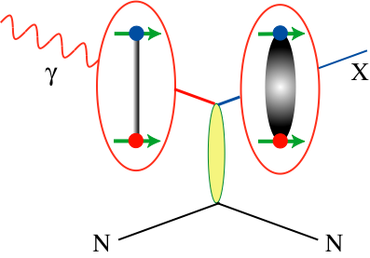
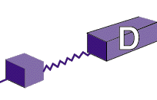
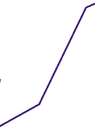

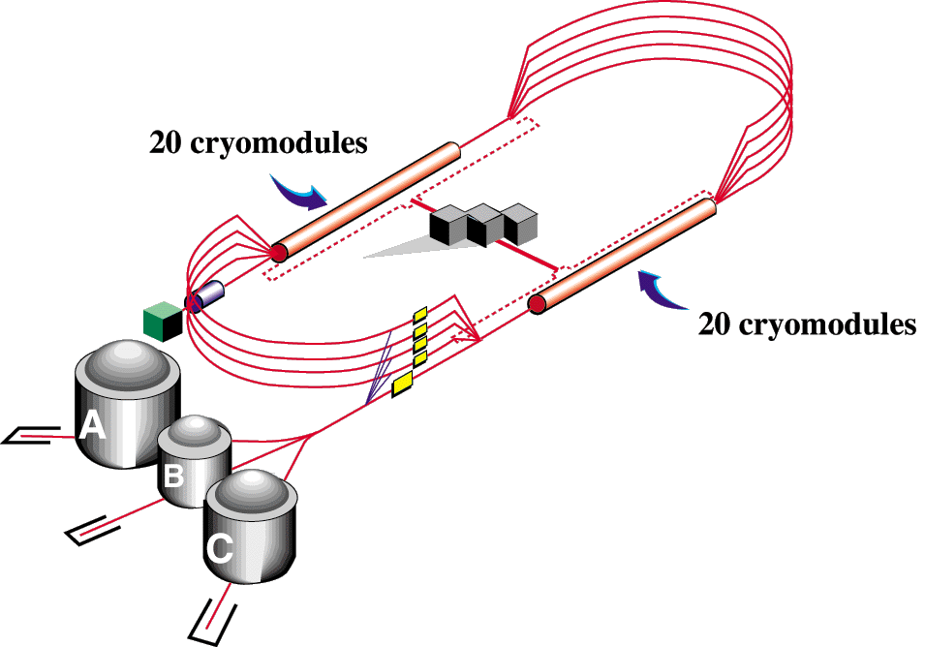

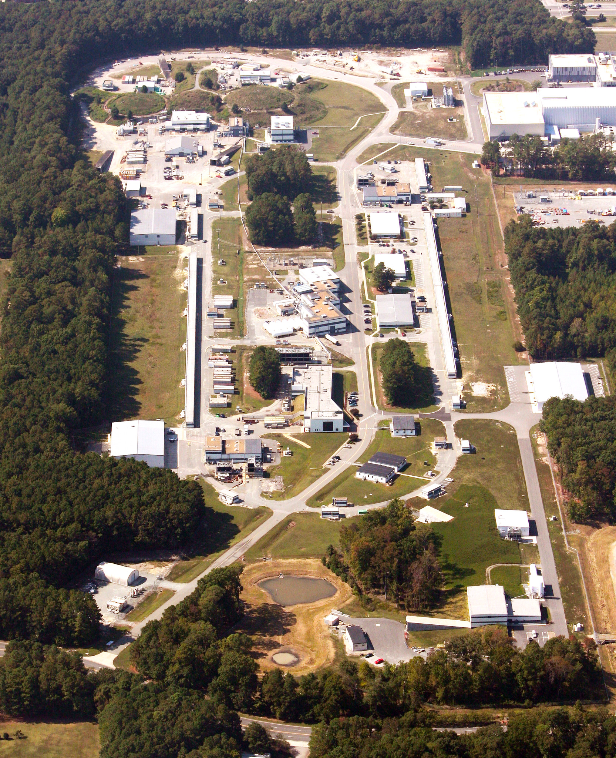
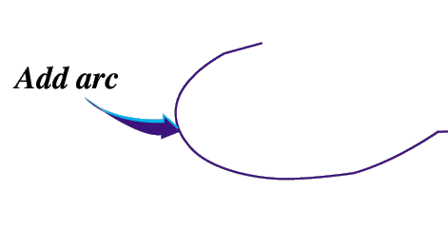

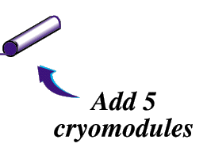
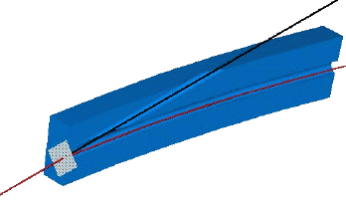
12-GeV CEBAF – Photoproduction
CHL-2
Linearly polarized
photons out
12GeV electrons
spectrometer
20 μm thick
Diamond crystal

Slide 15
Experimental Evidence for Hybrids
Photo Production:
There are limited results from the CLAS at 6 GeV from Jefferson Lab. No π₁ that decays to ρπ produced in π exchange.
The GlueX experiment at Jefferson Lab will start physics in 2015. Double the photon energy, much better acceptance, linear polarization and higher rates.
Unexplored production mechanism.

Slide 16
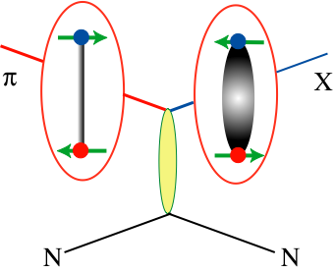
Photoproduction
More likely to find mesons with spin-aligned quarks using photons.
Simple (0⁺⁺) exchange with L=1: 0⁺⁻,1⁺⁻,2⁺⁻
Simple (0⁻⁺) exchange with L=1: 0⁻,1⁻,2⁻
Simple (1⁻⁻) exchange with L=1: 0⁻⁺,1⁻⁺,2⁻⁺
Dudek (2009) Radiative decays in charmonium to normal and hybrid mesons have comparable rates.
8.4-9 GeV tagged, linearly polarized photon beam, up to 10⁸/s

Slide 17
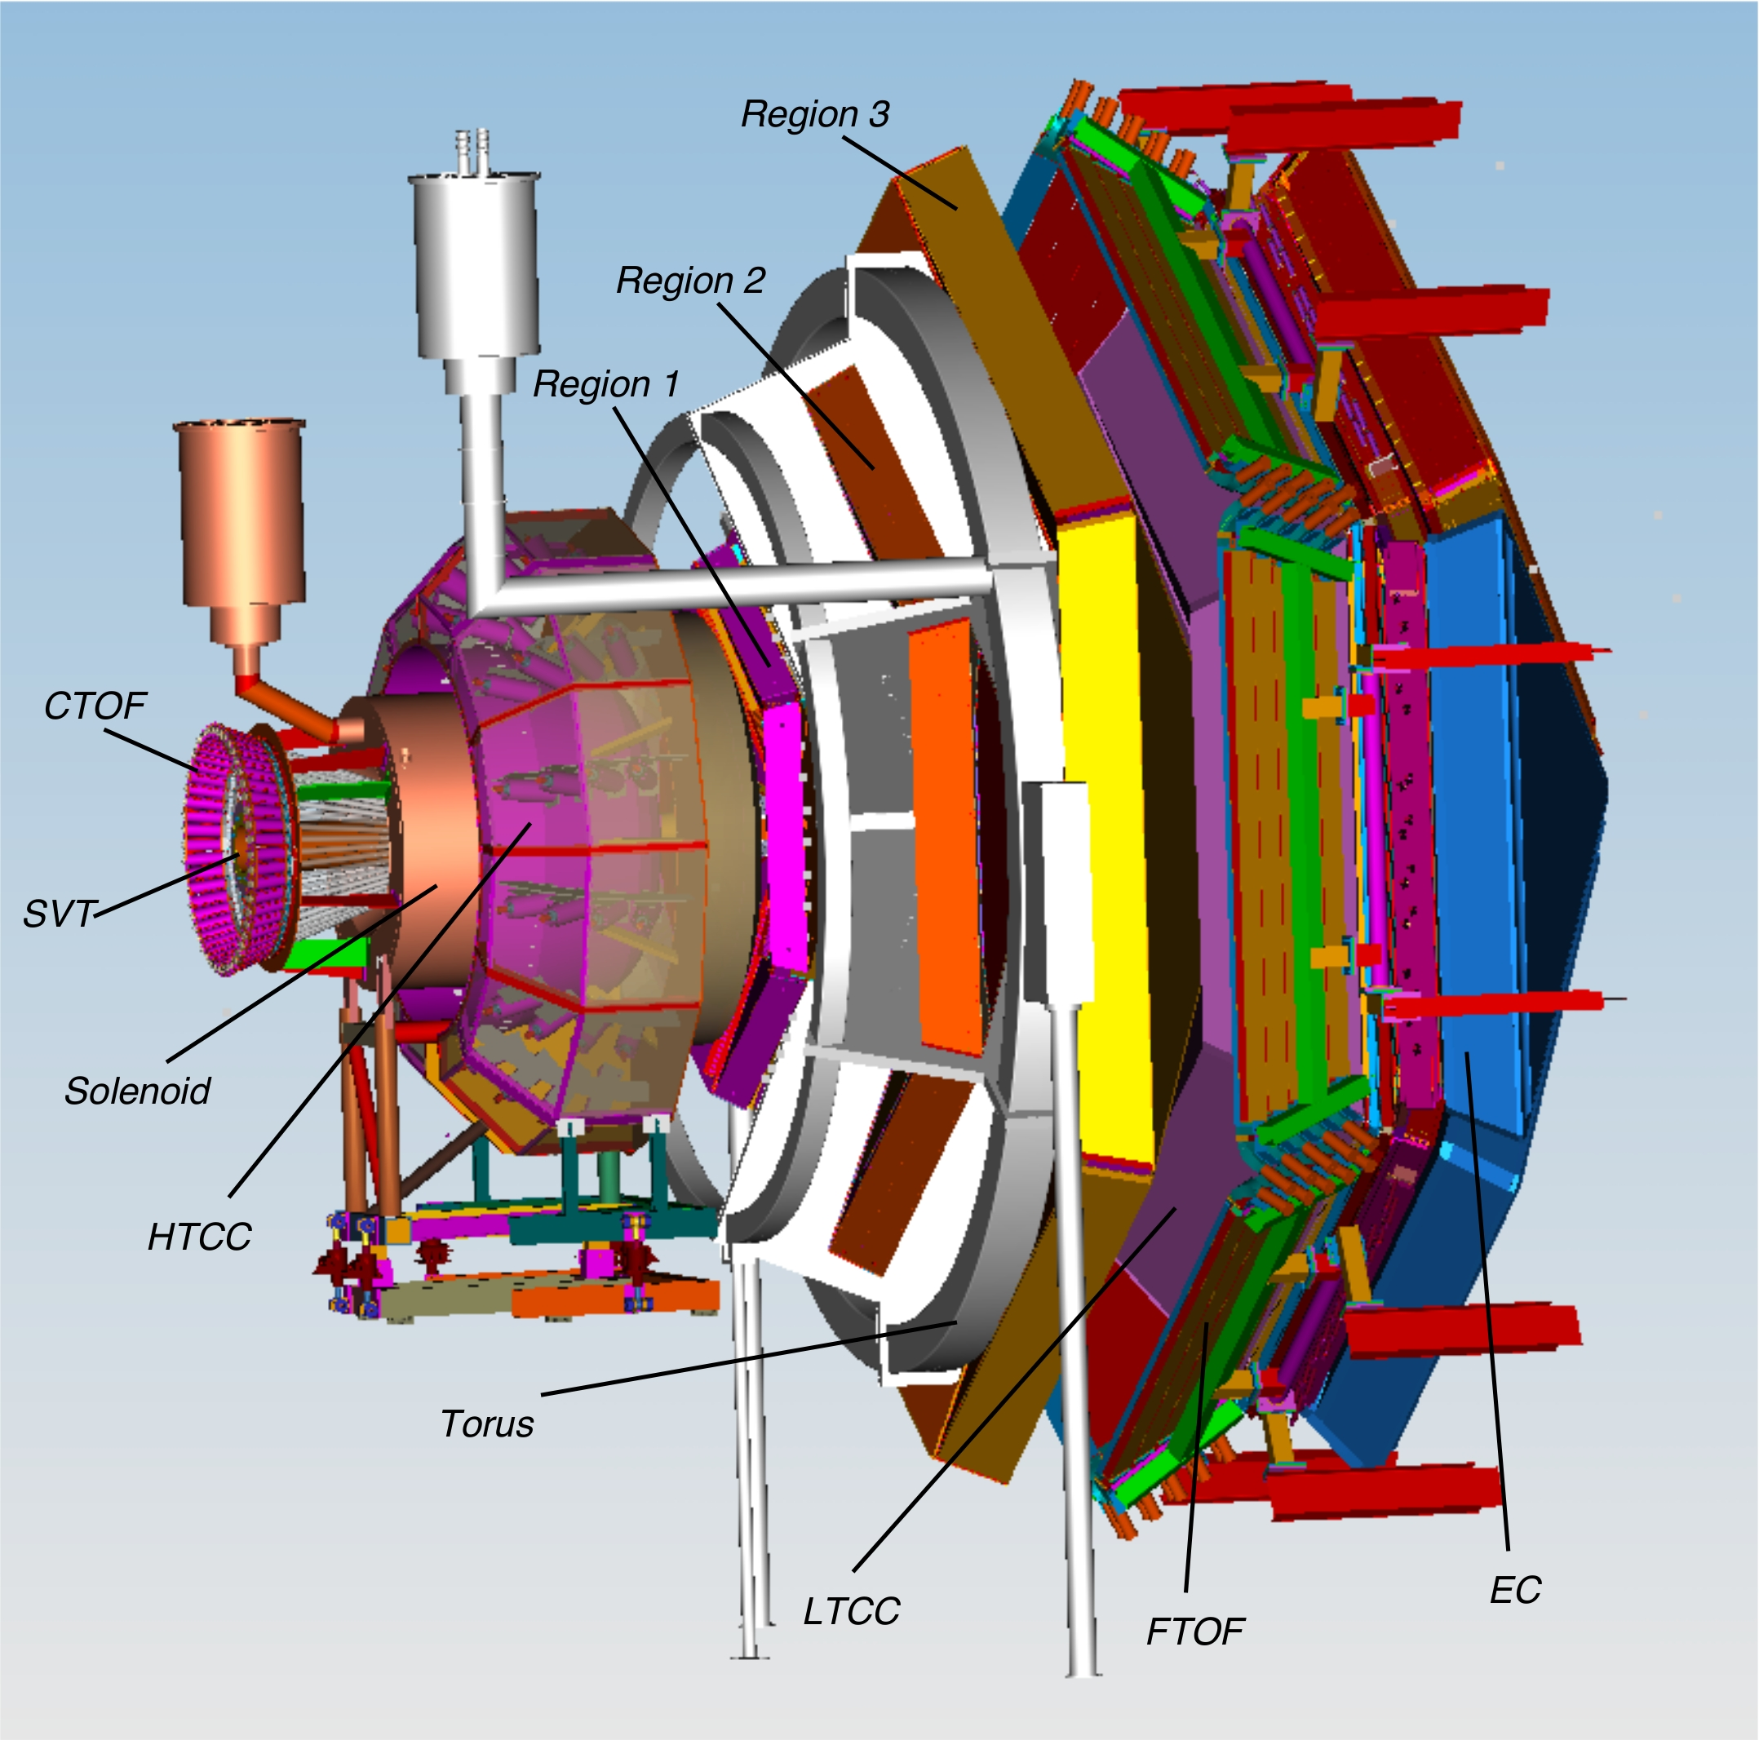
The CLAS12 Experiment at Jefferson Lab
Quasi-Real Photo Production
Light-quark Mesons
Physics in 2017

Slide 18
The GlueX Experiment at Jefferson Lab
BaBar DIRC Bars
Photo Production
Light-quark Mesons
Strangeonium States
Physics in 2015

Slide 19
Expected Decay Modes
π₁ → πρ, πb₁ , πf₁,πη’, ηa₁
η₁ → ηf₂,a₂π,ηf₁, ηη’,π(1300)π, a₁π,
η₁’→ K*Κ, Κ₁(1270)Κ, Κ₁(1270)Κ , ηη’
b₂ → ωπ, a₂π, ρη, f₁ρ, a₁π, h₁π, b₁η
h₂ → ρπ,b₁π,ωη, f₁ω
h’₂ → Κ₁(1270)Κ, Κ₁(1270)Κ, K₂*Κ, φη, f₁φ
b₀ → π(1300)π , h₁π, f₁ρ, b₁η
h₀ → b₁π , h₁η
h’₀ → K₁(1270)Κ, Κ(1460)Κ, h₁η
Early Reach With Statistics Hard
Kaons do not have exotic QN’s

Slide 20
Amplitude Analysis
Describe the process of producing a particular final state as a set of possible amplitudes :
E.g.
Build a total amplitude by coherently summing all the individual amplitudes. This total amplitude yields a probability that the given sum describes a particular event ``k’’.
is a normalization factor and
are complex coefficients.
Form the likelihood and then minimize the natural log of it with respect
to the . This is a CPU-intensive problem
that we have found scales very well on
graphical processor units (GPUs). To do this requires the four-vectors of all events plus a comparable Monte Carlo data sample to do the normalization.
Notes:
An amplitude analysis uses a physics amplitude to describe a process that connects the initial and final states. Several such processes may be possible, and the resulting amplitude is a coherent sum of all of these. The resulting amplitude can be used to evaluate the probability that a given event comes from the particular amplitude. A likelihood is formed as a product of these probabilities, which is turned into a sum by taking the logarithm. This log likelihood I then minimized with respect to the complex a’s.

Slide 21
GlueX Physics Analysis
Strong theoretical support from the Jefferson Lab and international theory community.
Very strong and integrated presence at Jefferson Lab.
Series of Workshops and Summer Schools.
Strong desire work with the experimentalists.
A strong Lattice QCD Effort.
Important results on the meson spectrum that guide the experimental program.
Ongoing work focused on production and decay.
Very important for the success of the entire program.

Slide 22
Physics in
8.4-9.0 GeV linearly polarized photons from 12 GeV electrons in a thin diamond wafer
Charged particle tracking + timing and photon detection in a 2T magnetic field.
These channels have been studied in Monte Carlo to understand the acceptance.
These studies stress the offline reconstruction software.
Fully reconstruct final states
Notes:
Coherent bremsstrahlung beam with linearly polarized (40%) photons and the GlueX detector to search for exotics. The detector is a nearly hermetic detector for charged particles and photons in a 2.2T magnetic field. The expected reaction is the photo production of some meson X which then decays. Typical decay chains for a some exotic states are shown, and the final states that they yield. GlueX needs to reconstruct complete final states to carry out amplitude analysis.

Slide 23
GlueX Physics Analysis
GlueX ready to do physics, analyses being worked out in advance using the full suite of GlueX/Hall-D software and data from large-scale data challenges.
Physics reactions of interest:
Understand the detector
Initial exotic hybrid searches
Strange Baryons
Activity in the physics working group has shifted to physics analysis.
Other Physics Interests
Decays
Primakov
J/ψ Production
…

Slide 24
Lattice QCD
Charmonium States ( )

Slide 25
Charmonium: Many Discoveries
X J^{PC}<>1—
Y J^{PC} = 1—
Z
Taken from E. Swanson hadron 2013

Slide 26
What are these States?
4-quark state
Non-exotic Hybrid?
Near DD* Threshold

Slide 27
What about strange-quark States?
Does something similar happen in the 2-GeV mass range for strangeonium states?
Non-exotic Hybrid?
Do ``Z’’ states exist ?

Slide 28
What about strange-quark States?
The relevant data are part of nominal running.

Slide 29
Experimental Program
Light-quark sector
  COMPASS @ CERN (analyzing data)
  GlueX @ 12-GeV Jefferson Lab (2015)
  CLAS-12 @ 12-GeV Jefferson Lab (2017)
  PANDA @ FAIR (2019)
Charmonium – X,Y,Z states
  BES III @ Bejing (now)
  LHCb @ CERN (now)
  PANDA @ FAIR (2019)

Slide 30
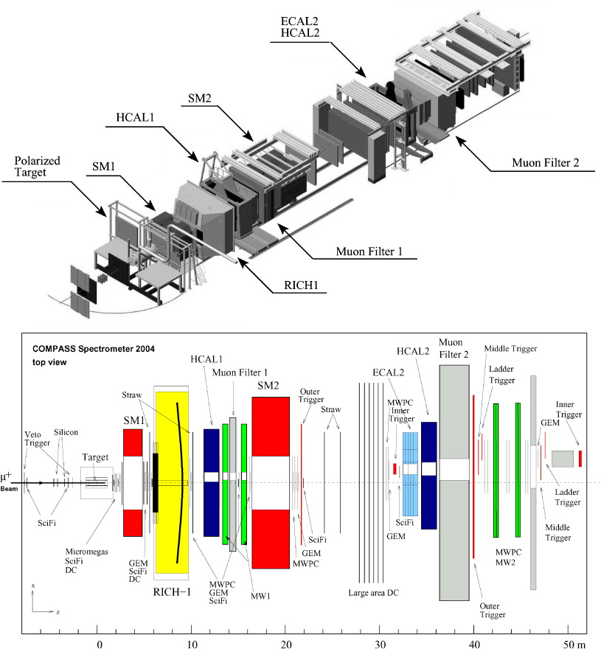
The COMPASS Detector at CERN
Light-quark Mesons
COMPASS: 180 GeV/c π beam.⁻Detects photons and charged particles in the final state.

Slide 31
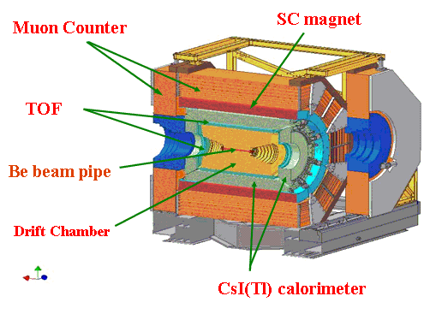
BES III in Beijing
Charmonium States
Glueballs
X,Y,Z States
Running

Slide 32
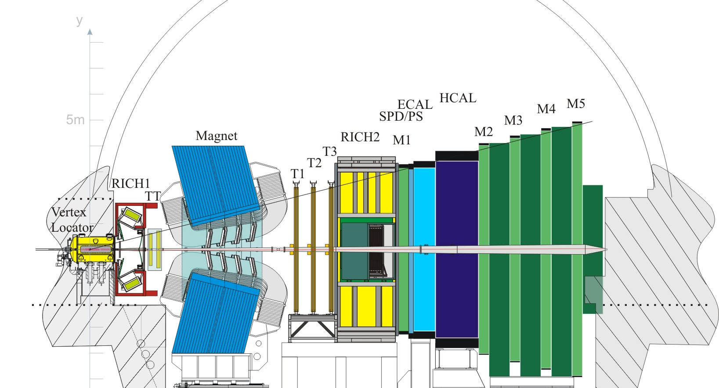
The LHCb Experiment at CERN
X,Y,Z States
Running

Slide 33
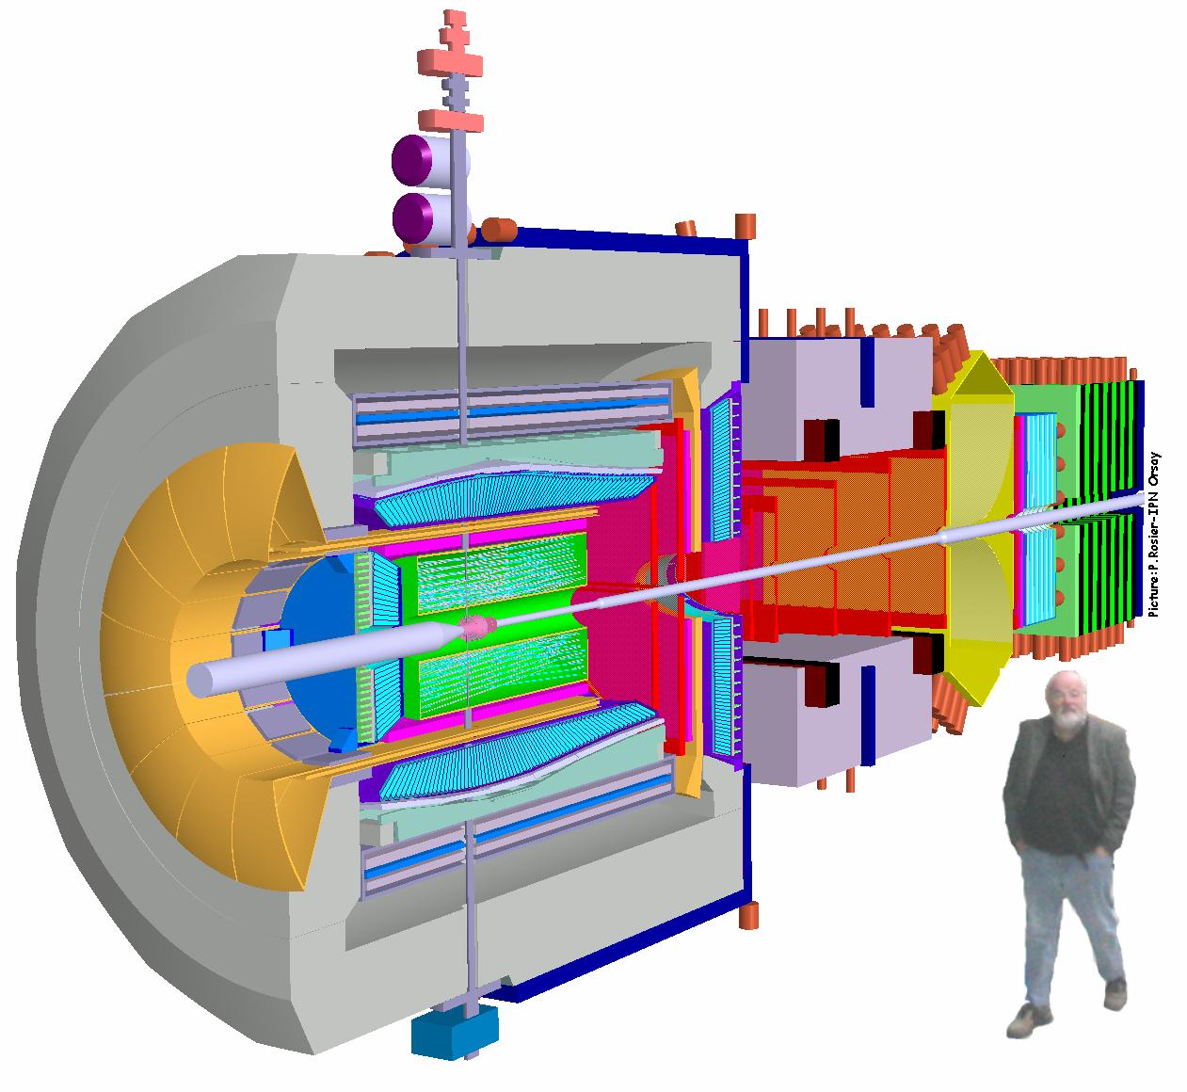
PANDA @ FAIR
Light-quark Mesons
Charmonium States
Glueballs
Physics in 2019?

Slide 34
Summary
Where are the QCD states with static glue?
Photoproduction programs starting in 2015.
Very exciting meson program over the next 10 years.
Charmonium is very intriguing. Does it carry over to lighter quarks? Is it a heavy-quark phenomena?

