Slide 1
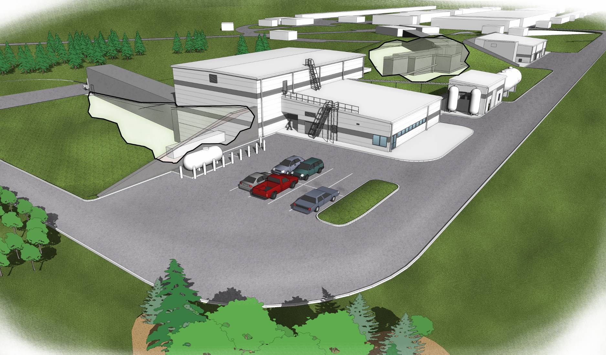
Physics in Hall-D
Curtis A. Meyer, GlueX Spokesperson
Athens University, Arizona State University, Carlton University, Carnegie Mellon University,
Catholic University, Christopher Newport University, University of Connecticut, Florida
International University, Florida State University, University of Glasgow, Indiana University, Jefferson Lab, University of Massachusetts Amherst, Massachusetts Institute of Technology, MEPHI, University of North Carolina A&T, University of North Carolina Wilmington, Old Dominion University, Oxford University, University of Pittsburgh, University T`ecnica Federico Santa Mari’a and University of Regina.

Slide 2
Outline
The GlueX Experiment in Hall D
Meson Spectroscopy and QCD
Lattice QCD and Gluonic Excitations
Experimental Evidence
GlueX Running

Slide 3
The GlueX Experiment

Slide 4
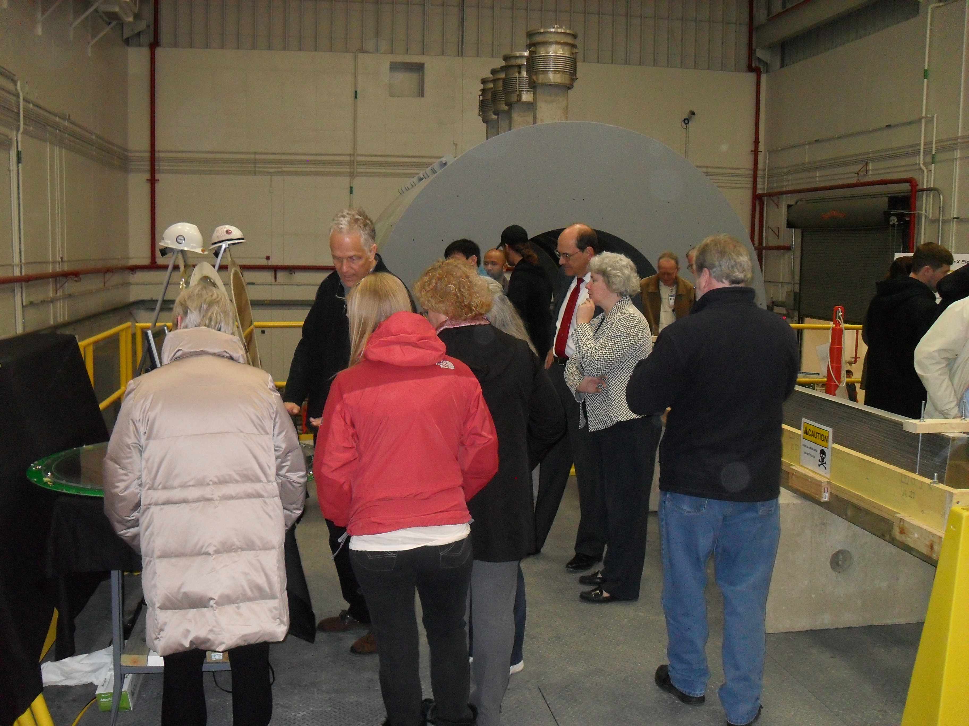
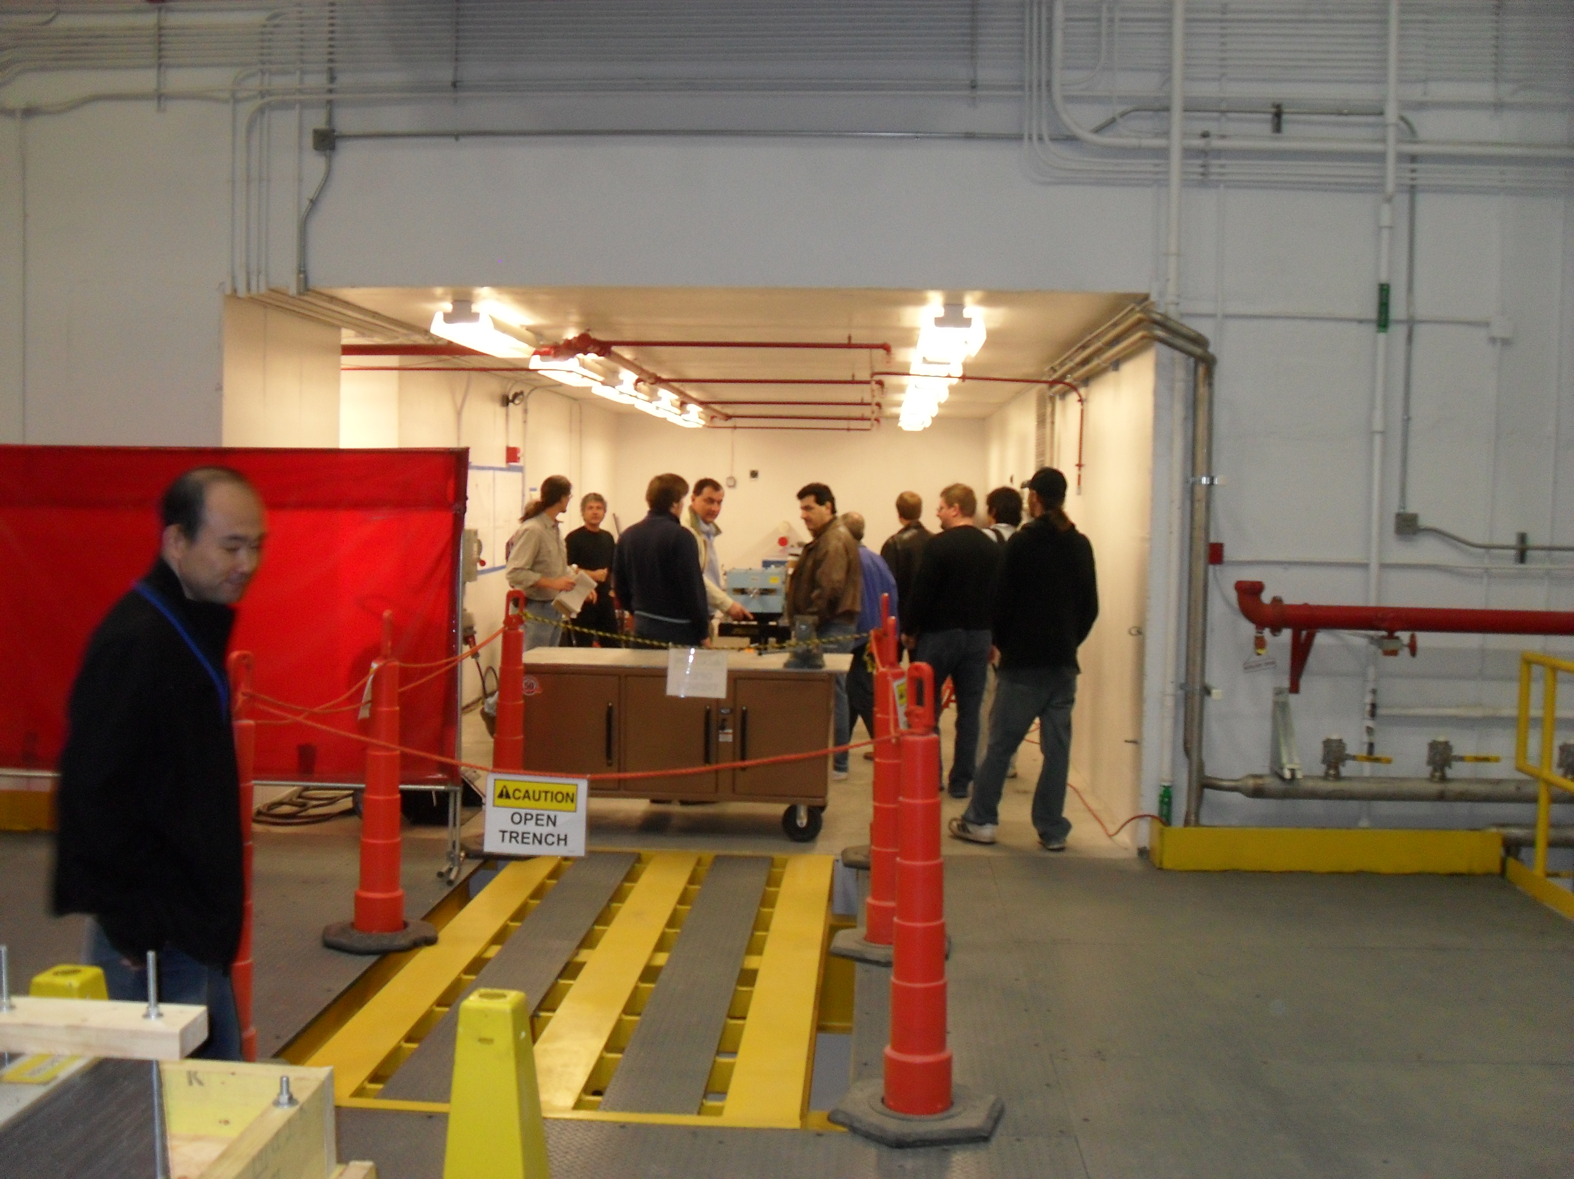
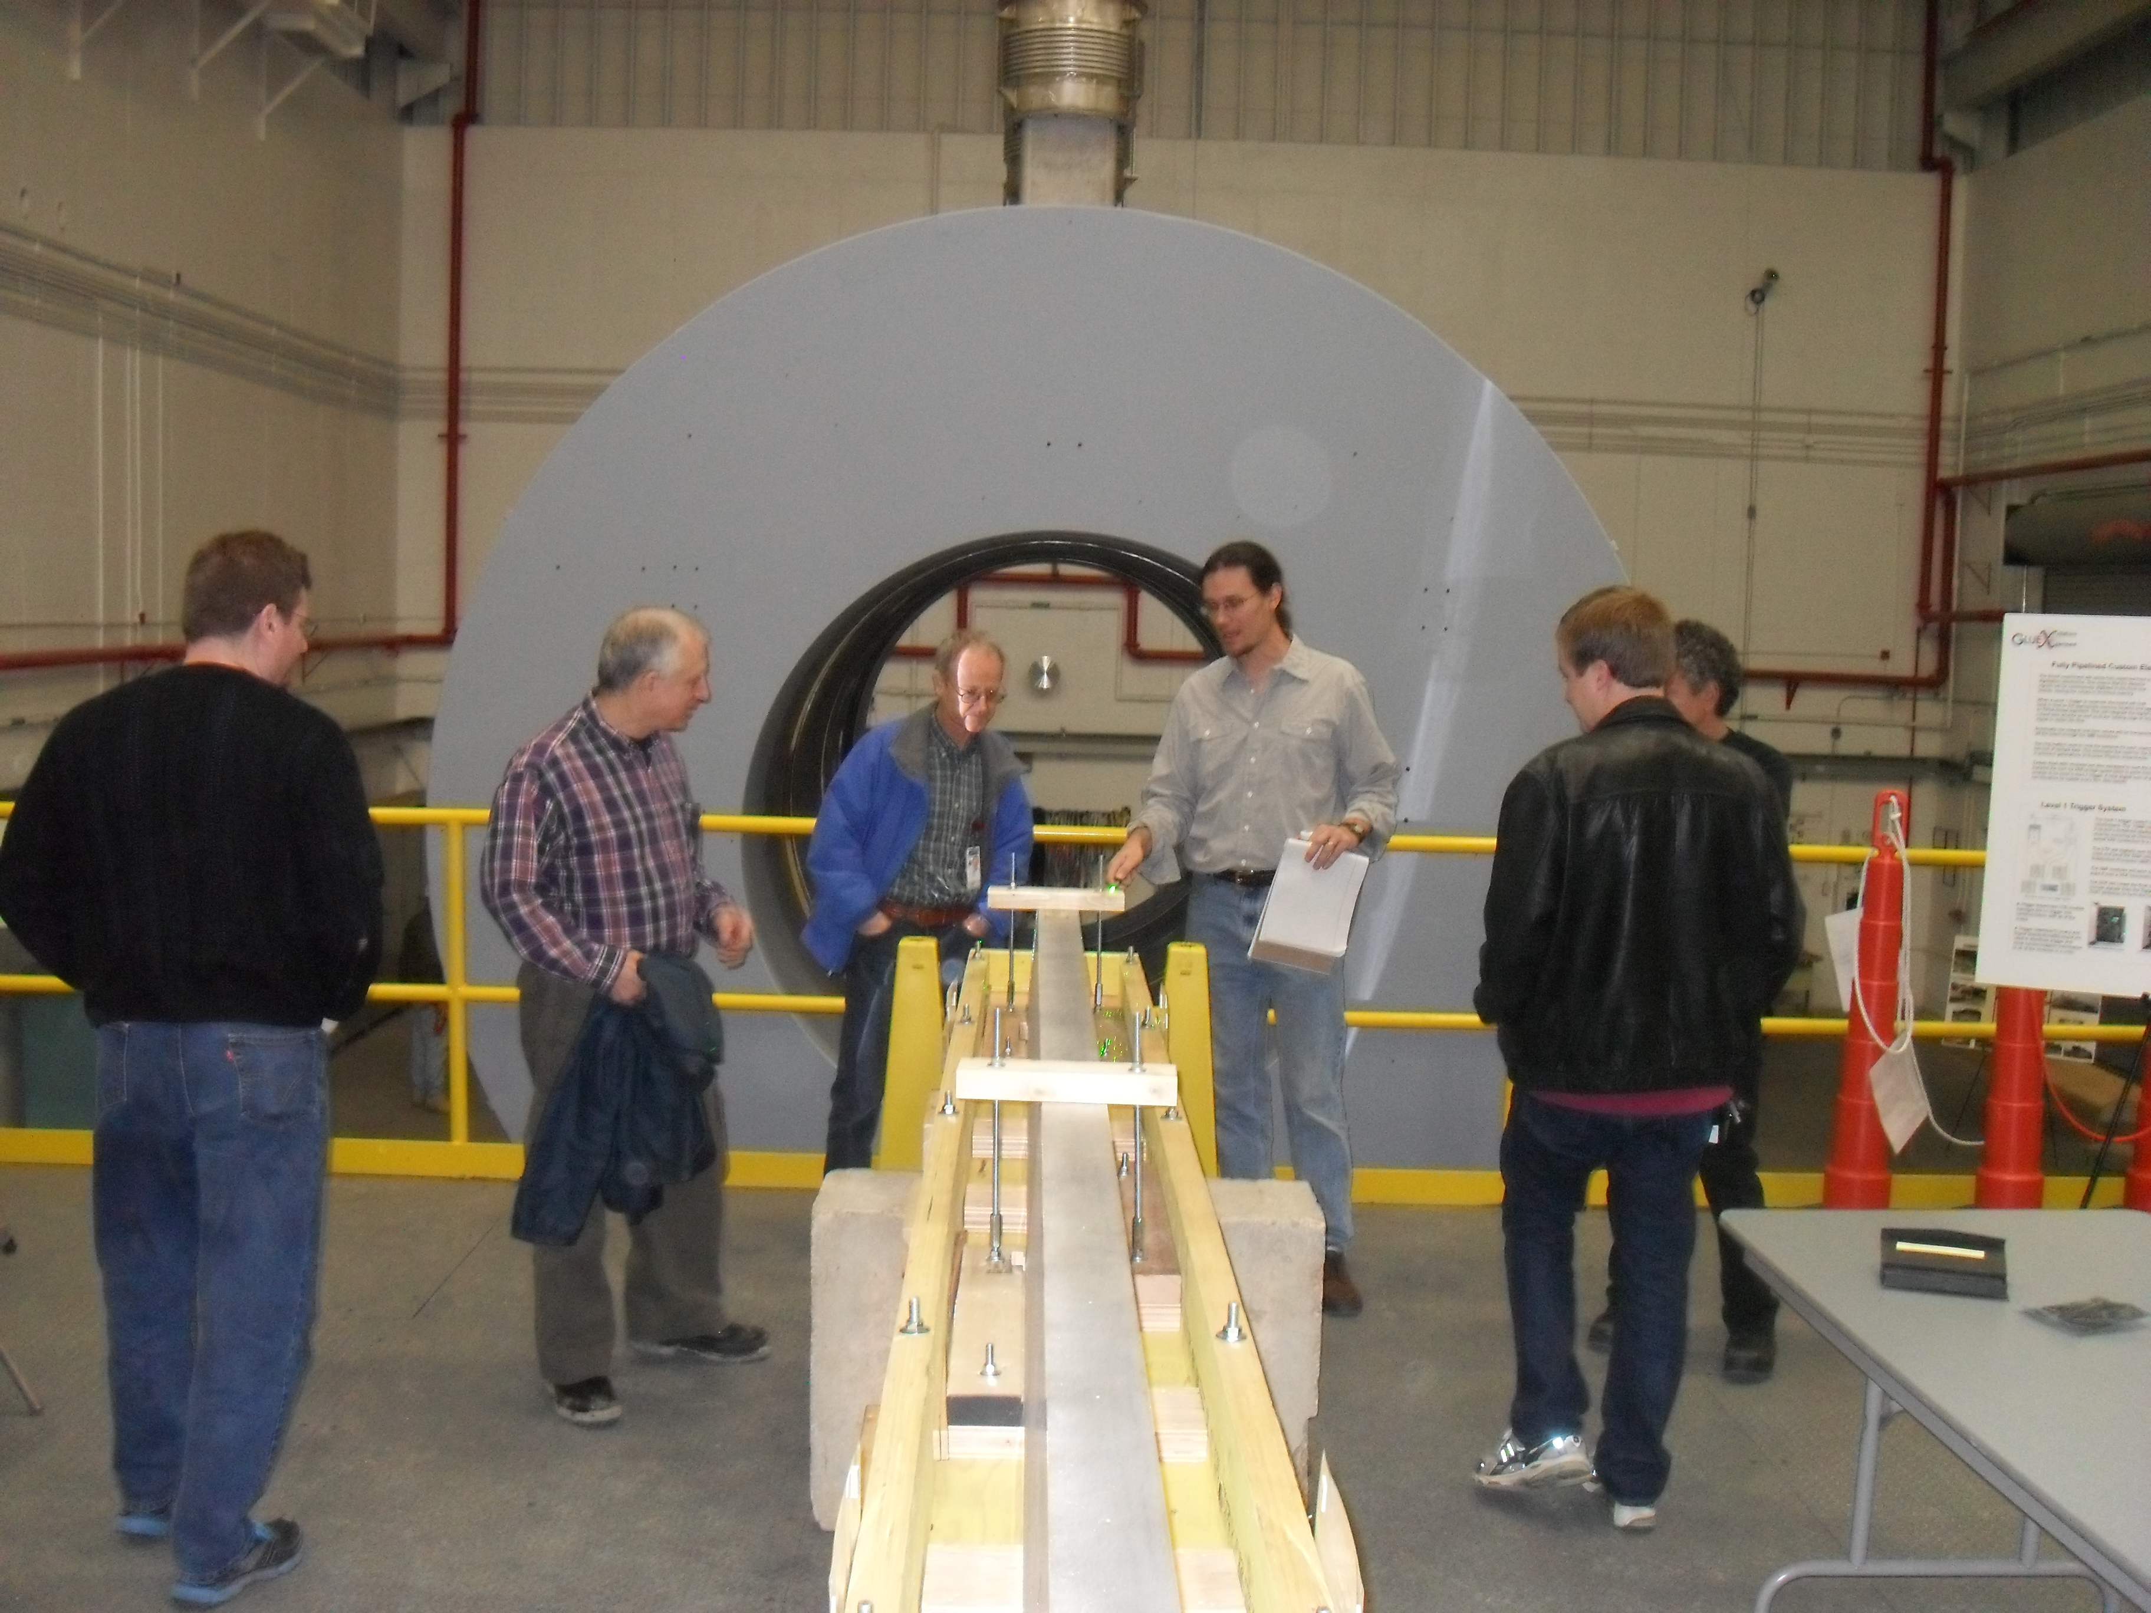
Hall-D Open House
We received beneficial occupancy of Hall D in January 2012 and of the tagger hall in February 2012. On January 11, 2012, the lab held an open house in Hall-D. Nearly 400 people visited Hall-D during the event.

Slide 5
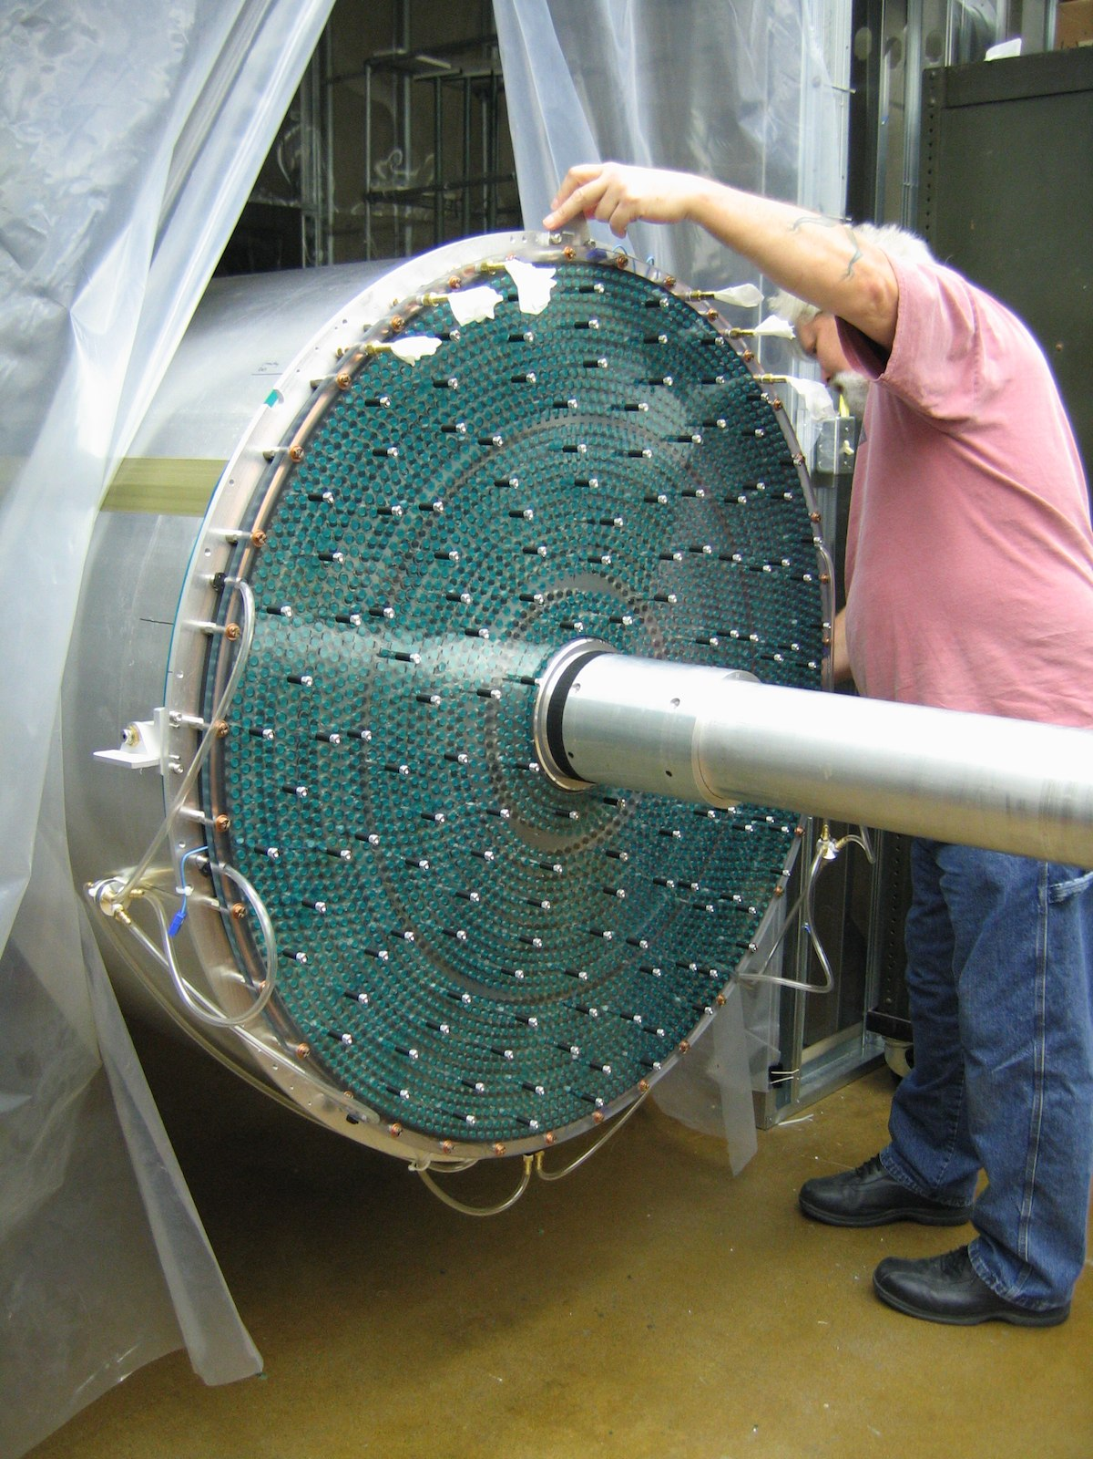
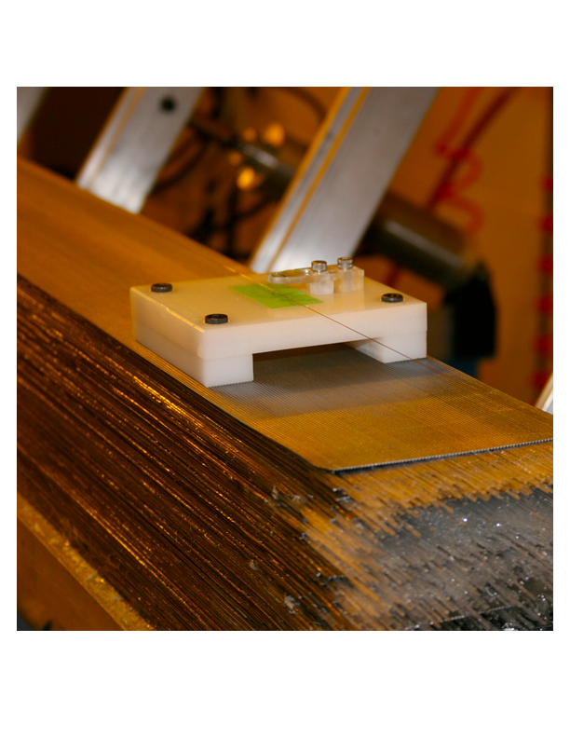
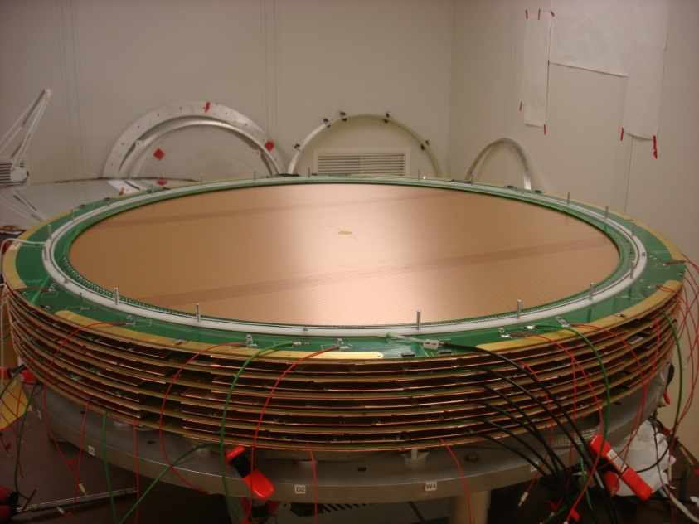
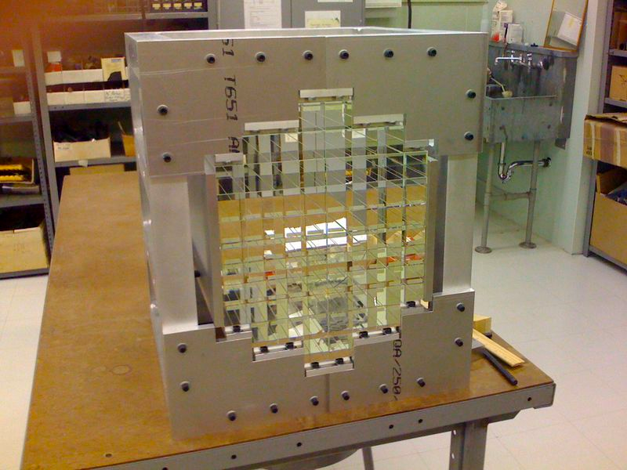
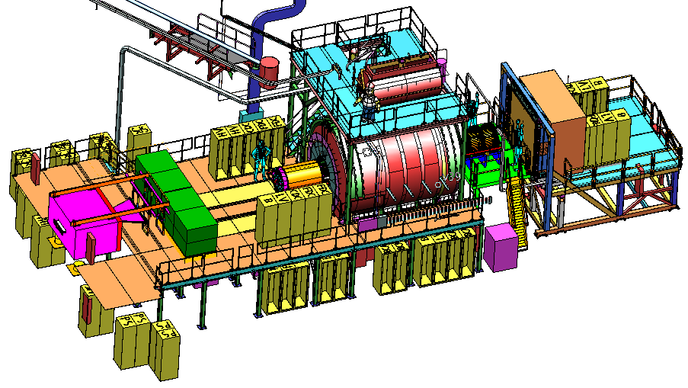
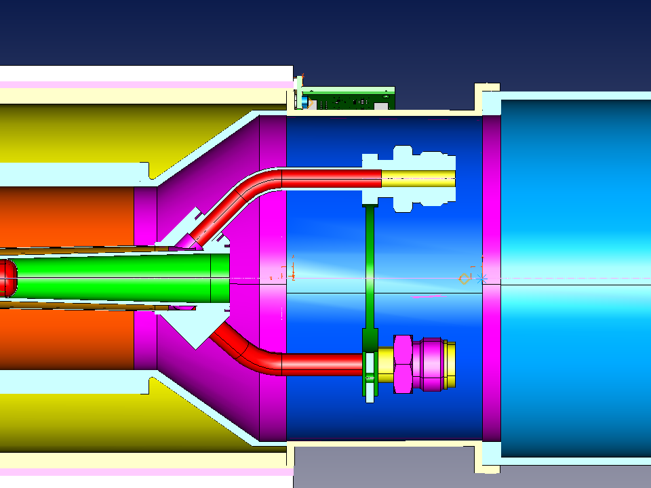
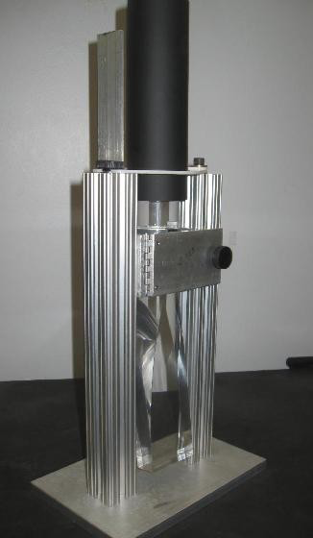
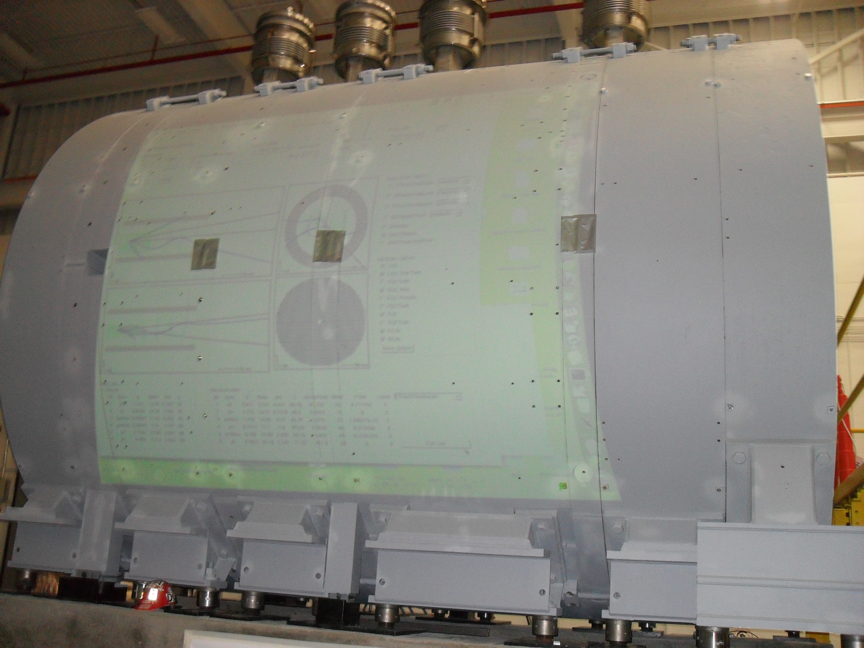
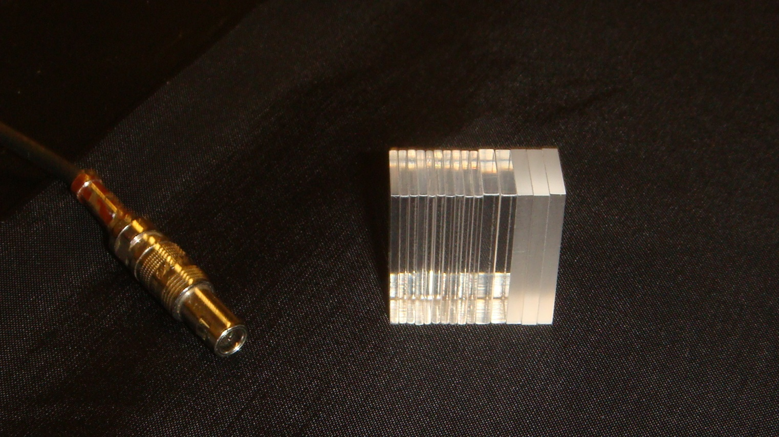
Construction Progress
CDC @ CMU
BCAL Readout @ USM
BCAL @ Regina
all modules at JLab
Calibration @ Athens
FDC @ JLab
FCAL @ IU
Forward PID @ MIT
START @ FIU
TOF @ FSU
Solenoid @ JLab
TRIGGER @ Jlab, CNU
P.S. @ UNCW
Electronics @ JLab, ICO, UMASS, USM
DAQ @ JLab
Beamline/Tagger @ UCONN, ASU, CUA

Slide 6
Gluonic Excitations
ground-state
flux-tube
m=0
excited flux-tube
m=1
Gluonic Excitations provide an
experimental measurement of
the excited QCD potential.

Slide 7
Spectroscopy and QCD
Quark-model Classification of Mesons
Quarkonium
Spin: S=S_{q1}+S_{q2} ½ + ½ =(0,1)
q
q
Orbital Angular Momentum: L=0,1,2,…
Reflection in a mirror:
Parity: P=-(-1)^{(L)}
S_{q1}=1/2
Particle<->Antiparticle:
Charge Conjugation: C=(-1)^{(L+S)}
S_{q2}=1/2
Total Spin: J=L+S
L=0, S=0 : J=0 J^{PC} = 0⁻⁺ L=0, S=1 : J=1 J^{PC} = 1⁻⁻
L=1 , S=0 : J=1 J^{PC} = 1⁺⁻ L=1, S=1 : J=0,1,2 J^{PC} = 0⁺⁺ 1⁺⁺ 2⁺⁺
L=2 , S=0 : J=1 J^{PC} = 2⁻⁺ L=2, S=1 : J=1,2,3 J^{PC} = 1⁻⁻ 2⁻⁻ 3⁻⁻
… …
0⁺⁺ 0⁺⁻ 0⁻⁺ 0⁻⁻ 1⁺⁺ 1⁺⁻ 1⁻⁺ 1⁻⁻ 2⁺⁺ 2⁺⁻ 2⁻⁺ 2⁻⁻ 3⁺⁺ 3⁺⁻ 3⁻⁺ 3⁻⁻ …
0⁺⁺ 0⁺⁻ 0⁻⁺ 0⁻⁻ 1⁺⁺ 1⁺⁻ 1⁻⁺ 1⁻⁻ 2⁺⁺ 2⁺⁻ 2⁻⁺ 2⁻⁻ 3⁺⁺ 3⁺⁻ 3⁻⁺ 3⁻⁻ …
0⁺⁺ 0⁺⁻ 0⁻⁺ 0⁻⁻ 1⁺⁺ 1⁺⁻ 1⁻⁺ 1⁻⁻ 2⁺⁺ 2⁺⁻ 2⁻⁺ 2⁻⁻ 3⁺⁺ 3⁺⁻ 3⁻⁺ 3⁻⁻ …
Quark-model Quantum Numbers
Exotic Quantum Numbers

Slide 8
Spectroscopy and QCD
Quarkonium
Consider the three lightest quarks
9 Combinations
q
q
Nonets
s
u
d
d
u
s
Ideal Mixing: θ=35.26º
These two states can mix:

Slide 9
Spectroscopy and QCD
Experimental Spectrum
Quarkonium
q
q
I=0
I=1
Two I=0 per I=1

Slide 10
Spectroscopy and QCD
Quarkonium
q
q

Slide 11
Spectroscopy and QCD
Quarkonium
Lattice QCD Predictions
q
q

Slide 12
Spectroscopy and QCD
Quarkonium
Lattice QCD Predictions
q
q
States with non-trivial glue in their wave function.

Slide 13
Spectroscopy and QCD
Quarkonium
Lattice QCD Predictions
q
q
Beyond the normal meson spectrum, there are predictions for states with exotic quantum numbers
Lattice QCD calculation of the light-quark meson spectrum
2.5Gev
2.0GeV
Exotic QN
0⁺⁻
1⁻⁺
2⁺⁻
Normal QN
Several nonets predicted
Notes:
What are gluonic excitations and why are we looking for them? Lattice QCD predictions for the mesons and in particular, a class of mesons with non-quark-antiquark quantum numbers. Also not that mixing angles are predicted. GlueX needs to measure particle J(PC), masses, widths and decay modes to be able to map these out.

Slide 14
Spectroscopy and QCD
Quarkonium
Lattice QCD Predictions
q
q
``Constituent gluon’’ behaves like it has J^{PC} = 1⁺⁻
Lightest hybrid nonets: 1⁻⁻, (0⁻⁺,1⁻⁺, 2⁻⁺)
The 0+- and two 2+- exotic nonets:
also a second 1⁻⁺ nonet.
p-wave meson plus a ``gluon’’.
2.5Gev
2.0GeV
0⁺⁻
1⁻⁺
2⁺⁻
Several nonets predicted
Notes:
What are gluonic excitations and why are we looking for them? Lattice QCD predictions for the mesons and in particular, a class of mesons with non-quark-antiquark quantum numbers. Also not that mixing angles are predicted. GlueX needs to measure particle J(PC), masses, widths and decay modes to be able to map these out.

Slide 15
Spectroscopy and QCD
Quarkonium
The angular momentum in the flux
tube stays in one of the daughter
mesons (an (L=1) and (L=0) meson).
L_{flux}
Exotic Quantum Number Hybrids
L_{flux}
π₁→ πb₁ , πf₁ , πρ , ηa₁
η₁→π(1300)π , a₁π
b₂ → a₁π , h₁π , ωπ , a₂π
h₂ → b₁π , ρπ , ωη
b₀ → π(1300)π , h₁π
h₀ → b₁π , h₁η
Mass and model
dependent
predictions
1⁻⁺
Populate final states with
π±,π⁰,K±,K⁰,η, (photons)
2⁺⁻
The channels we are looking at for PWA.
Other interesting channels for PWA.
0⁺⁻

Slide 16
Experimental Evidence
The most extensive data sets to date are from the BNL E852 experiment. There is also data from the VES experiment at Protvino and some results from the Crystal Barrel experiment at LEAR. Results from the COMPASS experiment at CERN are available . There are also results from the CLEO-c experiment. Finally, there are null results from CLAS.
π₁ I^{G}(J^{PC})=1⁻(1⁻⁺)
π₁(1400) Width ~ 0.3 GeV, Decays: only ηπ
weak signal in πp production (scattering??)
strong signal in antiproton-deuterium.
K₁ I^{G}(J^{PC})= ½ (1⁻)
π₁(1600) Width ~ 0.30 GeV, Decays ρπ,η’π,(b₁π)
Seen in πp production, (E852,VES,COMPASS)
Seen in χ_{c} decays. There is some controversy
around the ρπ decay mode. Not observed in
CLAS.
η’₁ I^{G}(J^{PC})=0⁺(1⁻⁺)
η₁ I^{G}(J^{PC})=0⁺(1⁻⁺)
No signal for η₁ or η₁’.
No signal for 2⁺⁻ or 0⁺⁻
π₁(2000) Weak evidence in preferred hybrid
modes f₁π and b₁π only seen in E852.

Slide 17
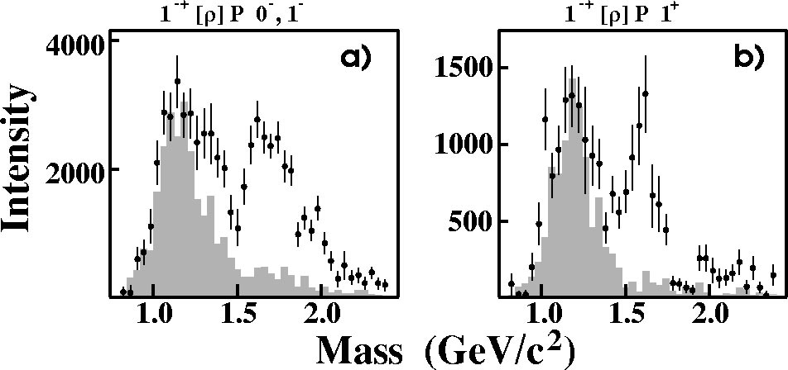
E852 Experiment
Natural-parity exchange: 0⁺,1⁻,2⁺,…
Unnatural-parity exchange: 0⁻,1⁺,2⁻,…
π₁(1600)
Unnatural exchange
Natural exchange
π₁(1600)
M = 1598 ±8+29-47 MeV/c²
Γ = 168±20+150-12 MeV/c²
Leakage from other
partial waves.
Only quote results from the 1⁺ (natural parity) exchange.

Slide 18
COMPASS Experiment
(420,000 Events)
(180 GeV pions)
1 ⁻⁺ Exotic Wave
π₁(1600) m=1660 Γ=269 π₂(1670) m=1658 Γ=271
arXiv:0910.5842
42 Partial waves included, exotic is dominantly 1⁺ production.

Slide 19
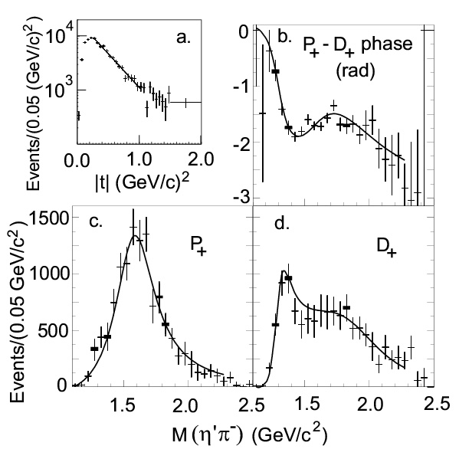
E852 Experiment
Data are dominated by 1⁻⁺, 2⁺⁺ and 4⁺⁺ partial waves.
Data are dominated by natural parity exchange.
π⁻p → η’π⁻p
(~6000 Events)
π₁(1600)
M = 1597±10+45-10 MeV/c²
Γ = 340±40±50 MeV/c²
The exotic wave is the dominant
wave in this channel.

Slide 20
COMPASS
2⁺⁺
Δphase
2⁺⁺ - 1⁻⁺
1⁻⁺

Slide 21
E852 Experiment
(~145,000 Events)
π⁻ p→ωπ⁰π⁻p
π₁(1600)→b₁π
M = 1664±8±10 MeV/c²
Γ = 185±25±38 MeV/c²
Seen in both natural and
unnatural parity exchange.
The unnatural dominates
m^{ε}=0⁻
1⁻⁺b₁π
m^{ε}=1⁺
1⁻⁺b₁π
2⁺⁺ωρ
4⁺⁺ωρ
π₁(2000)→b₁π
M = 2014±20±16 MeV/c²
Γ = 230±32±73 MeV/c²
Seen primarily in natural
parity exchange.
The natural dominates
Δφ(1⁻⁺ - 2⁺⁺)
Δφ(1⁻⁺ - 4⁺⁺)
Δφ(2⁺⁺ - 4⁺⁺)
Solid curves are a two-pole 1⁻⁺ solution.
Dashed curves are a one-pole 1⁻⁺ solution.

Slide 22
E852 Experiment
(~69000 Events)
π⁻ p→ηπ⁺π⁻π⁻p
1⁺⁺f₁π⁻
π₁(1600)→f₁π
M = 1709±24±41 MeV/c²
Γ = 403±80±115 MeV/c²
Natural parity exchange
ΔΦ(1⁻⁺ - 2⁻⁺)
2⁻⁺f₁π⁻
ΔΦ(1⁻⁺ - 1⁺⁺)
π₁(2000)→f₁π
M = 2001±30±92 MeV/c²
Γ = 333±52±49 MeV/c²
Natural parity exchange
1⁻⁺f₁π⁻
ΔΦ(1⁺⁺ - 2⁻⁺)
Black curves are a two-pole 1⁻⁺ solution.
Red curves are a one-pole 1⁻⁺ solution.

Slide 23
Spectroscopy and QCD
Decay Modes
Quarkonium
π₁→ b₁π , f₁π , ρπ , a₁η
η₁→π(1300)π , a₁π, f₁η
b₂ → a₁π , h₁π , ωπ , a₂π
h₂ → b₁π , ρπ , ωη
b₀ → π(1300)π , h₁π
h₀ → b₁π , h₁η
q
q
ρπ πππ 5-10μb
b₁π ωππ 0.2μb
a₂π ηππ 0.2μb
f₁π , η’π 0.1μb
ωπ 1μb
~1000 evts
10⁷ γ/s
If we produce an exotic with a 2 nb cross section over 400 MeV in mass (peak) (20 20MeV-wide bins), we expect about 30000 events per year, or about 1000 events per bin. This is a solid signal for the expected rates.
Notes:
What are gluonic excitations and why are we looking for them? Lattice QCD predictions for the mesons and in particular, a class of mesons with non-quark-antiquark quantum numbers. Also not that mixing angles are predicted. GlueX needs to measure particle J(PC), masses, widths and decay modes to be able to map these out.

Slide 24
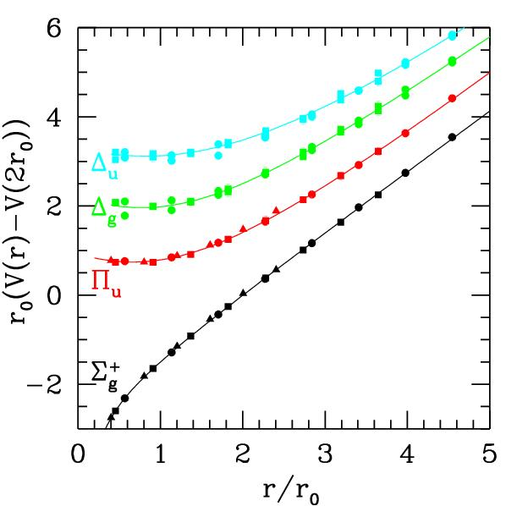
Exotics and QCD
In order to establish the existence of gluonic excitations,
We need to establish the existence and nonet nature of the 1⁻⁺ state.
We need to establish at other exotic QN nonets – the 0⁺⁻ and 2^{+-.}
Decay Patterns are Crucial
Coupled Channel PWA Needed.
Very Large Data Sets Expected
From GlueX
The challenge is carrying out a PWA
with huge statistics and good theoretical
underpinnings to the method.

Slide 25
Other Physics
PrimEx measurement on the η approved in Hall-D.
Rare η decay measurement submitted to PAC 39.
LOI for pion polarizability submitted to PAC 39.
Spectroscopy run focusing on the strange-onium part of the hybrid sector submitted to PAC 39.
We would love to have other ideas as well! We are happy to work with people to develop new ideas.

Slide 26
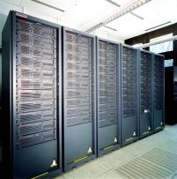

Conclusions
The quest to understand confinement
and the strong force is starting to make
great leaps forward.
Advances in theory and computing have
allowed us to start to understand the
meson spectrum and the role of glue.
Definitive experiments to confirm or refute our expectations on the role of glue are under construction with data expected in 2015.
The synchronized advances in LQCD and experiment will allow us to understand the role of glue in QCD and confinement.

