Slide 1
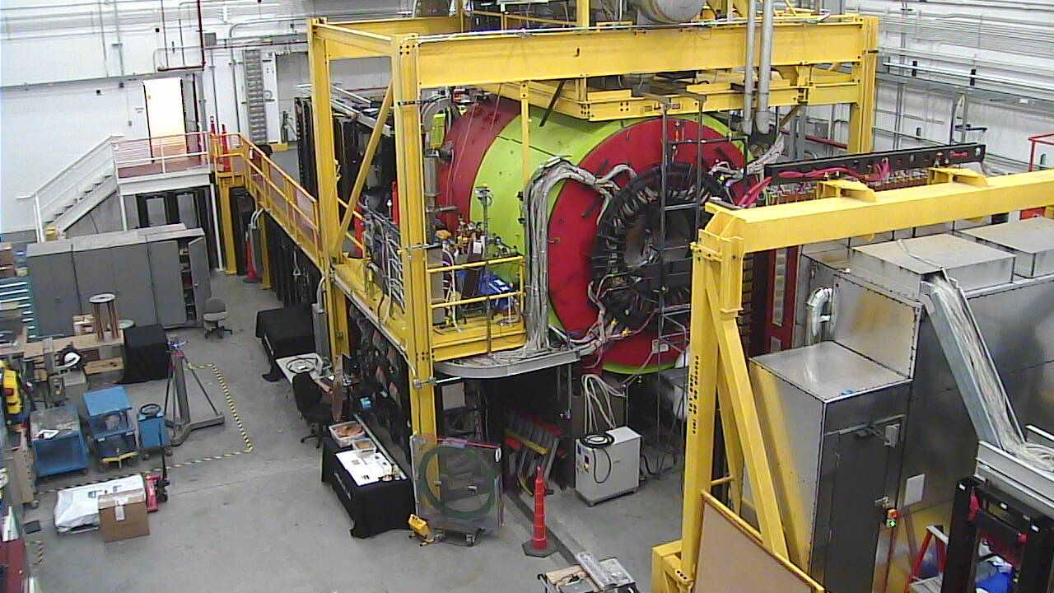
Physics in Hall-D
Curtis A. Meyer, GlueX Spokesperson
Athens University, Arizona State University, Carnegie Mellon University, Catholic University, Christopher Newport University, University of Connecticut, Florida International University, Florida State University, University of Glasgow, Indiana University, ITEP Moscow, Jefferson Lab, University of Massachusetts Amherst, Massachusetts Institute of Technology, MEPHI, Norfolk State University, University of North Carolina A&T, University of North Carolina Wilmington, Northwestern, University T`ecnica Federico Santa Mari’a, University of Regina and Yerevan Physics Institute.

Slide 2
Outline
QCD and Gluonic Excitations
Hybrid Mesons in GlueX/Hall D.
The Long Road to Physics in Hall D.
The Status of the GlueX Detector and Tagger.
Preparations for Running in Hall D.
Preparations for Processing GlueX Data.
Preparing for Physics Analysis.
Summary.

Slide 3
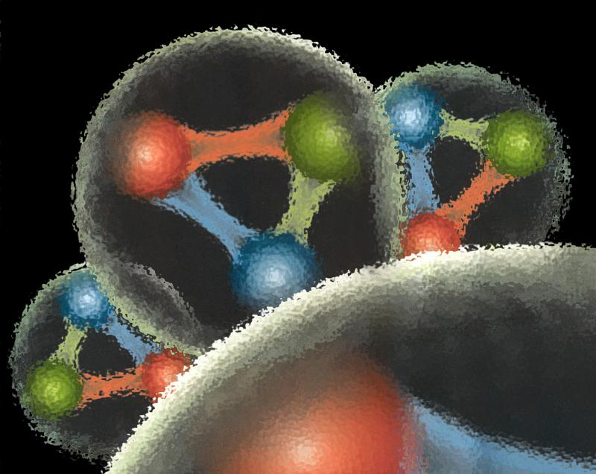
Quantum Chromo Dynamics
QCD describes the interactions of quarks and gluons and should predict the spectrum of bound-state baryons ( ) and mesons ( ).
There should also be mesons in which the gluonic field contributes directly to the J^{PC} quantum numbers of the states --- hybrid mesons. Some are expected to have ``exotic’’ quantum numbers.
Lattice QCD calculation of the light-quark meson spectrum
2.5Gev
2.0GeV
Exotic QN
0⁺⁻
1⁻⁺
2⁺⁻
Normal QN
Several nonets predicted
Notes:
What are gluonic excitations and why are we looking for them? Lattice QCD predictions for the mesons and in particular, a class of mesons with non-quark-antiquark quantum numbers. Also not that mixing angles are predicted. GlueX needs to measure particle J(PC), masses, widths and decay modes to be able to map these out.

Slide 4
Lattice QCD Meson Spectrum
States with non-trivial gluonic fields.
1⁻⁻, 0⁻⁺ , 1⁻⁺ , 2⁻⁺

Slide 5
Quantum Chromo Dynamics
QCD describes the interactions of quarks and gluons and should predict the spectrum of bound-state baryons ( ) and mesons ( ).
There should also be mesons in which the gluonic field contributes directly to the J^{PC} quantum numbers of the states --- hybrid mesons. Some are expected to have ``exotic’’ quantum numbers.
Lattice QCD calculation of the light-quark meson spectrum
2.5Gev
2.0GeV
Exotic QN
0⁺⁻
1⁻⁺
2⁺⁻
Normal QN
Several nonets predicted
Notes:
What are gluonic excitations and why are we looking for them? Lattice QCD predictions for the mesons and in particular, a class of mesons with non-quark-antiquark quantum numbers. Also not that mixing angles are predicted. GlueX needs to measure particle J(PC), masses, widths and decay modes to be able to map these out.

Slide 6
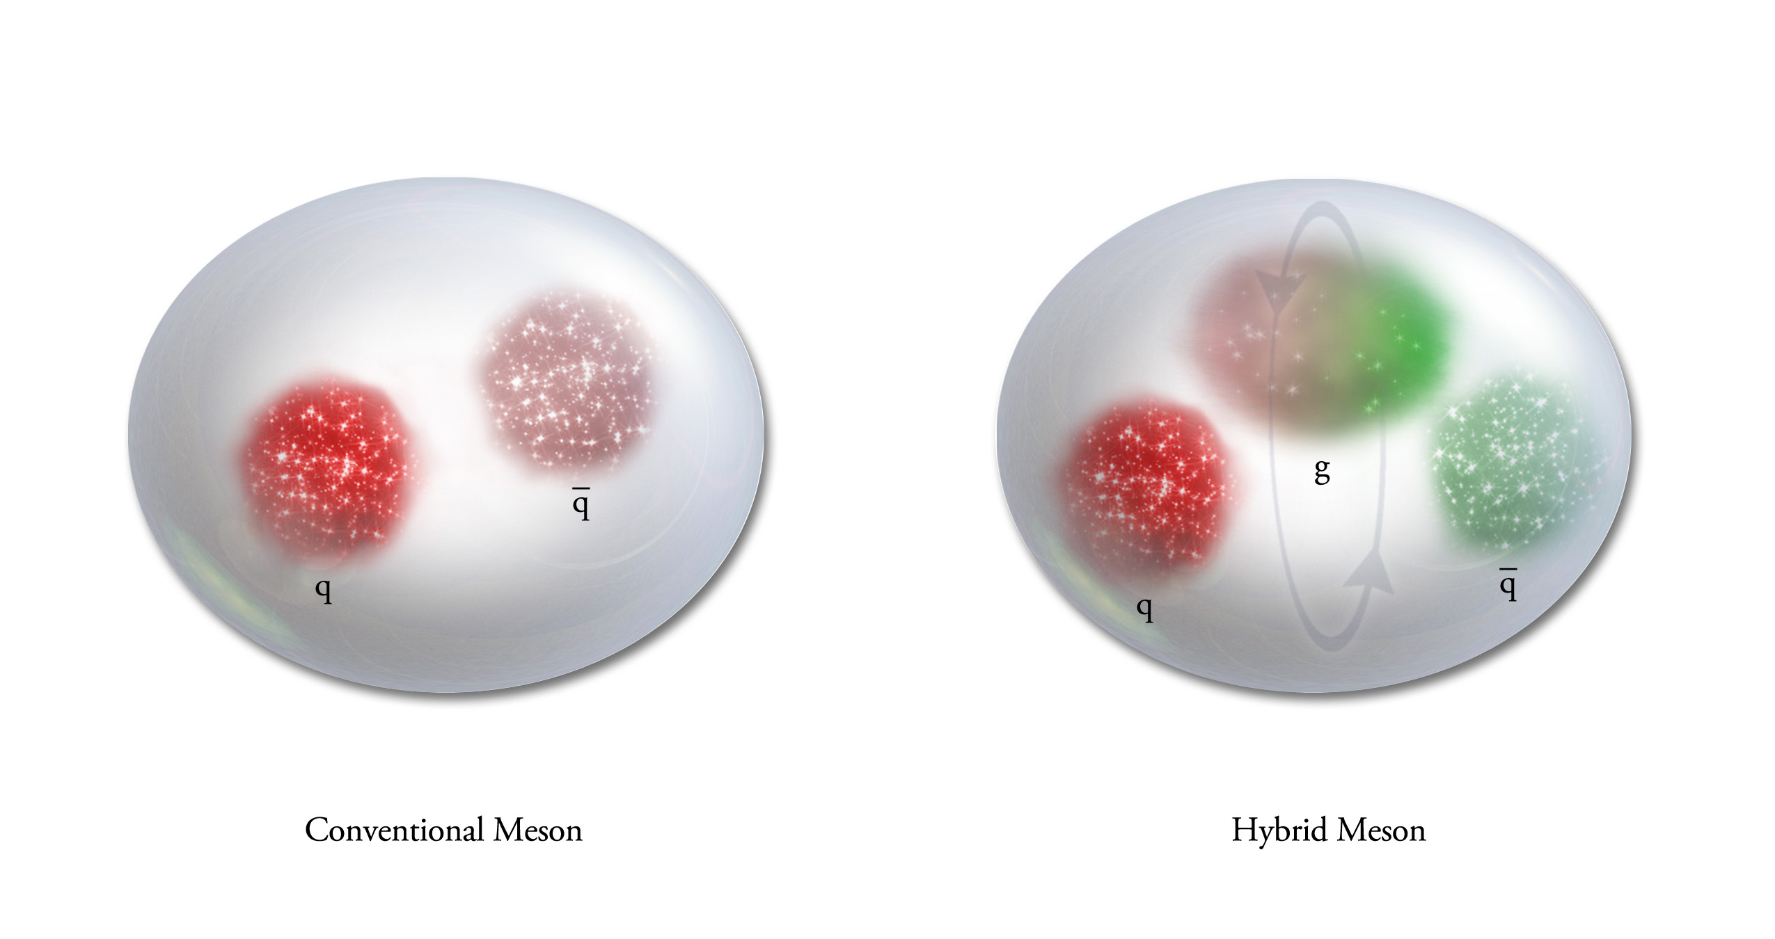
QCD Exotics
We expect 5 nonets of exotic-quantum-number mesons:
1 nonet of 0⁺⁻ exotic mesons
2 nonets of 1⁻⁺ exotic mesons
2 nonets of 2⁺⁻ exotic mesons
Lattice shows two nonets here.
Experimental evidence exists for π₁ states.
π₁ I^{G}(J^{PC})=1⁻(1⁻⁺)
K₁ I^{G}(J^{PC})= ½ (1⁻)
η’₁ I^{G}(J^{PC})=0⁺(1⁻⁺)
η₁ I^{G}(J^{PC})=0⁺(1⁻⁺)

Slide 7
Finding the States?
Lattice QCD suggest where to look for exotic states:
Models suggest how the states should fall apart
π₁→ πb₁ , πf₁, πρ, ηa₁, πη’
η₁→π(1300)π, a₁π, ηf₁, ηη’
b₂ → f₁ρ, a₁π, h₁π, b₁η, ωπ, a₂π, ρη
h₂ → b₁π, ρπ, ωη, f₁ω
b₀ → π(1300)π , h₁π, f₁ρ, b₁η
h₀ → b₁π , h₁η
L_{flux}
L_{flux}
Populate final states with
π±,π⁰,K±,K⁰,η, (photons)

Slide 8
Finding the States?
Lattice QCD suggest where to look for exotic states:
Models suggest how the states should fall apart
π₁→ πb₁ , πf₁, πρ, ηa₁, πη’
η₁→π(1300)π, a₁π, ηf₁, ηη’
b₂ → f₁ρ, a₁π, h₁π, b₁η, ωπ, a₂π, ρη
h₂ → b₁π, ρπ, ωη, f₁ω
b₀ → π(1300)π , h₁π, f₁ρ, b₁η
h₀ → b₁π , h₁η
L_{flux}
L_{flux}
Populate final states with
π±,π⁰,K±,K⁰,η, (photons)

Slide 9
Physics in
8.4-9.0 GeV linearly polarized photons from 12 GeV electrons in a thin diamond wafer
Charged particle tracking + timing and photon detection in a 2T magnetic field.
All of these channels have been studied in Monte Carlo to understand the acceptance.
These studies have been used to ``stress’’ our offline reconstruction software.
Fully reconstruct final states
Notes:
Coherent bremsstrahlung beam with linearly polarized (40%) photons and the GlueX detector to search for exotics. The detector is a nearly hermetic detector for charged particles and photons in a 2.2T magnetic field. The expected reaction is the photo production of some meson X which then decays. Typical decay chains for a some exotic states are shown, and the final states that they yield. GlueX needs to reconstruct complete final states to carry out amplitude analysis.

Slide 10
Amplitude Analysis
Describe the process of producing a particular final state as a set of possible amplitudes :
E.g.
Build a total amplitude by coherently summing all the individual amplitudes. This total amplitude yields a probability that the given sum describes a particular event ``k’’.
is a normalization factor and
are complex coefficients.
Form the likelihood and then minimize the natural log of it with respect
to the . This is a CPU-intensive problem
that we have found scales very well on
graphical processor units (GPUs). To do this requires the four-vectors of all events plus a comparable Monte Carlo data sample to do the normalization.
Notes:
An amplitude analysis uses a physics amplitude to describe a process that connects the initial and final states. Several such processes may be possible, and the resulting amplitude is a coherent sum of all of these. The resulting amplitude can be used to evaluate the probability that a given event comes from the particular amplitude. A likelihood is formed as a product of these probabilities, which is turned into a sum by taking the logarithm. This log likelihood I then minimized with respect to the complex a’s.

Slide 11
The Long Road
Jul. 1997 – Workshop at Indiana University
Dec. 1999 – External Project Review
Apr. 2004 – Critical Decision 0
Oct. 2004 – External Detector Review
Oct. 2008 – Critical Decision 3
Apr. 2009 – Hall-D Complex Ground Breaking
Jan. 2012 – Beneficial Occupancy of Hall D
May 2014 – 10.5 GeV electron beam to tagger dump.
Oct. 2014 – Photon beam to GlueX.
Apr. 2015 – Engineering/Physics Running with GlueX.
Sep. 2015 – Physics Running with GlueX!
18 Years

Slide 12
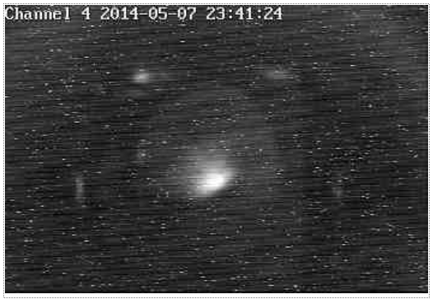
The Long Road
Jul. 1997 – Workshop at Indiana University
Dec. 1999 – External Project Review
Apr. 2004 – Critical Decision 0
Oct. 2004 – External Detector Review
Oct. 2008 – Critical Decision 3
Apr. 2009 – Hall-D Complex Ground Breaking
Jan. 2012 – Beneficial Occupancy of Hall D
May 2014 – 10.5 GeV electron beam to tagger dump.
Oct. 2014 – Photon beam to GlueX.
Apr. 2015 – Engineering/Physics Running with GlueX.
Sep. 2015 – Physics Running with GlueX!
18 Years

Slide 13
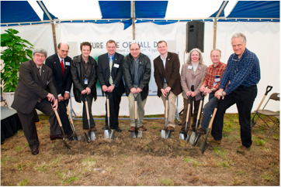
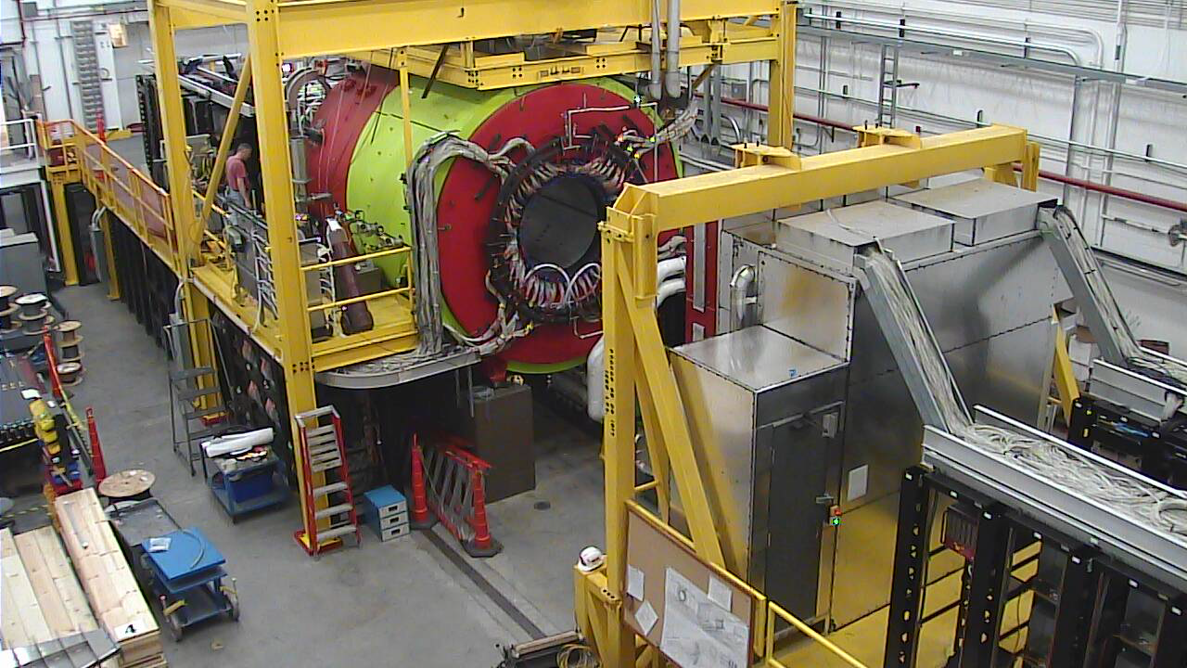
The Experimental Hall
Construction of Hall-D broke ground
April 2009.
Experimental Hall D
May 19, 2014.

Slide 14
The GlueX Experiment

Slide 15
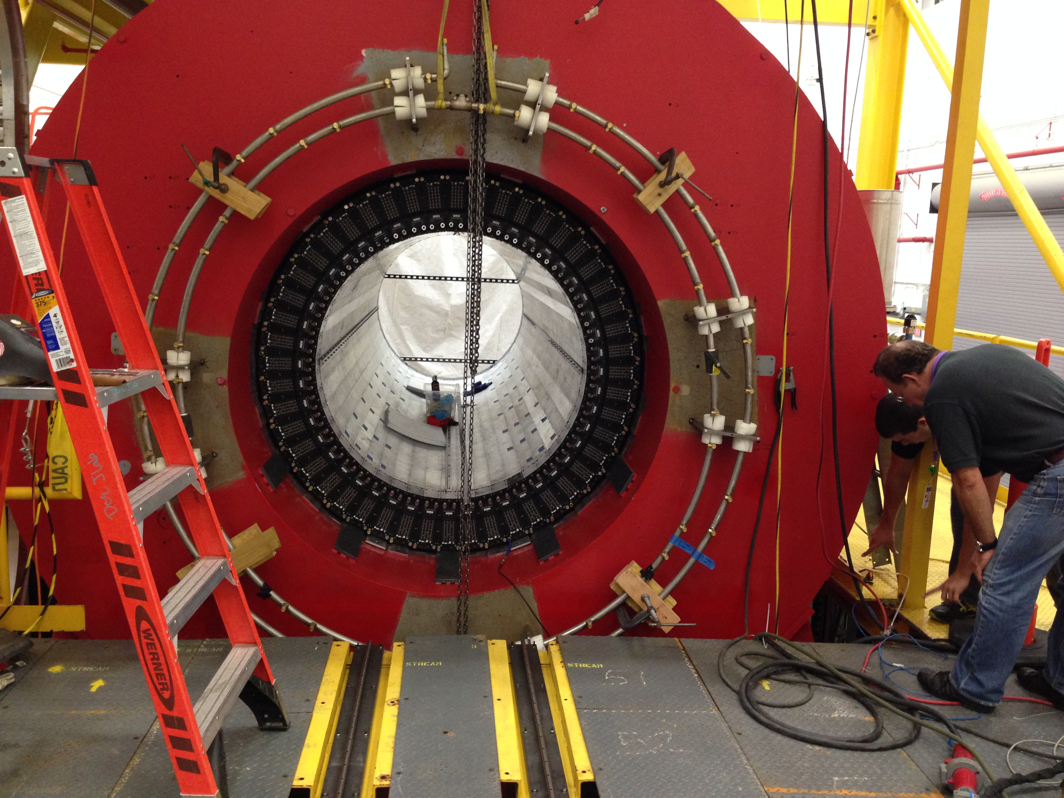
Hall-D Solenoid
Magnetic field was mapped in 2013. Refrigerator is being refurbished.
Ready to run at 1350A in fall 2014 (2 T magnetic field).

Slide 16
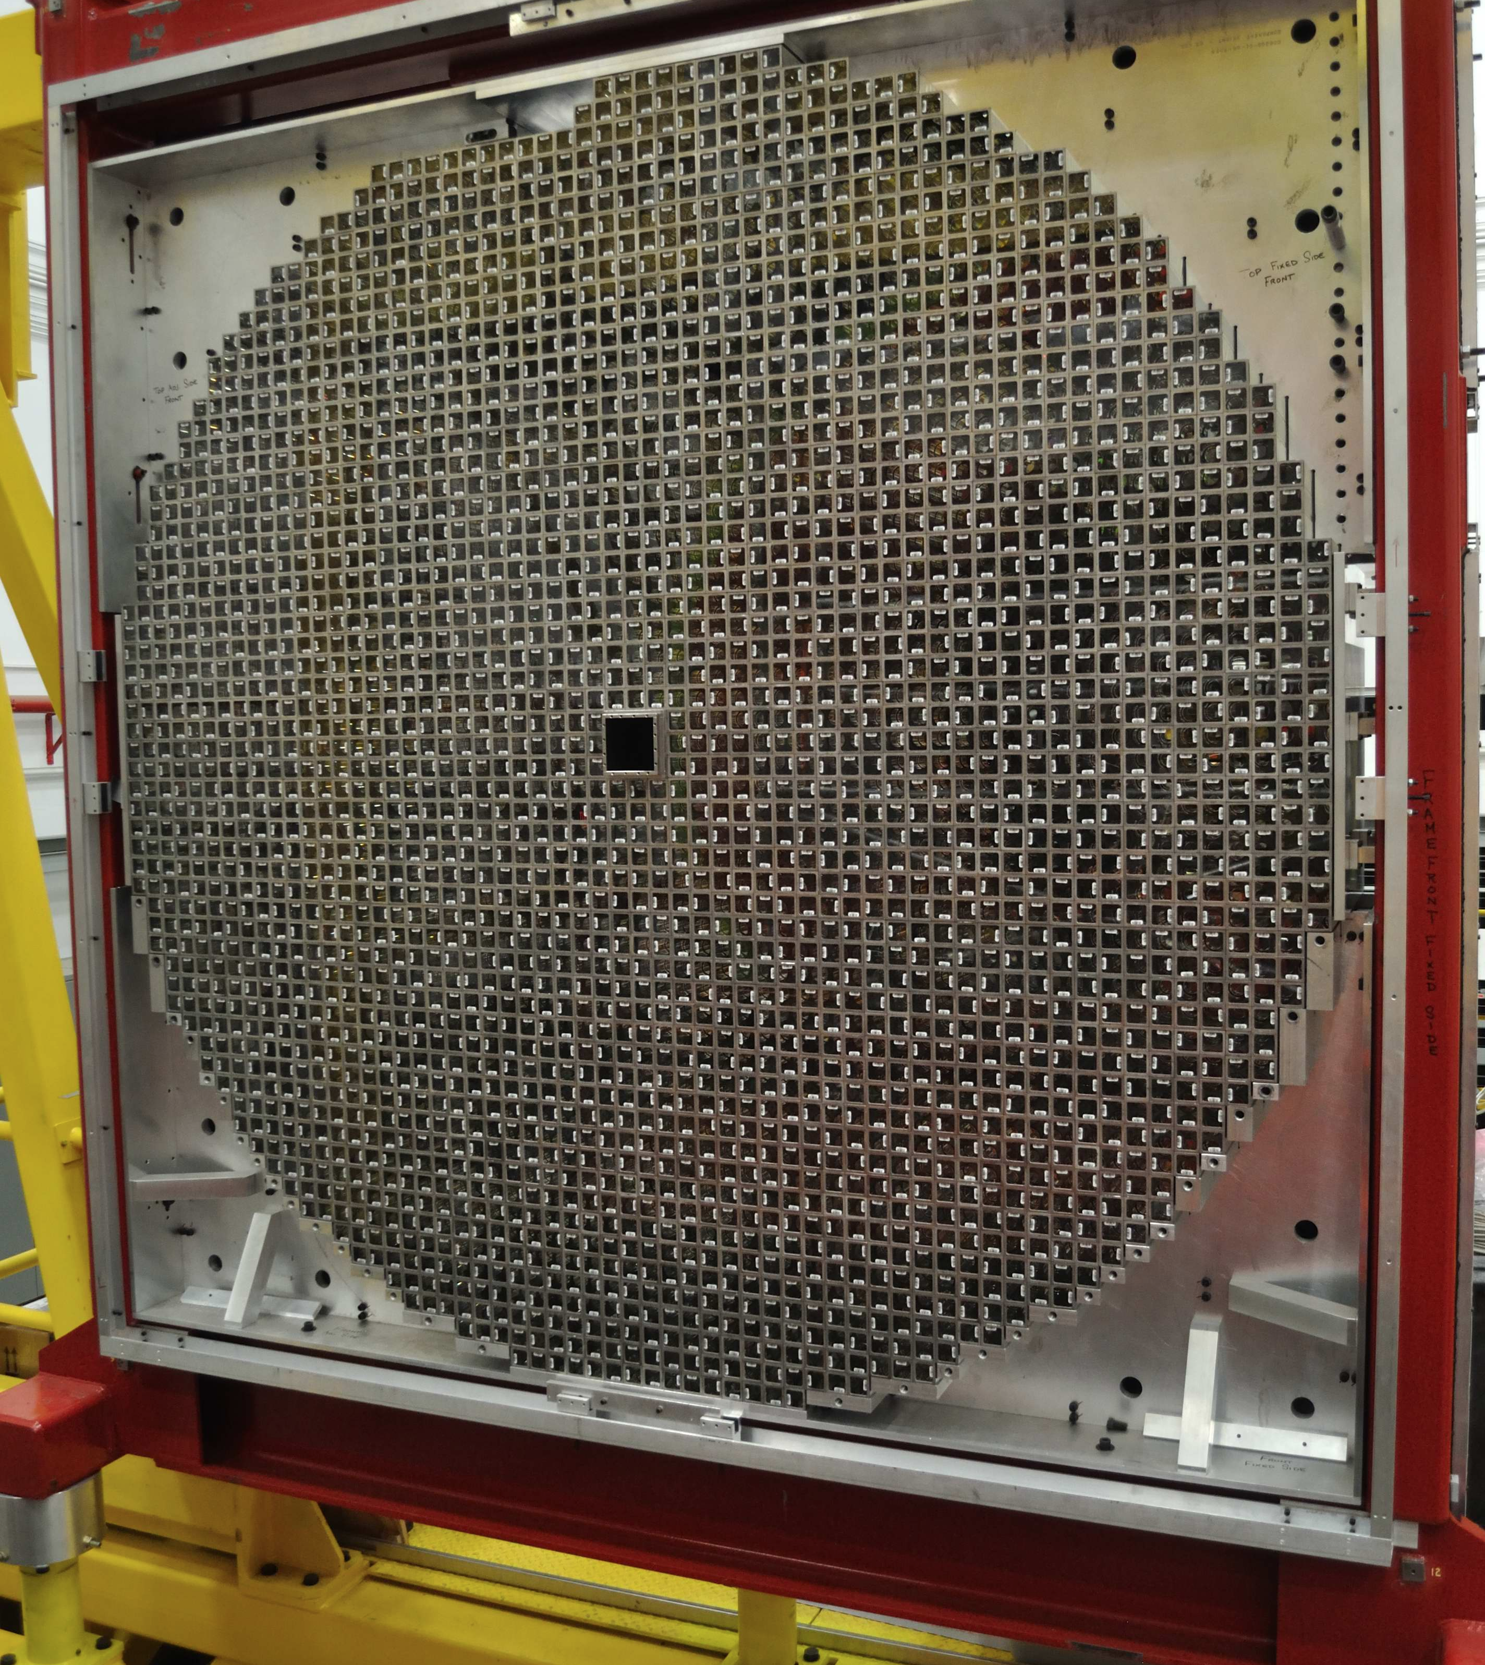
The Forward Calorimeter
Nearly 2800 lead-glass blocks with phototube readout.
The first GlueX detector to be fully installed and read out.
Ready for beam in fall 2014.

Slide 17
Cosmic Events in the FCAL
Trigger generated from OR of 2 scintillators (120 cm x 20 cm each) on top AND OR of 2 scintillators below detector
Trigger rate 1 Hz

Slide 18
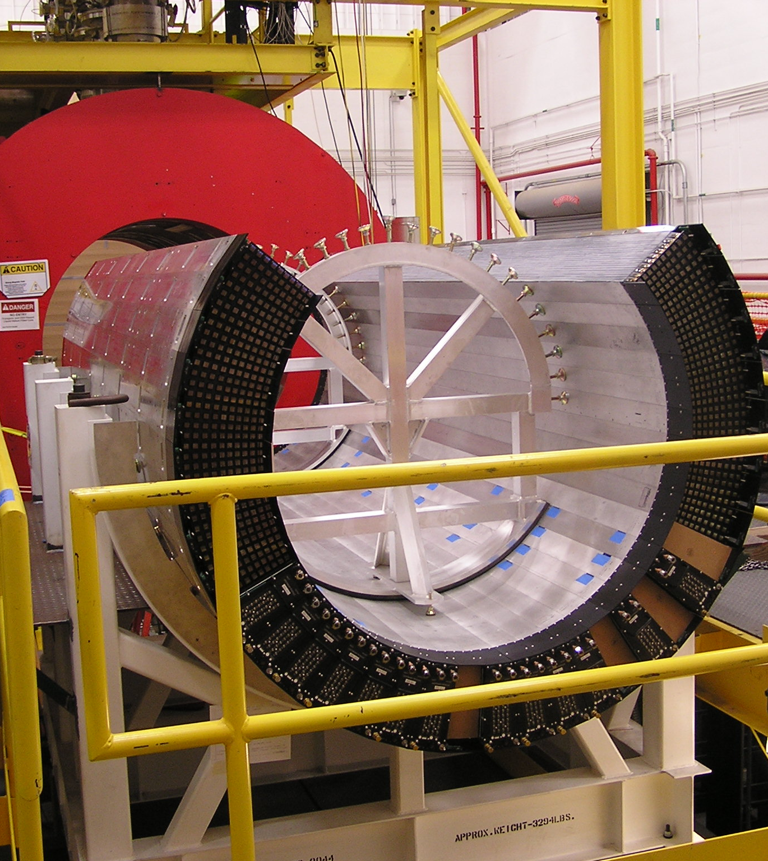
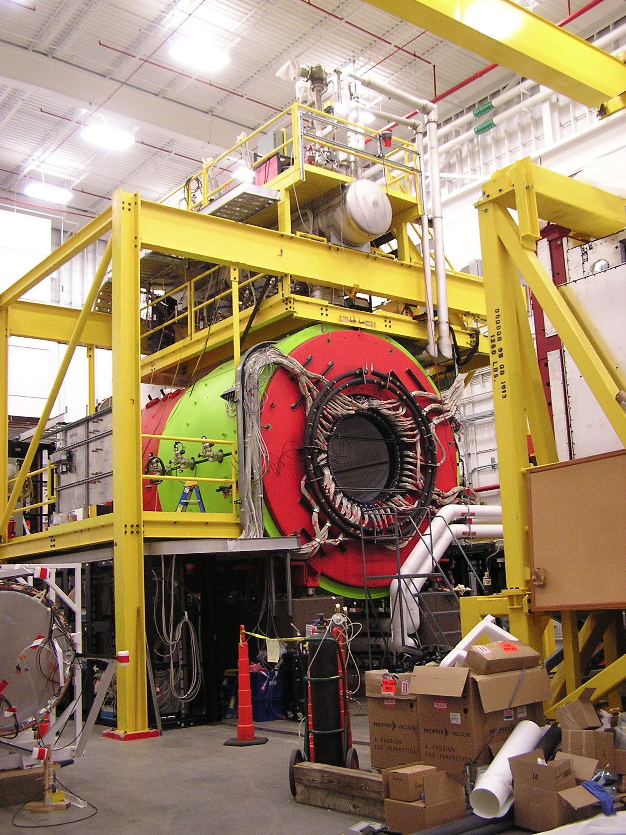
The Barrel Calorimeter
Fully installed and connected, collecting cosmic data. Ready for beam in fall 2014.

Slide 19
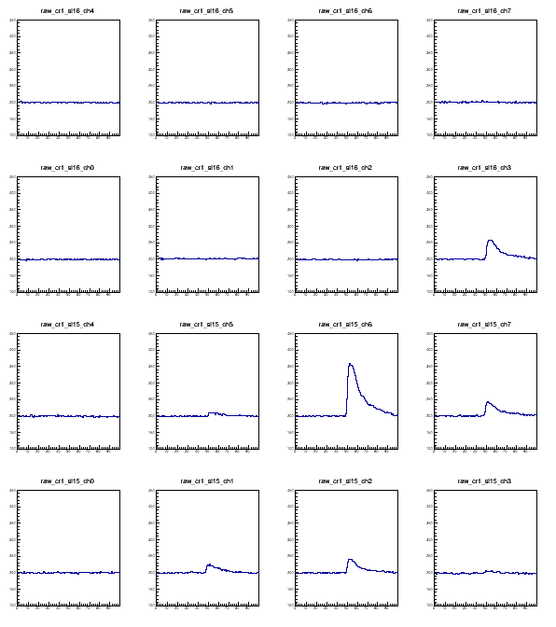
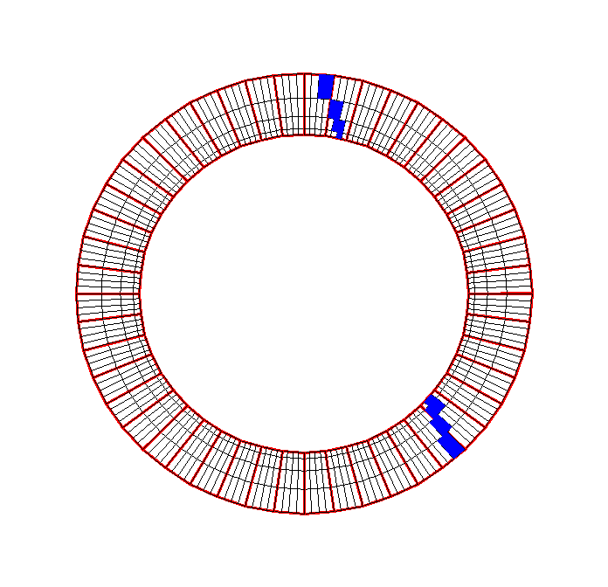
Cosmic Events in the BCAL
upstream (module 30)
Layer 4
ADC amplitude
Run 405, event 8
Layer 3
BCAL upstream
12
North
South
Layer 2
Layer 1
downstream (module 30)
1
24
Layer 4
Layer 3
Trigger: module 30
Layer 2
36
Layer 1
ADC samples

Slide 20
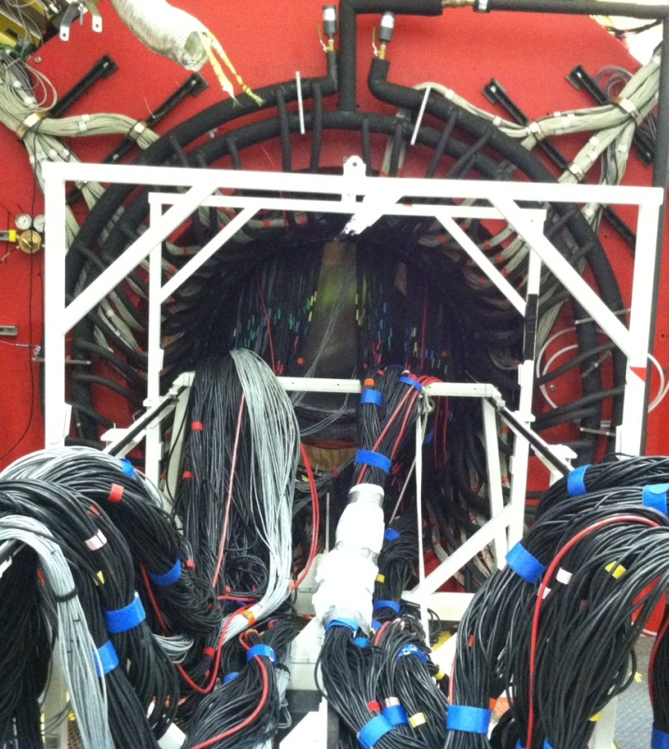
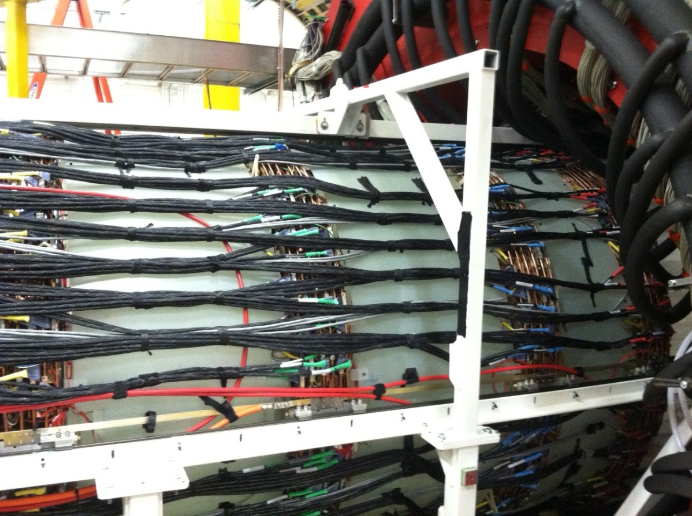
The Forward Drift Chamber
Fully installed and cabled, starting to collect cosmic data. Ready for beam in fall 2014.

Slide 21
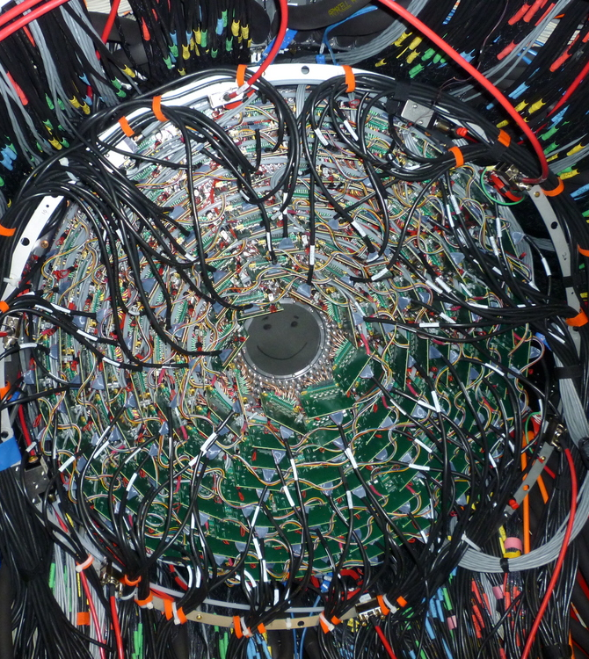
The Central Drift Chamber
Fully installed and connected . Collecting cosmic data for alignment studies this summer.
Ready for beam in fall 2014.

Slide 22
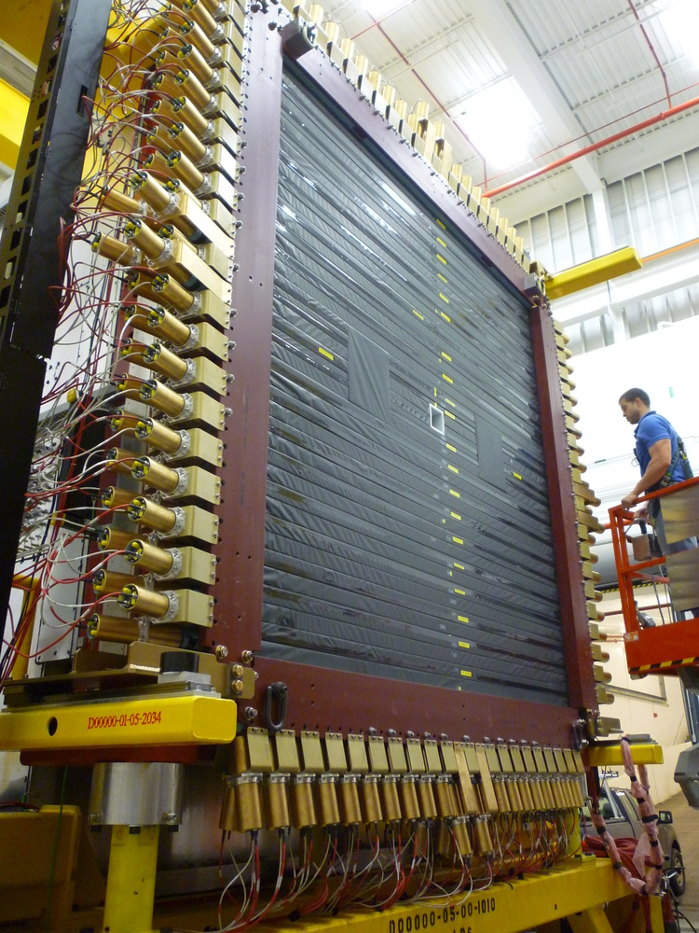
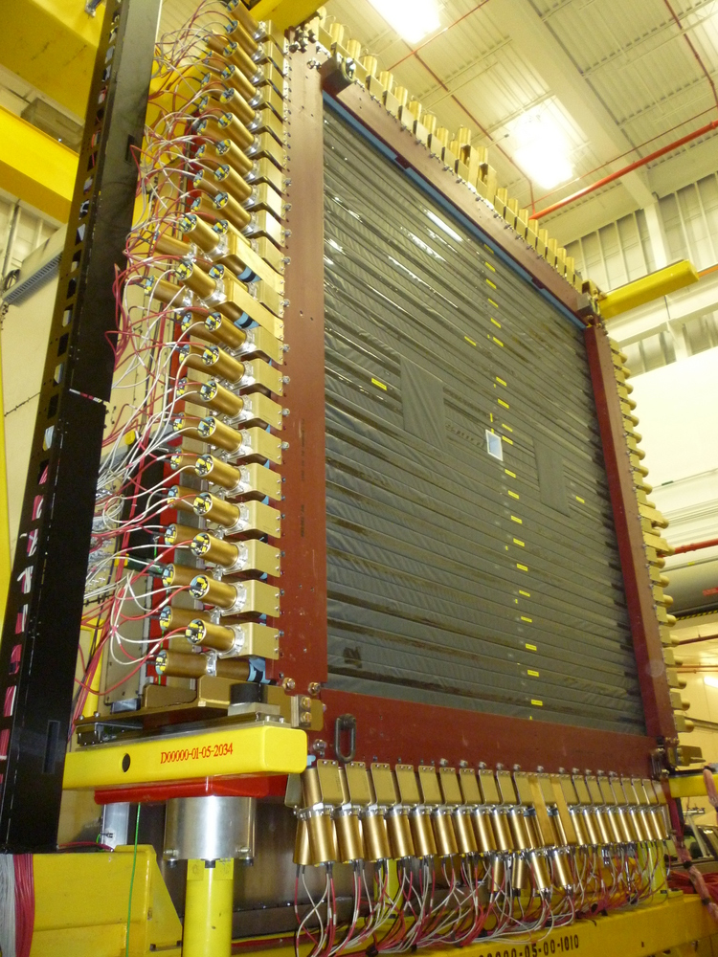
The Time-of-flight Wall
Fully installed and connected. Collecting cosmic data during the summer of 2014.
Ready for beam in fall 2014.

Slide 23
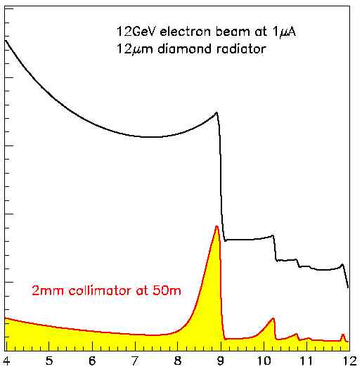
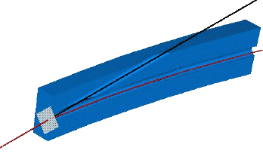
Coherent Bremsstrahlung
12 GeV electrons
This technique provides requisite energy, flux and polarization
Incoherent &
coherent spectrum
flux
40%
polarization
in peak
Linearly polarized
photons out
electrons in
collimated
spectrometer
20 μm thick
Diamond crystal
photon energy (GeV)
tagged
with 0.1% resolution

Slide 24
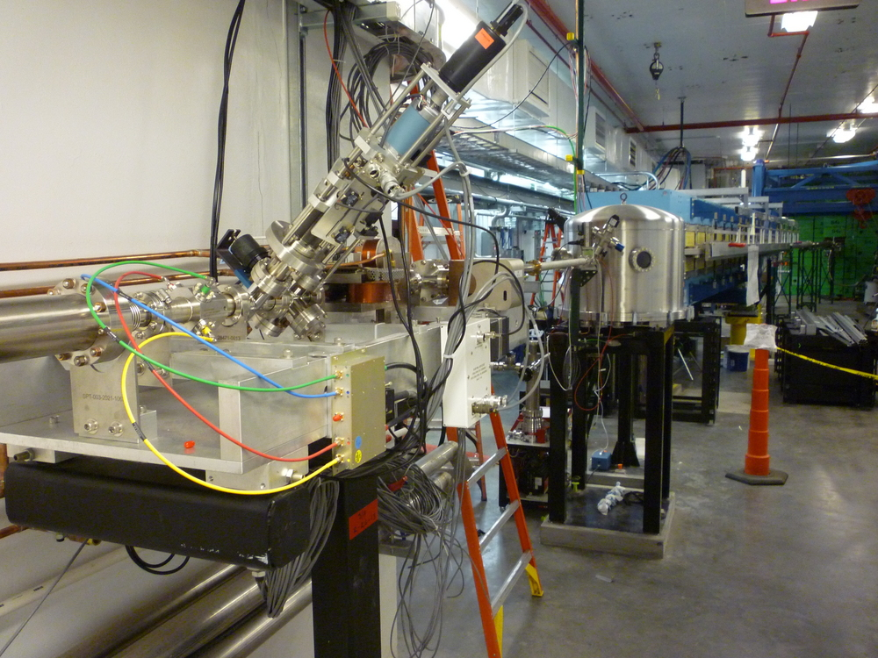
The Tagger Hall and Photon Beam
The tagger magnet has been installed and mapped.
The pair spectrometer magnet has been installed and mapped.
The tagger microscope is a fine-grain tagger array that covers the coherent peak with excellent energy resolution.
Tagger hodoscope array provides coarser energy coverage over full photon energy range.
Ready for beam in fall of 2014.

Slide 25
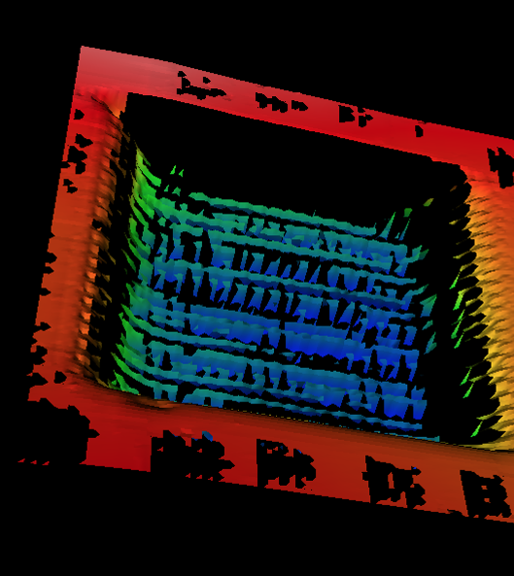
Diamond Radiator
Linearly polarized photons are produced via coherent bremsstrahlung by a 12 GeV electron beam going through a 20-micron thick diamond.
The UCONN group can laser-ablate 200-300 micron thick diamonds to 25 microns thick in a picture-frame pattern.
Diamonds available for physics running in 2015.

Slide 26
GlueX Running
Phased Running: Event Rates Data Volume Yearly Data Storage
Phase Rate Year E_{e} Raw DST Raw DST Raw DST
γ/s GeV kHz kHz MB/s MB/s PB PB
I 10⁶ 2014 10 2 0.1 30 1.5 0.1 0.1
II 10⁷ 2015 11 20 1 300 15 0.8 0.2
III 10⁷ 2015 12 20 2 300 30 1.6 0.2
IV 5 10⁷ 2016 12 20 10 300 150 1.6 1.0
Data formats are defined and implemented with the design goal of minimizing the data foot print of reconstructed (REST) data.
EVIO Raw Data 15kbyte/evt.
REST DST Data ~2kbyte/evt. (Fine tuning with feedback from analysis.)
PART Physics Analysis (root tree).
Calibration and alignment efforts are ongoing with cosmic events, and preparations are being made for the beam in Fall 2014.
Notes:
This is the flow-diagram for GlueX software. Will see a variant of this repeated throughout the talk. Describe the three phases of
Running in our approved beam time. Phase I and II are essentially engineering runs with the first dedicated physics run in phase III. We of course hope to get physics out of phase II running.

Slide 27
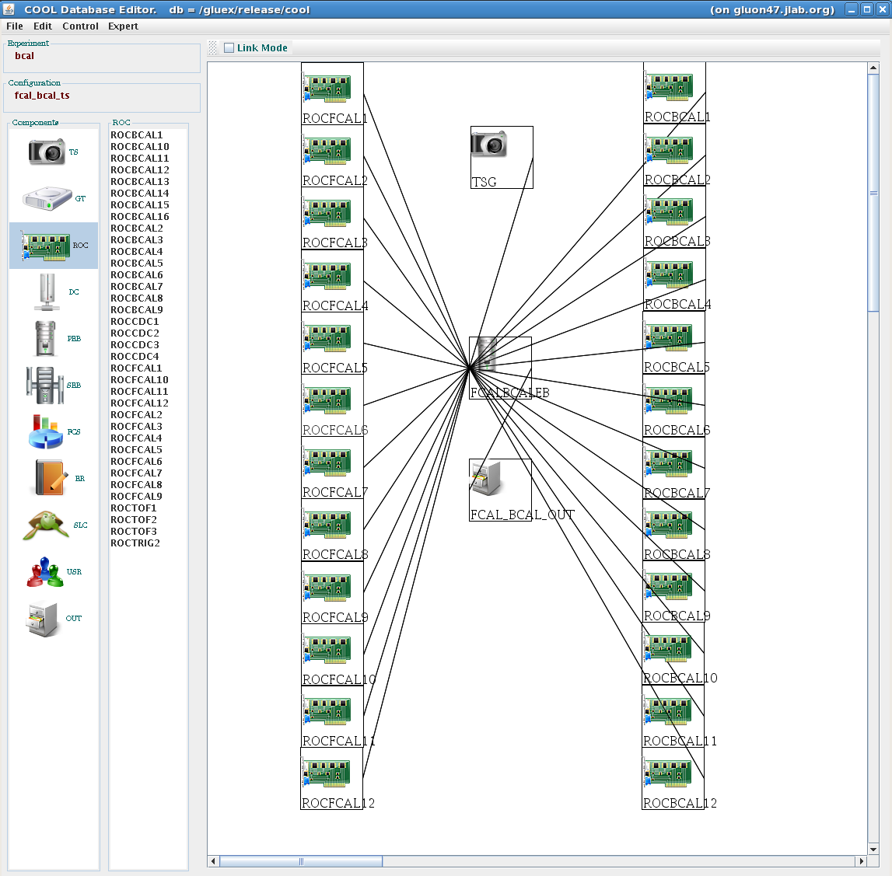
The Hardware Trigger
Global Trigger
Distribution
Triggers distributed
from TS to
12 FCAL and
12 BCAL crates.
25 crates in the setup
Check trigger/sync
alignment
Ready to take data in fall 2014.

Slide 28
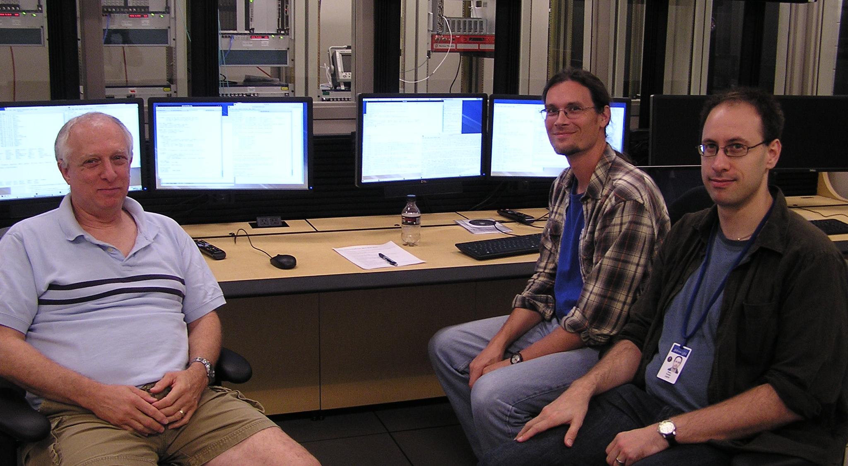
Online Data Challenges
August 2013:
Test online system.
Injection at event builder.
Write data to tape.
Test monitoring at all phases.
Test Level-3 Trigger.
Summer 2014:
Injection into ROC on crates.
Build events.
Write data to tape.
Test monitoring at all phases.
Test Level-3 Trigger.
On going:
Read out cosmic events.

Slide 29
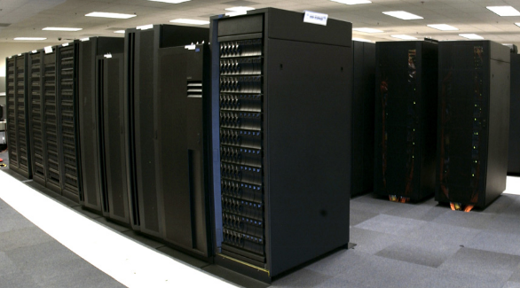
Large-scale Data Challenges
December 2012: 5 x10⁹ Events
E_{γ} -- Only in the coherent peak.
No EM backgrounds
Approximately 3 months of physics from Phase-III running (1.4 kHz).
April 2014: 9 x 10⁹ Events
E_{γ} – 7GeV to the end point.
Full EM background for both phase-III and Phase-IV running.
Approximately 3 months of physics from Phase-III running (1.4 kHz).
JLab: 4500 concurrent jobs.
OSG: 11000 concurrent jobs.
Also at MIT, CMU and FSU
15TB of data via srm copy.
Job success rate > 99%

Slide 30
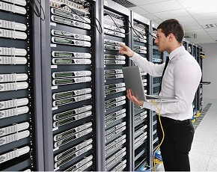
Workflow Tools
We are working with the Jefferson Lab IT division to implement workflow tools.
Such an effort requires close coordination with the experimental efforts.
Timeline of Production Data Challenges to Stress Workflow at JLab
Simulation and Reconstruction
Production from Tape
~100 jobs @ JLab December 2012
~500 jobs @ JLab October 2013
~5000 jobs @ Jlab Spring 2014
DONE
Preload EVIO data to tape.
~500 cores @ Jlab Summer 2014
~5000 cores @ JLab by Fall 2014

Slide 31
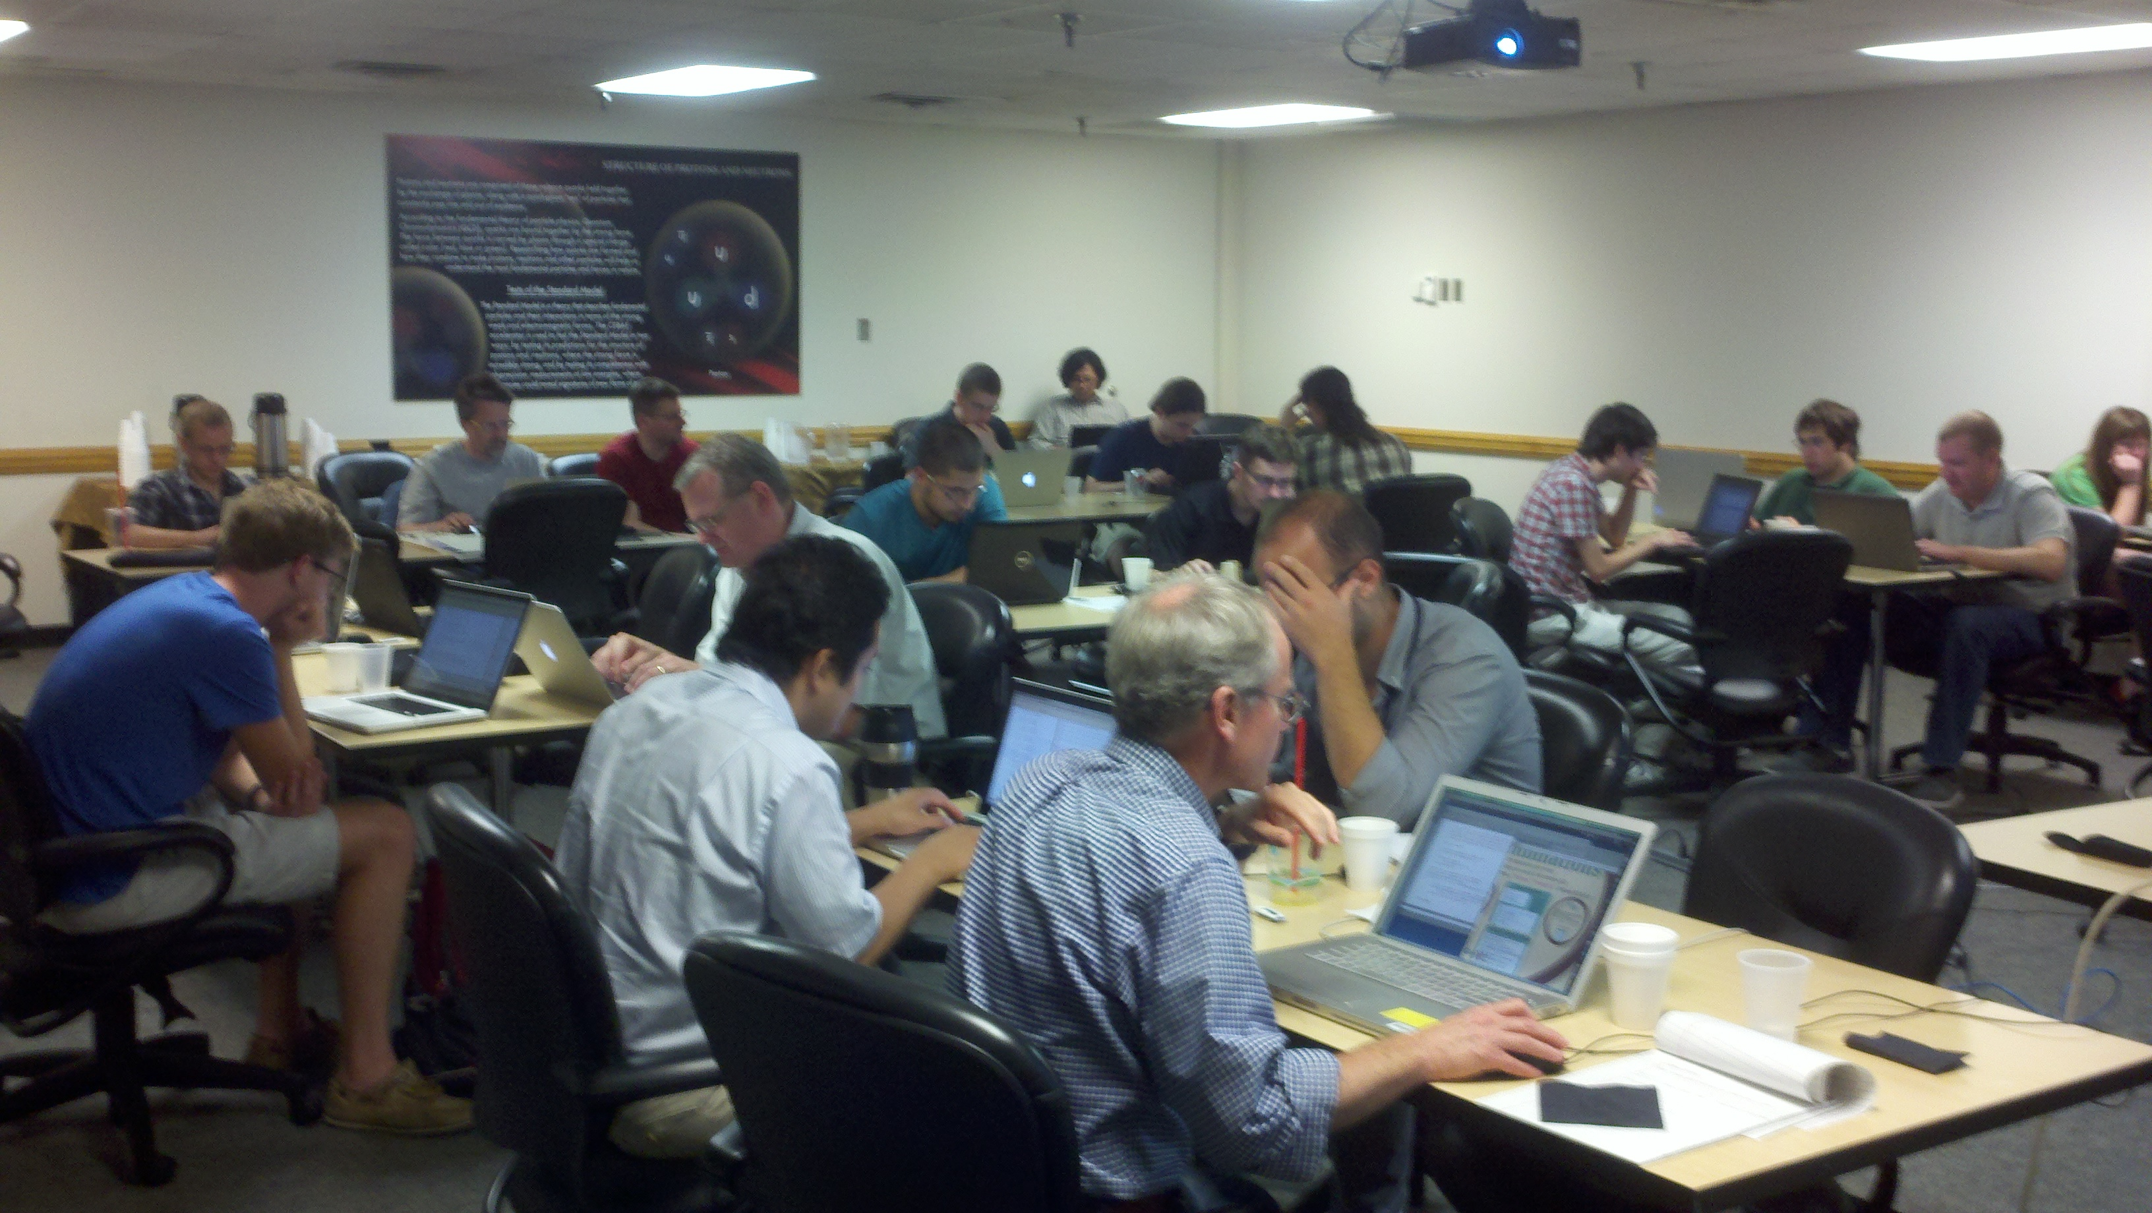
July 2013 Software Workshop
2-day long workshop held at JLab with a video broadcast. Over 30 participants.
Event generation
Background simulation
Simulation with HDGEANT
Reconstruction (JANA)
Event Selection
Multivariate Analysis
Amplitude Analysis
95% purity
~22% efficiency
https://halldweb1.jlab.org/wiki/index.php/GlueX_Analysis_Workshop_2013

Slide 32
Physics Analysis
To be ready to do physics on day one, analyses need to be worked out in advance using the full suite of GlueX/Hall-D software and data from our large-scale data challenges.
Physics reactions of interest:
Prove we understand the detector
Initial exotic hybrid searches
Strange Baryons
Activity in the physics working group is beginning to shift to full-scale analyses
The analysis software is deployed and the large-scale data challenges provide the input to fully develop physics analyses in GlueX/Hall-D.

Slide 33
Physics Analysis
To be ready to do physics on day one, analyses need to be worked out in advance using the full suite of GlueX/Hall-D software and data from our large-scale data challenges.
Physics reactions of interest:
Prove we understand the detector
Initial exotic hybrid searches
Strange Baryons
Activity in the physics working group is beginning to shift to full-scale analyses
Good statistics with 30 days of beam.
The analysis software is deployed and the large-scale data challenges provide the input to fully develop physics analyses in GlueX/Hall-D.

Slide 34
Summary
After 17 years, we are on the verge of physics in Hall D using the GlueX detector.
Starting now to commission and calibrate with cosmic events.
The data acquisition and triggers will be ready for the detector to take commissioning beam in fall of 2014.
Offline software is tested and deployed for physics analysis.
Physics analysis will be ready to start in 2015.
The GlueX graduate students can now see their thesis data around the corner.

