Slide 1
Analysis Plans for the GlueX Experiment
Curtis A. Meyer
Carnegie Mellon University
Notes:
25 + 5 Presentation ….

Slide 2
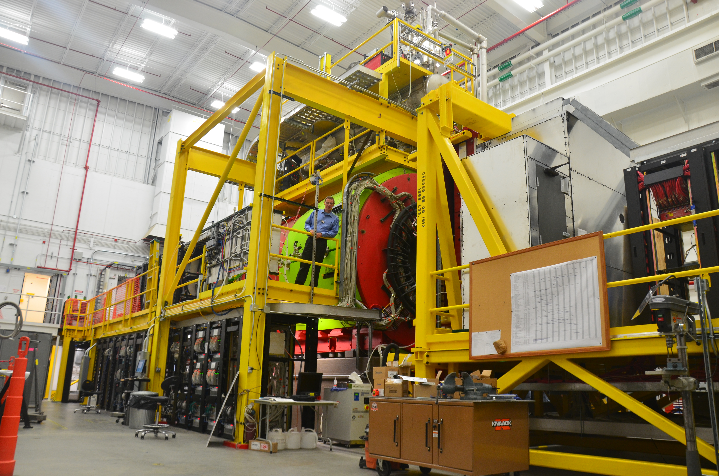
Outline
The GlueX Experiment.
Exotic Hybrid Mesons.
Reactions of Interest.
GlueX Timelines.
Approaches to Analysis.

Slide 3
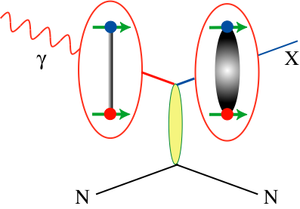
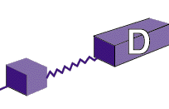
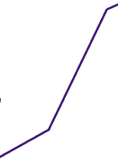

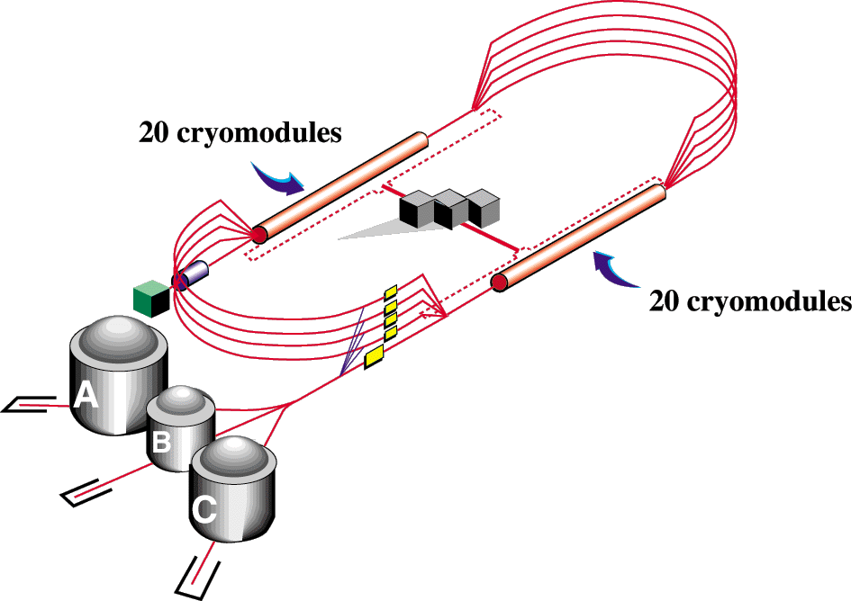

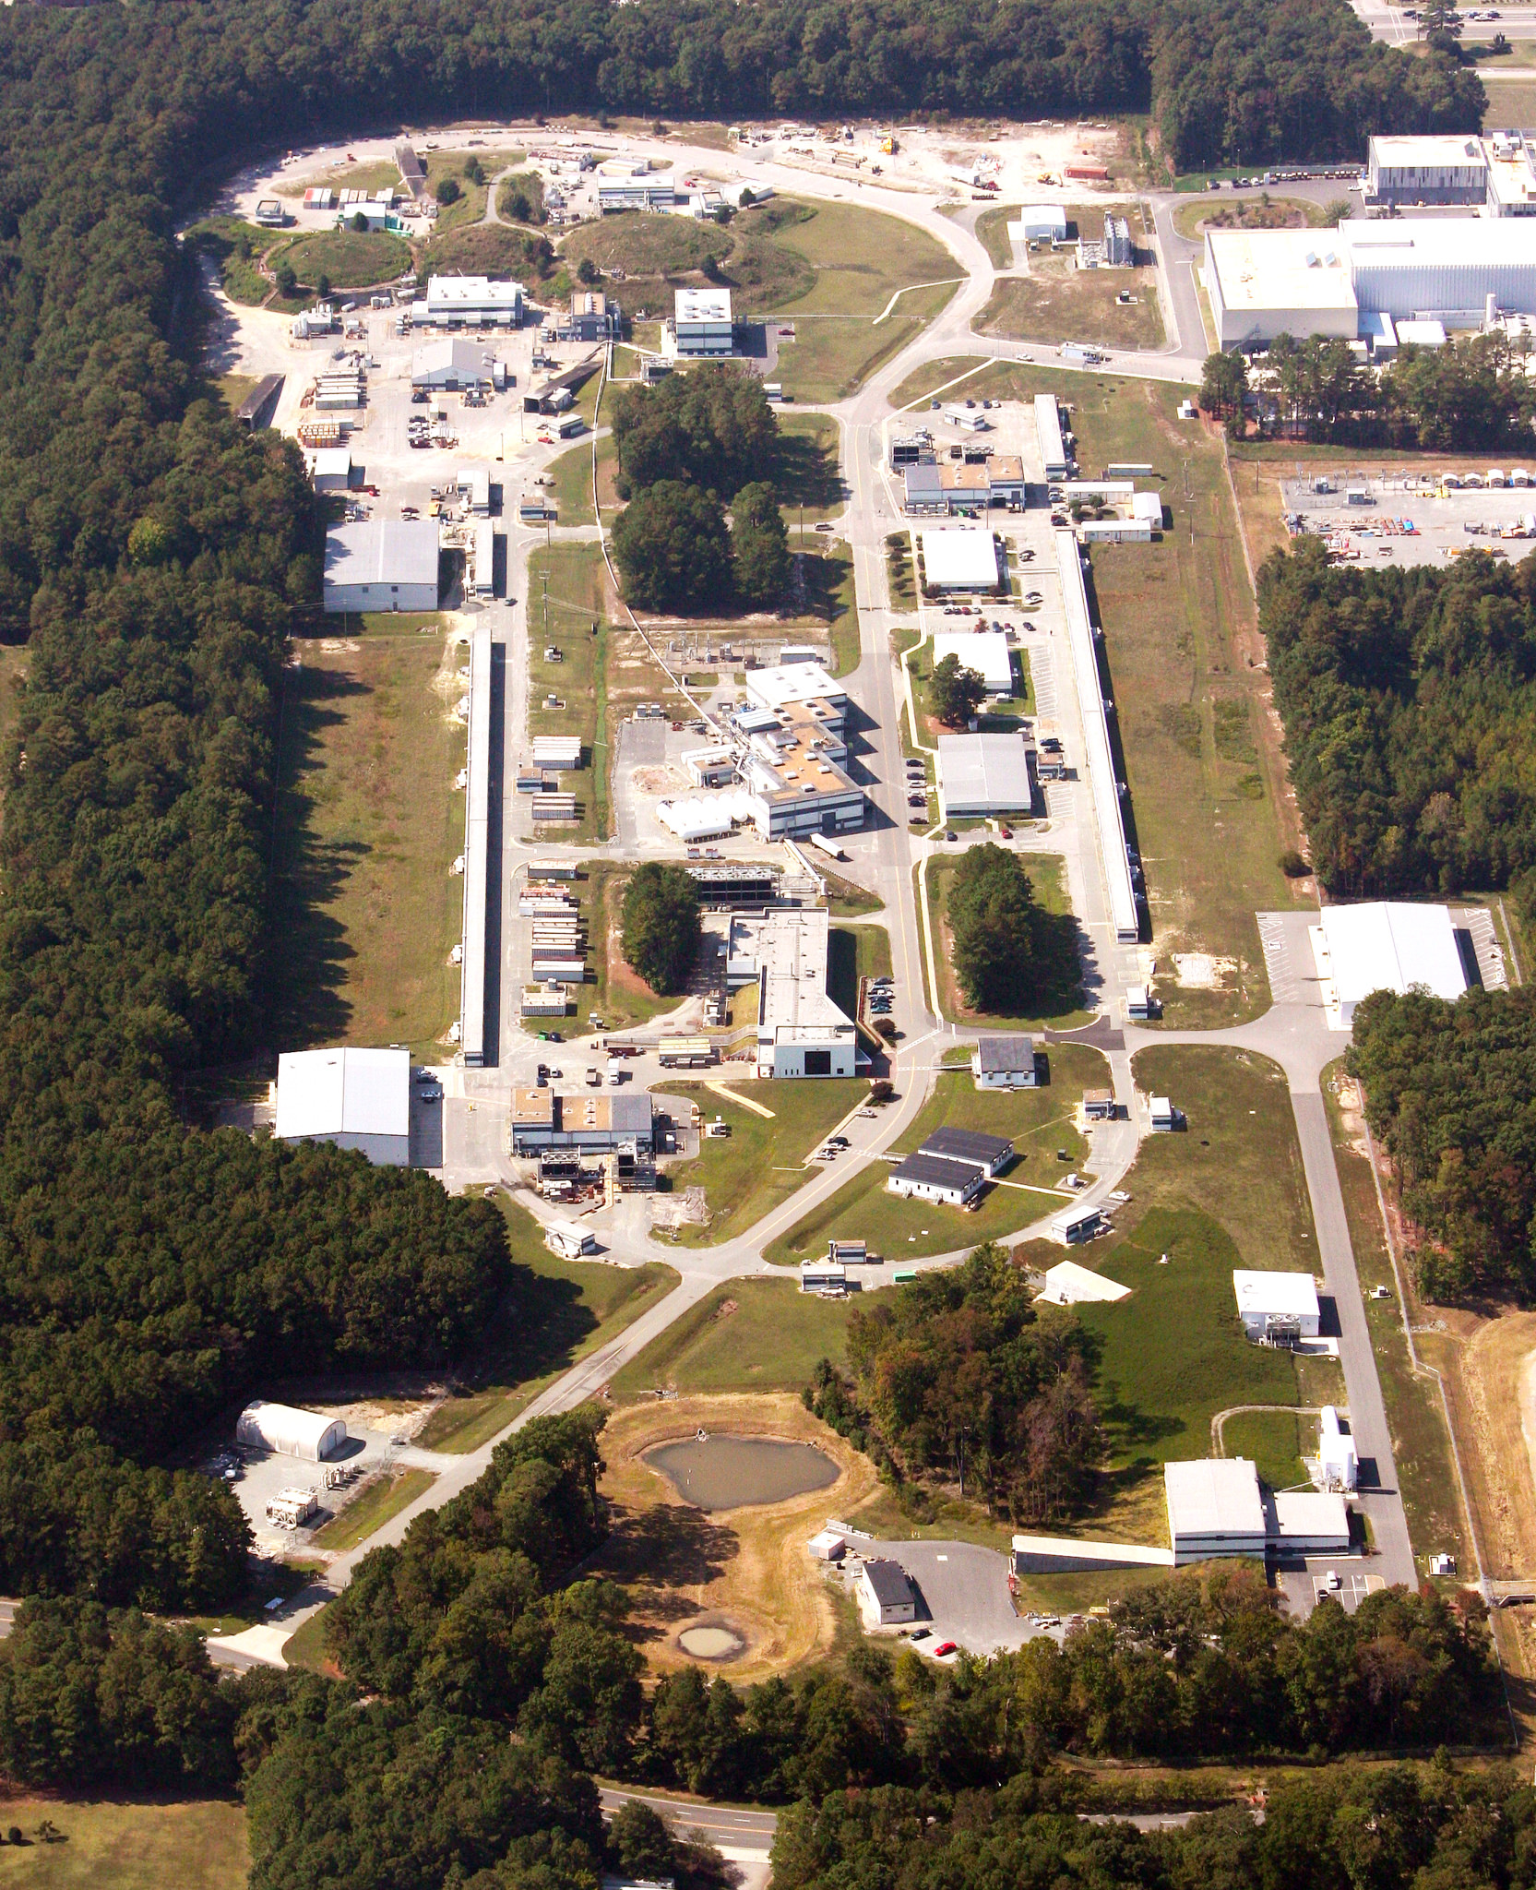
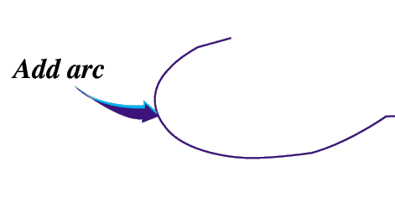


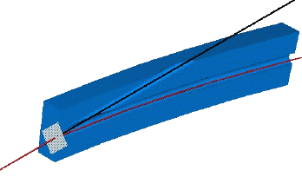
12-GeV CEBAF – Photoproduction
CHL-2
Linearly polarized
photons out
12GeV electrons
spectrometer
20 μm thick
Diamond crystal

Slide 4
The GlueX Experiment at Jefferson Lab
BaBar DIRC Bars
Photo Production
Light-quark Mesons
Strangeonium States
Physics in 2015

Slide 5
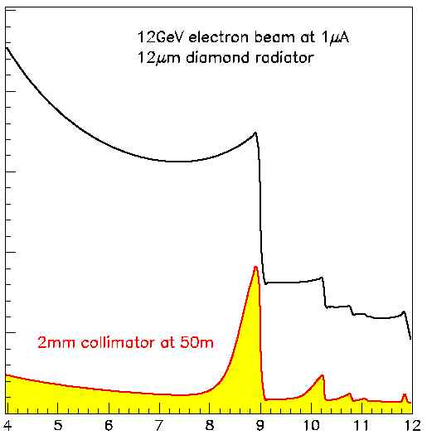
Coherent Bremsstrahlung
12 GeV electrons
This technique provides requisite energy, flux and polarization
Incoherent &
coherent spectrum
flux
40%
polarization
in peak
Linearly polarized
photons out
electrons in
collimated
spectrometer
20 μm thick
Diamond crystal
photon energy (GeV)
tagged
with 0.1% resolution

Slide 6
The GlueX Experiment
Oct. 2014

Slide 7
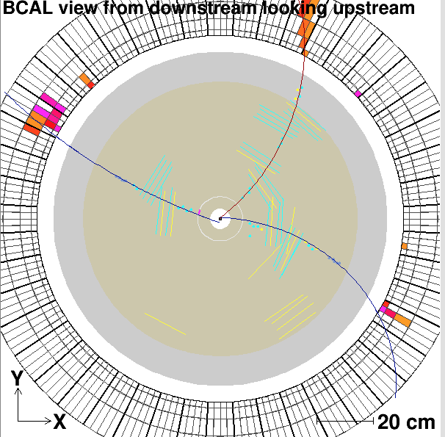
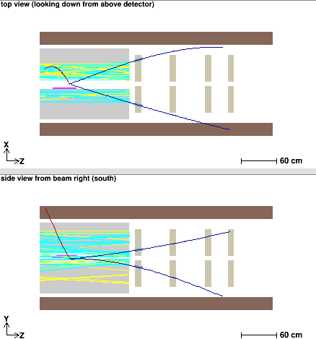
Ongoing Commissioning Run

Slide 8
Lattice QCD
Light-quark Mesons (u,d,s)

Slide 9
Lattice QCD
Light-quark Mesons (u,d,s)
2⁻⁺
1⁻⁺
States with non-trivial gluonic fields.
Supermultiplet
1⁻⁻
1⁻⁻, 0⁻⁺ , 1⁻⁺ , 2⁻⁺
0⁻⁺

Slide 10
Spectroscopy and QCD
Phys. Rev. D84 (2011) 074023
``Constituent gluon’’ behaves like it has J^{PC} = 1⁺⁻
Mass ~ 1-1.5 GeV
Lightest hybrid nonets: 1⁻⁻, (0⁻⁺,1⁻⁺, 2⁻⁺)
The 0+- and two 2+- exotic nonets and
also a second 1⁻⁺ nonet p-wave meson plus a
``gluon’’
2.5Gev
2.0GeV
0⁺⁻
1⁻⁺
2⁺⁻
Several nonets predicted
π₁ I^{G}(J^{PC})=1⁻(1⁻⁺)
K₁ I^{G}(J^{PC})= ½ (1⁻)
η’₁ I^{G}(J^{PC})=0⁺(1⁻⁺)
η₁ I^{G}(J^{PC})=0⁺(1⁻⁺)
Notes:
What are gluonic excitations and why are we looking for them? Lattice QCD predictions for the mesons and in particular, a class of mesons with non-quark-antiquark quantum numbers. Also not that mixing angles are predicted. GlueX needs to measure particle J(PC), masses, widths and decay modes to be able to map these out.

Slide 11
Expected Decay Modes
π₁ → πρ, πb₁ , πf₁,πη’, ηa₁
η₁ → ηf₂,a₂π,ηf₁, ηη’,π(1300)π, a₁π,
η₁’→ K*Κ, Κ₁(1270)Κ, Κ₁(1270)Κ , ηη’
b₂ → ωπ, a₂π, ρη, f₁ρ, a₁π, h₁π, b₁η
h₂ → ρπ,b₁π,ωη, f₁ω
h’₂ → Κ₁(1270)Κ, Κ₁(1270)Κ, K₂*Κ, φη, f₁φ
b₀ → π(1300)π , h₁π, f₁ρ, b₁η
h₀ → b₁π , h₁η
h’₀ → K₁(1270)Κ, Κ(1460)Κ, h₁η
Early Reach With Statistics Hard
Kaons do not have exotic QN’s

Slide 12
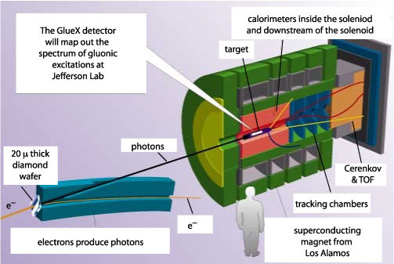
Forward Kaon Identification

Slide 13
Forward Kaon Identification
De-scoped in 2008

Slide 14
Baseline Kaon Identification
Focus on reactions where the recoil proton is detected.
At least 4-constraint kinematic fitting possible.
Train a BDT to isolate final states with kaons.
γp→ pK⁺K⁻
γp→ pK⁺K⁻π⁺π⁻
γp→ pK⁺K_{S}π⁻ → pK⁺π⁺π⁻π⁻
γp → K⁺Y* → K+Ξ*K
Ξ*→ Ξπ , ΚΛ
Focus on charged final states with kaons.
γp → ph’₂(2600) → pK₁⁺K⁻ → pK⁺K⁻π⁺π⁻
γp → pη’₁(2300) → pK^{*0}K_{S} → pK⁺π⁺π⁻π⁻
γp → pY(2175) → pφf₀ → pK⁺K⁻π⁺π⁻
γp → pφ₃(1850) → pK⁺K
A sampling of related final states

Slide 15
Global Particle Identification
53% Eff.
73% Eff.
31%
67%
32% Eff.
26% Eff.
15%
9%
Request 90% purity in the event sample.
The baseline GlueX detector can provide pure kaonic event samples with good efficiency.
Request 95% purity in the event sample.

Slide 16
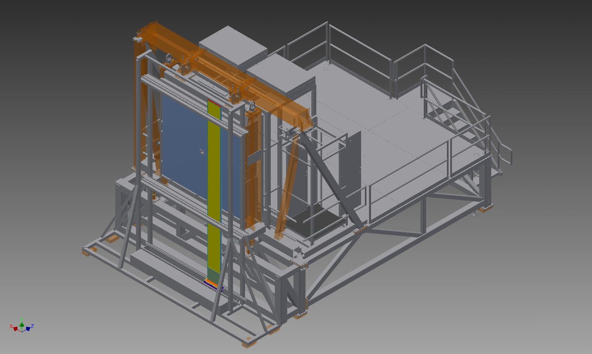
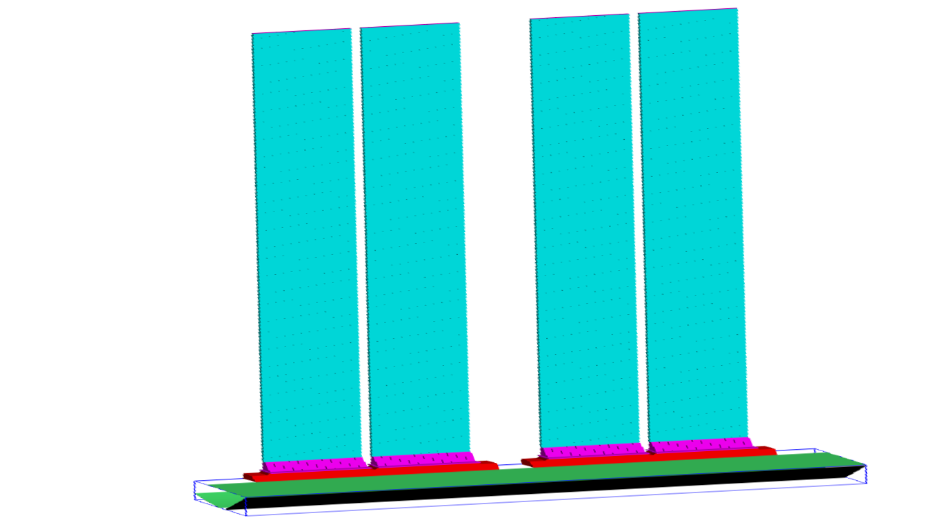
Forward Kaon Identification
In June 2014, GlueX was given four of the twelve BaBar DIRC boxes.
GlueX Forward Calorimeter
1 of 4 DIRC Boxes shown
Beam Axis
Focusing Oil Box
Extends the range of reactions and improves
the purity.

Slide 17
GlueX Running
GlueX is taking commissioning data now (Phase I).
There is an engineering/physics run in Spring of 2015 (Phase II).
  Beam energy is below 12-GeV.
  Some linear polarization.
  Hydrogen target.
Low-intensity physics running in late 2015.
  12-GeV electron beam.
  Linearly polarized photons.
  Software trigger tests.
High-intensity physics running starting in 2016.
Forward kaon identification in 2017.
Phased Running: Event Rates Data Volume Yearly Data Storage
Phase Rate Year E_{e} Raw DST Raw DST Raw DST
γ/s GeV kHz kHz MB/s MB/s PB PB
I 10⁶ 2014 10 2 0.1 30 1.5 0.1 0.1
II 10⁷ 2015 11 20 1 300 15 0.8 0.2
III 10⁷ 2015 12 20 2 300 30 1.6 0.2
IV 5 10⁷ 2016 12 20 10 300 150 1.6 1.0

Slide 18
GlueX Physics Analysis
GlueX is ready to do physics and several analyses are already being worked out using the full suite of GlueX/Hall-D software and data from large-scale data challenges.
Physics reactions of interest:
Understand the detector
Initial exotic hybrid searches
Strange Baryons

Slide 19
Key First Measurements
Demonstrate that we understand the detector and the reconstruction software.
Measure cross sections and polarization observables.
Meson ``two body” final states.
The and reactions are of high interest.

Slide 20
Interesting for Exotic Searches
Lots of challenges in this reaction. No signal in CLAS at 5GeV.
Couples to a number of exotic hybrids through several decay paths. In principle, these can couple to π₁ ,η₁ , b₂, h₂
These channels should provide a framework to test new amplitudes developed for these.

Slide 21
Amplitude Analysis
Describe the process of producing a particular final state as a set of possible amplitudes :
E.g.
Build a total amplitude by coherently summing all the individual amplitudes. This total amplitude yields a probability that the given sum describes a particular event ``k’’.
is a normalization factor and
are complex coefficients.
Form the likelihood and then minimize the natural log of it
with respect to the . This is a CPU-intensive problem that appears to scale well on graphical processor units (GPUs). To do this requires the four-vectors of all events plus a comparable Monte Carlo data sample to do the normalization.
Notes:
An amplitude analysis uses a physics amplitude to describe a process that connects the initial and final states. Several such processes may be possible, and the resulting amplitude is a coherent sum of all of these. The resulting amplitude can be used to evaluate the probability that a given event comes from the particular amplitude. A likelihood is formed as a product of these probabilities, which is turned into a sum by taking the logarithm. This log likelihood I then minimized with respect to the complex a’s.

Slide 22
Amplitude Analysis
We generally try to find the smallest set of to describe the data.
This is done summing over all of the experimental and simulated data.
We look at the amplitudes described by each of the partial waves and look for intensity and phase motion between them.

Slide 23
Observables
What if we take a very large number of , but do not attribute meaning to the individual ones. Instead, we try to extract the complex amplitude.
It is easier to compare a model to an observable than to the original data.
With a good model, one can then fit the data directly.

Slide 24
Amplitudes Lead to Observables
What are the observables that can be measured in a reaction?
A_{tot} has indices associated with initial and final spin states.
  Cross sections.
  Spin Observables. Sum over A’s with flipped spin indices.
  Moments ….

Slide 25
Example of ω Photo Production
We use a ``complete set’’ of s-channel amplitudes:
Build a total amplitude as:
Essentially fit the intensity of each event, x, with complex coefficients α
Proportional to cross section
SDMEs

Slide 26
Example of ω Photo Production
Total amplitude is an excellent description of all the data in all of its dimensions:
However, the fit coefficients α_{i} may have no physics meaning, they are just fitting parameters.
Because the amplitude does describe the data, it can be used to project observables.
The method handles both circularly and linearly polarized photons on an event-by-event basis.

Slide 27
Example of ω Photo Production
The method also does detector acceptance automatically. Use the fit parameters to determine the intensity of a given event.
The acceptance for a set of events near some event, is
Sum over accepted MC events
Sum over generated MC events

Slide 28
Extensive Program in CLAS
PHYSICAL REVIEW C 80, 045213 (2009)
Differential cross sections for the reactions γ p → pη and γ p → pη′
PHYSICAL REVIEW C 80, 065208 (2009)
Differential cross sections and spin density matrix elements for the reaction γ p → pω
PHYSICAL REVIEW C 81, 025201 (2010)
Differential cross section and recoil polarization measurements for the γ p → K+Λ reaction
^{using CLAS at Jefferson Lab}
PHYSICAL REVIEW C 82, 025202 (2010)
Differential cross sections and recoil polarizations for the reaction γ p → K+Σ0
PHYSICAL REVIEW C 89, 055208 (2014)
Data analysis techniques, differential cross sections, and spin density matrix elements for ^{the reaction γ p → φp}
PHYSICAL REVIEW C 83, 055208 (2011)
Polarization observables in the longitudinal basis for pseudo-scalar meson photoproduction
using a density matrix approach
^{Measurement of SDMEs for} γ p → pω using linearly polrized photons
Differential cross section and SDME measurements for the γ p → K+Λ(1520)

Slide 29
What are the Observables?
Can we define observables that can be extracted independent of a partial-wave interpretation of a particular reaction?
With such observables, many (complicated) models of the data can be tested.
A smaller subsets of vetted models can then be used to directly confront the data.

Slide 30
Summary
GlueX is very close to having its first physics data.
Amplitude analysis issues will quickly move into the forefront of our experimental efforts.
The work being done now will be crucial to our ultimate success.
Can we define observables that make sense?

