Slide 1
Analysis Plans for the GlueX Experiment
Curtis A. Meyer
Carnegie Mellon University
April 13, 2015
Notes:
25 + 5 Presentation ….

Slide 2
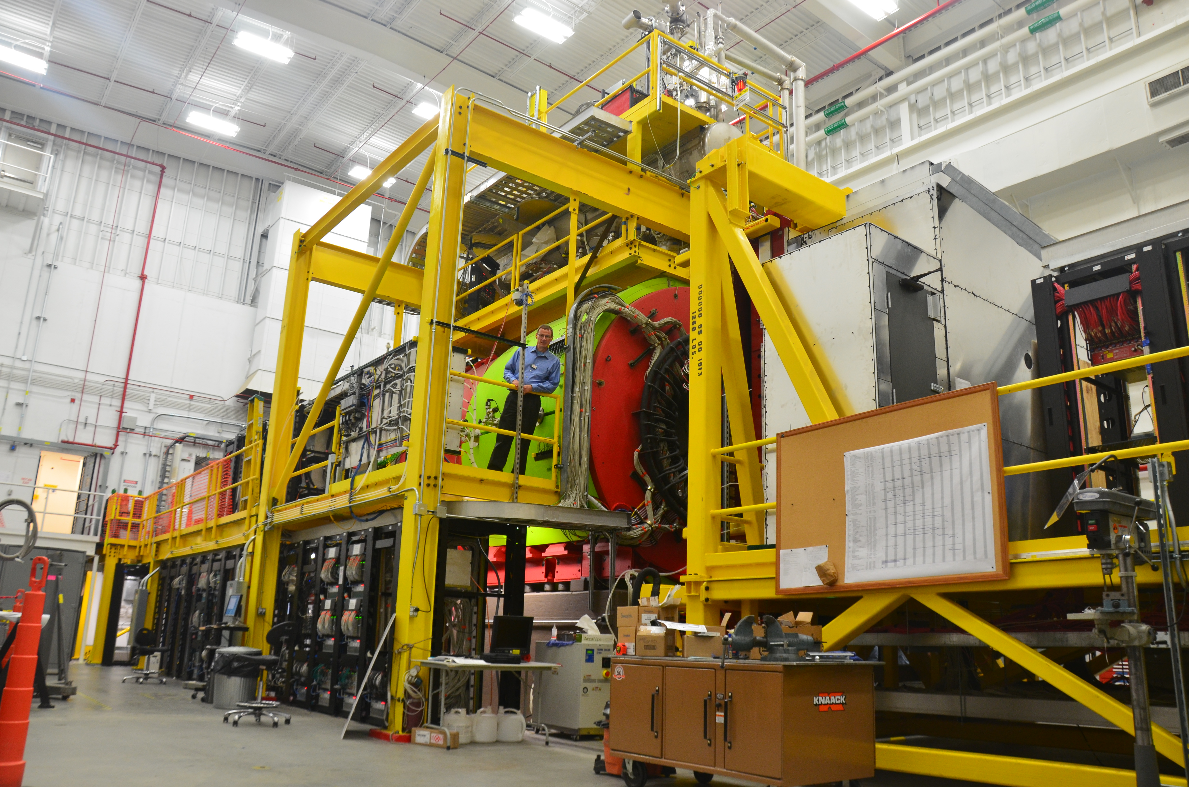
Outline
The GlueX Experiment.
Status and Timelines
Exotic Hybrid Mesons.
Reactions of Interest.
Analyses.

Slide 3
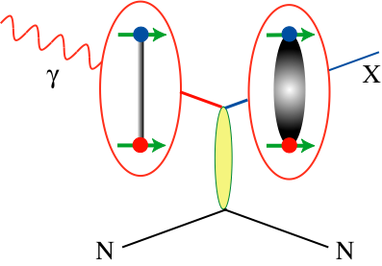
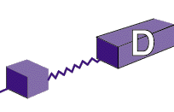
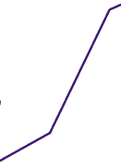

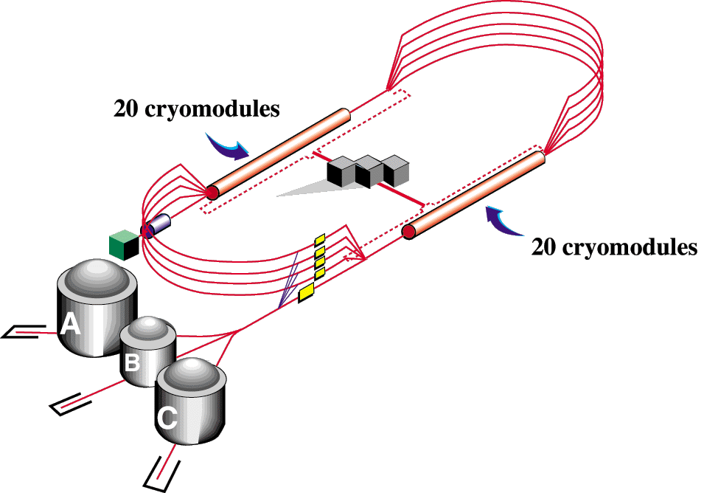

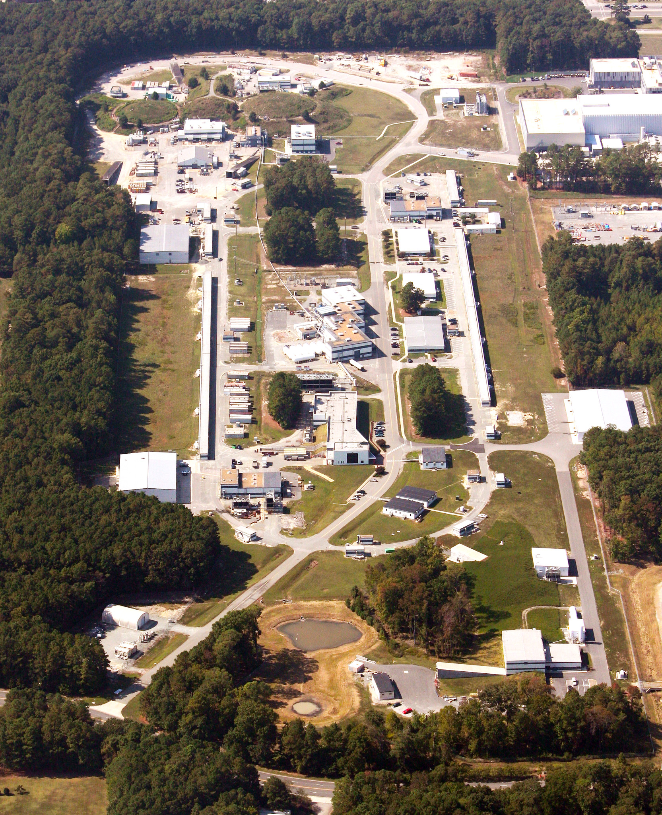
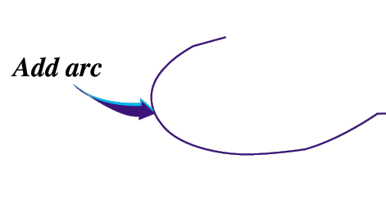

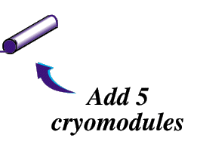
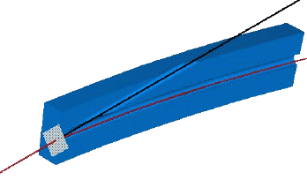
12-GeV CEBAF – Photoproduction
CHL-2
Linearly polarized
photons out
12GeV electrons
spectrometer
20 μm thick
Diamond crystal

Slide 4
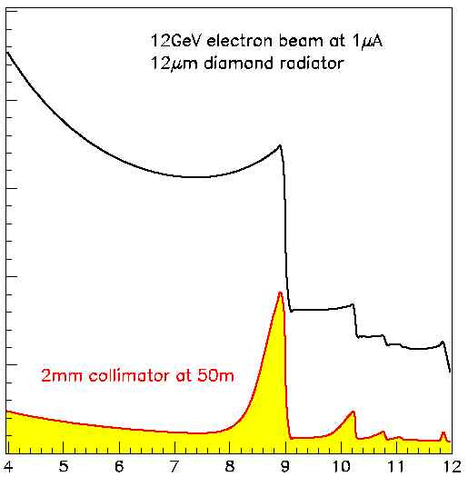
Coherent Bremsstrahlung
12 GeV electrons
This technique provides requisite energy, flux and polarization
Incoherent &
coherent spectrum
flux
40%
polarization
in peak
Linearly polarized
photons out
electrons in
collimated
spectrometer
20 μm thick
Diamond crystal
photon energy (GeV)
tagged
with 0.1% resolution

Slide 5
The GlueX Experiment at Jefferson Lab
BaBar DIRC Bars
Photo Production
Light-quark Mesons
Strangeonium States
Physics in 2016

Slide 6
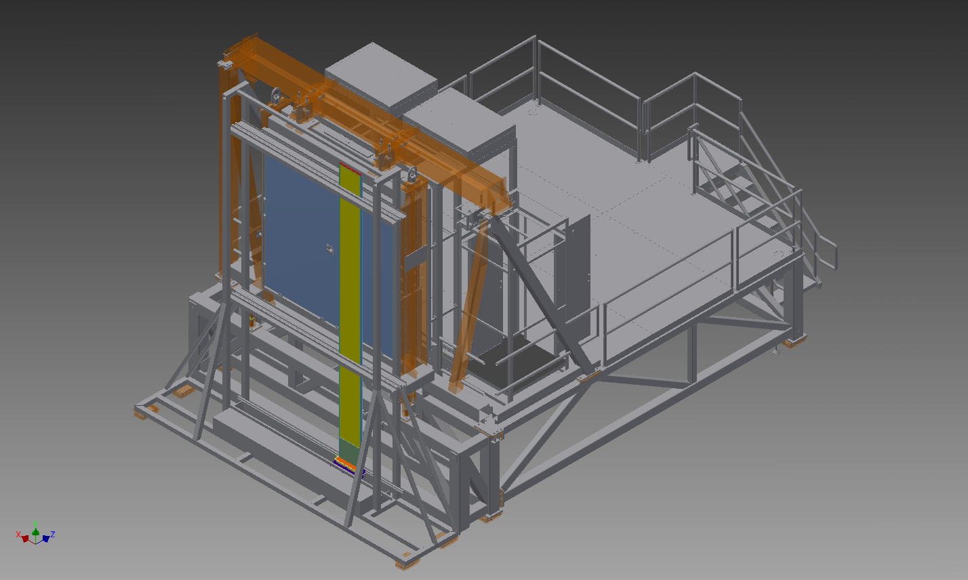
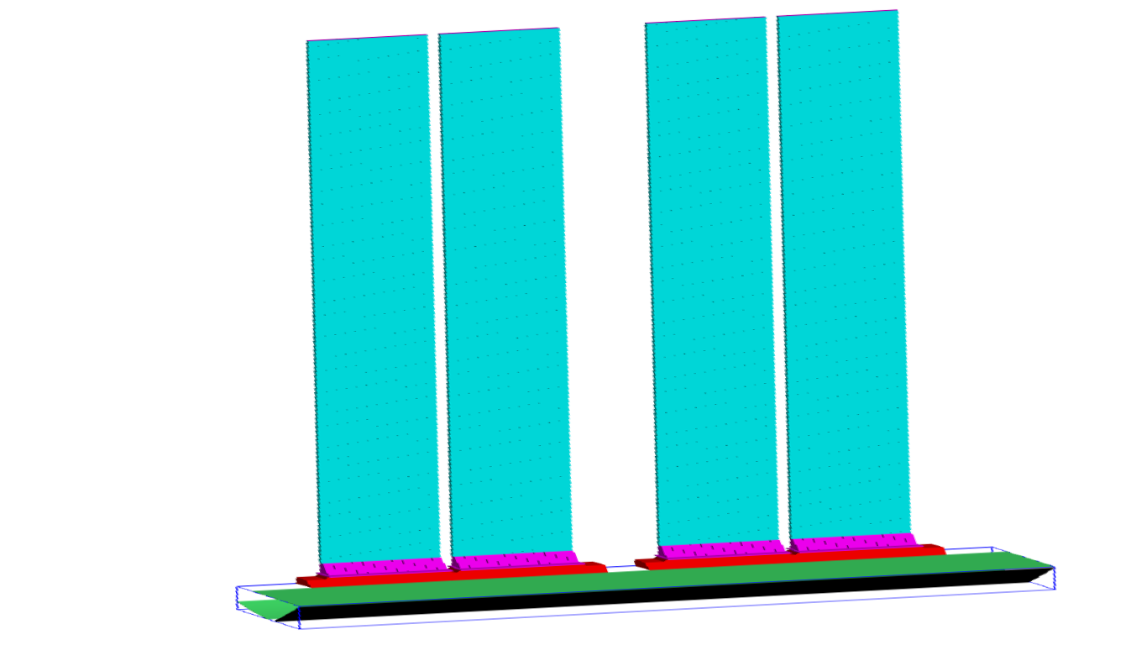
Upgraded Kaon Identification
In June 2014, GlueX was given four of the twelve BaBar DIRC boxes.
GlueX Forward Calorimeter
1 of 4 DIRC Boxes shown
Beam Axis
Focusing Oil Box
This will extends the range of reactions and improve
the purity of the resulting event samples.

Slide 7
Global Particle Identification
46% Eff.
67% Eff.
20%
61%
32% Eff.
31% Eff.
15%
16%
Request 90% purity in the event sample.
The baseline GlueX detector can provide pure kaonic event samples with good efficiency.
Request 95% purity in the event sample.

Slide 8
Global Particle Identification
65% Eff.
74% Eff.
55%
68%
28%
38%
48% Eff.
49% Eff.
33%
33%
5%
8%
Request 90% purity in the event sample.
The baseline GlueX detector can provide pure kaonic event samples with good efficiency.
The DIRC will significantly enhance this capability.
Request 95% purity in the event sample.
Request 99% purity in the event sample.

Slide 9
GlueX Running
GlueX took commissioning data Oct. to Dec. 2014.
There is an on-going commissioning run now.
  Beam energy is below 6-GeV.
  Some linear polarization.
  Hydrogen target.
Commissioning run in Fall 2015.
  12-GeV electron beam.
  Linearly polarized photons.
  Software trigger tests.
Physics Commissioning in Spring 2016.
  Low-intensity running.
  Full baseline detector.
  Software trigger tests.
Physics running in Fall 2016/ Spring 2017.
  Move to higher intensity.
  Implement software trigger
Upgraded kaon identification in Fall 2017/Spring 2018.
  High intensity running with full detector capabilities.

Slide 10
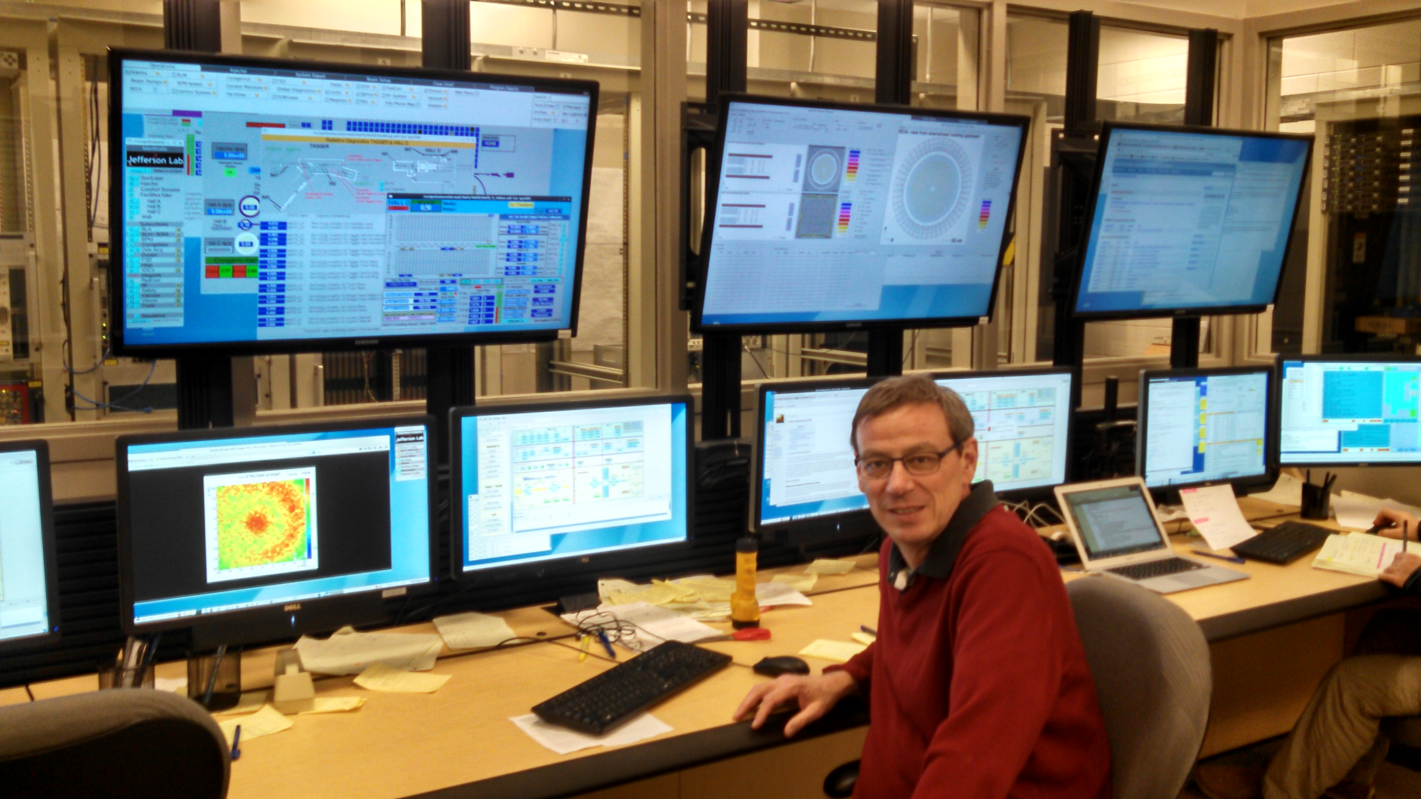
Fall 2014 GlueX Commissioning
Ran from late October until just before Christmas.
All systems worked and all detectors recorded data simultaneously.
Multiple triggers tested.
120TB of data collected, all data have since been processed multiple times.
Calibration and alignment is in an advanced state.
Hoped to complete calibrations using Spring’15 commissioning data.

Slide 11
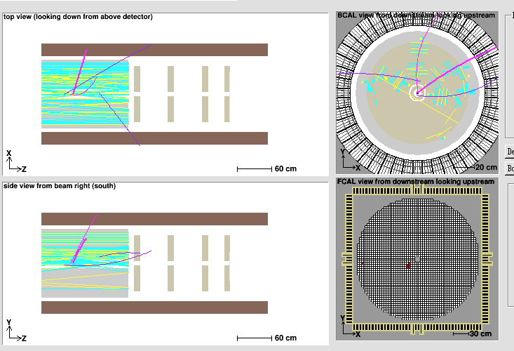
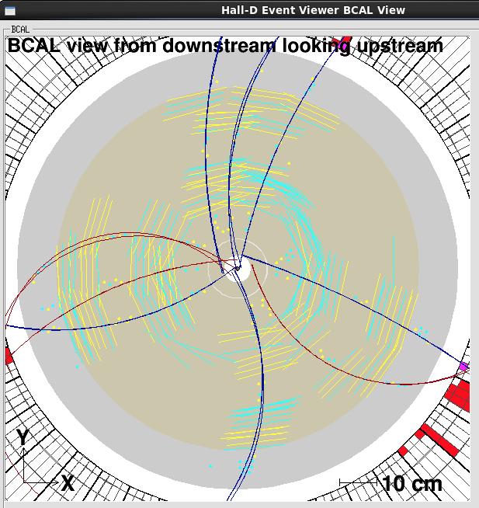
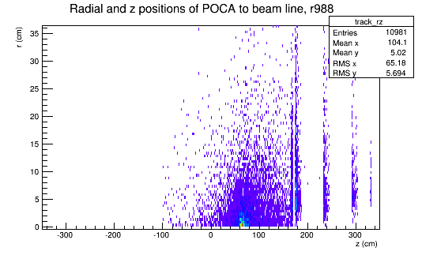
Fall 2014 GlueX Commissioning
First beam, November 5, 2014
November 6, 2014
Targets installed on November 11, 2014
First π⁰ in FCAL November 27, 2014

Slide 12
Fall 2014 GlueX Commissioning
January 2015
Reconstruct the decay and then combine with a positive and negative track. Clear signal for

Slide 13
Fall 2014 GlueX Commissioning
February 2015
Identify two charged particles from a secondary vertex. A clear signal for the

Slide 14
Fall 2014 GlueX Commissioning
February 2015
Identify two charged particles from a secondary vertex. A clear signal for the

Slide 15
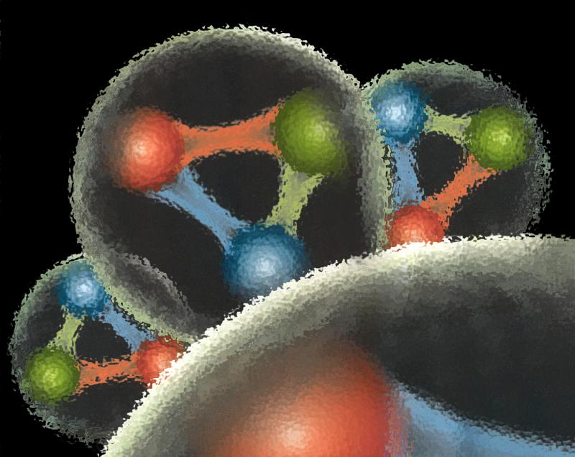
Quantum Chromo Dynamics
QCD describes the interactions of quarks and gluons and should predict the spectrum of bound-state baryons ( ) and mesons ( ).
There should also be mesons in which the gluonic field contributes directly to the J^{PC} quantum numbers of the states --- hybrid mesons. Some are expected to have ``exotic’’ quantum numbers.
Lattice QCD calculation of the light-quark meson spectrum
2.5Gev
2.0GeV
Exotic QN
0⁺⁻
1⁻⁺
2⁺⁻
Normal QN
Several nonets predicted
Notes:
What are gluonic excitations and why are we looking for them? Lattice QCD predictions for the mesons and in particular, a class of mesons with non-quark-antiquark quantum numbers. Also not that mixing angles are predicted. GlueX needs to measure particle J(PC), masses, widths and decay modes to be able to map these out.

Slide 16
Lattice QCD
Light-quark Mesons (u,d,s)

Slide 17
Lattice QCD
Light-quark Mesons (u,d,s)
2⁻⁺
1⁻⁺
States with non-trivial gluonic fields.
Supermultiplet
1⁻⁻
1⁻⁻, 0⁻⁺ , 1⁻⁺ , 2⁻⁺
0⁻⁺

Slide 18
QCD Exotics
Lattice QCD suggests 5 nonets of mesons with exotic quantum number:
1 nonet of 0⁺⁻ exotic mesons
2 nonets of 1⁻⁺ exotic mesons
2 nonets of 2⁺⁻ exotic mesons
Lattice shows two nonets here.
Experimental evidence exists for π₁ states.
π₁ I^{G}(J^{PC})=1⁻(1⁻⁺)
K₁ I^{G}(J^{PC})= ½ (1⁻)
``Constituent gluon’’ behaves like J^{PC} = 1⁺⁻ with a mass of 1-1.5 GeV
The lightest hybrid nonets:
1⁻⁻, (0⁻⁺,1⁻⁺, 2⁻⁺)
η’₁ I^{G}(J^{PC})=0⁺(1⁻⁺)
η₁ I^{G}(J^{PC})=0⁺(1⁻⁺)

Slide 19
Possible Decay Modes
π₁ → πρ, πb₁ , πf₁,πη’, ηa₁
η₁ → ηf₂,a₂π,ηf₁, ηη’,π(1300)π, a₁π,
η₁’→ K*Κ, Κ₁(1270)Κ, Κ₁(1270)Κ , ηη’
b₂ → ωπ, a₂π, ρη, f₁ρ, a₁π, h₁π, b₁η
h₂ → ρπ,b₁π,ωη, f₁ω
h’₂ → Κ₁(1270)Κ, Κ₁(1270)Κ, K₂*Κ, φη, f₁φ
b₀ → π(1300)π , h₁π, f₁ρ, b₁η
h₀ → b₁π , h₁η
h’₀ → K₁(1270)Κ, Κ(1460)Κ, h₁η
Models suggest narrower states are in the spin-1 and spin-2 nonets, while the spin-0 nonets are broad.
Early Reach With Statistics Hard
Hybrid kaons do not have exotic QN’s

Slide 20
Key First Measurements
Demonstrate that we understand the detector and the reconstruction software.
Measure cross sections and polarization observables.
Meson ``two body” final states.
The and reactions are of high interest.

Slide 21
GlueX Physics Analysis
GlueX is ready to do physics and several analyses are being worked out using the full suite of GlueX/Hall-D software and data from large-scale data challenges.
Physics reactions of interest:
Understand the detector
Initial exotic hybrid searches
Strange Baryons

Slide 22
Interesting for Exotic Searches
Lots of challenges in this reaction.
No signal in CLAS at 5GeV for recoil neutron.
Couples to a number of exotic hybrids through several decay paths. In principle, these can couple to π₁ ,η₁ , b₂, h₂
These channels should provide a framework to test new amplitudes developed for these.

Slide 23
Amplitude Analysis
Describe the process of producing a particular final state as a set of possible amplitudes :
E.g.
Build a total amplitude by coherently summing all the individual amplitudes. This total amplitude yields a probability that the given sum describes a particular event ``k’’.
is a normalization factor and
are complex coefficients.
Form the likelihood and then minimize the natural log of it
with respect to the . This is a CPU-intensive problem that appears to scale well on graphical processor units (GPUs). To do this requires the four-vectors of all events plus a comparable Monte Carlo data sample to do the normalization.
Notes:
An amplitude analysis uses a physics amplitude to describe a process that connects the initial and final states. Several such processes may be possible, and the resulting amplitude is a coherent sum of all of these. The resulting amplitude can be used to evaluate the probability that a given event comes from the particular amplitude. A likelihood is formed as a product of these probabilities, which is turned into a sum by taking the logarithm. This log likelihood I then minimized with respect to the complex a’s.

Slide 24
Amplitude Analysis
We generally try to find the smallest set of to describe the data.
This is done summing over all of the experimental and simulated data.
We look at the amplitudes described by each of the partial waves and look for intensity and phase motion between them.

Slide 25
Observables
What if we take a very large number of A_{j}s, but do not attribute meaning to the individual ones. Instead, we try to extract the complex amplitude.
It is easier to compare a model to an observable than to the original data.
With a good model, one can then fit the data directly.

Slide 26
Example of ω Photo Production
Total amplitude is an excellent description of all the data in all of its dimensions:
However, the fit coefficients α_{i} may have no physics meaning, they are just fitting parameters.
Because the amplitude does describe the data, it can be used to project observables.
The method handles both circularly and linearly polarized photons on an event-by-event basis.

Slide 27
Example of ω Photo Production
The method also does detector acceptance automatically. Use the fit parameters to determine the intensity of a given event.
The acceptance for a set of events near some event, is
Sum over accepted MC events
Sum over generated MC events

Slide 28
Amplitudes Lead to Observables
What are the observables that can be measured in a reaction?
A_{tot} has indices associated with initial and final spin states.
  Cross sections.
  Spin Observables. Sum over A’s with flipped spin indices.
  Moments ….

Slide 29
What are the Observables?
Can we define observables that can be extracted independent of a partial-wave interpretation of a particular reaction?
With such observables, many (complicated) models of the data can be tested.
A smaller subsets of vetted models can then be used to directly confront the data.

Slide 30
Summary
GlueX had a very successful commissioning run and is looking forward to its first physics data soon.
Analysis and Amplitude Analysis issues will quickly move into the forefront of our experimental efforts.
The techniques discussed here, and being developed now will be crucial to our ultimate success.
Are there other observables beyond amplitude analyses results?

