Slide 1

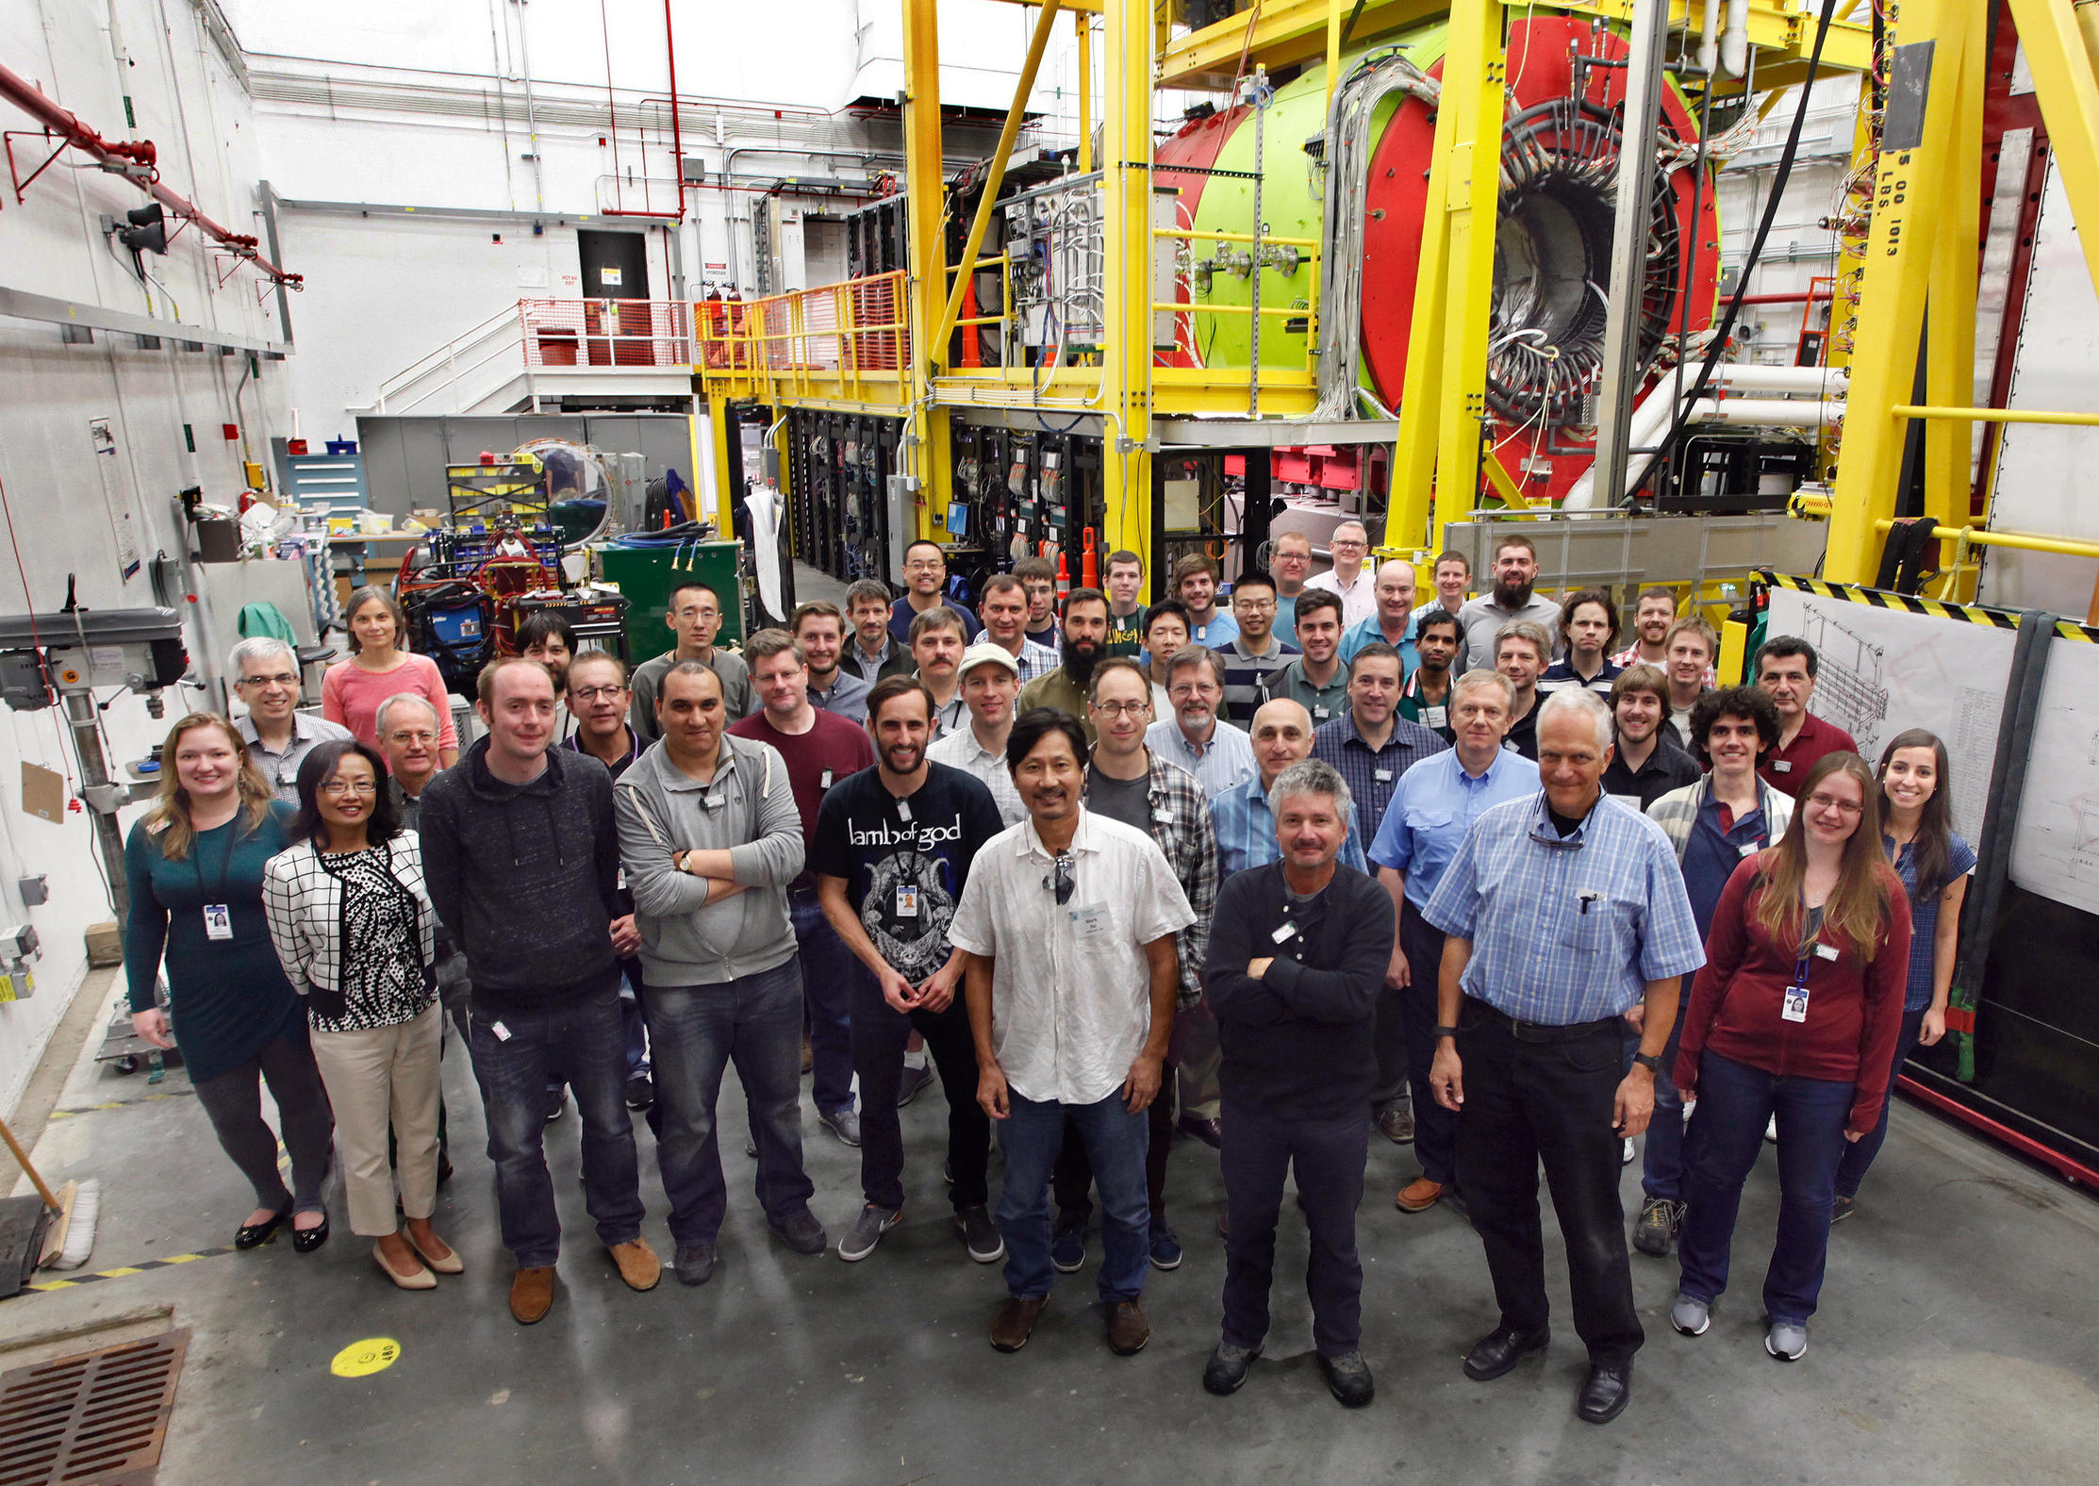
A Map to Hadronic physics from
Curtis A. Meyer
Carnegie Mellon University

Slide 2
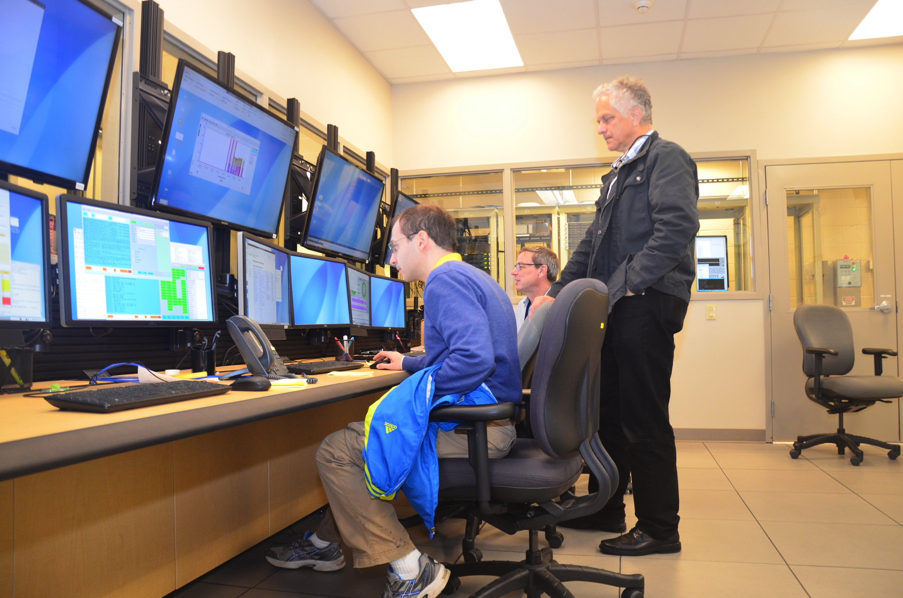
Outline
What are gluonic excitations.
How to search for gluonic excitations?
The GlueX experiment.
First physics from GlueX.
GlueX moving forward.
12-GeV beam, Dec. 2015

Slide 3
The GlueX Collaboration
Arizona State, Athens, Carnegie Mellon, Catholic University, Univ. of Connecticut, Florida International, Florida State, George Washington, Glasgow, GSI, Indiana University, ITEP, Jefferson Lab, U. Mass Amherst, MIT, MePhi, Norfolk State, North Carolina A&T, Univ. North Carolina Wilmington, Northwestern, Old Dominion, Santa Maria, University of Regina, Tomsk, Wuhan and Yerevan Physics Institute.
Over 125 collaborators from more than 25 institutions with others joining and more are welcome.

Slide 4
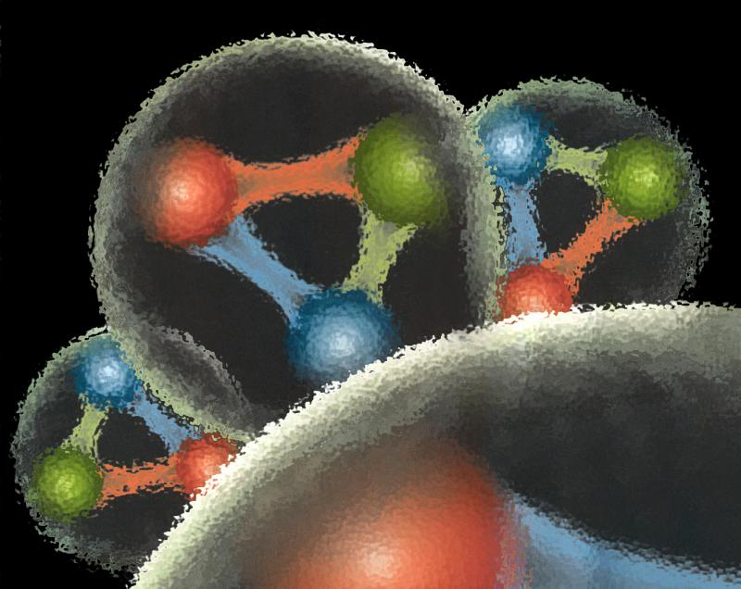
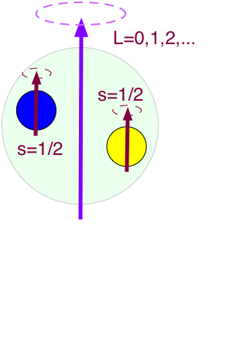
Quantum Chromo Dynamics
Focus on mesons built from the three lightest quarks, u, d and s, and their antiquarks.
Combine two spin ½ objects to S=0 or S=1
Orbital angular momentum of two quarks:
L=0,1,2,3,…
Total angular momentum, J=L+S
J=0,1,2,3,…
Spatial Reflection Symmetry:
Parity P=-(-1)^{L}
Quark-antiquark Reflection:
C-parity C=(-1)^{L+S}
J^{PC}

Slide 5

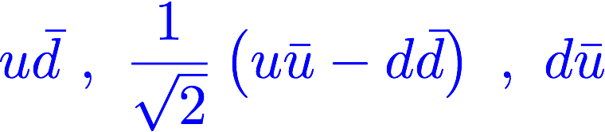

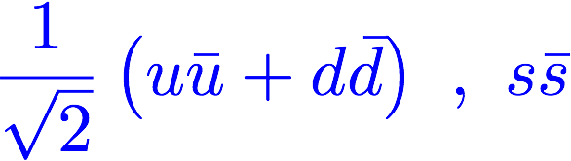
Quantum Chromo Dynamics
L=3, S=1, J^{PC}=4⁺⁺
J^{PC}=3⁺⁺
J^{PC}=2⁺⁺
L=3, S=0, J^{PC}=3⁺⁻
Each J^{PC} corresponds to nine quark-antiquark states, nonets .
L=2, S=1, J^{PC}=3⁻⁻
J^{PC}=2⁻⁻
J^{PC}=1⁻⁻
L=2, S=0, J^{PC}=2⁻⁺
L=1, S=1, J^{PC}=2⁺⁺
J^{PC}=1⁺⁺
J^{PC}=0⁺⁺
L=1, S=0, J^{PC}=1⁺⁻
L=0, S=1, J^{PC}=1⁻⁻
L=0, S=0, J^{PC}=0⁻⁺
Can mix
Notes:
What are gluonic excitations and why are we looking for them? Lattice QCD predictions for the mesons and in particular, a class of mesons with non-quark-antiquark quantum numbers. Also not that mixing angles are predicted. GlueX needs to measure particle J(PC), masses, widths and decay modes to be able to map these out.

Slide 6
Quantum Chromo Dynamics
L=3, S=1, J^{PC}=4⁺⁺
J^{PC}=3⁺⁺
J^{PC}=2⁺⁺
L=3, S=0, J^{PC}=3⁺⁻
Each J^{PC} corresponds to nine quark-antiquark states.
L=2, S=1, J^{PC}=3⁻⁻
J^{PC}=2⁻⁻
J^{PC}=1⁻⁻
L=2, S=0, J^{PC}=2⁻⁺
0⁻⁻ , 0⁻⁺ , 0⁺⁻ , 0⁺⁺
1⁻⁻ , 1⁻⁺ , 1⁺⁻ , 1⁺⁺
2⁻⁻ , 2⁻⁺ , 2⁺⁻ , 2⁺⁺
3⁻⁻ , 3⁻⁺ , 3⁺⁻ , 3⁺⁺
L=1, S=1, J^{PC}=2⁺⁺
J^{PC}=1⁺⁺
J^{PC}=0⁺⁺
L=1, S=0, J^{PC}=1⁺⁻
Exotic Quantum Numbers
L=0, S=1, J^{PC}=1⁻⁻
L=0, S=0, J^{PC}=0⁻⁺
Can mix
Notes:
What are gluonic excitations and why are we looking for them? Lattice QCD predictions for the mesons and in particular, a class of mesons with non-quark-antiquark quantum numbers. Also not that mixing angles are predicted. GlueX needs to measure particle J(PC), masses, widths and decay modes to be able to map these out.

Slide 7
Lattice QCD
Light-quark Mesons (u,d,s)
PRD83, 111502 & PRD88, 094505

Slide 8
Lattice QCD
Light-quark Mesons (u,d,s)
2⁻⁺
1⁻⁺
States with non-trivial gluonic fields.
Supermultiplet
1⁻⁻
1⁻⁻, 0⁻⁺ , 1⁻⁺ , 2⁻⁺
0⁻⁺
PRD83, 111502 & PRD88, 094505

Slide 9
QCD Exotics
2.5Gev
Lattice QCD suggests 5 nonets of mesons with exotic quantum number:
1 nonet of 0⁺⁻ exotic mesons
2 nonets of 1⁻⁺ exotic mesons
2 nonets of 2⁺⁻ exotic mesons
2.0GeV
0⁺⁻
1⁻⁺
2⁺⁻
Experimental evidence exists for π₁ states.
π₁ I^{G}(J^{PC})=1⁻(1⁻⁺)
K₁ I^{G}(J^{PC})= ½ (1⁻)
``Constituent gluon’’ behaves like J^{PC} = 1⁺⁻ with a mass of 1-1.5 GeV
The lightest hybrid nonets:
1⁻⁻, (0⁻⁺,1⁻⁺, 2⁻⁺)
η’₁ I^{G}(J^{PC})=0⁺(1⁻⁺)
η₁ I^{G}(J^{PC})=0⁺(1⁻⁺)
Kaon states do not have exotic QNs
PRD84, 074023

Slide 10
QCD Exotics
2.5Gev
Experimental Evidence for Exotics?
??
π₁(2015)
The π₁(1600) has been observed by several experiments, mostly in pion-beam experiments. It has been seen in a number of decay modes, some of which are controversial.
The π₁(2015) has been observed by a single low-statistics experiment. Confirmation is needed.
2.0GeV
?
π₁(1600)
0⁺⁻
1⁻⁺
2⁺⁻
Not observed:
η₁ , η₁’
b₀ , h₀ , h₀’
b₂ , h₂ , h₂’
Prog. Part. and Nucl. Phys. B82, 21, (2015).

Slide 11
Compass Results
π⁻p → pπ⁻π⁺π⁻
In the ρπ system at larger momentum transfer, |t|, they observe a signal with phase motion in the 1⁻⁺ exotic wave, the π₁(1600),
They also see a signal in the η’π channel.
Other reports in various decay modes from E852, VES and others.
Intensity of 1⁻⁺
Phase Difference to 4⁺⁺ Phase Difference to 4⁺⁺
EPJ Web. Conf., 137 (2017) 05012.

Slide 12
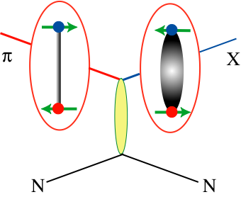
Producing QCD Exotics
High-statistics experiments have used pion beams to search for hybrids: VES at Protvino, E852 at Brookhaven and Compass at CERN: π⁻p → pX⁻ or nX⁰
A pion undergoes t-channel exchange with a nucleon and creates an excited meson or hybrid. Involves charge exchange and/or isospin-1 particles. Easier to make pion-like states.

Slide 13
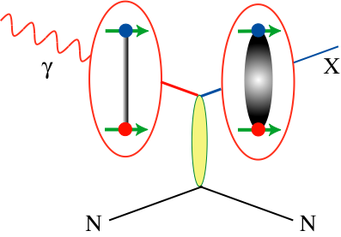
Producing QCD Exotics
High-statistics experiments have used pion beams to search for hybrids: VES at Protvino, E852 at Brookhaven and Compass at CERN: π⁻p pX⁻ or nX⁰
A pion undergoes t-channel exchange with a nucleon and creates an excited meson or hybrid. Involves charge exchange and/or isospin-1 particles. Easier to make pion-like states.
Photoproduction is a poorly-studied mechanism, ~1000s of events total.
Photon can fluctuate into a spin-1 particle. Do not need charge exchange or isospin-1 final states. Linear polarization filters exchange mechanisms.

Slide 14
Photoproduction Mechanisms
Simple quantum number counting for production: (I^{G})J^{PC} up to L=2
P = Pomeron exchange
ρπ,ρω π₁
ωω,ρρ η₁
ωω,ρρ,φω η’₁
ρP b₀
ωP h₀
ωP, φP h’₀
ωπ,ρη,ρP b₂
ρπ,ωη,ωP h₂
ρπ,ωη,φP h’₂
ρπ is charge-exchange only
Can couple to all the lightest exotic hybrid nonets through photo- production and VMD.
Linear polarization is a filter on the naturality of the exchanged particle.

Slide 15
Decay Modes of Exotic Hybrids
π₁ → πρ, πb₁ , πf₁,πη’, ηa₁
η₁ → ηf₂,a₂π,ηf₁, ηη’,π(1300)π, a₁π,
η₁’ → K*Κ, Κ₁(1270)Κ, Κ₁(1410)Κ , ηη’
b₂ → ωπ, a₂π, ρη, f₁ρ, a₁π, h₁π, b₁η
h₂ → ρπ,b₁π,ωη, f₁ω
h’₂ → Κ₁(1270)Κ, Κ₁(1410)Κ, K₂*Κ, φη, f₁φ
b₀ → π(1300)π , h₁π, f₁ρ, b₁η
h₀ → b₁π , h₁η
h’₀ → K₁(1270)Κ, Κ(1460)Κ, h₁η
Models suggest narrower states are in the spin-1 and spin-2 nonets, while the spin-0 nonets are broad.
Early Reach With Statistics Hard
Hybrid kaons do not have exotic QN’s

Slide 16
Decay Modes of Exotic Hybrids
π₁ → πρ, πb₁ , πf₁,πη’, ηa₁
η₁ → ηf₂,a₂π,ηf₁, ηη’,π(1300)π, a₁π,
η₁’ → K*Κ, Κ₁(1270)Κ, Κ₁(1410)Κ , ηη’
b₂ → ωπ, a₂π, ρη, f₁ρ, a₁π, h₁π, b₁η
h₂ → ρπ,b₁π,ωη, f₁ω
h’₂ → Κ₁(1270)Κ, Κ₁(1410)Κ, K₂*Κ, φη, f₁φ
b₀ → π(1300)π , h₁π, f₁ρ, b₁η
h₀ → b₁π , h₁η
h’₀ → K₁(1270)Κ, Κ(1460)Κ, h₁η
Models suggest narrower states are in the spin-1 and spin-2 nonets, while the spin-0 nonets are broad.
Early Reach With Statistics Hard
Hybrid kaons do not have exotic QN’s

Slide 17
The GlueX Experiment
2018
Photo Production of Hybrids,
Light-quark Mesons
and Strangeonium States
Physics Running started in 2017
(See Naomi Jarvis’ talk on Friday for more details.)

Slide 18
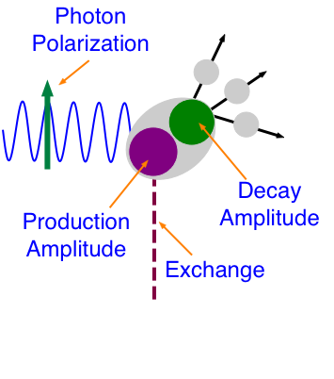
Doing Physics with GlueX
Production Amplitude produces a state X with J^{PC} quantum numbers and some polarization (density matrix, ρ).
Decay Amplitude describes the decay of X to final state particles. It is related to ρ and the spin and orbital angular momentum of the final-state particles.
Observables are the angular distributions of the final-state particles.
l_{i},s_{i}
J^{PC}
j^{pc}

Slide 19
Doing Physics with GlueX
Theoretical work is necessary to extract the full physics potential from the GlueX program.
Of particular importance is Joint Physics Analysis Center (JPAC) with both their phenomenological work and the efforts to make this work available to experiment in analyzing data.
l_{i},s_{i}
J^{PC}
j^{pc}

Slide 20


Doing Physics with GlueX
l_{i},s_{i}
J^{PC}
Perform an un-binned log-likelihood fit to make our model for W agree with the experimental distribution for W by varying the α_{j}.
j^{pc}
Several different states, all decaying to the same final particles are produced, and they interfere (complex amplitudes).

Slide 21
Doing Physics with GlueX
Understand the photon’s polarization.
Understand the photon beam.
Know the efficiency and acceptance of the experimental apparatus.
Have a very accurate model of the detector (simulation).
l_{i},s_{i}
J^{PC}
j^{pc}
Several different states, all decaying to the same final particles are produced, and they interfere (complex amplitudes).

Slide 22
Doing Physics with GlueX
Photon beam asymmetry measurements. Need to understand the photon polarization, but most other factors cancel out.
Understand the photon’s polarization.
Understand the photon beam.
Know the efficiency and acceptance of the experimental apparatus.
Have a very accurate model of the detector (simulation).
(See talks on Friday by Tegan Beattie, William McGinley and Jonathan Zarling.)

Slide 23
Doing Physics with GlueX
Photon beam asymmetry measurements. Need to understand the photon polarization, but most other factors cancel out.
Understand the photon’s polarization.
Understand the photon beam.
Know the efficiency and acceptance of the experimental apparatus.
Have a very accurate model of the detector (simulation).
Spin-density matrix elements of vector mesons are obtained by fitting complicated angular distributions.
Requires understanding of detector acceptance.

Slide 24
Doing Physics with GlueX
Photon beam asymmetry measurements. Need to understand the photon polarization, but most other factors cancel out.
Understand the photon’s polarization.
Understand the photon beam.
Know the efficiency and acceptance of the experimental apparatus.
Have a very accurate model of the detector (simulation).
Opportunistic Physics from data exploration! Focus on results where small statistics and modest errors can have a big impact.
Charmonium
Double-strange Baryons
BSM Physics

Slide 25
Doing Physics with GlueX
Photon beam asymmetry measurements. Need to understand the photon polarization, but most other factors cancel out.
Understand the photon’s polarization.
Understand the photon beam.
Know the efficiency and acceptance of the experimental apparatus.
Have a very accurate model of the detector (simulation).
Amplitude analysis of known states. Full understanding of the detector where the answer is known.
This then leads to the search for new states, in particular the exotic hybrid mesons.

Slide 26
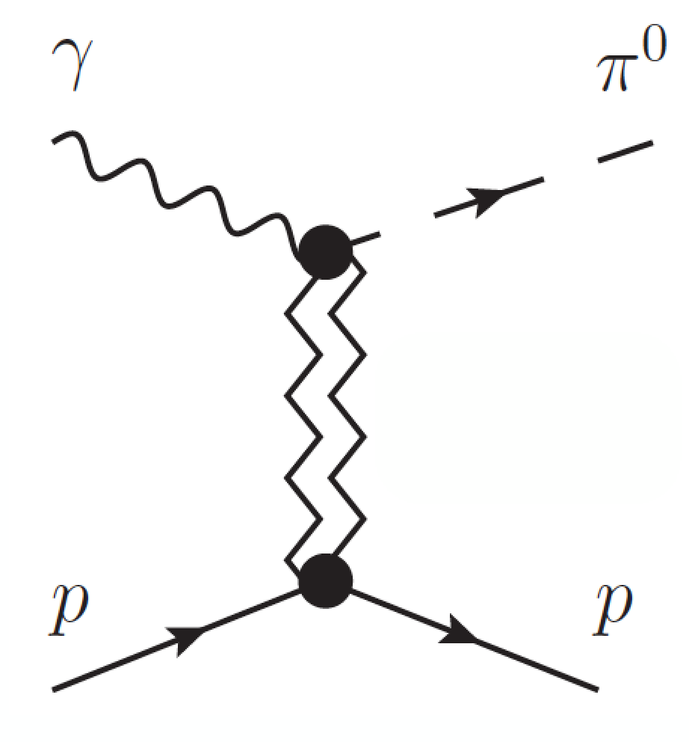
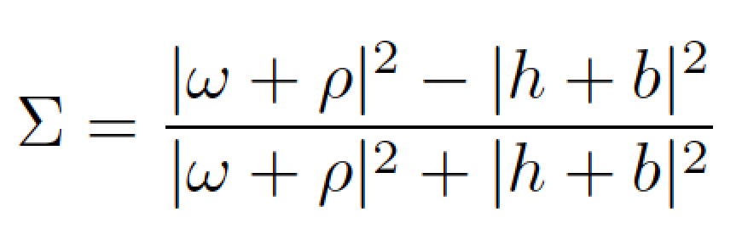


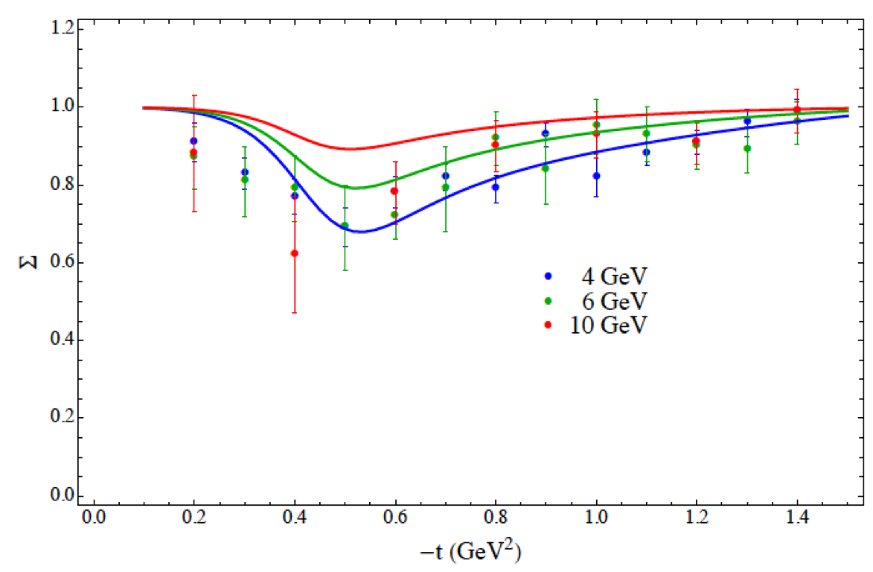
π⁰ beam asymmetry
Beam asymmetry Σ provides insight into dominant production mechanism
Understanding production mechanism critical to disentangling J^{PC} of observed states in exotic hybrid search.
From experimental standpoint easily extended to ɣp→pη where there are no previous measurements!
Exchange J^{PC}
Mathieu et al. PRD 92, 074013
Data at different
beam energies

Slide 27
Photon-beam Polarization
Coherent bremsstrahlung where we use the the 8.5 to 9.0 GeV photons.
~40% Linear polarization which depends on the photon energy.
We measure the energy and then have the polarization of each incident photon.

Slide 28
Beam Asymmetry Measurement
Exchange J^{PC}
Impacts extraction of baryon resonances from low-energy photoproduction experiments.
Understanding the meson production mechanisms at 9GeV is needed for our bigger program.
Phys. Rev. C95, 042201 (2017)

Slide 29
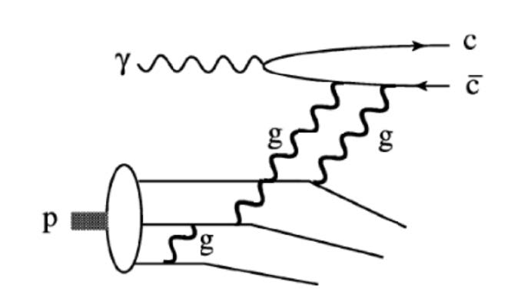
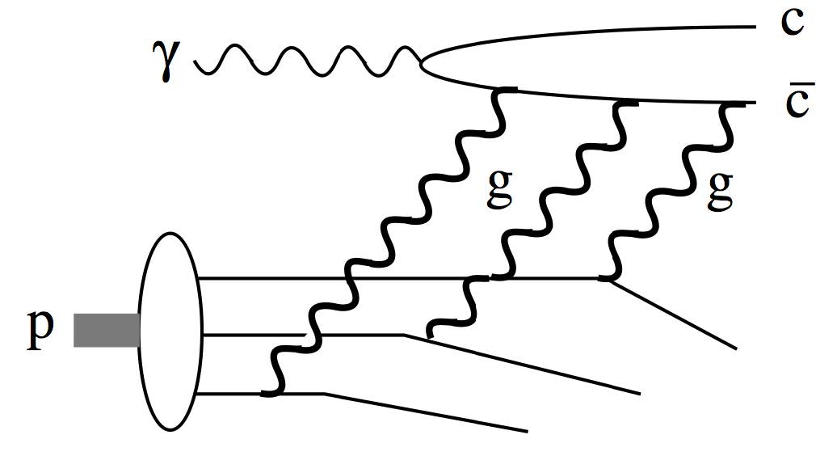
Opportunistic Physics
Probes gluon distributions in proton
[Kharzeev et al., NPA 661, 568 (1999)]
Also multiquark correlations
[Brodsky et al., PLB 498, 23 (2001)]
GlueX Energies
The two mechanisms have different energy dependences near threshold.

Slide 30
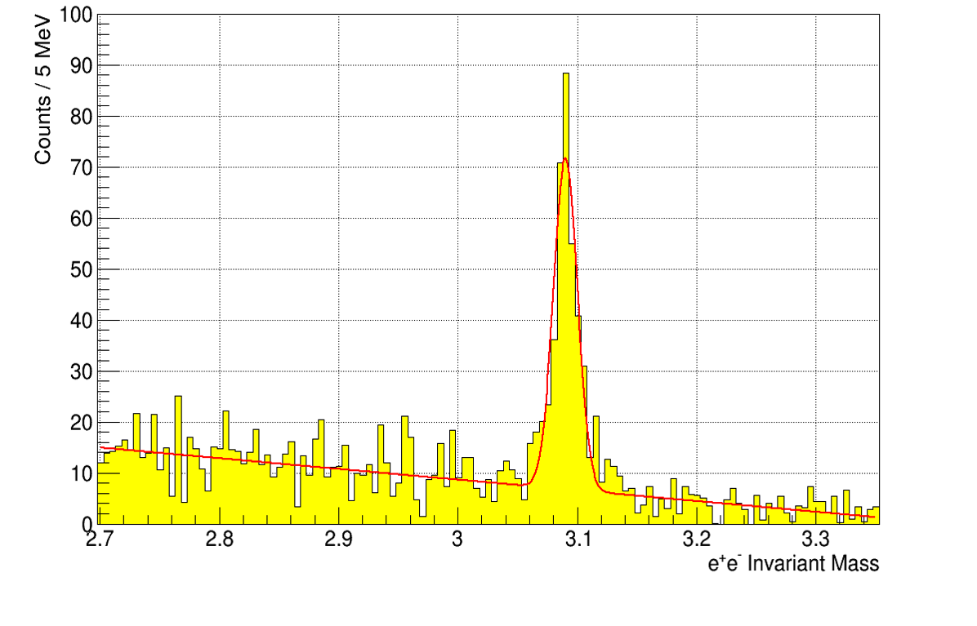

Opportunistic Physics
Detect J/ψ through its e⁺e⁻ decay
(2016 & 2017 Data)
(2016 Data)
LHCb
Pentaquark
323 +/- 23
(See talk on Friday by Luke Robison.)

Slide 31
Opportunistic Physics
Double-strange baryons: ssu ( Ξ⁰ ) & ssd ( Ξ⁻ )
Ξ(1320) (1/2)⁺ ∗∗∗∗
Ξ(1530) (3/2)⁺ ∗∗∗∗
Ξ(1690) ∗∗∗
Ξ(1820) (3/2)⁻ ∗∗∗
Ξ(1950) ∗∗∗
Ξ(2030) ∗∗∗
We expect many more of these states to exist, and many are expected to be relatively narrow.
CLAS observed the lightest two in photoproduction at lower energies.
Any observation of a significant “bump” can add significantly to our knowledge of these states.

Slide 32



Opportunistic Physics
Ξ(1320)
GlueX reconstructs exclusive final states, so decay distributions can be measured.
?
Ξ(1820)
2017 Data: Expect more than an order of magnitude more data from initial GlueX running.
(See talk on Friday by Ashley Ernest.)

Slide 33


Spin-Density Matrix Elements
Measures the spin transfer from the polarized photon to the vector meson and is sensitive to the production mechanism.
These are important demonstrations of our understanding of the acceptance of the detector.
The can be used to monitor the linear polarization of the photon nearly online.
(See talk on Friday be Alex Barnes.)

Slide 34
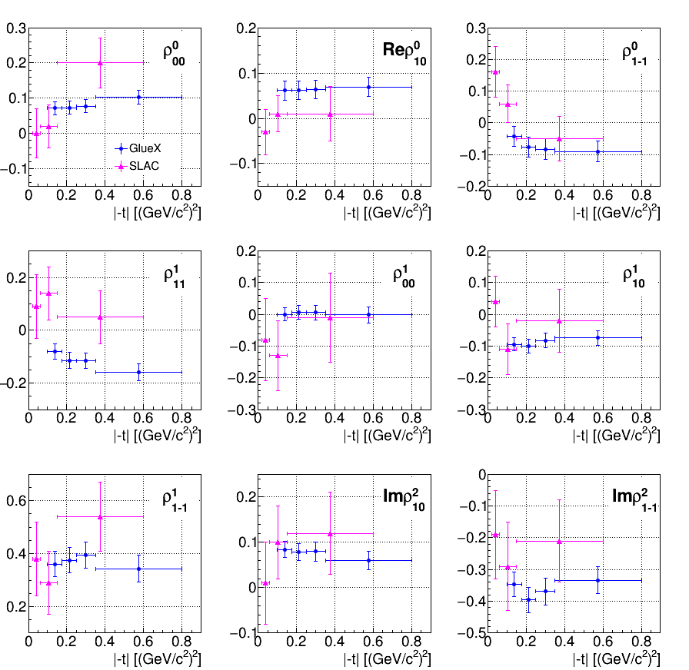
Spin-Density Matrix Elements
Two of the elements are very sensitive to the transfer of spin from the photon to the ω meson.
If the exchange is pure “pomeron”, +½ and –½. If it is pure pion exchange, -½ and +½. We see ~.35 and -.35.
M. Staib CMU Ph.D. Thesis 9/17

Slide 35
Beam Asymmetry in ρ Photoproduction
Huge increase in statistics over the existing data from SLAC.
Working with JPAC on models for analysis
~40% Polarization
Acceptance errors not included
Large polarization transfer to the ρ

Slide 36


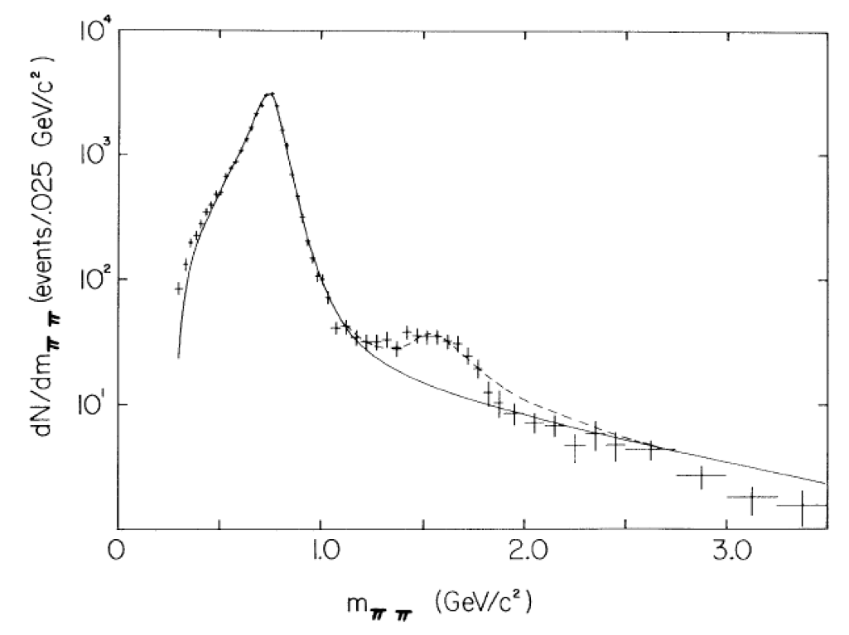


Observed Known States
In the ρ event sample, we can look for higher-mass vector mesons. We observe an enhancement around 1.6 GeV with significantly more statistics than existed; we should be able to measure polarization observables.
10⁴
SLAC:
20 GeV
ρ’?
PRL 53, 751 (1984)

Slide 37
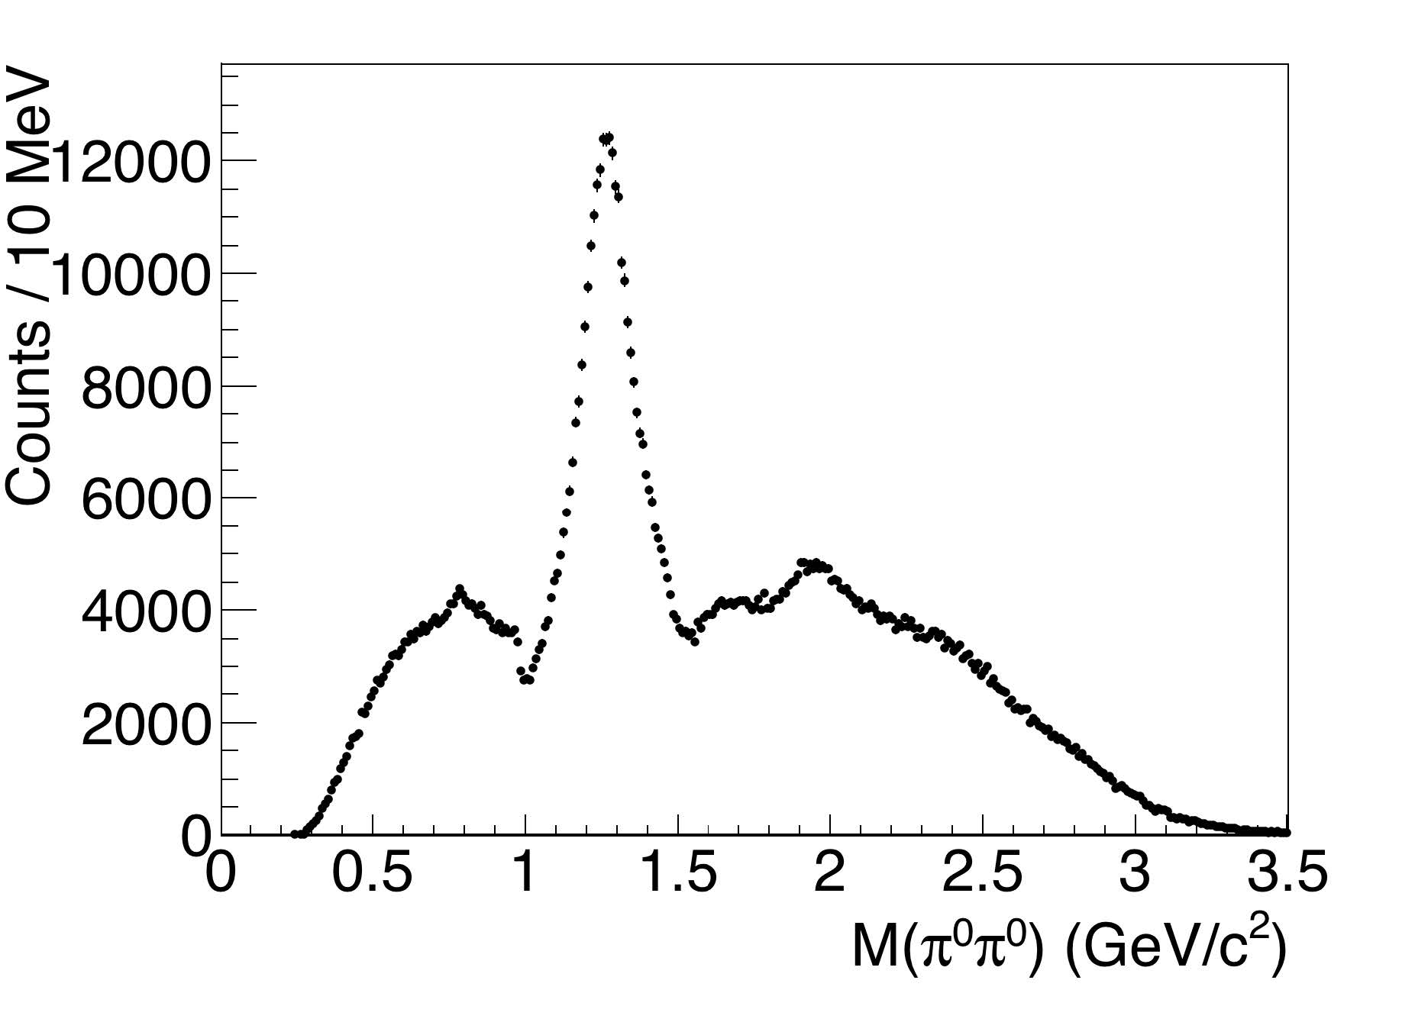
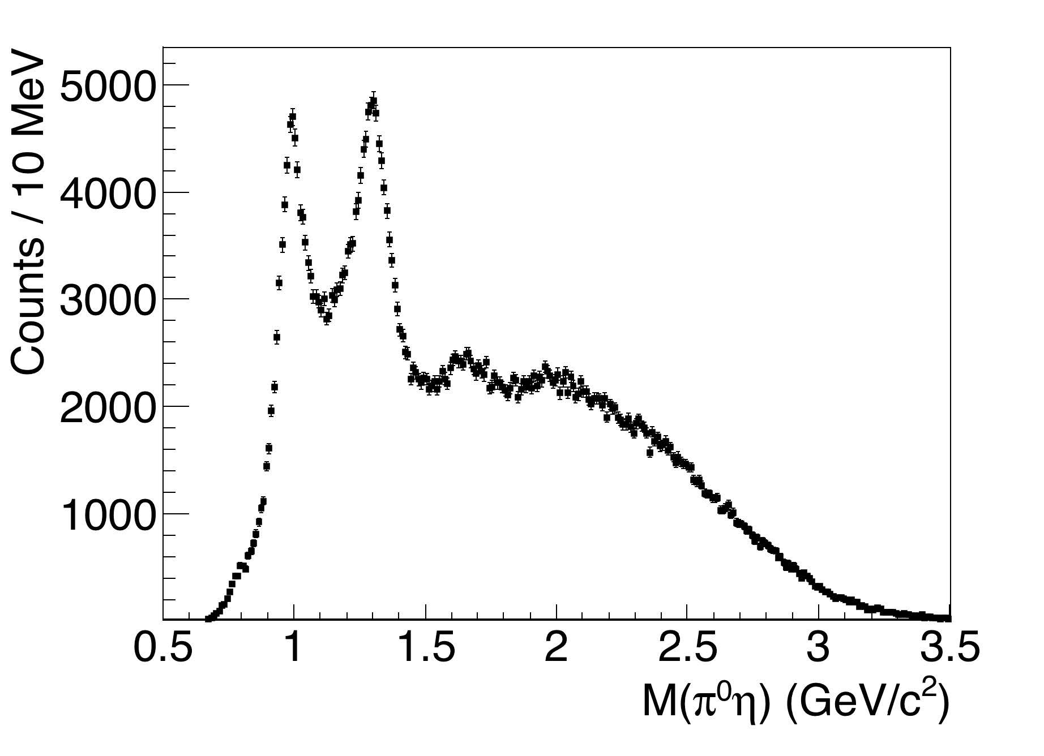



Observed Known States
2016 and some 2017 statistics.
Clear signals for f₀(980), f₂(1270), a₀(980) and a₂(1320).
(See talk on Friday by Shuang Han.)

Slide 38



Interesting Hybrid Channels
ρ → ππ
f₂ → ππ
a₂ → ηπ
γp → pη₁ γp → pb₂
η₁ → ηf₂,a₂π
b₂ → a₂π, ρη
Look for these
η’(958)
f₁(1285)
several known
states
Hybrid regime
80 hours of beam
2016 Engineering Run

Slide 39
Interesting Hybrid Channels
2016 Engineering Run
m²(ηπ)
a₀(980)
a₂(1320)
m(ηπ)
m²(ππ)
Clear signals for
ρ(770)
f₂(1270)?
Weak signal for
m(ππ)

Slide 40
Summary
GlueX is installed, commissioned and started physics running in Spring 2017.
All detector systems are near to or better than design specifications.
We have published our first results, and are aggressively moving ahead on other physics measurements.
The broader program of exotic mesons is in sight.
A large number of GlueX results as well as related theoretical work will be presented in the GlueX Physics minisymposium on Friday.

