Slide 1

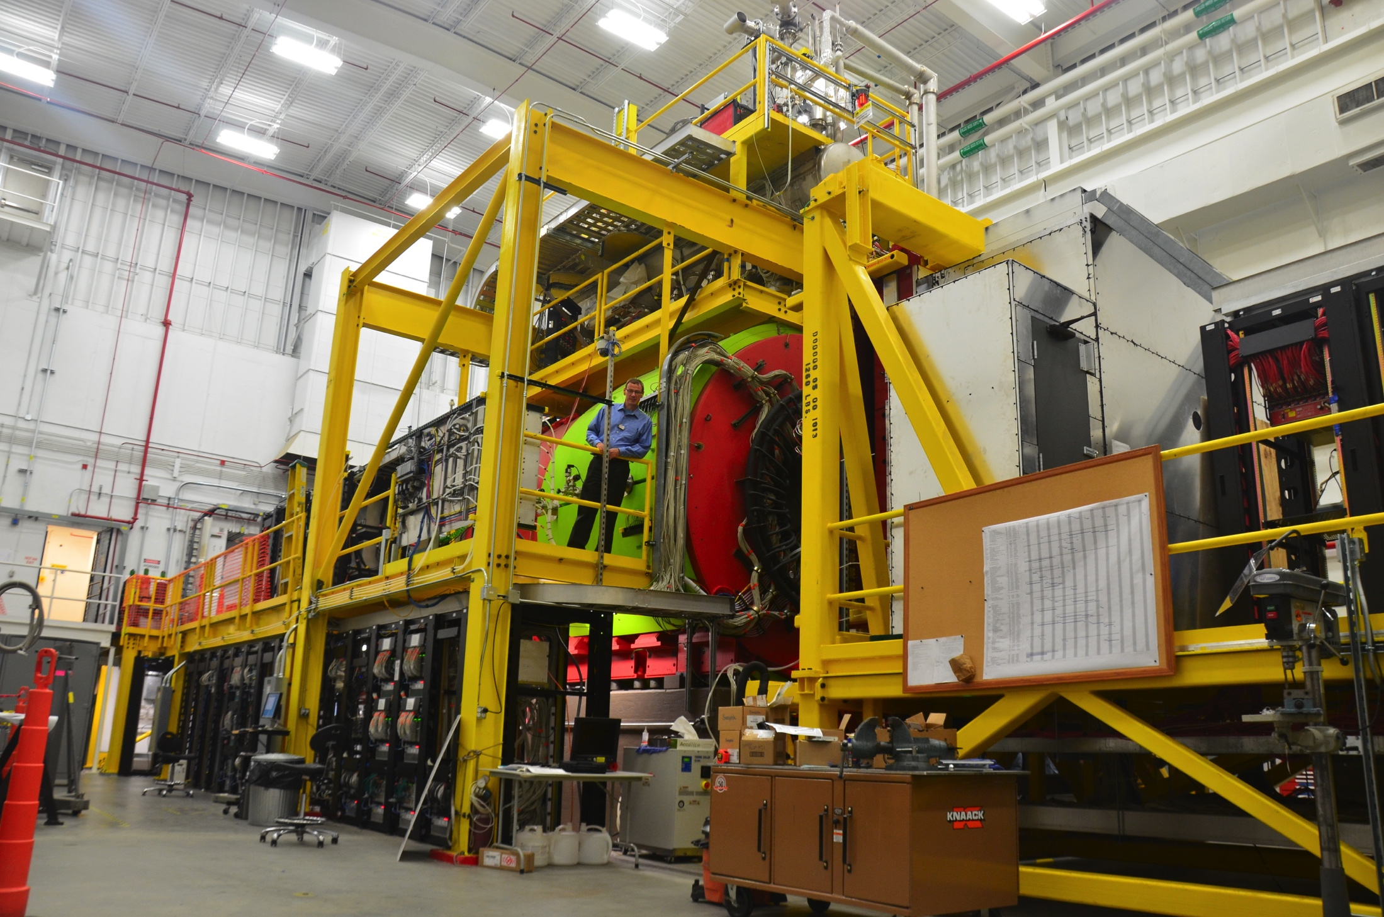
The Experiment
Curtis A. Meyer
Carnegie Mellon

Slide 2
The GlueX Collaboration
Arizona State, Athens, Carnegie Mellon, Catholic University, Univ. of Connecticut, Florida International, Florida State, George Washington, Glasgow, GSI, Indiana University, ITEP, Jefferson Lab, U. Mass Amherst, MIT, MePhi, Norfolk State, North Carolina A&T, Univ. North Carolina Wilmington, Northwestern, Santa Maria, University of Regina, Tomsk and Yerevan Physics Institute.
Over 120 collaborators from 24 institutions with others joining and more are welcome.

Slide 3
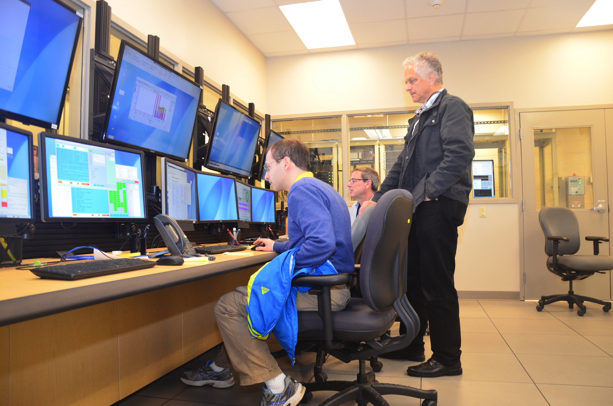
Outline
The GlueX physics program.
The GlueX experiment and its performance during commissioning.
Expected initial physics from GlueX.
Future plans and other physics.
Summary.
12-GeV beam, Dec.2015

Slide 4
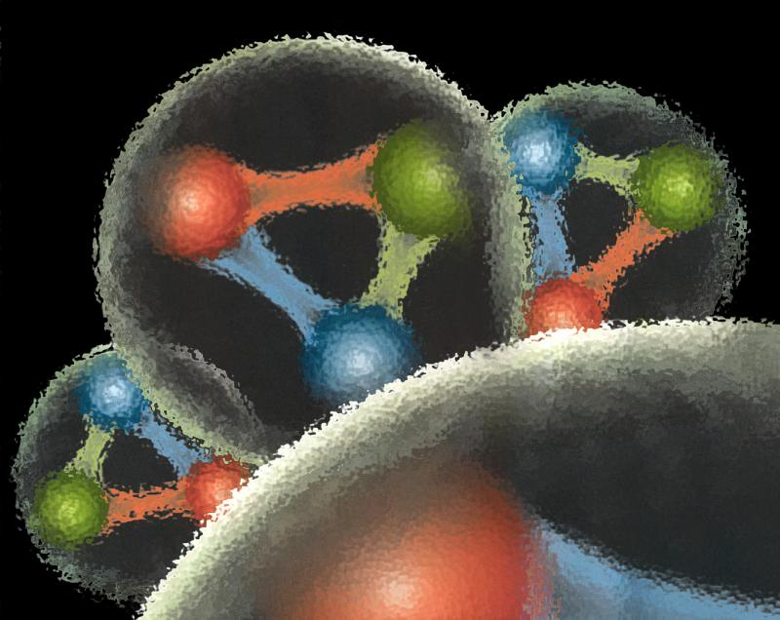
Quantum Chromo Dynamics
QCD describes the interactions of quarks and gluons and should predict the spectrum of bound-state baryons ( ) and mesons ( ).
There should also be mesons in which the gluonic field contributes directly to the J^{PC} quantum numbers of the states --- hybrid mesons. Some are expected to have ``exotic’’ quantum numbers.
Lattice QCD calculation of the light-quark meson spectrum.
``Constituent gluon’’: J^{PC} = 1⁺⁻ mass of 1-1.5 GeV.
The lightest hybrid nonets
1⁻⁻, (0⁻⁺,1⁻⁺, 2⁻⁺)
2.5Gev
2.0GeV
0⁺⁻
1⁻⁺
2⁺⁻
Notes:
What are gluonic excitations and why are we looking for them? Lattice QCD predictions for the mesons and in particular, a class of mesons with non-quark-antiquark quantum numbers. Also not that mixing angles are predicted. GlueX needs to measure particle J(PC), masses, widths and decay modes to be able to map these out.

Slide 5
Lattice QCD
Light-quark Mesons (u,d,s)
PRD83, 111502 & PRD88, 094505

Slide 6
Lattice QCD
Light-quark Mesons (u,d,s)
2⁻⁺
1⁻⁺
States with non-trivial gluonic fields.
Supermultiplet
1⁻⁻
1⁻⁻, 0⁻⁺ , 1⁻⁺ , 2⁻⁺
0⁻⁺
PRD83, 111502 & PRD88, 094505

Slide 7
QCD Exotics
2.5Gev
Lattice QCD suggests 5 nonets of mesons with exotic quantum number:
1 nonet of 0⁺⁻ exotic mesons
2 nonets of 1⁻⁺ exotic mesons
2 nonets of 2⁺⁻ exotic mesons
2.0GeV
0⁺⁻
1⁻⁺
2⁺⁻
Experimental evidence exists for π₁ states.
π₁ I^{G}(J^{PC})=1⁻(1⁻⁺)
K₁ I^{G}(J^{PC})= ½ (1⁻)
``Constituent gluon’’ behaves like J^{PC} = 1⁺⁻ with a mass of 1-1.5 GeV
The lightest hybrid nonets:
1⁻⁻, (0⁻⁺,1⁻⁺, 2⁻⁺)
η’₁ I^{G}(J^{PC})=0⁺(1⁻⁺)
η₁ I^{G}(J^{PC})=0⁺(1⁻⁺)
Kaon states do not have exotic QNs
PRD84, 074023

Slide 8
Photoproduction Mechanisms
Simple quantum number counting for production: (I^{G})J^{PC} up to L=2
P = Pomeron exchange
ρπ,ρω π₁
ωω,ρρ η₁
ωω,ρρ,φω η’₁
ρP b₀
ωP h₀
ωP, φP h’₀
ωπ,ρη,ρP b₂
ρπ,ωη,ωP h₂
ρπ,ωη,φP h’₂
ρπ is charge-exchange only
Can couple to all the lightest exotic hybrid nonets through photo- production and VMD.
Linear polarization is a filter on the naturality of the exchanged particle.

Slide 9
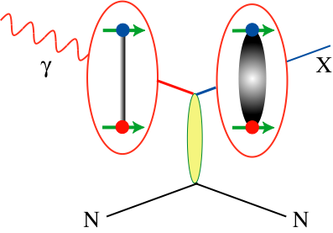
Decay Modes of Exotic Hybrids
π₁ → πρ, πb₁ , πf₁,πη’, ηa₁
η₁ → ηf₂,a₂π,ηf₁, ηη’,π(1300)π, a₁π,
η₁’→ K*Κ, Κ₁(1270)Κ, Κ₁(1410)Κ , ηη’
b₂ → ωπ, a₂π, ρη, f₁ρ, a₁π, h₁π, b₁η
h₂ → ρπ,b₁π,ωη, f₁ω
h’₂ → Κ₁(1270)Κ, Κ₁(1410)Κ, K₂*Κ, φη, f₁φ
b₀ → π(1300)π , h₁π, f₁ρ, b₁η
h₀ → b₁π , h₁η
h’₀ → K₁(1270)Κ, Κ(1460)Κ, h₁η
Models suggest narrower states are in the spin-1 and spin-2 nonets, while the spin-0 nonets are broad.
Early Reach With Statistics Hard
Hybrid kaons do not have exotic QN’s

Slide 10
The GlueX Experiment
BaBar DIRC Bars
Photo Production of Hybrids,
Light-quark Mesons
and Strangeonium States
Initial Physics in 2016

Slide 11
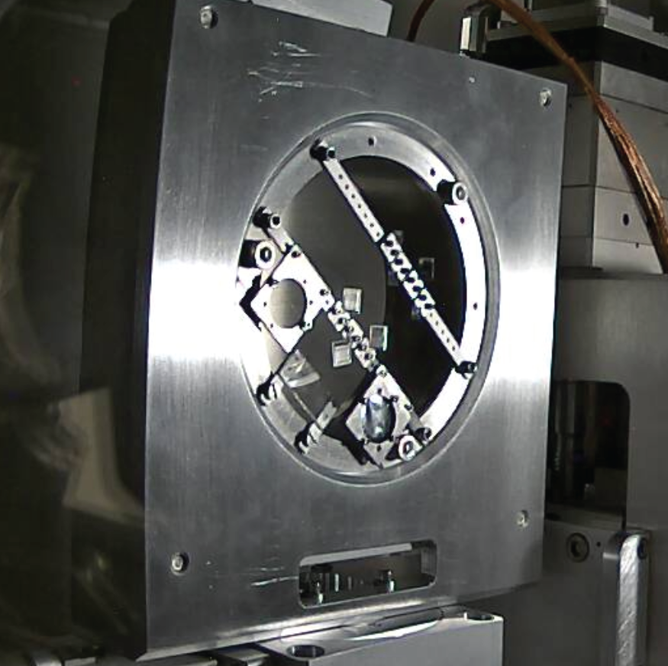
The GlueX Experiment
Polarimeter
12 GeV e⁻ beam up to 2.2 μA.
Linearly polarized photons (P_{ɣ}≈40%) from coherent bremsstrahlung on thin diamond radiator.
Polarization parallel and perpendicular to floor.
Design intensity of 10⁸ ɣ/s in coherent peak (E_{ɣ} = 8.4-9 GeV)
Goniometer with diamonds

Slide 12
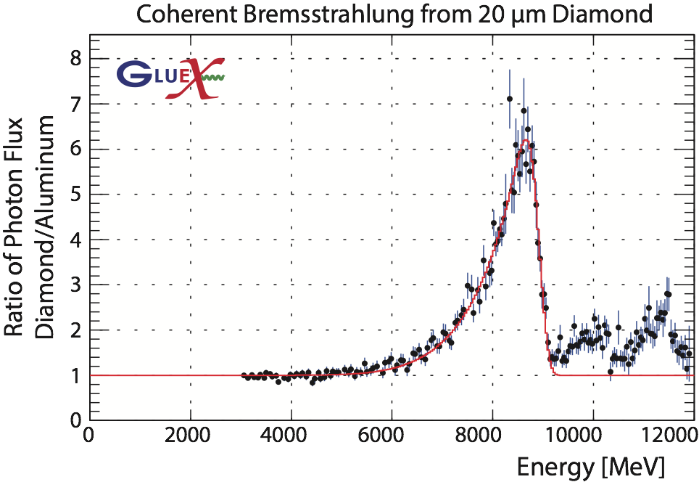
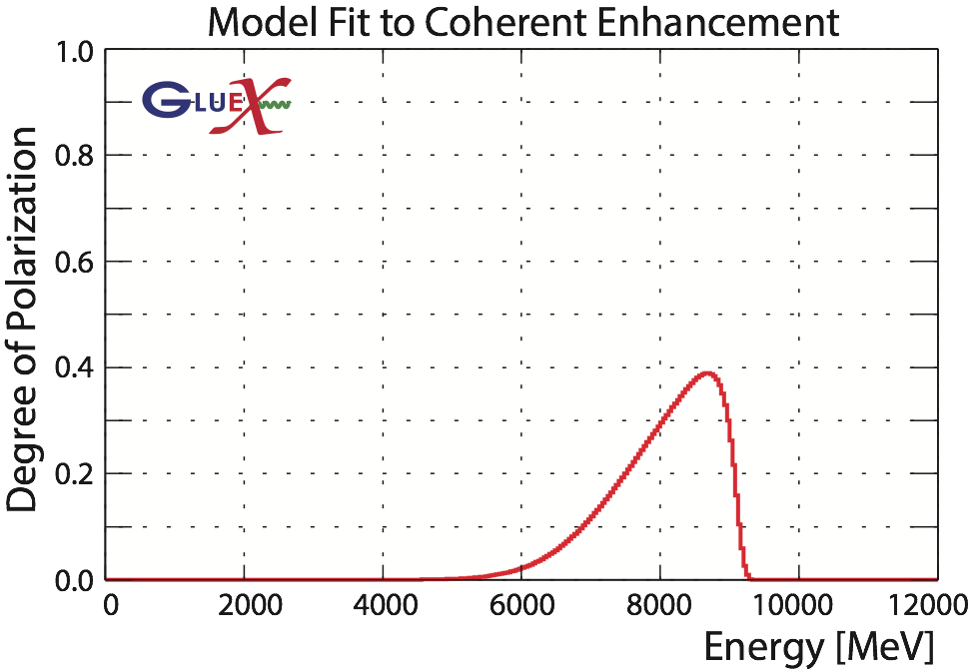
The GlueX Experiment
Polarimeter

Slide 13
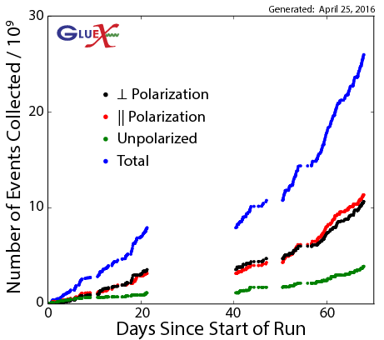
GlueX Commissioning
Spring 2016 run with 12-GeV electrons on thin diamond radiators. Linear polarization, both perpendicular and parallel to the earth, collected.

Slide 14
GlueX Calorimeter Performance

Slide 15
GlueX Tracking Performance

Slide 16
GlueX Particle Identification

Slide 17
Start of Physics in GlueX
Initial reactions will be polarization transfer and beam asymmetry measurements.
Spin-density matrix elements to understand production mechanisms.
Opportunistic results from data exploration.
Cross section measurements.
Identify known mesons in PWA.
Move on to the search for exotic hybrids.

Slide 18
Early Physics in GlueX
Initial reactions will be polarization transfer and beam asymmetry measurements.
Spin-density matrix elements to understand production mechanisms.
Opportunistic results from data exploration.
Cross section measurements.
Identify known mesons in PWA.
Move on to the search for exotic hybrids.

Slide 19
Beam Asymmetry in ρ Photoproduction
Between 100 and 1000 times the 3000 existing events from SLAC.
Working with JPAC on models for analysis
~40% Polarization
Acceptance errors not included
Large polarization transfer to the ρ

Slide 20
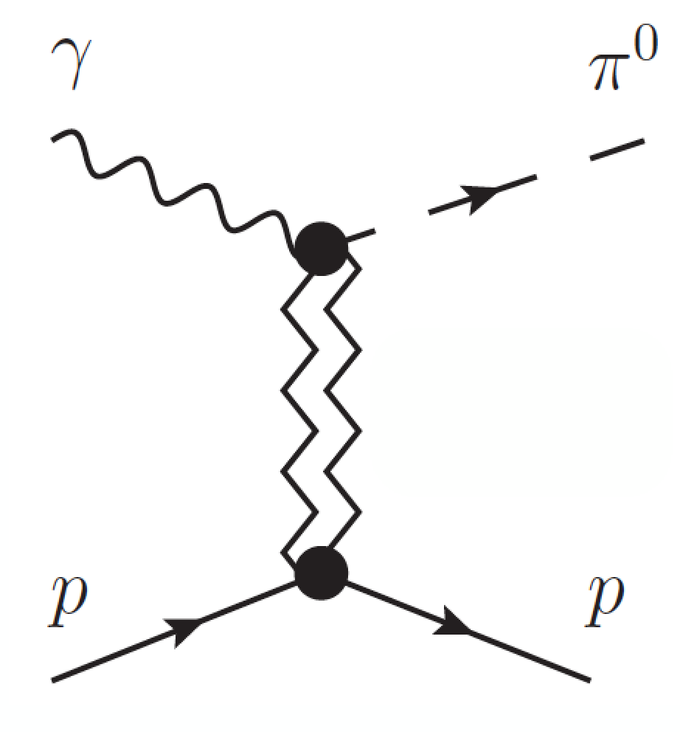
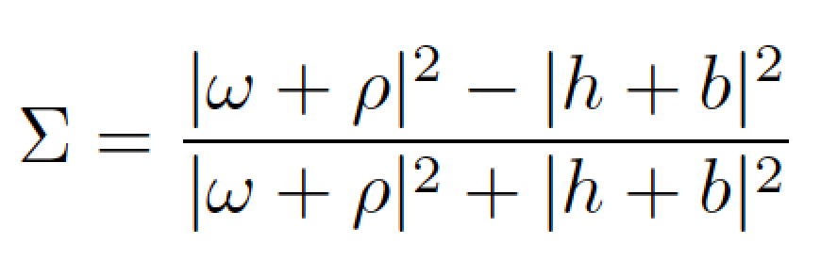


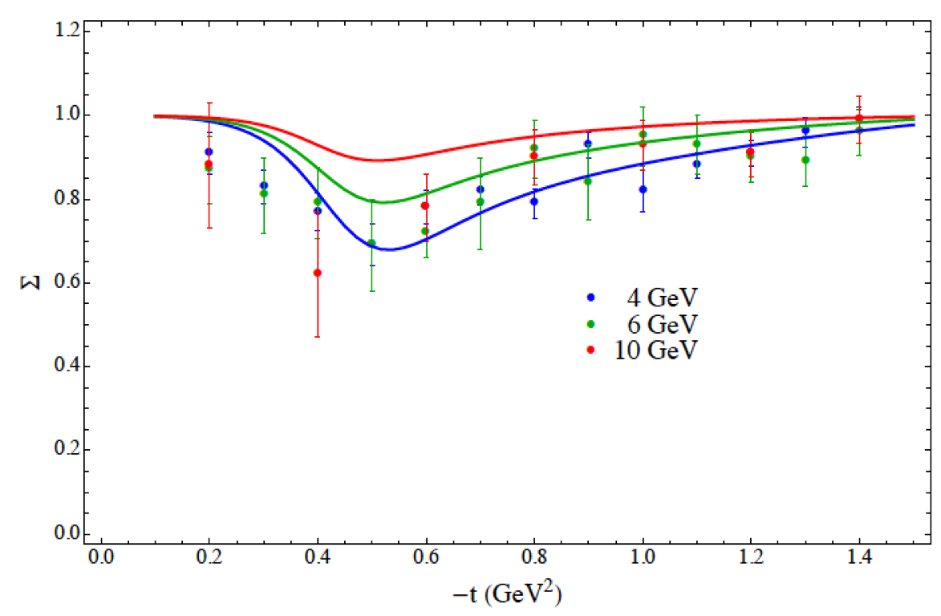
π⁰ beam asymmetry
Beam asymmetry Σ provides insight into dominant production mechanism
Understanding production mechanism critical to disentangling J^{PC} of observed states in exotic hybrid search.
From experimental standpoint easily extended to ɣp→η where there are no previous measurements!
Exchange J^{PC}
Mathieu et al. PRD 92, 074013
Data at different
beam energies
See Adam Szczepaniak’s talk on JPAC

Slide 21
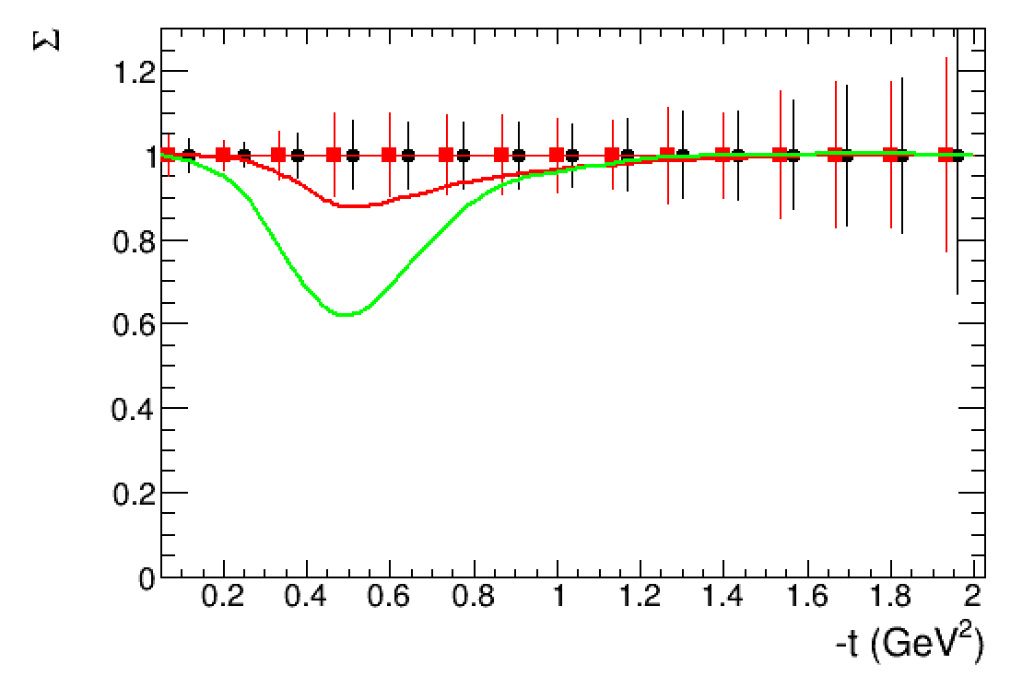
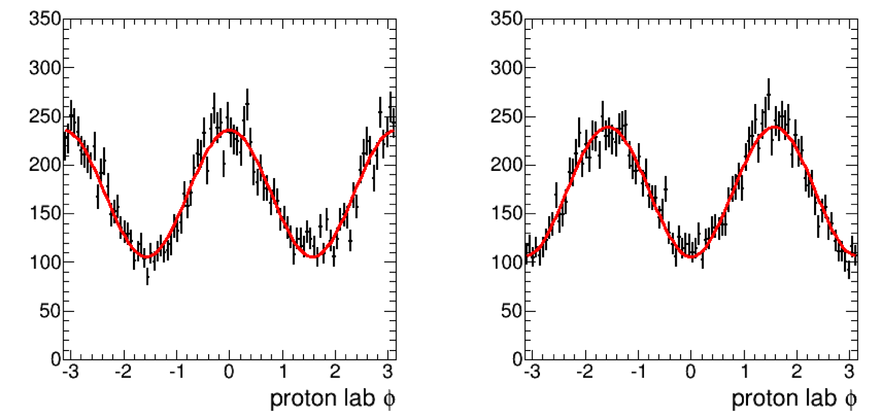

π⁰ model: integration with JPAC
Simulation from JPAC Model
12 hours of beam: statistical errors only
Σ
V. Mathieu (JPAC) PRD 92, 074013
A Donnachie PRC 93, 025203
Similar to ρ⁰ model, simply calculate intensity based on JPAC provided function
Generate ɣp→π⁰p events and process through full detector simulation and reconstruction
Before Spring 2016 run estimated yields for 12 hours of beam; evaluated statistical precision
Actually collected >10x more data!

Slide 22
Pseudoscalar Beam Asymmetries
From a subset of all available data.
Polarization not yet determined.
Preliminary
Asymmetry
Preliminary
Asymmetry

Slide 23
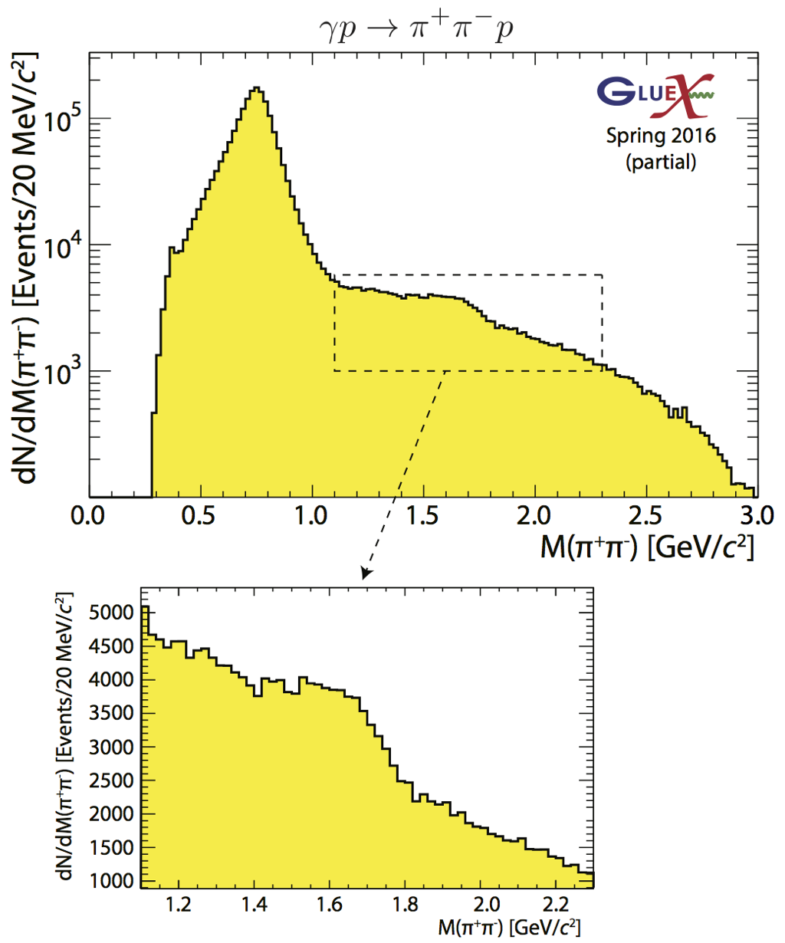
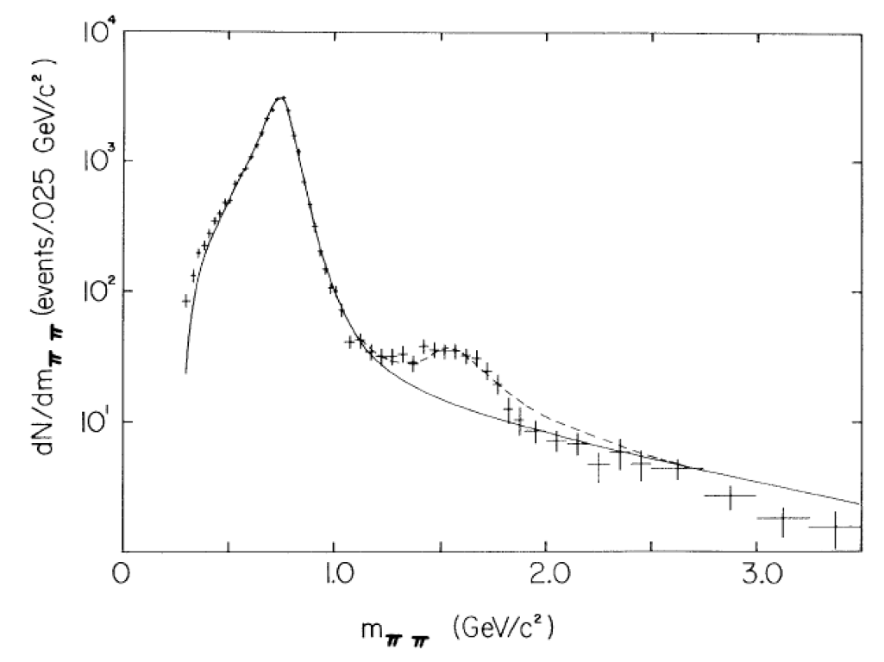

Physics Opportunities
In the ρ event sample, we can look for higher-mass vector mesons. We observe an enhancement around 1.6 GeV with significantly more statistics than existed and we should be able to measure polarization observables.
SLAC:
ρ’?
PRL 53, 751 (1984)

Slide 24
Four photon final states
About 6% of the spring 2016 statistics from early in the run and using a very preliminary production run.
Clear signals for σ, f₀(980), f₂(1270), a₀(980) and a₂(1320).

Slide 25
Forward Kaon Identification
Four of the BaBar DIRC bar boxes will be installed in front of the TOF wall.
This combined with the other PID systems in GlueX will allow us to fully study final states with strange quarks.
Strangeonium mesons and hybrids can be studied.
Hyperon and cascade baryons can be studied.
Expected in 2018/2019

Slide 26
GlueX Experiments
GlueX—Hybrid mesons/spectroscopy
PR-06-102, PR-12-002 & PR-13-003
GlueX—PrimEx-eta
PR-10-011
(calorimeter plug)
GlueX—Pion polarizability
PR-13-008
(forward muon detector)
GlueX—JEF: Rare eta decays
PR14-004
(calorimeter upgrade)
A rating
340-540 PAC days
A- rating
79 PAC Days
A- rating
25 PAC Days
Conditionally
Approved

Slide 27
GlueX Experiments
GlueX—Study of ω photoproduction
on nuclei.
Workshop held in February 2016
https://www.jlab.org/conferences/kl2016/
GlueX—Physics opportunities with a
secondary K_{L} beam
Workshop held in April 2016
https://www.jlab.org/conferences/photoproduction16/
LOI 2015
LOI 2015

Slide 28
Summary
GlueX is installed, commissioned and ready to start physics running in Fall 2016.
All detector systems are near design specifications.
We are aggressively moving ahead on our first physics measurements.
The broader program of exotic mesons is in sight.
Addition of kaon identification and five-times higher intensity is planned in 2018 to allow us to cover all parts of the GlueX exotic hybrid program.
We have an extensive program beyond exotic hybrids and are excited to have new ideas and new collaborators.

