Slide 1
The GlueX Experiment in Hall-D
Curtis A. Meyer
GlueX Spokesperson
October 3, 2014

Slide 2
The Long Road to Now
Jul. 1997 – Workshop at Indiana University
Dec. 1999 – External Project Review
Apr. 2004 – Critical Decision 0
Oct. 2004 – External Detector Review
Oct. 2008 – Critical Decision 3
Apr. 2009 – Hall-D Complex Ground Breaking
Jan. 2012 – Beneficial Occupancy of Hall D
May 2014 – 10.5 GeV electron beam to tagger dump.
Oct. 2014 – Photon beam to GlueX.
Apr. 2015 – Engineering/Physics Running with GlueX.
Sep. 2015 – Physics Running with GlueX!
18 Years

Slide 3
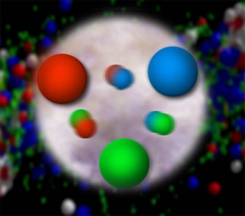
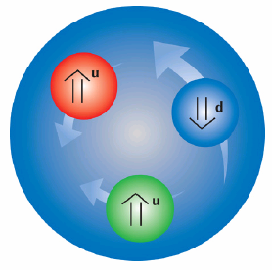
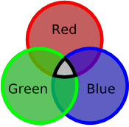
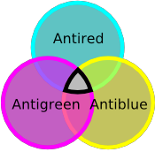
Quantum Chromo Dynamics
The rules that govern how the quarks
froze out into hadrons are given by QCD.
Quarks have color
charge: red, blue and
green. Antiquarks
have anticolors:
cyan, yellow and
magenta.
Atoms are electrically
neutral: a charge and
an anti-charge ( + - ).
Hadrons are color neutral (white),
red-cyan, blue-yellow, green-magenta
or red-blue-green, cyan-yellow-magenta.

Slide 4
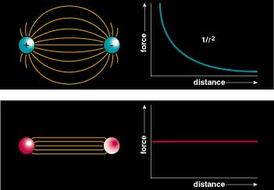
Quantum Chromo Dynamics
Color Field: Because of self interaction, confining flux tubes form between static color charges
Confinement arises from flux tubes and their excitation leads to a new spectrum of mesons

Slide 5
The QCD Potential
ground-state
flux-tube
m=0
linear potential

Slide 6
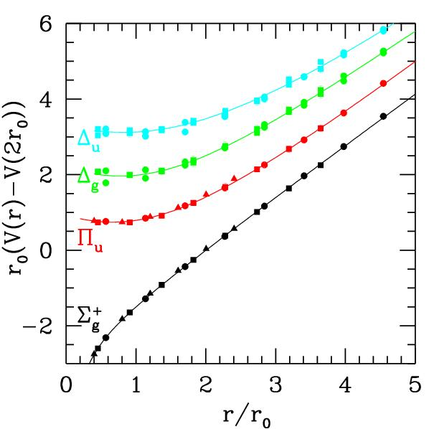
The QCD Potential
ground-state
flux-tube
m=0
Excited gluonic field
linear potential
Gluonic Excitations provide an
experimental measurement of
the excited QCD potential.
Observations of the nonets on the excited potentials are
the best experimental signal of gluonic excitations.

Slide 7
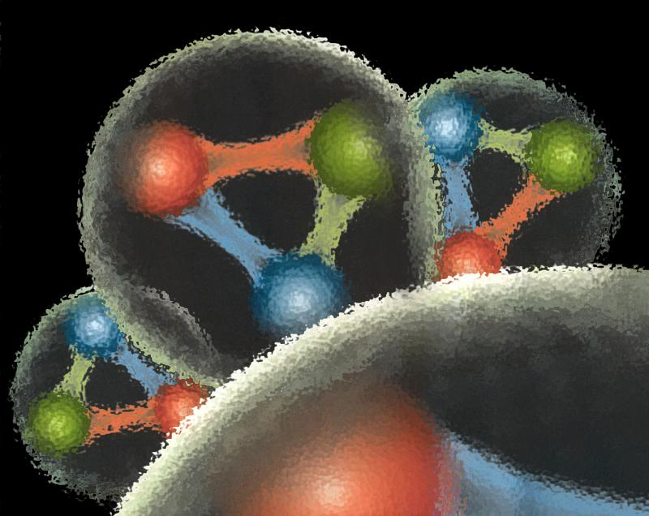
Quantum Chromo Dynamics
QCD describes the interactions of quarks and gluons and should predict the spectrum of bound-state baryons ( ) and mesons ( ).
There should also be mesons in which the gluonic field contributes directly to the J^{PC} quantum numbers of the states --- hybrid mesons. Some are expected to have ``exotic’’ quantum numbers.
Lattice QCD calculation of the light-quark meson spectrum
2.5Gev
2.0GeV
Exotic QN
0⁺⁻
1⁻⁺
2⁺⁻
Normal QN
Several nonets predicted
Notes:
What are gluonic excitations and why are we looking for them? Lattice QCD predictions for the mesons and in particular, a class of mesons with non-quark-antiquark quantum numbers. Also not that mixing angles are predicted. GlueX needs to measure particle J(PC), masses, widths and decay modes to be able to map these out.

Slide 8
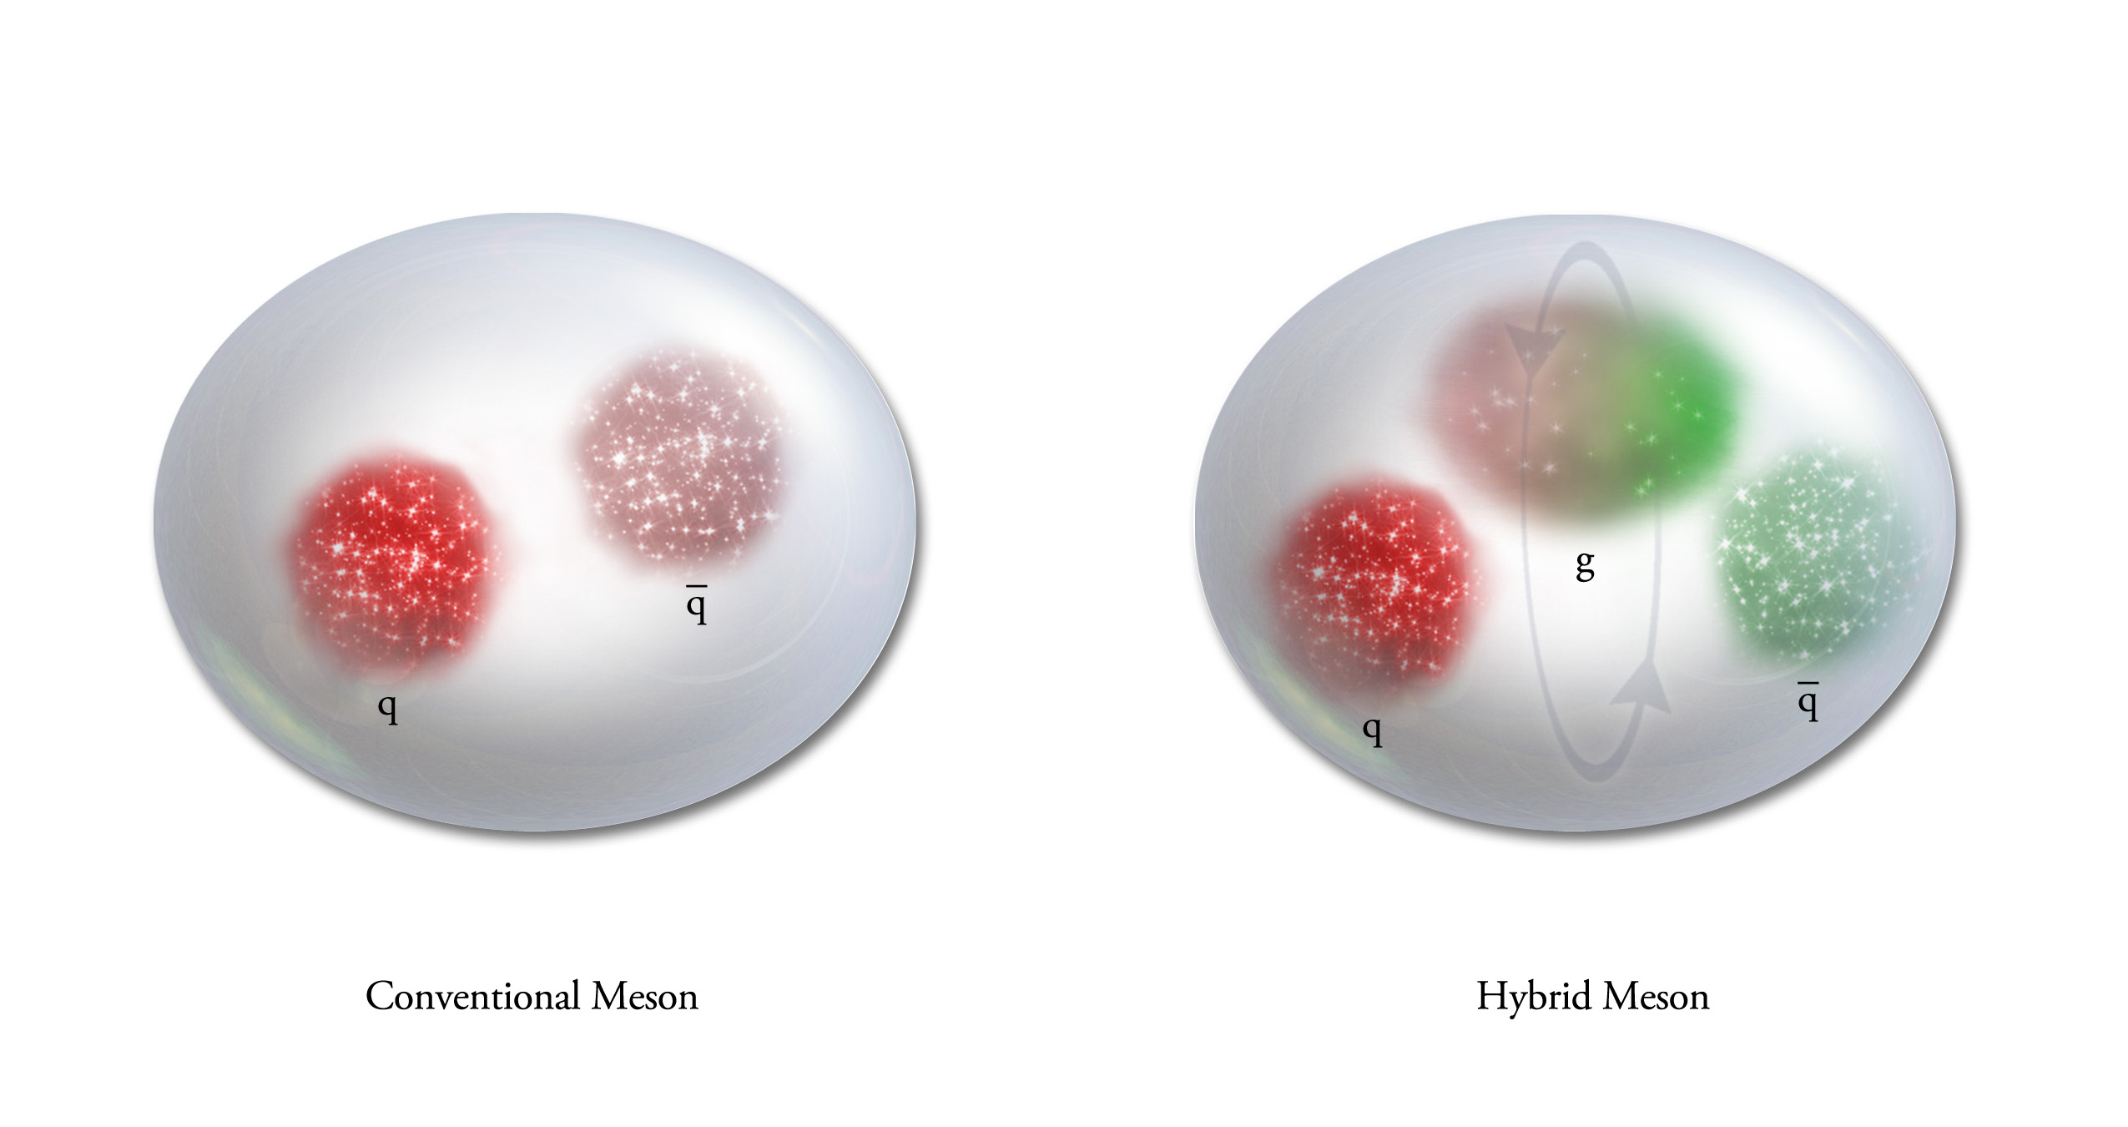
QCD Exotics
3 types of quarks:
up, down and strange
3 types of anti-quarks:
9 quark-antiquark pairs == nonet
π₁ I^{G}(J^{PC})=1⁻(1⁻⁺)
K₁ I^{G}(J^{PC})= ½ (1⁻)
η’₁ I^{G}(J^{PC})=0⁺(1⁻⁺)
η₁ I^{G}(J^{PC})=0⁺(1⁻⁺)
We expect 5 nonets of exotic-quantum-number mesons:
1 nonet of 0⁺⁻ exotic mesons
2 nonets of 1⁻⁺ exotic mesons
2 nonets of 2⁺⁻ exotic mesons
Lattice shows two nonets here.
Experimental evidence exists for π₁ states.

Slide 9
The GlueX Experiment

Slide 10
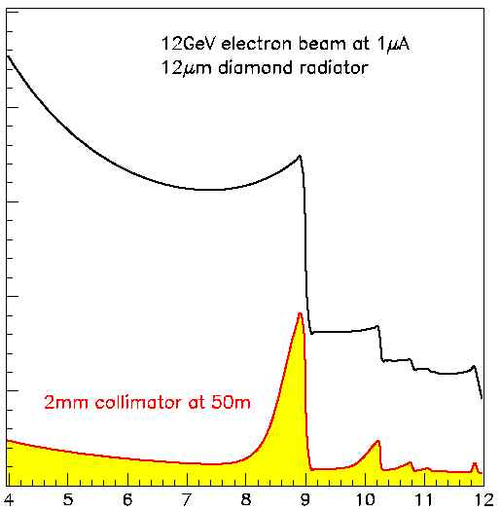
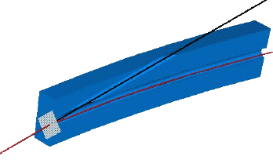
Coherent Bremsstrahlung
12 GeV electrons
This technique provides requisite energy, flux and polarization
Incoherent &
coherent spectrum
flux
40%
polarization
in peak
Linearly polarized
photons out
electrons in
collimated
spectrometer
20 μm thick
Diamond crystal
photon energy (GeV)
tagged
with 0.1% resolution

Slide 11
Physics in
8.4-9.0 GeV linearly polarized photons from 12 GeV electrons in a thin diamond wafer
Charged particle tracking + timing and photon detection in a 2T magnetic field.
All of these channels have been studied in Monte Carlo to understand the acceptance.
These studies have been used to ``stress’’ our offline reconstruction software.
Fully reconstruct final states
Notes:
Coherent bremsstrahlung beam with linearly polarized (40%) photons and the GlueX detector to search for exotics. The detector is a nearly hermetic detector for charged particles and photons in a 2.2T magnetic field. The expected reaction is the photo production of some meson X which then decays. Typical decay chains for a some exotic states are shown, and the final states that they yield. GlueX needs to reconstruct complete final states to carry out amplitude analysis.

Slide 12
Summary
We are excited to have the GlueX/Hall-D photoproduction programs starting very soon.
We anticipate an exciting meson program over the next decade.
When we are done, we hope that we have the answer to: ``Where are the QCD states with static glue?’’

Slide 13
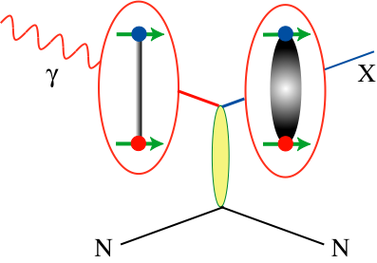
Expected Decay Modes
π₁ → πρ, πb₁ , πf₁,πη’, ηa₁
η₁ → ηf₂,a₂π,ηf₁, ηη’,π(1300)π, a₁π,
η₁’→ K*Κ, Κ₁(1270)Κ, Κ₁(1270)Κ , ηη’
b₂ → ωπ, a₂π, ρη, f₁ρ, a₁π, h₁π, b₁η
h₂ → ρπ,b₁π,ωη, f₁ω
h’₂ → Κ₁(1270)Κ, Κ₁(1270)Κ, K₂*Κ, φη, f₁φ
b₀ → π(1300)π , h₁π, f₁ρ, b₁η
h₀ → b₁π , h₁η
h’₀ → K₁(1270)Κ, Κ(1460)Κ, h₁η
Early Reach With Statistics Hard
Kaons do not have exotic QN’s

Slide 14
GlueX Physics Analysis
GlueX ready to do physics, analyses being worked out in advance using the full suite of GlueX/Hall-D software and data from large-scale data challenges.
Physics reactions of interest:
Understand the detector
Initial exotic hybrid searches
Strange Baryons
Activity in the physics working group has shifted to physics analysis.
Other Physics Interests
Decays
Primakov
J/ψ Production
…

