Slide 1
Amplitude Analysis in GlueX
Curtis A. Meyer
Carnegie Mellon University

Slide 2
Outline
The GlueX Detector
Hybrid Mesons (LQCD)
Hybrid Mesons (Decays)
Physics Analyses
Summary

Slide 3
The GlueX Experiment

Slide 4
LQCD: The Spectrum of Mesons
Dynamical calculation of the isospin-one light-quark mesons.
3 identical quarks, pion mass ~700MeV
Two lattice volumes.
(exotic)
J^{PC}
J^{PC}
J^{PC}
J.J. Dudek (et al.) Phys. Rev. D82, 034508 (2010)

Slide 5
LQCD: The Spectrum of Mesons
Dynamical calculation of the isospin-one light-quark mesons.
Extra
states ???
Non-exotic
QN hybrids.
0⁻⁺
1—
2⁻⁺
1⁺⁻
1⁺⁺
Large overlap with non-trivial operators in the gluonic fields
(exotic)
J^{PC}
J^{PC}
J^{PC}
J.J. Dudek (et al.) Phys. Rev. D82, 034508 (2010)

Slide 6
LQCD: The Spectrum of Mesons
Dynamical calculation of the isospin-one light-quark mesons.
Extra
states ???
Non-exotic
QN hybrids.
0⁻⁺
1—
2⁻⁺
1⁺⁻
1⁺⁺
Large overlap with non-trivial operators in the gluonic fields
This does not look like the flux-tube spectrum. At first glance, it looks more like the bag model predictions? Talk to Adam for
a better description.
(exotic)
J^{PC}
J^{PC}
J^{PC}
J.J. Dudek (et al.) Phys. Rev. D82, 034508 (2010)

Slide 7
QCD Exotics
We expect 3 nonets of exotic-quantum-number mesons: 0⁺⁻, 1⁻⁺, 2⁺⁻
π₁ I^{G}(J^{PC})=1⁻(1⁻⁺)
K₁ I^{G}(J^{PC})= ½ (1⁻)
Lattice shows two states here.
η’₁ I^{G}(J^{PC})=0⁺(1⁻⁺)
η₁ I^{G}(J^{PC})=0⁺(1⁻⁺)
π , η , η’ , K → π₁ , η₁ , η’₁, K₁
What are the mixing angles between the isoscalar states?
1⁻⁺
0⁺⁻
2⁺⁻
b₀, h₀, h₀’, K₀
b₂, h₂, h₂’, K₂

Slide 8
Hybrid Decays
L_{flux}
The angular momentum in the flux
tube stays in one of the daughter
mesons (an (L=1) and (L=0) meson).
L_{flux}
Exotic Quantum Number Hybrids
π₁→ πb₁ , πf₁ , πρ , ηa₁
η₁→π(1300)π , a₁π
b₂ → a₁π , h₁π , ωπ , a₂π
h₂ → b₁π , ρπ , ωη
b₀ → π(1300)π , h₁π
h₀ → b₁π , h₁η
Mass and model
dependent
predictions
Populate final states with
π±,π⁰,K±,K⁰,η, (photons)

Slide 9
Hybrid Decays
L_{flux}
The angular momentum in the flux
tube stays in one of the daughter
mesons (an (L=1) and (L=0) meson).
L_{flux}
Exotic Quantum Number Hybrids
π₁→ πb₁ , πf₁ , πρ , ηa₁
η₁→π(1300)π , a₁π
b₂ → a₁π , h₁π , ωπ , a₂π
h₂ → b₁π , ρπ , ωη
b₀ → π(1300)π , h₁π
h₀ → b₁π , h₁η
Mass and model
dependent
predictions
Populate final states with
π±,π⁰,K±,K⁰,η, (photons)
The good channels to look at with amplitude analysis.

Slide 10
Hybrid Decays
L_{flux}
The angular momentum in the flux
tube stays in one of the daughter
mesons (an (L=1) and (L=0) meson).
L_{flux}
Exotic Quantum Number Hybrids
π₁→ πb₁ , πf₁ , πρ , ηa₁
η₁→π(1300)π , a₁π
b₂ → a₁π , h₁π , ωπ , a₂π
h₂ → b₁π , ρπ , ωη
b₀ → π(1300)π , h₁π
h₀ → b₁π , h₁η
Mass and model
dependent
predictions
Populate final states with
π±,π⁰,K±,K⁰,η, (photons)
The good channels to look at with amplitude analysis.
Other interesting channels for amplitude analysis.

Slide 11
Analysis Amplitude
Likelihood is a product of probabilities over all measured events, n.
Take the natural log to turn into a sum over the data. We need a Monte Carlo sample to be able to integrate over all phase space and normalize the probabilities.
data
Monte Carlo
Minimize
Physics Model

Slide 12
Un-binned Likelihood Fitting
Amplitude analysis fits coherent and incoherent sums of amplitudes to experimental distributions . These fits are done to individual events, and the un-binned likelihood fitting is reduced to a sum over events which can trivially parallelize on computers.
A historic issue has been that unlike a binned fit where a χ² can be defined, and a goodness of fit defined, with likelihood fitting, only relative goodness of fits were possible. Thus, one could tell if one fit were better than another, but not how good either fit really was.
Motivated by work started at CMU [arXiv:0807.1582], Mike Williams has showen several robust methods to obtain a true goodness of fit from these procedures.
M. Williams, How good are your fits? Un-binned multivariate goodness-of-fit tests in high energy physics, JINST 5, P09004, (2010). [arXiv:1006.3019]

Slide 13
Physics Analysis
Make Amplitude generation straightforward:
AmpTools – see Matt Shepherd.
qft++ - developed for CLAS, M. Williams,
Comp. Phys. Comm. 180, 1847 (2009).
Amplitudes Issues:
more than just simple t-channel production.
final state particles with non-zero spin.
move beyond the isobar model
direct 3-body processes
Unitarity, analyticity, …

Slide 14
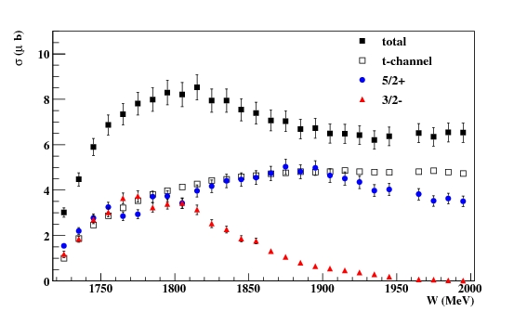
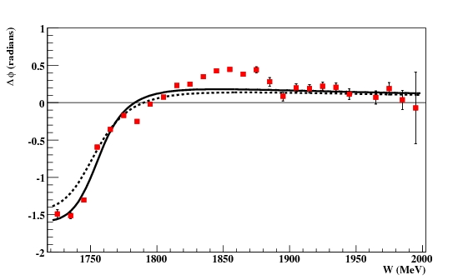
CLAS Photoproduction: γp→ωp
Fit showing three amplitudes.
(3/2)⁻ D₁₃
(5/2)⁺ F₁₅
t-channel
Can also include
u-channel
Intensities
Phase Difference
Proper coherence between
amplitudes is needed to
describe the physics.
Strong evidence for:
(3/2)⁻ N(1700) ***
(5/2)⁺ N(1680) ****
(5/2)⁺ N(2000) **
Phys. Rev. C80, 065209, (2009)

Slide 15
Isospin Aspects of Analysis
Consistent results over related channels
Consistent results across different decay modes.
Consistent results across different decay modes.

Slide 16
Non-strange final states
Ultimately we need to be able to analyze all of these data simultaneously in the same fit. This will allow constraints between fits and give us the best access to decay rates.
We have the capability to do this now with CLAS data at CMU, and it will be part of the GlueX analysis framework.
Final Mesons Exotics

Slide 17
On-going Analyses
@Indiana University
@CMU and @UCONN
@FSU

Slide 18
Procedures
IU 3-pion analysis:
Monte Carlo generation on the grid. PYTHIA background events generated that can be mixed into the sample in addition to the physics events.
Full event reconstruction.
Amplitude Analysis based on AmpTools
CMU b1-pi analysis:
Local Monte Carlo generation. Pythia background events that can be mixed into the event sample.
Full event reconstruction, event selection by kinematic fitting.
Amplitude Analysis based on CLAS codes at CMU.
UCONN b1-pi analysis:
Monte Carlo generation in the grid.
Plan to use the AmpTools.
FSU Cascade analysis:
Local Monte Carlo generation.
Reconstruction and studies of event selection.

Slide 19
Summary
GlueX has been working to develop a fitting framework that will enable us to fit the large expected data sets.
The framework takes advantage of highly-parallel computing on GPUs.
This framework should allow us to ``easily’’ input amplitudes from theorists and let them confront the data.
The framework should allow us to perform more global fits across several data sets to more accurately pin down the the properties of the exotics.
All theoretical work is welcome and needed!

