Slide 1
Shedding light on the color forces that bind matter
Curtis A. Meyer
Carnegie Mellon University
April 24, 2015

Slide 2
Outline
Fundamental Interactions
Quantum Chromo Dynamics
Color Charges and Gluons
Exciting the Glue
The GlueX Experiment

Slide 3
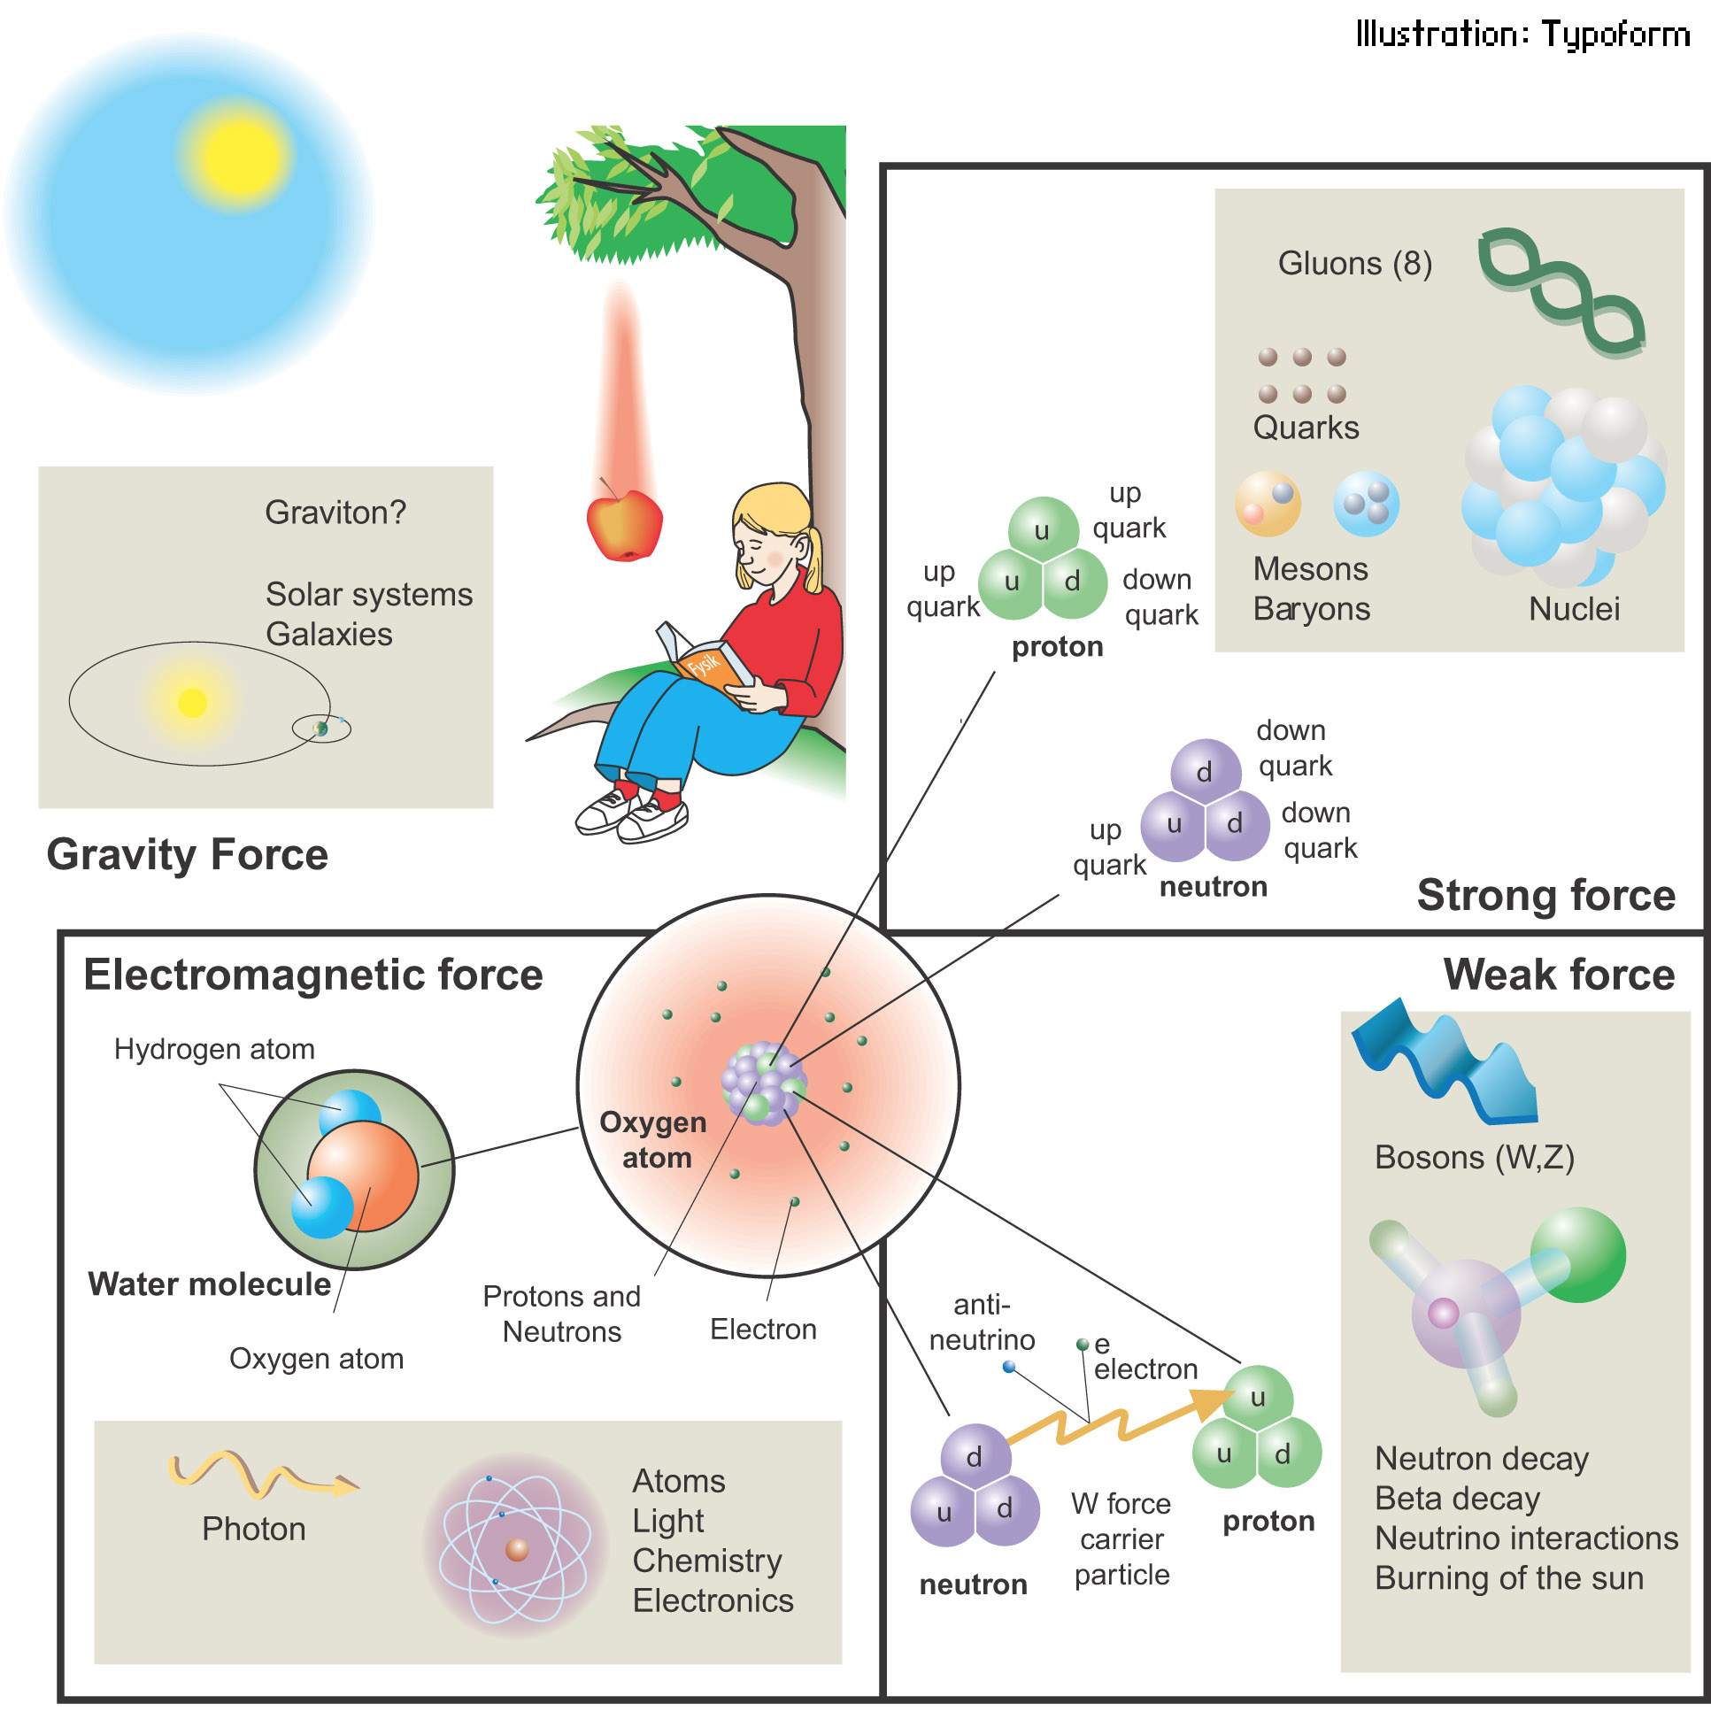
Fundamental Interactions
Interactions act on a large range of distance scales.
Each interaction involves its own charges.
Interactions cause forces and changes in configuration.
Interactions are associated with microscopic particles.

Slide 4
Microscopic Particles
Leptons
Quarks
Electric Charge
Can effectively describe everything we see in the world around us.
Quarks build the protons and neutrons in the nucleus of atoms.

Slide 5
Microscopic Particles
Leptons
Quarks
Its not that easy ….
1
>0
~4
~10
205
>0
~3000
~1000
~3500
>0
~350000
~10000
Mass (electron masses)

Slide 6
Microscopic Particles
Antimatter as well ….
Leptons
Quarks

Slide 7
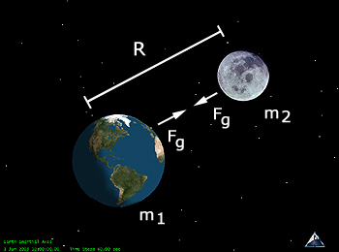
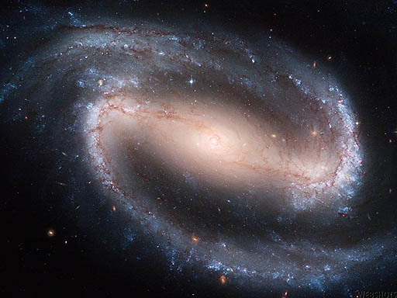
Gravitational Interaction
Gravity has an infinite range.
``Mass’’ is the ``charge’’ of gravity.
Short-range limits look for deviations to gravitational force on very short distances. Limits on deviations can be probed to micron-level and better.
On very large distance scales, dark energy creates a repulsive force that counteracts gravity.

Slide 8
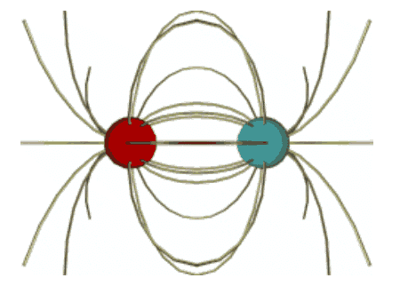
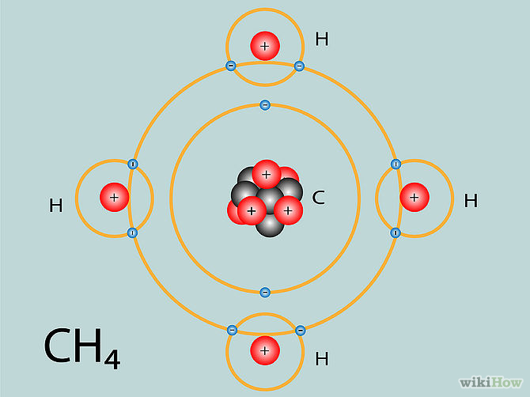
Electromagnetic Interaction
The Electric force has an infinite range.
``Electric Charge’’ is the ``charge’’ of the interaction.
Responsible for friction and tension forces.
Responsible for chemistry and biology.

Slide 9
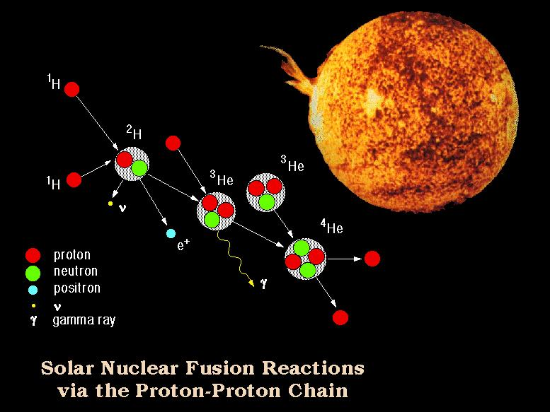
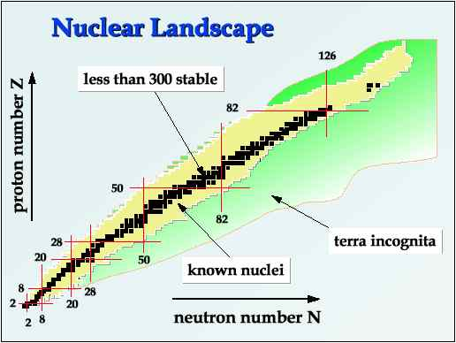
Weak Interaction
An interaction that changes particles into other particles.
Responsible for fusion in the center of stars by fusing protons into heavier elements.
Responsible for which isotopes of nuclei are stable.

Slide 10
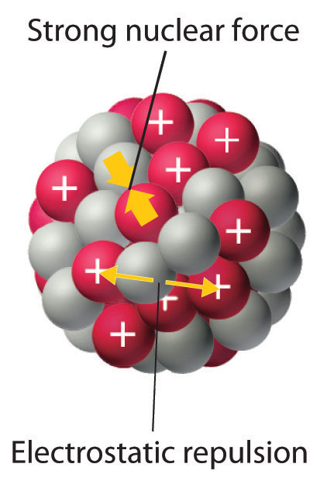
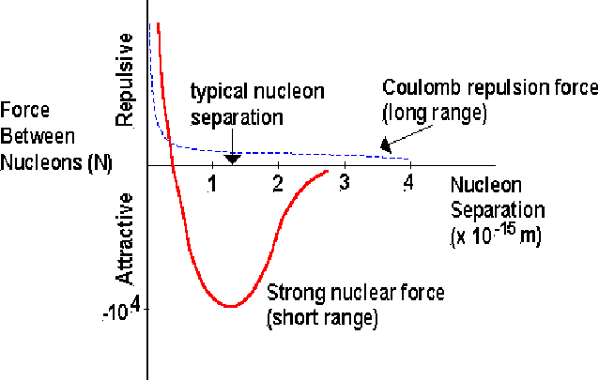
Strong Interaction
The classic nuclear physics force binds the protons and neutrons together in a nucleus. It is stronger than the electric force as it overcomes the electrostatic repulsion between the protons.
This is just a residual force from a more fundamental force that forms the protons and neutrons.

Slide 11
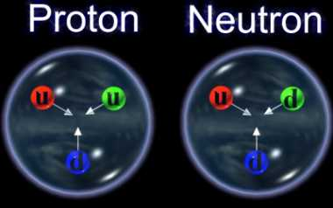
Strong Interaction – Interactions of Quarks
Protons and neutrons are made of three quarks. The proton is two ``up quarks’’ and a ``down quark’’. The neutron is two “down quarks’’ and an ``up quark’’.
Quarks carry electric charge, but there primary interaction is through there ``color charge’’, of which there are three: red, blue and green.
Quantum Chromo Dynamics (QCD) describes the interactions involving color forces.

Slide 12
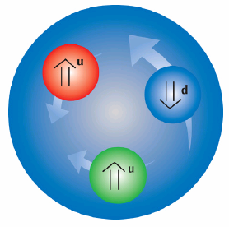
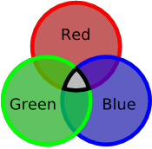
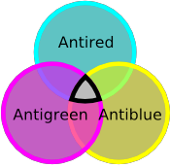
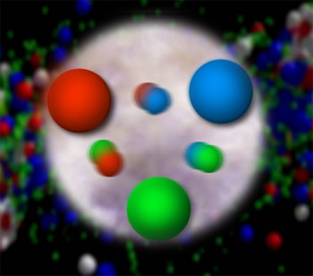
Quantum Chromo Dynamics
The rules that govern how the quarks froze out into protons and neutrons (hadrons) are given by QCD.
Quarks have color charge: red, blue and green. Antiquarks have anticolors: cyan, yellow and magenta.
Bound states of quarks are color neutral, ``white’’.
``White’’ can be one of each color:
red-blue-green, cyan-yellow-magenta
or a color and an anticolor:
red-cyan, blue-yellow, green-magenta

Slide 13
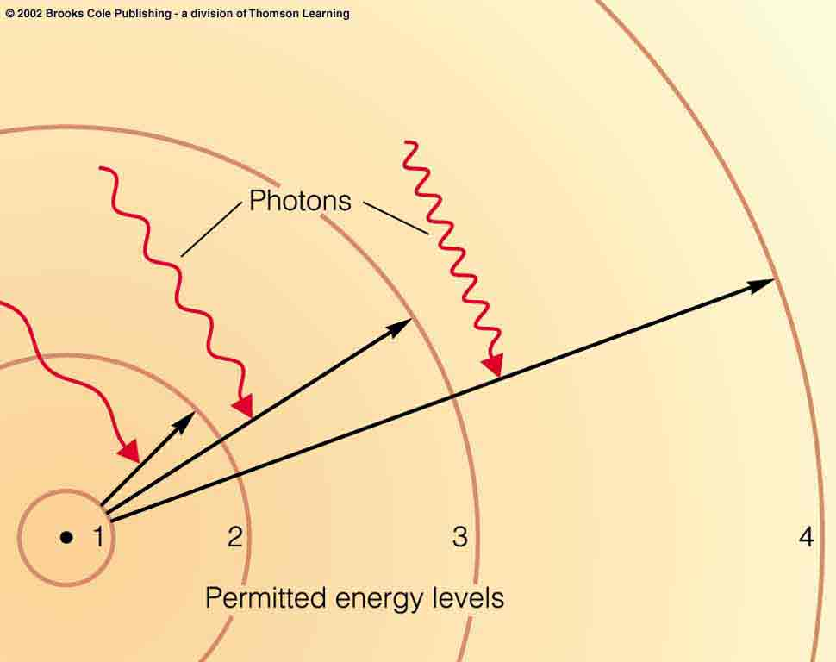
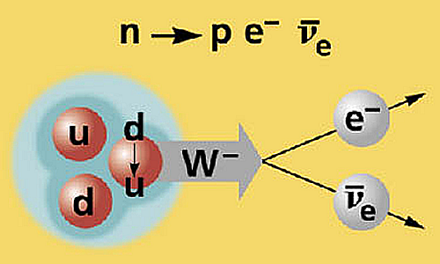
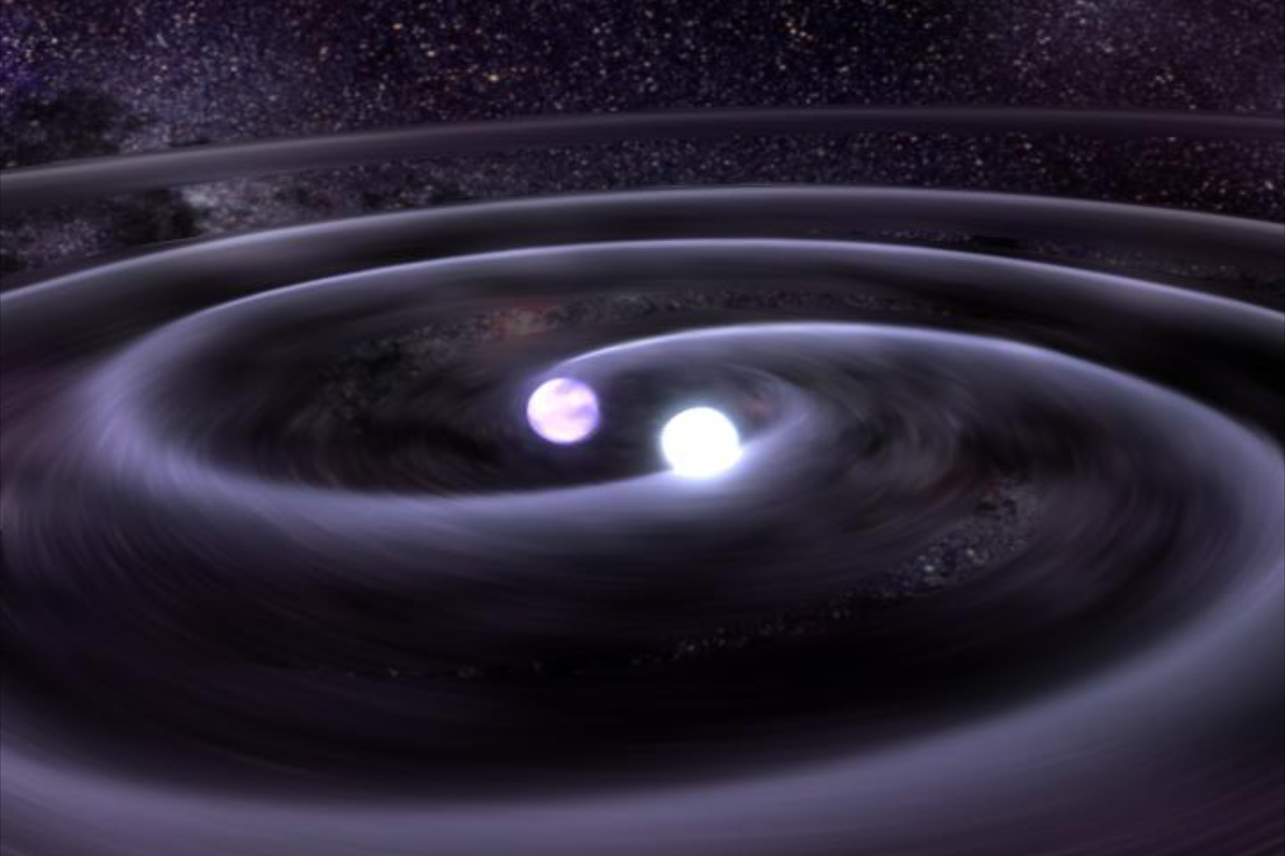
Force Mediators
Electromagnetic Interactions
Photons are the force carriers for the E-M force.
Photons are electrically neutral.
Massless photons lead to infinite range.
Weak Interactions
W and Z bosons mediate the weak interaction.
Massive particles lead to very short range.
Gravitational Interactions
Gravitons mediate the gravitational force.
Massless gravitons lead to infinite range.

Slide 14
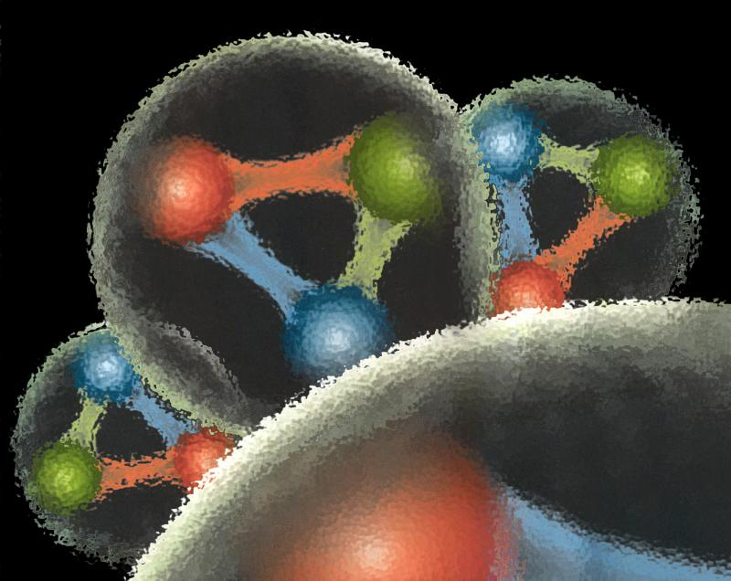
Quantum Chromo Dynamics
Force Mediators
Gluons are the force carriers of QCD.
Gluons carry color and an anticolor charges.
Gluons are not white.
Gluons strongly interact with quarks
G
R
R
R
R
R
G
G
B
B
G
R
G
G
R
B
G
B
R
R
Gluons strongly interact with other gluons.
This makes QCD different than all other interactions.

Slide 15
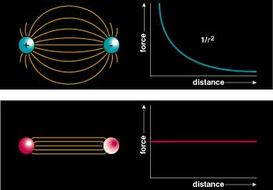
Quantum Chromo Dynamics
Color Field: Because of self interaction, confining flux tubes form between static color charges
Confinement arises from flux tubes and their excitation leads to a new spectrum of mesons

Slide 16
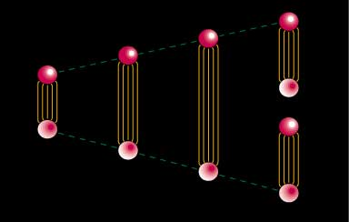
Quark Confinement
Quarks can never be isolated.
There is a linearly rising potential energy.
  Constant 16-ton force between quarks.
  Separation of quark from antiquark takes an infinite amount of energy
  Gluon flux breaks, new quark-antiquark pair produced --- E=mc^{2.}

Slide 17
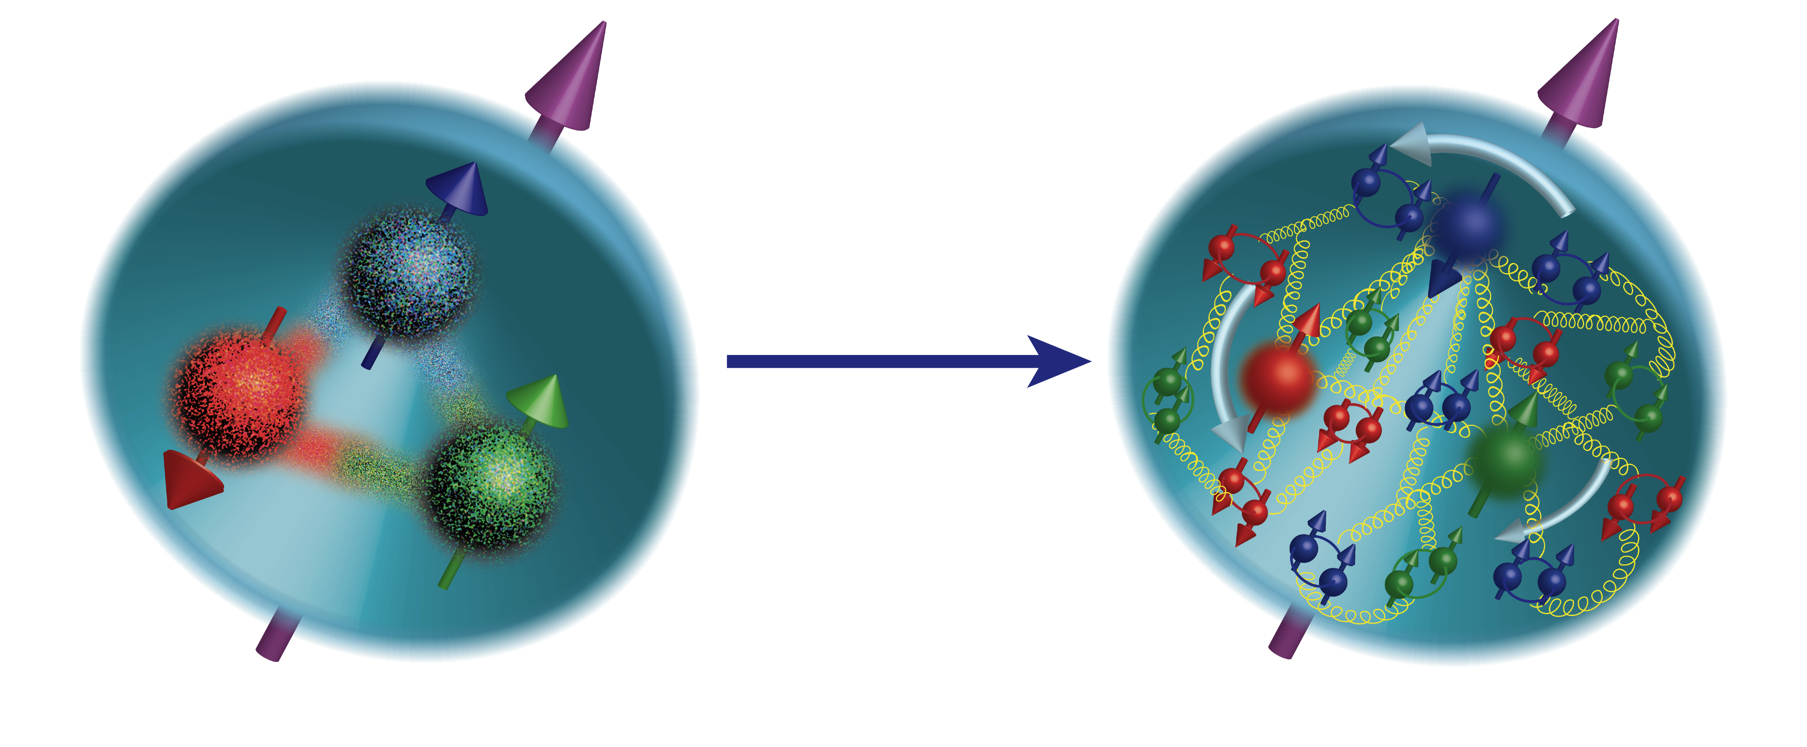
The Mass of The Proton?
The proton has a mass ~1800 times that of the electron.
The bare masses of the up and down quarks are
~18 times the mass of the electron.
18 m_{e} ←→ 1800 m_{e} ??
In many experiments, the proton behaves like it contains three objects of mass ~600 times the mass of the electron.
Three ``heavy” objects confined in a 1fm sized space.

Slide 18
The Mass of The Proton?
The proton has a mass ~1800 times that of the electron.
The bare masses of the up and down quarks are
~18 times the mass of the electron.
18 m_{e} ←→ 1800 m_{e} ??
If gluons did not carry color charges, QCD would look much more like the electromagnetic interaction.
The energy density is associated with color-charge density in a quark-gluon system.
An balancing of size and color charge has to occur.

Slide 19
The Mass of The Proton?
The proton has a mass ~1800 times that of the electron.
The bare masses of the up and down quarks are
~18 times the mass of the electron.
18 m_{e} ←→ 1800 m_{e} ??
The gluonic field binding the quarks generates the most of the proton’s mass.
Most of the visible (not dark) mass of the universe is gluons!

Slide 20
The Spin of the Proton?
What makes up the spin ½ of the proton?
Three Spin ½ quarks? ΔΣ is only 25% of the total spin!
Spin of gluons? J_{g} is also only 25% of the total spin!
Orbital motion? L_{q} is currently unexplored.

Slide 21
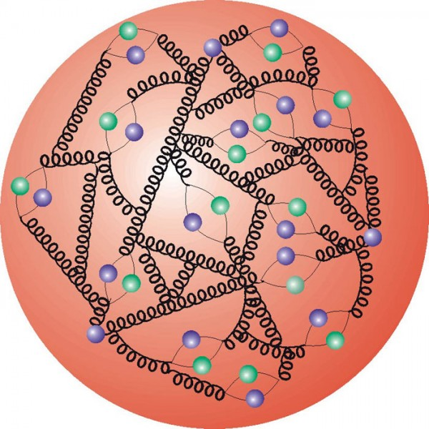
The Structure of The Proton

Slide 22
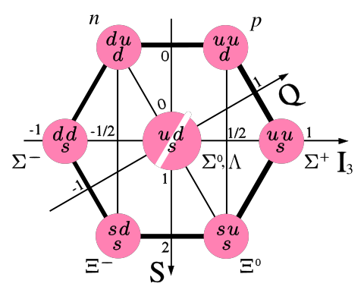
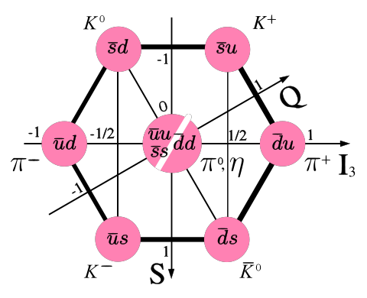
Observed Quark Configurations
(u,d,s)
3-Quark Systems
Baryons
Quark-antiquark Systems
Mesons
Groups of 8 (octet)
and 10 (decuplet).
Groups of
9 (nonet).
proton and neutron
π meson or pion
Other Configurations?
4-quark
glueballs
pentaquarks
hybrids

Slide 23
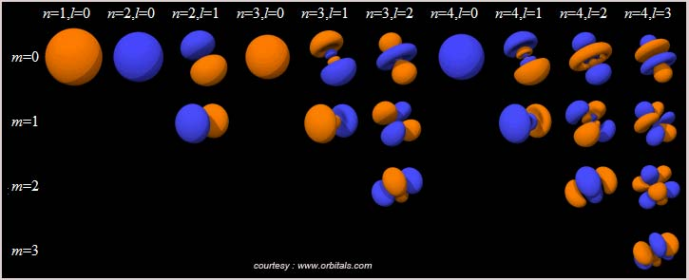
Positronium
Spectroscopy - a probe of QED
e⁺
e⁻
Include spin, S, total angular momentum J: J = L + S: ^{(2S+1)}L_{J}

Slide 24
Positronium
Spectroscopy - a probe of QED
e⁺
e⁻
Spin: S=S₁+S₂=(0,1)
Orbital Angular Momentum: L=0,1,2,…
Total Spin: J=L+S
L=0, S=0 : J=0 L=0, S=1 : J=1
L=1, S=0 : J=1 L=1, S=1 : J=0,1,2
… …

Slide 25
Positronium
Spectroscopy - a probe of QED
e⁺
e⁻
Spin: S=S₁+S₂=(0,1)
Orbital Angular Momentum: L=0,1,2,…
Total Spin: J=L+S
L=0, S=0 : J=0 L=0, S=1 : J=1
L=1, S=0 : J=1 L=1, S=1 : J=0,1,2
… …
Reflection in a mirror:
Parity: P=-(-1)^{(L)}
Particle<->Antiparticle:
Charge Conjugation: C=(-1)^{(L+S)}
Notation: J^{(PC)} 0⁻⁺, 1⁻⁻, 1⁺⁻, 0⁺⁺, 1⁺⁺, 2⁺⁺
^{(2S+1)}L_{J} ¹S₀, ³S₁, ¹P₁, ³P₀, ³P₁, ³P₂,…

Slide 26
QCD and Spectroscopy: quark-antiquark
Quarkonium
Mesons
Each state is a particle
q
q
radial
Consider the three lightest quarks
4⁺⁺
L=3
3⁺⁺
2⁺⁺
9 Combinations
3⁺⁻
3⁻⁻
L=2
2⁻⁻
1⁻⁻
2⁻⁺
2⁺⁺
L=1
1⁺⁺
0⁺⁺
1⁺⁻
1⁻⁻
S=1
S=0
L=0
0⁻⁺

Slide 27
QCD and Spectroscopy: quark-antiquark
Quarkonium
Mesons
q
q
4⁺⁺
L=3
3⁺⁺
2⁺⁺
3⁺⁻
ρ,K*,ω,φ
Mesons come in
Nonets of the same
J^{PC} Quantum Numbers
3⁻⁻
L=2
2⁻⁻
π,K,η,η’
1⁻⁻
2⁻⁺
a,K,f,f’
2⁺⁺
L=1
1⁺⁺
b,K,h,h’
SU(3) is broken
Last two members mix
0⁺⁺
1⁺⁻
ρ,K*,ω,φ
1⁻⁻
S=1
S=0
L=0
0⁻⁺
π,K,η,η’

Slide 28
QCD and Spectroscopy: quark-antiquark
Quarkonium
Mesons
q
q
4⁺⁺
L=3
3⁺⁺
2⁺⁺
Allowed J^{PC} Quantum numbers:
3⁺⁻
3⁻⁻
0⁺⁺ 0⁻⁺
1^{–-} 1⁺⁺ 1⁺⁻
2⁻⁻ 2⁺⁺ 2⁻⁺
3⁻⁻ 3⁺⁺ 3⁺⁻
4⁻⁻ 4⁺⁺ 4⁻⁺
5⁻⁻ 5⁺⁺ 5⁺⁻
L=2
2⁻⁻
1⁻⁻
2⁻⁺
2⁺⁺
L=1
1⁺⁺
0⁺⁺
1⁺⁻
1⁻⁻
S=1
S=0
L=0
0⁻⁺

Slide 29
QCD and Spectroscopy: quark-antiquark
Quarkonium
Mesons
q
q
4⁺⁺
L=3
3⁺⁺
2⁺⁺
Allowed J^{PC} Quantum numbers:
3⁺⁻
0⁻⁻ 0⁺⁻
1⁻⁺
2⁺⁻
3⁻⁺
4⁺⁻
5⁻⁺
3⁻⁻
0⁺⁺ 0⁻⁺
1^{–-} 1⁺⁺ 1⁺⁻
2⁻⁻ 2⁺⁺ 2⁻⁺
3⁻⁻ 3⁺⁺ 3⁺⁻
4⁻⁻ 4⁺⁺ 4⁻⁺
5⁻⁻ 5⁺⁺ 5⁺⁻
L=2
2⁻⁻
1⁻⁻
2⁻⁺
2⁺⁺
L=1
1⁺⁺
0⁺⁺
1⁺⁻
S=1
S=0
Exotic Quantum Numbers
non quark-antiquark description
1⁻⁻
L=0
0⁻⁺

Slide 30
QCD Potential
ground-state
flux-tube
m=0
linear potential

Slide 31
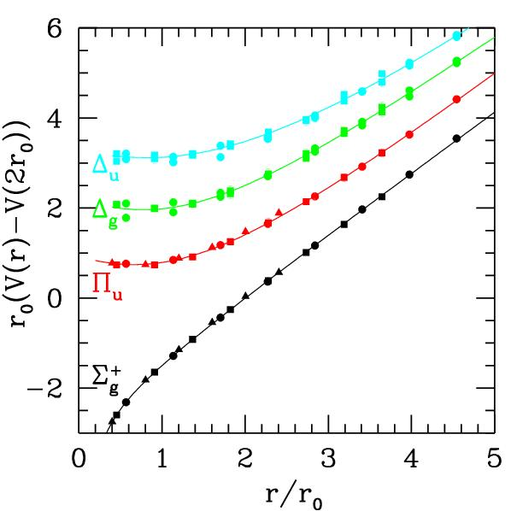
QCD Potential
ground-state
flux-tube
m=0
Excited gluonic field (m=1)
linear potential
Mapping the spectrum of meson states associated with excitations of the gluonic field. The light-quark systems will be measured at Jefferson Lab.

Slide 32
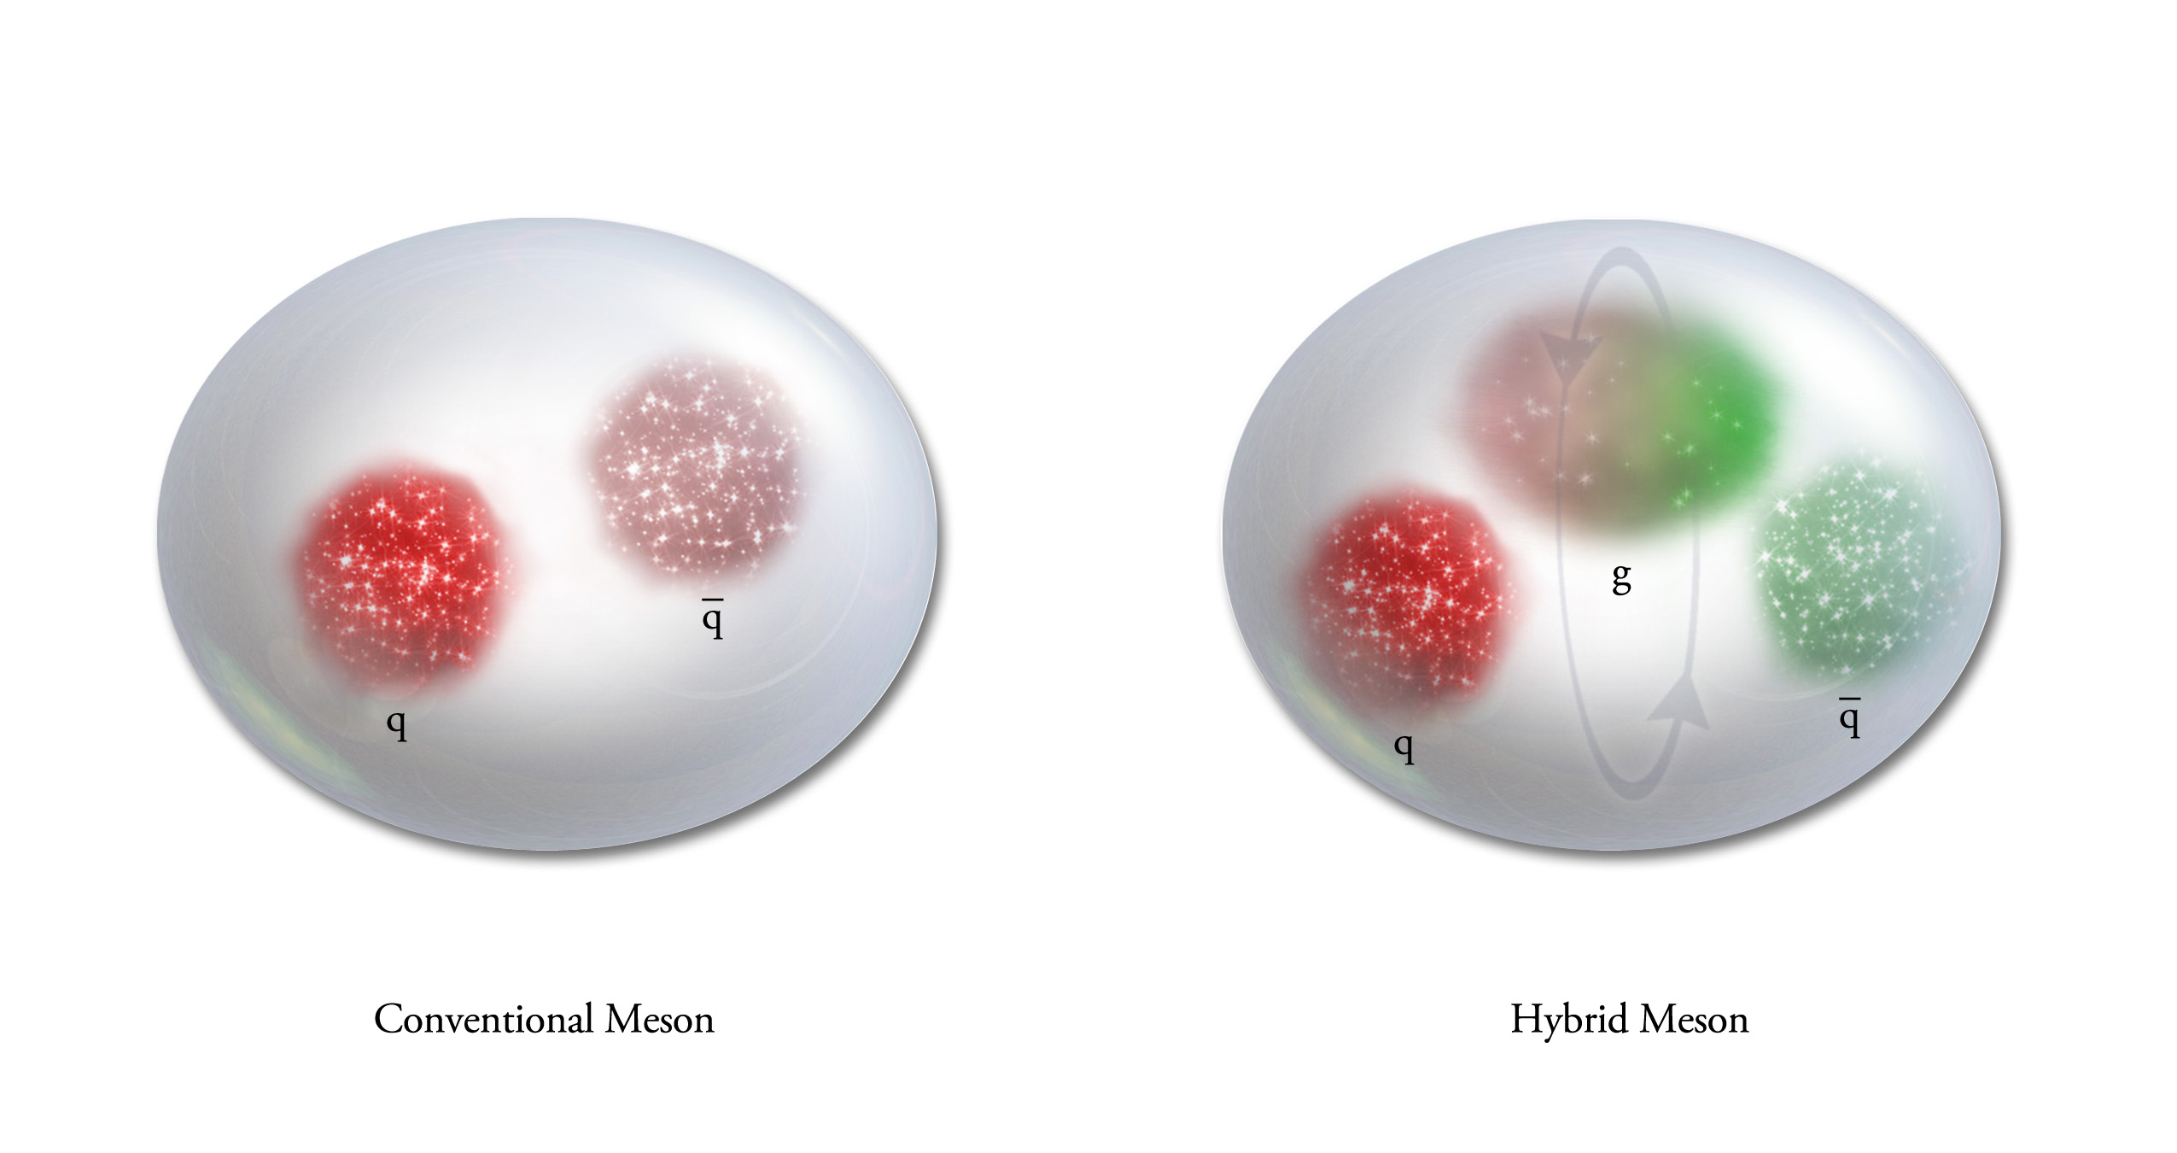
QCD Potential
Conventional Meson
Hybrid Meson
Exciting the Glue provides an
experimental window to the confining potential of QCD.
Mapping out the families of hybrid mesons is the best
experimental signature of gluonic excitations.

Slide 33
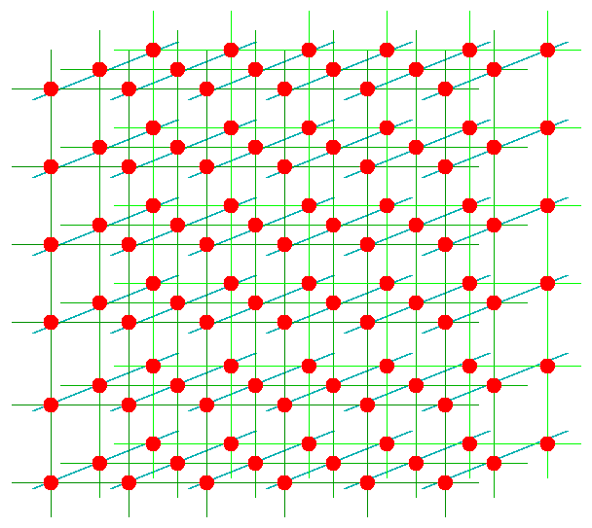
Lattice QCD
Numerically solve QCD on a space-time lattice.
quarks
gluons
Computationally very intensive
Gauge configurations on leadership-class computers.
``Mine’’ the configurations for physics on smaller clusters.

Slide 34
Lattice QCD Meson Spectrum
Dudek et. al, 2010, 2011,2012,2013

Slide 35
Lattice QCD Meson Spectrum
isovector
isoscalar

Slide 36
Lattice QCD Meson Spectrum
States with non-trivial gluonic fields.
1⁻⁻, 0⁻⁺ , 1⁻⁺ , 2⁻⁺

Slide 37
QCD Exotics
We expect 5 nonets of exotic-quantum-number mesons:
1 nonet of 0⁺⁻
2 nonets of 1⁻⁺
2 nonets of 2⁺⁻
Lattice shows two nonets here.
π₁ I^{G}(J^{PC})=1⁻(1⁻⁺)
K₁ I^{G}(J^{PC})= ½ (1⁻)
η’₁ I^{G}(J^{PC})=0⁺(1⁻⁺)
η₁ I^{G}(J^{PC})=0⁺(1⁻⁺)

Slide 38
Finding the States?
Lattice QCD suggest where to look for exotic states:
Models suggest how the states should fall apart
π₁→ πb₁ , πf₁ , πρ , ηa₁
η₁→π(1300)π , a₁π
b₂ → a₁π , h₁π , ωπ , a₂π
h₂ → b₁π , ρπ , ωη
b₀ → π(1300)π , h₁π
h₀ → b₁π , h₁η
L_{flux}
L_{flux}
Populate final states with
π±,π⁰,K±,K⁰,η, (photons)

Slide 39
Experimental Evidence for Hybrids
Pion peripheral production:
The most extensive data sets to date are from the BNL E852 experiment. There is also data from the VES experiment at Protvino and from the COMPASS experiment at CERN.
Proton-antiproton annihilation:
There is data from the Crystal Barrel experiment at LEAR. This is also one of the pushes of the future PANDA experiment.

Slide 40
Experimental Evidence for Hybrids
Charmonium Decays:
There is data from the CLEO-c at Cornell. This is also an area of interest of the BES III experiment in Beijing. This will also be part of the PANDA program at FAIR.
X
Photo Production:
There are limited results from the CLAS experiment at Jefferson Lab. This is the main push of the future GlueX experiment at Jefferson Lab.
γ
e
N
N

Slide 41
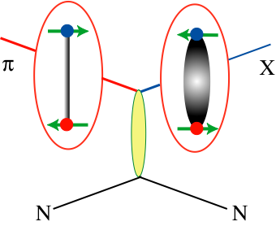
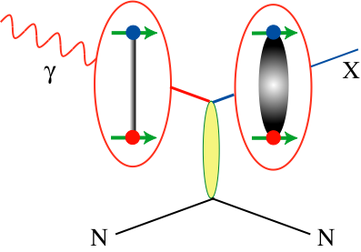
How to Produce Hybrids
Beams of photons may be a more natural way to create hybrid mesons.
Simple Quantum Number counting leads to the exotics.
There is almost no data for photon beams at 9GeV energies. We can increase data by 3-4 orders of magnitude.

Slide 42
The GlueX Experiment at Jefferson Lab
BaBar DIRC Bars
Photo Production
Light-quark Mesons
Strangeonium States
Physics in 2016

Slide 43
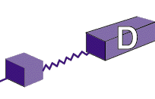
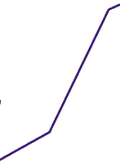

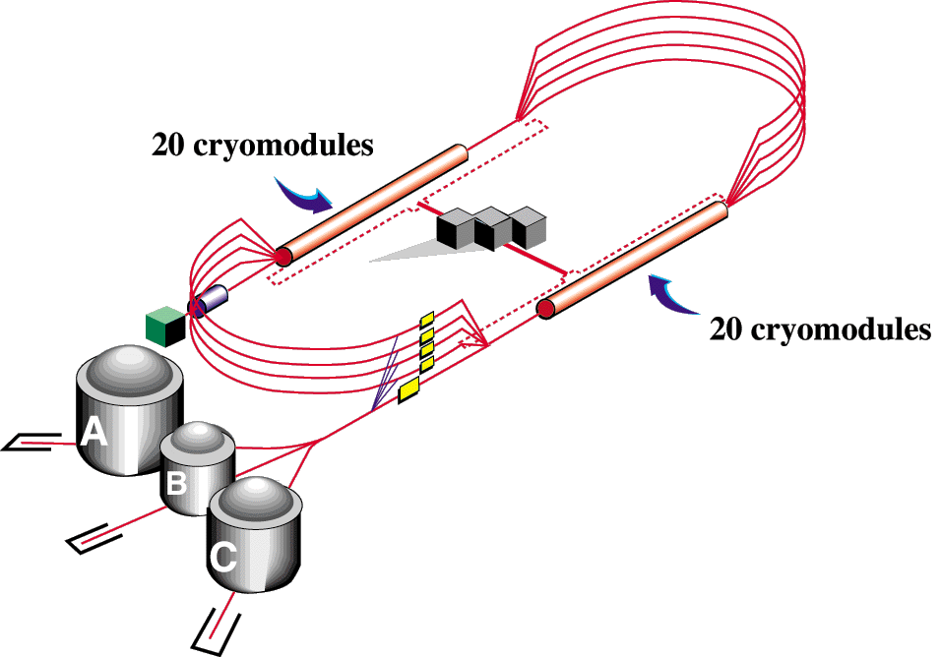

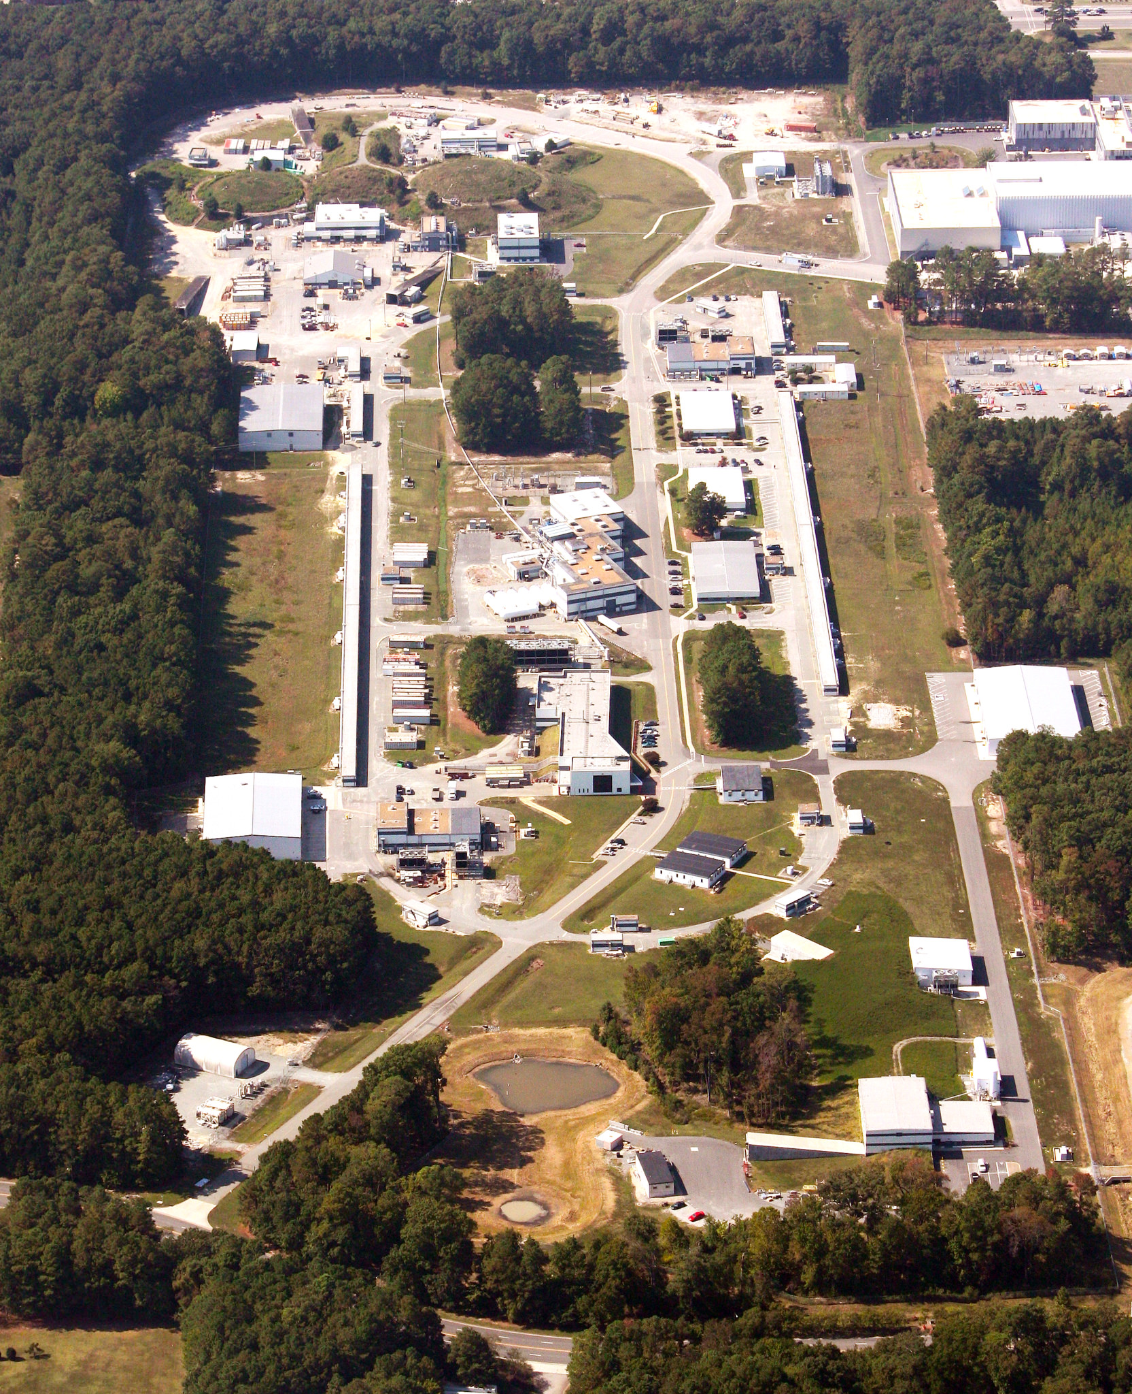
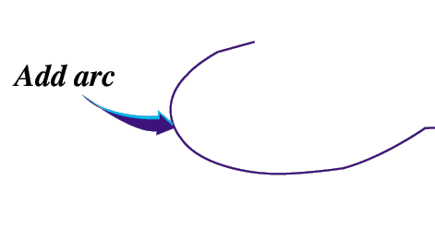

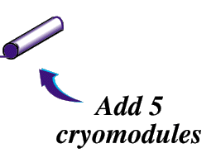
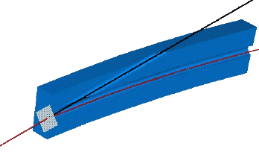
12-GeV CEBAF – Photoproduction
CHL-2
Linearly polarized
photons out
12GeV electrons
spectrometer
20 μm thick
Diamond crystal

Slide 44
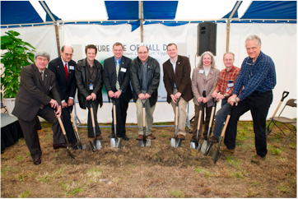
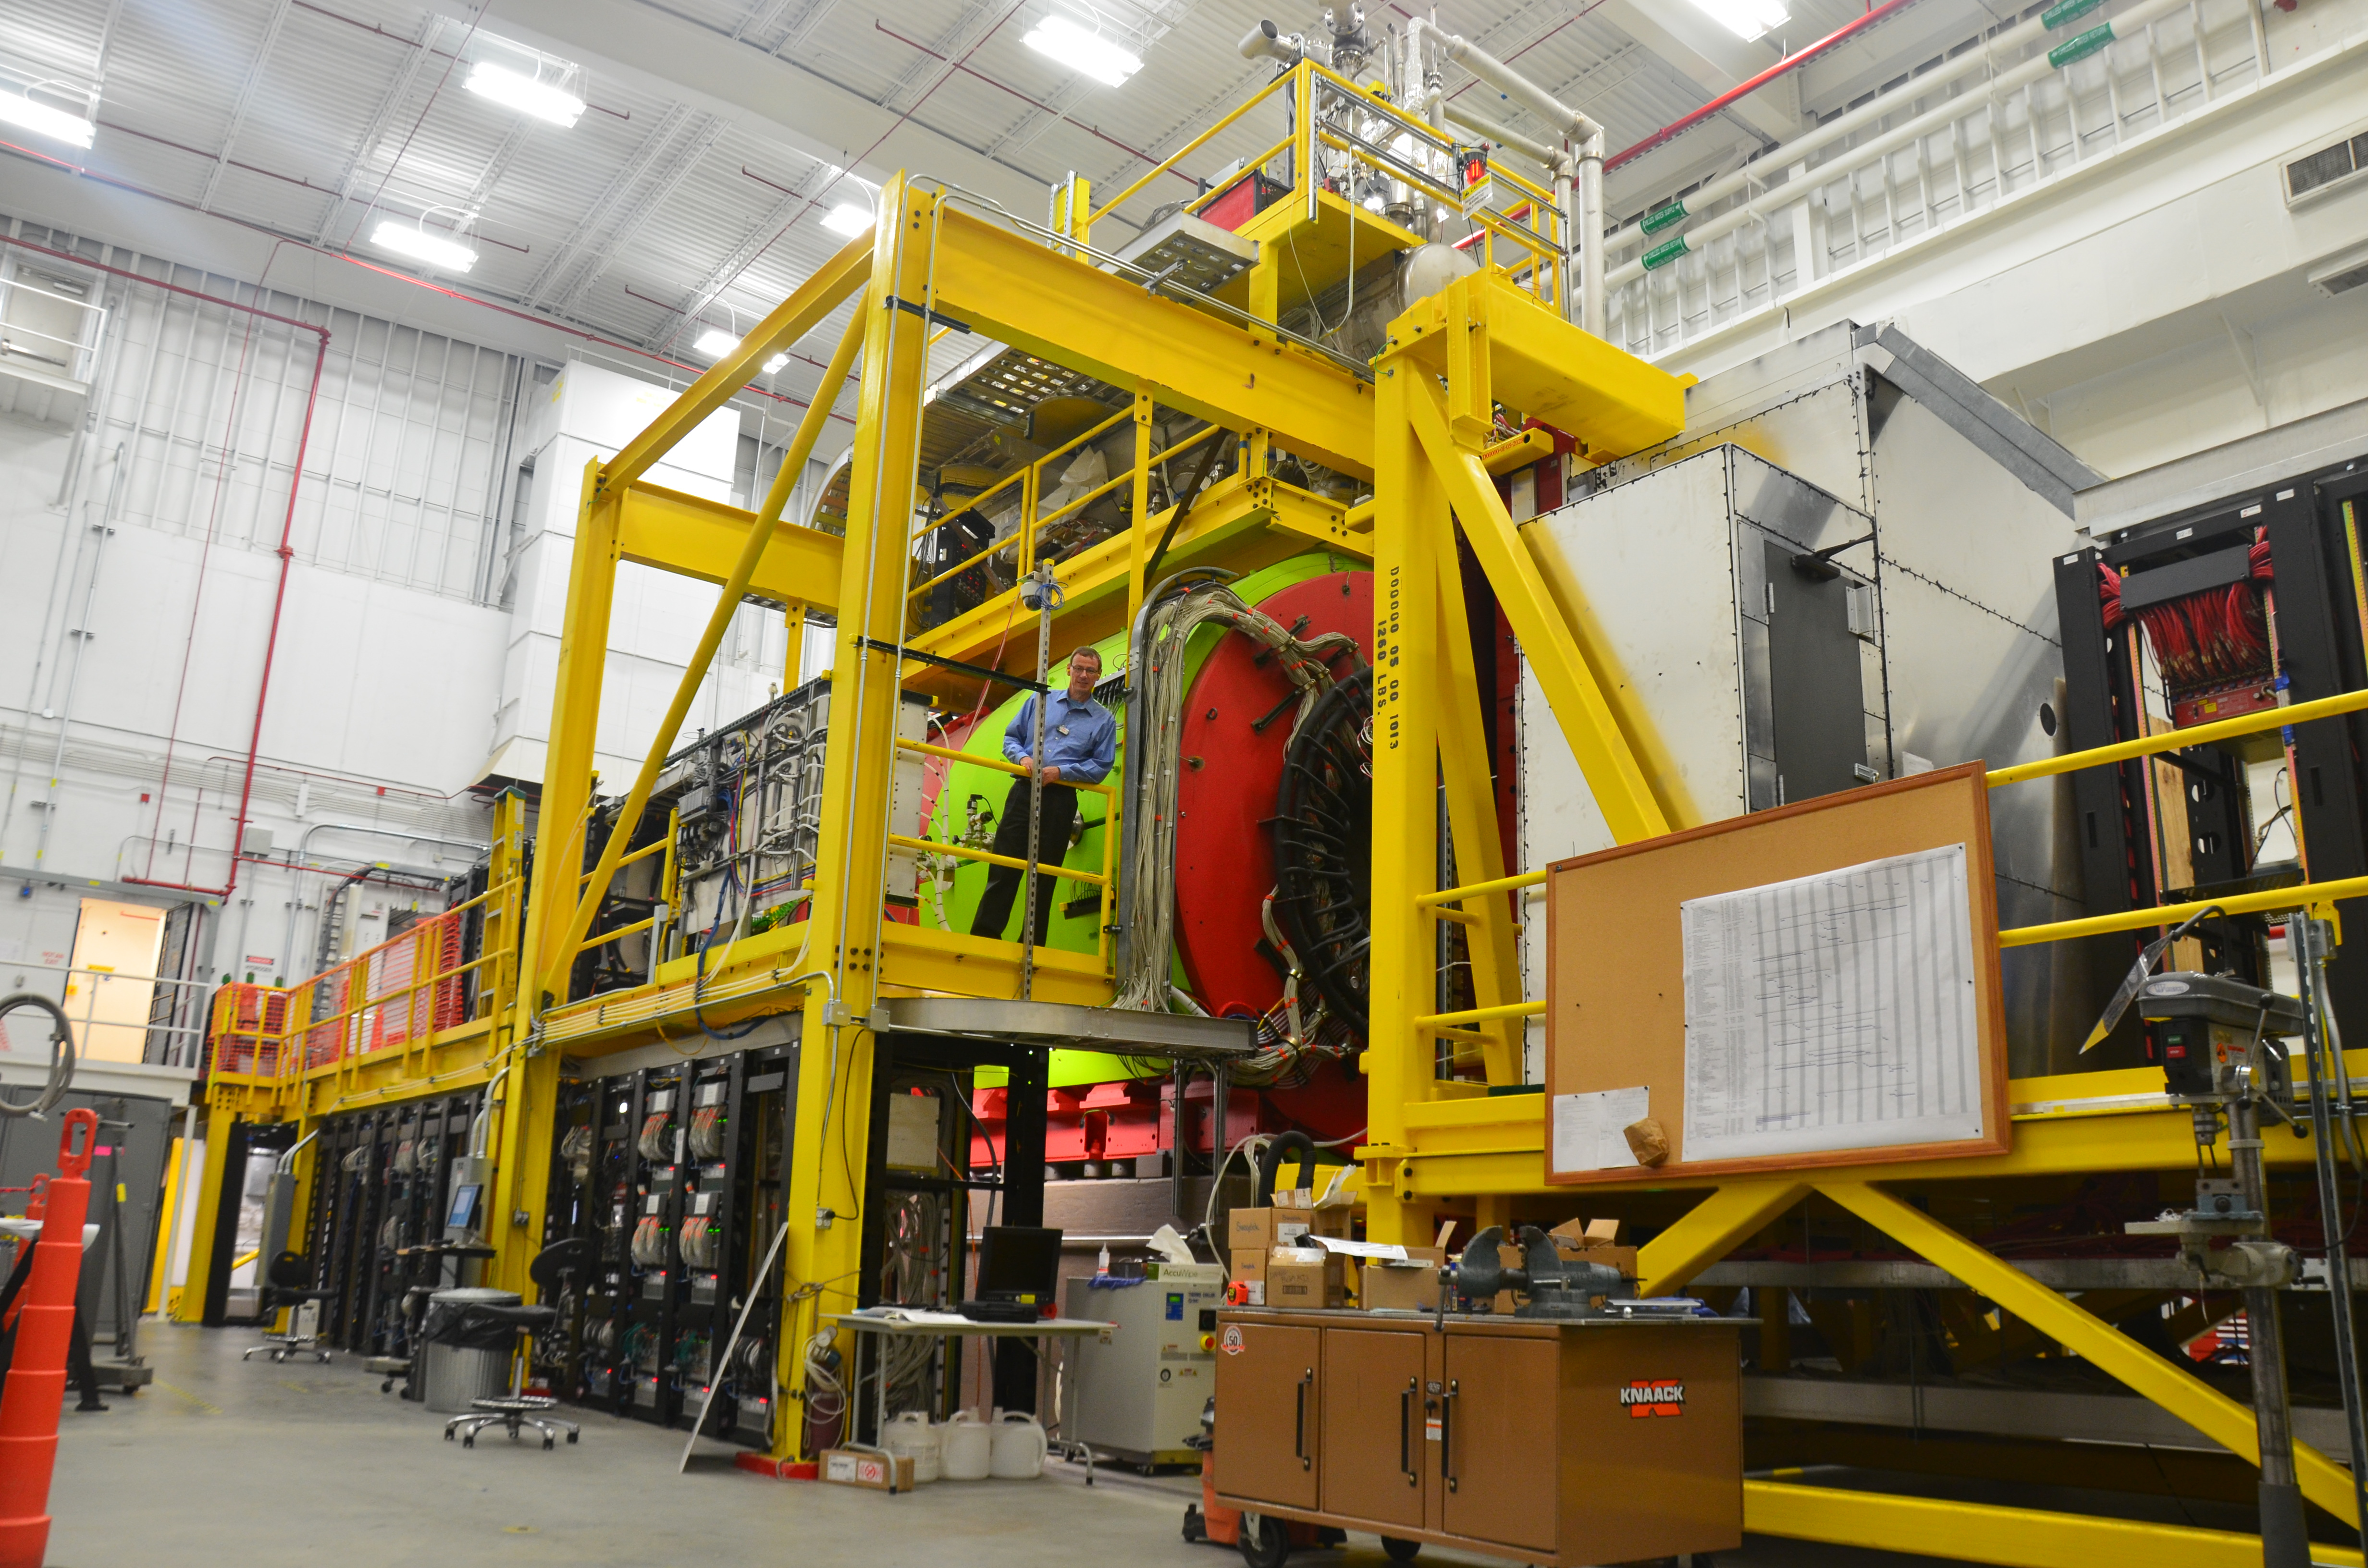
The GlueX Detector in Hall-D
Timeline to a New Experiment
Planning started in 1998.
The beginning of the DOE process started in 2004.
Construction of Hall-D broke ground in April 2009.
In 2015, the 12 GeV upgrade of Jefferson Lab is nearly complete.
The GlueX Experiment is ready to start collecting data.
Hall-D Groundbreaking

Slide 45
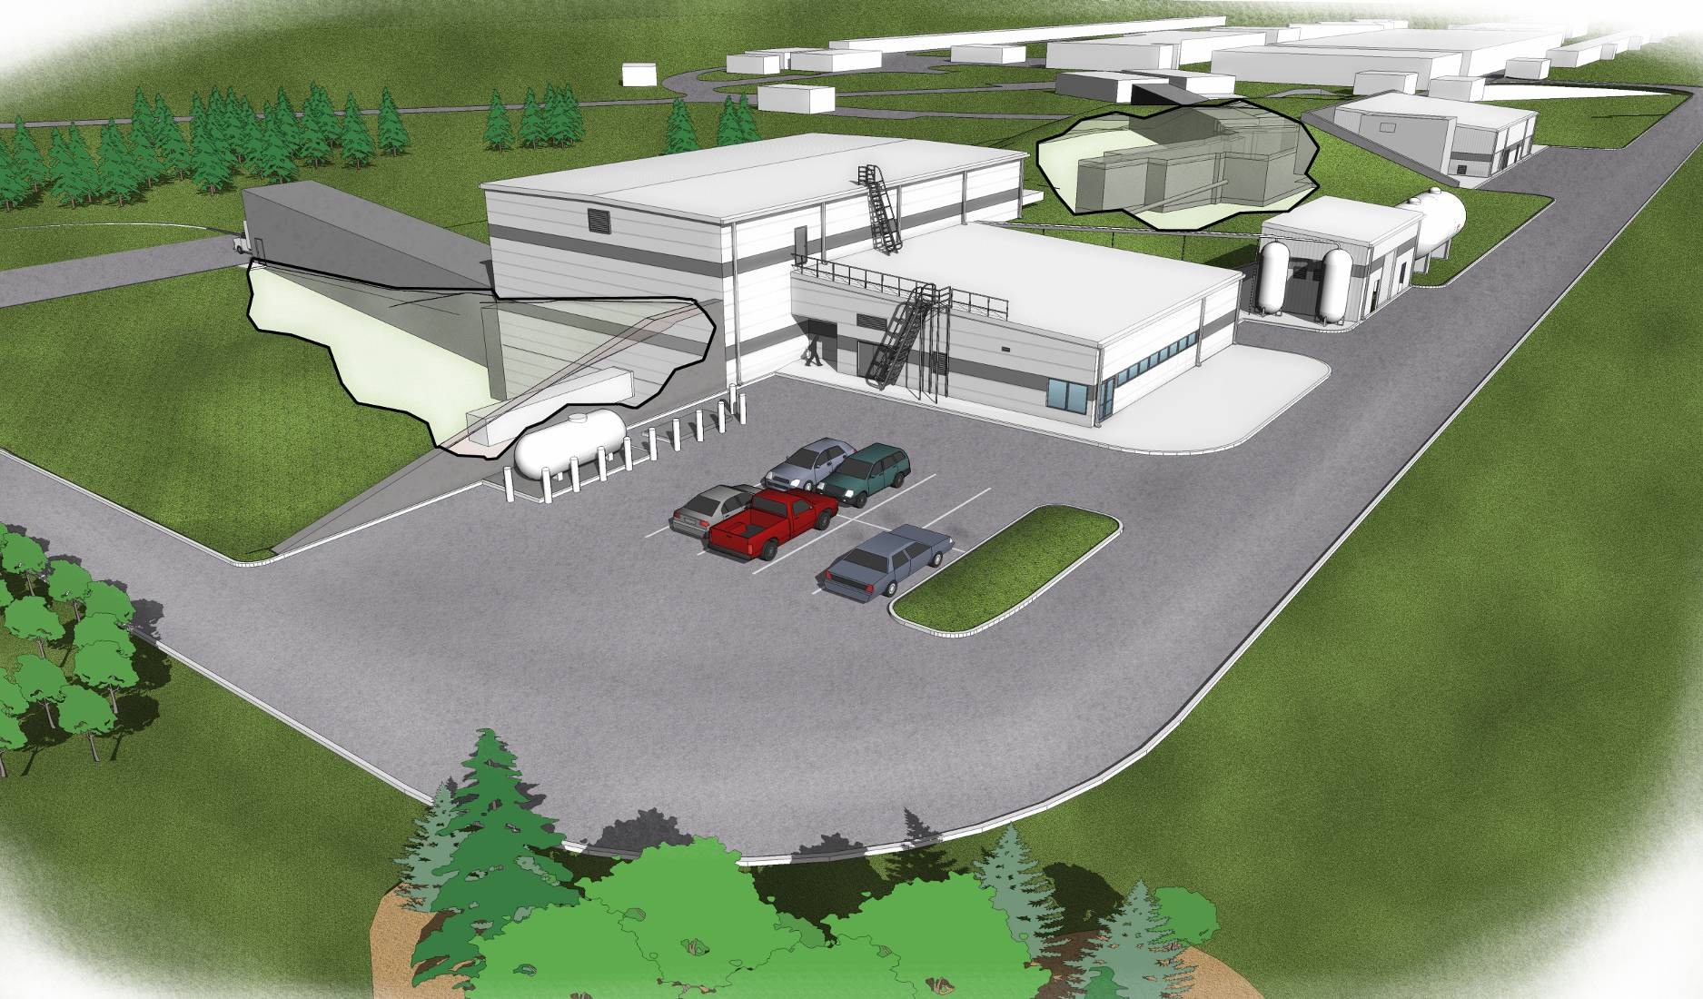
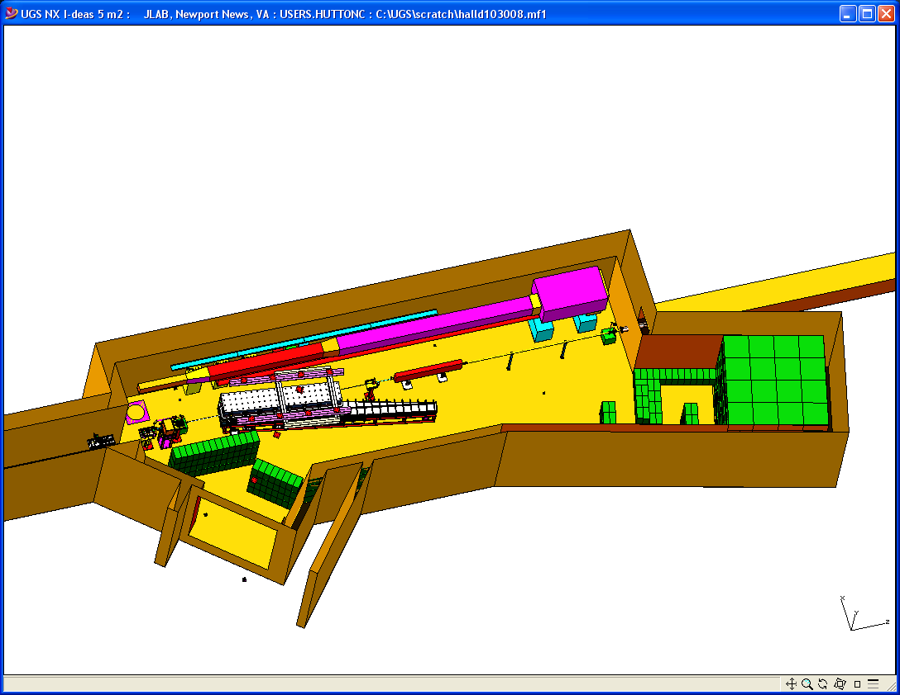
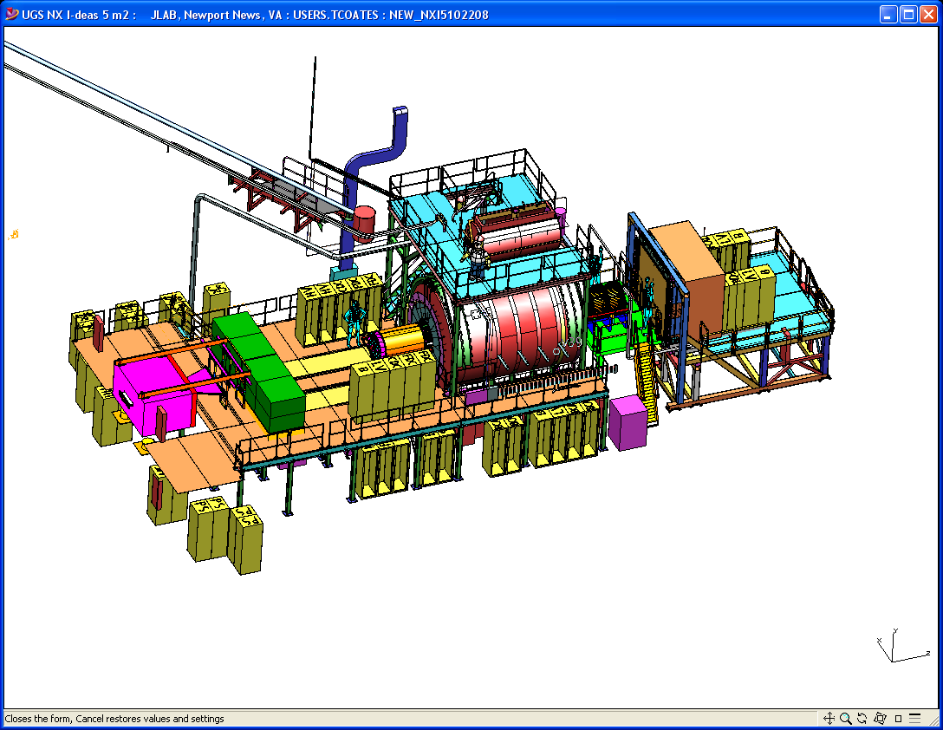
Hall D
Counting House
Tagger Area w/ Electron Beam Dump
Photon Beam Dump
Notes:
Quick slide to show the Hall-D complex as well as the detector and the tagger area. Comment on relevant details such as tagger resolution, magnet, electronics, ….

Slide 46
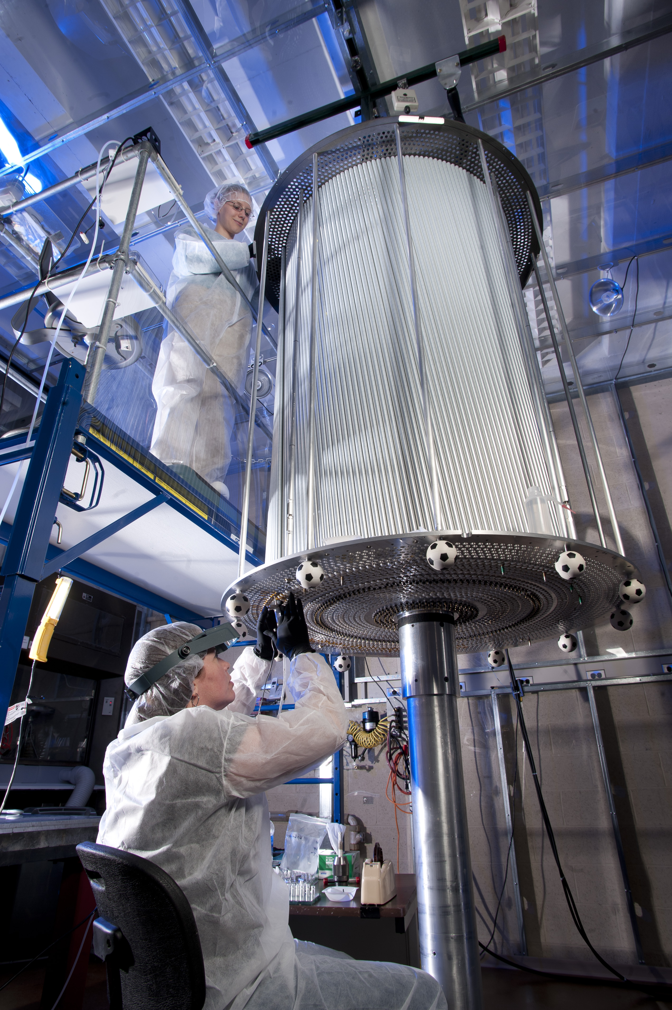
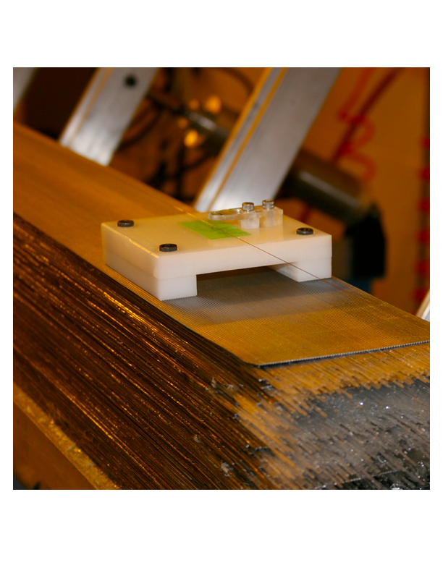
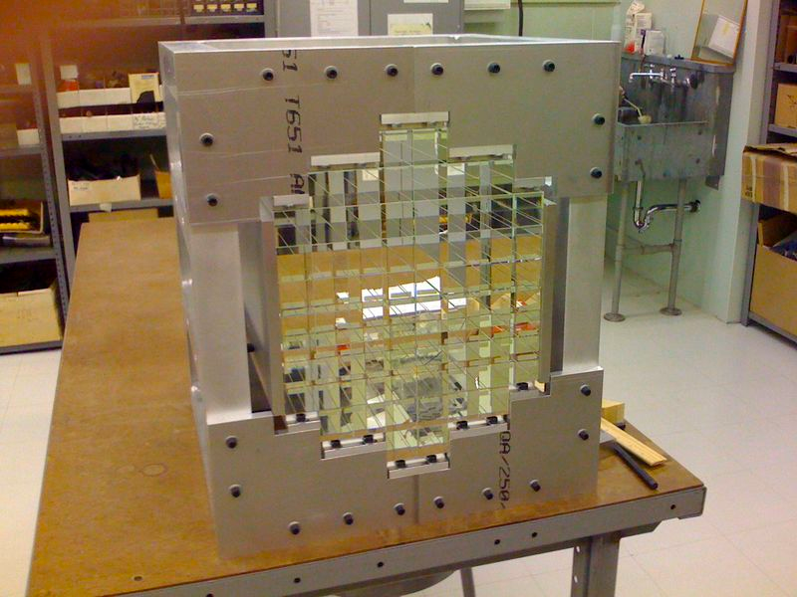
The Experimental Hall
CDC @ CMU
BCAL @ Regina
40/48 modules at JLab
Future PID @ MIT
BCAL Readout @ USM
Calibration @ Athens
FCAL @ IU
FDC @ JLab
P.S. @ UNCW
TOF @ FSU
START @ FIU
TRIGGER @ Jlab, CNU
Calibration@Northwestern
Electronics @ JLab, ICO, UMASS, USM
Solenoid @ JLab, ICO
DAQ @ JLab
The GlueX Detector

Slide 47
Photon Beam Production and Tagging
Microscope @ UCONN
Polarimetry @ ASU
Support @ UNC A&T
Tagger Magnet @ JLab
Support@Yervan
Tagger @ CUA
Diamond @ UCONN
Goniometer@Glasgow
Active Collimator @ UCONN
Pair Spectrometer@UNC Wilmington

Slide 48
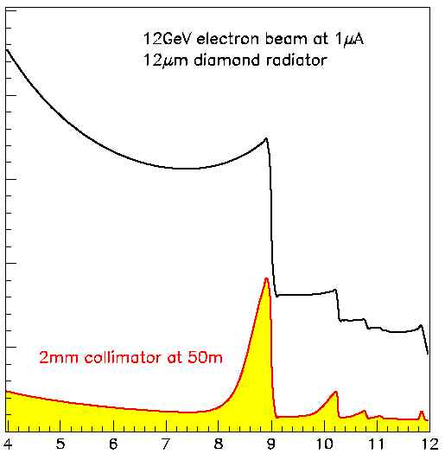
Coherent Bremsstrahlung
12 GeV electrons
This technique provides requisite energy, flux and polarization
Incoherent &
coherent spectrum
flux
40%
polarization
in peak
Linearly polarized
photons out
electrons in
collimated
spectrometer
20 μm thick
Diamond crystal
photon energy (GeV)
tagged
with 0.1% resolution

Slide 49
Amplitude Analysis
Angular distributions of reactions let you determine the spin and parity of intermediate resonances.
Classical Electrodynamics:
Monopole Radiation (L=0)
Dipole Radiation (L=1)
Quadrupole Radiation (L=2)

Slide 50
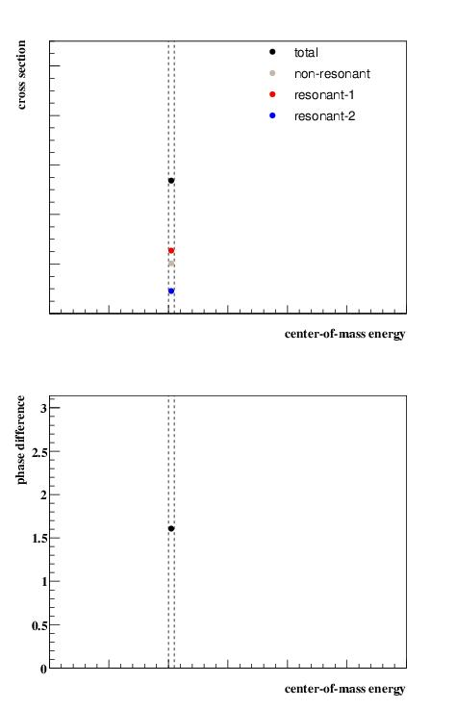
Amplitude Analysis
A simple model with three
complex amplitudes, 2 of
which are particles with
different QNs
Start with a single energy
bin.
Fit to get the strengths and
the phase difference between
the two resonances.

Slide 51
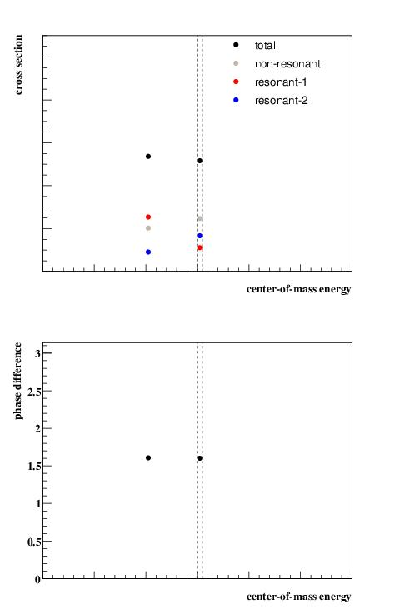
Amplitude Analysis
A simple model with three
complex amplitudes, 2 of
which are particles with
different QNs
Start with a single energy
bin.
Fit to get the strengths and
the phase difference between
the two resonances.
Fit a 2nd bin.

Slide 52
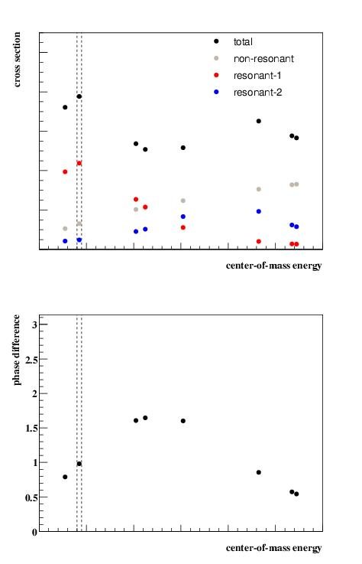
Amplitude Analysis
A simple model with three
complex amplitudes, 2 of
which are particles with
different QNs
Start with a single energy
bin.
Fit to get the strengths and
the phase difference between
the two resonances.
Continue fitting bins …

Slide 53
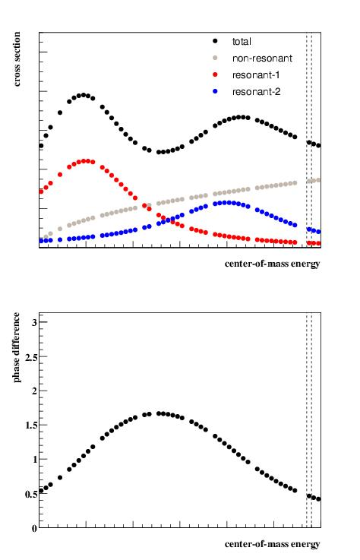
Amplitude Analysis
A simple model with three
complex amplitudes, 2 of
which are particles with
different QNs
Start with a single energy
bin.
Fit to get the strengths and
the phase difference between
the two resonances.
… and continue …

Slide 54

Amplitude Analysis
A simple model with three
complex amplitudes, 2 of
which are particles with
different QNs. The masses
peak where the two lines
are.
The need for intensity and
the phase difference are
indicative of two resonances.
Can fit for masses and widths.

Slide 55

Amplitude Analysis
3.5 Hours of beamtime
Fit the data event-by event to sums of high-dimensional angular distributions using complex weights.
Intensity and phase differences
Search for particles in several final states at once.

Slide 56

Fall 2014 GlueX Commissioning
Ran from late October until just before Christmas.
All systems worked and all detectors recorded data simultaneously.
Multiple triggers tested.
120TB of data collected, all data have since been processed multiple times.
Calibration and alignment is in an advanced state.
Hoped to complete calibrations using Spring’15 commissioning data.

Slide 57

GlueX/Hall-D Data Challenges
Data formats defined for all
levels of GlueX/Hall-D analysis.
EVIO Raw Data 18kbyte/evt.
REST DST Data 2.7kbyte/evt.
PART Physics Analysis (root tree).
EventStore
January 2015 (on going) – process 2014 data (150TB)
7000 ~20GB files on JLab Tapes, Run 6 threads per job
Data on cache disk (~4800 JLab threads)
Data from tape (~1200 JLab threads)
February 2015 (ongoing) – process simulated data from tape
Optimize process of from tape to processors.
Optimize threading of jobs.

Slide 58
Computing Needs
MC Generation: 0.16 s/evt Raw Data Size: 18 kB/evt
Reconstruction: 0.045 s/evt Produced Data: 2.7 kB/evt
Event rate is 20 KHz
Year FY15 FY16 FY17 FY18 FY19
Cores 380 3080 4810 3460 4230
Raw Data 0.2PB 1.6PB 2.5PB 1.8PB 2.2PB
REST Data 75TB 240TB 371TB 267TB 327TB
MC Rest ~100TB ~500TB ~700 TB ~500TB ~650TB

Slide 59
QCD Exotics
Lattice shows two nonets here.
We hope to be able to illuminate this spectrum of exotic-quantum-number mesons and ultimately understand the QCD potentials associated with exciting the glue in normal matter.

Slide 60

Conclusions
The quest to understand confinement
and the strong force is about to make
great leaps forward.
Advances in theory and computing will soon
allow us to solve QCD and understand the
the role of glue in the spectrum of hadrons.
Definitive experiments to confirm or refute our expectations on the role of glue have just started.
The synchronized advances in both areas will allow
us to finally understand QCD and confinement.

