Slide 1

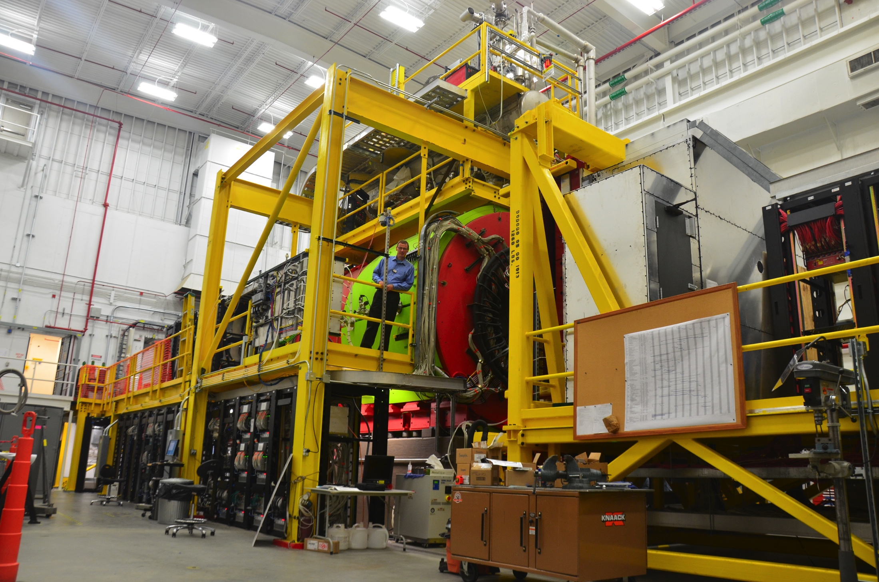
First Results of
Curtis A. Meyer
GlueX Spokesperson

Slide 2
The GlueX Collaboration
Arizona State, Athens, Carnegie Mellon, Catholic University, Univ. of Connecticut, Florida International, Florida State, George Washington, Glasgow, Indiana University, ITEP, Jefferson Lab, U. Mass Amherst, MIT, MePhi, Norfolk State, North Carolina A&T, Univ. North Carolina Wilmington, Northwestern, Santa Maria, University of Regina and Yerevan Physics Institute.
Over 100 collaborators from 22 institutions. Others planning to join over the next 6 months and more are welcome.

Slide 3
Outline
The GlueX Experiment and the Photon Beam.
The physics program in GlueX
Performance of GlueX during Commissioning.
Initial Physics from GlueX
Future Plans
Summary

Slide 4
The GlueX Experiment
BaBar DIRC Bars
Physics in 2016
Photo Production of Hybrids,
Light-quark Mesons
and Strangeonium States

Slide 5
The GlueX Experiment
12 GeV e⁻ beam up to 2.2 μA.
Linearly polarized photons (P_{ɣ}≈40%) from coherent bremsstrahlung on diamond radiator
Design intensity of 10⁸ ɣ/s in coherent peak (E_{ɣ} = 8.4-9 GeV)

Slide 6
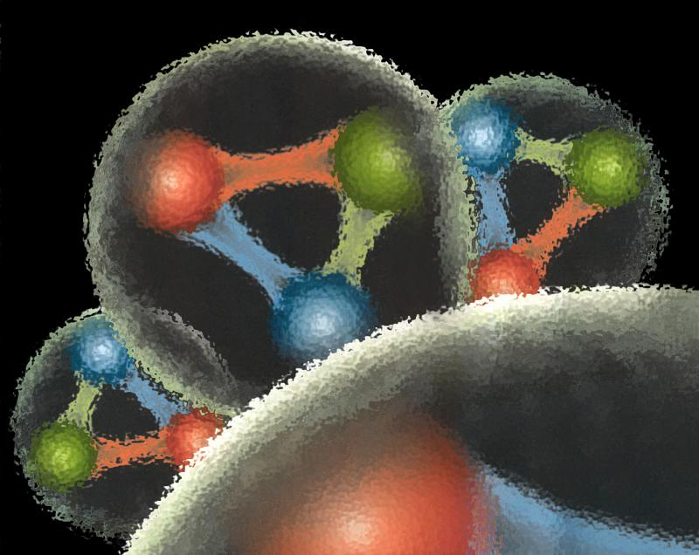
Quantum Chromo Dynamics
QCD describes the interactions of quarks and gluons and should predict the spectrum of bound-state baryons ( ) and mesons ( ).
There should also be mesons in which the gluonic field contributes directly to the J^{PC} quantum numbers of the states --- hybrid mesons. Some are expected to have ``exotic’’ quantum numbers.
Lattice QCD calculation of the light-quark meson spectrum.
``Constituent gluon’’: J^{PC} = 1⁺⁻ mass of 1-1.5 GeV.
The lightest hybrid nonets
1⁻⁻, (0⁻⁺,1⁻⁺, 2⁻⁺)
2.5Gev
2.0GeV
0⁺⁻
1⁻⁺
2⁺⁻
Notes:
What are gluonic excitations and why are we looking for them? Lattice QCD predictions for the mesons and in particular, a class of mesons with non-quark-antiquark quantum numbers. Also not that mixing angles are predicted. GlueX needs to measure particle J(PC), masses, widths and decay modes to be able to map these out.

Slide 7
Lattice QCD
Light-quark Mesons (u,d,s)
Dudek, et. al, Phys. Rev. D83, 111502 (2011)

Slide 8
Lattice QCD
Light-quark Mesons (u,d,s)
2⁻⁺
1⁻⁺
States with non-trivial gluonic fields.
Supermultiplet
1⁻⁻
1⁻⁻, 0⁻⁺ , 1⁻⁺ , 2⁻⁺
0⁻⁺

Slide 9
QCD Exotics
Lattice QCD suggests 5 nonets of mesons with exotic quantum number:
1 nonet of 0⁺⁻ exotic mesons
2 nonets of 1⁻⁺ exotic mesons
2 nonets of 2⁺⁻ exotic mesons
Lattice shows two nonets here.
Experimental evidence exists for π₁ states.
π₁ I^{G}(J^{PC})=1⁻(1⁻⁺)
K₁ I^{G}(J^{PC})= ½ (1⁻)
``Constituent gluon’’ behaves like J^{PC} = 1⁺⁻ with a mass of 1-1.5 GeV
The lightest hybrid nonets:
1⁻⁻, (0⁻⁺,1⁻⁺, 2⁻⁺)
η’₁ I^{G}(J^{PC})=0⁺(1⁻⁺)
η₁ I^{G}(J^{PC})=0⁺(1⁻⁺)

Slide 10
Photoproduction Mechanisms
Simple quantum number counting for production: (I^{G})J^{PC} up to L=2
P = Pomeron exchange
ρπ,ρω π₁
ωω,ρρ η₁
ωω,ρρ,φω η’₁
ρP b₀
ωP h₀
ωP, φP h’₀
ωπ,ρη,ρP b₂
ρπ,ωη,ωP h₂
ρπ,ωη,φP h’₂
ρπ is charge-exchange only
Can couple to all the lightest exotic hybrid nonets through photoproduction and VMD.
Linear polarization is a filter on the naturality of the exchanged particle.

Slide 11
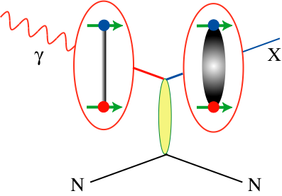
Decay Modes of Exotic Hybrids
π₁ → πρ, πb₁ , πf₁,πη’, ηa₁
η₁ → ηf₂,a₂π,ηf₁, ηη’,π(1300)π, a₁π,
η₁’→ K*Κ, Κ₁(1270)Κ, Κ₁(1410)Κ , ηη’
b₂ → ωπ, a₂π, ρη, f₁ρ, a₁π, h₁π, b₁η
h₂ → ρπ,b₁π,ωη, f₁ω
h’₂ → Κ₁(1270)Κ, Κ₁(1410)Κ, K₂*Κ, φη, f₁φ
b₀ → π(1300)π , h₁π, f₁ρ, b₁η
h₀ → b₁π , h₁η
h’₀ → K₁(1270)Κ, Κ(1460)Κ, h₁η
Models suggest narrower states are in the spin-1 and spin-2 nonets, while the spin-0 nonets are broad.
Early Reach With Statistics Hard
Hybrid kaons do not have exotic QN’s

Slide 12
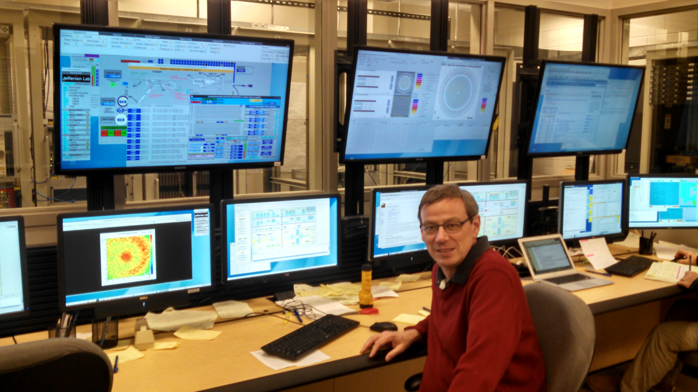
GlueX Commissioning Runs
Late October to mid December 2014 with 10 GeV electrons. No polarized photons, and solid GlueX targets.
All systems worked, all detectors recorded data using multiple triggers. 120TB of data collected,
930M events.
April 2015 ran for a few days with 6GeV electrons producing linearly-polarized photons on the liquid-hydrogen GlueX target.
Better DAQ and triggering led to higher-quality data. 74TB of data collected, 1285M events.
Many detector systems at design specs, all detector systems are within 30% of design specs.
Data are fully processed every two weeks. We are extracting physics from GlueX.

Slide 13
Coherent Bremsstrahlung
Spring 2015—6 GeV electron beam on diamond radiator
6 GeV electron beam on amorphous radiator
Linear Polarization
Polarized photon beam commissioning started.

Slide 14
Mass Peaks in GlueX

Slide 15
Particle Identification

Slide 16
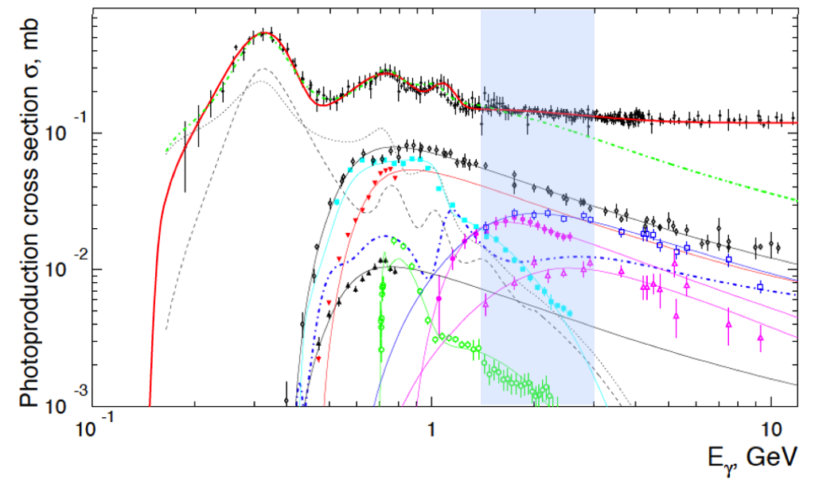
Physics signals
Observed reactions σ_{rect.}/σ_{tot}
~10%
~5%
~5%
~1%
~10%

Slide 17
Polarization transfer to the ρ
P=Linear Polarization
Σ=Beam Asymmetry~1.0
A few hours of beam

Slide 18
Early Physics
Initial reactions will be polarization transfer and beam asymmetry measurements.
Cross section measurements.
Spin-density matrix elements to understand production mechanisms.
Identify known mesons in PWA.
Move on to the search for exotic hybrids.

Slide 19
Forward Kaon Identification
Four of the BaBar DIRC bar boxes will be installed in front of the TOF wall.
This combined with the other PID systems in GlueX will allow us to fully study final states with strange quarks.
Strangeonium mesons and hybrids can be studied.
Hyperon and cascade baryons can be studied.
Expected late 2017/ 2018

Slide 20
Experiments using GlueX
GlueX—Hybrid mesons/spectroscopy
PR-06-102, PR-12-002 & PR-13-003
GlueX—PrimEx-eta
PR-10-011
(calorimeter plug)
GlueX—Pion polarizability
PR-13-008
(forward muon detector)
GlueX—JEF: Rare eta decays
PR14-004
(calorimeter upgrade)
A rating
340-540 PAC days
A- rating
79 PAC Days
A- rating
25 PAC Days
Conditionally
Approved

Slide 21
Experiments using GlueX
GlueX—Study of ω photoproduction
on nuclei.
GlueX—Physics opportunities with a
secondary K_{L} beam
Workshop planned at JLab in February 2016
https://www.jlab.org/conferences/kl2016/
LOI 2015
LOI 2015

Slide 22
Summary
GlueX is installed and well into its commissioning.
All detector systems are approaching design specifications in performance, but additional data are needed for full calibration.
The experiment is ready to do first physics measurements of simple reactions.
The broader program of exotic mesons is in sight and an upgrade plan is in place to allow us to cover all parts of that program is moving forward.
We have an extensive program beyond exotic hybrids and are excited to have new ideas and new collaborators.

