Slide 1
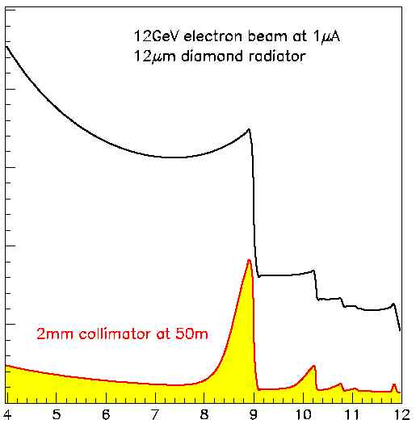
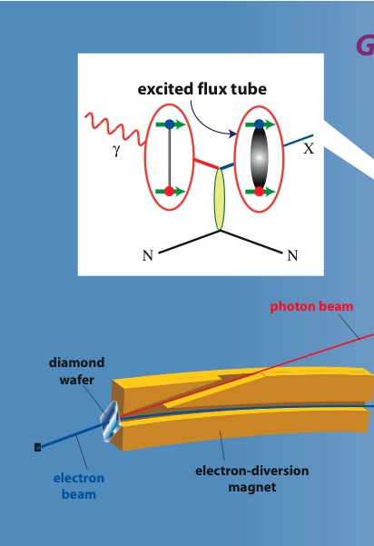
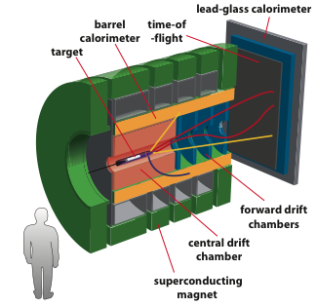
The GlueX Experiment
Curtis A. Meyer
Carnegie Mellon University
The GlueX Collaboration
12 GeV electrons
GlueX
Uncollimated
Coherent Peak
40% lin. Pol.
Collimated
Notes:
Opening slide contains schematic drawings of the tagger and detector and reminds people that we use linearly polarized photons to produce mesons. Tagged photons travel ~90 meters and interact in the LH2 target. Charged particles give signals in the start counter and then are tracked in the CDC and FDC system. Time-of-flight is measured in the TOF wall and in the BCAL. Photons are measured in both the BCAL and the FCAL. Space has been reserved for a future PID system.

Slide 2
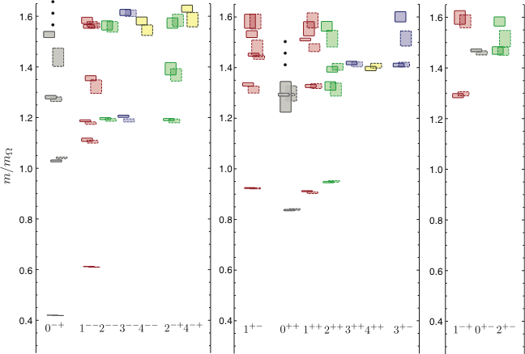
LQCD: The Spectrum of Mesons
Flux-tube Hybrids: ρ₁ a₁ b₀ π₀ a₀ π₁ π₂ b₂
Dynamical calculation of the isovector light-quark mesons.
3 identical quarks, pion mass~700MeV
Two lattice volumes
Non-trivial Glue
Exotic Quantum Numbers
(exotic)
J.J. Dudek (et al.)
Phys. Rev. D 82, 034508 (2010)
J^{PC}
J^{PC}
J^{PC}
Notes:
While the flux tube picture is a simple way to view hybrids, the these states are expected in most models. Very recent lattice calculations that determine the spectrum of isovector mesons also predicts that these states exist. The three towers on the right correspond to the exotic-quantum-number states. These calculations also give us a handle on the gluonic content of the states when overlap with configurations with non-trivial glue is considered. The exotic states have a large overlap, but several non-exotic states also have this overlap. These lattice calculations are currently being extended to isoscalar states as well as to much lower (~280 MeV) pion masses.

Slide 3
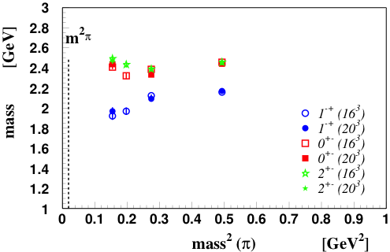
LQCD: The Spectrum of Mesons
Flux-tube Hybrids: ρ₁ a₁ b₀ π₀ a₀ π₁ π₂ b₂
Dynamical calculation of the isovector light-quark mesons.
3 identical quarks, pion mass~700MeV
Two lattice volumes.
Non-trivial Glue
Exotic Quantum Numbers
Mass in the 1.6 to 2.5 GeV Range
(exotic)
J^{PC}
J^{PC}
J^{PC}
J.J. Dudek (et al.) Phys. Rev. D 82, 034508 (2010)
Notes:
While the flux tube picture is a simple way to view hybrids, the these states are expected in most models. Very recent lattice calculations that determine the spectrum of isovector mesons also predicts that these states exist. The three towers on the right correspond to the exotic-quantum-number states. These calculations also give us a handle on the gluonic content of the states when overlap with configurations with non-trivial glue is considered. The exotic states have a large overlap, but several non-exotic states also have this overlap. These lattice calculations are currently being extended to isoscalar states as well as to much lower (~280 MeV) pion masses.

Slide 4
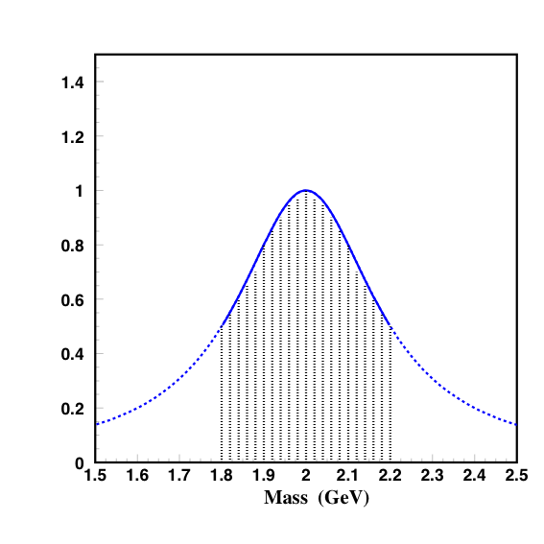
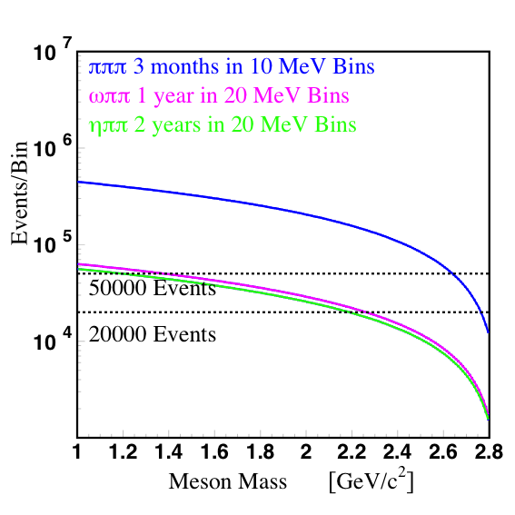
Identifying Exotics
ρπ πππ 5-10μb
b₁π ωππ 0.2μb
a₂π ηππ 0.2μb
f₁π , η’π 0.1μb
ωπ 1μb
The π₁(1600) is reported in ρπ η’π b₁π f₁π
Decay model expectations
π₁→ b₁π , f₁π , ρπ , a₁η
η₁→π(1300)π , a₁π, f₁η
b₂ → a₁π , h₁π , ωπ , a₂π
h₂ → b₁π , ρπ , ωη
b₀ → π(1300)π , h₁π
h₀ → b₁π , h₁η
π₁→ b₁π , f₁π , ρπ , a₁η
η₁→π(1300)π , a₁π, f₁η
b₂ → a₁π , h₁π , ωπ , a₂π
h₂ → b₁π , ρπ , ωη
b₀ → π(1300)π , h₁π
h₀ → b₁π , h₁η
26 weeks running, 1/3 beam on,
30% reconstruction.
~1000 evts
10⁷γ/s
If we produce an exotic with a 2 nb cross section over
400 MeV in mass (peak) (20 20MeV-wide bins), we expect
about 30000 events per year, or about 1000 events per
bin. This is a solid signal for the expected rates.
Notes:
Decays of exotic hybrids are still model dependent, with the 3P0 model being the most common choice. Expectations are for final states which typically involve 4-5 particles, though simpler ones exist. The rho-pi and the b1-pi are expected to overlap with several of the exotic hybrids and provide a good starting point in which to search. Cross sections are such that both of these channels can be searched using lower intensity photon beams (~10^7). Other final states will require higher intensity beams to achieve the needed statistics. A few nb cross section should be reachable in some of the final states.

Slide 5
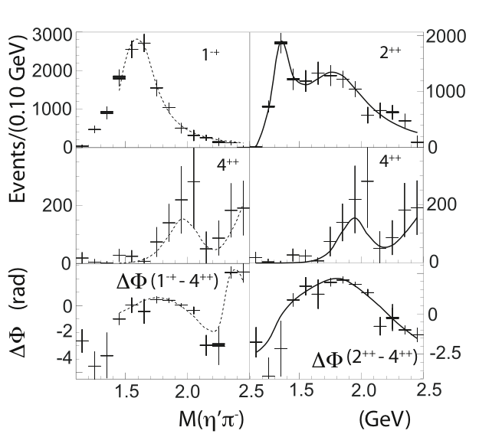
Amplitude Analysis
Determine Q.M. amplitudes (A_{i}) to describe data.
Fit for contributions of each A_{i} to get intensity and phases.
Fit for intensity and phase differences.
E852 π⁻p -> Xp -> η’π⁻p
(1⁻⁺) π₁
(2⁺⁺) a₂
(4⁺⁺) a₄
NSF: Physics at the Information Frontier
IU/CMU/UCONN
Develop Amplitude Analysis (AA) code appropriate for GlueX analysis. This includes theoretically more correct amplitudes, better interfaces to connect the amplitudes to data, Open Science Grid tools for AA and now development of GPU based tools.
OSG works for Monte Carlo production.
First generation tools used on CLAS data.
GPU code working on CLEO-c data.
Pursuing simulated GlueX data analysis.
Notes:
AA is the method by which we extract the exotic signals. Extractions using a vey simple Monte Carlo were first done in 2000. Work is currently underway to use our full GEANT simulation, realistic PYTHIA backgrounds and the GlueX reconstruction software to carry out the next generation of these studies. We also have a NSF funded effort to improve the tools used to do this analysis as well as improve the physics that goes into the analysis. GPUs look very promising at the moment.

Slide 6
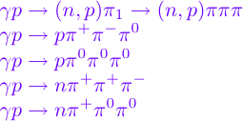
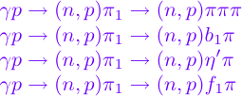
Checks on the Amplitude Analysis
Consider the photo production of a π₁ state.
Different isospin channels
We should find consistent production and decay results across similar channels.
We should be able to establish relative decay rates which is important when interpreting the results.
Different decay modes
Notes:
The 4pi nature of GlueX for both charged particles and photons allows for important cross checks on the analyses. Different isospin channels are important constraints in that if the same production mechanism is allowed, the same physics should be present for different isospin-related final states. Also, ultimately detecting multiple decay modes and extracting relative branching fractions is the best method to get at information about the underlying quark/gluon structure of the states.

Slide 7
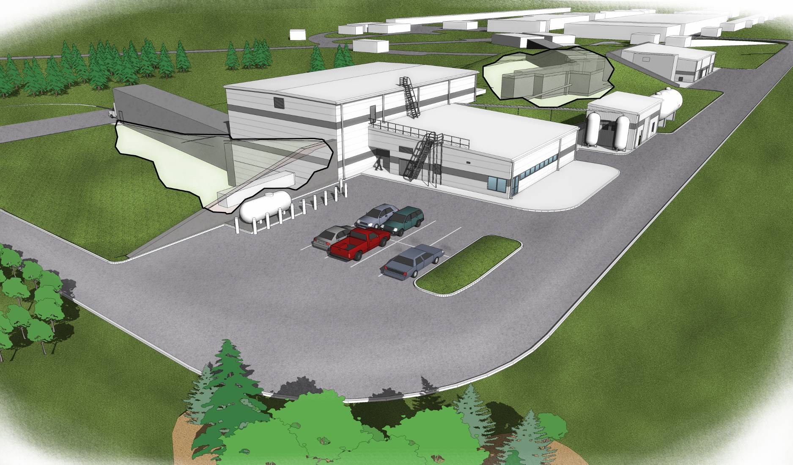
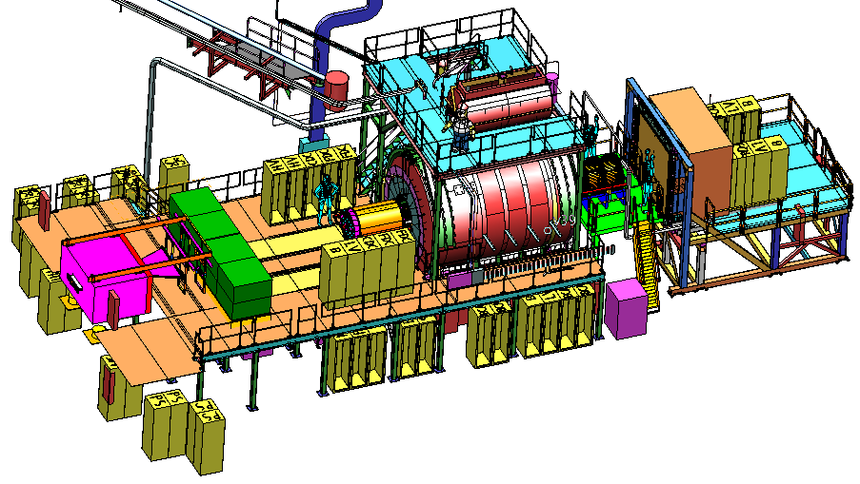
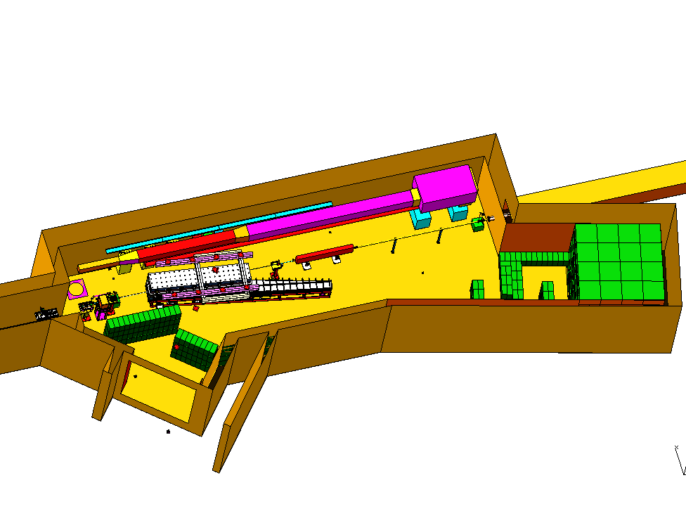
Hall D
Counting House
Tagger Area w/ Electron Beam Dump
Photon Beam Dump
Notes:
Quick slide to show the Hall-D complex as well as the detector and the tagger area. Comment on relevant details such as tagger resolution, magnet, electronics, ….

Slide 8
Construction has started
Microscope @ UCONN
Support @ UNC A&T
Tagger Magnet @ JLab
Tagger @ CUA
Diamond @ UCONN
Active Collimator @ UCONN

Slide 9
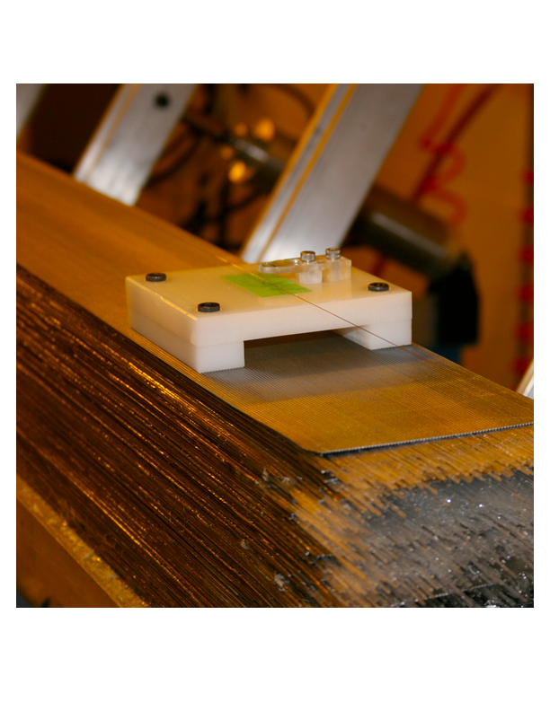
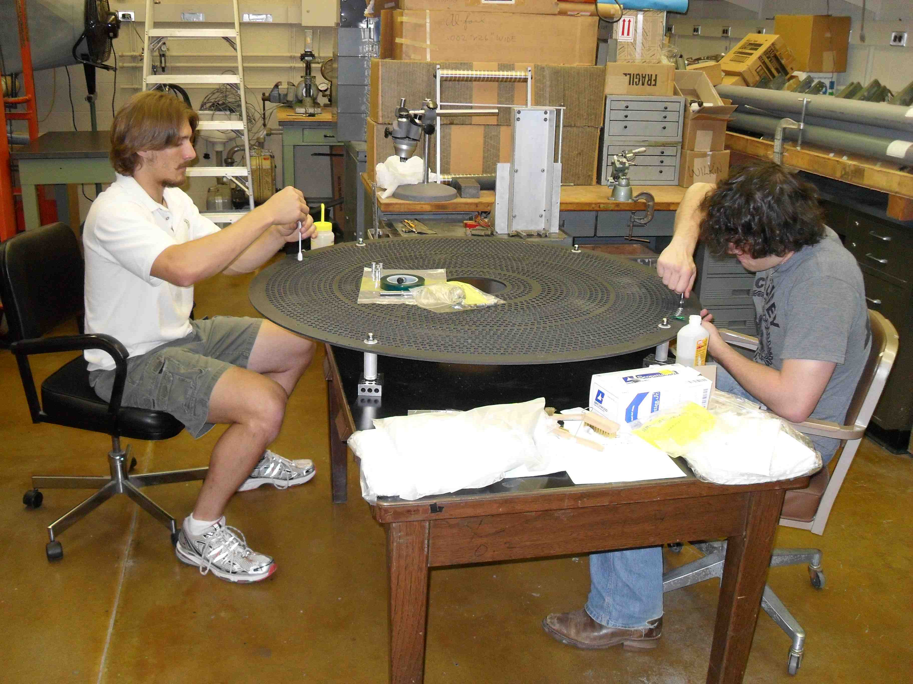
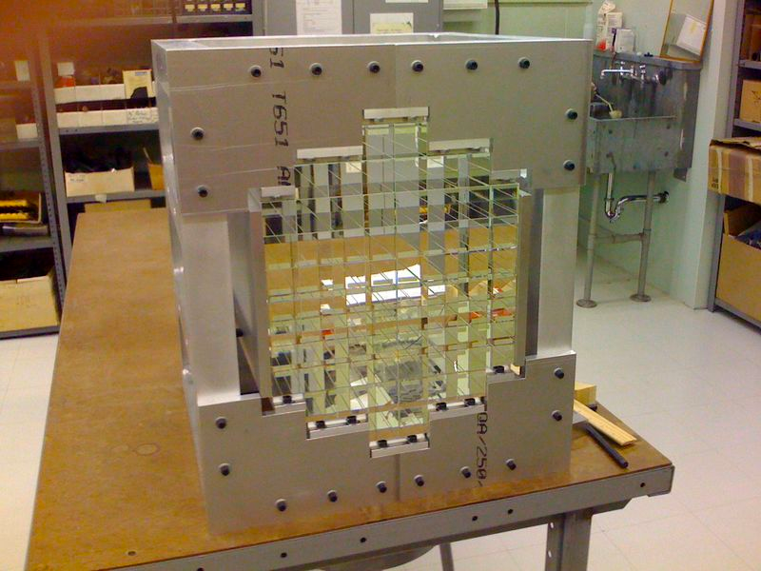
Construction has started
BCAL @ Regina
12/48 modules at JLab
CDC @ CMU
BCAL Readout @ USM
Calibration @ Athens
FCAL @ IU
FDC @ JLab
P.S. @ UNCW
TOF @ FSU
START @ FIU
TRIGGER @ Jlab, CNU
Electronics @ JLab, ICO, UMASS, USM
Solenoid @ JLab, ICO
DAQ @ JLab

