Slide 1
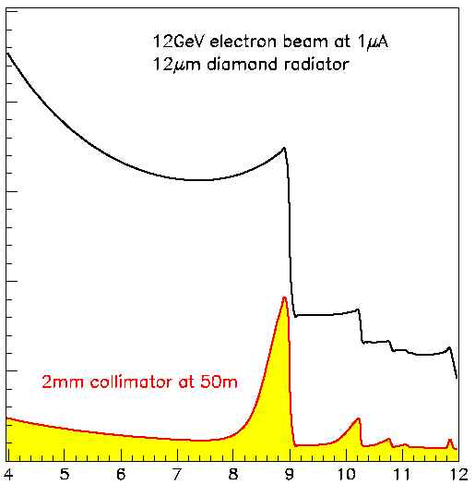
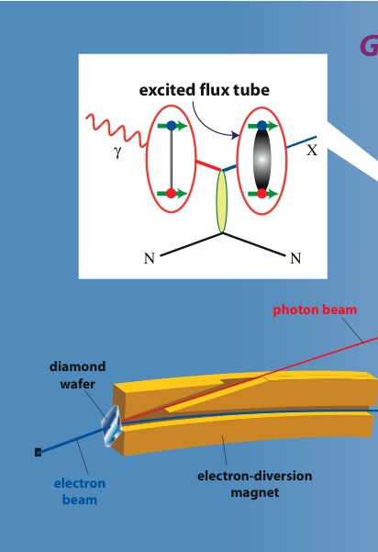
An initial study of mesons and baryons containing strange quarks with GlueX
A Proposal to Jefferson Lab PAC 40
The GlueX Collaboration
Curtis A. Meyer, GlueX Spokesperson
12 GeV electrons
GlueX
Uncollimated
Coherent Peak
40% lin. Pol.
Collimated

Slide 2
Outline
Lattice QCD and the meson spectrum.
The GlueX Physics Program.
Cascade Baryons.
The Baseline capabilities of the GlueX experiment.
The initial strangeness program in GlueX.
Event Rates.
The Level-3 software trigger.

Slide 3
Spectroscopy and QCD
Lattice QCD Predictions
Phys. Rev. D83 (2011) 111502

Slide 4
Spectroscopy and QCD
Lattice QCD Predictions
States with non-trivial glue in their wave function.

Slide 5
Spectroscopy and QCD
Phys. Rev. D84 (2011) 074023
``Constituent gluon’’ behaves like it has J^{PC} = 1⁺⁻
Mass ~ 1-1.5 GeV
Lightest hybrid nonets: 1⁻⁻, (0⁻⁺,1⁻⁺, 2⁻⁺)
The 0+- and two 2+- exotic nonets:
also a second 1⁻⁺ nonet
p-wave meson plus a ``gluon’’
2.5Gev
2.0GeV
0⁺⁻
1⁻⁺
2⁺⁻
Several nonets predicted
The GlueX program is to map the nonets of hybrid mesons.
Notes:
What are gluonic excitations and why are we looking for them? Lattice QCD predictions for the mesons and in particular, a class of mesons with non-quark-antiquark quantum numbers. Also not that mixing angles are predicted. GlueX needs to measure particle J(PC), masses, widths and decay modes to be able to map these out.

Slide 6
Spectroscopy and QCD
Experimental results on mixing:
Quarkonium
q
q
Ideal Mixing:
θ = 35.3º
Lattice QCD suggests some nonets do not have ideal mixing:
Measure through decay rates:
f₂(1270) → KK / f₂(1270) → ππ ~ 0.05
f’₂(1525) → ππ / f’₂(1525) → KK ~ 0.009
GlueX needs to observe the ss and ll states and see their decays to strange final states.
0⁻⁺ ground state and radial
1⁻⁻ ³D₁ ground state.
1⁺⁺ ground state
1⁻⁺ exotic

Slide 7
Spectroscopy and QCD
Exotic Quantum Number Hybrids
Initial GlueX searches.
Higher statistics needed.
Kaon identification
π₁→ πb₁ , πf₁ , πρ , ηa₁, η’π
η₁→π(1300)π , a₁π
η’₁→Κ₁(1400)Κ, Κ₁(1270)Κ, K*K
b₂ → a₁π , h₁π , ωπ , a₂π
h₂ → b₁π , ρπ , ωη
h’₂ → K(1460)K, K₁(1270)K, h₁η
b₀ → π(1300)π , h₁π
h₀ → b₁π , h₁η
h’₀ → Κ₁(1400)Κ, Κ₁(1270)Κ, K₂K
1⁻⁺
2⁺⁻
This proposal:
We will get higher statistics.
We begin the kaon program.
γp→ pK⁺K⁻π⁺π⁻
γp→ pK⁺K_{S}π⁻
0⁺⁻

Slide 8
Cascade Baryons
Information is limited:
J^{P} is only known for 3 states.
PDG: Nothing of significance has been added since 1988.
Expectations that many are narrow.
Experimentally challenging:
Produced through hyperon decay.
Many-particle final states.
Small cross sections.
GlueX acceptance and rates are ideal:
Production kinematics are challenging.
PDG 2012
Ξ(1320) J^{P} = (1/2) ^{+? ****}
Ξ∗(1530) J^{P} = (3/2) ^{+ ****}
Ξ∗(1620) J^{P} = (?/2) ? *
Ξ∗(1690) J^{P} = (?/2) ? ***
Ξ∗(1820) J^{P} = (3/2) ^{- ***}
Ξ∗(1950) J^{P} = (?/2) ? ***
Ξ∗(2030) J^{P} = (?/2) ? ***
Ξ∗(2120) J^{P} = (?/2) ? *
Ξ∗(2250) J^{P} = (?/2) ? **
Ξ∗(2370) J^{P} = (?/2) ? **
Ξ∗(2500) J^{P} = (?/2) ? *

Slide 9
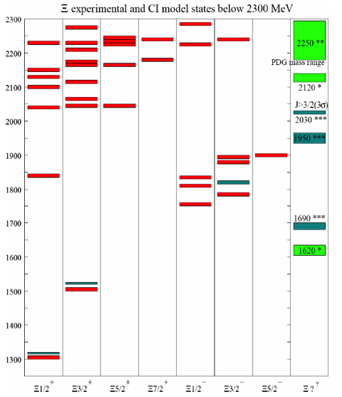
Cascade Baryons
Information is limited:
J^{P} is only known for 3 states.
PDG: Nothing of significance has been added since 1988.
Expectations that many are narrow.
Experimentally challenging:
Produced through hyperon decay.
Many-particle final states.
Small cross sections.
GlueX acceptance and rates are ideal:
Production kinematics are challenging
PDG 2012
Ξ(1320) J^{P} = (1/2) ^{+? ****}
Ξ∗(1530) J^{P} = (3/2) ^{+ ****}
Ξ∗(1620) J^{P} = (?/2) ? *
Ξ∗(1690) J^{P} = (?/2) ? ***
Ξ∗(1820) J^{P} = (3/2) ^{- ***}
Ξ∗(1950) J^{P} = (?/2) ? ***
Ξ∗(2030) J^{P} = (?/2) ? ***
Ξ∗(2120) J^{P} = (?/2) ? *
Ξ∗(2250) J^{P} = (?/2) ? **
Ξ∗(2370) J^{P} = (?/2) ? **
Ξ∗(2500) J^{P} = (?/2) ? *

Slide 10
Baseline Kaon Identification
No one system can identify all kaons
Time-of-flight wall
Time-of-flight in BCAL
dE/dx in the CDC
The Hermetic GlueX Detector allows for kinematic constraints
Kinematic fitting
Vertex constraints
Secondary vertices
Isolation tests in calorimeters
Use everything globally to take advantage of correlations between variables. Our studies have been carried out with a Boosted Decision Tree (BDT).

Slide 11
Baseline Kaon Identification
Focus on reactions where the recoil proton is detected
At least 4-constraint kinematic
Train a BDT to isolate final states with kaons.
γp→ pK⁺K⁻
γp→ pK⁺K⁻π⁺π⁻
γp→ pK⁺K_{S}π⁻ → pK⁺π⁺π⁻π⁻
γp → K⁺Y* → K+Ξ*K
Ξ*→ Ξπ , ΚΛ
Focus on charged final states with kaons.
γp → ph’₂(2600) → pK₁⁺K⁻ → pK⁺K⁻π⁺π⁻
γp → pη’₁(2300) → pK^{*0}K_{S} → pK⁺π⁺π⁻π⁻
γp → pY(2175) → pφf₀ → pK⁺K⁻π⁺π⁻
γp → pφ₃(1850) → pK⁺K
A sampling of related final states

Slide 12
Global Particle Identification
The red boxes show the 4σ coverage of the exiting TOF system in GlueX.

Slide 13
Global Particle Identification
53% Eff.
73% Eff.
31%
67%
32% Eff.
26% Eff.
15%
9%
Request 90% purity in the event sample.
The baseline GlueX detector can provide pure kaonic event samples with good efficiency.
Request 95% purity in the event sample.

Slide 14
Global Particle Identification
γp → K⁺Y* → K+Ξ*K
Ξ*→ Ξπ , ΚΛ
36% Eff.
27%
Request 90% purity.
Request 95% purity.

Slide 15
The GlueX Program
Key enhancements for Phase IV running:
Implementation of the level-3 (software) trigger.
An order of magnitude more statistics than Phases I-III.
Approved Proposed
Phase I Phase II Phase III Phase IV
______________________________________________________________
Duration (PAC Days) 30 30 60 200
Date of running (nominal) 2014 2015 2016 2017+
Minimum electron energy (GeV) <10 11 12 12
Average photon flux (γ/s) 10⁶ 10⁷ 10⁷ 5x10⁷
Average beam current (nA) 50-200 220 220 1100
Maximum beam emittance (mm-μr) 50 20 10 10
Level-1 (hardware) trigger rate (kHz) 2 20 20 200
Raw Data Volume (TB) 60 600 1200 2300
______________________________________________________________

Slide 16
Event Rates
10⁴ events per 10-MeV bin for analysis.
Energy distribution of events depends on meson mass and t-slope.
10⁷ events detected over all masses.
Allows analysis in the 2.5-3.0 GeV mass range.
If only 4x10⁶ events detected over all masses, we can do analysis in the 2.0-2.5 GeV mass range.
Two methods to estimate the number of events:
Use track reconstruction efficiency based on software performance and final states coupled with estimated cross sections.
Events from PYTHIA generator through GEANT simulation and reconstructed by the full GlueX software.

Slide 17
Event Rates
Use track reconstruction efficiency based on software performance and final states coupled with estimated cross sections.
Final State Cross Section Phase I-III Phase IV
(μb) (x 10⁶) (x 10⁶)
______________________________________________
π⁺π⁻π⁰ 10 300 3000
π⁺π⁻π⁺ 4 120 1200
ω_{3π}ππ 0.2 4 40
ω_{γπ}ππ 0.2 0.6 6
η_{γγ}ππ 0.2 3 30
η_{γγ}πππ 0.2 2 20
η’_{πππ}ππ 0.1 0.3 3
ΚΚππ 0.5 4 40
ΚΚπ 0.1 1 10
Phase III
Higher
statistics
Estimates
Kaons
A factor 10 increase in statistics allows access to small signals from initial running.

Slide 18
Event Rates
Events from PYTHIA generator through GEANT simulation and reconstructed by the full GlueX software.
GlueX Data Challenge: (December 2012) We simulated and reconstructed 5.3 x 10⁹ events. These were based on the full hadronic cross section in the 8.4-9.0 GeV photon energy window and represent 70% of phase III running in GlueX. Trained and used BDTs to extract final states of interest.
Meson Final Mass Events Events/10MeV
State Window
_________________________________________________
h’₂(2600) KKππ 2.42-2.79 1.5x10⁶ 4.0x10⁴
η’₁(2300) Kπππ 2.00-2.60 0.46x10⁶ 1.5x10⁴
φ₃(1850) KK 1.72-1.98 5.3x10⁶ 21.x10⁴
Y(2175) KKππ 2.06-2.29 0.12x10⁶ 0.52x10⁴
Ξ∗(1820) KKKΛ 90x10³

Slide 19
Level-3 Software Trigger
Coherent bremsstrahlung leads to 40% linear polarization for 8.4-9.0 GeV photons. GlueX has a rate limit of 10⁸ γ/s in this range.
GlueX is limited to 10⁷ γ/s in this range without a Level-3 trigger.
GlueX was designed to have a software trigger to allow for higher rates, and to reduce data volume and increase analysis efficiency. The trigger should reduce the data rate by a factor of 10:
3GB/s ➔ 300 MB/s
The infrastructure for the trigger exists in the baseline GlueX. The compute farm is needed to enable the trigger.
Needed hardware is estimated at ~2000 of today’s compute cores (@64 per box ~32 blades), less expensive than tape storage.
The GlueX MIT group developed the LHCb software trigger and have taken on the GlueX trigger.

Slide 20
Summary
This request will allow GlueX to move into its main production running and acquire data that will afford the study many of the important final states for exotic hybrid mesons.
Implementation of the GlueX Level-3 trigger is necessary to achieve the beam rates necessary to collect these data. We are working with the lab to try and have some test capability available early. The MIT group has been funded to develop and implement the trigger algorithms.
The capabilities of the baseline GlueX will allow us to start the kaon physics needed for a full hybrid search, but additional kaon-identification capabilities will be needed to complete this (our conditionally approved proposal from last year).

Slide 21
Backup Slides on PID

Slide 22
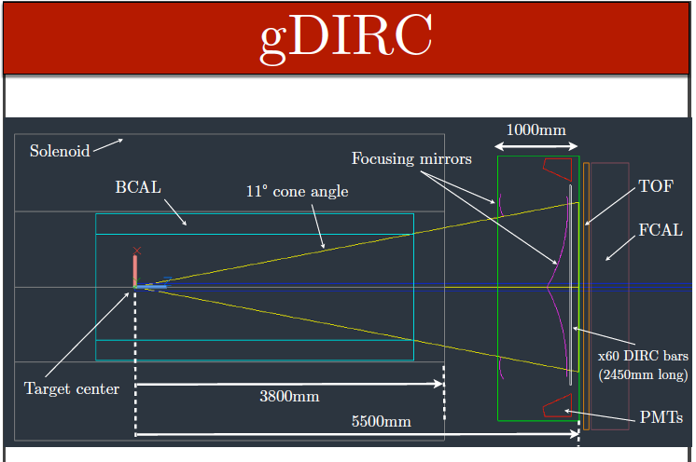
GlueX Forward Particle Identification
Threshold gas Cherenkov combined with a DIRC system.

Slide 23
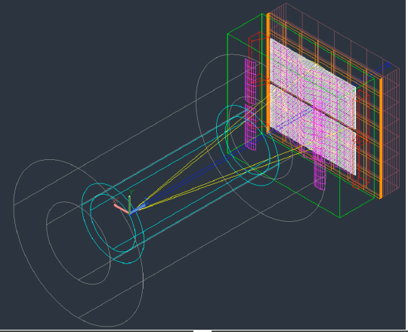

Slide 24
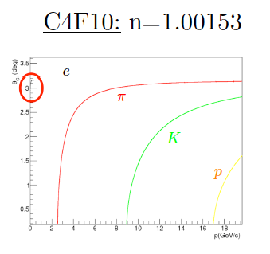
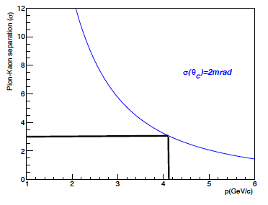
gDirc Particle Identification
DIRC: 3σ K/π Separation up to ~4GeV/c
Threshold Gas Cherenkov: 3σ K/π Separation from ~3GeV/c up to 9GeV/c
Existing TOF: 3σ K/π Separation up to ~2GeV/c
DIRC/Quartz Bars

Slide 25
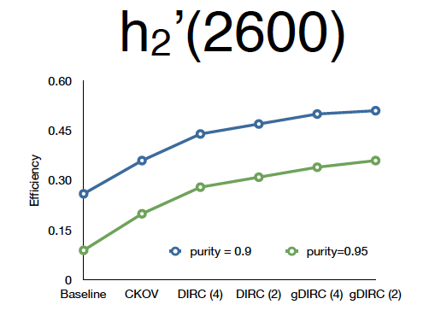
gDirc Particle Identification
Going from 90% to 95% purity doubles the experiments sensitivity.
Not shown, but we can push the purity to 99%, which is a 10-fold improvement in sensitivity.
This proposal
gDIRC PID System

Slide 26
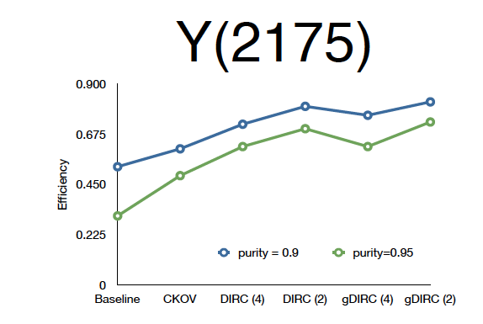
gDirc Particle Identification

Slide 27
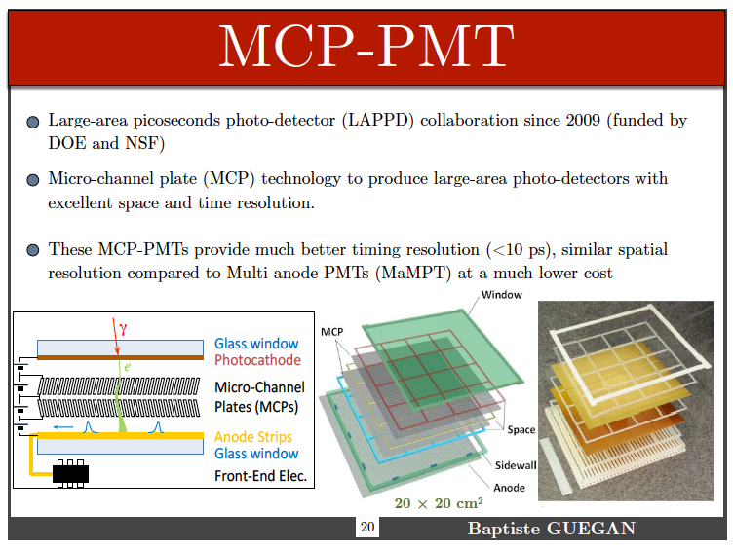
Common Readout

Slide 28
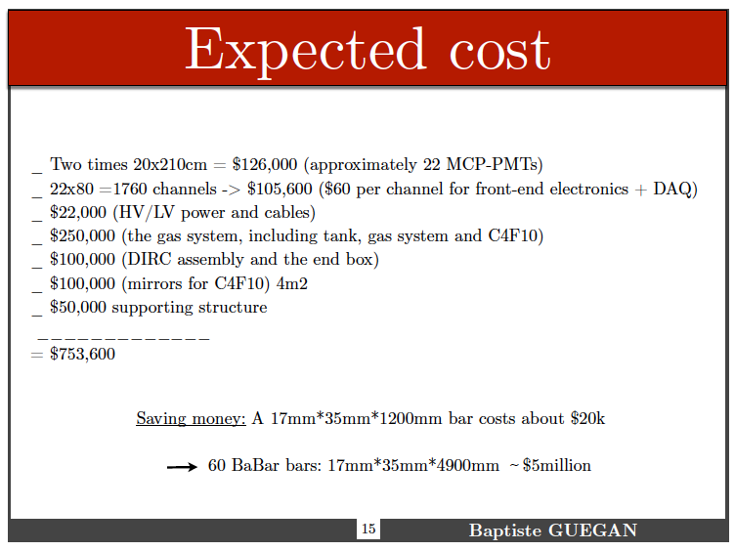
Very Preliminary Cost Estimate
Items are missing, but we believe we can keep to TPC below $2million.

Slide 29
gDirc Particle Identification
The enhanced Kaon-identification allows us to improve sensitivity to small signals by a factor of up to 10 over the baseline GlueX detector.
The enhanced Kaon-identification makes possible analyses in which the recoil baryon is not detected (neutron or missing proton).
Depending on timeline and funding, this would likely run (partially) in parallel with the current proposal.

