Slide 1
GlueX/Hall-D Physics
Curtis A. Meyer
Carnegie Mellon University
Jlab Users Meeting, June 2010

Slide 2
Outline
Meson spectroscopy and hybrid mesons.
New information from Lattice QCD.
The experimental situation.
Status of GlueX/Hall-D.
Amplitude analysis.

Slide 3
Spectroscopy and QCD
Mesons
Quarkonium
radial
q
q
4⁺⁺
L=3
3⁺⁺
2⁺⁺
Consider the three lightest quarks
3⁺⁻
3⁻⁻
9 Combinations
L=2
2⁻⁻
1⁻⁻
2⁻⁺
2⁺⁺
L=1
1⁺⁺
0⁺⁺
1⁺⁻
1⁻⁻
S=1
S=0
L=0
0⁻⁺

Slide 4
Spectroscopy and QCD
Mesons
Quarkonium
q
q
4⁺⁺
L=3
3⁺⁺
2⁺⁺
3⁺⁻
ρ,K*,ω,φ
Mesons come in
nonets of the same
J^{PC} Quantum Numbers
3⁻⁻
L=2
2⁻⁻
π,K,η,η’
1⁻⁻
2⁻⁺
a,K,f,f’
2⁺⁺
L=1
1⁺⁺
b,K,h,h’
SU(3) is broken
last two members mix
0⁺⁺
1⁺⁻
ρ,K*,ω,φ
1⁻⁻
S=1
S=0
L=0
0⁻⁺
π,K,η,η’

Slide 5
Spectroscopy and QCD
Mesons
^{2S+1}L_{J}
Quarkonium
Nothing to do
with Glue!
³F₄
q
q
4⁺⁺
³F₃
L=3
3⁺⁺
³F₂
2⁺⁺
¹F₃
Allowed J^{PC} Quantum numbers:
3⁺⁻
³D₃
3⁻⁻
0⁻⁻ 0⁺⁻
1⁻⁺
2⁺⁻
3⁻⁺
4⁺⁻
5⁻⁺
³D₂
0⁺⁺ 0⁻⁺
1^{–-} 1⁺⁺ 1⁺⁻
2⁻⁻ 2⁺⁺ 2⁻⁺
3⁻⁻ 3⁺⁺ 3⁺⁻
4⁻⁻ 4⁺⁺ 4⁻⁺
5⁻⁻ 5⁺⁺ 5⁺⁻
L=2
2⁻⁻
1⁻⁻
³D₁
2⁻⁺
¹D₂
³P₂
2⁺⁺
³P₁
L=1
1⁺⁺
³P₀
0⁺⁺
1⁺⁻
¹P₁
³S₁
Exotic Quantum Numbers
non quark-antiquark description
1⁻⁻
S=1
S=0
L=0
0⁻⁺
¹S₀

Slide 6
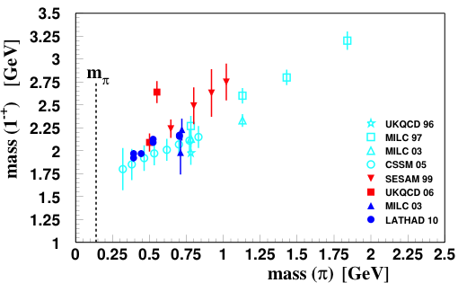
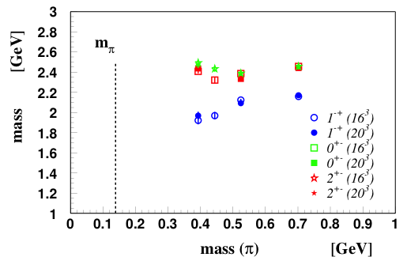
Hybrid Predictions
Flux-tube model: 8 degenerate nonets
1⁺⁺,1⁻⁻ 0⁻⁺,0⁺⁻,1⁻⁺,1⁺⁻,2⁻⁺,2⁺⁻ ~1.9 GeV/c²
Lattice QCD Calculations
S=0
S=1
Lattice QCD Calculations
1^{-+ ~}1.9
2⁺⁻ ~2.2
0^{+- ~}2.2
At the physical pion mass?
In the charmonium sector:
1⁻⁺ 4.39 ±0.08
0⁺⁻ 4.61 ±0.11
Many models predict exotic-QN hybrids.

Slide 7
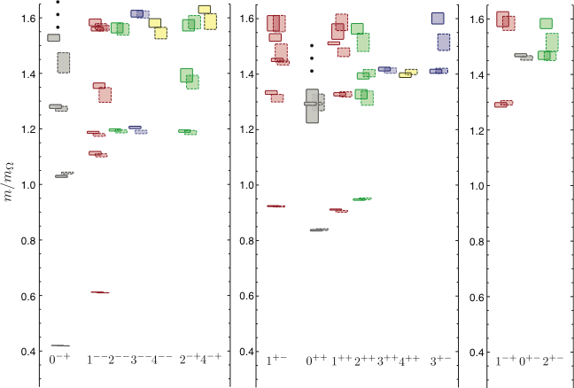
LQCD: The Spectrum of Mesons
Dynamical calculation of the isospin-one light-quark mesons.
3 identical quarks, pion mass~700MeV
Two lattice volumes.
(exotic)
J^{PC}
J^{PC}
J^{PC}
J.J. Dudek (et al.) arXiv:1004.4930

Slide 8
LQCD: The Spectrum of Mesons
Dynamical calculation of the isospin-one light-quark mesons.
Quark-
model
states
(exotic)
J^{PC}
J^{PC}
J^{PC}
J.J. Dudek (et al.) arXiv:1004.4930

Slide 9
LQCD: The Spectrum of Mesons
Dynamical calculation of the isospin-one light-quark mesons.
Extra
states ???
Non-exotic
QN hybrids.
0⁻⁺
1—
2⁻⁺
1⁺⁻
1⁺⁺
Large overlap with non-trivial operators in the gluonic fields
(exotic)
J^{PC}
J^{PC}
J^{PC}
J.J. Dudek (et al.) arXiv:1004.4930

Slide 10
Hybrid Decays
L_{flux}
The angular momentum in the flux
tube stays in one of the daughter
mesons (an (L=1) and (L=0) meson).
L_{flux}
Exotic Quantum Number Hybrids
π₁→ πb₁ , πf₁ , πρ , ηa₁
η₁→π(1300)π , a₁π
b₂ → a₁π , h₁π , ωπ , a₂π
h₂ → b₁π , ρπ , ωη
b₀ → π(1300)π , h₁π
h₀ → b₁π , h₁η
Mass and model
dependent
predictions
Populate final states with
π±,π⁰,K±,K⁰,η, (photons)

Slide 11
Hybrid Decays
L_{flux}
The angular momentum in the flux
tube stays in one of the daughter
mesons (an (L=1) and (L=0) meson).
L_{flux}
Exotic Quantum Number Hybrids
π₁→ πb₁ , πf₁ , πρ , ηa₁
η₁→π(1300)π , a₁π
b₂ → a₁π , h₁π , ωπ , a₂π
h₂ → b₁π , ρπ , ωη
b₀ → π(1300)π , h₁π
h₀ → b₁π , h₁η
Mass and model
dependent
predictions
Populate final states with
π±,π⁰,K±,K⁰,η, (photons)
The good channels to look at with amplitude analysis.

Slide 12
Hybrid Decays
L_{flux}
The angular momentum in the flux
tube stays in one of the daughter
mesons (an (L=1) and (L=0) meson).
L_{flux}
Exotic Quantum Number Hybrids
π₁→ πb₁ , πf₁ , πρ , ηa₁
η₁→π(1300)π , a₁π
b₂ → a₁π , h₁π , ωπ , a₂π
h₂ → b₁π , ρπ , ωη
b₀ → π(1300)π , h₁π
h₀ → b₁π , h₁η
Mass and model
dependent
predictions
Populate final states with
π±,π⁰,K±,K⁰,η, (photons)
The good channels to look at with amplitude analysis.
Other interesting channels for amplitude analysis.

Slide 13
Experimental Evidence for Hybrids
The most extensive data sets to date are from the BNL E852 experiment. There is
also data from the VES experiment at Protvino and some results from the Crystal
Barrel experiment at LEAR. Finally, there is a CLAS (Jefferson Lab) result. We have
Also just started to see results from the COMPASS experiment at CERN.

Slide 14
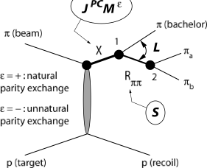
Experimental Evidence for Hybrids
The most extensive data sets to date are from the BNL E852 experiment. There is
also data from the VES experiment at Protvino and some results from the Crystal
Barrel experiment at LEAR. Finally, there is a CLAS (Jefferson Lab) result. We have
Also just started to see results from the COMPASS experiment at CERN.
Diffractive production
E852: 18 GeV/c
VES: 37 GeV/c
COMPASS: 160 GeV/c
M: spin projection
: reflectivity
Natural-parity-exchange: J^{P}=0⁺,1⁻,2⁺, …
Unnatural-parity-exchange: J^{P}=0⁻,1⁺,2⁻, …

Slide 15
Experimental Evidence for Hybrids
Mode Mass Width Production
ηπ⁻ 1370±15+50-30 385±40+65-105 1⁺
ηπ⁰ 1257±20±25 354±64±60 1⁺
ηπ 1400 310 seen in annihilation
π₁(1400)
Mode Mass Width Production
3π 1598 ±8+29-47 168±20+150-12 1⁺,0⁻,1-
η’π 1597±10+45-10 340±40±50 1⁺
b₁π 1664±8±10 185±25±38 0⁻ ,1⁺
f₁π 1709±24±41 403±80±115 1⁺
3π 1660 ±10+64-0 269±21+42-64 1⁺
π₁(1600)
Mode Mass Width Production
b₁π 2014±20±16 230±32±73 1⁺
f₁π 2001±30±92 332±52±49 1⁺
π₁(2015)

Slide 16
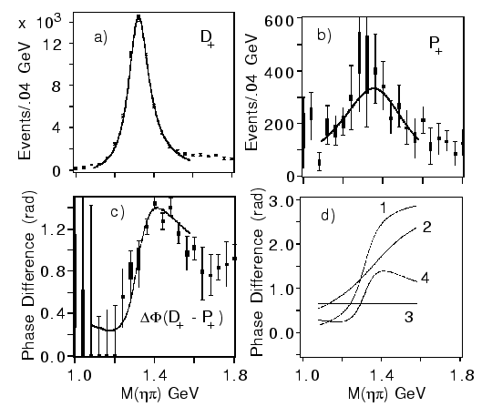
Experimental Evidence for Hybrids
Mode Mass Width Production
ηπ⁻ 1370±15+50-30 385±40+65-105 1⁺
ηπ⁰ 1257±20±25 354±64±60 1⁺
ηπ 1400 310 seen in annihilation
π₁(1400)
E852 + CBAR (1997)
While everyone seems to agree that there is intensity in the P⁺ exotic wave, there are a number of alternative (non-resonant) explanations for this state.
Unlikely to be a hybrid based on its mass. Also , the only observed decay should not couple to a member of an SU(3) octet. It could couple to an SU(3) decuplet state (e.g. 4-quark).

Slide 17
Experimental Evidence for Hybrids
Mode Mass Width Production
3π 1598 ±8+29-47 168±20+150-12 1⁺,0⁻,1-
η’π 1597±10+45-10 340±40±50 1⁺
b₁π 1664±8±10 185±25±38 0⁻ ,1⁺
f₁π 1709±24±41 403±80±115 1⁺
3π 1660 ±10+64-0 269±21+42-64 1⁺
π₁(1600)
Mode Mass Width Production
3π 1598 ±8+29-47 168±20+150-12 1⁺,0⁻,1-
η’π 1597±10+45-10 340±40±50 1⁺
b₁π 1664±8±10 185±25±38 0⁻ ,1⁺
f₁π 1709±24±41 403±80±115 1⁺
3π 1660 ±10+64-0 269±21+42-64 1⁺
π₁(1600)

Slide 18
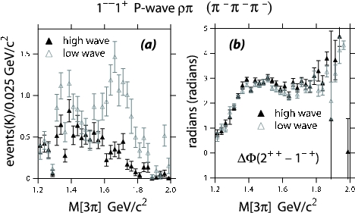
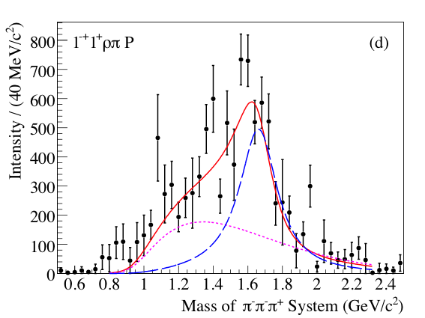
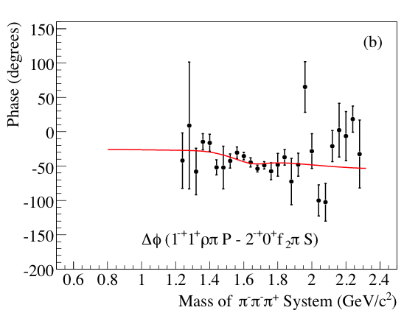
Experimental Evidence for Hybrids
Mode Mass Width Production
3π 1598 ±8+29-47 168±20+150-12 1⁺,0⁻,1⁻ E852
η’π 1597±10+45-10 340±40±50 1⁺ E852,VES
b₁π 1664±8±10 185±25±38 0⁻ ,1⁺ E852,VES,CBAR
f₁π 1709±24±41 403±80±115 1⁺ E852,VES
3π 1660 ±10+64-0 269±21+42-64 1⁺ COMPASS
π₁(1600)
Decay mode sensitive to model
But not in
COMPASS
Exactly the same mass and width as the
Confused production in E852??
This is consistent with a hybrid meson

Slide 19
Experimental Evidence for Hybrids
π₁(2015)
Mode Mass Width Production
b₁π 2014±20±16 230±32±73 1⁺
f₁π 2001±30±92 332±52±49 1⁺
Mode Mass Width Production
b₁π 2014±20±16 230±32±73 1⁺
f₁π 2001±30±92 332±52±49 1⁺
π₁(2015)

Slide 20
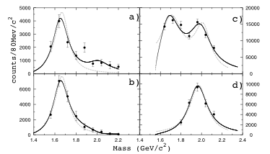
Experimental Evidence for Hybrids
π₁(2015)
Mode Mass Width Production
b₁π 2014±20±16 230±32±73 1⁺ E852
f₁π 2001±30±92 332±52±49 1⁺ E852
Need two J^{PC}=1⁻⁺ states
π₁(2000)→b₁π
M = 2014±20±16 MeV/c²
Γ = 230±32±73 MeV/c²
Seen primarily in natural
parity exchange.
The natural dominates
m^{ε}=0⁻
1⁻⁺b₁π
m^{ε}=1⁺
1⁻⁺b₁π
Seen in one experiment with low statistics It needs confirmation. If this exists, it is also a good candidate for an exotic hybrid meson.

Slide 21
QCD Exotics
We expect 3 nonets of exotic-quantum-number mesons: 0⁺⁻, 1⁻⁺, 2⁺⁻
π₁ I^{G}(J^{PC})=1⁻(1⁻⁺)
K₁ I^{G}(J^{PC})= ½ (1⁻)
Lattice showed two states here.
η’₁ I^{G}(J^{PC})=0⁺(1⁻⁺)
η₁ I^{G}(J^{PC})=0⁺(1⁻⁺)
π , η , η’ , K → π₁ , η₁ , η’₁, K₁
1⁻⁺
0⁺⁻
2⁺⁻
What are the mixing angles between the isoscalar states?
b₀, h₀, h₀’, K₀
b₂, h₂, h₂’, K₂

Slide 22
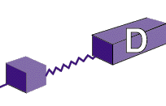
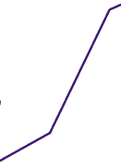
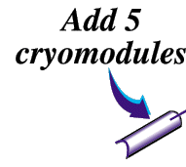
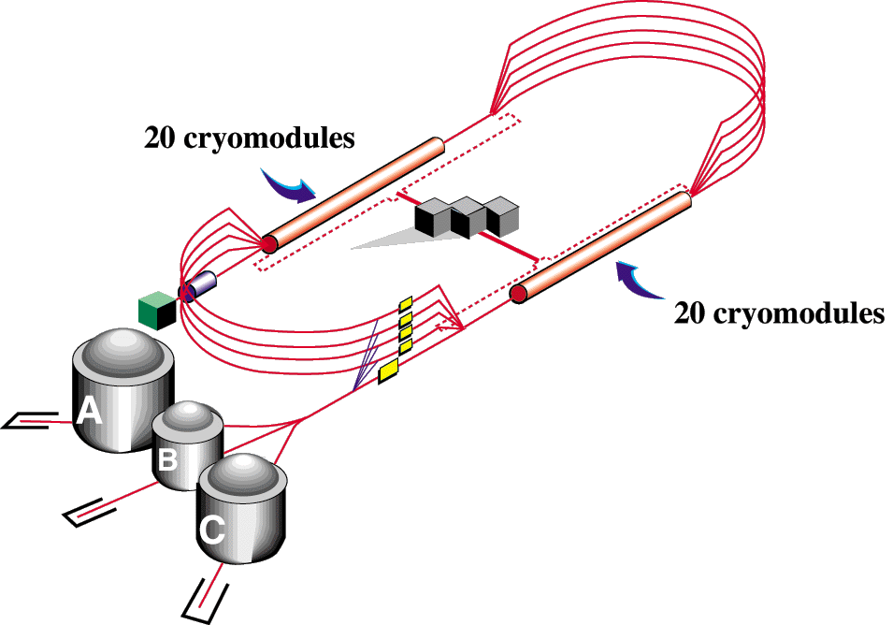

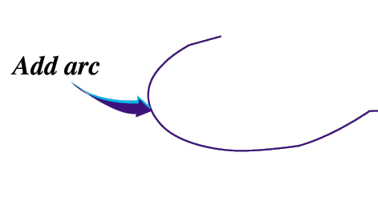

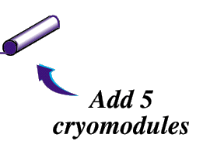
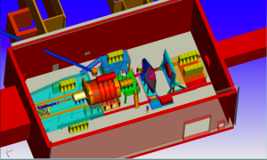
The GlueX Detector in Hall-D
Upgrade magnets and power supplies
CHL-2

Slide 24
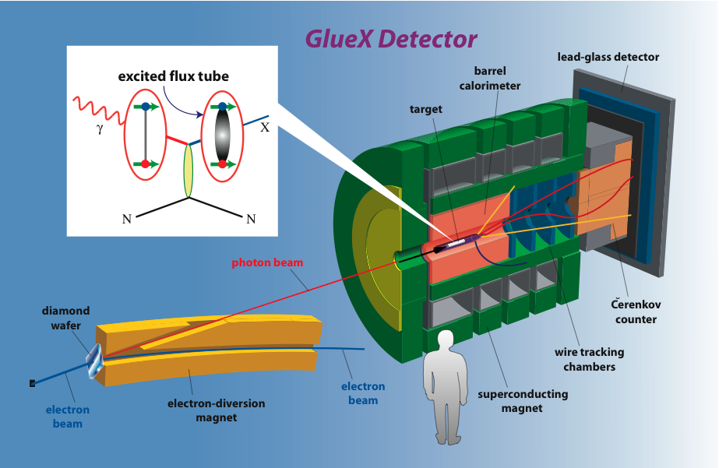
The GlueX Detector in Hall D
Future

Slide 25
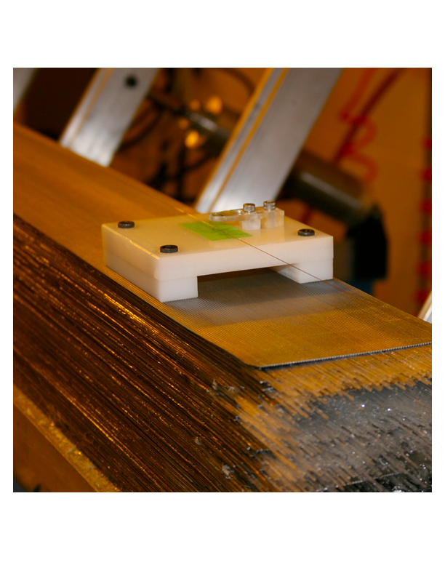
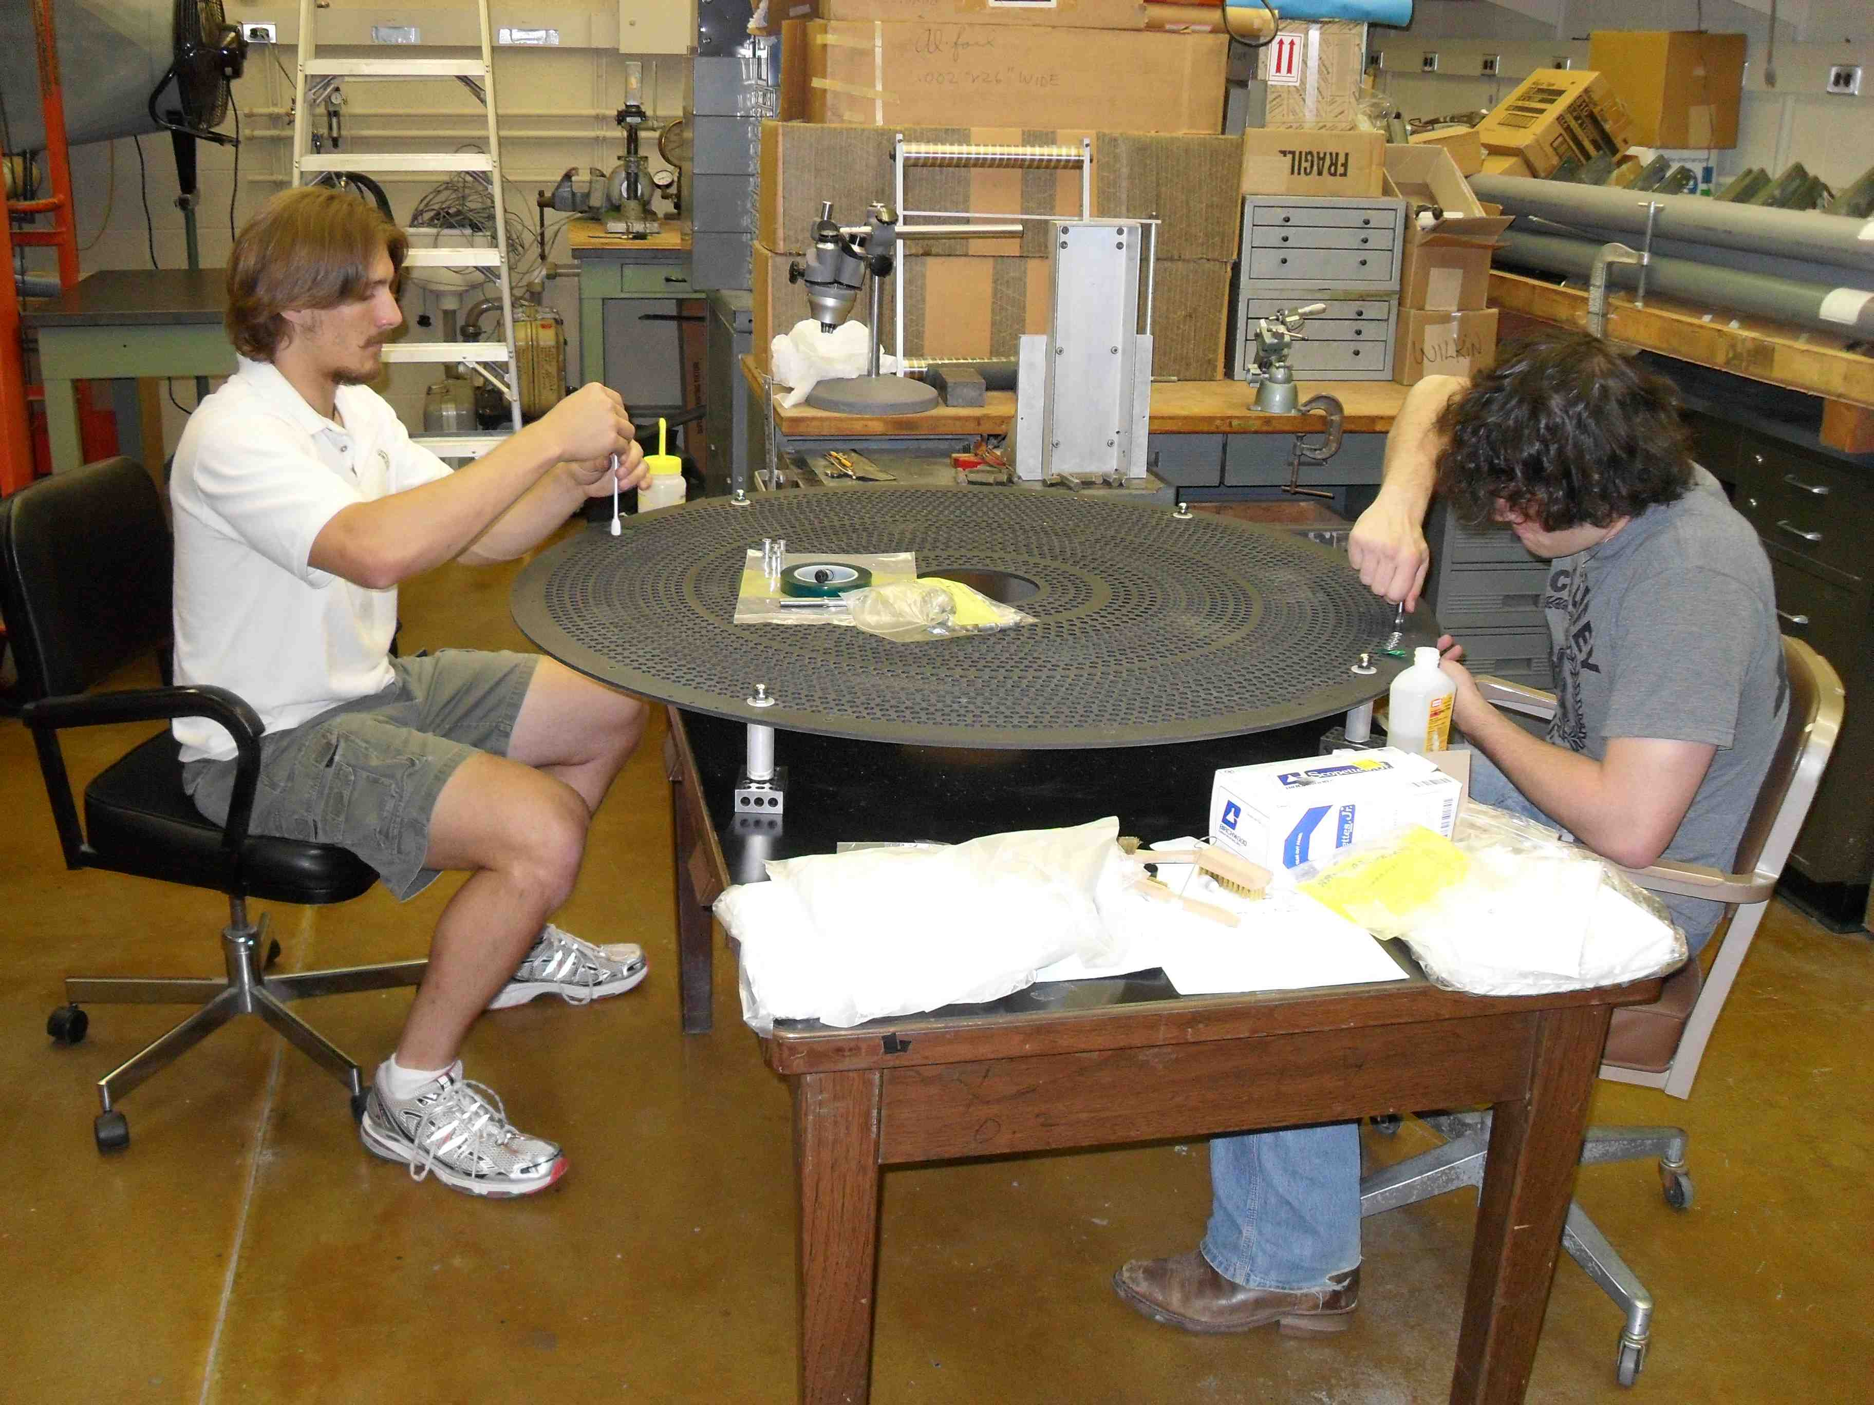
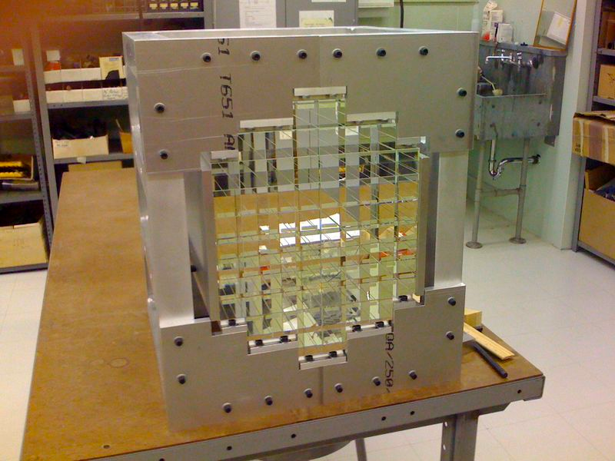
Detector Construction Underway
BCAL at Univ. Regina
CDC at CMU
FCAL at IU
First 4 of 48 modules have been delivered to Jlab.

Slide 26

Amplitude Analysis
In order to find the exotic QN exotics, it is necessary to carry out an amplitude analysis:
Analyze a particular final state
Consider normal meson channels:
J^{PC} = 2⁻⁺, 1⁺⁻, 3⁺⁻, …
Consider exotic meson channels:
J^{PC} = 2⁺⁻
Different decay modes
Different isospin channels

Slide 27



Amplitude Analysis
Write down quantum mechanical amplitudes for each process:
Create a total amplitude which yields an intensity:
(Fitting angular distributions in some high-dimensional space)
Maximize the probability (likelihood).

Slide 28
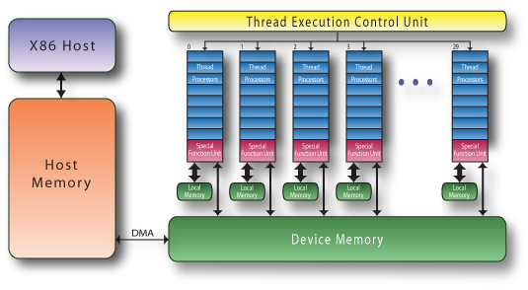
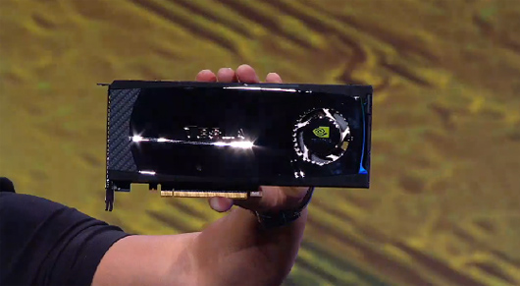
Amplitude Analysis
If one can compute the normalization once, then relatively quick, but this limits the form of the amplitude and may bias your answer. If you wanted to allow the mass and width of a resonance to be fit, you have to recompute the normalization each step.
GPUs
The problem appears well suited to run on graphical processor (GPU). The next generation will have up to 512 cpu cores per GPU and four can be installed per box. We are currently studying how well the problem scales, but our first studies have been very promising. These work because there are a lot of repeated parallel calculations.

Slide 29
Amplitude Analysis
We have also developed tools to facilitate the writing of amplitudes (qft++). This has been used to analyze the photoproduction of Baryons using CLAS data.
GlueX is a member of the OpenScienceGrid (OSG) and we are currently able to generate and process Monte Carlo data on the grid. We believe that this will be a major part of our data model.
We are working on pushing our A.A. onto the grid, but the recent results with GPUs may change our paradigm.

Slide 30
Amplitude Analysis
We are currently carrying out A.A. on several promising channels using simulated data and the full GlueX Monte Carlo and reconstruction code base.
We are working with phenomenologists to develop better formulations for our amplitudes that satisfy known physical constraints. These are more computationally challenging, but the GPUs may solve this problem.
Members are performing PWA on CLEO-c, BES-III, E852 and CLAS data.

Slide 31
Summary
The search for exotic hybrids still remains limited by statistics, and information only exists for isospin-one 1⁻⁺ states.
Exciting recent lattice results reaffirm the case for these states and provide theoretical methods to measure the gluonic content of states.
The GlueX/Hall-D complex is under construction with detector elements delivered to Jlab and we are on-track to first beam in 2014.
Work continues on Amplitude Analysis with a lot of interesting progress. By 2014 we should have a very robust set of tools.

