Slide 1
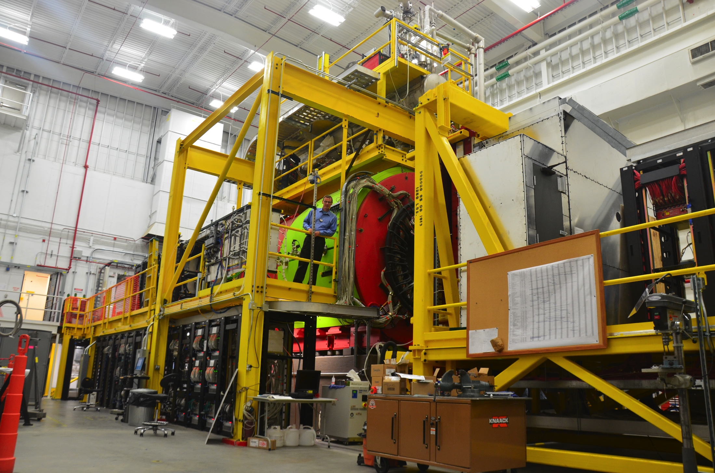
The Search for Gluonic Excitations
Curtis A. Meyer
Carnegie Mellon
October 18, 2018

Slide 2
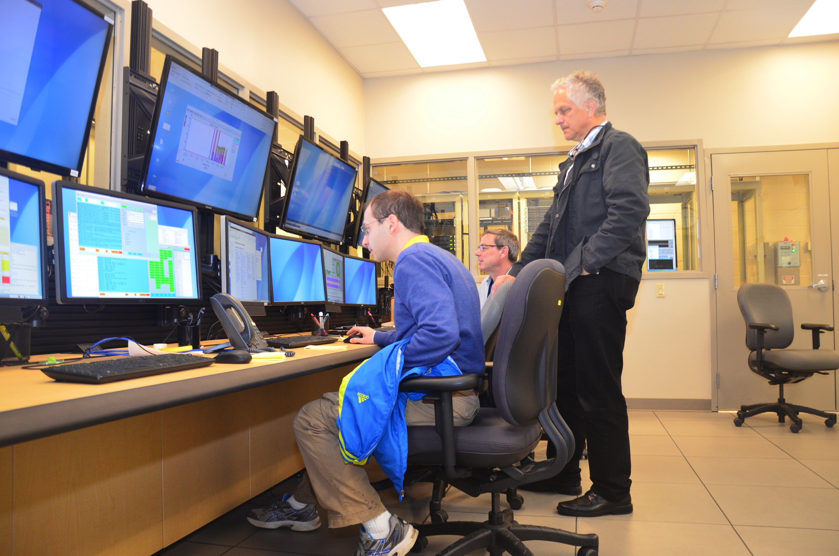
Outline
What are gluonic excitations.
Only Glue?
Exotic Glue?
The GlueX experiment.
Summary.
12-GeV beam, Dec. 2015

Slide 3
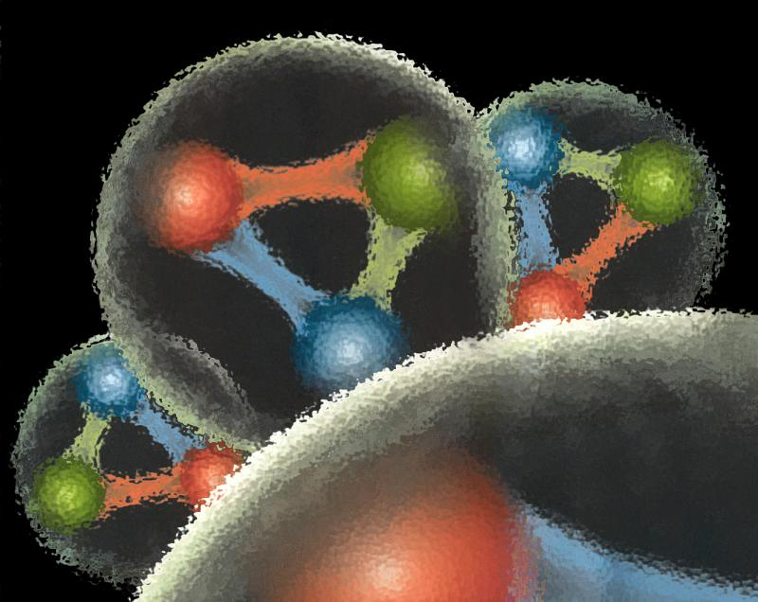
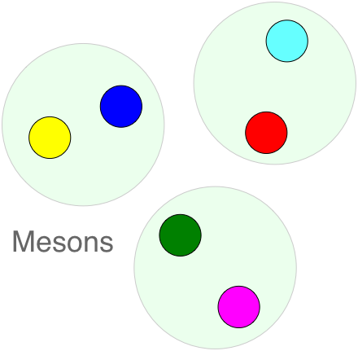
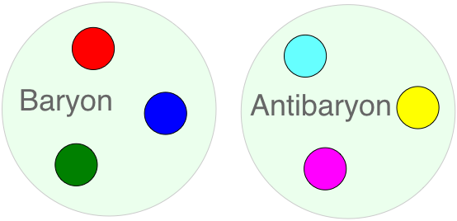
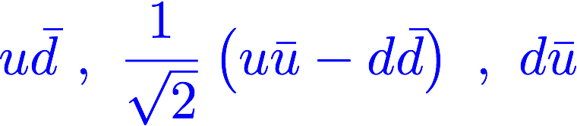
Quantum Chromo Dynamics
QCD describes the interactions of quarks and gluons and should predict the spectrum of bound-state. Three “color” charges if QCD, bound states are ”color neutral” or “white”.
red, blue, green
cyan, yellow, magenta
Baryons consist of three quarks and antibaryons consist of three antiquarks.
proton uud neutron ddu
Mesons are quark-antiquark states.
π⁺ π⁰ π⁻

Slide 4
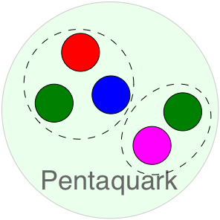
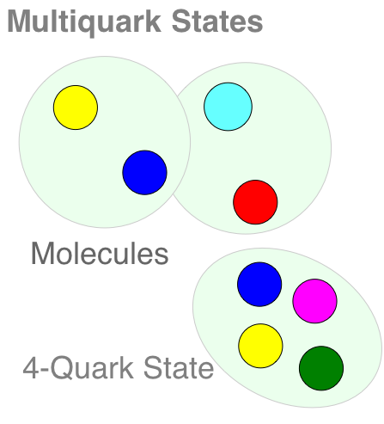
Quantum Chromo Dynamics
Which color-neutral objects exist in nature?
The LHCb experiment has recently reported on pentaquark candidates involving charm quarks.
Candidates exists in a number of charmonium states. There are also models in which some light-quark states are these states.

Slide 5
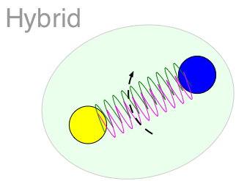
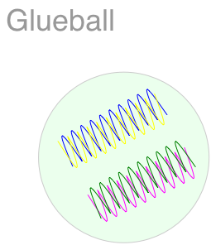
Quantum Chromo Dynamics
The force-carrier in QCD is the gluon. The eight gluons carry both a color and an anti-color charge, but they are not color neutral. (SU(3) Octets)
Can gluons also build color-neutral objects?
An excited gluonic field can contribute to the quantum numbers of a meson. Some of these quantum numbers are not possible for mesons, known as exotic.
Pure states of gluons are known as glueballs. Nominally 2-gluon or 3-gluon objects. A candidate exists, but it is mixed (QM) with mesons.

Slide 6
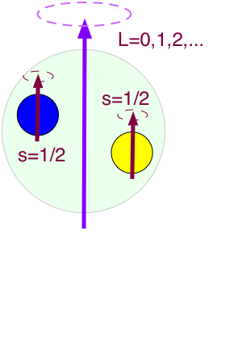
Quantum Chromo Dynamics
Focus on mesons built from the three lightest quarks, u, d and s, and their antiquarks.
Combine two spin ½ objects to S=0 or S=1
Orbital angular momentum of two quarks:
L=0,1,2,3,…
Total angular momentum, J=L+S
J=0,1,2,3,…
Spatial Reflection Symmetry:
Parity P=-(-1)^{L}
Quark-antiquark Reflection:
C-parity C=(-1)^{L+S}
J^{PC}

Slide 7


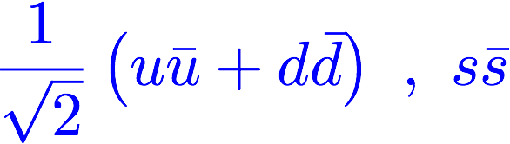
Quantum Chromo Dynamics
L=3, S=1, J^{PC}=4⁺⁺
J^{PC}=3⁺⁺
J^{PC}=2⁺⁺
L=3, S=0, J^{PC}=3⁺⁻
Each J^{PC} corresponds to nine quark-antiquark states, nonets .
L=2, S=1, J^{PC}=3⁻⁻
J^{PC}=2⁻⁻
J^{PC}=1⁻⁻
L=2, S=0, J^{PC}=2⁻⁺
L=1, S=1, J^{PC}=2⁺⁺
J^{PC}=1⁺⁺
J^{PC}=0⁺⁺
L=1, S=0, J^{PC}=1⁺⁻
L=0, S=1, J^{PC}=1⁻⁻
L=0, S=0, J^{PC}=0⁻⁺
Can mix
Notes:
What are gluonic excitations and why are we looking for them? Lattice QCD predictions for the mesons and in particular, a class of mesons with non-quark-antiquark quantum numbers. Also not that mixing angles are predicted. GlueX needs to measure particle J(PC), masses, widths and decay modes to be able to map these out.

Slide 8






Quantum Chromo Dynamics
L=3, S=1, J^{PC}=4⁺⁺
J^{PC}=3⁺⁺
J^{PC}=2⁺⁺
L=3, S=0, J^{PC}=3⁺⁻
Each J^{PC} corresponds to nine quark-antiquark states, nonets .
L=2, S=1, J^{PC}=3⁻⁻
J^{PC}=2⁻⁻
J^{PC}=1⁻⁻
L=2, S=0, J^{PC}=2⁻⁺
L=1, S=1, J^{PC}=2⁺⁺
J^{PC}=1⁺⁺
J^{PC}=0⁺⁺
L=1, S=0, J^{PC}=1⁺⁻
L=0, S=1, J^{PC}=1⁻⁻
L=0, S=0, J^{PC}=0⁻⁺

Slide 9
Quantum Chromo Dynamics
L=3, S=1, J^{PC}=4⁺⁺
J^{PC}=3⁺⁺
J^{PC}=2⁺⁺
L=3, S=0, J^{PC}=3⁺⁻
Each J^{PC} corresponds to nine quark-antiquark states.
L=2, S=1, J^{PC}=3⁻⁻
J^{PC}=2⁻⁻
J^{PC}=1⁻⁻
L=2, S=0, J^{PC}=2⁻⁺
0⁻⁻ , 0⁻⁺ , 0⁺⁻ , 0⁺⁺
1⁻⁻ , 1⁻⁺ , 1⁺⁻ , 1⁺⁺
2⁻⁻ , 2⁻⁺ , 2⁺⁻ , 2⁺⁺
3⁻⁻ , 3⁻⁺ , 3⁺⁻ , 3⁺⁺
L=1, S=1, J^{PC}=2⁺⁺
J^{PC}=1⁺⁺
J^{PC}=0⁺⁺
L=1, S=0, J^{PC}=1⁺⁻
Exotic Quantum Numbers
L=0, S=1, J^{PC}=1⁻⁻
L=0, S=0, J^{PC}=0⁻⁺
Can mix
Notes:
What are gluonic excitations and why are we looking for them? Lattice QCD predictions for the mesons and in particular, a class of mesons with non-quark-antiquark quantum numbers. Also not that mixing angles are predicted. GlueX needs to measure particle J(PC), masses, widths and decay modes to be able to map these out.

Slide 10
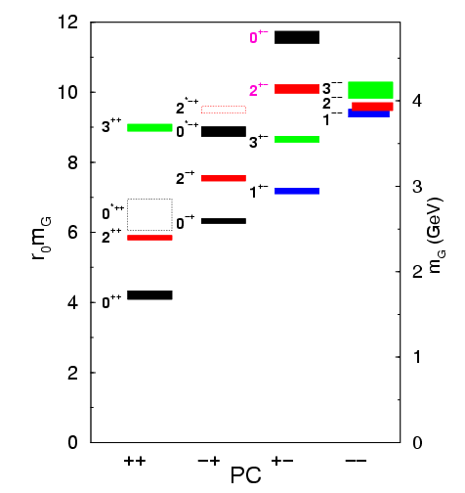
Lattice QCD Glueball Predictions
Gluons can bind to form glueballs
EM analogue: massive globs
of pure light.
Lattice QCD predicts masses
The lightest glueballs have
“normal” quantum numbers.
Glueballs will Q.M. mix
The observed states will
be mixed with normal
mesons.
Strong experimental evidence
For the lightest state.

Slide 11
Identification of Glueballs
Lightest Glueball predicted near two states of same Q.N..
“Over population” Predict 2, see 3 states
Glueballs should decay in a flavor-blind fashion.
Gluons couple the same to all quarks.
Production Mechanisms:
Certain are expected to by Glue-rich, others are
Glue-poor. Where do you see them?
Proton-antiproton Annihilations
Central Production
J/ψ decays

Slide 12
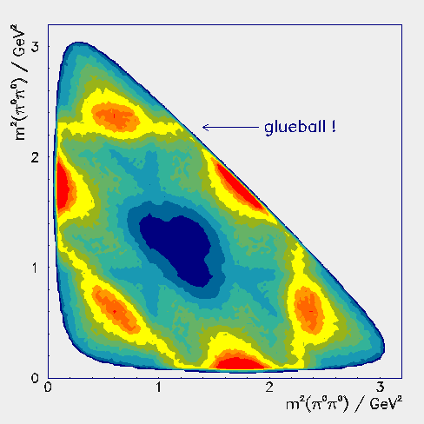
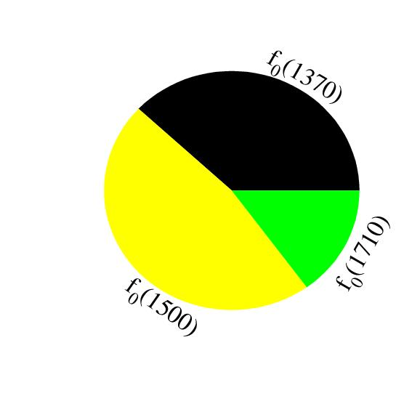
Experimental Evidence
Scalar (0⁺⁺) Glueball and two
nearby mesons are mixed.
f₀(1710)
f₀(1500)
a₀(1450)
K*₀(1430)
f₀(1370)
a₀(980)
f₀(980)
Glueball
spread
over 3
mesons
Are there other glueballs?

Slide 13
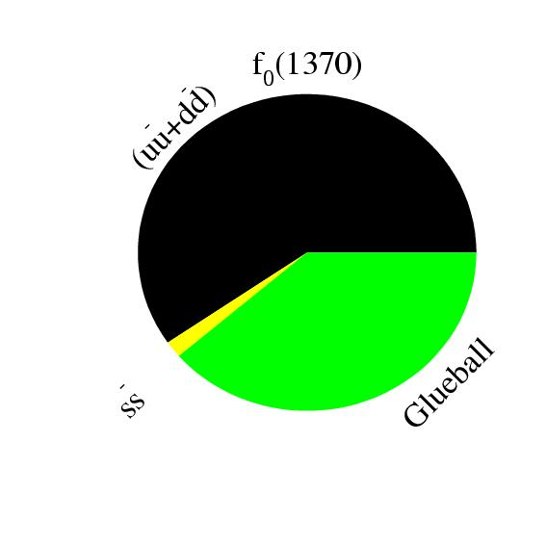
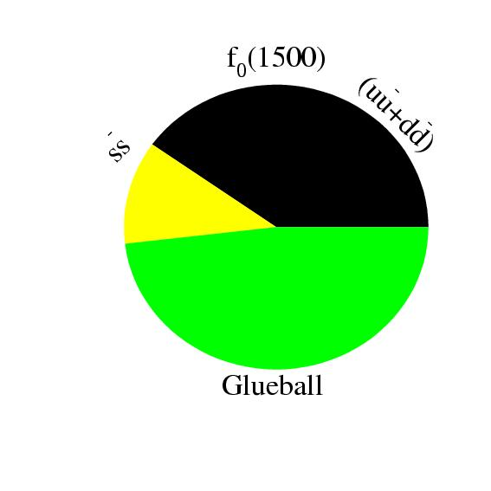
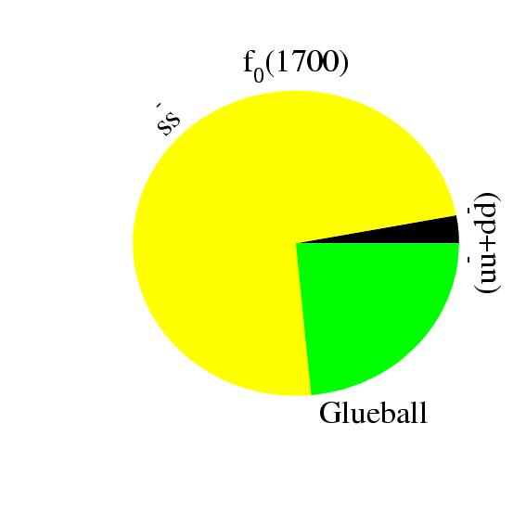
Glueball-Meson Mixing
meson
1
meson
meson
meson
r₂
Glueball
meson
meson
r₃
Glueball
meson
flavor blind? r
Solve for mixing scheme

Slide 14
Higher Mass Glueballs?
Part of the BES program is to search for glueballs in J/ψ decays. Also part of the upcoming PANDA program at GSI.
Lattice predicts that the 2⁺⁺ and the 0⁻⁺ are the
next two, with masses just above 2GeV/c^{2.}
Radial Excitations of the 2⁺⁺ ground state
L=3 2⁺⁺ States + Radial excitations
f2(1950), f2(2010), f2(2300), f2(2340)…
2’nd Radial Excitations of the η and η’,
perhaps a bit cleaner environment! (I would
Not count on it though….)
I expect this to be very challenging.

Slide 15
Lattice QCD
Light-quark Mesons (u,d,s)
PRD83, 111502 & PRD88, 094505

Slide 16
Lattice QCD
Light-quark Mesons (u,d,s)
Observed States
Kaon observed
Kaon observed
PRD83, 111502 & PRD88, 094505

Slide 17
Lattice QCD
Light-quark Mesons (u,d,s)
2⁻⁺
1⁻⁺
States with non-trivial gluonic fields.
Supermultiplet
1⁻⁻
1⁻⁻, 0⁻⁺ , 1⁻⁺ , 2⁻⁺
0⁻⁺
PRD83, 111502 & PRD88, 094505

Slide 18
QCD Exotics
2.5Gev
Lattice QCD suggests 5 nonets of mesons with exotic quantum number:
1 nonet of 0⁺⁻ exotic mesons
2 nonets of 1⁻⁺ exotic mesons
2 nonets of 2⁺⁻ exotic mesons
2.0GeV
0⁺⁻
1⁻⁺
2⁺⁻
Experimental evidence exists for π₁ states.
π₁ I^{G}(J^{PC})=1⁻(1⁻⁺)
K₁ I^{G}(J^{PC})= ½ (1⁻)
``Constituent gluon’’ behaves like J^{PC} = 1⁺⁻ with a mass of 1-1.5 GeV
The lightest hybrid nonets:
1⁻⁻, (0⁻⁺,1⁻⁺, 2⁻⁺)
η’₁ I^{G}(J^{PC})=0⁺(1⁻⁺)
η₁ I^{G}(J^{PC})=0⁺(1⁻⁺)
Kaon states do not have exotic QNs
PRD84, 074023

Slide 19
QCD Exotics
2.5Gev
Experimental Evidence for Exotics?
??
π₁(2015)
The π₁(1600) has been observed by several experiments, mostly in pion-beam experiments. It has been seen in a number of decay modes, some of which are controversial.
The π₁(2015) has been observed by a single low-statistics experiment. Confirmation is needed.
2.0GeV
?
π₁(1600)
0⁺⁻
1⁻⁺
2⁺⁻
Not observed:
η₁ , η₁’
b₀ , h₀ , h₀’
b₂ , h₂ , h₂’
Prog. Part. and Nucl. Phys. B82, 21, (2015).

Slide 20
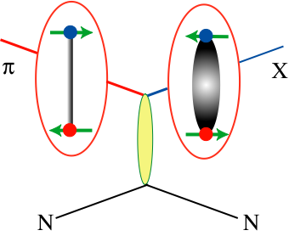
Producing QCD Exotics
High-statistics experiments have used pion beams to search for hybrids: VES at Protvino, E852 at Brookhaven and Compass at CERN: π⁻p → pX⁻ or nX⁰
A pion undergoes t-channel exchange with a nucleon and creates an excited meson or hybrid. Involves charge exchange and/or isospin-1 particles. Easier to make pion-like states.

Slide 21
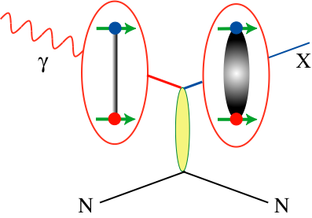
Producing QCD Exotics
High-statistics experiments have used pion beams to search for hybrids: VES at Protvino, E852 at Brookhaven and Compass at CERN: π⁻p pX⁻ or nX⁰
A pion undergoes t-channel exchange with a nucleon and creates an excited meson or hybrid. Involves charge exchange and/or isospin-1 particles. Easier to make pion-like states.
Photoproduction is a poorly-studied mechanism, ~1000s of events total.
Photon can fluctuate into a spin-1 particle. Do not need charge exchange or isospin-1 final states. Linear polarization filters exchange mechanisms.

Slide 22
Photoproduction Mechanisms
Simple quantum number counting for production: (I^{G})J^{PC} up to L=2
P = Pomeron exchange
ρπ,ρω π₁
ωω,ρρ η₁
ωω,ρρ,φω η’₁
ρP b₀
ωP h₀
ωP, φP h’₀
ωπ,ρη,ρP b₂
ρπ,ωη,ωP h₂
ρπ,ωη,φP h’₂
ρπ is charge-exchange only
Can couple to all the lightest exotic hybrid nonets through photo- production and VMD.
Linear polarization is a filter on the naturality of the exchanged particle.

Slide 23
Decay Modes of Exotic Hybrids
π₁ → πρ, πb₁ , πf₁,πη’, ηa₁
η₁ → ηf₂,a₂π,ηf₁, ηη’,π(1300)π, a₁π,
η₁’ → K*Κ, Κ₁(1270)Κ, Κ₁(1410)Κ , ηη’
b₂ → ωπ, a₂π, ρη, f₁ρ, a₁π, h₁π, b₁η
h₂ → ρπ,b₁π,ωη, f₁ω
h’₂ → Κ₁(1270)Κ, Κ₁(1410)Κ, K₂*Κ, φη, f₁φ
b₀ → π(1300)π , h₁π, f₁ρ, b₁η
h₀ → b₁π , h₁η
h’₀ → K₁(1270)Κ, Κ(1460)Κ, h₁η
Models suggest narrower states are in the spin-1 and spin-2 nonets, while the spin-0 nonets are broad.
Early Reach With Statistics Hard
Hybrid kaons do not have exotic QN’s

Slide 24
Decay Modes of Exotic Hybrids
π₁ → πρ, πb₁ , πf₁,πη’, ηa₁
η₁ → ηf₂,a₂π,ηf₁, ηη’,π(1300)π, a₁π,
η₁’ → K*Κ, Κ₁(1270)Κ, Κ₁(1410)Κ , ηη’
b₂ → ωπ, a₂π, ρη, f₁ρ, a₁π, h₁π, b₁η
h₂ → ρπ,b₁π,ωη, f₁ω
h’₂ → Κ₁(1270)Κ, Κ₁(1410)Κ, K₂*Κ, φη, f₁φ
b₀ → π(1300)π , h₁π, f₁ρ, b₁η
h₀ → b₁π , h₁η
h’₀ → K₁(1270)Κ, Κ(1460)Κ, h₁η
Models suggest narrower states are in the spin-1 and spin-2 nonets, while the spin-0 nonets are broad.
Early Reach With Statistics Hard
Hybrid kaons do not have exotic QN’s

Slide 25
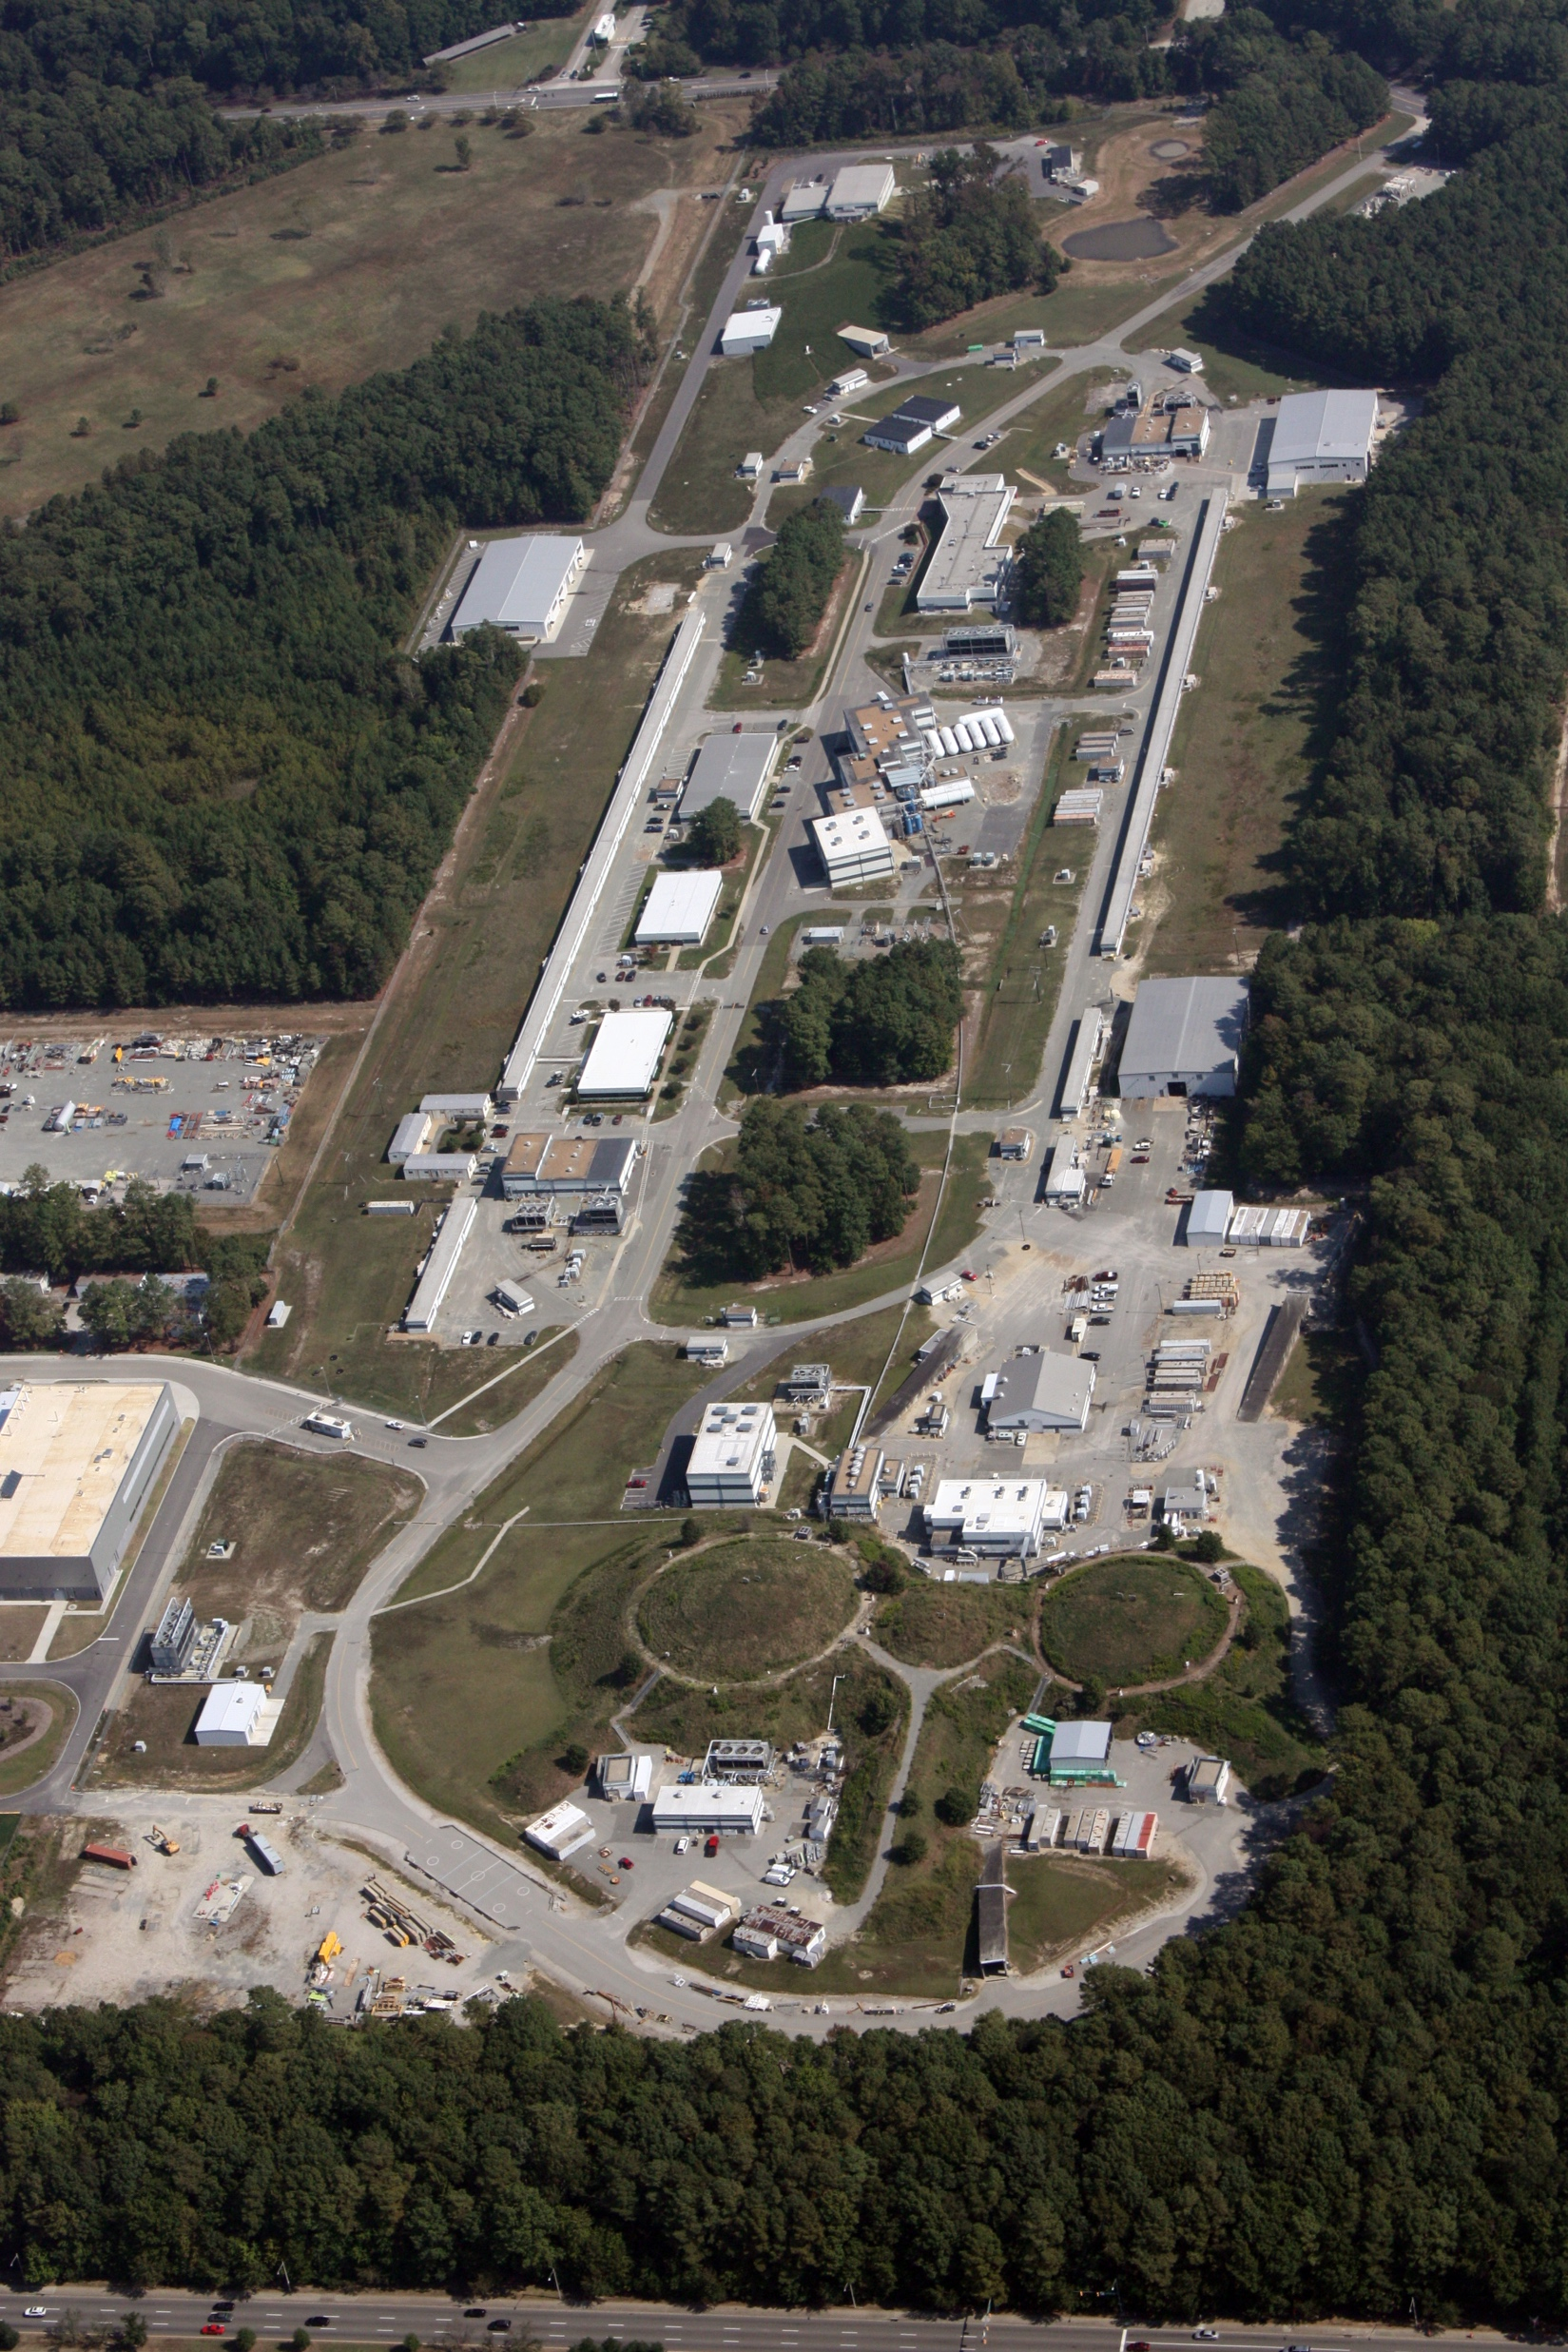
Jefferson Lab
D
Newport New Virginia
12-GeV Electron Accelerator
4 Experimental Areas (A-D)
Completed a major upgrade.
A
C
B

Slide 27
The GlueX Experiment
2018
Photo Production of Hybrids,
Light-quark Mesons
and Strangeonium States
Physics Running started in 2017

Slide 28
The GlueX Collaboration
Arizona State, Athens, Carnegie Mellon, Catholic University, Univ. of Connecticut, Florida International, Florida State, George Washington, Glasgow, GSI, IHEP (Chinese Academy of Sciences) Indiana University, ITEP, Jefferson Lab, U. Mass Amherst, MIT, MePhi, Norfolk State, North Carolina A&T, Univ. North Carolina Wilmington, Northwestern, Old Dominion, Santa Maria, University of Regina, Tomsk, William & Mary, Wuhan and Yerevan Physics Institute.
Over 125 collaborators from almost 30 institutions with others joining and more are welcome.

Slide 29
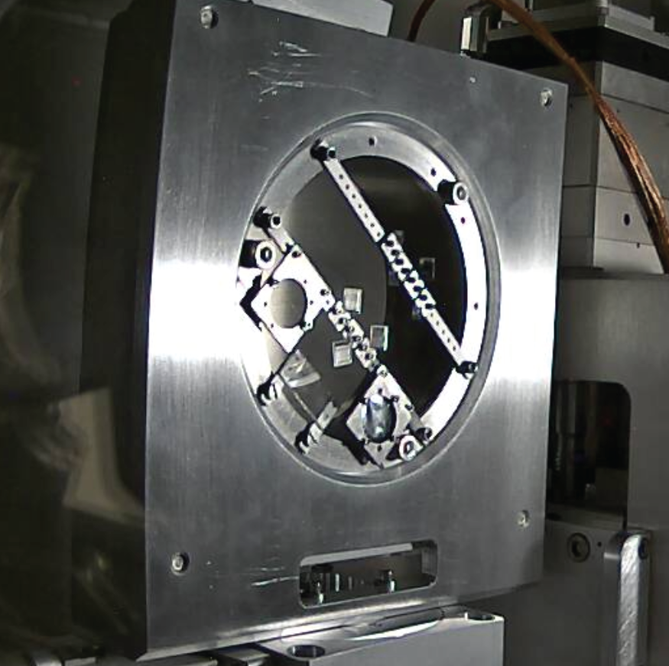
The GlueX Experiment
Polarimeter
12 GeV e⁻ beam up to 2.2 μA.
Linearly polarized photons (P_{ɣ}≈40%) from coherent bremsstrahlung on thin diamond radiator.
4 Polarization orientations, parallel and perpendicular to floor and 45º tilt.
Design intensity of 10⁸ ɣ/s in coherent peak (E_{ɣ} = 8.4-9 GeV) (5x10⁷ is needed).
Goniometer with diamonds

Slide 30
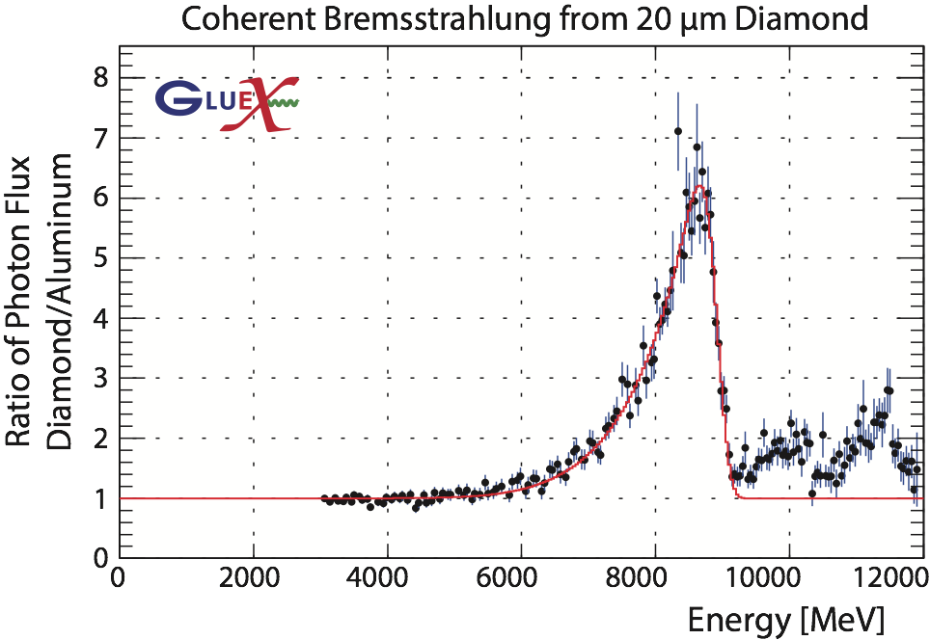
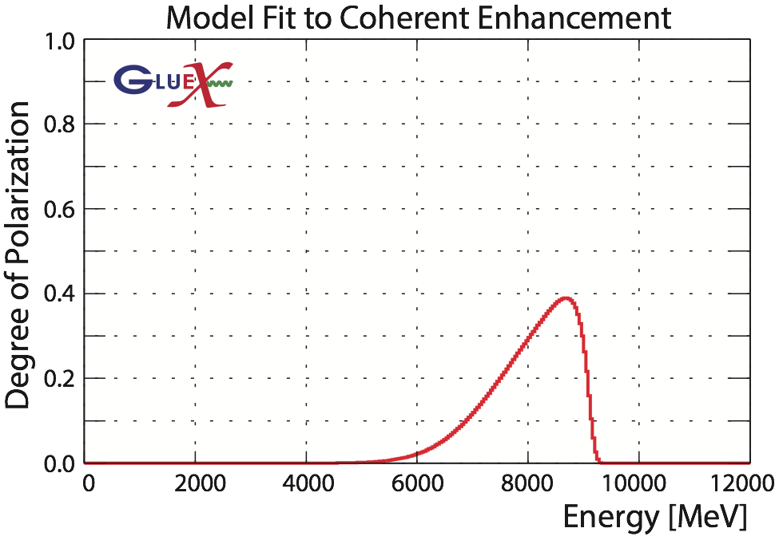
The GlueX Experiment
Polarimeter

Slide 31
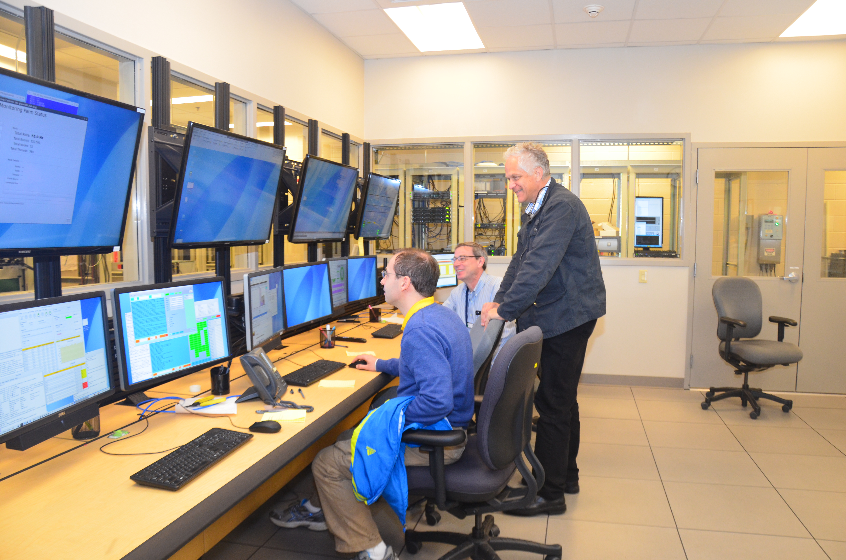
GlueX Running
Fall ‘14 to Spring ’15: Detector & Beamline Commissioning
Spring ’16: Engineering Run
~80 Hours of Physics-quality data.
Spring ‘17 to Spring ’18 -– GlueX Physics
~20% of Phase I in Spring 2017
~70% of Phase I in Spring 2018
~2PB of Data (~200 billion events)
Fall ‘18 & Beyond – GlueX Physics
Finish Phase I
Upgrades to Detector and High-intensity running.
All detector systems are at or better than design specifications.

Slide 32
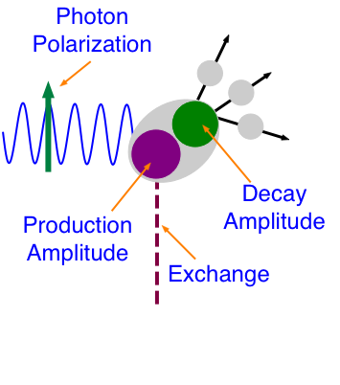
Doing Physics with GlueX
Production Amplitude produces a state X with J^{PC} quantum numbers and some polarization (density matrix, ρ).
Decay Amplitude describes the decay of X to final state particles. It is related to ρ and the spin and orbital angular momentum of the final-state particles.
Observables are the angular distributions of the final-state particles.
l_{i},s_{i}
J^{PC}
j^{pc}

Slide 33


Doing Physics with GlueX
l_{i},s_{i}
J^{PC}
Perform an un-binned log-likelihood fit to make W-model and W-experiment agree by varying the α_{j}.
j^{pc}
Several different states, all decaying to the same final particles are produced, and they interfere (complex amplitudes).

Slide 34
Doing Physics with GlueX
Understand the photon’s polarization.
Understand the photon beam.
Know the efficiency and acceptance of the experimental apparatus.
Have a very accurate model of the detector (simulation).
l_{i},s_{i}
J^{PC}
j^{pc}
Several different states, all decaying to the same final particles are produced, and they interfere (complex amplitudes).

Slide 35
Doing Physics with GlueX
Photon beam asymmetry measurements. Need to understand the photon polarization, but most other factors cancel out.
Understand the photon’s polarization.
Understand the photon beam.
Know the efficiency and acceptance of the experimental apparatus.
Have a very accurate model of the detector (simulation).

Slide 36
Doing Physics with GlueX
Photon beam asymmetry measurements. Need to understand the photon polarization, but most other factors cancel out.
Understand the photon’s polarization.
Understand the photon beam.
Know the efficiency and acceptance of the experimental apparatus.
Have a very accurate model of the detector (simulation).
Spin-density matrix elements of vector mesons are obtained by fitting complicated angular distributions.
Requires understanding of detector acceptance.

Slide 37
Doing Physics with GlueX
Photon beam asymmetry measurements. Need to understand the photon polarization, but most other factors cancel out.
Understand the photon’s polarization.
Understand the photon beam.
Know the efficiency and acceptance of the experimental apparatus.
Have a very accurate model of the detector (simulation).
Opportunistic Physics from data exploration! Focus on results where small statistics and modest errors can have a big impact.
Charmonium
Double-strange Baryons
BSM Physics

Slide 38
Doing Physics with GlueX
Photon beam asymmetry measurements. Need to understand the photon polarization, but most other factors cancel out.
Understand the photon’s polarization.
Understand the photon beam.
Know the efficiency and acceptance of the experimental apparatus.
Have a very accurate model of the detector (simulation).
Amplitude analysis of known states. Full understanding of the detector where the answer is known.
This then leads to the search for new states, in particular the exotic hybrid mesons.

Slide 39
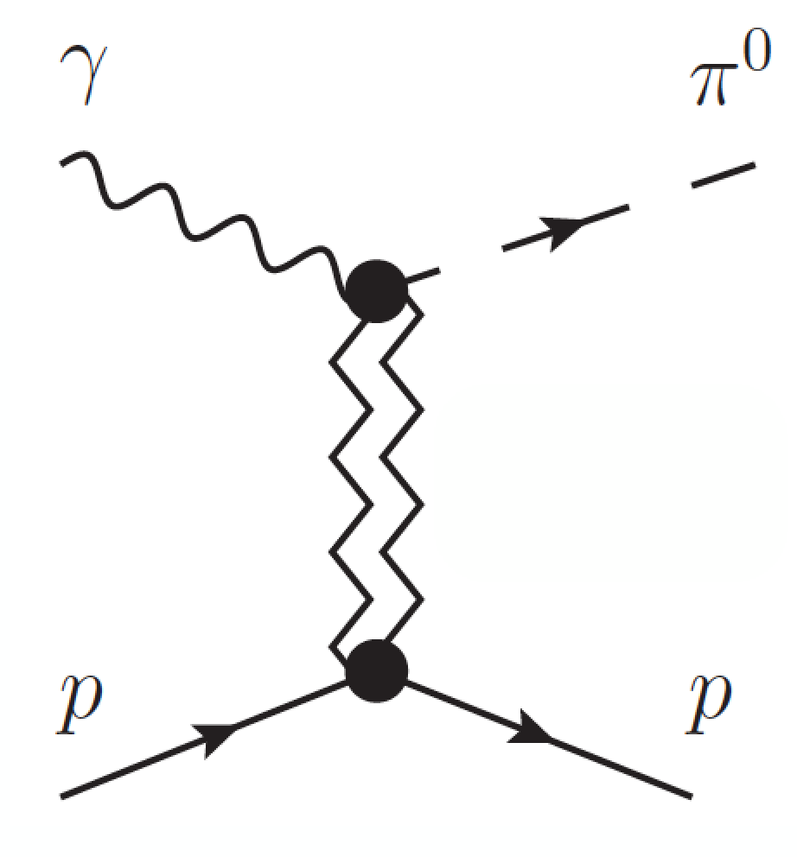
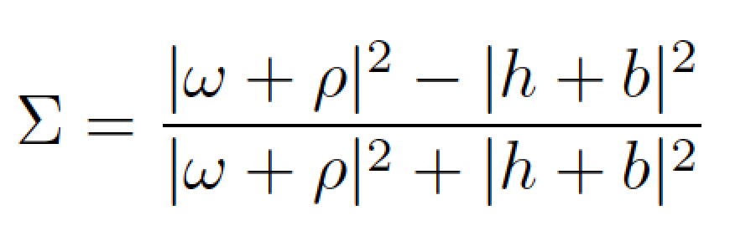


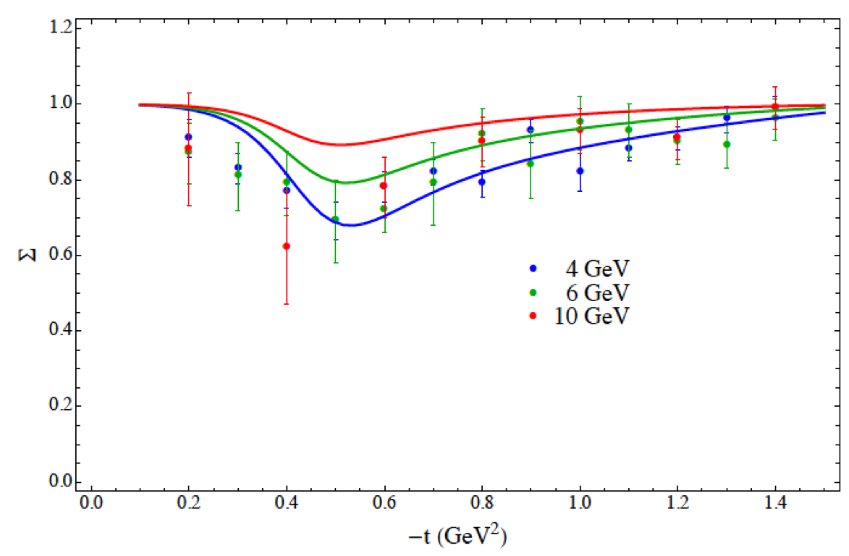
π⁰ beam asymmetry
Beam asymmetry Σ provides insight into dominant production mechanism
Understanding production mechanism critical to disentangling J^{PC} of observed states in exotic hybrid search.
From experimental standpoint easily extended to ɣp→pη where there are no previous measurements!
Exchange J^{PC}
Mathieu et al. PRD 92, 074013
Data at different
beam energies

Slide 40
Photon-beam Polarization
Coherent bremsstrahlung where we use the the 8.5 to 9.0 GeV photons.
~40% Linear polarization which depends on the photon energy.
We measure the energy and then have the polarization of each incident photon.

Slide 41
Beam Asymmetry Measurement
Exchange J^{PC}
Impacts extraction of baryon resonances from low-energy photoproduction experiments.
Understanding the meson production mechanisms at 9GeV is needed for our bigger program.
Phys. Rev. C95, 042201 (2017)

Slide 42
Spin-Density Matrix Elements
A 3 by 3 complex matrix, ρ, that represents the polarization of the produced ω meson. The decay of the ω to π⁺π⁻π⁰ allows us to measure some elements of ρ. The second large decay of ω to π⁰γ should give the same answer.
Very sensitive to our understanding of acceptances in GlueX.
Linear polarization allows us to map out production mechanisms in GlueX.
Fitting angular distributions is the first step towards full amplitude analysis.

Slide 43

Spin-Density Matrix Elements
Two of the elements are very sensitive to the transfer of spin from the photon to the ω meson.
If the exchange is pure “pomeron”, +½ and –½. If it is pure pion exchange, -½ and +½. We see ~.35 and -.35.
M. Staib CMU Ph.D. Thesis 9/17

Slide 44


Spin-Density Matrix Elements
Measures the spin transfer from the polarized photon to the vector meson and is sensitive to the production mechanism.
These are important demonstrations of our understanding of the acceptance of the detector.
The can be used to monitor the linear polarization of the photon nearly online.

Slide 45
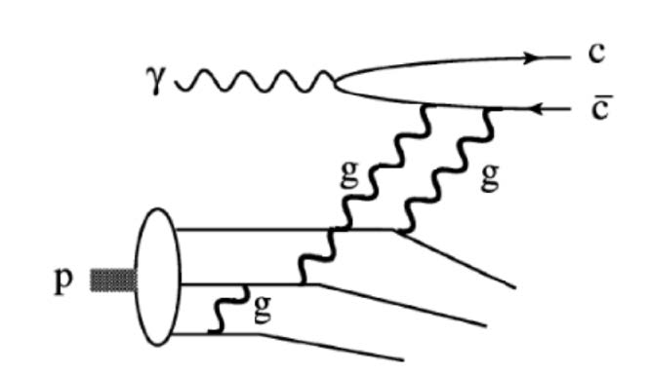
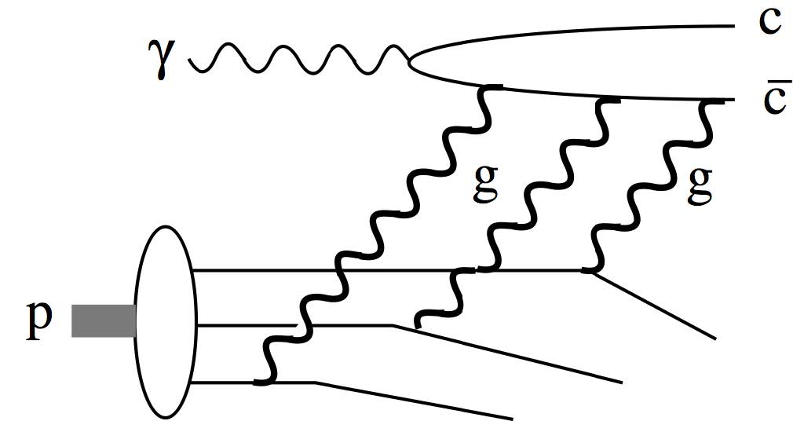
Opportunistic Physics
Probes gluon distributions in proton
[Kharzeev et al., NPA 661, 568 (1999)]
Also multiquark correlations
[Brodsky et al., PLB 498, 23 (2001)]
GlueX Energies
The two mechanisms have different energy dependences near threshold.

Slide 46
Opportunistic Physics
Detect J/ψ through its e⁺e⁻ decay

Slide 47
Opportunistic Physics
Detect J/ψ through its e⁺e⁻ decay

Slide 48

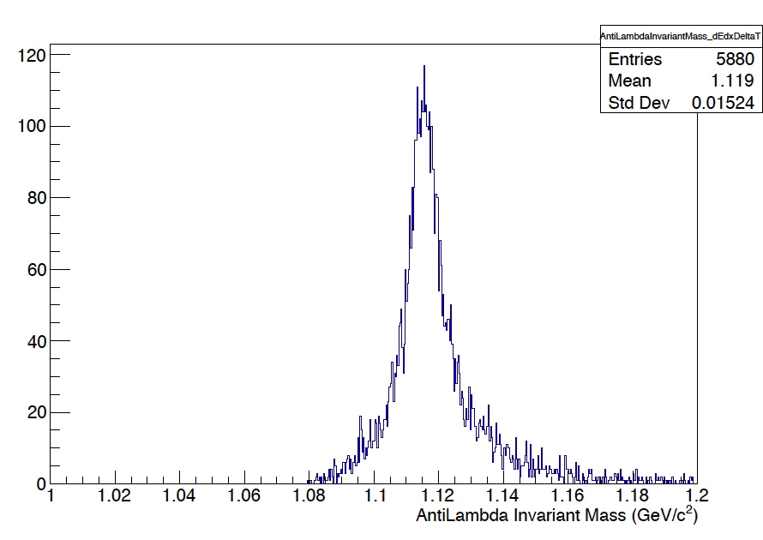

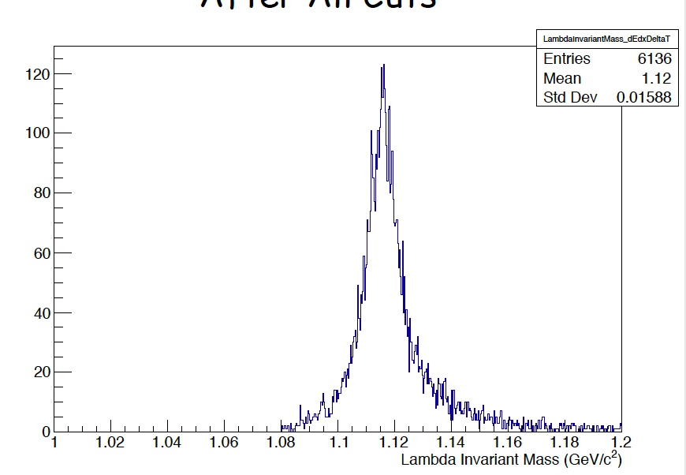

Baryon-antibaryon Photoproduction
Never seen before in photoproduction!
Limited statistics from 2016, larger samples to come.
Lifetime of both are within 15% of known values without corrections.
The decay of the Lambda allows us to analyze the polarization transfer from the photon.

Slide 49



Interesting Hybrid Channels
ρ → ππ
f₂ → ππ
a₂ → ηπ
γp → pη₁ γp → pb₂
η₁ → ηf₂,a₂π
b₂ → a₂π, ρη
Look for these
η’(958)
f₁(1285)
several known
states
Hybrid regime
80 hours of beam
2016 Engineering Run

Slide 50
Interesting Hybrid Channels
2016 Engineering Run
m²(ηπ)
a₀(980)
a₂(1320)
m(ηπ)
m²(ππ)
Clear signals for
ρ(770)
f₂(1270)?
Weak signal for
m(ππ)

Slide 51
Interesting Hybrid Channels
2016 Engineering Run
m²(ηπ)
a₀(980)
a₂(1320)
m(ηπ)
m²(ππ)
Clear signals for
ρ(770)
f₂(1270)?
Weak signal for
m(ππ)

Slide 52
Interesting Hybrid Channels
Promising final states for exotic hybrid searches are clearly visible in even the low-statistics 2016 engineering data.
While these currently do not indicate the existence of exotic hybrids in our data, we are encouraged by these presence these channels.
a₀(980)
a₂(1320)
Clear signals for
ρ(770)
f₂(1270)?
Weak signal for

Slide 53
Summary
GlueX is installed, commissioned and started physics running in Spring 2017.
All detector systems are near to or better than design specifications.
We have published our first results, and are aggressively moving ahead on other physics measurements.
The broader program of exotic mesons is in sight.
Addition of kaon identification and higher intensity beams are planned in 2019 to allow us to cover all parts of the GlueX exotic hybrid program.
We have an extensive program beyond exotic hybrids and are excited to have new ideas and new collaborators.

