Slide 1
QCD Exotics at BNL and JLab
Curtis A. Meyer
Carnegie Mellon University

Slide 2
Outline
What are light-quark exotic mesons?
How should we look for these mesons?
What is the Experimental Evidence?
BNL & JLab
Where do we go from here?

Slide 3
Spectroscopy and QCD
Quarkonium
Mesons
q
q
radial
Consider the three lightest quarks
4⁺⁺
L=3
3⁺⁺
2⁺⁺
9 Combinations
3⁺⁻
3⁻⁻
L=2
2⁻⁻
1⁻⁻
2⁻⁺
2⁺⁺
L=1
1⁺⁺
0⁺⁺
1⁺⁻
1⁻⁻
S=1
S=0
L=0
0⁻⁺

Slide 4
Spectroscopy an QCD
Quarkonium
Mesons
q
q
4⁺⁺
L=3
3⁺⁺
2⁺⁺
3⁺⁻
ρ,K*,ω,φ
Mesons come in
nonets of the same
J^{PC} Quantum Numbers
3⁻⁻
L=2
2⁻⁻
π,K,η,η’
1⁻⁻
2⁻⁺
a,K,f,f’
2⁺⁺
L=1
1⁺⁺
b,K,h,h’
SU(3) is broken
last two members mix
0⁺⁺
1⁺⁻
ρ,K*,ω,φ
1⁻⁻
S=1
S=0
L=0
0⁻⁺
π,K,η,η’

Slide 5
Spectroscopy an QCD
Quarkonium
Quarkonium
Mesons
q
q
Nothing to do
with Glue!
4⁺⁺
L=3
3⁺⁺
2⁺⁺
Allowed J^{PC} Quantum numbers:
3⁺⁻
3⁻⁻
0⁻⁻ 0⁺⁻
1⁻⁺
2⁺⁻
3⁻⁺
4⁺⁻
5⁻⁺
0⁺⁺ 0⁻⁺
1^{–-} 1⁺⁺ 1⁺⁻
2⁻⁻ 2⁺⁺ 2⁻⁺
3⁻⁻ 3⁺⁺ 3⁺⁻
4⁻⁻ 4⁺⁺ 4⁻⁺
5⁻⁻ 5⁺⁺ 5⁺⁻
L=2
2⁻⁻
1⁻⁻
2⁻⁺
2⁺⁺
L=1
1⁺⁺
0⁺⁺
1⁺⁻
Exotic Quantum Numbers
non quark-antiquark description
1⁻⁻
S=1
S=0
L=0
0⁻⁺

Slide 6
QCD Potential
Lattice QCD
ground-state
flux-tube
m=0
linear potential
The normal mesons are built up from a “quark-antiquark
pair” with and a “ground-state” flux tube.
(π,K,η,η’)
(ρ,K*,ω,Φ)
(b₁,K₁,h₁,h₁’)
( ☹ )
J^{PC}=0⁻⁺
J^{PC}=1⁻⁻
J^{PC}=1⁺⁻
0⁺⁺,1⁺⁺,2⁺⁺,2⁻⁻,2⁻⁺,3⁺⁺,3⁻ ⁻,3⁺ ⁻

Slide 7
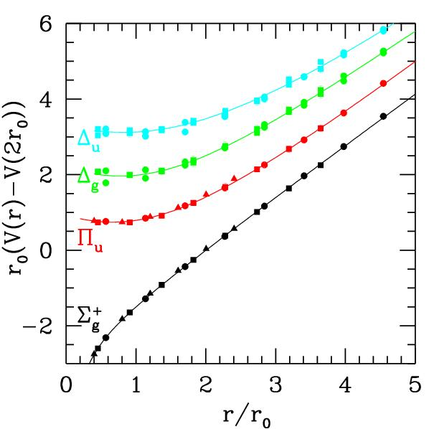
QCD Potential
Lattice QCD
ground-state
flux-tube
m=0
S=0,L=0,m=1
S=1,L=0,m=1
excited flux-tube
m=1
J=1 CP=+
J=1 CP=-
J^{PC}=1⁺⁺,1⁻⁻
(not exotic)
J^{PC}=0⁻⁺,0⁺⁻
1⁻⁺,1⁺⁻
2⁻⁺,2⁺⁻
linear potential
exotic
Gluonic Excitations provide an
experimental measurement of
the excited QCD potential.
Many of the hybrid nonets have exotic quantum numbers.

Slide 8
Hybrid Predictions
Flux-tube model: 8 degenerate nonets
1⁺⁺,1⁻⁻ 0⁻⁺,0⁺⁻,1⁻⁺,1⁺⁻,2⁻⁺,2⁺⁻ ~1.9 GeV/c²
S=0
S=1
Lattice calculations --- 1⁻⁺ nonet is the lightest
UKQCD (97) 1.87 ±0.20
MILC (97) 1.97 ±0.30
MILC (99) 2.11 ±0.10
Lacock(99) 1.90 ±0.20
Mei(02) 2.01 ±0.10
Bernard(04) 1.792±0.139
All masses in GeV/c²
1⁻⁺ 1.9± 0.2
2⁺⁻ 2.0± 0.11
0⁺⁻ 2.3± 0.6
In the charmonium sector:
1⁻⁺ 4.39 ±0.08
0⁺⁻ 4.61 ±0.11
Splitting = 0.20

Slide 9
QCD Exotics
We expect 3 nonets of exotic-quantum-number mesons: 0⁺⁻, 1⁻⁺, 2⁺⁻
π₁ I^{G}(J^{PC})=1⁻(1⁻⁺)
K₁ I^{G}(J^{PC})= ½ (1⁻)
η’₁ I^{G}(J^{PC})=0⁺(1⁻⁺)
η₁ I^{G}(J^{PC})=0⁺(1⁻⁺)
π , η , η’ , K → π₁ , η₁ , η’₁, K₁
1⁻⁺
0⁺⁻
2⁺⁻
b₀, h₀, h₀’, K₀
b₂, h₂, h₂’, K₂

Slide 10
Hybrid Decays
L_{flux}
The angular momentum in the flux
tube stays in one of the daughter
mesons (an (L=1) and (L=0) meson).
L_{flux}
Exotic Quantum Number Hybrids
π₁→ πb₁ , πf₁ , πρ , ηa₁
η₁→π(1300)π , a₁π
b₂ → a₁π , h₁π , ωπ , a₂π
h₂ → b₁π , ρπ , ωη
b₀ → π(1300)π , h₁π
h₀ → b₁π , h₁η
Mass and model
dependent
predictions
Populate final states with
π±,π⁰,K±,K⁰,η, (photons)

Slide 11
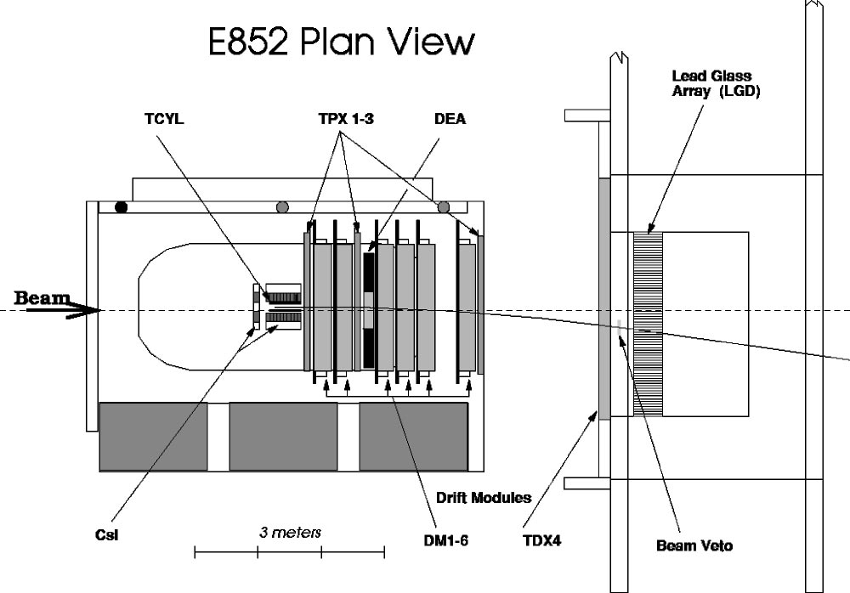
Experimental Evidence for Hybrids
The most extensive data sets to date are from the BNL E852 experiment. There is
also data from the VES experiment at Protvino and some results from the Crystal
Barrel experiment at LEAR. Finally, there is a CLAS (Jefferson Lab) result.
E852 used an 18 GeV/c beam
of π⁻ on a hydrogen target. It
detects photons and charged
particles in the final state.

Slide 12
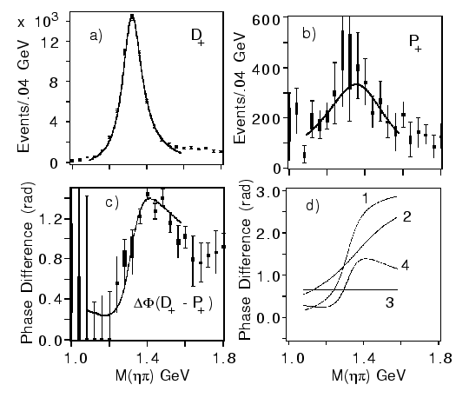
E852 Experiment
π⁻p→ηπ⁻ p
π₁(1400)
Mass = 1370 +-16⁺⁵⁰₋₃₀ MeV/c²
Width= 385 +- 40⁺⁶⁵₋₁₀₅ MeV/c²
(1997)
The a₂(1320) is the dominant
signal. There is a small (few %)
exotic wave.
a₂
π₁
Interference effects show
a resonant structure in 1⁻⁺ .
(Assumption of flat background
phase as shown as 3.)
Seen by Crystal Barrel in
ηπ⁻ and ηπ⁰

Slide 13
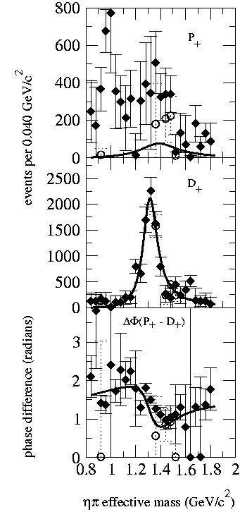
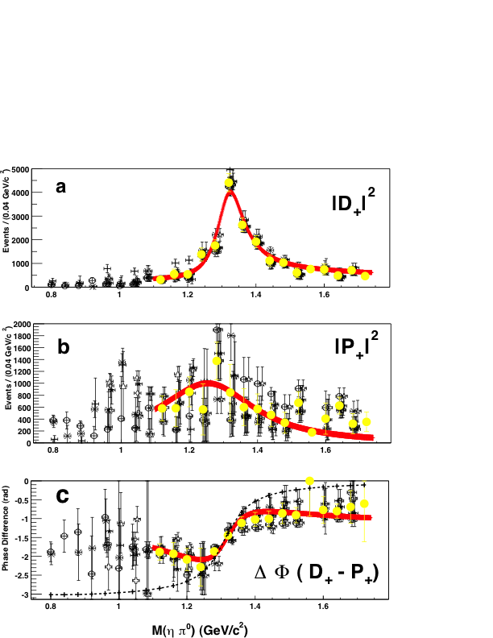
E852 Experiment
π⁻p → ηπ⁰ p
Dzierba (et. al) PRD67 (2003)
(~45000 Events)
Adams (et. al) PLB657 (2007)
Problematic Resonant Description
(~23000 Events)
Confirms the ηπ⁻ results

Slide 14
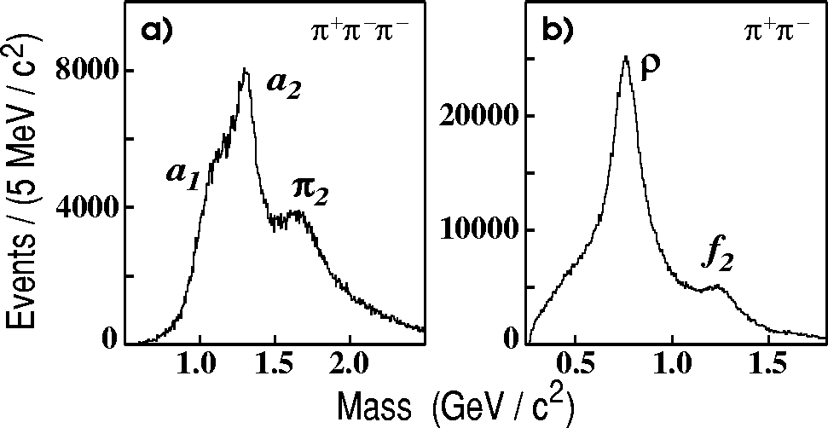
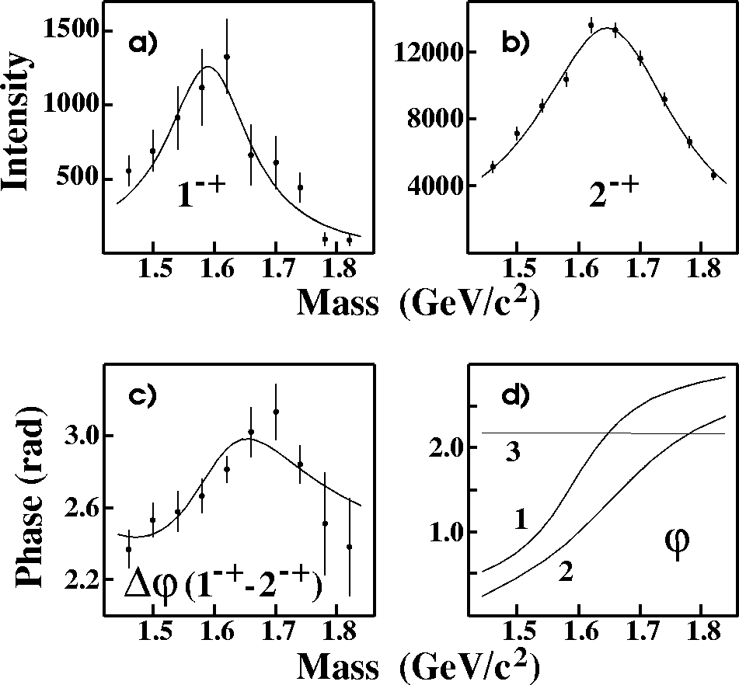
E852 Experiment
π⁻p → π⁺π⁻π⁻ p
(~250,000 Events)
Suggestive of a₁, a₂, π₂ →ρπ
π₂→f₂π
(1998)
Partial Wave Analysis
π₁(1600) →ρπ
M = 1598 ±8+29-47 MeV/c²
Γ = 168±20+150-12 MeV/c²

Slide 15
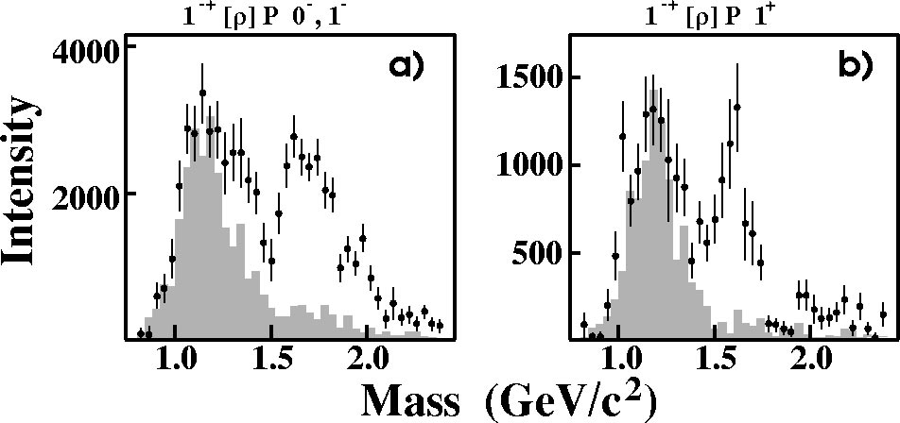
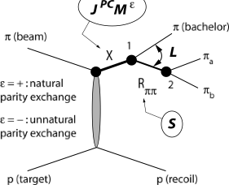
E852 Experiment
Natural-parity exchange: 0⁺,1⁻,2⁺,…
Unnatural-parity exchange: 0⁻,1⁺,2⁻,…
π₁(1600)
Unnatural exchange
Natural exchange
π₁(1600)
M = 1598 ±8+29-47 MeV/c²
Γ = 168±20+150-12 MeV/c²
Leakage from other
partial waves.
Only quote results from the 1⁺ (natural parity) exchange.

Slide 16
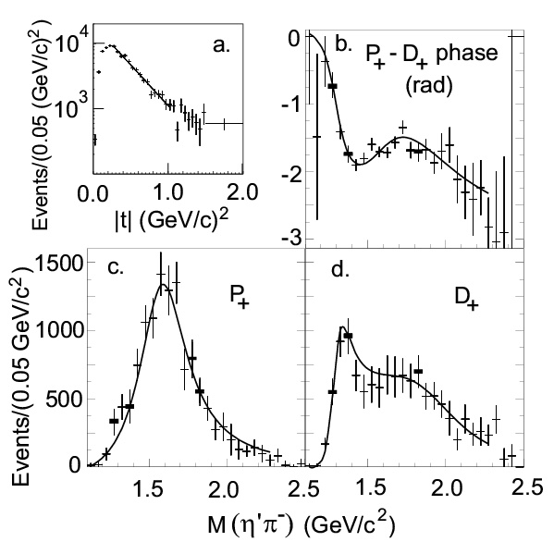
E852 Experiment
π⁻p → η’π⁻p
Data are dominated by 1⁻⁺, 2⁺⁺ and 4⁺⁺ partial waves.
Data are dominated by natural parity exchange.
(~6000 Events)
(2001)
π₁(1600)
M = 1597±10+45-10 MeV/c²
Γ = 340±40±50 MeV/c²
The exotic wave is the dominant
wave in this channel.

Slide 17
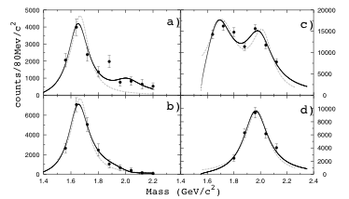
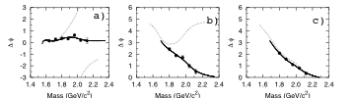
E852 Experiment
π⁻ p→ωπ⁰π⁻p
(2004)
(~145,000 Events)
π₁(1600)→b₁π
M = 1664±8±10 MeV/c²
Γ = 185±25±38 MeV/c²
Seen in both natural and
unnatural parity exchange.
The unnatural dominates
m^{ε}=0⁻
1⁻⁺b₁π
m^{ε}=1⁺
1⁻⁺b₁π
2⁺⁺ωρ
4⁺⁺ωρ
π₁(2000)→b₁π
M = 2014±20±16 MeV/c²
Γ = 230±32±73 MeV/c²
Seen primarily in natural
parity exchange.
The natural dominates
Δφ(1⁻⁺ - 2⁺⁺)
Δφ(1⁻⁺ - 4⁺⁺)
Δφ(2⁺⁺ - 4⁺⁺)
Solid curves are a two-pole 1⁻⁺ solution.
Dashed curves are a one-pole 1⁻⁺ solution.

Slide 18
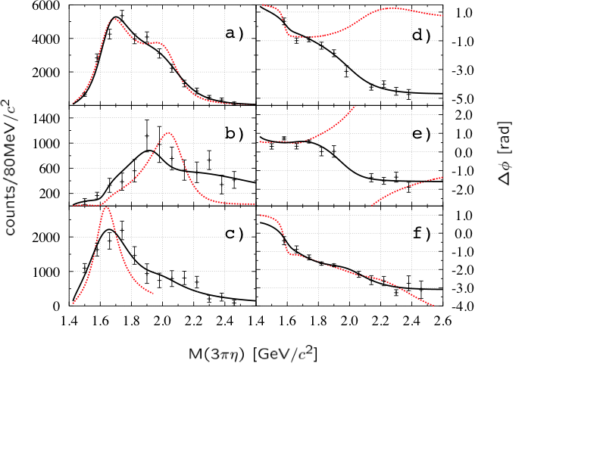
E852 Experiment
π⁻ p→ηπ⁺π⁻π⁻p
(2004)
(~69000 Events)
1⁺⁺f₁π⁻
π₁(1600)→f₁π
M = 1709±24±41 MeV/c²
Γ = 403±80±115 MeV/c²
Natural parity exchange
ΔΦ(1⁻⁺ - 2⁻⁺)
2⁻⁺f₁π⁻
ΔΦ(1⁻⁺ - 1⁺⁺)
π₁(2000)→f₁π
M = 2001±30±92 MeV/c²
Γ = 333±52±49 MeV/c²
Natural parity exchange
1⁻⁺f₁π⁻
ΔΦ(1⁺⁺ - 2⁻⁺)
Black curves are a two-pole 1⁻⁺ solution.
Red curves are a one-pole 1⁻⁺ solution.

Slide 19
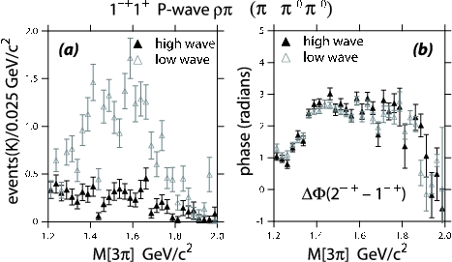
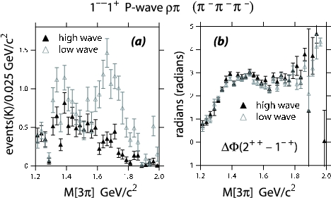
New Analysis
Dzierba et. al. PRD 73 (2006)
10 times statistics in each of two channels.
π⁻p→pπ⁻π⁰π⁰
(3000000 Events)
π⁻p→pπ⁻π⁻π⁺
(2600000 Events)
Get a better description of the data via moments comparison.
Intensity for the exotic 1⁻⁺ wave goes away.
Phase motion between the 1⁻⁺ and the 2⁺⁺ wave is not affected.
No Evidence for the π₁(1600)

Slide 20
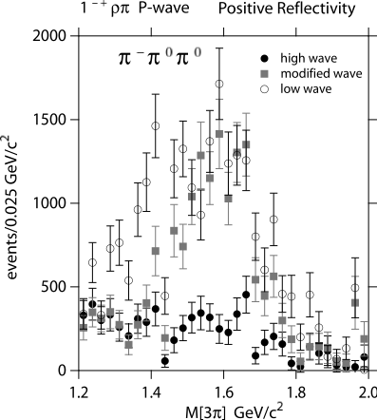
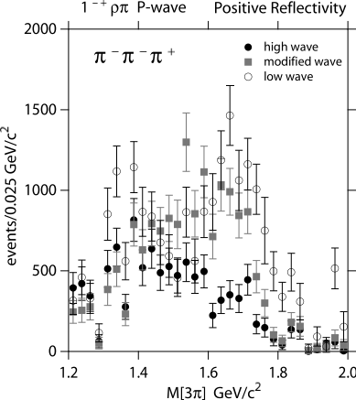
New Analysis
Where does the intensity go?
PDG: π₂(1670) Decays
3π 96%
f₂π 56%
ρπ 31%
Always Include:
(0⁺)π₂(1670)→f₂π(L=0)
(1⁺)π₂(1670)→f₂π(L=0)
(1-)π₂(1670)→f₂π(L=0)
(0⁺)π₂(1670)→f₂π(L=2)
(1⁺)π₂(1670)→f₂π(L=2)
Modified wave set:
Leave out
(1⁺)π₂(1670)→ρπ(L=1)
(1⁺)π₂(1670)→ρπ(L=3)
(0⁺)π₂(1670)→ρπ(L=3)
Most of the strength in the exotic π₁(1600) is better described by known decays of
the π₂(1670).

Slide 21
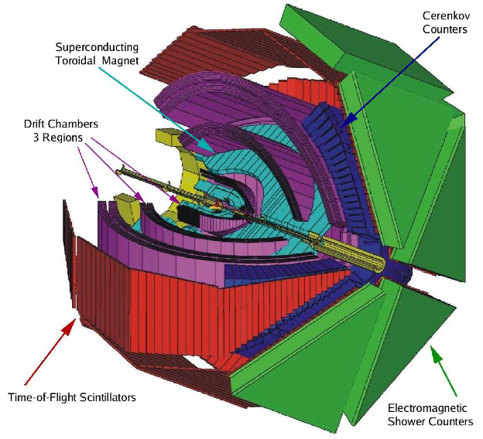
CLAS Experiment
Tagged photon beam incident
on a liquid hydrogen target.
Toroidal magnetic field with
high acceptance and good
resolution for charged
particles.
A number of acceptance holes
make partial wave analysis
difficult.

Slide 22
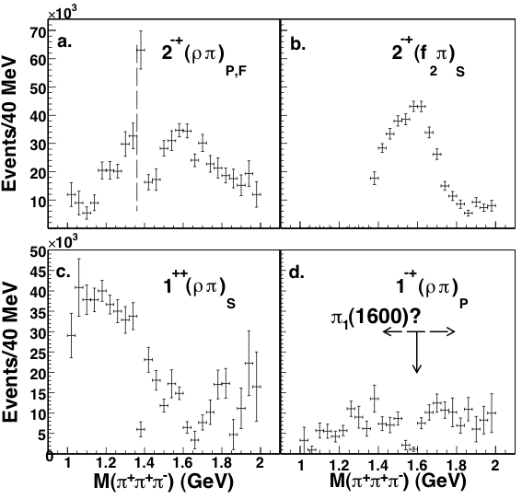
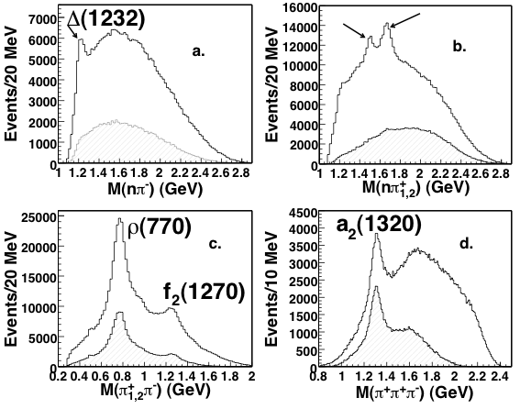
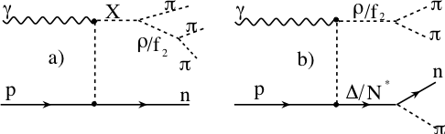
CLAS Experiment
γp→nπ⁺π⁺π⁻
E_{γ} = 4.8 – 5.4 GeV
83000 Events after all cuts
Overall Acceptance < 5%
Baryons “removed” by hard kinematic
cuts.
PWA
No evidence of π₁(1600)→ρπ,
(13.5 nb upper limit).

Slide 23
CLAS Experiment
New data collected in 2008 as part of the so-called “g12” run. Much higher
statistics and E_{e}=5.715 GeV (up to ~5.4 GeV photons).
Polarized electron beam give circularly polarized photons.
Data are currently under analysis:
π⁺π⁺π⁻[n] K⁺K⁻p[η] Δ⁺⁺π⁻[η] & K+K-[Ξ^{-*}]

Slide 24
Summary of the π₁(1400)
Mode Mass Width Production
ηπ⁻ 1370±15+50-30 385±40+65-105 1⁺
ηπ⁰ 1257±20±25 354±64±60 1⁺ (controversial)
Summary of the π₁(1600)
Mode Mass Width Production
3π 1598 ±8+29-47 168±20+150-12 1⁺,0⁻,1- (controversial)
η’π 1597±10+45-10 340±40±50 1⁺
b₁π 1664±8±10 185±25±38 0⁻ ,1⁺
f₁π 1709±24±41 403±80±115 1⁺
3π not seen in
photoproduction
Summary of the π₁(2000)
Mode Mass Width Production
b₁π 2014±20±16 230±32±73 1⁺
f₁π 2001±30±92 332±52±49 1⁺

Slide 25
Exotic Signals
π₁ I^{G}(J^{PC})=1⁻(1⁻⁺)
K₁ I^{G}(J^{PC})= ½ (1⁻)
η’₁ I^{G}(J^{PC})=0⁺(1⁻⁺)
η₁ I^{G}(J^{PC})=0⁺(1⁻⁺)
π₁(1400) Width ~ 0.3 GeV, Decays: only ηπ
weak signal in πp production (scattering??)
strong signal in antiproton-deuterium.
NOT A
HYBRID
What is
going on?
π₁(1600) Width ~ 0.30 GeV, Decays ρπ,η’π,(b₁π)
Only seen in πp production, (E852 + VES)
Production mechanisms not consistent.
π₁(2000) Weak evidence in preferred hybrid
modes f₁π and b₁π
natural parity exchange
The right
place. Needs
confirmation.

Slide 26
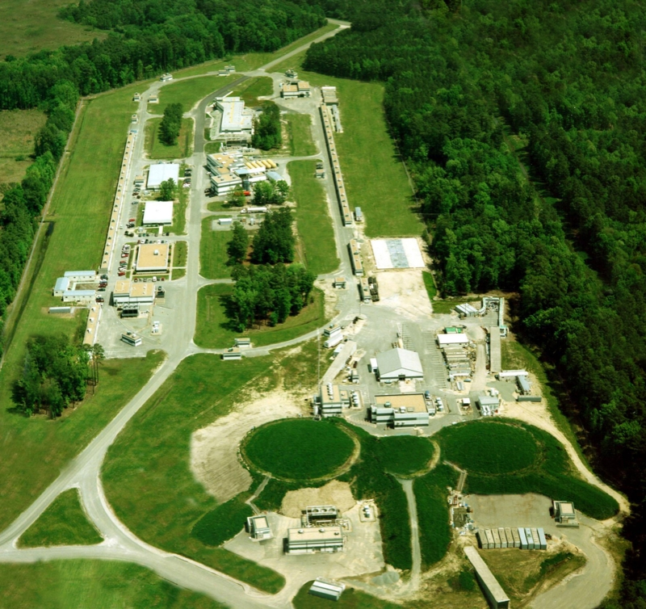
GlueX Here
Jefferson Lab
Accelerator
Newport News
VA
A
B
C

Slide 27
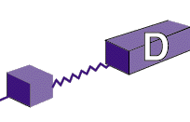
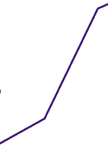

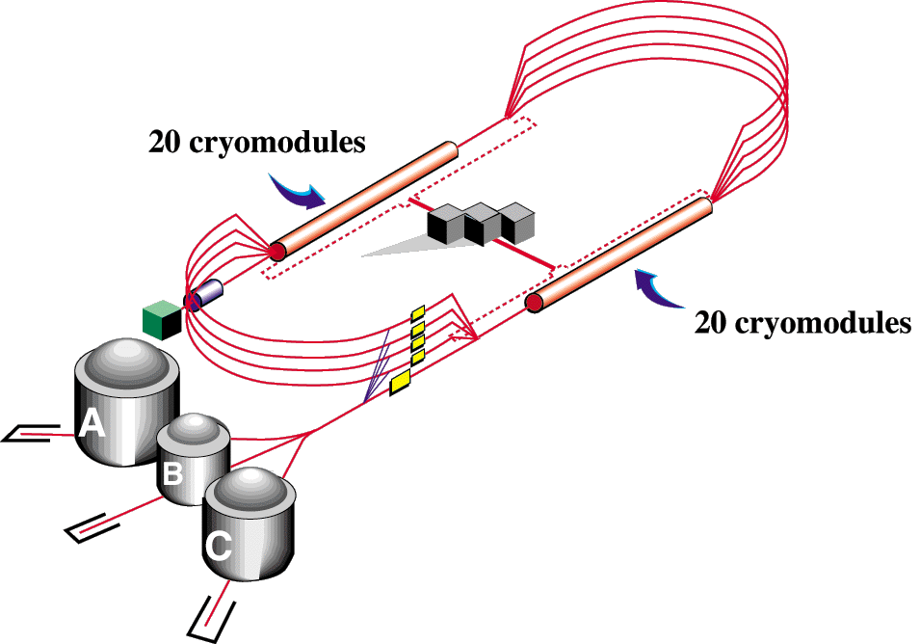

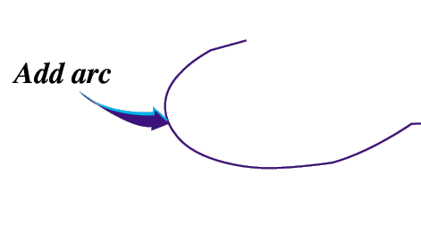


JLab Upgrade
Upgrade magnets and power supplies
CHL-2

Slide 28
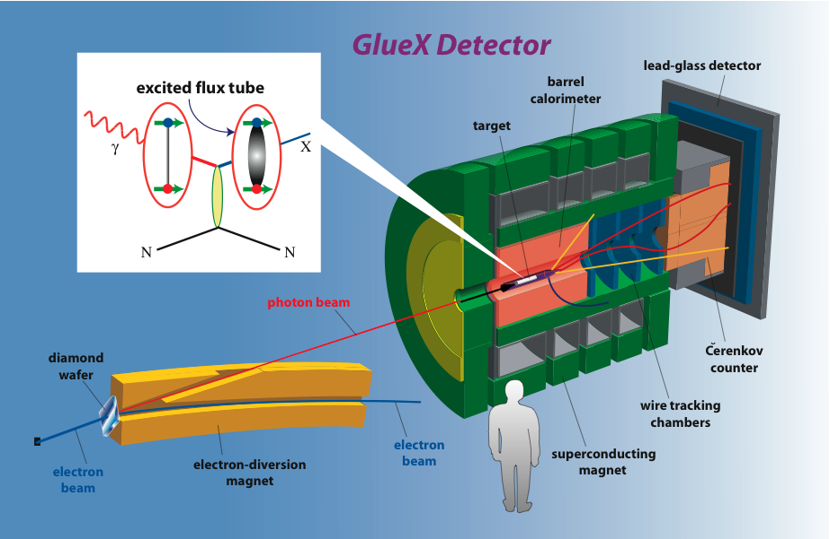
The GlueX Experiment
Future

Slide 29
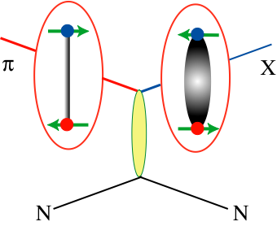
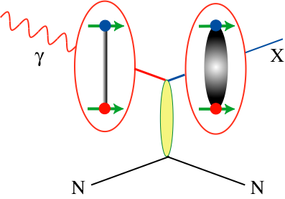
Photoproduction
More likely to find
exotic hybrid mesons
using beams of photons
Simple (0⁺⁺) natural parity exchange with L=1: 0⁺⁻,1⁺⁻,2⁺⁻
J. Dudek et. al, PRD 79 (2009) Compute radiative decays in charmonium to
normal and hybrid mesons. Rates are comparable. Work currently underway
to compute the same for light quarks.
8.4-9 GeV tagged, linearly polarized photon beam, up to 10⁸/s

Slide 30
Jlab 0⁺⁻ and 2⁺⁻
X
In photoproduction, couple to ρ, ω or φ?
γ
e
N
N
b₀ I^{G}(J^{PC})=1⁺(0⁺⁻)
ωa₁,ρf₀,ρf₁
h₀ I^{G}(J^{PC})=0⁻(0⁺⁻)
ωf₀,ωf₁,ρa₁
h’₀ I^{G}(J^{PC})=0⁻(0⁺⁻)
φf₀,φf₁,ρa₁
K₀ I(J^{P})=½(0⁺)
ωπ, ωa₁,ρf₀,ρf₁
b₂ I^{G}(J^{PC})=1⁺(2⁺⁻)
“Similar to π₁ ”
ωη,ρπ,ωf₀,ωf₁,ρa₁
h₂ I^{G}(J^{PC})=0⁻(2⁺⁻)
φη,ρπ,φf₀,φf₁,ρa₁
h’₂ I^{G}(J^{PC})=0⁻(2⁺⁻)
Kaons do not have exotic QN’s
K₂ I(J^{P})= ½(2⁺)

Slide 31
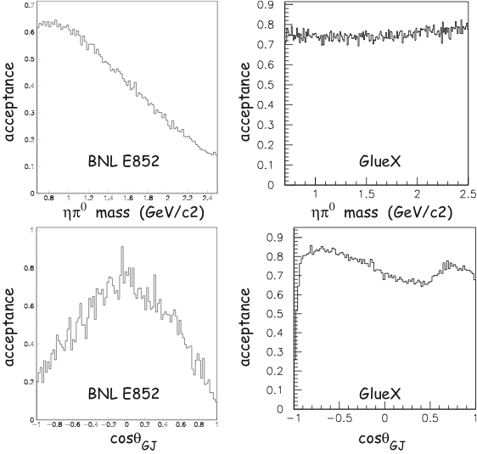
GlueX vs E852 Acceptance
π⁰η final state
GlueX
High, and reasonably uniform
Acceptance up to 2.5 GeV/c².
Sensitive to charged particles
And photons.
Some particle ID in the initial
phases, plans to upgrade this.
Able to fully reconstruct the 4-12
Particle final states.

Slide 32

The GlueX Experiment
The 12 GeV upgrade of Jefferson Lab is
currently under construction.
Construction of Hall-D broke ground in
April 2009.
Construction of the GlueX detector
has started.
Current plans call for the first beam in HallD/GlueX in late 2014.

Slide 33
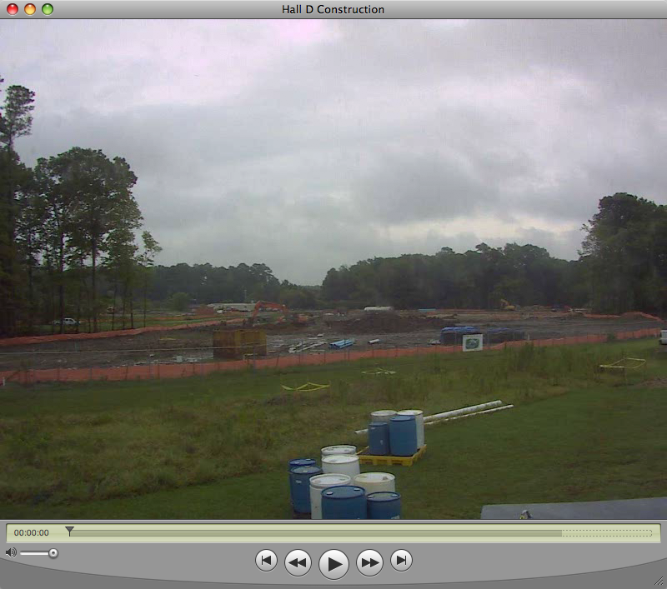
The GlueX Experiment
Hall D at Jefferson Lab
August 6, 2009

Slide 34
Exotics and QCD
In order to establish the existence of gluonic excitations,
We need to establish the existence and nonet nature of the 1⁻⁺ state.
We need to establish at other exotic QN nonets – the 0⁺⁻ and 2^{+-.}
Decay Patterns are Crucial
Coupled Channel PWA Needed.
Very Large Data Sets Expected
From GlueX

Slide 35
Summary
QCD predicts several nonets of exotic-quantum-number mesons.
Evidence hints at some exotic-quantum-number states, and two are
consistent with a π₁ state. Where are the other states?
The first searches in photoproduction have come up negative, but
the acceptance is poor, and the lower energy regime may not
have been optimal.
The GlueX experiment at Jefferson Lab is now under construction
with first beam in the hall expected in 2014.
The GlueX experiment has high acceptance for multi-particle final states,
sensitivity to photons, and a linearly polarize photon beam.

