Slide 1
Hybrid Mesons and Spectroscopy
Overview of the Experimental Evidence.
Curtis A. Meyer
Carnegie Mellon University
Based on C.A. Meyer and Y. Van Haarlem, Phys. Rev. C82, 025208 (2010).

Slide 2
Outline
Review of LQCD Expectations
Production Mechanisms
Contributing Experiments
Overview of The Data
Moving to the Future

Slide 3
Spectroscopy and QCD
Lattice QCD Predictions
Quarkonium
q
q
Beyond the normal meson spectrum, there are predictions for states with exotic quantum numbers
Lattice QCD calculation of the light-quark meson spectrum
2.5Gev
2.0GeV
Exotic QN
0⁺⁻
1⁻⁺
2⁺⁻
Normal QN
Several nonets predicted
Notes:
What are gluonic excitations and why are we looking for them? Lattice QCD predictions for the mesons and in particular, a class of mesons with non-quark-antiquark quantum numbers. Also not that mixing angles are predicted. GlueX needs to measure particle J(PC), masses, widths and decay modes to be able to map these out.

Slide 4
Spectroscopy and QCD
Phys. Rev. D84 (2011) 074023
``Constituent gluon’’ behaves like it has J^{PC} = 1⁺⁻
Mass ~ 1-1.5 GeV
Lightest hybrid nonets: 1⁻⁻, (0⁻⁺,1⁻⁺, 2⁻⁺)
The 0+- and two 2+- exotic nonets:
also a second 1⁻⁺ nonet
p-wave meson plus a ``gluon’’
2.5Gev
2.0GeV
0⁺⁻
1⁻⁺
2⁺⁻
Several nonets predicted
Notes:
What are gluonic excitations and why are we looking for them? Lattice QCD predictions for the mesons and in particular, a class of mesons with non-quark-antiquark quantum numbers. Also not that mixing angles are predicted. GlueX needs to measure particle J(PC), masses, widths and decay modes to be able to map these out.

Slide 5
Spectroscopy and QCD
Quarkonium
m_{π}=396 MeV
q
q
2.30
2.20
2.5Gev
The LQCD I=1 and light-quark I=0 states are on average 15% heavier than the physical states.
The LQCD s-sbar I=0 states are on average 5% heavier than the physical states.
1.75
2.0GeV
0⁺⁻
1⁻⁺
2⁺⁻
Might expect a π₁(1670), η₁(1800), π₁(2200), b₂(2200), h₂(2100),b₀(2100),h₀(2000), η₁’(2100),h₀’(2300),h₂’(2500).
Notes:
What are gluonic excitations and why are we looking for them? Lattice QCD predictions for the mesons and in particular, a class of mesons with non-quark-antiquark quantum numbers. Also not that mixing angles are predicted. GlueX needs to measure particle J(PC), masses, widths and decay modes to be able to map these out.

Slide 6
Hybrid Decays
The angular momentum in the flux
tube stays in one of the daughter
mesons (an (L=1) and (L=0) meson).
L_{flux}
L_{flux}
Exotic Quantum Number Hybrids
π₁→ πb₁ , πf₁ , πρ , ηa₁
η₁→π(1300)π , a₁π
η’₁→Κ₁(1270)Κ, Κ₁(1270)Κ ,K*Κ
b₂ → a₁π , h₁π , ωπ , a₂π
h₂ → b₁π , ρπ , ωη
h’₂ → Κ₁(1270)Κ, Κ₁(1270)Κ, K₂*Κ
b₀ → π(1300)π , h₁π
h₀ → b₁π , h₁η
h’₀ → Κ(1460)Κ , K₁(1270)Κ, h₁η
The good channels to look at with amplitude analysis.
Mass and model
dependent
predictions
Populate final states with
π±,π⁰,K±,K⁰,η, (photons)

Slide 7
Experimental Evidence for Hybrids
Pion peripheral production:
The most extensive data sets to date are from the BNL E852 experiment. There is also data from the VES experiment at Protvino and from the COMPASS experiment at CERN.
Proton-antiproton annihilation:
There is data from the Crystal Barrel experiment at LEAR. This is also one of the pushes of the future PANDA experiment.

Slide 8
Experimental Evidence for Hybrids
X
γ
Photo Production:
There are limited results from the CLAS experiment at Jefferson Lab. This is the main push of the future GlueX experiment at Jefferson Lab.
e
N
N
Charmonium Decays:
There is data from the CLEO-c at Cornell. This is also an area of interest of the BES III experiment in Beijing. This will also be part of the PANDA program at FAIR.

Slide 9
Experimental Evidence for Hybrids
The most extensive data sets to date are from the BNL E852 experiment. There is also data from the VES experiment at Protvino and some results from the Crystal Barrel experiment at LEAR. Results from the COMPASS experiment at CERN are available . There is a single result from the CLEO-c experiment and a null result from CLAS.
π₁(1400) Width ~ 0.3 GeV, Decays: only to ηπ
weak signal in πp production (scattering??)
strong signal in antiproton-deuterium.
π₁(1600) Width ~ 0.30 GeV, Decays ρπ,η’π,b₁π,f₁π
Seen in πp production, (E852,VES,COMPASS)
Seen in χ_{c} decays. There is some controversy
around the ρπ decay mode. Not observed in
photo production.
π₁(2000) Weak evidence in preferred hybrid
modes f₁π and b₁π only seen in E852.

Slide 10
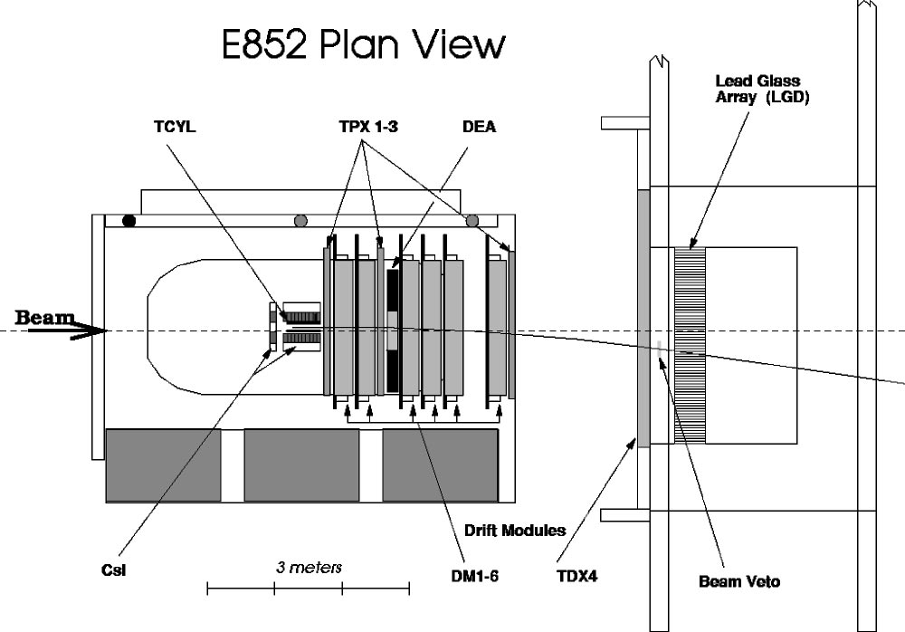
Experimental Evidence for Hybrids
The E852 Detector at BNL
E852 used an 18 GeV/c beam
of π⁻ on a hydrogen target. It
detects photons and charged
particles in the final state.

Slide 11
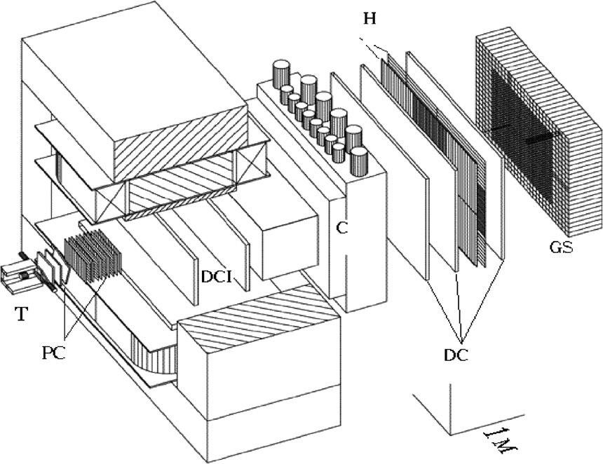
Experimental Evidence for Hybrids
The VES Detector at Protvino
VES used a 37 GeV/c beam
of π⁻ on nuclear targets. It
detected photons and charged
particles in the final state.

Slide 12
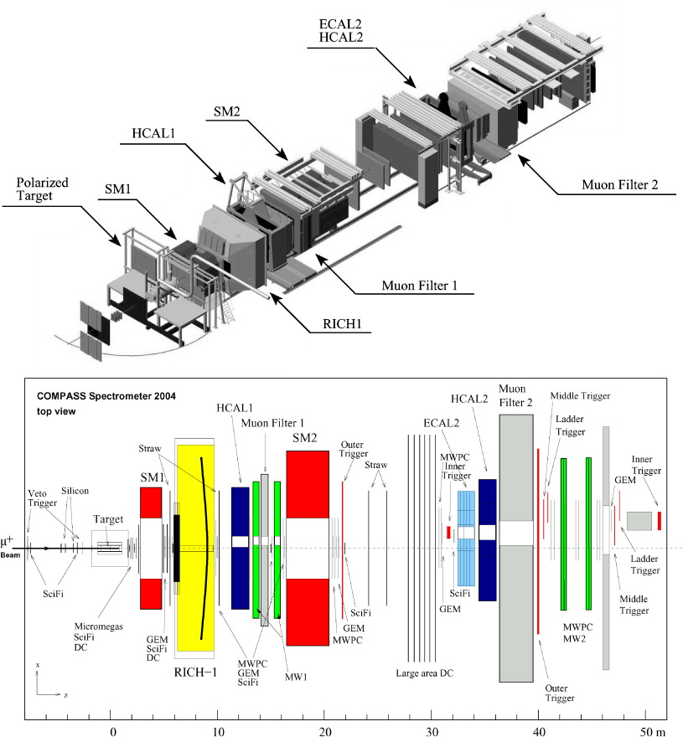
Experimental Evidence for Hybrids
The COMPASS Detector at CERN
COMPASS uses a 180 GeV/c beam of π⁻ on various targets. It
detects photons and charged
particles in the final state.

Slide 13
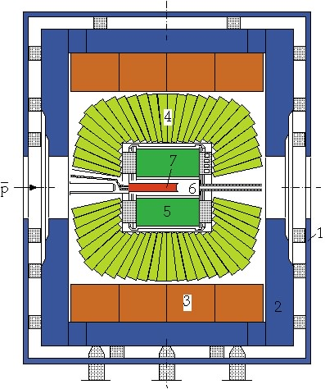
Experimental Evidence for Hybrids
The Crystal Barrel Experiment
Proton-antiproton annihilation:
There is data from the Crystal Barrel experiment at LEAR. This is also one of the pushes of the future PANDA experiment.

Slide 14
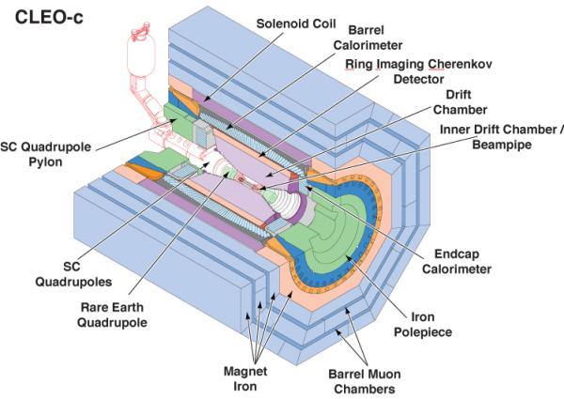
Experimental Evidence for Hybrids
Charmonium Decays:
There is data from the CLEO-c at Cornell. This is also an area of interest of the BES III experiment in Bejing.
The CLEO-c Experiment

Slide 15
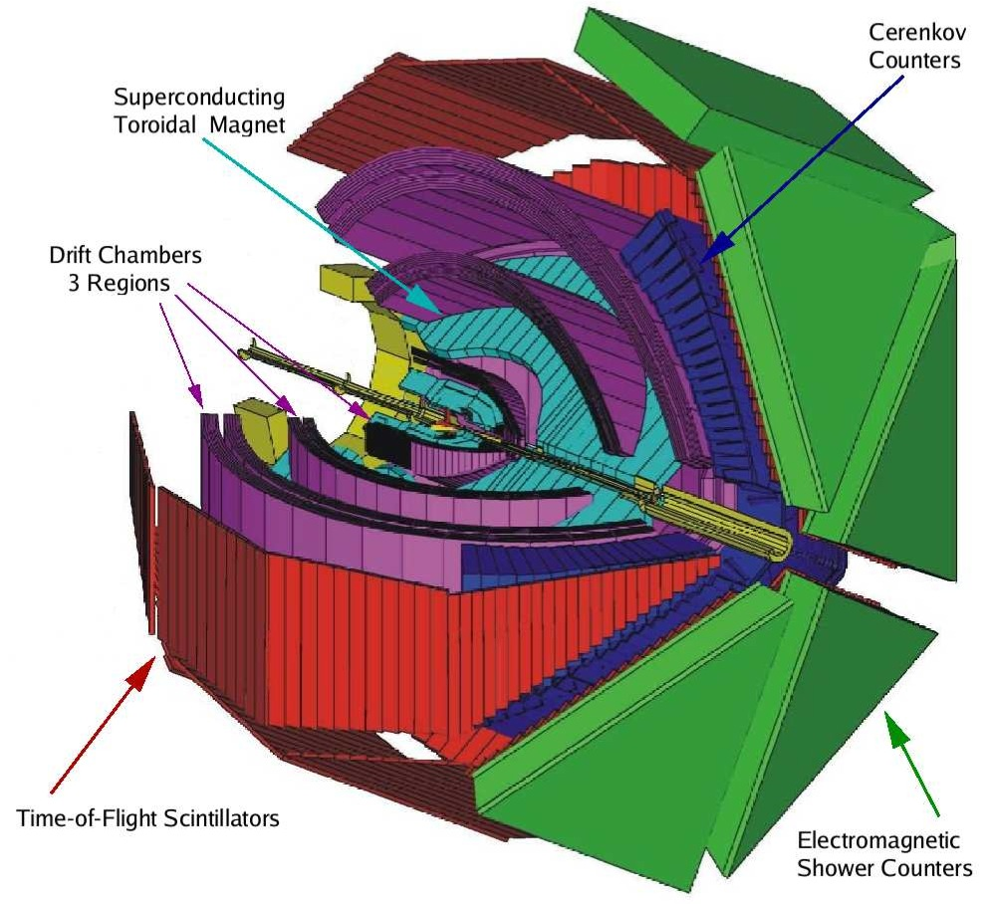
Experimental Evidence for Hybrids
CLAS Experiment
Photo production:
There are limited results from the CLAS experiment at Jefferson Lab. This is the main push of the future GlueX experiment at Jefferson Lab.
X
γ
e
N
N

Slide 16
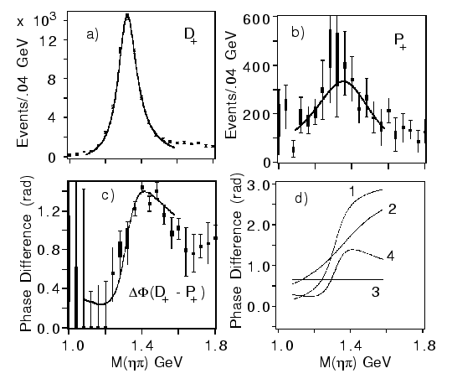
E852 Experiment
π⁻p→ηπ⁻ p
π₁(1400)
Mass = 1370 +-16⁺⁵⁰₋₃₀ MeV/c²
Width= 385 +- 40⁺⁶⁵₋₁₀₅ MeV/c²
(1997)
The a₂(1320) is the dominant
signal. There is a small (few %)
exotic wave.
a₂
π₁
Interference effects show
a resonant structure in 1⁻⁺ .
(Assumption of flat background
phase as shown as 3.)

Slide 17
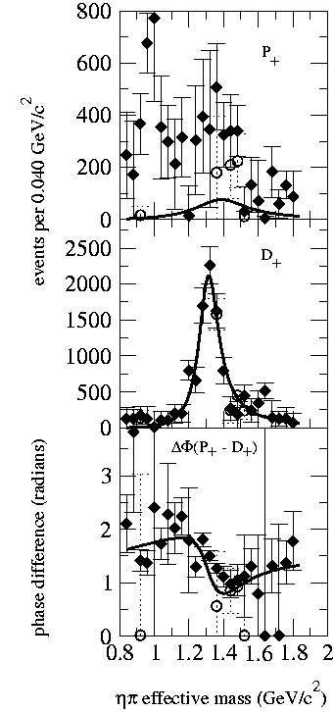
E852 Experiment
π⁻p → ηπ⁰ n
Dzierba (et. al) PRD67 (2003)
(~45000 Events)
Adams (et. al) PLB657 (2007)
Problematic Resonant Description
(~23000 Events)
Confirms the ηπ⁻ results

Slide 18
VES Experiment
π⁻A→ηπ⁻ A
The a₂(1320) is the dominant signal. There is a small (few percent) 1⁻⁺ exotic wave.
(1993)
2⁺⁺
1⁻⁺
Unable to unambiguously establish the nature of the structure in 1⁻⁺ . It could be fit with a Breit Wigner as:
They do not claim the existence of such a resonance.
Mass = 1316 +-12 MeV/c²
Width= 287 +- 25 MeV/c²

Slide 19
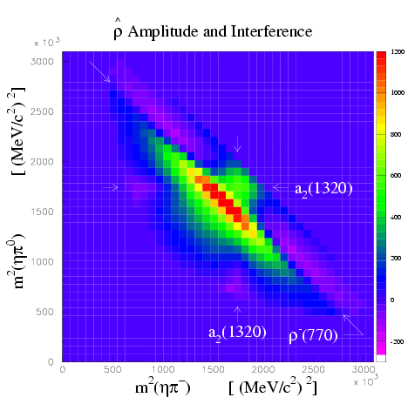
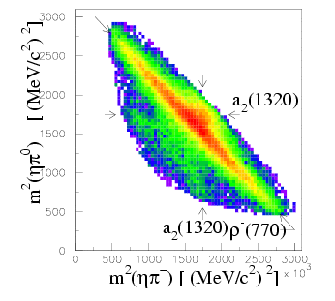
CBAR Exotic
Crystal Barrel Experiment
Antiproton-neutron annihilation at rest:
Same strength as the a₂.
Mass = 1400 +- 20 +- 20 MeV/c²
Width= 310+-50⁺⁵⁰₋₃₀ MeV/c²
Produced from states with one unit
of angular momentum.
π₁(1400)
Without π₁ χ²/ndf = 3, with = 1.29
ηπ⁰π⁻
1⁻⁺

Slide 20
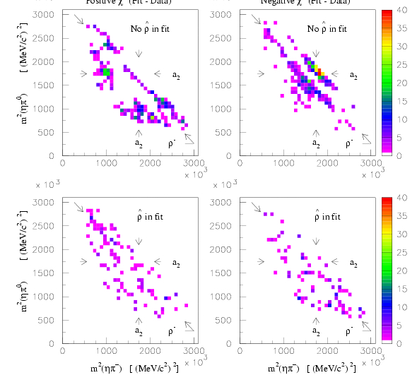
Significance of the signal.
Crystal Barrel Experiment
No 1-+
With the 1-+
Also sees a signal consistent with this in the ηπ⁰ channel.

Slide 21
Experimental Evidence for Hybrids
Mode Mass Width Production
ηπ⁻ 1370±15+50-30 385±40+65-105 1⁺
ηπ⁰ 1257±20±25 354±64±60 1⁺
ηπ 1400 310 seen in annihilation
π₁(1400)
E852 + CBAR (1997)
While everyone seems to agree that there is intensity in the P⁺ exotic wave, there are a number of alternative (non-resonant) explanations for this state.
Unlikely to be a hybrid based on its mass. Also , the only observed decay should not couple to a member of an SU(3) octet. It could couple to an SU(3) decuplet state (e.g. 4-quark).

Slide 22
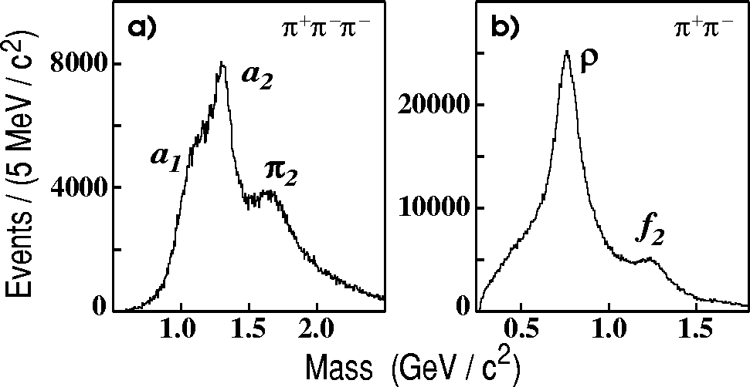
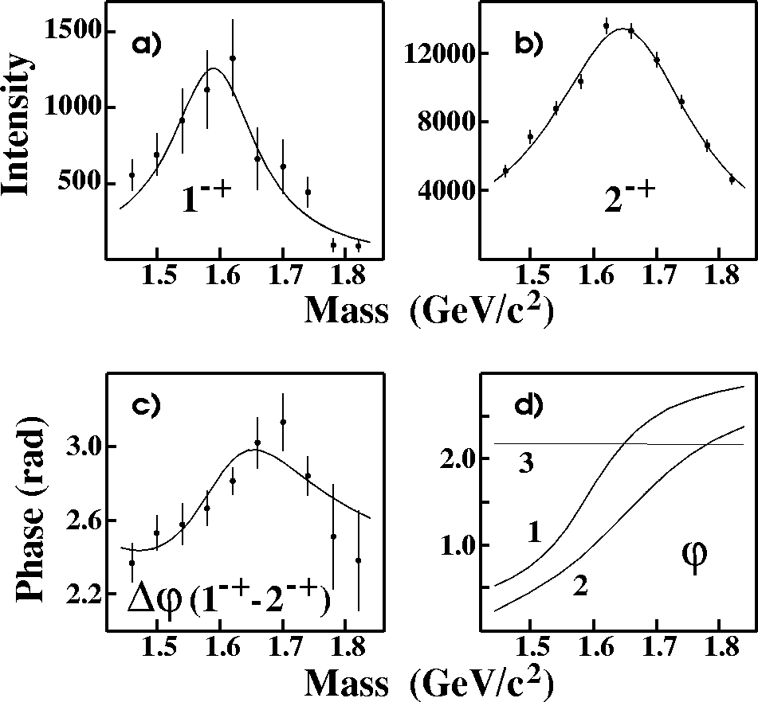
E852 Experiment
π⁻p → π⁺π⁻π⁻ p
(~250,000 Events)
Suggestive of a₁, a₂, π₂ →ρπ
π₂→f₂π
(1998)
Partial Wave Analysis
π₁(1600) →ρπ
M = 1598 ±8+29-47 MeV/c²
Γ = 168±20+150-12 MeV/c²

Slide 23
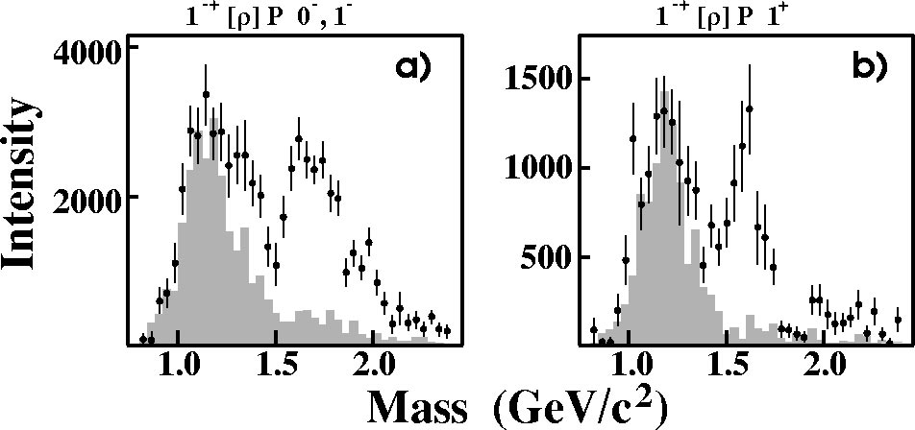
E852 Experiment
Natural-parity exchange: 0⁺,1⁻,2⁺,…
Unnatural-parity exchange: 0⁻,1⁺,2⁻,…
π₁(1600)
Unnatural exchange
Natural exchange
π₁(1600)
M = 1598 ±8+29-47 MeV/c²
Γ = 168±20+150-12 MeV/c²
Leakage from other
partial waves.
Only quote results from the 1⁺ (natural parity) exchange.

Slide 24
VES Experiment
π⁻A→π⁺π⁻π⁻ X
The VES experiment looked at this channel, and while they saw a structure in the 1⁻⁺ exotic wave consistent with a mass of 1.62GeV and a width of 0.24 GeV.
After much examination, VES felt that there was no resonant signal in the 3π channel.

Slide 25
COMPASS Experiment
(180 GeV pions)
(420,000 Events)
1 ⁻⁺ Exotic Wave
π₁(1600) m=1660 Γ=269 π₂(1670) m=1658 Γ=271
arXiv:0910.5842
42 Partial waves included, exotic is dominantly 1⁺ production.

Slide 26
COMPASS Experiment
Neutral and charged decays on hydrogen target.
Results on hydrogen target are consistent with the earlier running.
π₁(1600) m=1660 Γ=269 π₂(1670) m=1658 Γ=271
arXiv:0301.7723
42 Partial waves included, exotic is dominantly 1⁺ production.

Slide 27
CLAS Experiment
γp→nπ⁺π⁺π⁻
E_{γ} = 4.8 – 5.4 GeV
83000 Events after all cuts
Overall Acceptance < 5%
Baryons “removed” by hard kinematic
cuts.
PWA
No evidence of π₁(1600)→ρπ,
(13.5 nb upper limit).

Slide 28
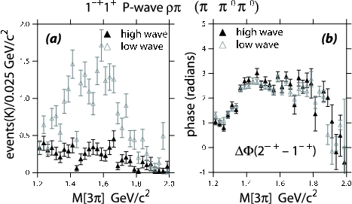
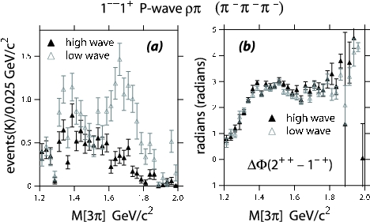
New Analysis
Dzierba et. al. PRD 73 (2006)
10 times statistics in each of two channels.
π⁻p→pπ⁻π⁰π⁰
(3000000 Events)
π⁻p→pπ⁻π⁻π⁺
(2600000 Events)
Get a better description of the data via moments comparison.
Intensity for the exotic 1⁻⁺ wave goes away.
Phase motion between the 1⁻⁺ and the 2⁺⁺ wave is not affected.
No Evidence for the π₁(1600)

Slide 29
E852 New Analysis
PDG: π₂(1670) Decays
3π 96%
f₂π 56%
ρπ 31%
Where does the intensity go?
Always Include:
(0⁺)π₂(1670)→f₂π(L=0)
(1⁺)π₂(1670)→f₂π(L=0)
(1-)π₂(1670)→f₂π(L=0)
(0⁺)π₂(1670)→f₂π(L=2)
(1⁺)π₂(1670)→f₂π(L=2)
Modified wave set:
Leave out
(1⁺)π₂(1670)→ρπ(L=1)
(1⁺)π₂(1670)→ρπ(L=3)
(0⁺)π₂(1670)→ρπ(L=3)
Most of the strength in the exotic π₁(1600) is better described by known decays of the π₂(1670).

Slide 30
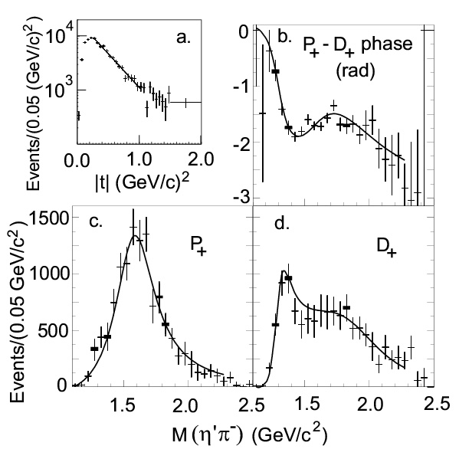
E852 Experiment
π⁻p → η’π⁻p
(~6000 Events)
Data are dominated by 1⁻⁺, 2⁺⁺ and 4⁺⁺ partial waves.
Data are dominated by natural parity exchange.
(2001)
π₁(1600)
M = 1597±10+45-10 MeV/c²
Γ = 340±40±50 MeV/c²
The exotic wave is the dominant
wave in this channel.

Slide 31
VES Experiment
π⁻p→η’π⁻ p
2⁺⁺
1⁻⁺
VES reported a clear signal for 1-+ exotic state:
m=1.56 (.06) Γ=0.34 (.06)

Slide 32
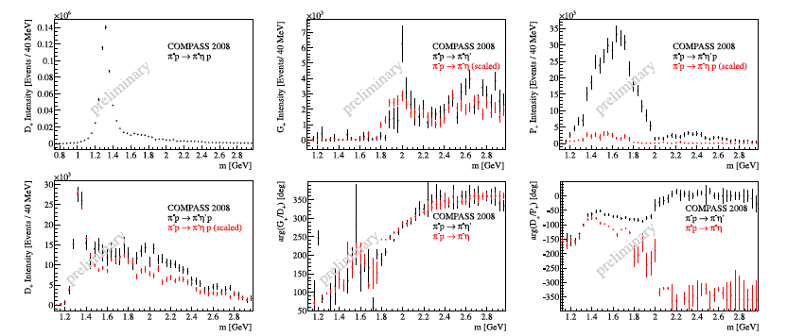
COMPASS Experiment
4⁺⁺
1⁻⁺
2⁺⁺
Compass reports a strong signal in the 1-+ partial wave, but have not extracted resonance parameters due to a poor understanding of higher-mass wave.

Slide 33
CLEO-c Experiment
Report a very strong signal in the exotic 1⁻⁺ wave. They did not have enough data to extract a resonance description from their data.

Slide 34
E852 Experiment
(2004)
(~145,000 Events)
π₁(1600)→b₁π
M = 1664±8±10 MeV/c²
Γ = 185±25±38 MeV/c²
Seen in both natural and
unnatural parity exchange.
The unnatural dominates
m^{ε}=0⁻
1⁻⁺b₁π
m^{ε}=1⁺
1⁻⁺b₁π
2⁺⁺ωρ
4⁺⁺ωρ
π₁(2000)→b₁π
M = 2014±20±16 MeV/c²
Γ = 230±32±73 MeV/c²
Seen primarily in natural
parity exchange.
The natural dominates
Δφ(1⁻⁺ - 2⁺⁺)
Δφ(1⁻⁺ - 4⁺⁺)
Δφ(2⁺⁺ - 4⁺⁺)
Solid curves are a two-pole 1⁻⁺ solution.
Dashed curves are a one-pole 1⁻⁺ solution.

Slide 35
VES Experiment
VES reported an observation of π₁(1600) decaying to b₁π. Where they find m~1.56GeV and Γ~0.34 GeV. They made no comment on the higher-mass region where E852 reported a π₁(2000).

Slide 36
E852 Experiment
(~69000 Events)
1⁺⁺f₁π⁻
π₁(1600)→f₁π
M = 1709±24±41 MeV/c²
Γ = 403±80±115 MeV/c²
Natural parity exchange
ΔΦ(1⁻⁺ - 2⁻⁺)
2⁻⁺f₁π⁻
ΔΦ(1⁻⁺ - 1⁺⁺)
π₁(2000)→f₁π
M = 2001±30±92 MeV/c²
Γ = 333±52±49 MeV/c²
Natural parity exchange
1⁻⁺f₁π⁻
ΔΦ(1⁺⁺ - 2⁻⁺)
(2004)
Black curves are a two-pole 1⁻⁺ solution.
Red curves are a one-pole 1⁻⁺ solution.

Slide 37
VES Experiment
VES reported an observation of π₁(1600) decaying to f₁π. Where they find m~1.64GeV and Γ~0.24 GeV. They made no comment on the higher-mass region where E852 reported a π₁(2000).

Slide 38
Experimental Evidence for Hybrids
The most extensive data sets to date are from the BNL E852 experiment. There is
also data from the VES experiment at Protvino and some results from the Crystal
Barrel experiment at LEAR. Finally, there is CLEO-c and a CLAS (Jefferson Lab) result. There are results from the COMPASS experiment at CERN.
Diffractive production
E852: 18 GeV/c
VES 37 GeV/c
COMPASS:160 GeV/c
M: spin projection
: reflectivity
Natural-parity-exchange: J^{P}=0⁺,1⁻,2⁺, …
Unnatural-parity-exchange: J^{P}=0⁻,1⁺,2⁻, …

Slide 39
Experimental Evidence for Hybrids
Mode Mass Width Production
3π 1598 ±8+29-47 168±20+150-12 1⁺,0⁻,1⁻ E852
η’π 1597±10+45-10 340±40±50 1⁺ E852,VES,CLEO-c
b₁π 1664±8±10 185±25±38 0⁻ ,1⁺ E852,VES,CBAR
f₁π 1709±24±41 403±80±115 1⁺ E852,VES
3π 1660 ±10+64-0 269±21+42-64 1⁺ COMPASS
π₁(1600)
Decay mode sensitive to model
But not in
COMPASS
Exactly the same mass and width as the
Confused production in E852??
This is consistent with a hybrid meson

Slide 40
Experimental Evidence for Hybrids
π₁(2015)
Mode Mass Width Production
b₁π 2014±20±16 230±32±73 1⁺ E852
f₁π 2001±30±92 332±52±49 1⁺ E852
Need two J^{PC}=1⁻⁺ states
π₁(2000)→b₁π
M = 2014±20±16 MeV/c²
Γ = 230±32±73 MeV/c²
Seen primarily in natural
parity exchange.
The natural dominates
m^{ε}=0⁻
1⁻⁺b₁π
m^{ε}=1⁺
1⁻⁺b₁π
Seen in one experiment with low statistics It needs confirmation. If this exists, it is also a good candidate for an exotic hybrid meson.

Slide 41
Experimental Evidence for Hybrids
Mode Mass Width Production
ηπ⁻ 1370±15+50-30 385±40+65-105 1⁺
ηπ⁰ 1257±20±25 354±64±60 1⁺
ηπ 1400 310 seen in annihilation
π₁(1400)
Mode Mass Width Production
3π 1598 ±8+29-47 168±20+150-12 1⁺,0⁻,1-
η’π 1597±10+45-10 340±40±50 1⁺
b₁π 1664±8±10 185±25±38 0⁻ ,1⁺
f₁π 1709±24±41 403±80±115 1⁺
3π 1660 ±10+64-0 269±21+42-64 1⁺
π₁(1600)
Mode Mass Width Production
b₁π 2014±20±16 230±32±73 1⁺
f₁π 2001±30±92 332±52±49 1⁺
π₁(2015)

Slide 42
QCD Exotics
We expect 3 nonets of exotic-quantum-number mesons: 0⁺⁻, 1⁻⁺, 2⁺⁻
π₁ I^{G}(J^{PC})=1⁻(1⁻⁺)
K₁ I^{G}(J^{PC})= ½ (1⁻)
Lattice shows two nonets here.
η’₁ I^{G}(J^{PC})=0⁺(1⁻⁺)
η₁ I^{G}(J^{PC})=0⁺(1⁻⁺)
π , η , η’ , K → π₁ , η₁ , η’₁, K₁
What are the mixing angles between the isoscalar states?
1⁻⁺
0⁺⁻
2⁺⁻
b₀, h₀, h₀’, K₀
b₂, h₂, h₂’, K₂

Slide 43
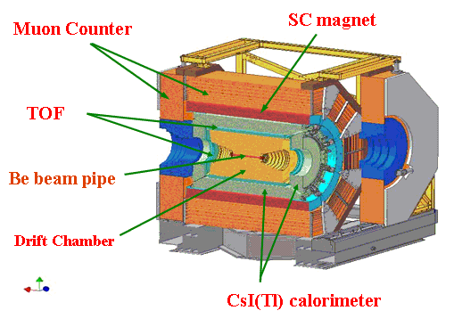
BES III in Beijing
Running

Slide 44
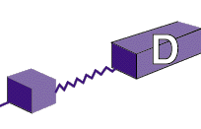
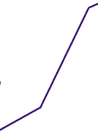

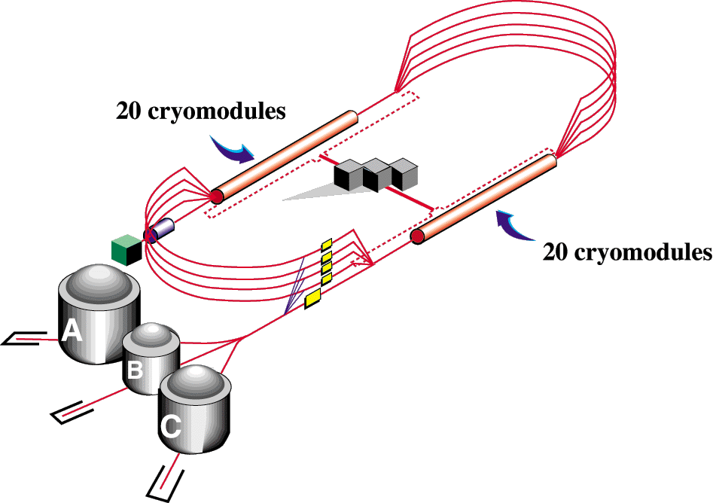

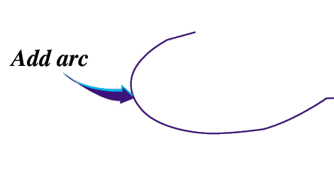

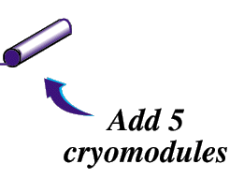
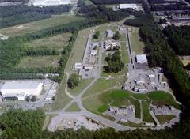
Jefferson Lab Upgrade
340M$ DOE finished in 2017
(I started in 1997)
Upgrade magnets and power supplies
CHL-2

Slide 45
The GlueX Experiment
Photo Production

Slide 46
The GlueX Program
Key enhancements for Phase IV running:
Implementation of the level-3 (software) trigger.
An order of magnitude more statistics than Phases I-III.
Phase I Phase II Phase III Phase IV
Duration (PAC Days) 30 30 60 200
Date of running (nominal) 2014 2015 2016 2017+
Minimum electron energy (GeV) <10 11 12 12
Average photon flux (γ/s) 10⁶ 10⁷ 10⁷ 5x10⁷
Average beam current (nA) 50-200 220 220 1100
Maximum beam emittance (mm-μr) 50 20 10 10
Level-1 (hardware) trigger rate (kHz) 2 20 20 200
Raw Data Volume (TB) 60 600 1200 2300

Slide 47
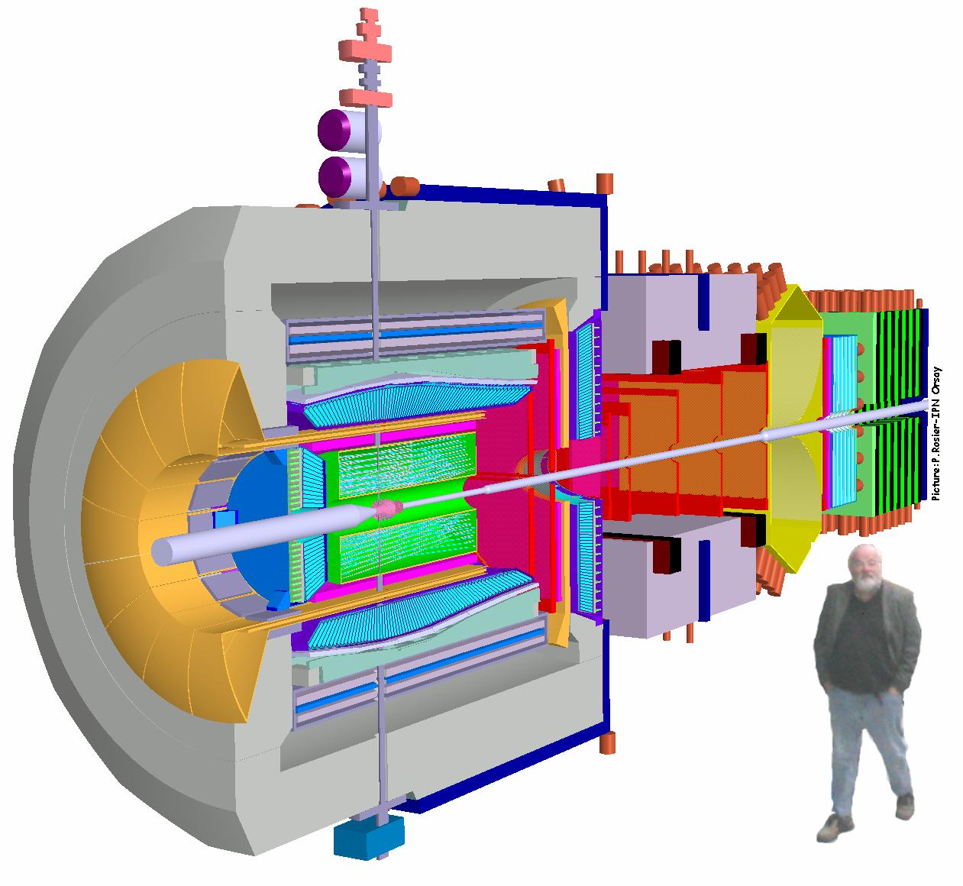
PANDA @ FAIR
States
Glueballs
Physics in 2019?

Slide 48
Future Prospects
COMPASS at CERN collected a large data set in 2009. Analysis is underway.
BES III in China has been running for over a year. Analysis on χdecays are looking for light-quark exotics.
GlueX at Jefferson Lab will use photo-production to look for exotic mesons at Jefferson Lab. First physics in 2015.
CLAS12 at Jefferson Lab will look at low-multiplicity final states in very-low Q**2 reactions, physics in 2018.
PANDA at GSI will use antiprotons to search for charmed hybrid states physics in 2019.

