Slide 1
Hybrid Mesons and Spectroscopy
Expectations for Hybrid Mesons.
Curtis A. Meyer
Carnegie Mellon University
Based on C.A. Meyer and Y. Van Haarlem, Phys. Rev. C82, 025208 (2010).

Slide 2
Outline
Quantum Chromo Dynamics (QCD)
Hadrons
Quantum numbers of Mesons
The Spectrum of Mesons
Gluonic Excitations of Mesons (Hybrids)
Mixing and Decays of Hybrids
Molecules and 4-quark States
Glueballs
Finding Hybrids – Amplitude Analysis

Slide 3
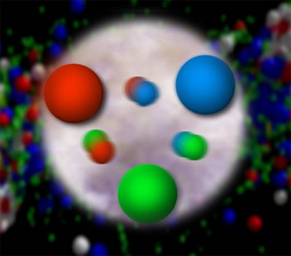
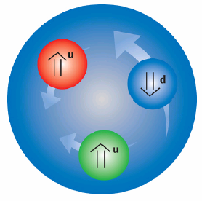
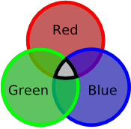
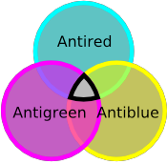
Quantum Chromo Dynamics
The rules that govern how the quarks
froze out into hadrons are given by QCD.
Quarks have color
charge: red, blue and
green. Antiquarks
have anticolors:
cyan, yellow and
magenta.
Atoms are electrically
neutral: a charge and
an anti-charge ( + - ).
Hadrons are color neutral (white),
red-cyan, blue-yellow, green-magenta
or red-blue-green, cyan-yellow-magenta.

Slide 4
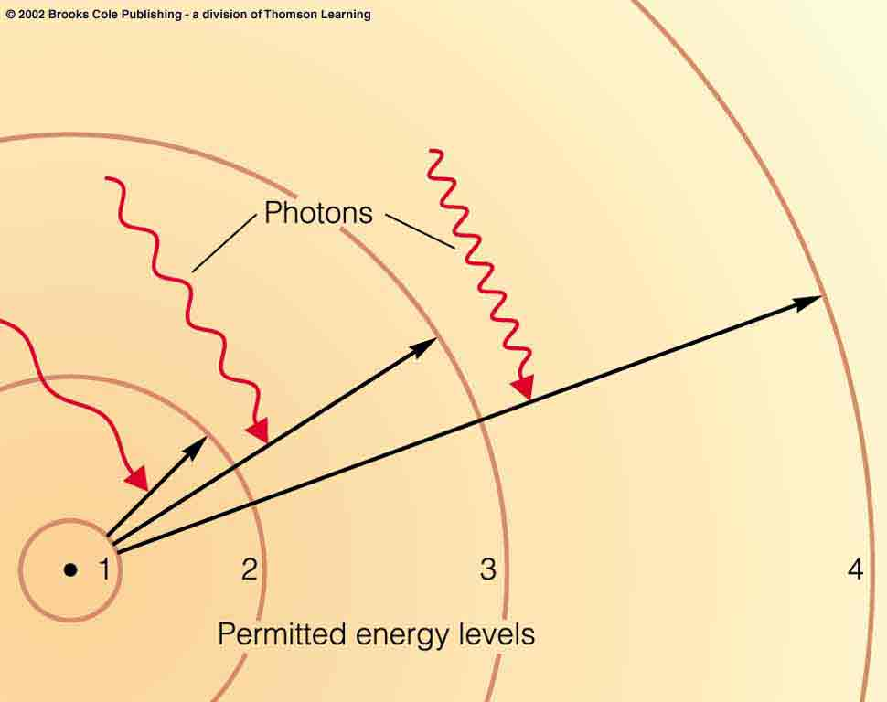
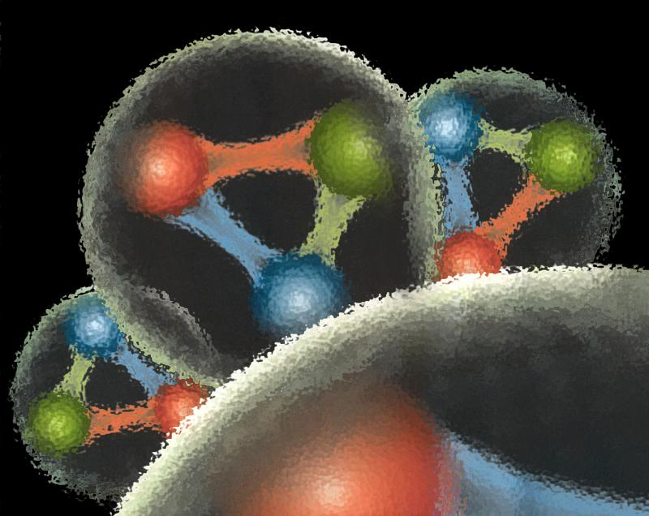
Quantum Chromo Dynamics
QCD describes the interactions of quarks and gluons.
Gluons are the force
carriers of QCD.
Gluons carry a color
and an anticolor
Charge.
Photons are the force
carriers for the E-M
force. Photons are
electrically neutral.
G
R
In nature, QCD appears to have two configurations.
three quarks ( ) Baryons
proton: uud neutron: udd
quark-antiquark ( ) Mesons
G
R
G
R

Slide 5
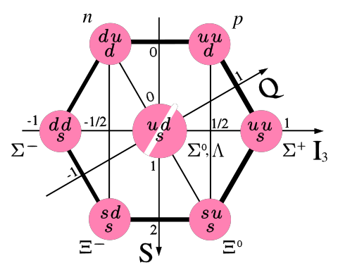
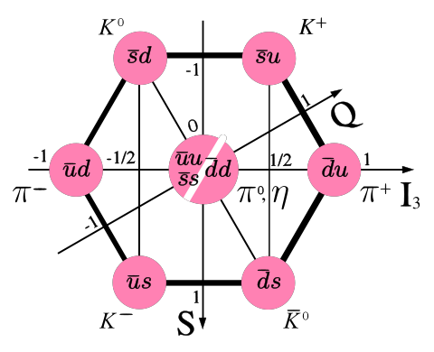
Observed Hadrons
Baryons
Mesons
Groups of 8 (octet)
And 10 (decuplet).
Groups of
9 (nonet).
Other Configurations?
4-quark
glueballs
pentaquarks
hybrids

Slide 6
The Baryons
The Issues with Hadrons
What are the fundamental degrees of freedom
inside of a proton and a neutron?
Quarks? Combinations of Quarks? Gluons?
The spectrum is very sparse.
The Mesons
What is the role of glue in a quark-antiquark
system and how is this related to the confinement
of QCD?
What are the properties of predicted states
beyond simple quark-antiquark?
Need to map out new states.

Slide 7
The QCD Potential
ground-state
flux-tube
m=0
linear potential

Slide 8
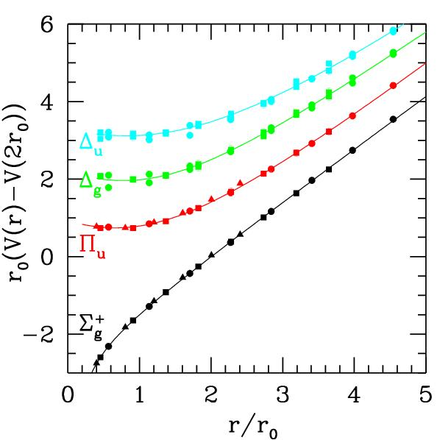
The QCD Potential
ground-state
flux-tube
m=0
Excited gluonic field
linear potential
Gluonic Excitations provide an
experimental measurement of
the excited QCD potential.
Observations of the nonets on the excited potentials are
the best experimental signal of gluonic excitations.

Slide 9
Positronium
Spectroscopy and QED
e⁺
e⁻
Worry about the angular and spin portion of the wave function:
Spin: S=S₁+S₂=(0,1)
Orbital Angular Momentum: L=0,1,2,…
Total Spin: J=L+S
L=0, S=0 : J=0 L=0, S=1 : J=1
L=1 , S=0 : J=1 L=1, S=1 : J=0,1,2
… …
Quantum numbers for L,S and J
Notation: ^{(2S+1)}L_{J} ¹S₀, ³S₁, ¹P₁, ³P₀, ³P₁, ³P₂,…

Slide 10
Spectroscopy of Mesons
Quarkonium
Spin: S=S₁+S₂=(0,1)
q
q
Orbital Angular Momentum: L=0,1,2,…
Total Spin: J=L+S
L=0, S=0 : J=0 L=0, S=1 : J=1
L=1 , S=0 : J=1 L=1, S=1 : J=0,1,2
… …
Notation: ^{(2S+1)}L_{J} ¹S₀, ³S₁, ¹P₁, ³P₀, ³P₁, ³P₂,…
For mesons, these states are referred to as “particles” and cataloged by the Particle Data Group.
There are other quantum numbers conserved by the strong interaction that prove to be more useful.
Reflection in a mirror:
Parity: P=-(-1)^{(L)}
Particle<->Antiparticle:
Charge Conjugation: C=(-1)^{(L+S)}

Slide 11
Spectroscopy of Mesons
Quarkonium
Parity: Reflection in a mirror
q
q
A particle and its antiparticle have opposite parity, so
P=-(-1)^{(L)}
Charge Conjugation: Particle<->Antiparticle
This effectively takes so we get a factor of . This also “flips” the spin of the quark and the antiquark.
For a symmetric spin function, we get (+1) (S=0).
For an antisymmetric spin function, we get (S=1).
Charge Conjugation: C=(-1)^{(L+S)}
Notation: J^{(PC)} 0⁻⁺, 1⁻⁻, 1⁺⁻, 0⁺⁺, 1⁺⁺, 2⁺⁺
^{(2S+1)}L_{J} ¹S₀, ³S₁, ¹P₁, ³P₀, ³P₁, ³P₂,…

Slide 12
Spectroscopy of Mesons
Quarkonium
Isospin: up-down quarks
q
q
up-quark: | I, I_{z}> = | ½ , +½>
down-quark: | I, I_{z}> = | ½ , -½>
I=0 :
I=1 :
I = ½ :
kaons
G-Parity: Generalized C-Parity
C would flip the sign of a charged particle, this is a rotation in isospin.
Charge Conjugation: G=C (-1)^{(I)} = (-1) ^{(L+S+I)}
Notation: (I^{G})J^{(PC)}

Slide 13
Spectroscopy and QCD
Quarkonium
Mesons
q
q
radial
Consider the three lightest quarks
4⁺⁺
L=3
3⁺⁺
2⁺⁺
9 Combinations
3⁺⁻
3⁻⁻
L=2
2⁻⁻
1⁻⁻
2⁻⁺
2⁺⁺
L=1
1⁺⁺
0⁺⁺
1⁺⁻
1⁻⁻
S=1
S=0
L=0
0⁻⁺

Slide 14
Mesons
Spectroscopy an QCD
Quarkonium
q
q
4⁺⁺
L=3
3⁺⁺
2⁺⁺
3⁺⁻
ρ,K*,ω,φ
Mesons come in
Nonets of the same
J^{PC} Quantum Numbers
3⁻⁻
L=2
2⁻⁻
π,K,η,η’
1⁻⁻
2⁻⁺
a,K,f,f’
2⁺⁺
L=1
1⁺⁺
b,K,h,h’
SU(3) is broken
Last two members mix
0⁺⁺
1⁺⁻
ρ,K*,ω,φ
1⁻⁻
S=1
S=0
L=0
0⁻⁺
π,K,η,η’

Slide 15
Spectroscopy an QCD
Quarkonium
Mesons
q
q
4⁺⁺
L=3
3⁺⁺
2⁺⁺
Allowed J^{PC} Quantum numbers:
3⁺⁻
3⁻⁻
0⁺⁺ 0⁻⁺
1^{–-} 1⁺⁺ 1⁺⁻
2⁻⁻ 2⁺⁺ 2⁻⁺
3⁻⁻ 3⁺⁺ 3⁺⁻
4⁻⁻ 4⁺⁺ 4⁻⁺
5⁻⁻ 5⁺⁺ 5⁺⁻
L=2
2⁻⁻
1⁻⁻
2⁻⁺
2⁺⁺
L=1
1⁺⁺
0⁺⁺
1⁺⁻
1⁻⁻
S=1
S=0
L=0
0⁻⁺

Slide 16
Spectroscopy an QCD
Quarkonium
Mesons
q
q
4⁺⁺
L=3
3⁺⁺
2⁺⁺
Allowed J^{PC} Quantum numbers:
3⁺⁻
3⁻⁻
0⁻⁻ 0⁺⁻
1⁻⁺
2⁺⁻
3⁻⁺
4⁺⁻
5⁻⁺
0⁺⁺ 0⁻⁺
1^{–-} 1⁺⁺ 1⁺⁻
2⁻⁻ 2⁺⁺ 2⁻⁺
3⁻⁻ 3⁺⁺ 3⁺⁻
4⁻⁻ 4⁺⁺ 4⁻⁺
5⁻⁻ 5⁺⁺ 5⁺⁻
L=2
2⁻⁻
1⁻⁻
2⁻⁺
2⁺⁺
L=1
1⁺⁺
0⁺⁺
1⁺⁻
S=1
S=0
Exotic Quantum Numbers
non quark-antiquark description
1⁻⁻
L=0
0⁻⁺

Slide 17
Spectroscopy an QCD
Quarkonium
q
q
The isospin-1 experimental states below 2GeV in mass taken from the 2012 Particle Data Book.

Slide 18
Spectroscopy an QCD
Quarkonium
q
q
The isospin-0 experimental states below 2GeV in mass taken from the 2012 Particle Data Book.

Slide 19
Spectroscopy an QCD
Quarkonium
Each nonet of mesons has two members with I=0. Thus, the same J^{PC} quantum numbers.
q
q
If SU(3) flavor holds, they would be:
|8>
|1>
s-quarks are different from u and d:
Nature is different than both of these: “nonet mixing”
θ=35.3º

Slide 20
Spectroscopy an QCD
Quarkonium
Experimental results on mixing:
q
q
Ideal Mixing:
θ = 35.3º
Measure through decay rates:
f₂(1270) → KK / f₂(1270) → ππ ~ 0.05
f’₂(1525) → ππ / f’₂(1525) → KK ~ 0.009
Just to make it confusing!

Slide 21
Beyond the Quark Model
Other configurations can be color-neutral:
Hybrid Mesons where the gluonic field plays an active role.
4-quark states
Should we expect to see these?
MIT Bag Model – quarks confined to a finite space, add a TE gluon J^{PC}=1⁺⁻ .
This leads to four new nonets of “hybrid mesons” 1⁻⁻ 0⁻⁺ 1⁻⁺ and 2⁻⁺ .
Mass(1⁻⁺) = 1.0 – 1.4 GeV
QCD spectral sum rules – a two-point correlator related to a dispersion relation. This predicts a 1⁺⁻ hybrid meson.
Mass(1⁻⁺) = 1.0 – 1.9 GeV
Flux-tube Model – model the gluonic field as 1⁺⁻ and 1⁻⁺ objects.
This leads to eight new nonets 0⁺⁻ 0⁻⁺ 1⁻⁻ 1⁺⁺ 1⁻⁺ 1⁺⁻ 2⁻⁺ and 2⁺⁻.
Mass(1⁻⁺) = 1.8 – 2.0 GeV
QCD Coulomb Gauge Hamiltonian: Lightest hybrids not exotic, need to go to L=1 to get 1⁻⁺ 3⁻⁺ and 0⁻⁻.
Mass(1⁻⁺) = 2.1 – 2.3 GeV

Slide 22
Spectroscopy and QCD
Lattice QCD Predictions
Phys. Rev. D83 (2011) 111502

Slide 23
Spectroscopy and QCD
Lattice QCD Predictions
States with non-trivial glue in their wave function.

Slide 24
Spectroscopy and QCD
Lattice QCD Predictions
Quarkonium
q
q
Beyond the normal meson spectrum, there are predictions for states with exotic quantum numbers
Lattice QCD calculation of the light-quark meson spectrum
2.5Gev
2.0GeV
Exotic QN
0⁺⁻
1⁻⁺
2⁺⁻
Normal QN
Several nonets predicted
Notes:
What are gluonic excitations and why are we looking for them? Lattice QCD predictions for the mesons and in particular, a class of mesons with non-quark-antiquark quantum numbers. Also not that mixing angles are predicted. GlueX needs to measure particle J(PC), masses, widths and decay modes to be able to map these out.

Slide 25
Spectroscopy and QCD
Phys. Rev. D84 (2011) 074023
``Constituent gluon’’ behaves like it has J^{PC} = 1⁺⁻
Mass ~ 1-1.5 GeV
Lightest hybrid nonets: 1⁻⁻, (0⁻⁺,1⁻⁺, 2⁻⁺)
The 0+- and two 2+- exotic nonets:
also a second 1⁻⁺ nonet
p-wave meson plus a ``gluon’’
2.5Gev
2.0GeV
0⁺⁻
1⁻⁺
2⁺⁻
Several nonets predicted
Notes:
What are gluonic excitations and why are we looking for them? Lattice QCD predictions for the mesons and in particular, a class of mesons with non-quark-antiquark quantum numbers. Also not that mixing angles are predicted. GlueX needs to measure particle J(PC), masses, widths and decay modes to be able to map these out.

Slide 26
Spectroscopy and QCD
Lattice QCD Predictions
Phys. Rev. D83 (2011) 111502

Slide 27
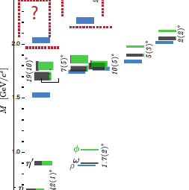
Spectroscopy and QCD
Lattice QCD Predictions
Lattice QCD predicts nonet mixing angles.
Small mixing angle is “ideal”.
0⁻⁺ 42º mixing angle
1⁺⁺ 31º mixing angle
1⁻⁻ 20º mixing angle
1⁻⁺ 23º mixing angle

Slide 28
Spectroscopy and QCD
Experimental results on mixing:
Quarkonium
q
q
Ideal Mixing:
θ = 35.3º
Lattice QCD suggests some nonets do not have ideal mixing:
Measure through decay rates:
f₂(1270) → KK / f₂(1270) → ππ ~ 0.05
f’₂(1525) → ππ / f’₂(1525) → KK ~ 0.009
0⁻⁺ ground state and radial
1⁺⁺ ground state.
1⁻⁺ exotic hybrid.
1⁻⁻ hybrid.

Slide 29
Hybrid Decays
The angular momentum in the flux
tube stays in one of the daughter
mesons (an (L=1) and (L=0) meson).
L_{flux}
L_{flux}
Exotic Quantum Number Hybrids
π₁→ πb₁ , πf₁ , πρ , ηa₁
η₁→π(1300)π , a₁π
η’₁→Κ₁(1270)Κ, Κ₁(1270)Κ ,K*Κ
b₂ → a₁π , h₁π , ωπ , a₂π
h₂ → b₁π , ρπ , ωη
h’₂ → Κ₁(1270)Κ, Κ₁(1270)Κ, K₂*Κ
b₀ → π(1300)π , h₁π
h₀ → b₁π , h₁η
h’₀ → Κ(1460)Κ , K₁(1270)Κ, h₁η
Mass and model
dependent
predictions
Populate final states with
π±,π⁰,K±,K⁰,η, (photons)

Slide 30
Hybrid Decays
The angular momentum in the flux
tube stays in one of the daughter
mesons (an (L=1) and (L=0) meson).
L_{flux}
L_{flux}
Exotic Quantum Number Hybrids
π₁→ πb₁ , πf₁ , πρ , ηa₁
η₁→π(1300)π , a₁π
η’₁→Κ₁(1270)Κ, Κ₁(1270)Κ ,K*Κ
b₂ → a₁π , h₁π , ωπ , a₂π
h₂ → b₁π , ρπ , ωη
h’₂ → Κ₁(1270)Κ, Κ₁(1270)Κ, K₂*Κ
b₀ → π(1300)π , h₁π
h₀ → b₁π , h₁η
h’₀ → Κ(1460)Κ , K₁(1270)Κ, h₁η
The good channels to look at with amplitude analysis.
Mass and model
dependent
predictions
Populate final states with
π±,π⁰,K±,K⁰,η, (photons)

Slide 31
Exotic Quantum Number States?
If you identify an exotic-quantum number state, is it a hybrid meson?
Consider two-quark and two-antiquark combinations. Using simple SU(3), two quarks can be in a or 6. You can combine these into multiplets.
4-quark states
Inverted hierarchy.

Slide 32
Exotic Quantum Number States?
If you identify an exotic-quantum number state, is it a hybrid meson?
Consider two-quark and two-antiquark combinations. Using simple SU(3), two quarks can be in a or 6. You can combine these into multiplets.
4-quark states
Inverted hierarchy.

Slide 33
Exotic Quantum Number States?
If you identify an exotic-quantum number state, is it a hybrid meson?
4-quark states
Model calculations do find exotic-quantum number states in the multi-quark spectrum. Most calculations find the lightest is J^{PC}=1⁻⁺ followed by a J^{PC}=0⁻⁻.
Lattice calculations currently do not see these states, but that may be that the correct operators were not included.

Slide 34
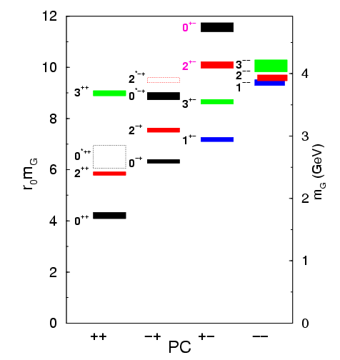
Lattice QCD Glueball Predictions
Gluons can bind to form glueballs
EM analogue: massive globs
of pure light.
Lattice QCD predicts masses
The lightest glueballs have
“normal” quantum numbers.
Glueballs will Q.M. mix
The observed states will
be mixed with normal
mesons.
Strong experimental evidence
For the lightest state.

Slide 35
Identification of Glueballs
Lightest Glueball predicted near two states of same Q.N..
“Over population” Predict 2, see 3 states
Glueballs should decay in a flavor-blind fashion.
Production Mechanisms:
Certain are expected to by Glue-rich, others are
Glue-poor. Where do you see them?
Proton-antiproton
Central Production
J/ψ decays

Slide 36
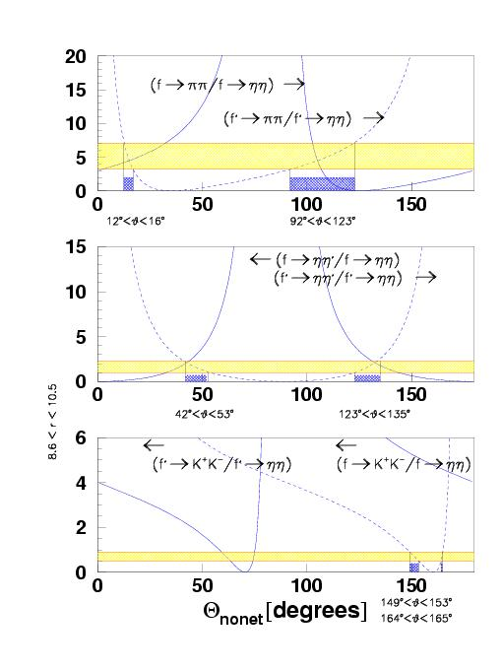
Decay Rates of 0⁺⁺

Slide 37
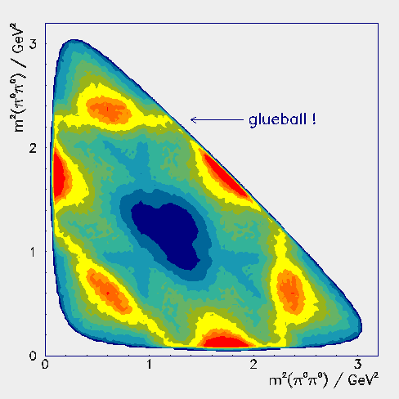
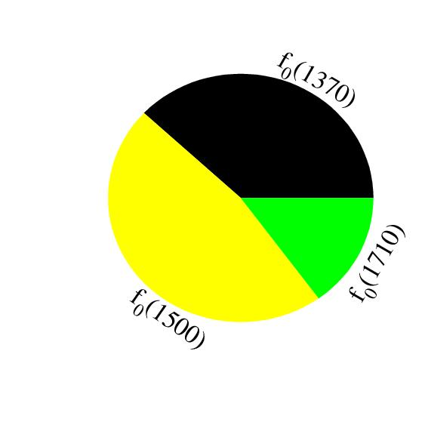
Experimental Evidence
Scalar (0⁺⁺) Glueball and two
nearby mesons are mixed.
f₀(1710)
f₀(1500)
a₀(1450)
K*₀(1430)
f₀(1370)
Glueball
spread
over 3
mesons
a₀(980)
f₀(980)
Are there other glueballs?

Slide 38
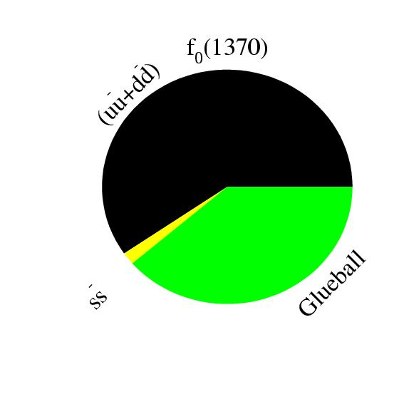
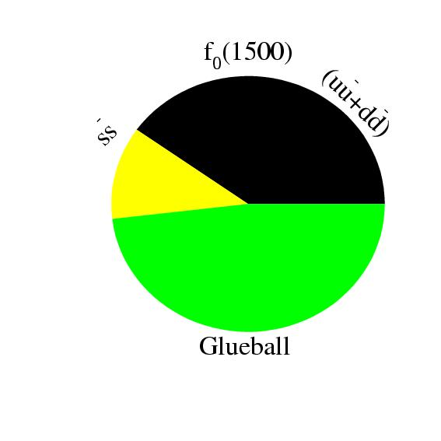
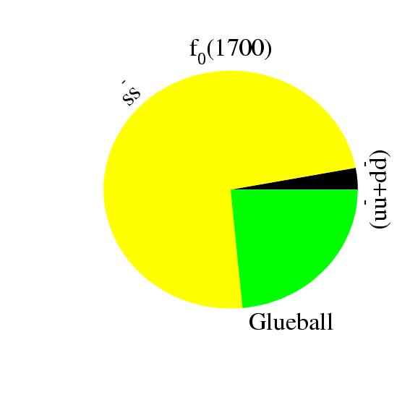
Glueball-Meson Mixing
meson
meson
1
meson
meson
Glueball
r₂
meson
meson
Glueball
r₃
meson
flavor blind? r
Solve for mixing scheme

Slide 39
Higher Mass Glueballs?
Part of the BES-III program will be to search for glueballs in radiative J/ψ decays. Also part of the PANDA program at GSI.
Lattice predicts that the 2⁺⁺ and the 0⁻⁺ are the
next two, with masses just above 2GeV/c^{2.}
Radial Excitations of the 2⁺⁺ ground state
L=3 2⁺⁺ States + Radial excitations
f2(1950), f2(2010), f2(2300), f2(2340)…
2’nd Radial Excitations of the η and η’,
perhaps a bit cleaner environment! (I would
Not count on it though….)
I expect this to be very challenging.

Slide 40
Looking for Hybrids
Decay Predictions
Analysis Method
Partial Wave Analysis
Meson
Fit n-D angular distributions
Fit Models of production and
decay of resonances.
Meson
L_{glue}
Meson
Angular momentum
in the gluon flux stays confined.
π₁ I^{G}(J^{PC})=1⁻(1⁻⁺)
K₁ I^{G}(J^{PC})= ½ (1⁻)
Nine state
η’₁ I^{G}(J^{PC})=0⁺(1⁻⁺)
η₁ I^{G}(J^{PC})=0⁺(1⁻⁺)
This leads to complicated multi-particle final states.

Slide 41
Partial Wave Analysis
Angular distributions of reactions let you determine
the spin and parity of intermediate resonances.
Classical Electrodynamics:
Monopole Radiation (L=0)
Dipole Radiation (L=1)
Quadrupole Radiation (L=2)

Slide 42
Partial Wave Analysis
Need a mathematical model that describes getting from the initial state to the final state.
Different exchange mechanisms.
Different intermediate states, X and R_{ππ.}
Different Ls
Combinations of pions
Natural-parity exchange: 0⁺,1⁻,2⁺,…
Unnatural-parity exchange: 0⁻,1⁺,2⁻,…
Physics amplitude for one term: A(J^{PC},M^{ε},L,…). Form a coherent/incoherent sum over all amplitudes. This yields an intensity.

Slide 43
Partial Wave Analysis
Likelihood is a product of probabilities over all measured events, n.
Take the natural log to turn into a sum over the data. We need a Monte Carlo sample to be able to integrate over all phase space and normalize the probabilities.
data
Monte Carlo
Minimize
Physics Model

Slide 44
Partial Wave Analysis
Make Amplitude generation straightforward:
AmpTools – see Matt Shepherd.
qft++ - developed for CLAS, M. Williams,
Comp. Phys. Comm. 180, 1847 (2009).
Amplitudes Issues:
more than just simple t-channel production.
final state particles with non-zero spin.
move beyond the isobar model
direct 3-body processes
Unitarity, analyticity, …

Slide 45
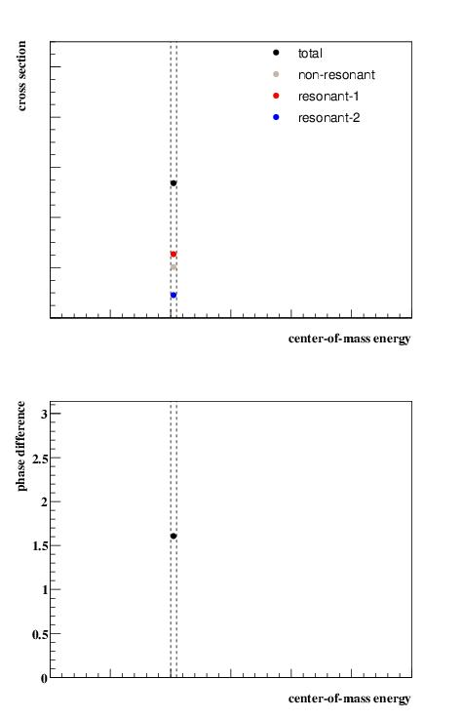
Partial Wave Analysis
A simple model with three
complex amplitudes, 2 of
which are particles with
different QNs
Start with a single energy
bin.
Fit to get the strengths and
the phase difference between
the two resonances.

Slide 46
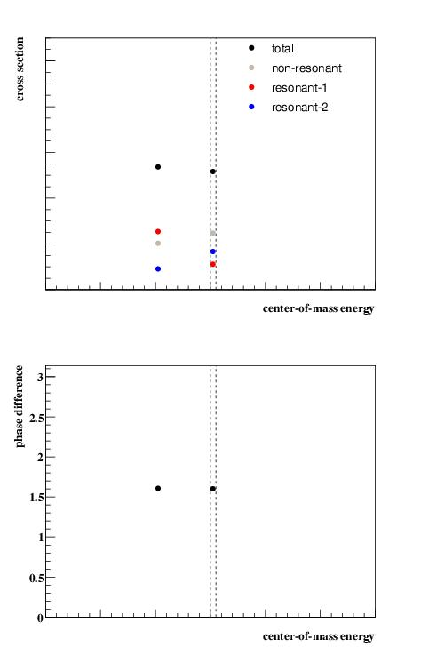
Partial Wave Analysis
A simple model with three
complex amplitudes, 2 of
which are particles with
different QNs
Start with a single energy
bin.
Fit to get the strengths and
the phase difference between
the two resonances.
Fit a 2nd bin.

Slide 47
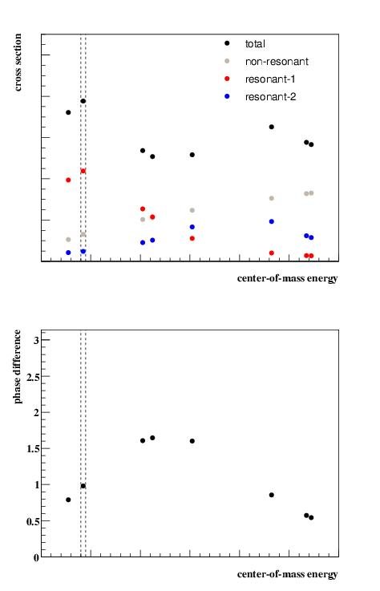
Partial Wave Analysis
A simple model with three
complex amplitudes, 2 of
which are particles with
different QNs
Start with a single energy
bin.
Fit to get the strengths and
the phase difference between
the two resonances.
Continue fitting bins …

Slide 48
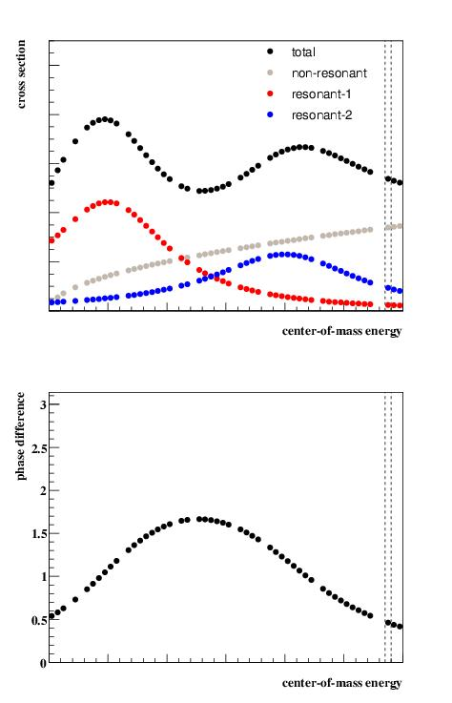
Partial Wave Analysis
A simple model with three
complex amplitudes, 2 of
which are particles with
different QNs
Start with a single energy
bin.
Fit to get the strengths and
the phase difference between
the two resonances.
… and continue …

Slide 49
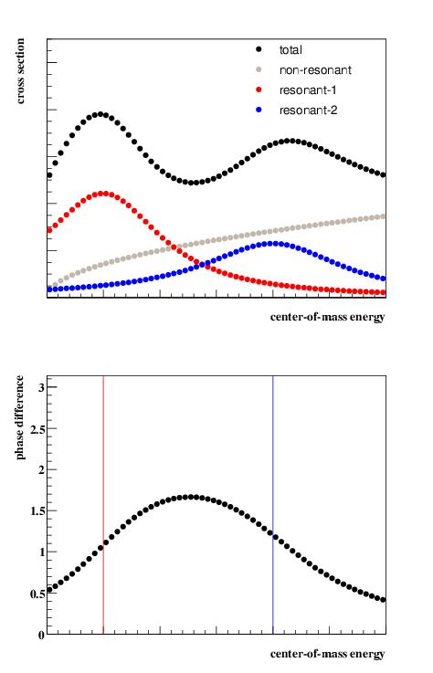
Partial Wave Analysis
A simple model with three
complex amplitudes, 2 of
which are particles with
different QNs. The masses
peak where the two lines
are.
The need for intensity and
the phase difference are
indicative of two resonances.
Can fit for masses and widths.

Slide 50
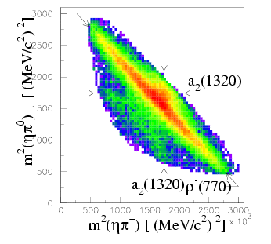
Partial Wave Analysis
For a three-body reaction from a ``known’’ initial state, one can do a Dalitz analysis. Only two variables are needed to describe the full kinematics.
ηπ⁰π⁻
Intermediate resonances include the
a₂(1320)->ηπ
and the
ρ(770)->ππ
and a possible 1⁻⁺ wave
π₁->ηπ

Slide 51
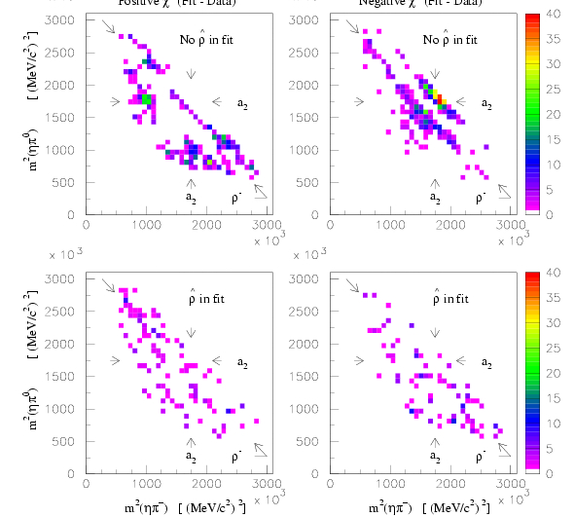
Partial Wave Analysis
ηπ⁰π⁻
Can see the significance of an amplitude.

Slide 52
Summary
There is good theoretical support that hybrid mesons exist and that there should be exotic-quantum number nonets of them.
To establish the hybrid nature requires mapping out nonets of these states, and establishing some reasonable part of the spectrum.
Decay modes need to be studied to experimentally access the structure of the states.
The next lecture will review the experimental situation.

