Slide 1
Big Science
How do you get a ``billion-dollar’’ science project funded and built?
Curtis A. Meyer

Slide 2
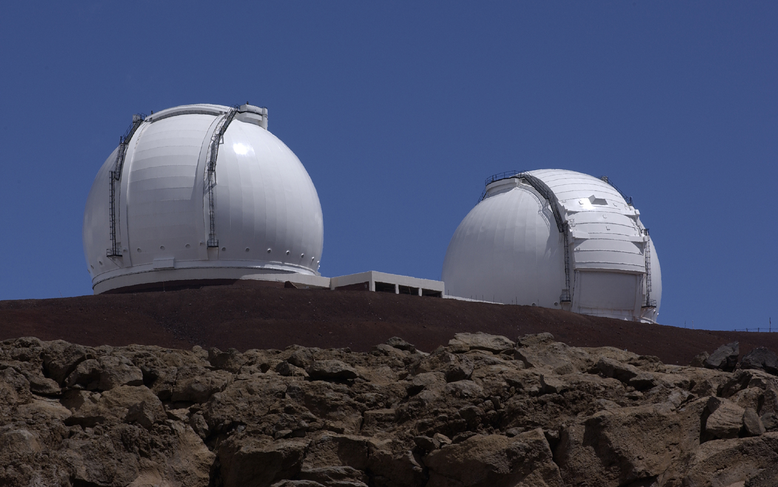
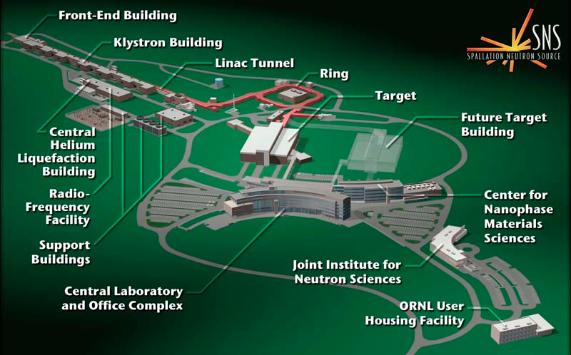
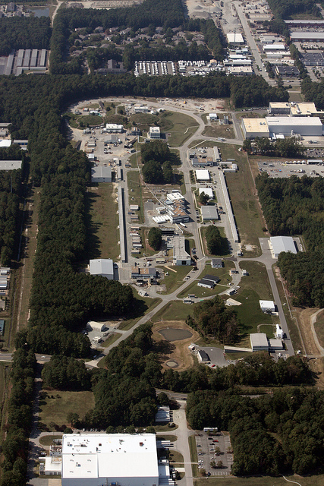
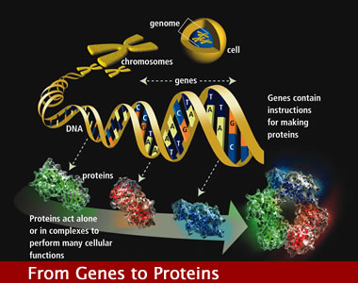
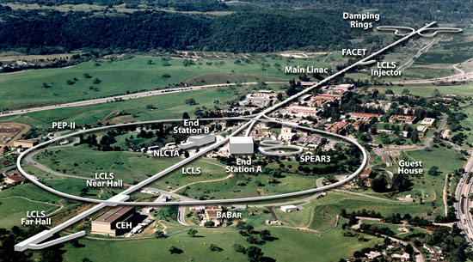
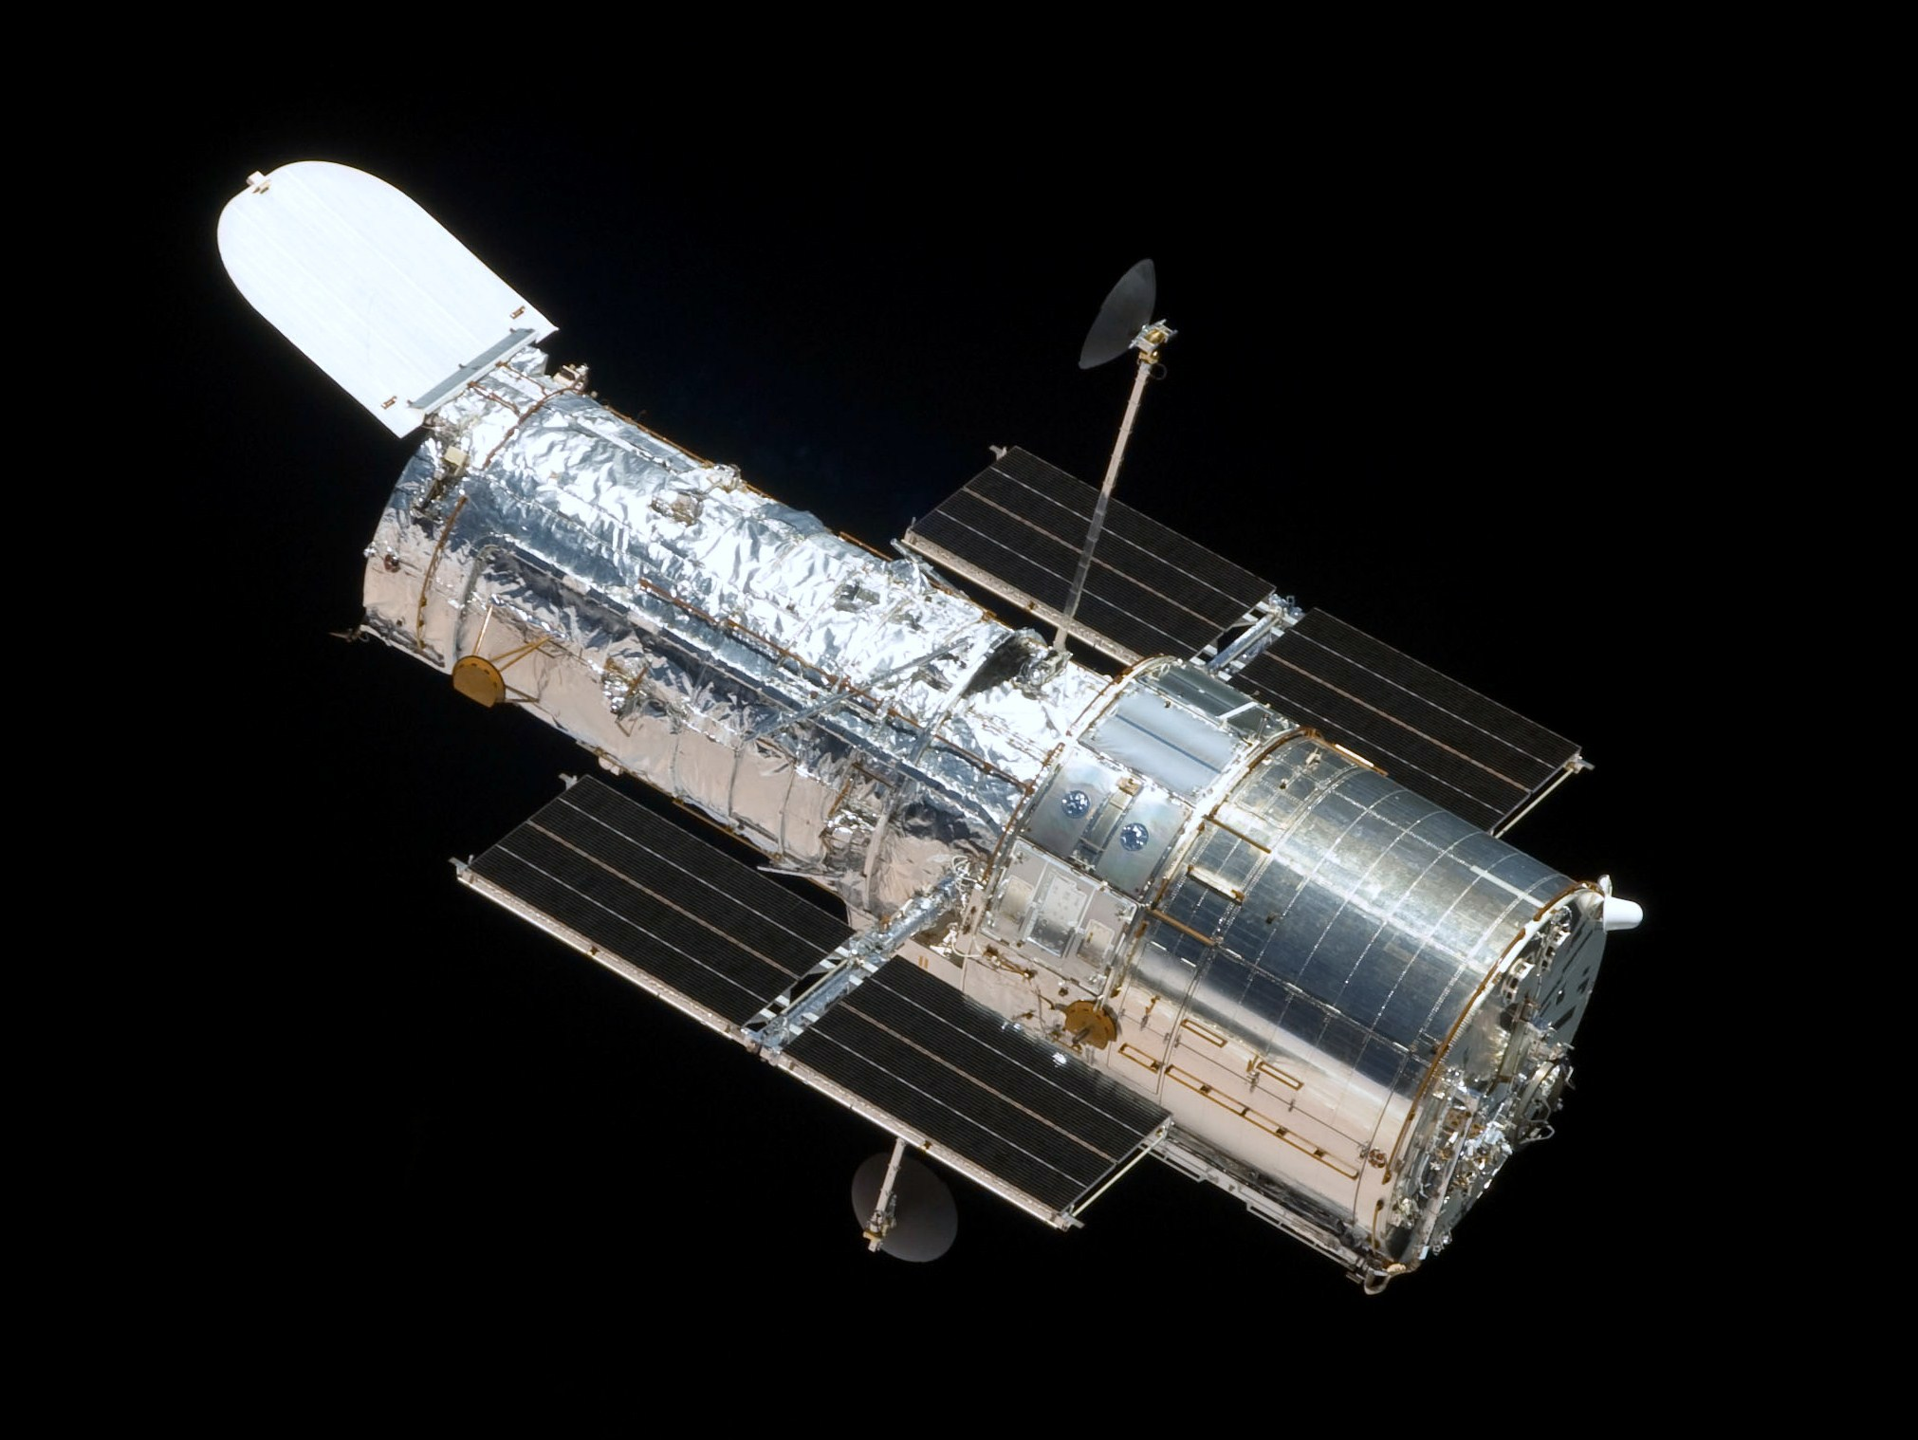
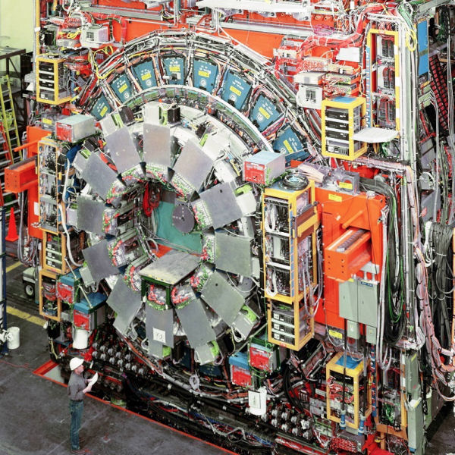
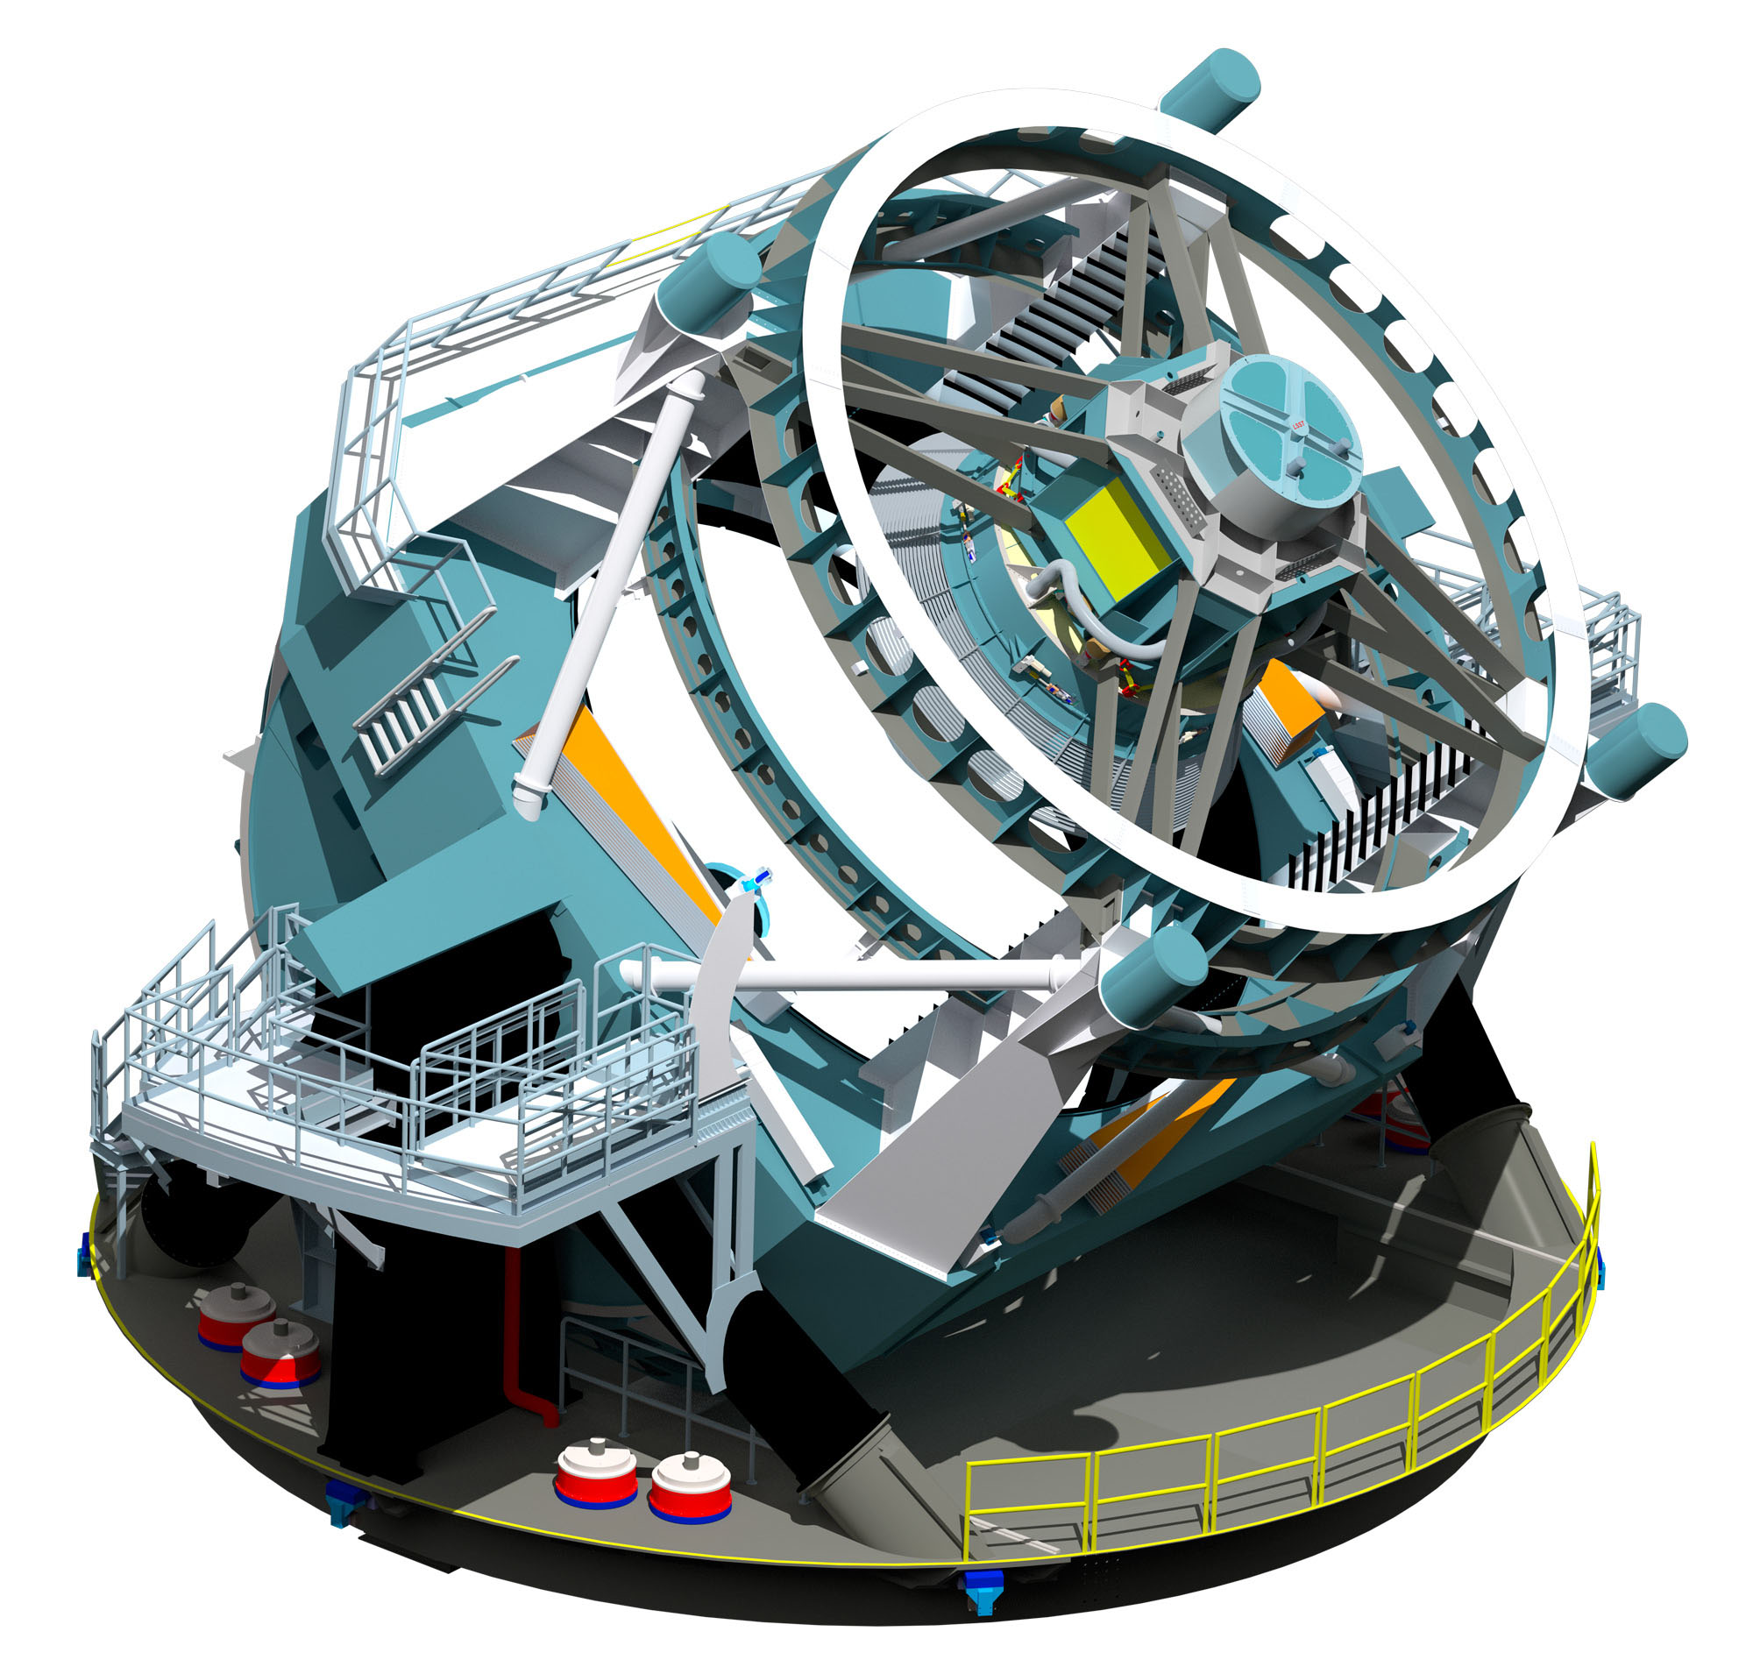

Slide 3
Outline
Who and how?
Focus in on Nuclear Physics.
What does Jefferson Lab do?
The Jefferson Lab 12-GeV Upgrade.
The GlueX Experiment
The role of CMU
Going forward.

Slide 4



The Federal Agencies
Department of Energy, Office of Science
Operates national labs
Builds major instrumentation
NASA
Satellite Projects
National Science Foundation
Major Instrumentation

Slide 5
Setting Priorities
Long-range planning by the individual fields provides guidance to the federal agencies as to where the field is going.
Within DOE/NSF, committees set up under the guidance of the Federal Advisory Committee Act (FACA) provide planning.
  Nuclear Physics: “NSAC Long-range Plan”
  High-energy physics: “P5 committee’’
Cosmology/Astrophysics
  ``Decadal Survey’’ done by the National Research Council (National Academy of Sciences).
  (Meyer)
  (Gilman)
  (di Matteo)

Slide 6
The Next Big Question
The results that we are getting today drive the next generations of large-scale science.
A major breakthrough leads to a completely new direction.
Technological advances allow us to improve on current science by orders of magnitude.
Advances in computing make new science possible.

Slide 7
National Science Planning
DOE/NSF FACA
ASCR- Advanced Scientific Computing Research ASCAC
BES – Basic Energy Sciences BESAC
BER – Biological and Environmental Research BERAC
FES – Fusion Energy Science FESAC
HEP – High Energy Physics HEPAP
NP - Nuclear Physics NSAC

Slide 8
NSAC Long-Range Plans
1976: Long Range Plan
    Identified the construction of Jefferson Lab (CEBAF) as top priority for new construction. Science started in 1994.
1983: A Long Range Plan for Nuclear Science
    Identified RHIC at BNL as top priority for new construction. Science started in 2000.
1996: Nuclear Science: A Long Range Plan
    Run the program and finish RHIC are top priorities.
2002 NSAC Long Range Plan: Opportunities in Nuclear Science, A Long-Range Plan for the Next Decade
    Rare isotope facility is top priority. Upgrade JLab is #4.
2007 Long Range Plan: The Frontiers of Nuclear Science
    Upgrade Jefferson Lab is top priority. FRIB is number 2. Expect Science from the Jlab 12-GeV in 2016.
Focus on the 12-GeV upgrade to Jefferson Lab

Slide 9
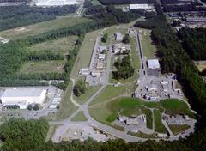
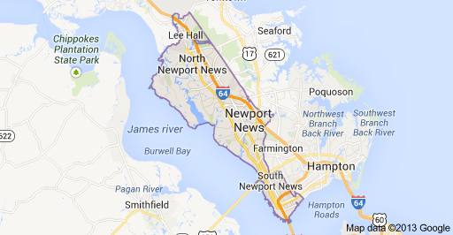
Jefferson Lab
Built as a “4 GeV” electron accelerator.
Can deliver extracted electron beams to three experimental halls simultaneously.
Energy can be in ¼ steps of beam energy.
Electron beams can be used to produce photon beams.
Original cost was about 600 million dollars.
Ultimately delivered nearly 6 GeV electron beams

Slide 10
Nuclear Physics Facility
The interaction of electrons and photons with matter are governed by the electromagnetic force (Quantum Electrodynamics --- QED). This is well understood.
The nucleus is governed by the strong nuclear force which in turn comes the from the interactions of quarks and gluons (Quantum Chromodynamics --- QCD). Not well understood.
Use a well understood probe to study a not well understood interaction.

Slide 11
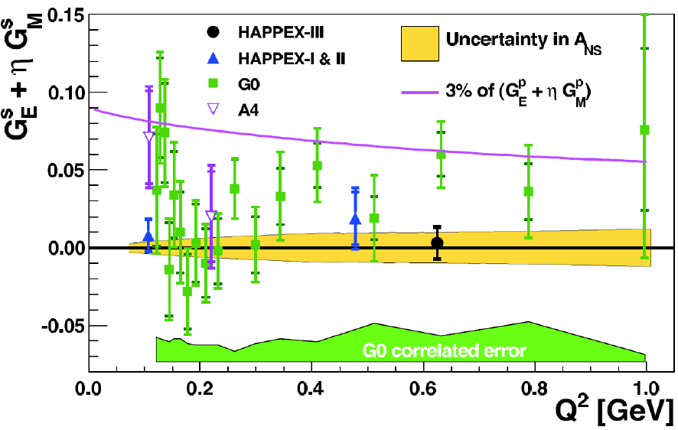
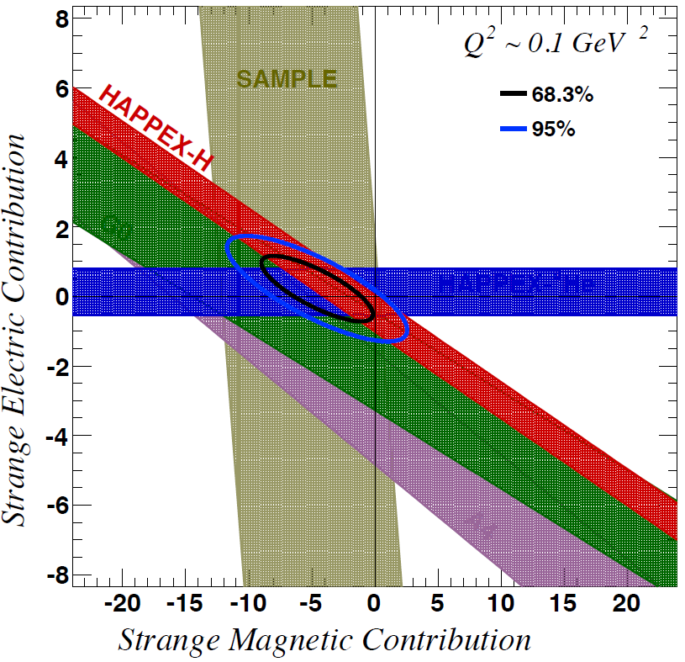
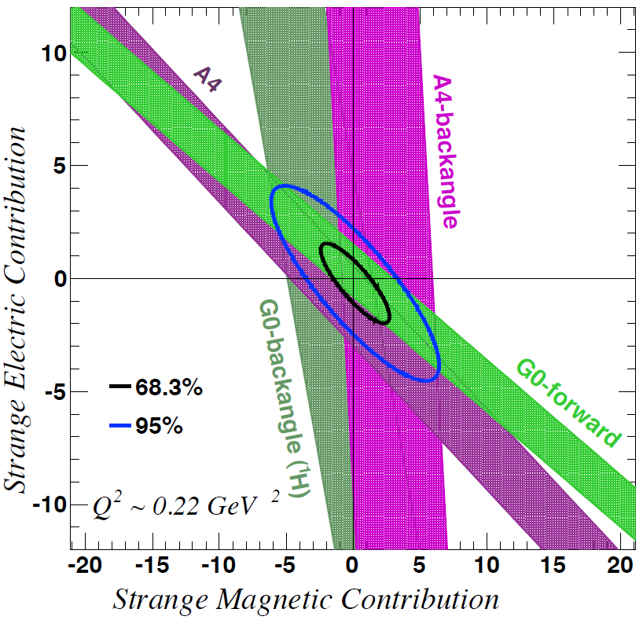
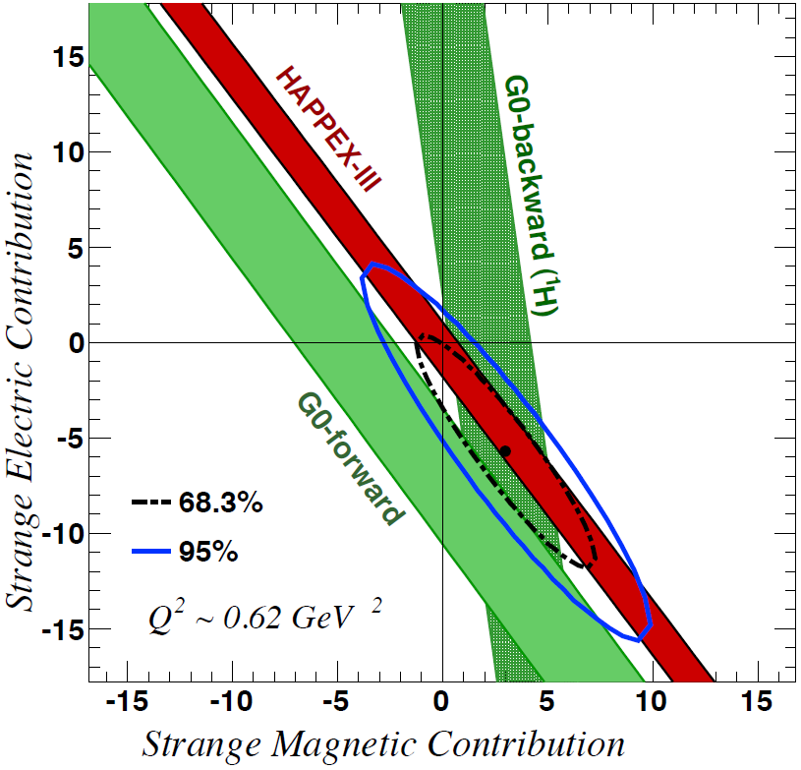
Strangeness Contribution to Nucleon Form Factors
New since 2007 LRP:
HAPPEx-3: PRL 108 (2012) 102001
G0-Backward: PRL 104 (2010) 012001
Purple line represents 3% of the proton form factors
→ strange quarks do not play a substantial role in the long-range electromagnetic structure of nucleons
Data available for E/M separation at three Q² values
Taken from R. Ent NSAC Presentation 2012

Slide 12
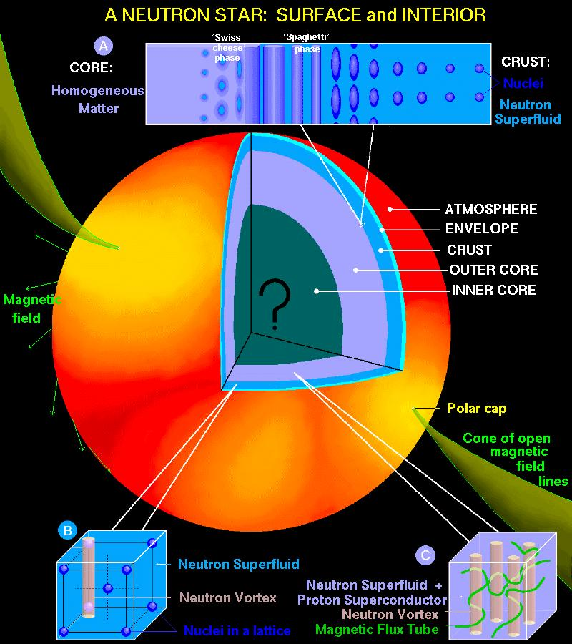
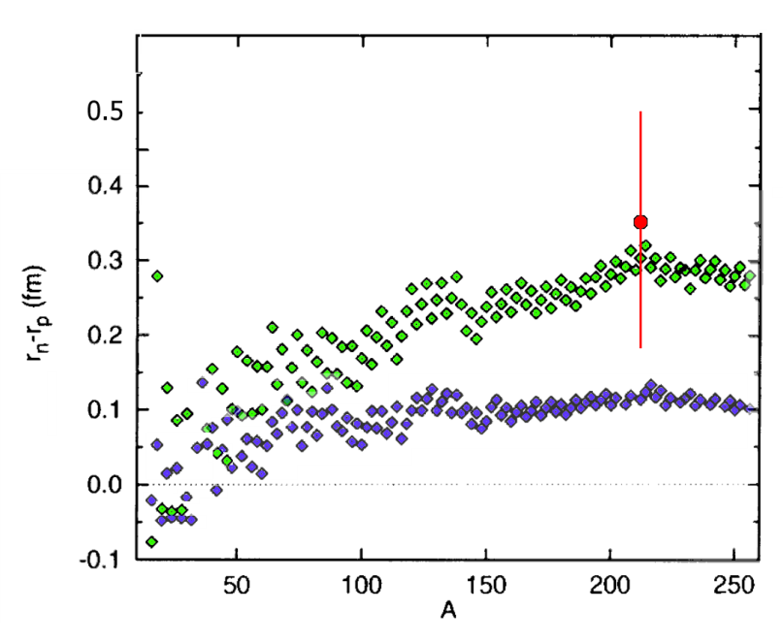
Lead (²⁰⁸Pb) Radius Experiment : PREX
Elastic Scattering Parity-Violating Asymmetry
Z⁰ : Clean Probe Couples Mainly to Neutrons
Applications : Nuclear Physics, Neutron Stars,
Atomic Parity, Heavy Ion Collisions
PREX
PREX
Relativistic mean field
Non-relativistic skyrme
A neutron skin of 0.2 fm or more has implications for our understanding of neutron stars and their ultimate fate
S. Abrahamyan et al., PRL 108 (2012) 112502
PREX finds neutron radius larger than proton radius by +0.35 fm (+0.15, -0.17).
This result provides confirmation of the existence of a neutron skin relevant for neutron star calculations.
Follow-up experiment to reduce uncertainties by 3 and pin down symmetry energy in EOS.
Taken from R. Ent NSAC Presentation 2012

Slide 13
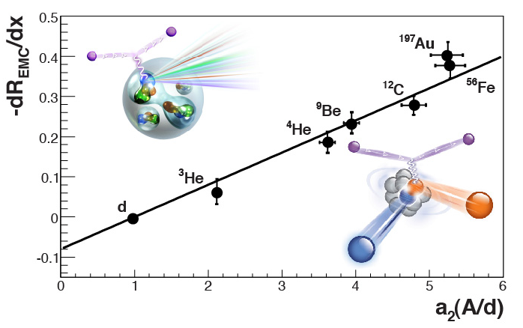
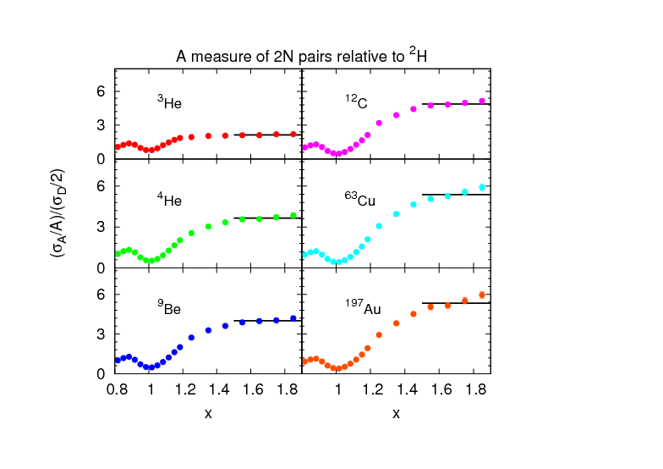
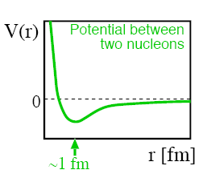
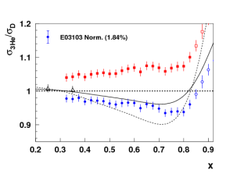
Short-Range Correlations (SRC) and European Muon Collaboration (EMC) Effect Are Correlated
EMC Slopes
0.35 ≤ X_{B} ≤ 0.7
Fomin et al., PRL 108, 092502 (2012)
SRC Scaling factors X_{B} ≥ 1.4
SRC: nucleons see strong repulsive core at short distances
EMC effect: quark momentum in nucleus is altered
Weinstein et al., PRL 106, 052301 (2011)
Taken from R. Ent NSAC Presentation 2012

Slide 14
CLAS impact on N* states in PDG 2012
Results based on Bonn-Gatchina coupled-channel analysis
State N(mass)J^{P} | Status PDG 2010 | Status PDG 2012 | KΛ 2012 | KΣ 2012 | Nγ 2012
N(1710)1/2⁺ | *** not seen in George Washington U analysis | *** | *** | ** | ***
N(1880)1/2⁺ |  | ** | ** | * | **
N(1895)1/2⁻ |  | ** | ** | * | ***
N(1900)3/2⁺ | ** | *** | *** | ** | ***
N(1875)3/2⁻ |  | *** | *** | ** | ***
N(2150)3/2⁻ |  | ** | ** |  | **
N(2000)5/2⁺ | * | *** | ** | * | **
N(2060)5/2⁻ |  | *** |  | ** | ***
Analysis based on a subset of the very precise JLab data (M. Mc Cracken et al., PRC 81, 025201, 2010 & B. Dey et al., PRC 82, 025202, 2010) indicates the existence of new nucleon states pointing to strong evidence for three independent quark degrees of freedom (and against a quark-diquark model with a point-like di-quark).
Taken from R. Ent NSAC Presentation 2012

Slide 15
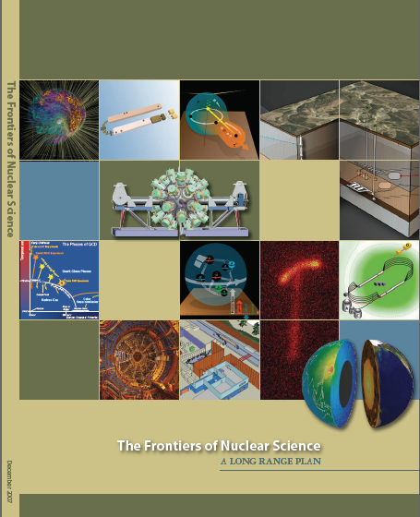
Jefferson 12 GeV Upgrade Project
Upgrade is designed to build on existing facility: vast majority of accelerator and experimental equipment have continued use
New Hall
Upgrade arc magnets
and supplies
Add 5 cryomodules
20 cryomodules
CHL upgrade
Maintain capability to deliver lower pass beam energies: 2.2, 4.4, 6.6….
Add arc
20 cryomodules
The completion of the
12 GeV Upgrade of CEBAF was ranked the highest priority in the 2007 NSAC Long Range Plan.
Add 5 cryomodules
Scope of the project includes:
Doubling the accelerator beam energy
New experimental Hall and beamline
Upgrades to existing Experimental Halls
Enhanced capabilities
in existing Halls
320 million dollar project

Slide 16
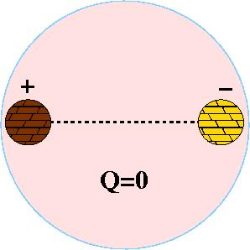
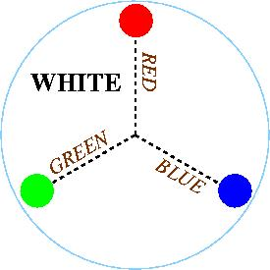
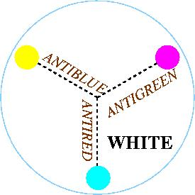
Quantum Chromo Dynamics (QCD)
The rules that govern how the quarks
froze out into hadrons are given by QCD.
Just like atoms are
electrically neutral,
hadrons have to be
neutral.
Color Charge
Three charges called RED, BLUE and
GREEN, and three anti colors. The
objects that form have to be color
neutral.

Slide 17

Gluons Carry the Force
The exchange of gluons
is continually changing the
Individual colors of the
quarks, but the overall
Color remains neutral
Meson
G
R
Meson
G
R
G
R
Time
R
R
G
B
B
G

Slide 18
Gluons Carry the Force
The exchange of gluons
is continually changing the
Individual colors of the
quarks, but the overall
Color remains neutral
Meson
G
R
Meson
G
R
G
R
Time
R
R
G
B
B
G

Slide 19
Gluons Carry the Force
The exchange of gluons
is continually changing the
Individual colors of the
quarks, but the overall
Color remains neutral
Meson
G
R
Meson
G
R
G
R
Time
R
R
G
B
Gluons produce the forces that
confine the quarks, but the gluons
do not appear to be needed to
understand normal hadrons
B
G

Slide 20
Gluon Interactions
G
R
R
R
R
R
G
G
B
B
G
G
R
B
G
B
R
R
3 Colors
3 Anti Colors
1 color neutral
8 colored objects
self-interaction of gluons
leads to both interesting
behavior of QCD, and its
extreme complications.
8 Gluons

Slide 21
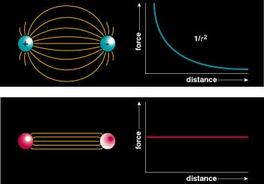
Flux Tubes
Flux Tubes and Confinement
Color Field: Because of self interaction, confining flux tubes form between static color charges
Notion of flux tubes comes about from model-independent
general considerations. Idea originated with Nambu in the ‘70s

Slide 22
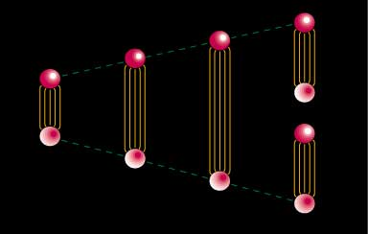
Quark Confinement
quarks can never be isolated
linearly rising potential
  separation of quark from antiquark takes an infinite amount of energy
  gluon flux breaks, new quark-antiquark pair produced

Slide 23
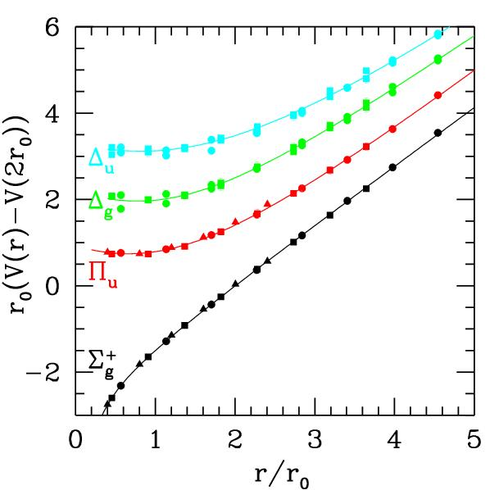
The QCD Potential
ground-state
flux-tube
excited flux-tube
Gluonic Excitations provide an
experimental measurement of
the excited QCD potential.
Observations of exotic quantum number nonets are the
best experimental signal of gluonic excitations.

Slide 24
Spectroscopy and QCD
Lattice QCD Predictions
States with non-trivial glue in their wave function.

Slide 25
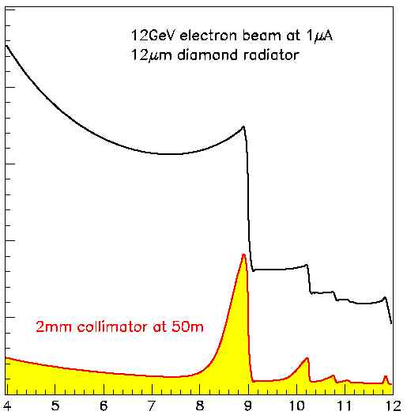
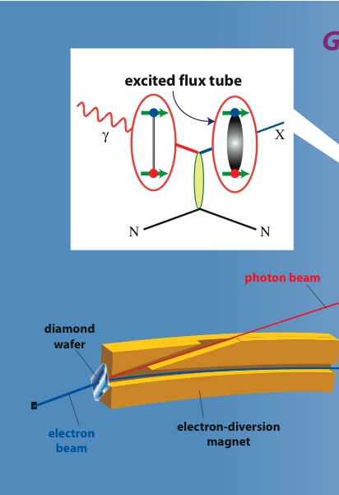
Map out the Gluonic Excitations of QCD
12 GeV electrons
GlueX
Uncollimated
Coherent Peak
40% lin. Pol.
Collimated

Slide 26
Developing the Physics Case
July 1997 - Workshop at Indiana University Community Interest
November 1997 – Workshop at NCSU Physics Interest and Feasibility
March 1998 - Workshop at Carnegie Mellon Detector Designs
June 1998 - Presentation to the JLab User’s Group
September 1998 – Workshop at Florida State Physics and Detectors
January 1999 Hall D Preliminary Design Report 170 pages
January 1999 Jefferson Lab Program Committee
March 1999 – Workshop at RPI, Collaboration formed.(*)
August 1999 – Design Report Version 2
December 1999 – External Review of the project – very positive.
March 2000 – Meet with DOE and NSF in DC
September 2000 – Article in American Scientist
October 2000 – APS DNP Meeting.
December 2000 – NSAC Town meeting
April 2001 – NSAC Long-range Planning Meeting.
* I become Deputy Spokesperson.

Slide 27
The Critical Decision Process
A project management system put in place to define the project and schedule of a large project and to make sure that it completes on time and on budget. ``CDi’’ means Critical Decision ``i”
CD0 Develop the conceptual design.
CD1 Perform needed R&D to establish costs.
CD2 Project engineering and develop baseline cost and schedule.
CD3 Start of construction.
CD4 Start of operations (project complete).
February 2002 – NSAC Long Range Plan is Approved.
April 2004 – DOE Awards CD0 to the project.
October 2004 - External Detector Review for GlueX.
2005 – Project reviews start in earnest.

Slide 28

Budgets Get Tight!
January 2005 – NSAC asked for guidance under tight-budget scenarios.
June 2005 – NSAC, by a slim margin, says operate RHIC and shutdown Jefferson Lab if money is tight.
January 2006 – Rising Above The Gathering
Storm report. Budgets improve.
February 2006 – CD1 awarded to the project.
March 2007 – Drift Chamber Review
October 2007 – I was elected spokesperson.
November 2007 – CD2 awarded to the project.
Now the fun starts! The purpose of CD2 is to establish the actual budget and schedule for the project, and everything is reviewed.
It also involves final R&D on the project.

Slide 29
Project Reviews
2-3 day long review with external reviewers. Prepare detailed written documentation and presentations. Practice presentations and respond to recommendations of the review committee!
February 2008 - FDC technology Review
February 2008 -Calorimeter Design Review
March 2008 - Tracking and PID Final Design Review
May 2008 - System and Infrastructure Design Review
July 2008 - IPR Lehmann Review
November - 2008 Beamline and Tagger Review.
February - 2009 - Installation Review
July 2009 - Tagger Magnet Design Review
July 2009 - BCAL Readout Review
November 2009 - Solenoid Magnet Internal Review
If you can get through this, you can get through anything!

Slide 30
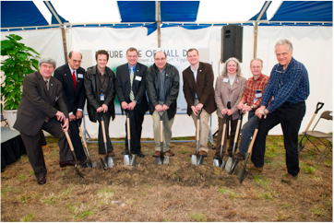
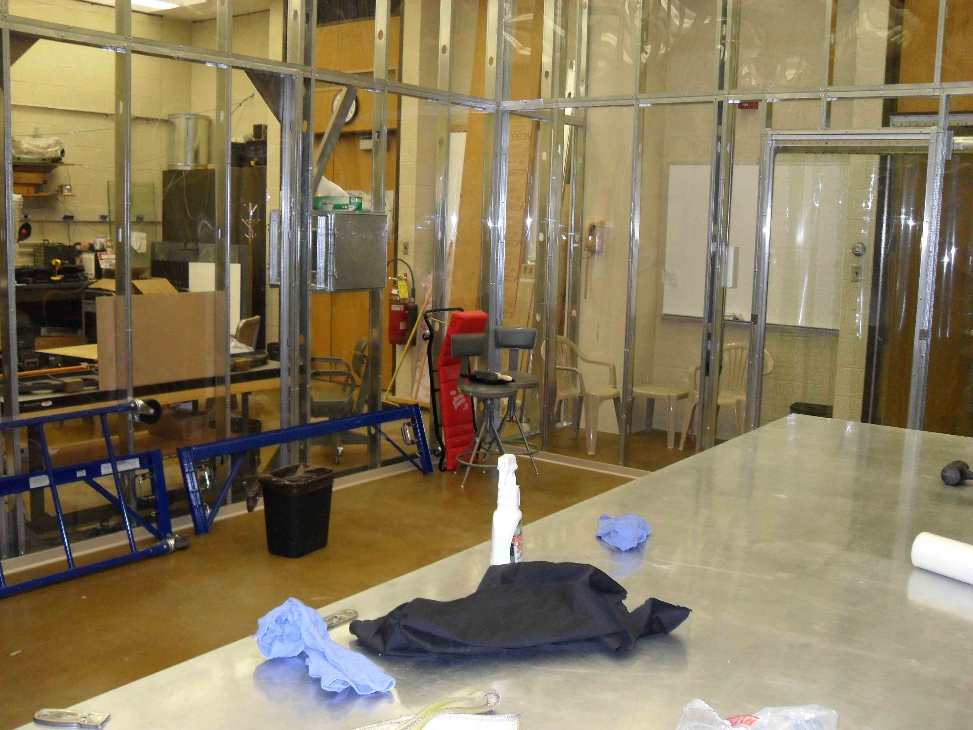
The GlueX Detector in Hall-D
Start of Construction
September 2008 - CD3 Awarded to the project( 320 million dollars). 12-GeV Upgrade with CD4 in fall of 2015.
April 2009 - Construction of Hall-D broke ground.
February 2010 – CMU Contract for the construction of the Central Drift Chamber Awarded!
Hall-D Groundbreaking
In spring of 2009, we built a class-2000 cleanroom in Wean.

Slide 31
Now you have to build it!
Athens University, Arizona State University, Carlton University, Carnegie Mellon University,
Catholic University, Christopher Newport University, University of Connecticut, Florida
International University, Florida State University, University of Glasgow, Indiana University, Jefferson Lab, University of Massachusetts Amherst, Massachusetts Institute of Technology, MEPHI, University of North Carolina A&T, University of North Carolina Wilmington, Northwestern, Old Dominion University, Oxford University, University of Pittsburgh, University T`ecnica Federico Santa Mari’a and University of Regina.
CMU
It takes a lot of people in a lot of institutions to make this happen!

Slide 32
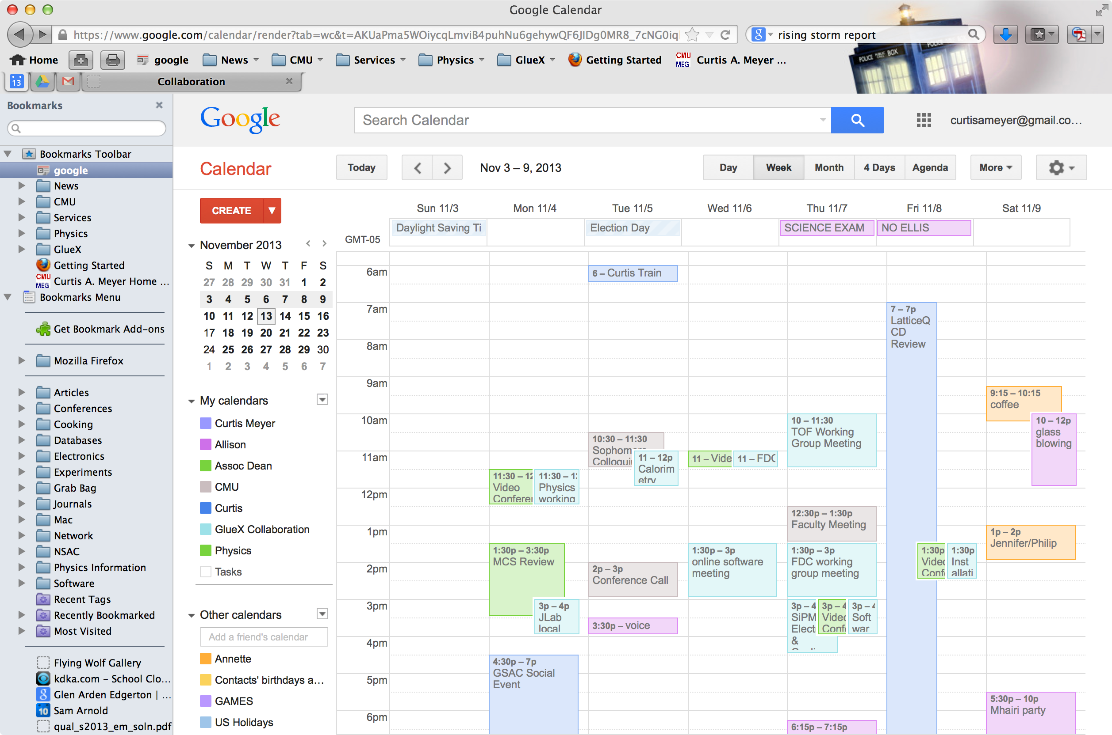
What Does a Spokesperson Do?

Slide 33
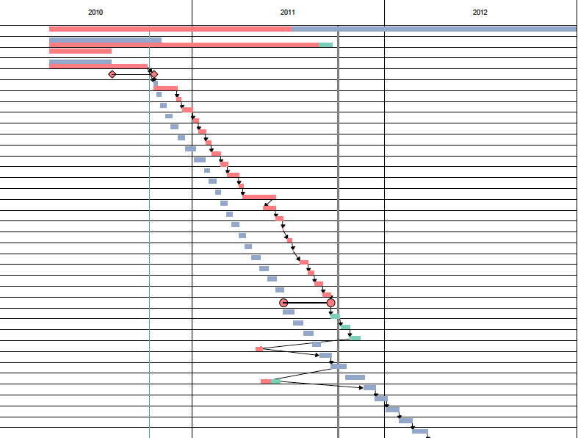
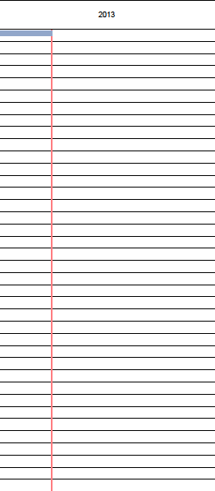
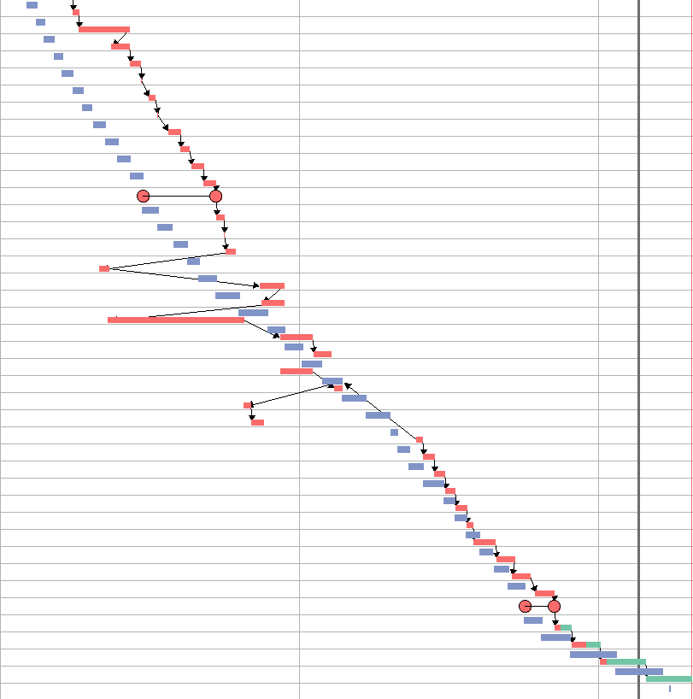
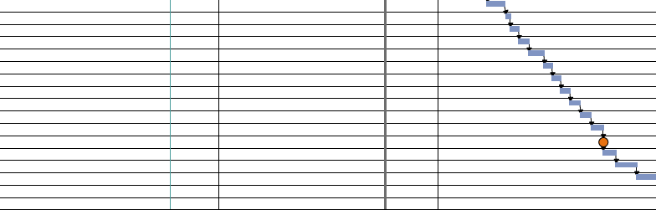
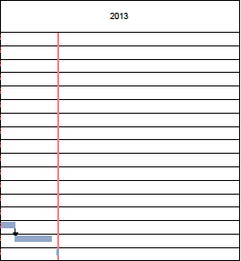
GANT Charts
Construction progress
2010 2011 2012 2013
Review
Straw prep and insertion
All straws installed
Gas lines
Shell
Stringing
Electrical
Stringing and hookup finished
Tests
Delivery

Slide 34
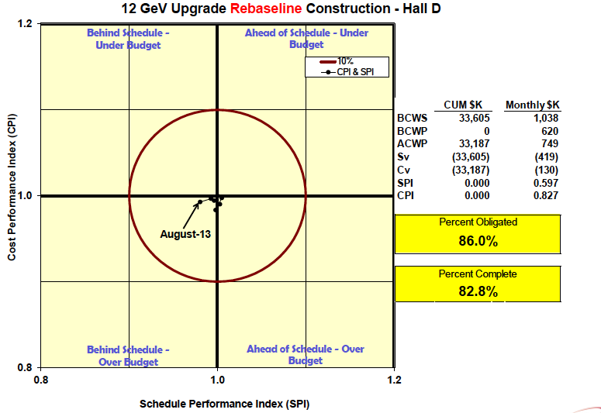
In Construction

Slide 35
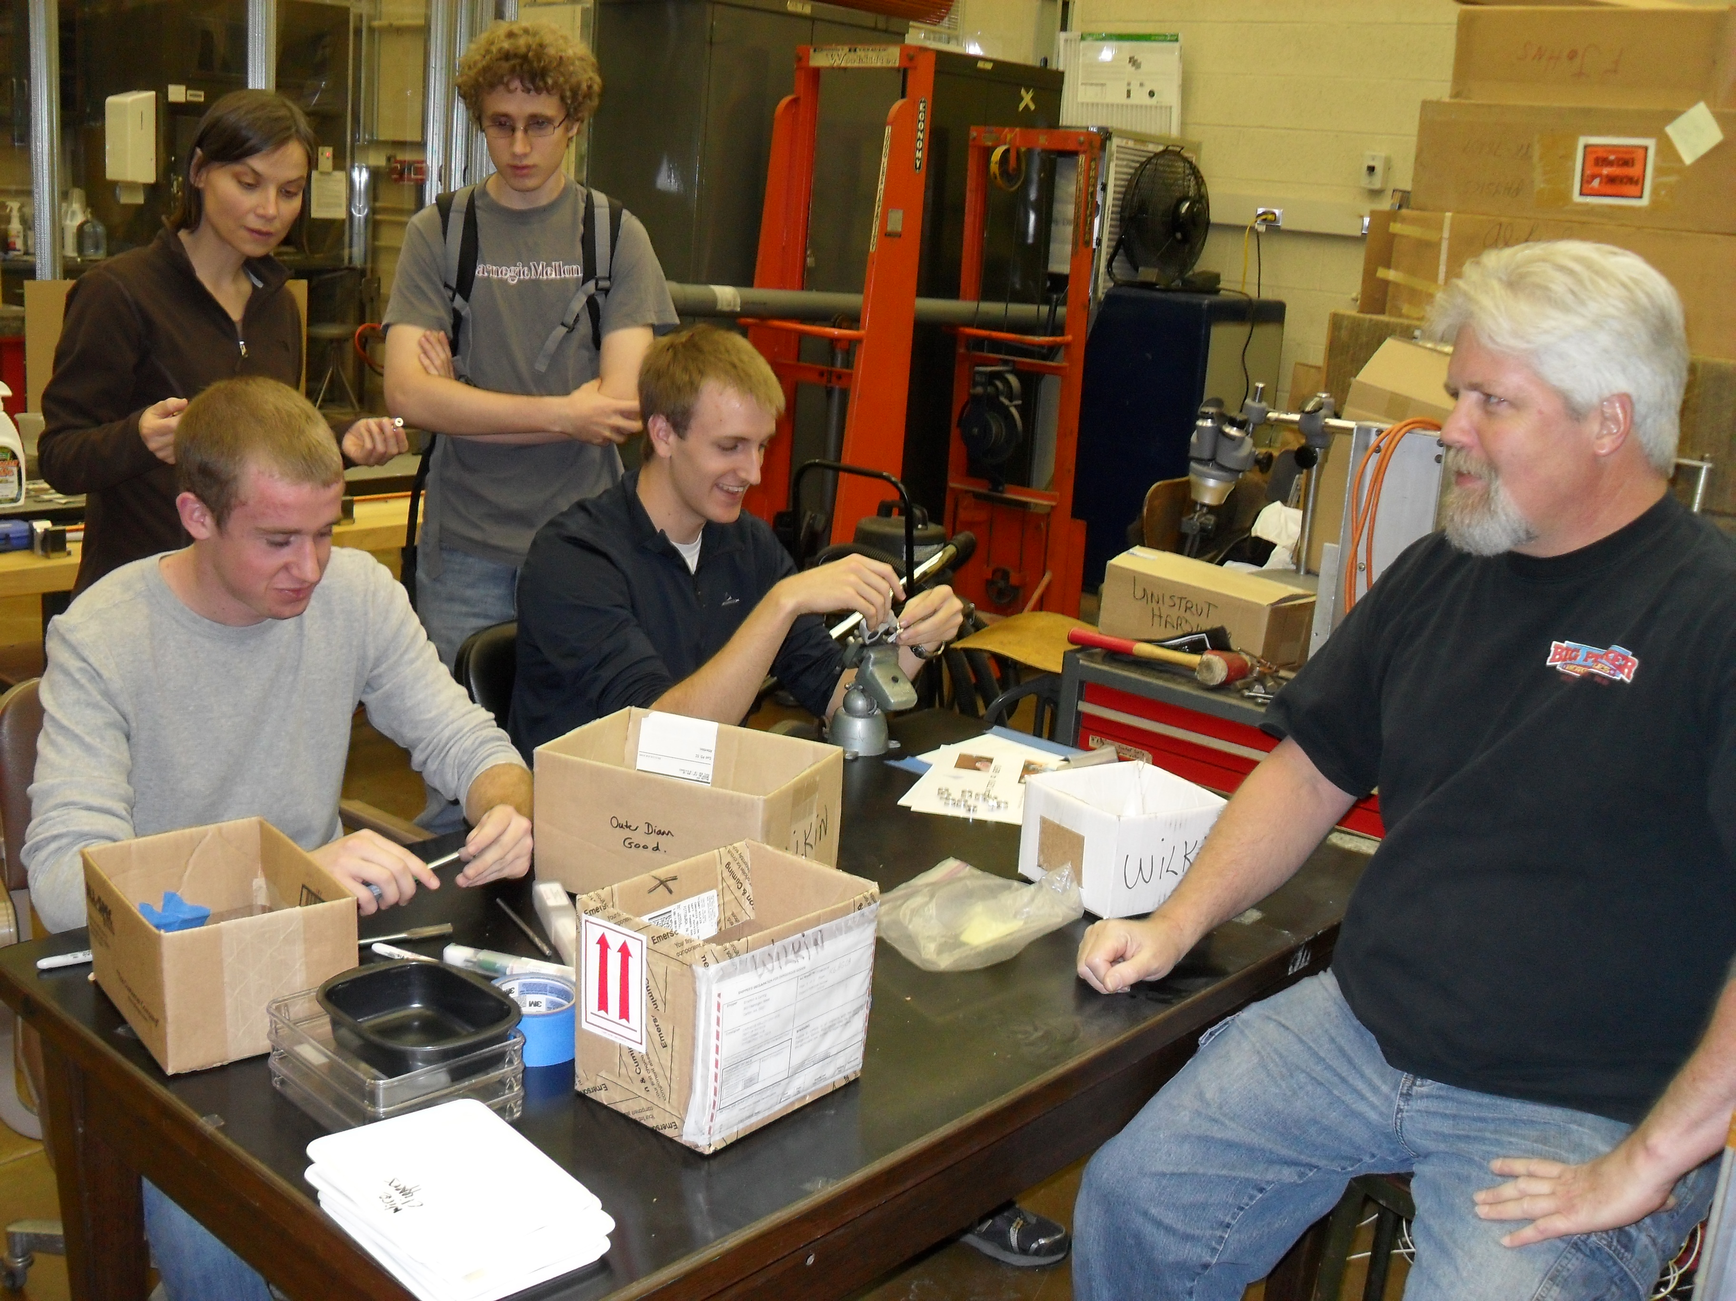
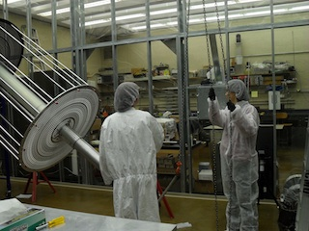
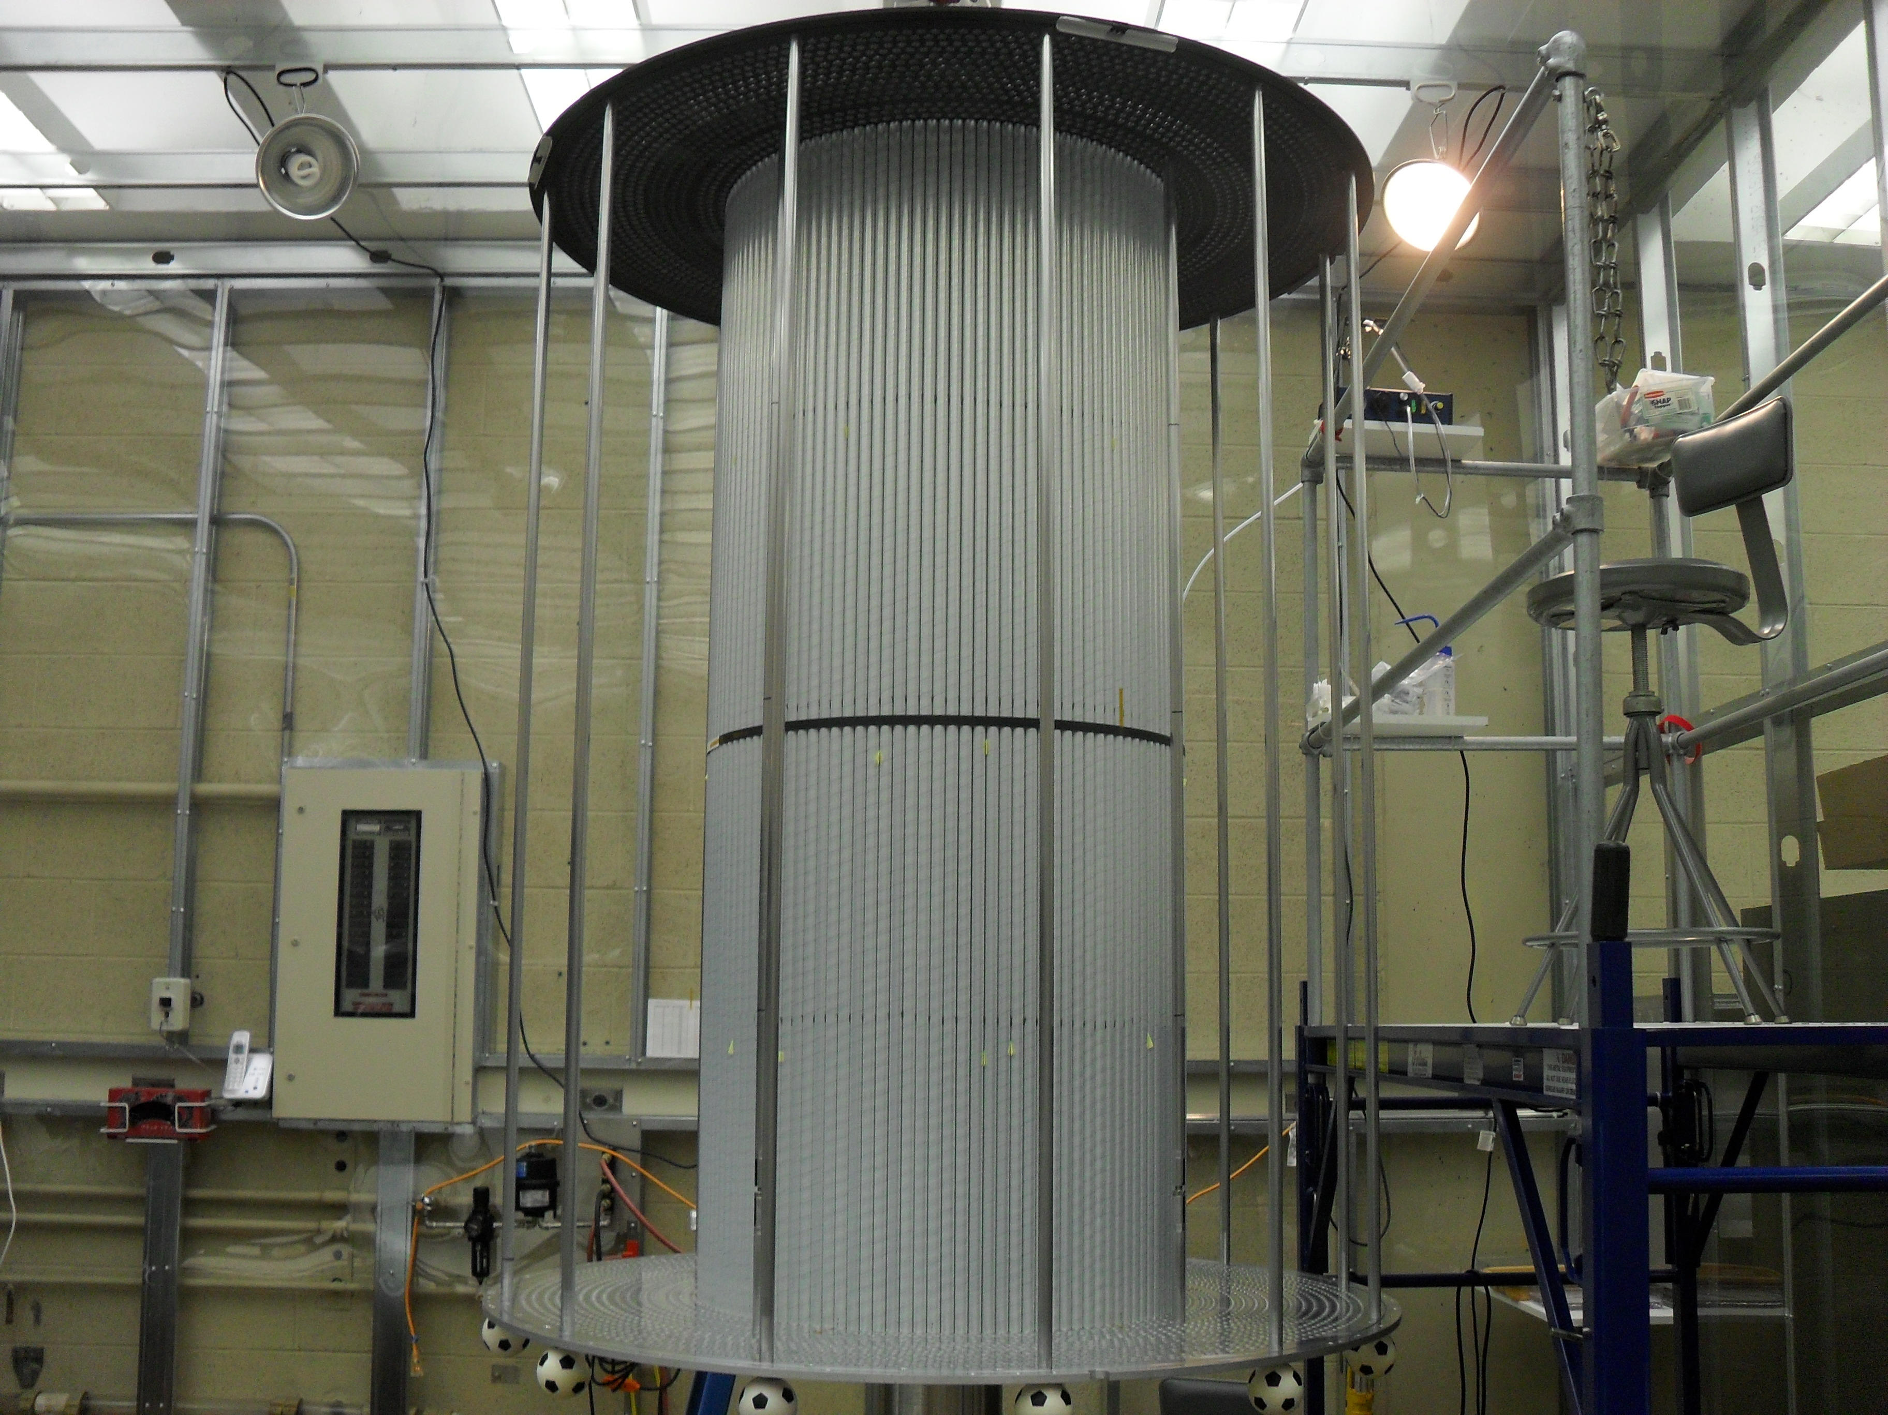
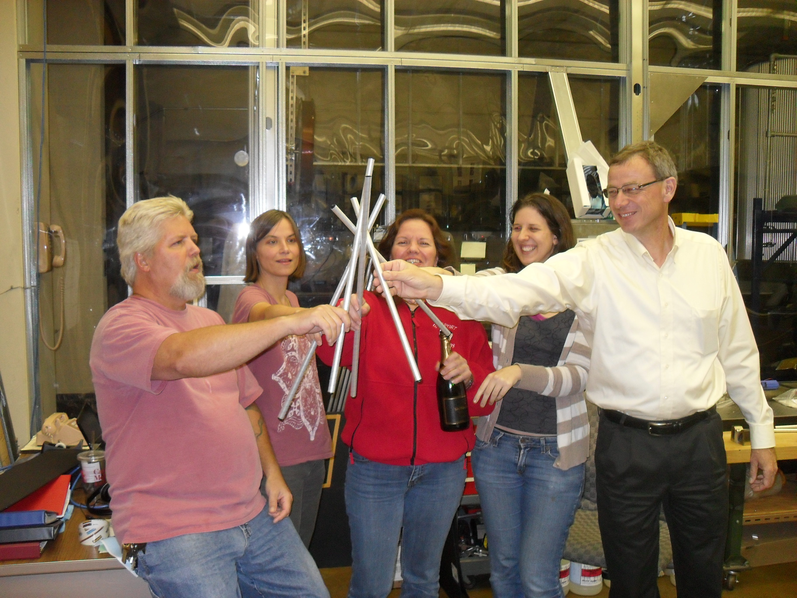
April 2010
September 2010
January 2011
August 2011

Slide 36
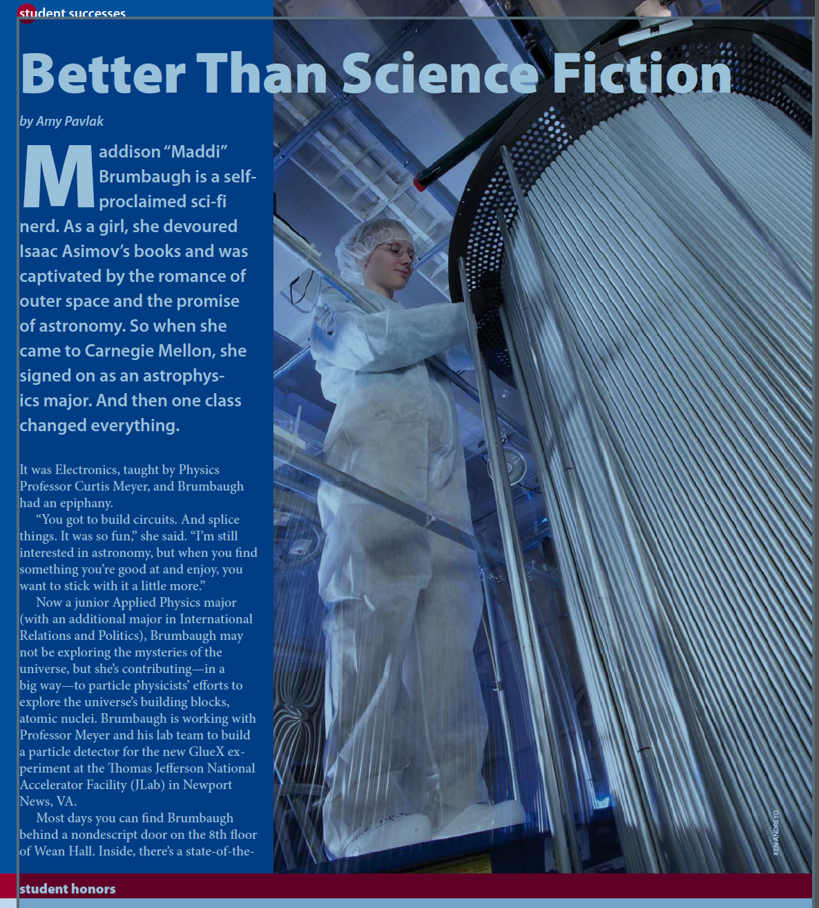
Summer 2011
The most labor intensive part of the project was installing the 3522 straw tubes into the frames. It required 3 people where we had initially thought it would be two.

Slide 37
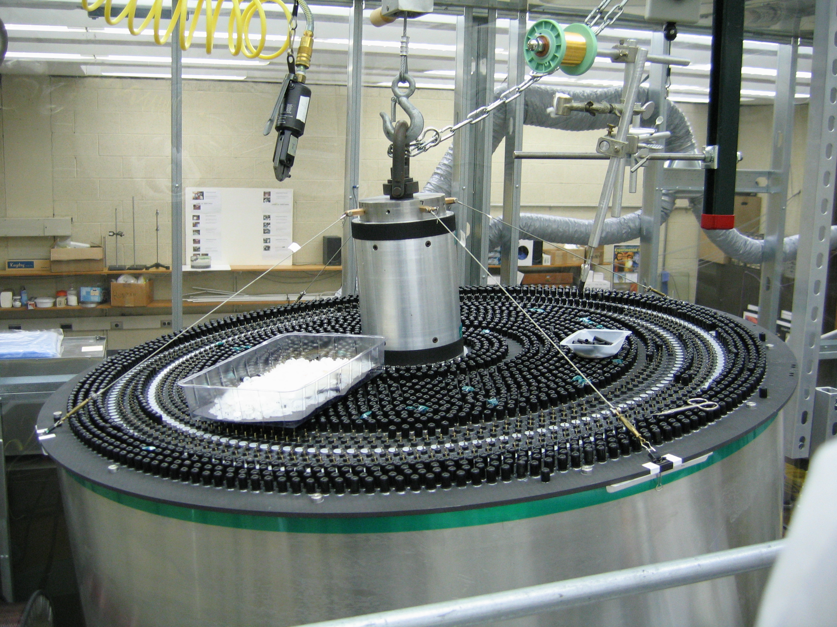
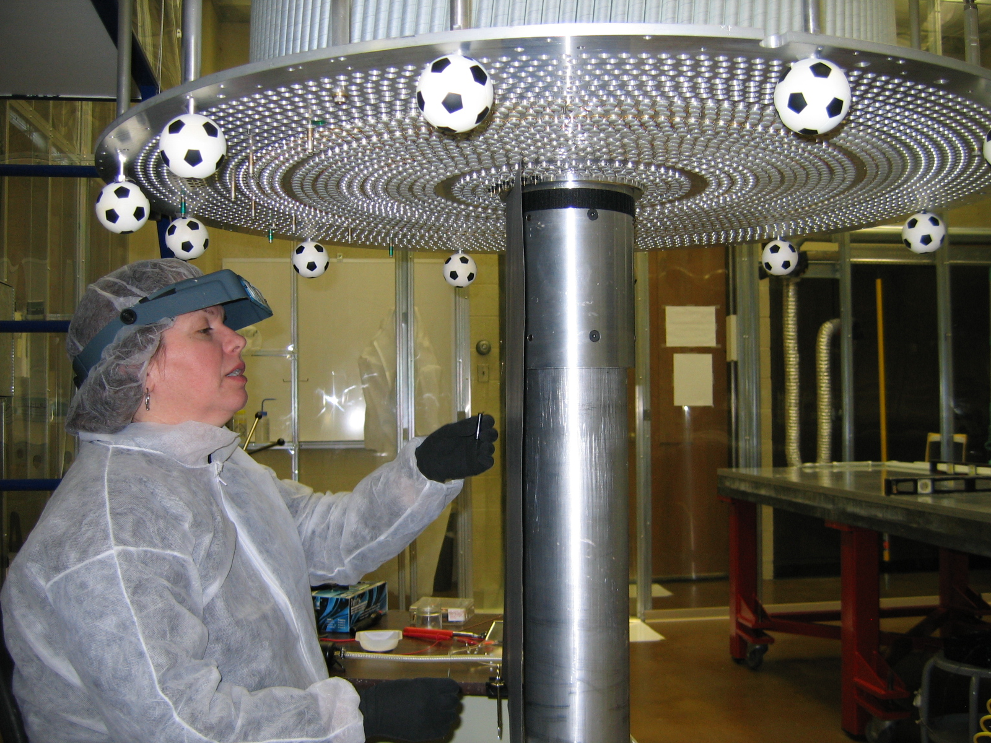
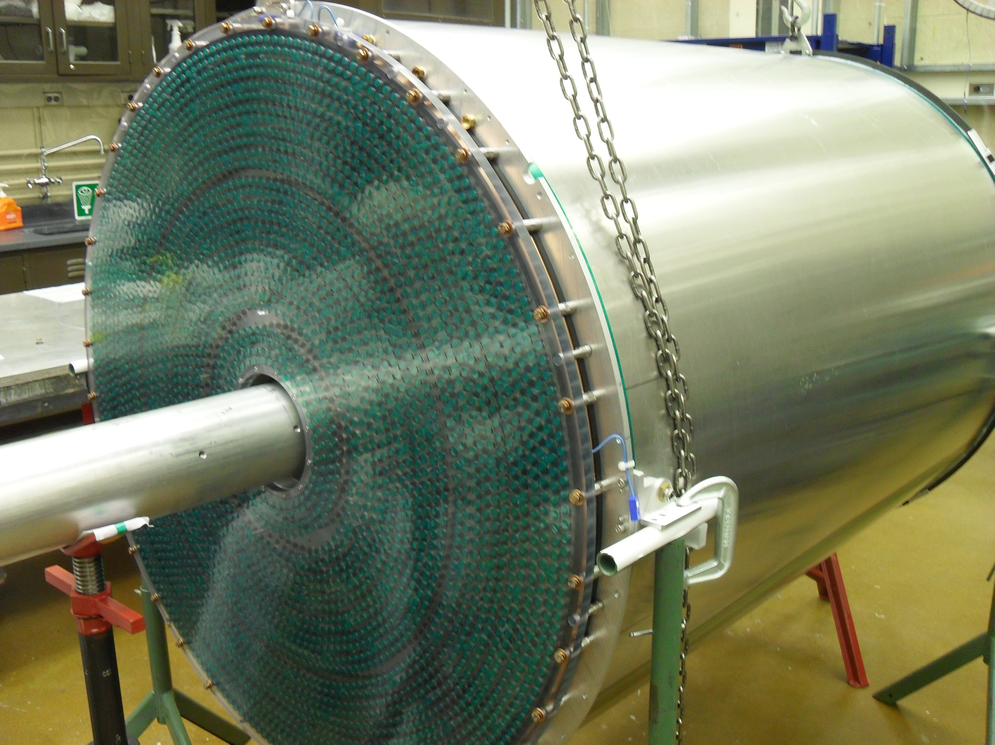
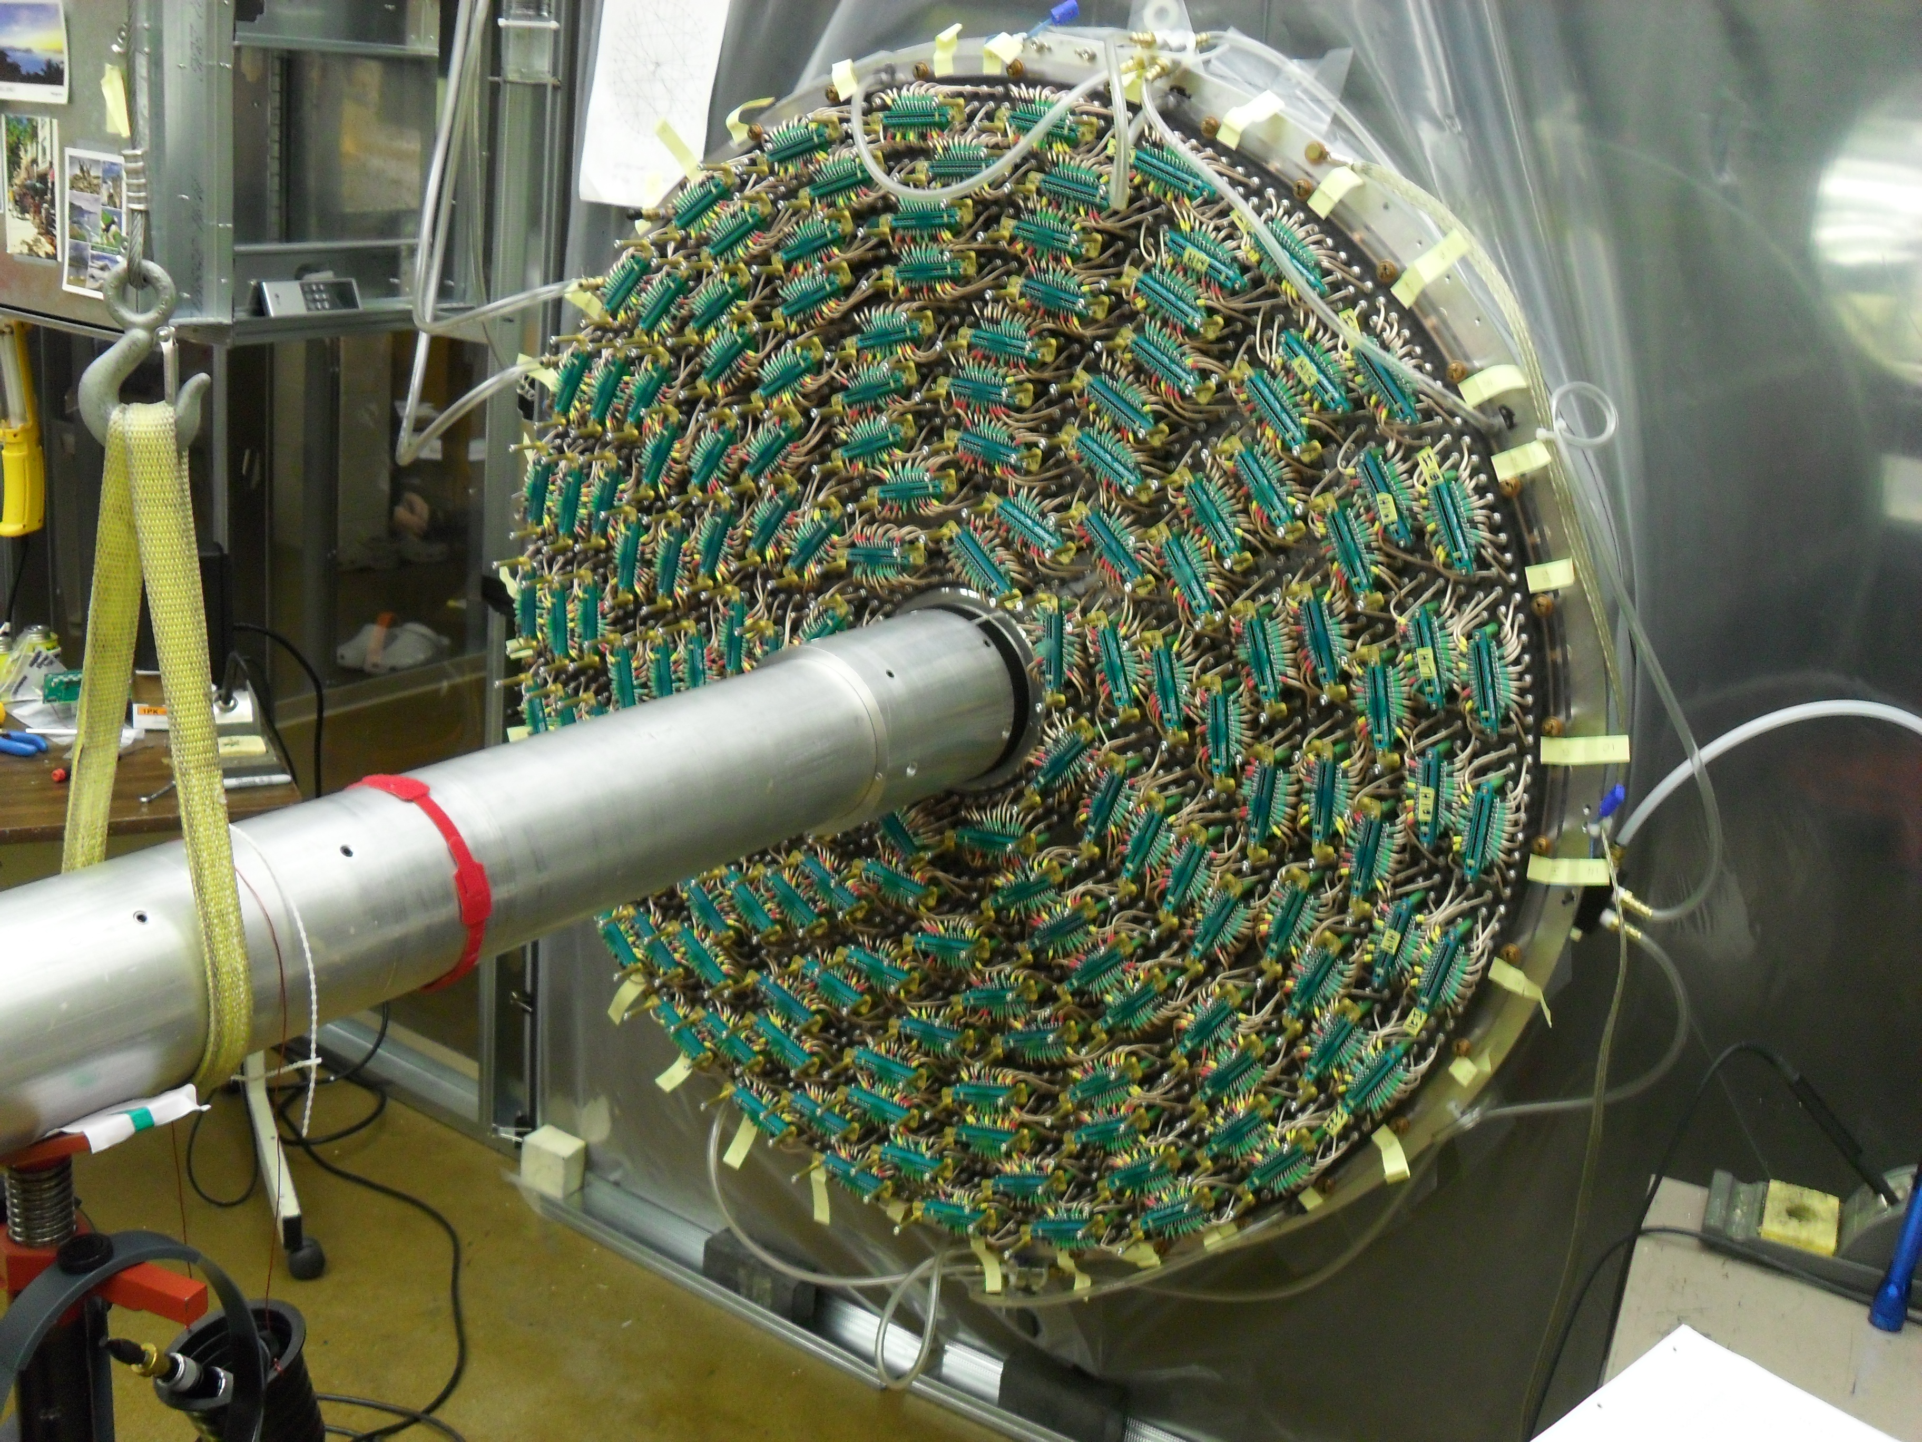
October 2011
January 2012
April 2012
January 2013

Slide 38
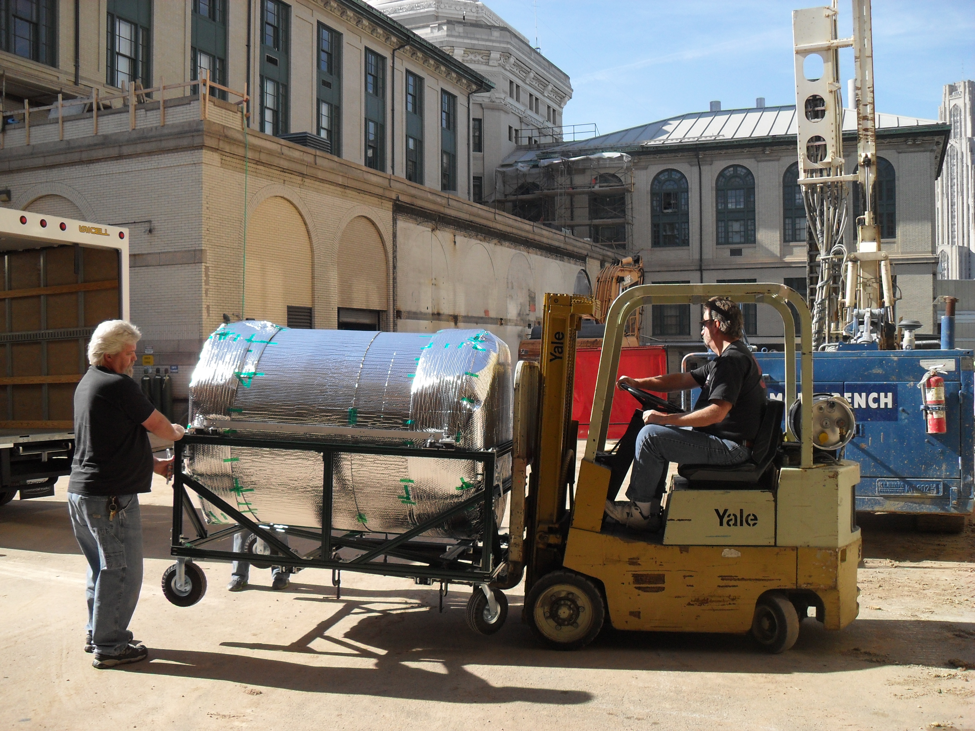
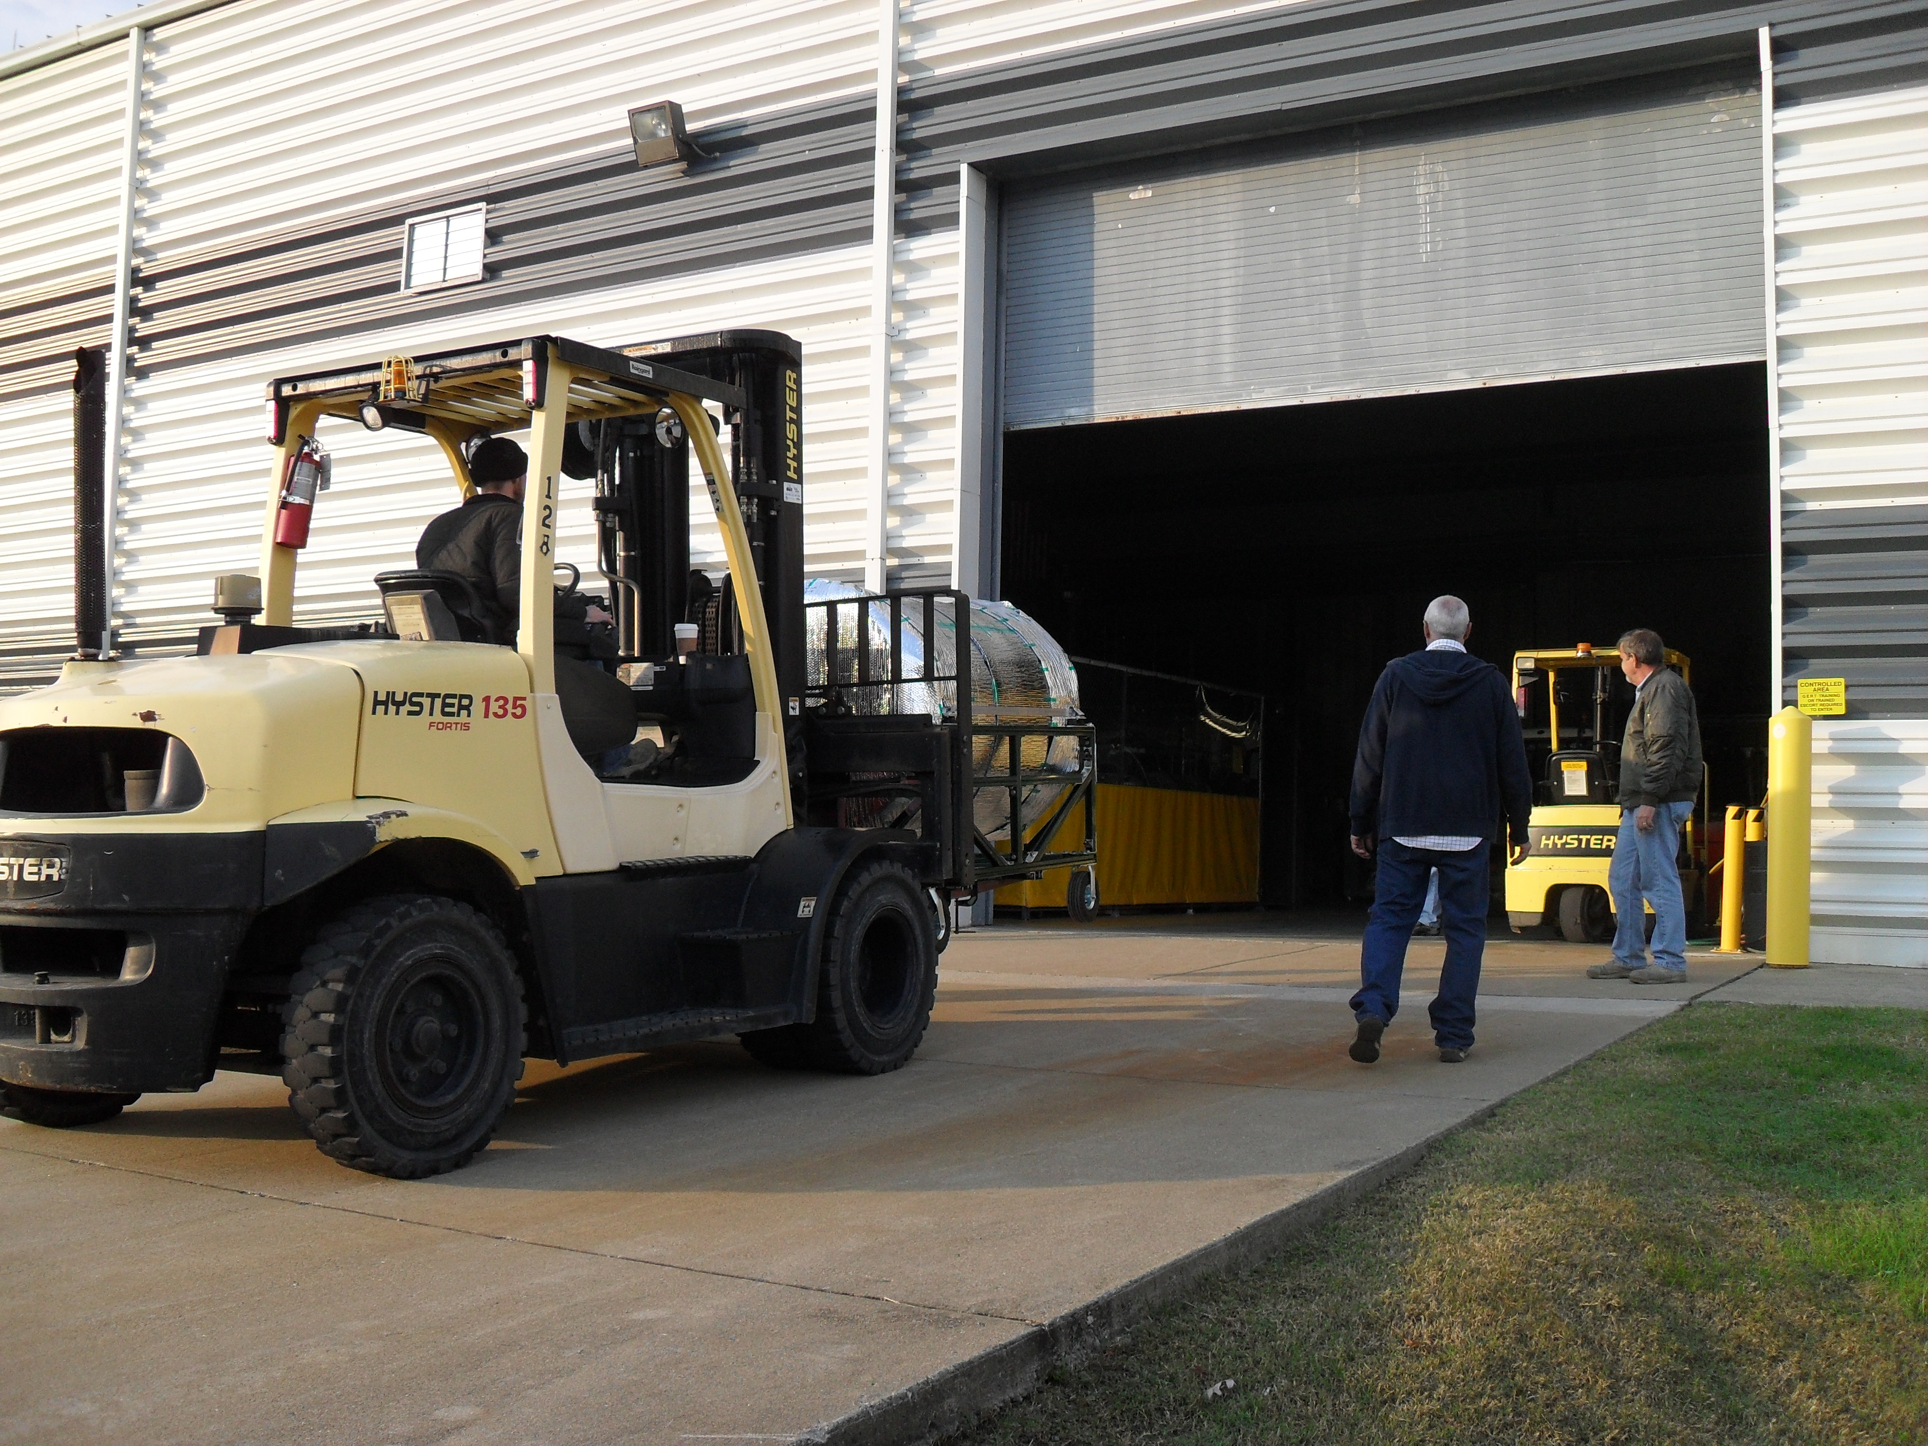
October 28, 2013
October 30, 2013
The CDC was delivered to Jefferson Lab

Slide 39
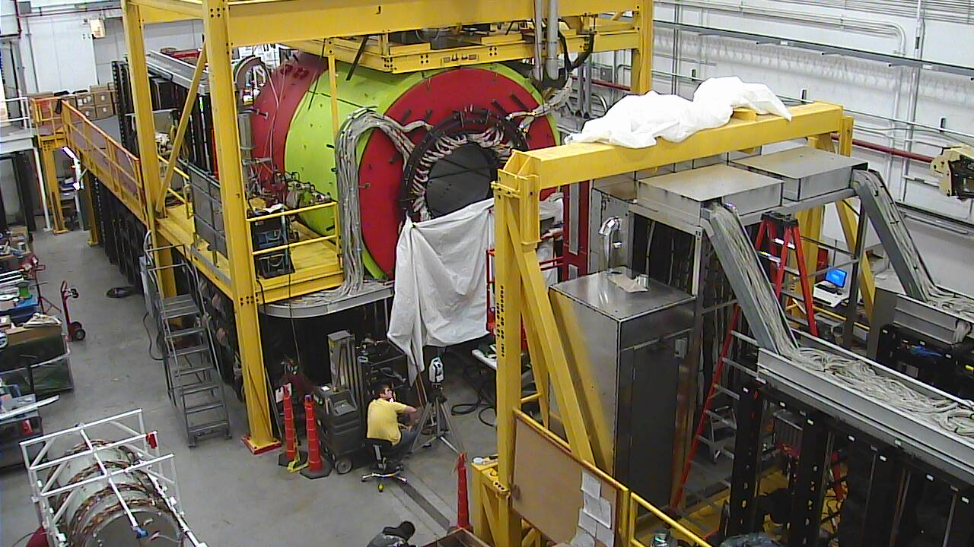




Installation of the Equipment
It all has to fit together!
November 2013

Slide 40

2012 Large-scale Data Challenge
Data formats defined for all
levels of GlueX/Hall-D analysis.
EVIO Raw Data 15kbyte/evt.
REST DST Data ~2kbyte/evt.
PART Physics Analysis (root tree).
~2 weeks of 20kHz data rate for phase III running.
~3 months of physics from phase III running.
OSG 4 Giga-Events (peaked at ~7000 cores)
JLab Farm 1 Giga-Event ~10Tbyte of data on srm disk.
CMU Farm 0.3 Giga-Events
2 weeks in December 2012
The need for this data was driven by the Physics and PID Upgrade working groups.

Slide 41

July 2013 Software Workshop
2-day long workshop held at JLab with a video broadcast. Over 30 participants.
Event generation
Background simulation
Simulation with HDGEANT
Reconstruction (JANA)
Event Selection
Multivariate Analysis
Amplitude Analysis
95% purity
>25% efficiency
See afternoon talk by Justin Stevens
https://halldweb1.jlab.org/wiki/index.php/GlueX_Analysis_Workshop_2013

Slide 42

August 2013 Online Data Challenge
See afternoon talk by Mark Ito
Test online system with injection at the event builder and write data to the JLab tape silos.
Test monitoring at all phases.
Test Level-3 Trigger

Slide 43

Workflow Development
A committee has been setup at Jefferson Lab by the IT division with representation from the Halls to implement workflow tools.
Such an effort requires coordination with the experimental efforts.
Timeline of Production Data Challenges to Stress Workflow at JLab
Simulation and Reconstruction
Production from Tape Silo
~100 cores @ JLab December 2012
~500 cores @ JLab October 2013
~1000 cores @ JLab Early 2014
~2500 cores @ JLab Mid 2014
~5000 cores @ JLab Fall 2014
Preload EVIO data 2013
~500 cores @ JLab Early 2014
~1000 cores @ JLab by Mid 2014
~5000 cores @ JLab by Fall 2014

Slide 44
Manpower & Resources
This represents 45 FTE*-years
This is 56% complete.
About 20 FTE-years of work remains.
GlueX/Hall-D has identified 47 FTE#- years
of manpower over the next 3 years (~15 in 2014, ~18 in 2015 and ~15 in 2016).
* About 36 FTE-years (total) of work in 2012.
# About 20 FTE-years of manpower identified in 2012
Remaining activities:
Analyses and Quality Assurance *
Calibration/ Alignment
Miscellaneous
Workflow Development
Exercise files access and catalogs
Data Challenge Management *
Online *
* New activities since 2012

Slide 45
GlueX Running
Raw-event size ~ 15Kbytes
Phased Running: Event Rates Data Volume Yearly Data Storage
photons year E_{e} Raw DST Raw DST Raw DST
I 10⁶ γ/s 2014 10GeV 2kHz 0.1kHz 30 MB/s 1.5MB/s 0.1 PB 0.1 PB
II 10⁷ γ/s 2015 11GeV 20kHz 1. kHz 300 MB/s 15MB/s 0.8 PB 0.2 PB
III 10⁷ γ/s 2016 12GeV 20kHz 2. kHz 300 MB/s 30MB/s 1.6 PB 0.1 PB
IV 5 10⁷ γ/s 2017 12GeV 20kHz 10 kHz 300 MB/s 30MB/s 1.6 PB 0.5 PB
To keep of with data and Monte Carlo in steady-state phase III + running will require ~9000 cores.
Brown indicate fraction complete, not all tasks are the same size.
Notes:
This is the flow-diagram for GlueX software. Will see a variant of this repeated throughout the talk. Describe the three phases of
Running in our approved beam time. Phase I and II are essentially engineering runs with the first dedicated physics run in phase III. We of course hope to get physics out of phase II running.

Slide 46
Summary
Big Science is not cheap, but it is also not easy!
A 340 million dollar project started in 1997 and will deliver science in 2016 – nearly 20 years!
Lots of Dedicated People with a Vision.
The expected scientific impact has to merit the project.
There are lots of ups and downs, but it is an exciting road to follow!

