Slide 1
Quarks, QCD and Confinement:
What we hope to learn at Jefferson Lab
Curtis A. Meyer
Carnegie Mellon University
25 February 2010
TexPoint fonts used in EMF.
Read the TexPoint manual before you delete this box.: AAAAAA

Slide 2
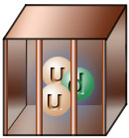
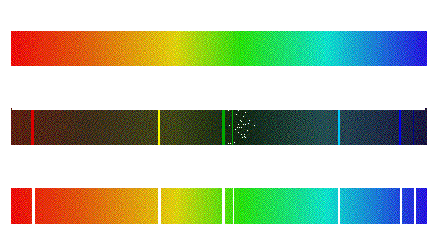

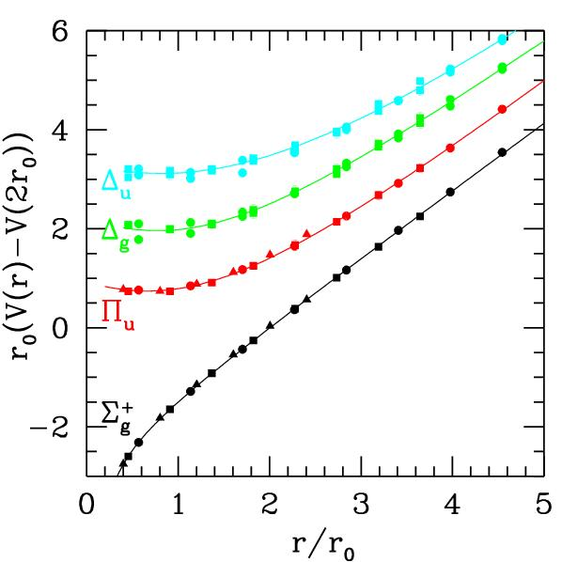
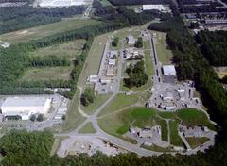
Quarks, QCD and Confinement:
What we hope to learn at Jefferson Lab
The strong force and QCD
Baryon Spectroscopy
Color Confinement
Finding Gluonic Particles
GlueX and the 12 GeV upgrade

Slide 3
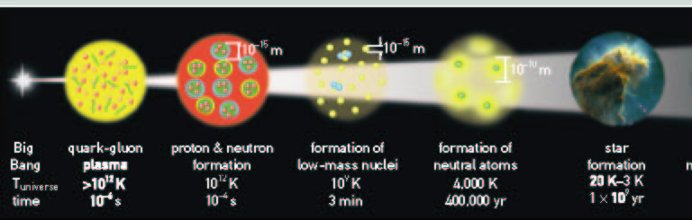
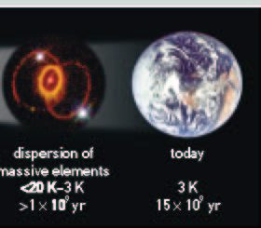
The First Seconds
of The Universe

Slide 4
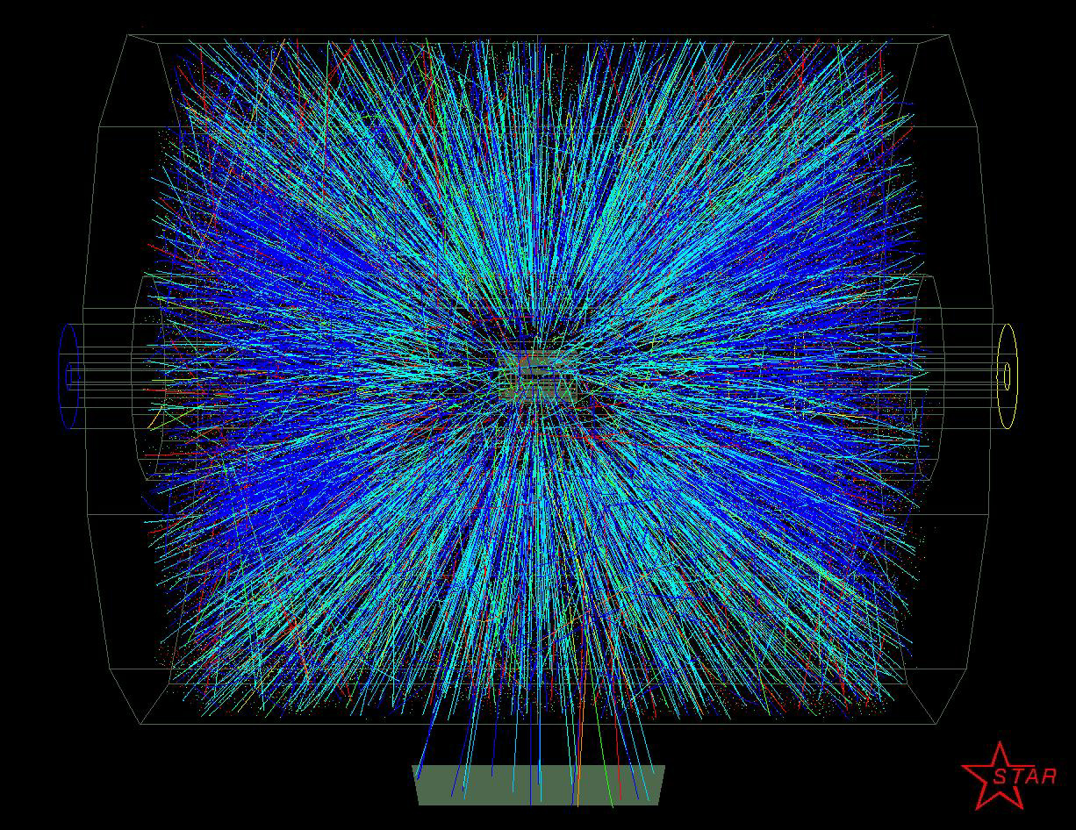
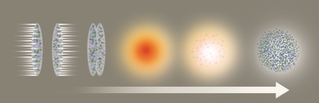
Quark Gluon Plasma
For a period from about 10⁻¹² s to 10⁻⁶ s the universe
contained a plasma of quarks, anti quarks and gluons.
Relativistic Heavy Ion Collisions are trying to
produce this state of matter in collisions

Slide 5
Confinement
From about 10⁻⁶ s on, the quark and anti quarks became
confined inside of Hadronic matter. At the age of 1s,
only protons and neutrons remained.
The gluons produce
the 16ton force that
binds the quarks.
Baryons
Mesons

Slide 6
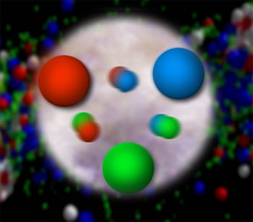
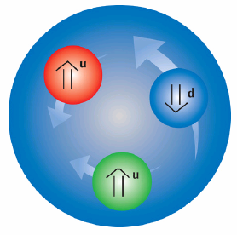
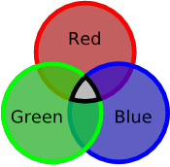
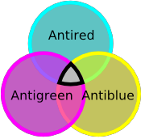
Quantum Chromo Dynamics
The rules that govern how the quarks
froze out into hadrons are given by QCD.
Quarks have color
charge: red, blue and
green. Antiquarks
have anticolors:
cyan, yellow and
magenta.
Atoms are electrically
neutral: a charge and
an anti-charge ( + - ).
Hadrons are color neutral (white),
red-cyan, blue-yellow, green-magenta
or red-blue-green, cyan-yellow-magenta.

Slide 7
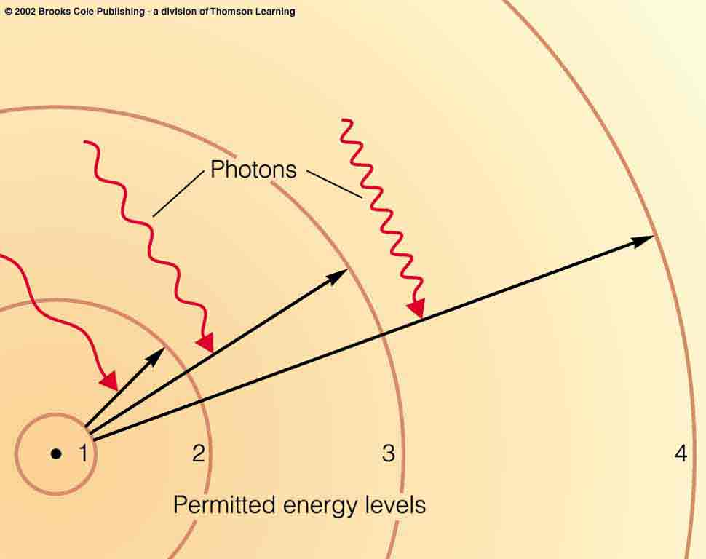
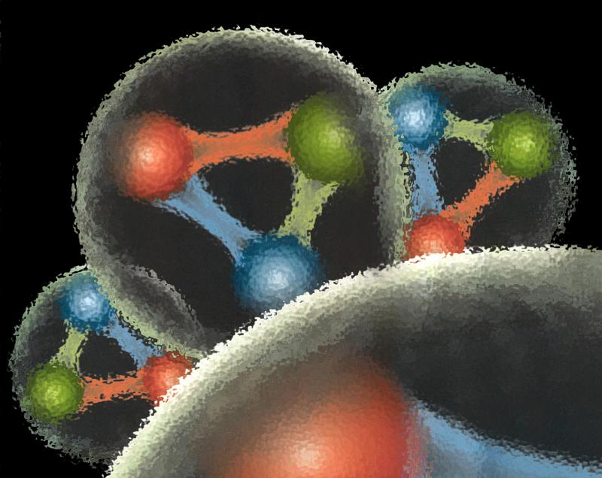
Quantum Chromo Dynamics
QCD describes the interactions of quarks and gluons.
Gluons are the force
carriers of QCD.
Gluons carry a color
and an anticolor
Charge.
Photons are the force
carriers for the E-M
force. Photons are
electrically neutral.
G
R
G
R
G
R

Slide 8
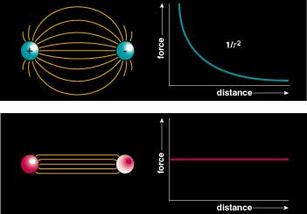
Quantum Chromo Dynamics
Color Field: Because of self interaction, confining flux tubes form between static color charges
Confinement arises from flux tubes and their excitation leads to a new spectrum of mesons

Slide 9
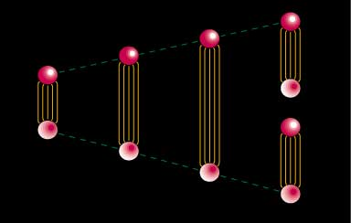
Quark Confinement
quarks can never be isolated
linearly rising potential
  separation of quark from antiquark takes an infinite amount of energy
  gluon flux breaks, new quark-antiquark pair produced

Slide 10
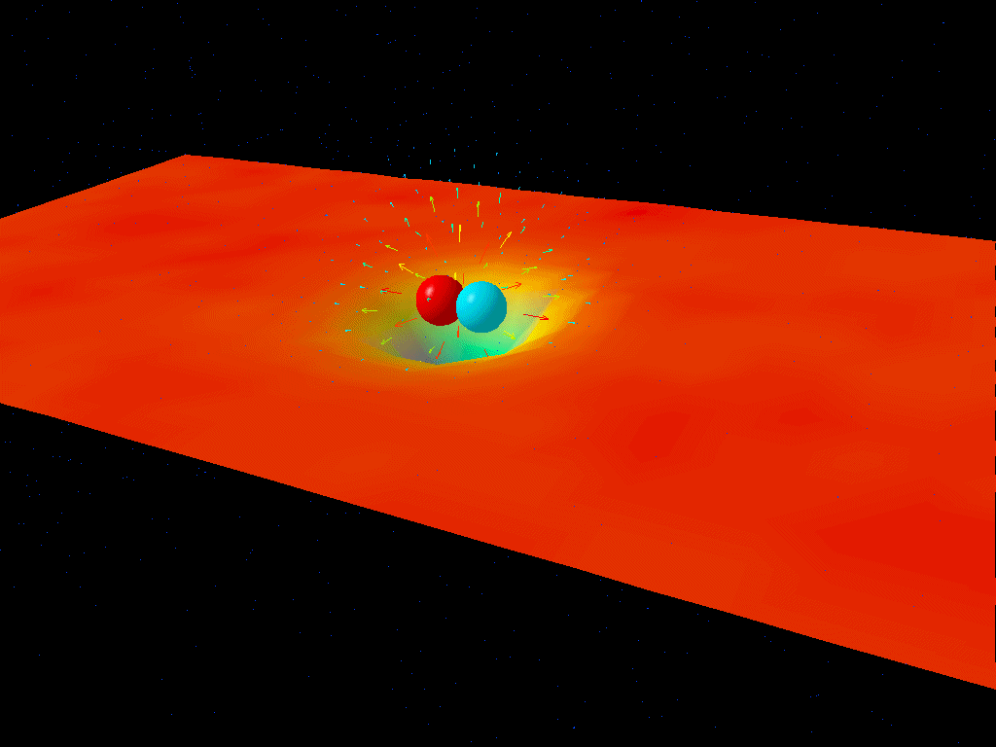
Flux Tubes

Slide 11



Observed Hadrons
Color singlet (white) objects observed in nature:
In nature, QCD appears to have two configurations.
three quarks ( ) Baryons
proton: uud neutron: udd
quark-antiquark ( ) Mesons
There are a large number of excited states which are
also considered particles. QCD should predict these
spectra and we can compare them to experiment.

Slide 12
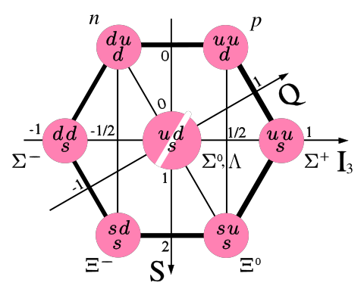
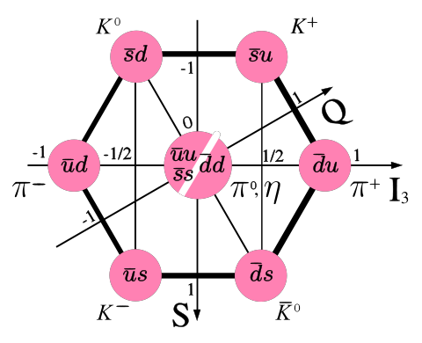
Observed Hadrons
Baryons
Mesons
Groups of 8 (octet)
And 10 (decuplet).
Groups of
9 (nonet).
Other Configurations?
4-quark
glueballs
pentaquarks
hybrids

Slide 13
The Baryons
The Issues with Hadrons
What are the fundamental degrees of freedom
inside of a proton and a neutron?
Quarks? Combinations of Quarks? Gluons?
The spectrum is very sparse.
The Mesons
What is the role of glue in a quark-antiquark
system and how is this related to the confinement
of QCD?
What are the properties of predicted states
beyond simple quark-antiquark?
Need to map out new states.

Slide 14
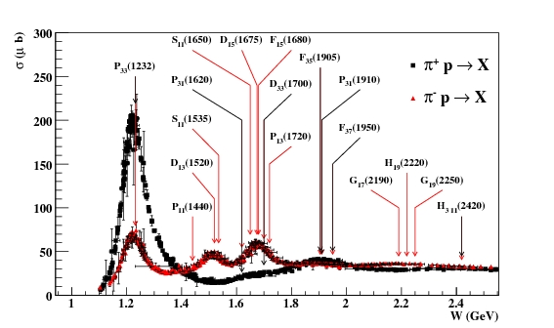
The Baryon Spectrum
Measured in the reaction .
Work done in 60’s to early 90’s.

Slide 15
The Baryon Spectrum
****, *** Known **,* Hints
In the quark model picture,
allow individual quarks to
be excited to higher levels:
baryon: q(1s)q(1s)q(1s)
P₁₁(1440) + ****
P₁₁(1710) + ***
P₁₁(1880) +
P₁₁(1975) +
P₁₃(1720) + ****
P₁₃(1870) + *
P₁₃(1910) +
P₁₃(1950) +
P₁₃(2030) +
F₁₅(1680) + ****
F₁₅(2000) + **
F₁₅(1995) +
F₁₇(1990) + **
1s -> 2s, 1s -> 2p
Nucleon
L_{2I,2J} (Mass) Parity Status
P₁₁(938) + ****
S₁₁(1535) - ****
S₁₁(1650) - ****
D₁₃(1520) - ****
D₁₃(1700) - ***
D₁₅(1675) - ****

Slide 16
The Baryon Spectrum
****, *** Known **,* Hints
In the quark model picture,
allow individual quarks to
be excited to higher levels:
baryon: q(1s)q(1s)q(1s)
Missing Baryons
P₁₁(1440) + ****
P₁₁(1710) + ***
P₁₁(1880) +
P₁₁(1975) +
P₁₃(1720) + ****
P₁₃(1870) + *
P₁₃(1910) +
P₁₃(1950) +
P₁₃(2030) +
F₁₅(1680) + ****
F₁₅(2000) + **
F₁₅(1995) +
F₁₇(1990) + **
1s -> 2s, 1s -> 2p
Nucleon
L_{2I,2J} (Mass) Parity Status
P₁₁(938) + ****
S₁₁(1535) - ****
S₁₁(1650) - ****
D₁₃(1520) - ****
D₁₃(1700) - ***
D₁₅(1675) - ****

Slide 17
The Baryon Spectrum
****, *** Known **,* Hints
Treat a quarks and a diquark
as the fundamental particles.
Allow excitations as before:
P₁₁(1440) + ****
P₁₁(1710) + ***
P₁₁(1880) +
P₁₁(1975) +
P₁₃(1720) + ****
P₁₃(1870) + *
P₁₃(1910) +
P₁₃(1950) +
P₁₃(2030) +
F₁₅(1680) + ****
F₁₅(2000) + **
F₁₅(1995) +
F₁₇(1990) + **
Nucleon
L_{2I,2J} (Mass) Parity Status
P₁₁(938) + ****
S₁₁(1535) - ****
S₁₁(1650) - ****
D₁₃(1520) - ****
D₁₃(1700) - ***
D₁₅(1675) - ****

Slide 18
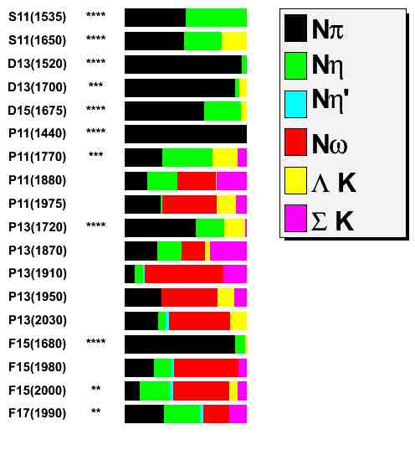

Looking in the wrong place
Nearly all the data used to
identify baryons has come
From scattering.
What if the missing states
do not couple to ?
(1/2)⁻
(1/2)⁻
(3/2)⁻
(3/2)⁻
(5/2)⁻
(1/2)⁺
(1/2)⁺
(1/2)⁺
(1/2)⁺
(3/2)⁺
(3/2)⁺
(3/2)⁺
(3/2)⁺
(3/2)⁺
(5/2)⁺
(5/2)⁺
(5/2)⁺
(7/2)⁺
Quark model predictions that
many of the missing states
have strong couplings to
other final states:

Slide 19
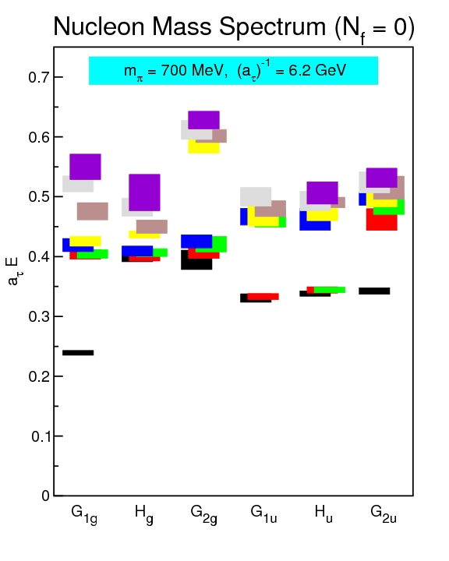
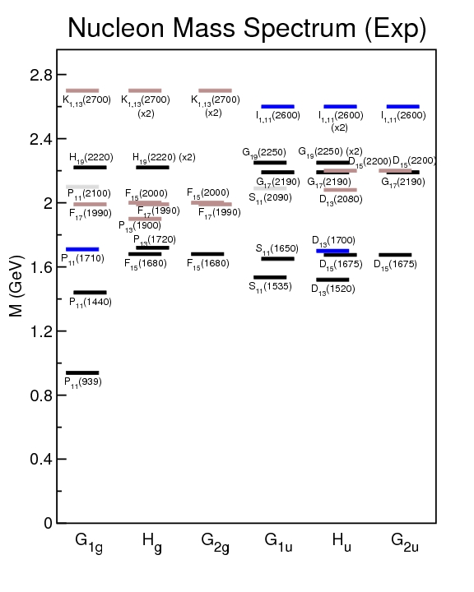
Lattice Calculations
First lattice calculation for baryons . Many
approximations, but shows what will be possible.

Slide 20
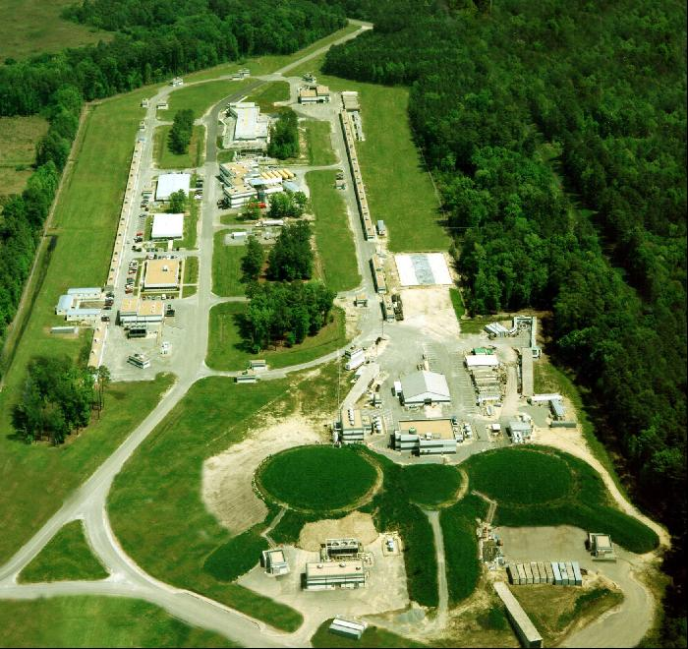
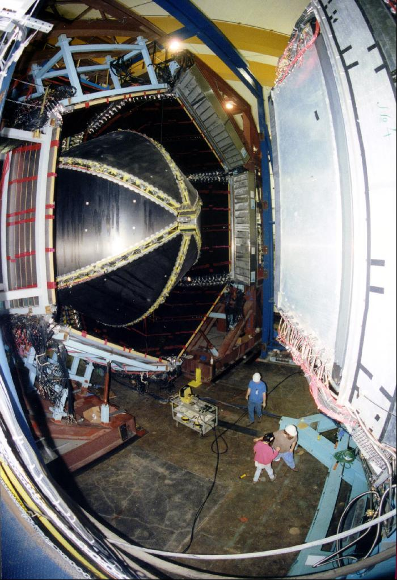
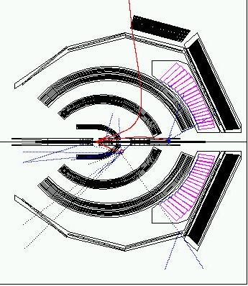
The CLAS Detector at JLab
Incident electron and tagged photon beams
(both polarized and unpolarized) (<6GeV)
Targets (H, D, ³He … )
(both polarized and unpolarized)
Large acceptance detector with access to
final states with several particles and PID
Large data sets both
currently in hand as
well as new ones
expected in the next
few years
Identify Baryons:
N*, Δ, Λ, Σ, Ξ

Slide 21
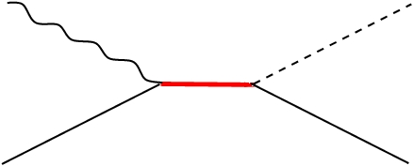
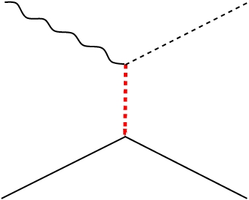
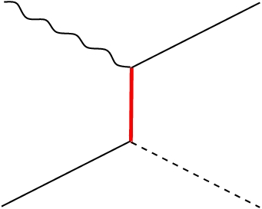
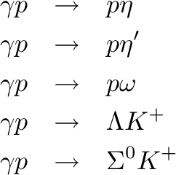
New Data Sets
Using 11TB of CLAS data from
a recent run period, simultaneously
analyzing reactions:
None of these channels have
been extensively studied, but
are supposed to couple to
some missing baryons.
~700k events
~250k events
~1300k events
Significant New Data
~1200k events
~1100k events
Enormous data sets require
new tools to carry out the
needed analysis.

Slide 22
Partial Wave Analysis
Angular distributions of reactions let you determine
the spin and parity of intermediate resonances.
Classical Electrodynamics:
Monopole Radiation (L=0)
Dipole Radiation (L=1)
Quadrupole Radiation (L=2)

Slide 23
Partial Wave Analysis
For a given reaction energy, quantum mechanical
amplitudes yields a probability distribution and
predicts angular distributions.
Particles nominally occur as a resonance which has
both an amplitude and phase as a function of the
difference between its nominal mass and the
reaction energy.
Fit the angular distribution as a sum of complex
amplitudes which describe particular quantum
numbers.

Slide 24
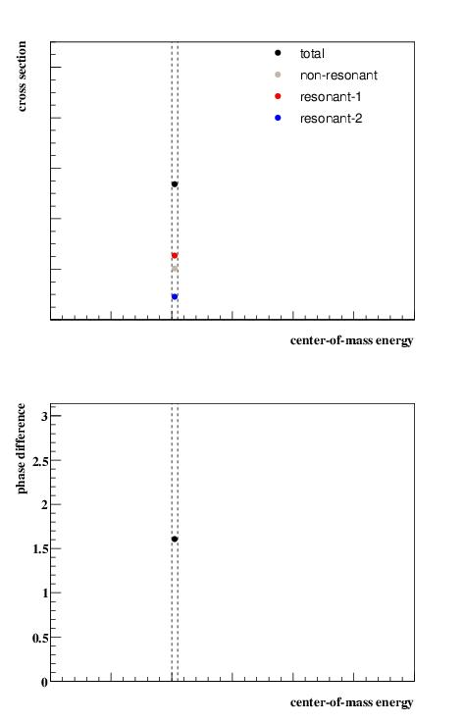
Partial Wave
Analysis
A simple model with three
complex amplitudes, 2 of
which are particles with
different QNs
Start with a single energy
bin.
Fit to get the strengths and
the phase difference between
the two resonances.

Slide 25
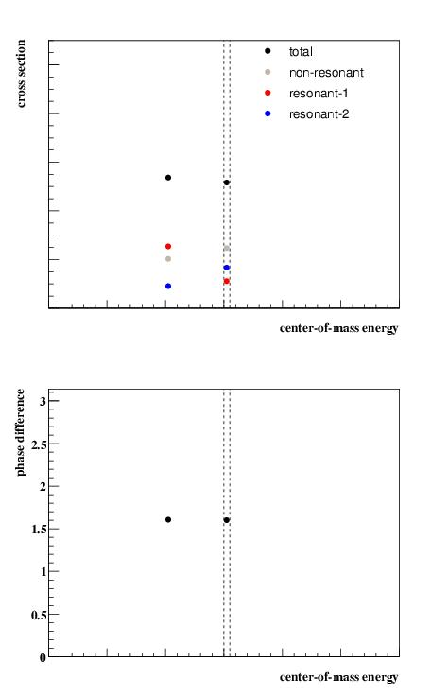
Partial Wave
Analysis
A simple model with three
complex amplitudes, 2 of
which are particles with
different QNs
Start with a single energy
bin.
Fit to get the strengths and
the phase difference between
the two resonances.
Fit a 2nd bin.

Slide 26
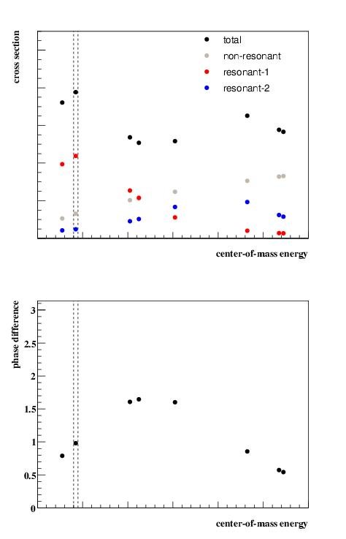
Partial Wave
Analysis
A simple model with three
complex amplitudes, 2 of
which are particles with
different QNs
Start with a single energy
bin.
Fit to get the strengths and
the phase difference between
the two resonances.
Continue fitting bins …

Slide 27
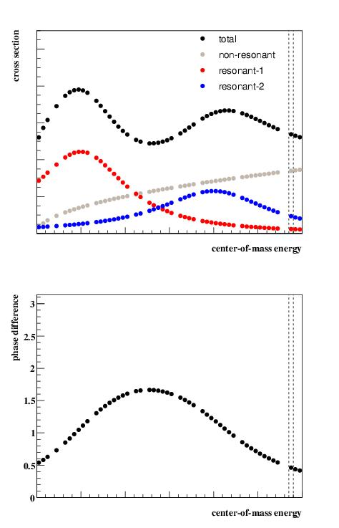
Partial Wave
Analysis
A simple model with three
complex amplitudes, 2 of
which are particles with
different QNs
Start with a single energy
bin.
Fit to get the strengths and
the phase difference between
the two resonances.
… and continue …

Slide 28
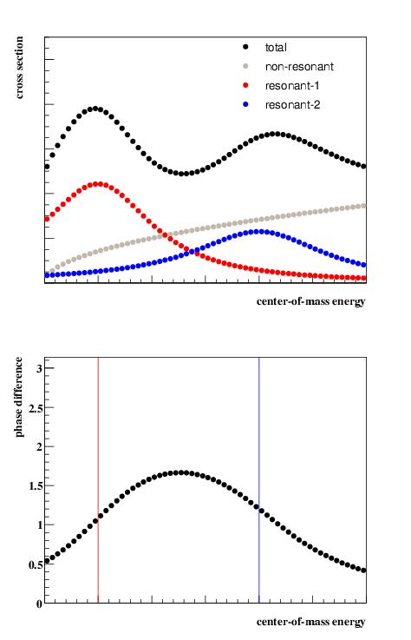
Partial Wave
Analysis
A simple model with three
complex amplitudes, 2 of
which are particles with
different QNs. The masses
peak where the two lines
are.
The need for intensity and
the phase difference are
indicative of two resonances.
Can fit for masses and widths.

Slide 29
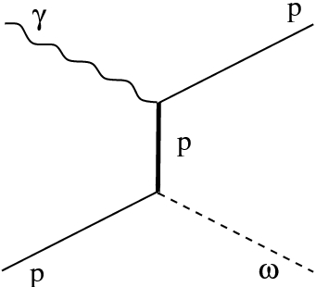
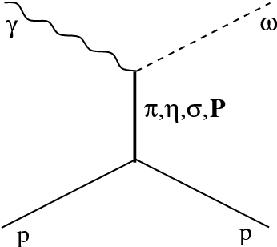
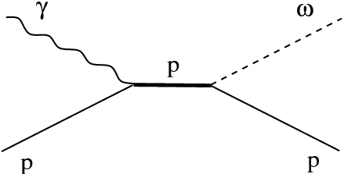
The system has never been studied
Any analysis needs to incorporate many different
processes. However, all the analyses of different
channels need to be self consistent (E.g. coupling
constants, production and decay … ).
Tools developed at CMU over the last several years allow
the easy input of any amplitude directly at the event
level in the analysis
Theory Experiment
Partial Wave Analysis
Complex amplitudes and
complex fit parameters.
I = | a_{lmn} A_{lmn} | ²
First time this type of PWA has been done for Baryons
About 13 million events in ~100 narrow energy bins

Slide 30
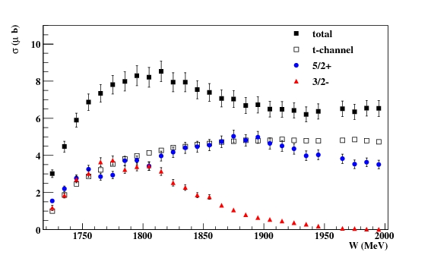
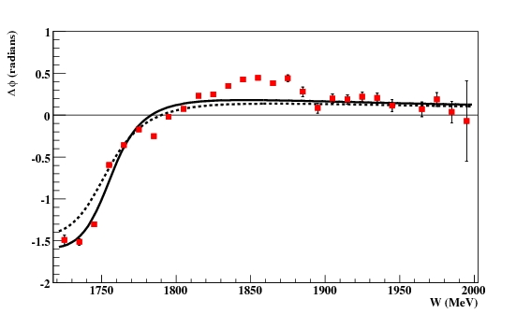
PWA Results
Fit showing three amplitudes.
(3/2)⁻ D₁₃
(5/2)⁺ F₁₅
t-channel
Intensities
Not Expected
Phase Difference
Strong evidence for:
(3/2)⁻ N(1700) ***
(5/2)⁺ N(1680) ****
The strong signals are well known states!

Slide 31
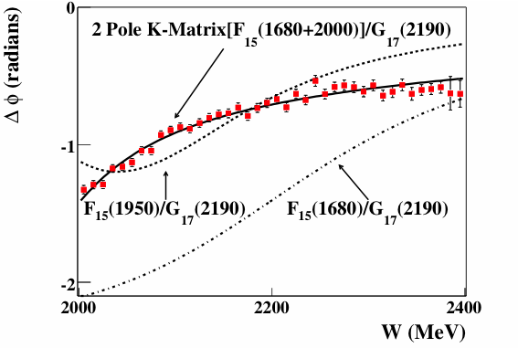
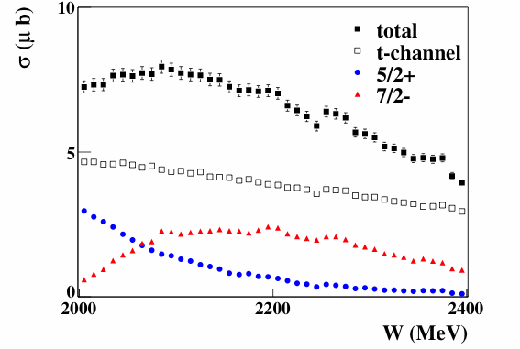
PWA Results
Fit showing three amplitudes.
(5/2)⁺ F₁₅
(7/2)⁻ G₁₇
t-channel
Strong evidence for:
(5/2)⁺ N(1680) ***
(5/2)⁺ N(1950) **
(7/2)⁻ N(2190) ****
A Missing State!

Slide 32
What is seen?
(1/2)⁻
(1/2)⁻
(3/2)⁻
(3/2)⁻
(5/2)⁻
(1/2)⁺
(1/2)⁺
(1/2)⁺
(1/2)⁺
(3/2)⁺
(3/2)⁺
(3/2)⁺
(3/2)⁺
(3/2)⁺
(5/2)⁺
(5/2)⁺
(5/2)⁺
(7/2)⁺
Strong evidence for:
(3/2)⁻ N(1700) ***
(5/2)⁺ N(1680) ****
(7/2)⁻ N(2190) ****
Hints here
(5/2)⁺ N(1950) **
(7/2)⁻ G₁₇(2190) ****

Slide 33
Baryon Analysis
The data demand four baryon resonances:
(3/2)⁻ , (5/2)⁺ , (5/2)⁺ and (7/2)⁻ .
There are hints of other missing baryons in the
data, but the models for the non-resonant parts
need to be improved (theoretical input).
High statistics data sets with sophisticated analysis
tools allowed us to pull out signals.
There are limitations in the acceptance of CLAS that
limit what can be done. For the , only about
7% of the events are fully reconstructed.

Slide 34
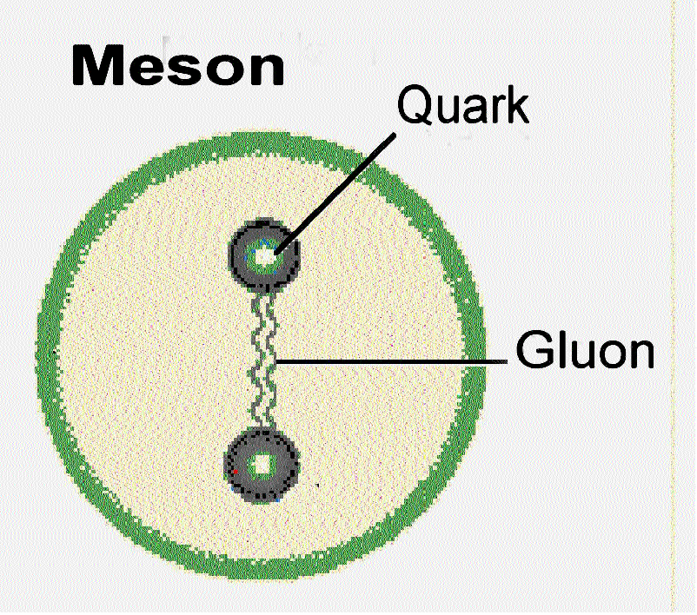
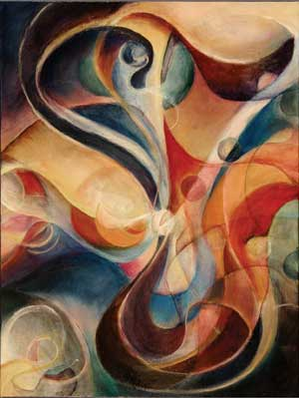
Mesons: quark-antiquark systems
What is the role of glue in a
quark-antiquark system and
how is this related to the
Confinement of QCD?
What are the properties of predicted
States beyond simple quark-antiquark?
Need to map out new states.

Slide 35
Positronium
Spectroscopy
A probe of QED
e⁺
e⁻
Spin: S=S₁+S₂=(0,1)
Orbital Angular Momentum: L=0,1,2,…
Total Spin: J=L+S
L=0, S=0 : J=0 L=0, S=1 : J=1
L=1 , S=0 : J=1 L=1, S=1 : J=0,1,2
… …
Reflection in a mirror:
Parity: P=-(-1)^{(L)}
Particle<->Antiparticle:
Charge Conjugation: C=(-1)^{(L+S)}
Notation: J^{(PC)} 0⁻⁺, 1⁻⁻, 1⁺⁻, 0⁺⁺, 1⁺⁺, 2⁺⁺
^{(2S+1)}L_{J} ¹S₀, ³S₁, ¹P₁, ³P₀, ³P₁, ³P₂,…

Slide 36
Quarkonium
Spectroscopy and QCD
Mesons
q
q
radial
Consider the three lightest quarks
4⁺⁺
L=3
3⁺⁺
2⁺⁺
9 Combinations
3⁺⁻
3⁻⁻
L=2
2⁻⁻
1⁻⁻
2⁻⁺
2⁺⁺
L=1
1⁺⁺
0⁺⁺
1⁺⁻
1⁻⁻
S=1
S=0
L=0
0⁻⁺

Slide 37
Quarkonium
Spectroscopy an QCD
Quarkonium
Mesons
q
q
Nothing to do
with Glue!
4⁺⁺
L=3
3⁺⁺
2⁺⁺
Allowed J^{PC} Quantum numbers:
3⁺⁻
3⁻⁻
0⁻⁻ 0⁺⁻
1⁻⁺
2⁺⁻
3⁻⁺
4⁺⁻
5⁻⁺
0⁺⁺ 0⁻⁺
1^{–-} 1⁺⁺ 1⁺⁻
2⁻⁻ 2⁺⁺ 2⁻⁺
3⁻⁻ 3⁺⁺ 3⁺⁻
4⁻⁻ 4⁺⁺ 4⁻⁺
5⁻⁻ 5⁺⁺ 5⁺⁻
L=2
2⁻⁻
1⁻⁻
2⁻⁺
2⁺⁺
L=1
1⁺⁺
0⁺⁺
1⁺⁻
Exotic Quantum Numbers
non quark-antiquark description
1⁻⁻
S=1
S=0
L=0
0⁻⁺

Slide 38
QCD Potential
ground-state
flux-tube
m=0
excited flux-tube
m=1
linear potential
Gluonic Excitations provide an
experimental measurement of
the excited QCD potential.
Observations of the nonets on the excited potentials are
the best experimental signal of gluonic excitations.

Slide 39
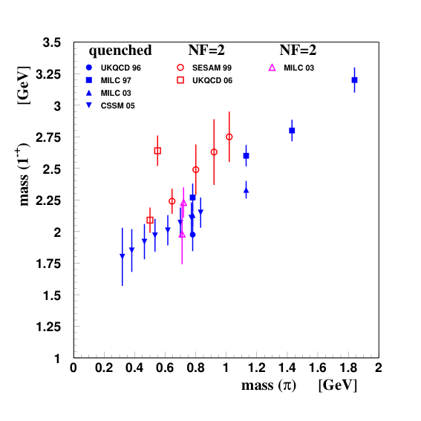
Hybrid Meson Predictions
Flux-tube model, start with a system and add one
unit of angular momentum in the flux tube.
S( ) J^{PC} of hybrid
0 1⁺⁺ 1⁻⁻
1 0⁻⁺,0⁺⁻,1⁻⁺,1⁺⁻,2⁻⁺,2⁺⁻
8 degenerate nonets
~1.9 GeV/c²
Lattice QCD: 1⁻⁺ nonet is lightest.
Mass Hierarchy
1⁻⁺ 1.9+/- 0.2 GeV/c²
2⁺⁻ 2.0+/- 1.1 GeV/c²
0⁺⁻ 2.3+/- 0.6 GeV/c²
In the charmonium sector:
1⁻⁺ 4.39 ±0.08 GeV/c²
0⁺⁻ 4.61 ±0.11 GeV/c²

Slide 40
Looking for Hybrids
Decay Predictions
Analysis Method
Partial Wave Analysis
Meson
Fit n-dim. angular distributions
Fit models of production and
decay of resonances.
Meson
L_{glue}
Meson
Angular momentum
in the gluon flux stays confined.
π₁ I^{G}(J^{PC})=1⁻(1⁻⁺)
K₁ I^{G}(J^{PC})= ½ (1⁻)
Nine state
η’₁ I^{G}(J^{PC})=0⁺(1⁻⁺)
η₁ I^{G}(J^{PC})=0⁺(1⁻⁺)
This leads to complicated multi-particle final states.

Slide 41
Experimental Evidence for Hybrids
The most extensive data sets to date are from the BNL E852 experiment.
There is also data from the VES experiment at Protvino and some results
from the Crystal Barrel experiment at LEAR. Finally, there is a CLAS
(Jefferson Lab) result. We have also just started to see results from the
COMPASS experiment at CERN.

Slide 42
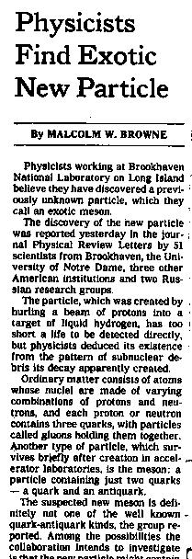
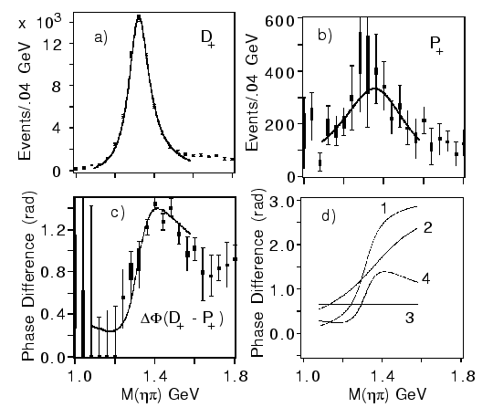
E852 Experiment
π⁻p→ηπ⁻ p
New York Times,
Sept. 2, 1997
π₁(1400)
Mass = 1370 +-16⁺⁵⁰₋₃₀ MeV/c²
Width= 385 +- 40⁺⁶⁵₋₁₀₅ MeV/c²
(1997)
The a₂(1320) is the dominant
signal. There is a small (few %)
exotic wave.
a₂
π₁
Interference effects show
a resonant structure in 1⁻⁺ .
(Assumption of flat background
phase as shown as 3.)
Seen by Crystal Barrel in
ηπ⁻ and ηπ⁰

Slide 43

E852 Results
At 18 GeV/c
to partial wave analysis
suggests

Slide 44
An Exotic Signal
Correlation of
Phase
&
Intensity
Exotic
Signal
π₁(1600)
Leakage
From
Non-exotic Wave
due to imperfectly
understood acceptance
3π m=1593+-8⁺²⁸₋₄₇ Γ=168+-20⁺¹⁵⁰₋₁₂
πη’ m=1597+-10⁺⁴⁵₋₁₀ Γ=340+-40+-50

Slide 45
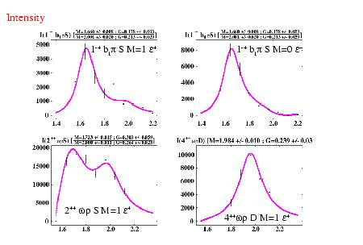
In Other Channels
E852 Results
1-+ in f₁π and b₁π
π⁻p → ηπ⁺π⁻π⁻p
π⁻p → ωπ⁰π⁻p
π₁(1600) → b₁π
π₁(1600) → f₁π
Mass=1.709±0.024 GeV
Width=0.403±0.08 GeV
In both b₁π and f₁π, observe
Excess intensity at about
2GeV/c².
Mass ~ 2.00 GeV,
Width ~ 0.2 to 0.3 GeV
Mass = 1.687±0.011 GeV
Width = 0.206±0.03 GeV

Slide 46
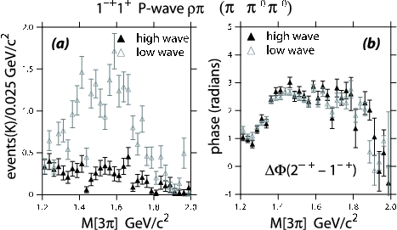
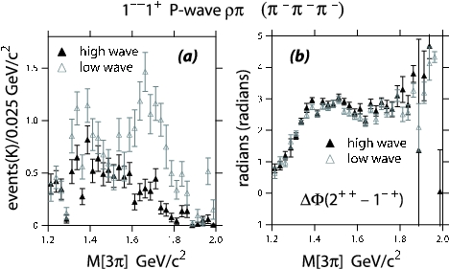
New Analysis
Dzierba et. al. PRD 73 (2006)
Add π₂(1670) −> ρπ (L=3)
Add π₂(1670) -> ρ₃π
Add π₂(1670) -> (ππ)_{S}π
Add a₃ decays
Add a₄(2040)
10 times statistics in
each of two channels.
Get a better description
of the data via moments
comparison
No Evidence for the π₁(1670)

Slide 47







COMPASS Experiment
(420,000 Events)
1 ⁻⁺ Exotic Wave
(180 GeV pions)
π₁(1600) m=1660 Γ=269 π₂(1670) m=1658 Γ=271
42 Partial waves included, exotic is dominantly 1⁺ production.

Slide 48
Summary of the π₁(1400)
Mode Mass Width Production
ηπ⁻ 1370±15+50-30 385±40+65-105 1⁺
ηπ⁰ 1257±20±25 354±64±60 1⁺ (controversial)
ηπ 1400 310 seen in proton-antiproton annihilation
Summary of the π₁(1600)
Mode Mass Width Production
3π 1598 ±8+29-47 168±20+150-12 1⁺,0⁻,1- (controversial)
η’π 1597±10+45-10 340±40±50 1⁺
b₁π 1664±8±10 185±25±38 0⁻ ,1⁺
f₁π 1709±24±41 403±80±115 1⁺
3π 1660 ±10+64-0 269±21+42-64 1⁺
3π not seen in
Photoproduction
COMPASS
Summary of the π₁(2000)
Mode Mass Width Production
b₁π 2014±20±16 230±32±73 1⁺
f₁π 2001±30±92 332±52±49 1⁺

Slide 49

Hybrid Nonets
Experimental Evidence
New York Times,
Sept. 2, 1997
1⁻⁺
Establish other Nonets:
0⁺⁻ 1⁻⁺ 2⁺⁻
Levels
Built on normal mesons
Identify other
states in nonet
to establish hybrid

Slide 50


How to Produce Hybrids
Beams of photons may be a more natural
way to create hybrid mesons.
Simple QN counting leads to the exotic mesons
There is almost no data for photon beams at
9GeV energies. GlueX will increase data by
3-4 orders of magnitude.

Slide 51



Jefferson Lab Upgrade

Slide 52





Jefferson Lab Upgrade
320M$ DOE finished in 2014
(I started in 1997)
Upgrade magnets and power supplies
CHL-2

Slide 53



Hall-D Complex at Jefferson Lab
electron beam
Construction has recently begun and will be completed Fall 2011. (Buildings only, detectors will follow)
~100 meters

Slide 54

Hall D: February 2010

Slide 55


The GlueX Detector
2.2 Tesla
Solenoid
2.2T superconducting solenoidal magnet
Fixed target (LH₂)
10⁸ tagged γ/s (8.4-9.0GeV)
hermetic
TOF
time of flight
SC
start counter
Charged particle tracking
Central drift chamber (straw tube)
Forward drift chamber (cathode strip)
Calorimetry
Barrel Calorimeter (lead, fiber sandwich)
Forward Calorimeter (lead-glass blocks)
PID
Time of Flight wall (scintillators)
Start counter
Barrel Calorimeter

Slide 56


Coherent
Bremsstrahlung
12 GeV electrons
Incoherent &
coherent spectrum
flux
This technique provides requisite energy, flux and polarization
40%
polarization
in peak
Linearly polarized
photons out
collimated
electrons in
spectrometer
diamond
crystal
photon energy (GeV)
tagged
with 0.1% resolution

Slide 57




Detector Construction
48-module BCAL at University of Regina
  Completing modules 3 and 4.
  First shipments to JLab in April

Slide 58


Detector Construction
Lead-glass Forward Calorimeter at Indiana University
  Contract for construction in place soon.
  Work starting spring 2010
Central Drift Chamber at Carnegie Mellon
  Contract for construction in place soon.
  Work starting spring 2010
More contracts starting in 2011 and 2010

Slide 59
Exotics
In Photoproduction
1⁻⁺ nonet
π₁ I^{G}(J^{PC})=1⁻(1⁻⁺)
K₁ I^{G}(J^{PC})= ½ (1⁻)
η’₁ I^{G}(J^{PC})=0⁺(1⁻⁺)
η₁ I^{G}(J^{PC})=0⁺(1⁻⁺)
X
Need to establish nonet nature
of exotics: π η η’
γ
e
Need to establish more than one
nonet: 0⁺⁻ 1⁻⁺ 2⁺⁻
N
N
Need very good partial wave analysis.
γ ⇔ ρ,ω,φ

Slide 60

Gluonic Hadrons and Confinement
What are the light quark
Potentials doing?
ΔE
Potentials corresponding
To excited states of glue.
Non-gluonic mesons –
ground state glue.
Lattice QCD potentials

Slide 61


Conclusions
The quest to understand confinement
and the strong force is about to make
great leaps forward.
Advances in theory and computing will soon
allow us to solve QCD and understand the
baryon spectrum and the role of glue.
New results on baryons and theoretical
work on models is near to giving us new
insight on the observed baryons.
The definitive experiments to
confirm or refute our expectations
on the role of glue are being built.
The synchronized advances in both areas will allow
us to finally understand QCD and confinement.

Slide 62

The GlueX Detector in Hall-D
The 12 GeV upgrade of Jefferson Lab is currently under construction
Construction of Hall-D broke ground in April 2009
Construction of the GlueX detector has started
Hall-D Groundbreaking
Current plans call for the first beam in Hall-D/GlueX in late 2014

